Slide 1
Uber Ride Data Analysis & Prediction
Data Science Project
By: Mathe SriLatha

Slide 2
Introduction
• Dataset: Uber ride booking & completion data
• Objective: Analyze ride completion rates and build ML models
• Goal: Identify key factors influencing ride completion

Slide 3
Dataset Overview
• Total records: 150,000
• Key columns: Booking Value, Ride Distance, Vehicle Type, Payment Method, Hour
• Target: Booking Status (Completed / Not Completed)

Slide 4
Ride Status Analysis
• Total rides: 150,000
• Completed rides: 93,000
• Completion rate: 62%
Distribution:
Completed 62%, Cancelled by Driver 18%, No Driver Found 7%, Cancelled by Customer 7%, Incomplete 6%

Slide 5
Average Metrics (Completed Rides)
• Avg. Booking Value: 508.17
• Avg. Ride Distance: 26.0 km

Slide 6
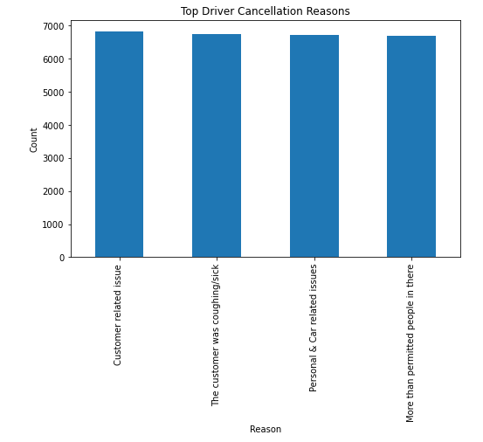
Feature Importance (Random Forest)

Slide 7
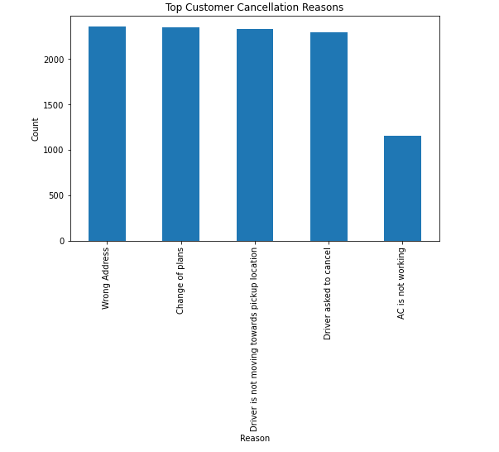
Logistic Regression Performance

Slide 8
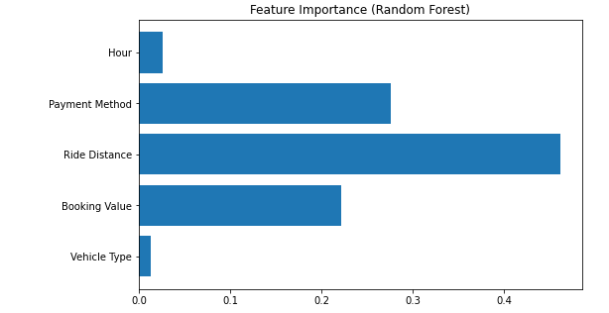
Random Forest Performance

Slide 9
Insights & Conclusion
• Random Forest achieved 94% accuracy vs 53% for Logistic Regression
• Most important factors: Ride Distance, Payment Method, Booking Value
• Business Insight: Improving driver availability & payment success could increase ride completion rates

Slide 10
Future Work & Next Steps
• Tune hyperparameters for better model performance
• Try gradient boosting (XGBoost, LightGBM)
• Build dashboard for real-time monitoring
• Deploy model in production for prediction

