Slide 1
Cyclistic Bike-Share
Case Study
How Annual Members and Casual Riders Use Bikes Differently
Date: 02/21/2025
Name: Srilatha

Slide 2
Business Objective
How can Cyclistic convert casual riders into annual members?
Analyze behavioral differences between annual members and casual riders
Identify usage patterns across time, duration, and frequency
Provide data-driven marketing recommendations to drive membership conversion

Slide 3
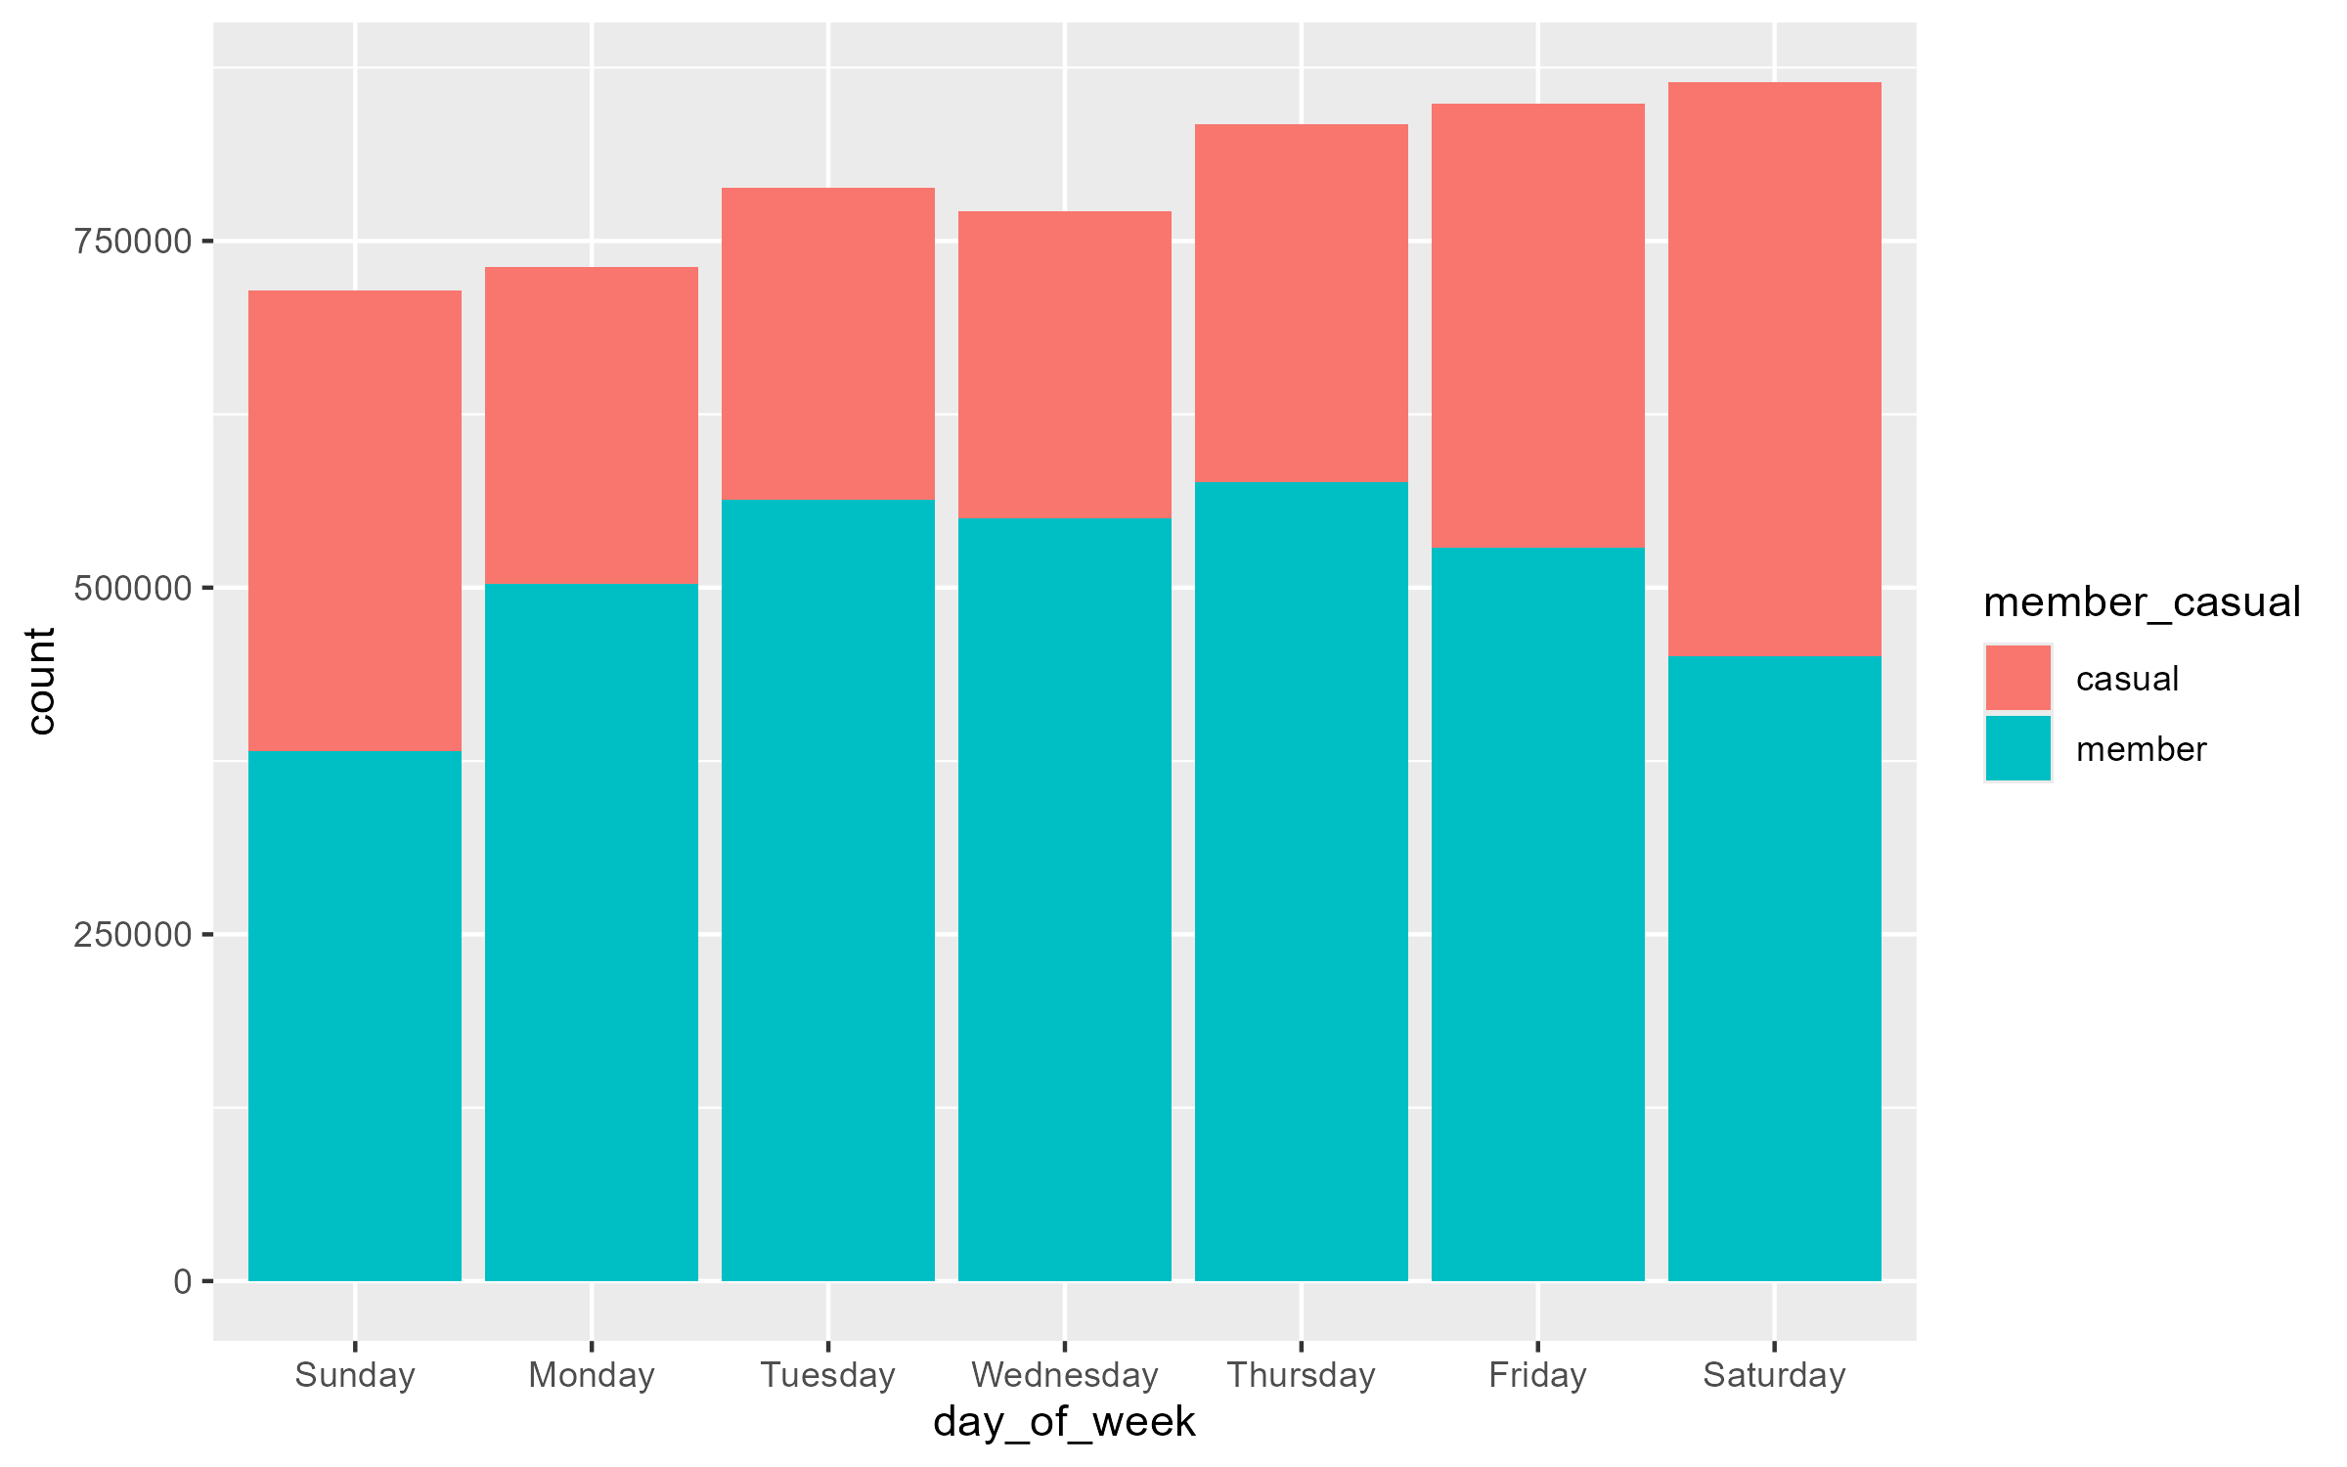
Ride Frequency by Day of Week
Key Insights
Members ride most on weekdays — routine commute usage
Casual riders peak on weekends — leisure behavior
Clear opportunity to target casuals with commuter messaging

Slide 4
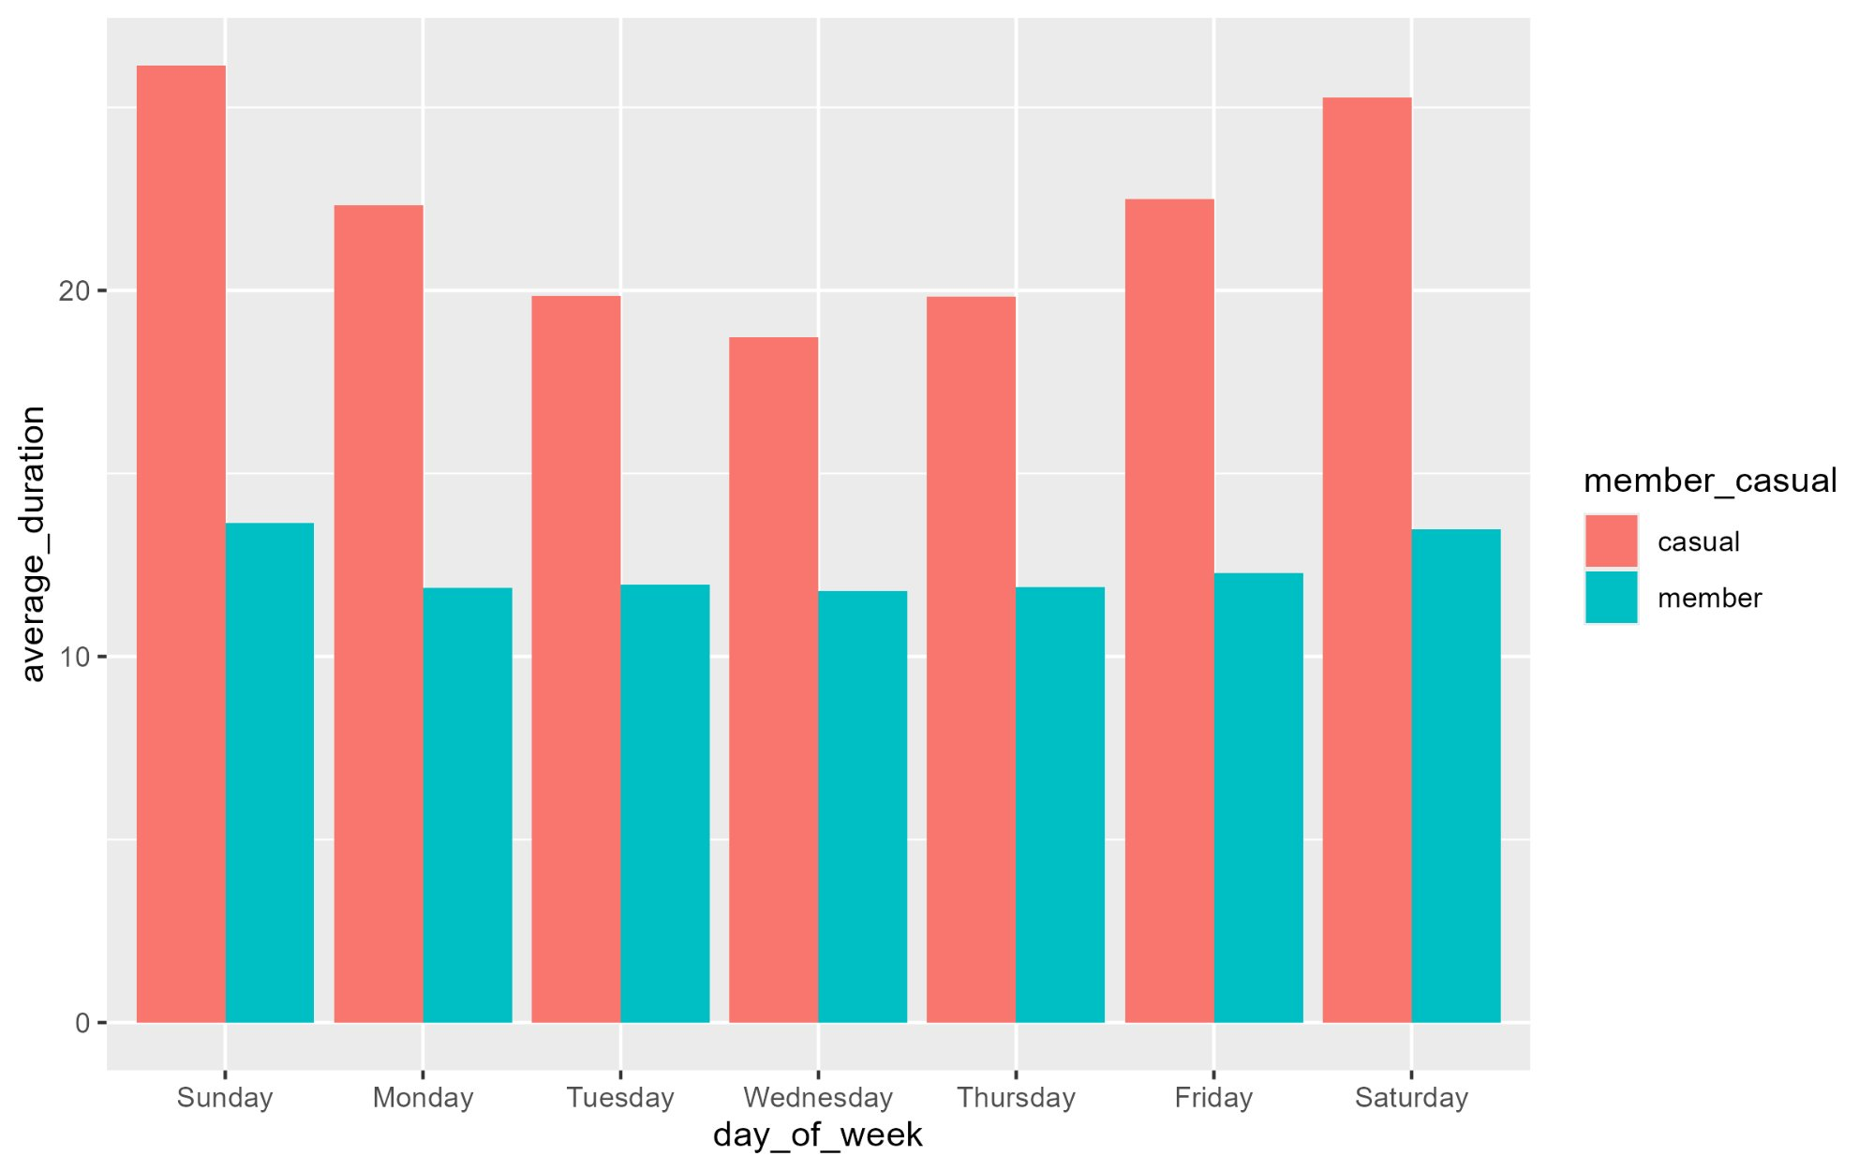
Average Ride Duration by Day
Key Insights
Casual riders take longer trips across all days
Members take shorter, frequent rides — efficiency focused
Casual = recreational, Members = routine

Slide 5
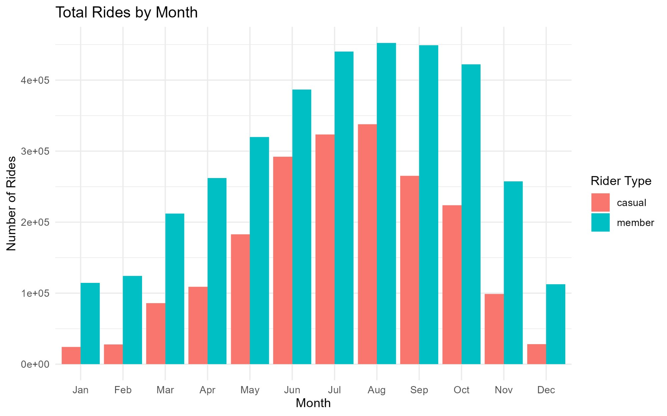
Total Rides by Month
Key Insights
Member ridership stays consistent year-round
Casual ridership spikes in summer (Jun–Sep)
Spring is the ideal window for conversion campaigns

Slide 6
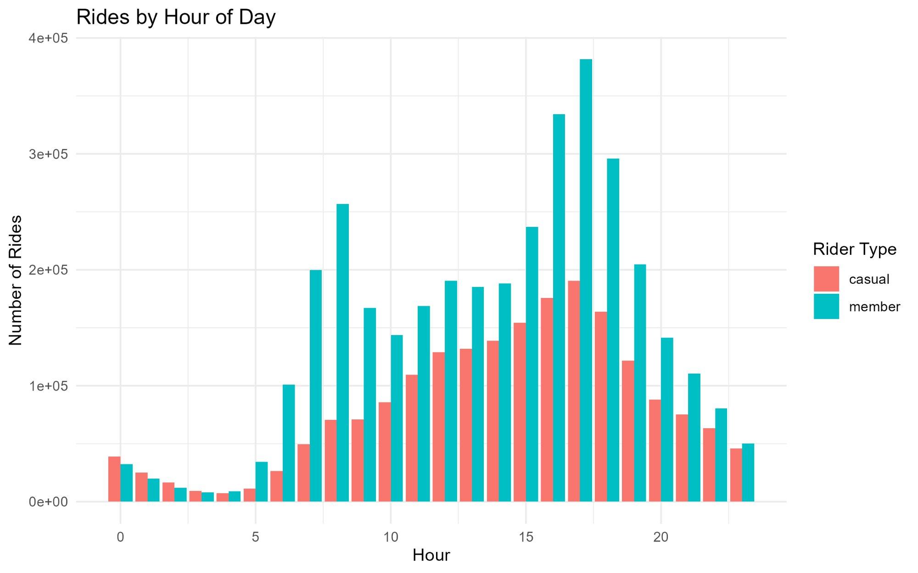
Rides by Hour of Day
Key Insights
Members peak at 8AM and 5PM — commute hours
Casual riders most active mid-day and evening
Supports targeted messaging by time-of-day

Slide 7
Key Findings
Members
Casual Riders
Opportunity
Consistent, commute-driven usage year-round
Peak at rush hours
Short, frequent trips
Seasonal — spike in summer
Leisure weekend usage
Longer trips, mid-day & evening peaks
High conversion potential identified
Casual riders are frequent but uncommitted
Incentives can shift behavior

Slide 8
Strategic Recommendations
01
Target High-Engagement Casual Riders
02
Launch Pre-Season Marketing Campaigns
03
Drive Conversion with Behavioral Incentives

Slide 9
Conclusion
Data reveals two distinct rider profiles. By targeting casual riders with personalized, season-timed, and behavior-based campaigns, Cyclistic can significantly increase annual memberships and long-term revenue.
Thank You

