Slide 1
Detecting Ship from Satellite images Using Deep Learning
Team members : guide name:
k.srilatha dr.t.satish kumar

Slide 2
Existing System
First, the sea-land image is segmented using texture and shape data and extract the sea region as the selected area (ROI). The potential object location is then determined using an algorithm such as the contrast box technique or moderately hierarchical segmentation. Finally, after post-processing, erroneous boxes are filtered to obtain the final detection findings.
Two VGG genes are VGG-16 and VGG-19. VGG-16 has thirteen fully associated networks and three pooling layer, whereas VGG-19 has sixteen final fully connected and three pooling layer. In both architectures, washout and max-pooling methods, as well as Relu algorithms, are applied.
The k-Nearest Neighbor method is used. The results of the kNN and the CNN SoftMax output are compared.

Slide 3
PROPOSED SYSTEM
In maritime surveillance, automatic ship detection of synthetic aperture radar (SAR) images is commonly utilized. SAR images have the ability to detect in all weather conditions and at all times of day. As a result, a variety of object detection algorithms have been presented, spanning from classical to deep learning techniques.
Seagoing boats are susceptible to current ship detecting technologies. In order to address these issues, this project proposes a unique multi-scale ship detection approach in SAR images based on a CNN network.
satellite image classification using Convolutional Neural Networks (CNNs) involves leveraging deep learning techniques to analyze and classify satellite images into predefined categories or classes. CNNs are well-suited for image classification tasks due to their ability to automatically learn hierarchical representations of visual features directly from pixel values.

Slide 4
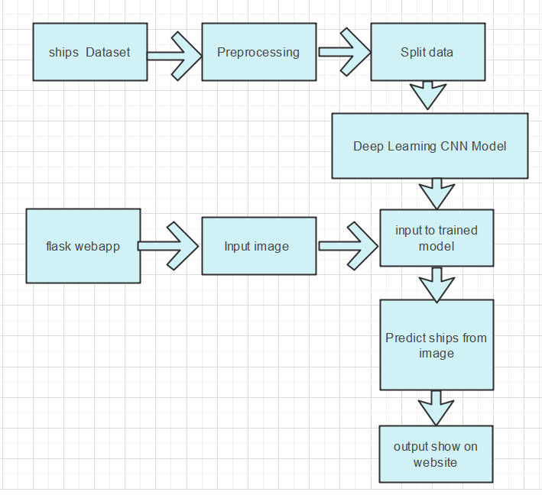
Architecture Diagram

Slide 5
Proposed Modules
MODULES
Dataset collection
Data Analysis
Handling Imbalanced Dataset
Images Augmenting
Training, Validation and Testing
Training Model

Slide 6
THANK YOU

