Slide 1

Exception handling
By, Rayankula Srilekha

Slide 2
Exception
Exceptions are events that occur during the execution of programs that disrupt the normal flow of instructions
(e.g. divide by zero, array access out of bound, etc.).

Slide 3
Exception Handling
Converts system defined error message to user friendly error message.
For Example :mail

Slide 4
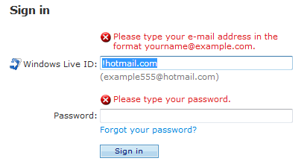
mail Example

Slide 5
Keywords of Exception handling
Try
Catch
Throw
Throws
finally

Slide 6
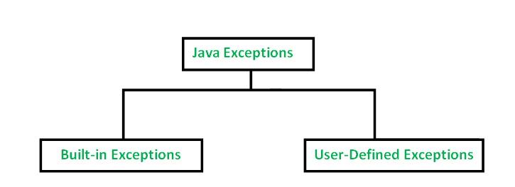
Types

Slide 7
Checked exceptions:
A checked exception is an exception that occurs at the compile time, these are also called as compile time exceptions.
ex: FileNotFoundException
Unchecked exceptions
An unchecked exception is an exception that occurs at the time of execution. These are also called as Runtime Exceptions.
ex: ArrayIndexOutOfBoundsExceptionexception

Slide 8
Keywords:
Try: Try block is used to handle error code
Catch: catch is used for handling code I.E, for the error user friendly message is set
Throws : To give indication about error throws is used
Throw : User defined exceptions are created
Finally : The block is used to closing connection, finally is executed if exception is handled or not.

Slide 9


