Slide 1
INHERITANCE
By,
K.SornaLakshmi

Slide 2
INHERITANCE
It is one of the most important features of Object Oriented Programming.
Inheritance is a mechanism through which we can derived classes from other classes.
The derived class is called as child class or sub class or we can say the extended class and the class from which we are deriving the sub class is called the base class or parent class.

Slide 3
Types of Inheritance
Single Inheritance
Multiple Inheritance
Multilevel Inheritance
Hierarchical Inheritance
Hybrid Inheritance

Slide 4
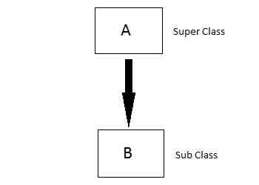
Single Inheritance

Slide 5
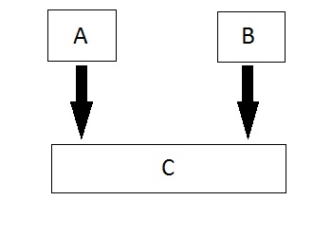
Multiple Inheritance

Slide 6
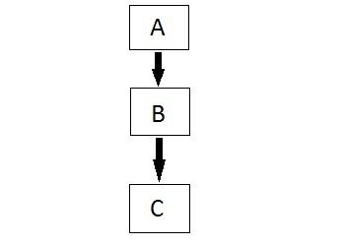
Multilevel Inheritance

Slide 7
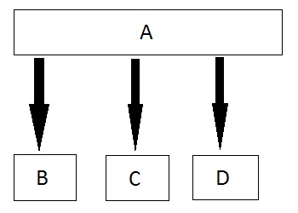
Hierarchical Inheritance

Slide 8
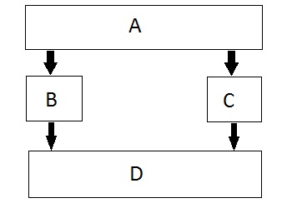
Hybrid Inheritance

Slide 9
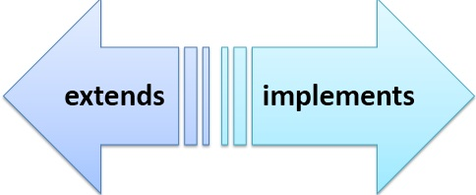
Keywords

Slide 10
Advantages of Inheritance
Code Reusability
Easy Maintenance

Slide 11


