Slide 1

STUDY HUB FOR TENTH STUDENTS
Batch Number-20
Vikas-21311A6213
Srilekha-21311A6243
Vamshi-21311A6233
Under the guidance of Mr.Lingaiah

Slide 2
Software and hardware requirements
HARDWARE REQUIREMENTS:
Computer system
Internet connection
SOFTWARE REQUIREMENTS:
VS CODE
HTML&CSS
Javascript

Slide 3

EXISTING PROBLEM
In the current educational landscape, 10th-grade students often face numerous challenges in their academic journey, ranging from grasping complex concepts to managing time effectively. These challenges can hinder their overall academic performance and lead to a lack of confidence in their abilities. Furthermore, the traditional classroom setting may not always cater to the diverse learning needs of every student, leaving some feeling disengaged or left behind.

Slide 4

Proposed Solution
Study hub for tenth students is a dynamic online platform dedicated to serving the academic needs of 10th-grade students. It offers a wide array of features and resources designed to enhance learning, foster collaboration, and support students in achieving their academic goals.
Comprehensive online study hub designed specifically for 10th-grade students, offering a tailored solution to their academic challenges and empowering them to excel in their studies. This platform integrates interactive learning tools, personalized tutoring, comprehensive curriculum coverage, and a supportive community to provide a holistic approach to education.

Slide 5
Abstract:
In today's educational landscape, 10th-grade students encounter numerous challenges in their academic journey, ranging from understanding complex concepts to preparing for standardized exams. To address these challenges, there is a critical need for a dedicated study hub tailored specifically to their needs. This abstract presents the problem statement and solution for the development of such a platform. The problem statement highlights the existing gaps in traditional educational approaches and emphasizes the necessity for a centralized platform that provides comprehensive support for 10th-grade students. Challenges such as the lack of personalized guidance, inadequate exam preparation resources, and the transition to higher academic standards are addressed. The proposed solution, STUDY HUB FOR TENTH STUDENTS, is a comprehensive online platform designed to serve as a study companion for 10th-grade students. It offers personalized learning paths, interactive study materials, live tutoring sessions, exam preparation tools, progress tracking, and peer collaboration features. Through these features, TenthGradeHub aims to empower students to excel academically, build confidence, and succeed in their educational endeavors.

Slide 6
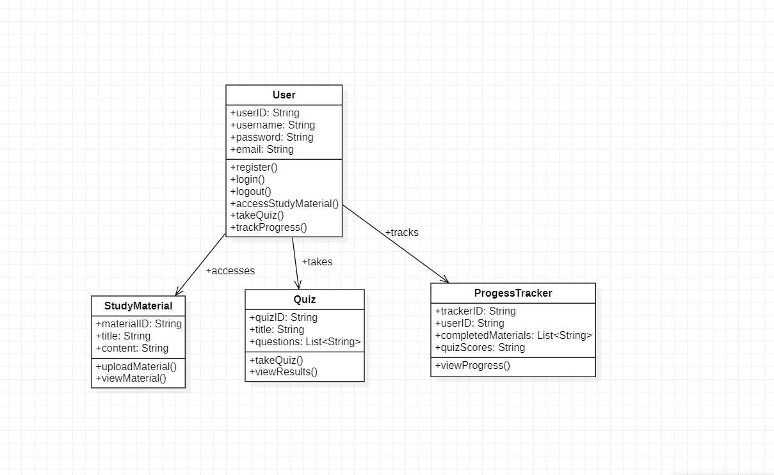
Class diagram:

Slide 7
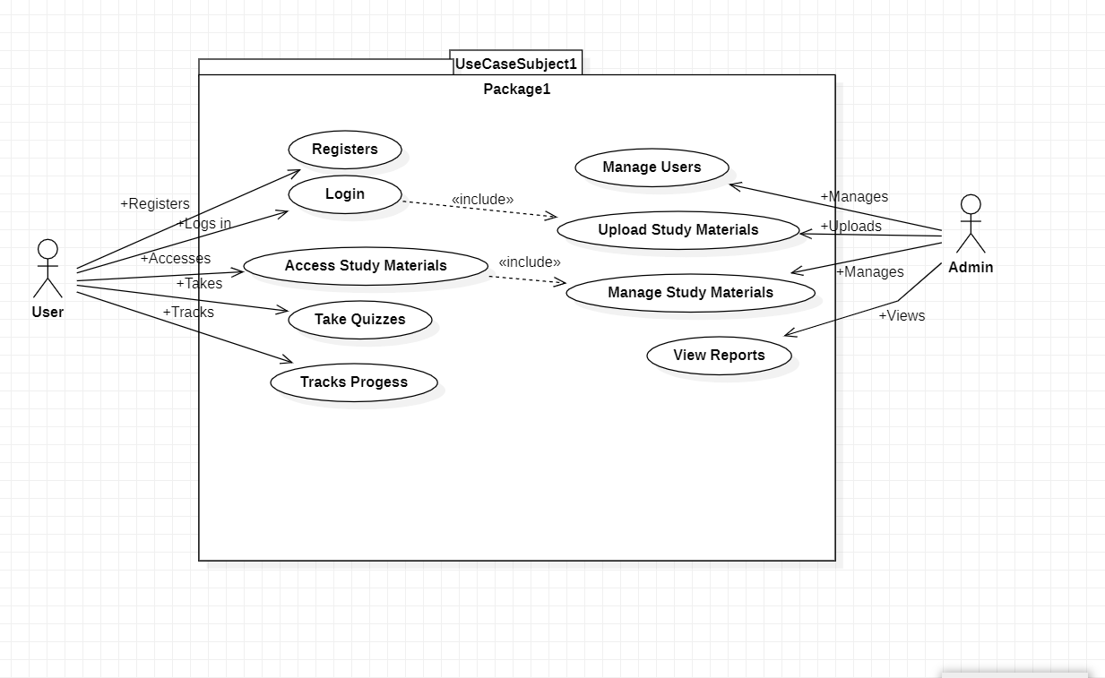
Use Case Diagram(1):

Slide 8
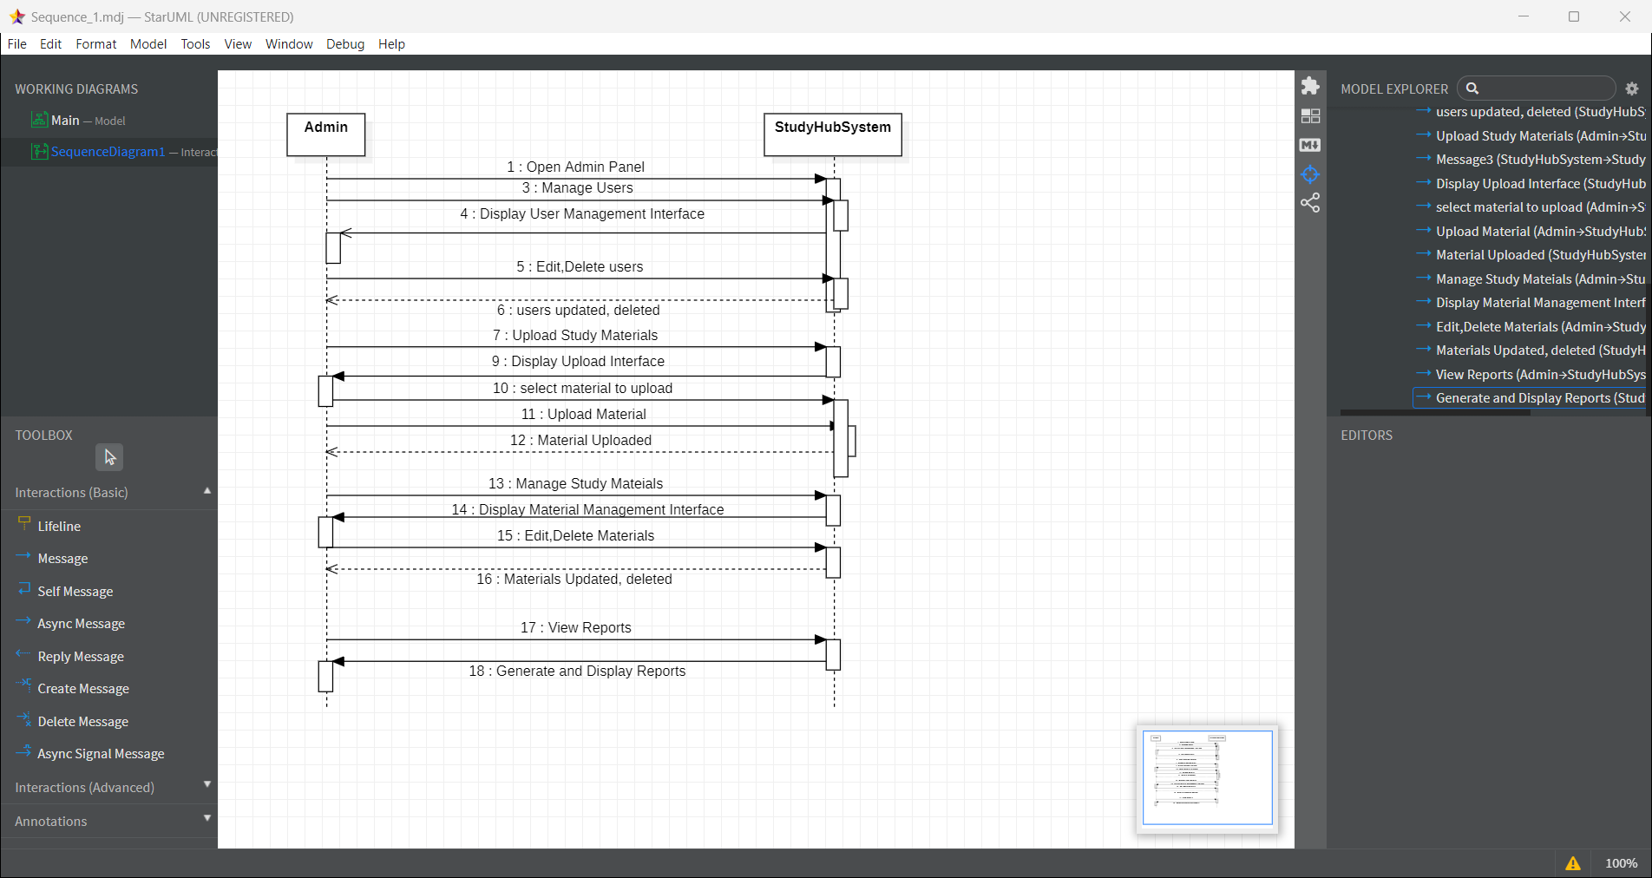
Sequence Diagram(1)

Slide 9
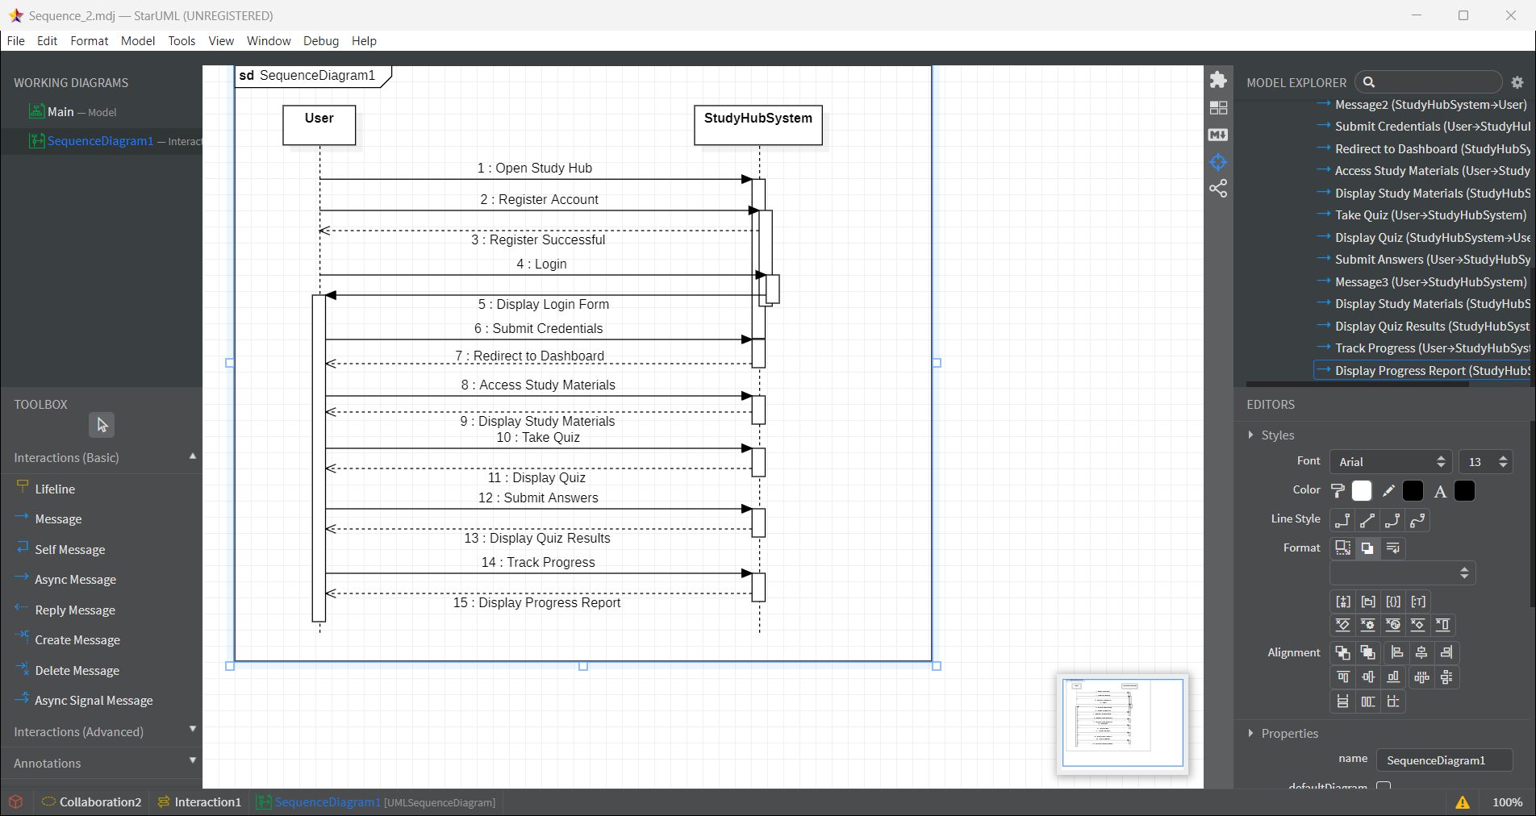
Sequence diagram(2):

Slide 10
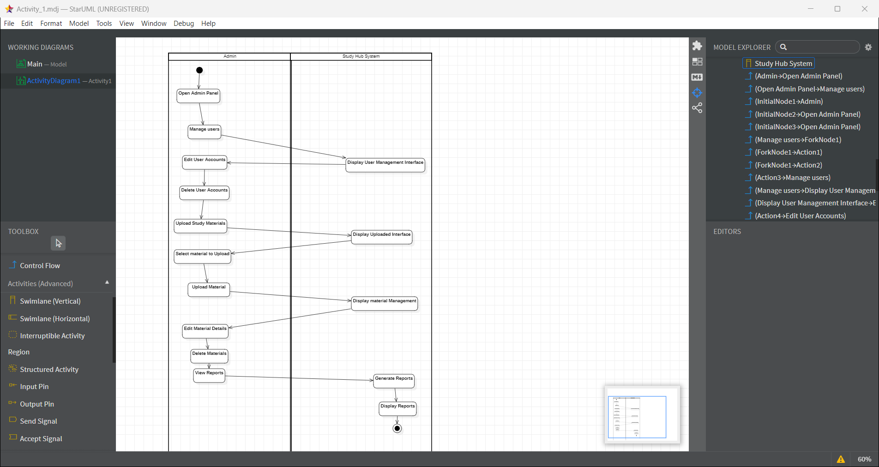
Activity diagram:

Slide 11
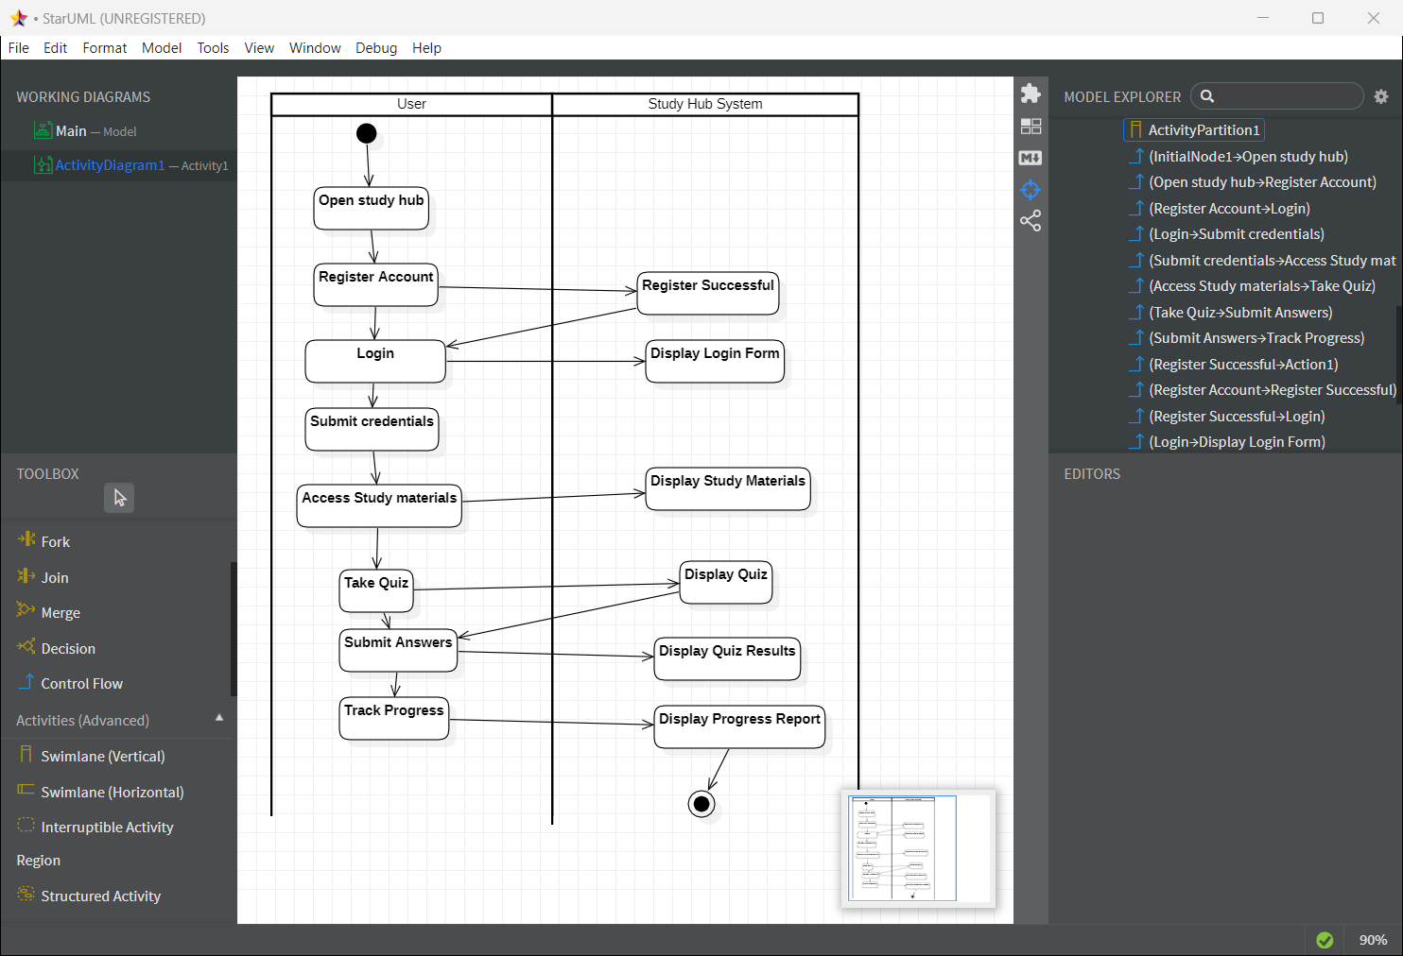
Activity Diagram

Slide 12
Explanation and Approach
Introduction to Study Hub for Tenth Students
Overview:Study Hub for Tenth students is a technology platform, a service provider.
Mission and Vision:
Academic Support and Enhancement
Personalized Learning Experience
Skill Development and Critical Thinking
Engagement and Motivation
Preparation for Higher Education and Career Readiness
Feedback Mechanism and Continuous Improvement

Slide 13
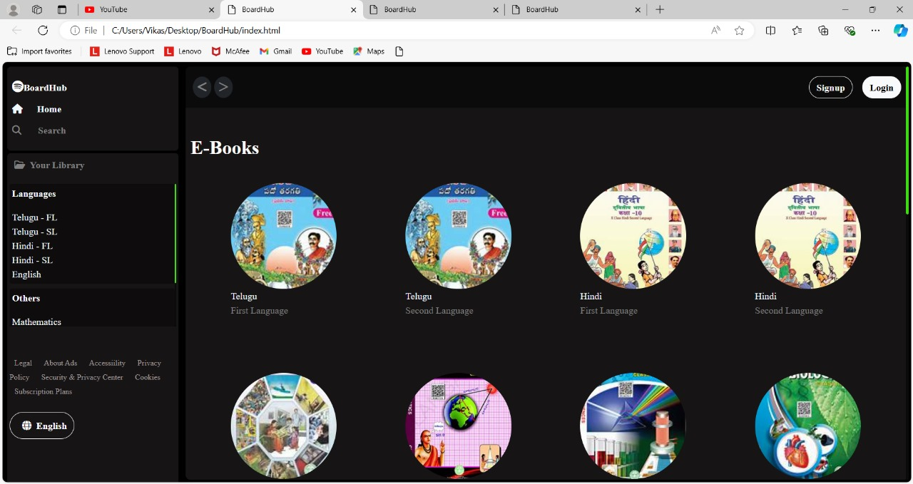
2. Website Overview
Purpose: Designing a Study Hub website for tenth-grade students involves creating a user-friendly, engaging platform that supports their academic journey. By incorporating these key components and features, the Study Hub can effectively cater to students’ educational needs, enhance learning experiences, and foster a collaborative and supportive online community.

Slide 14
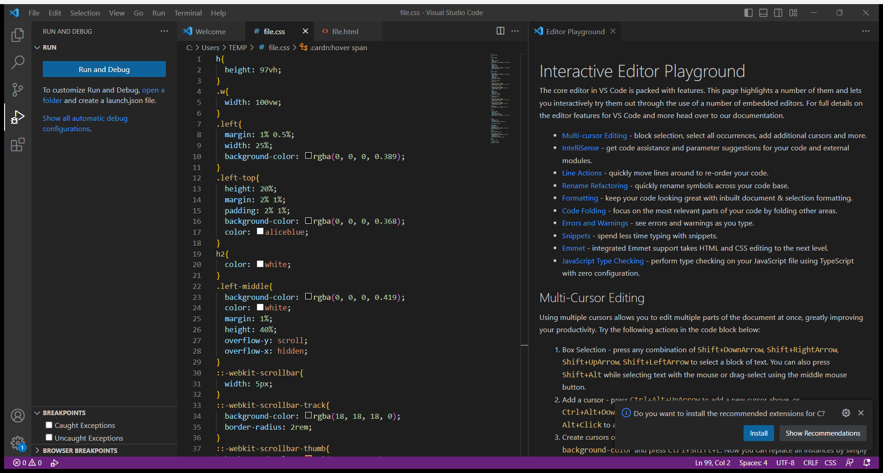
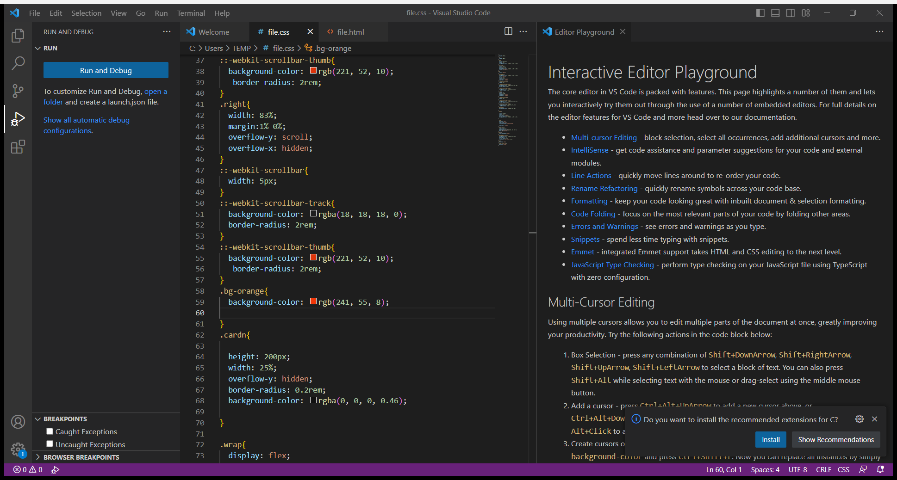
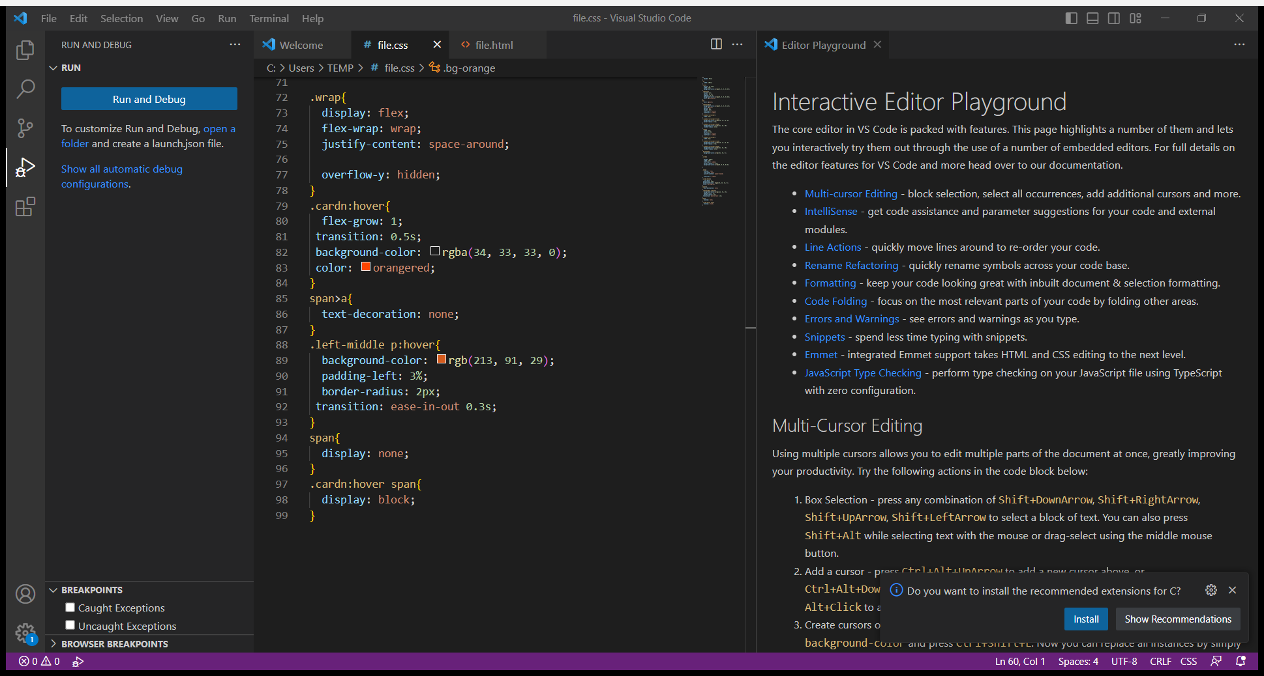
Source code:

Slide 15
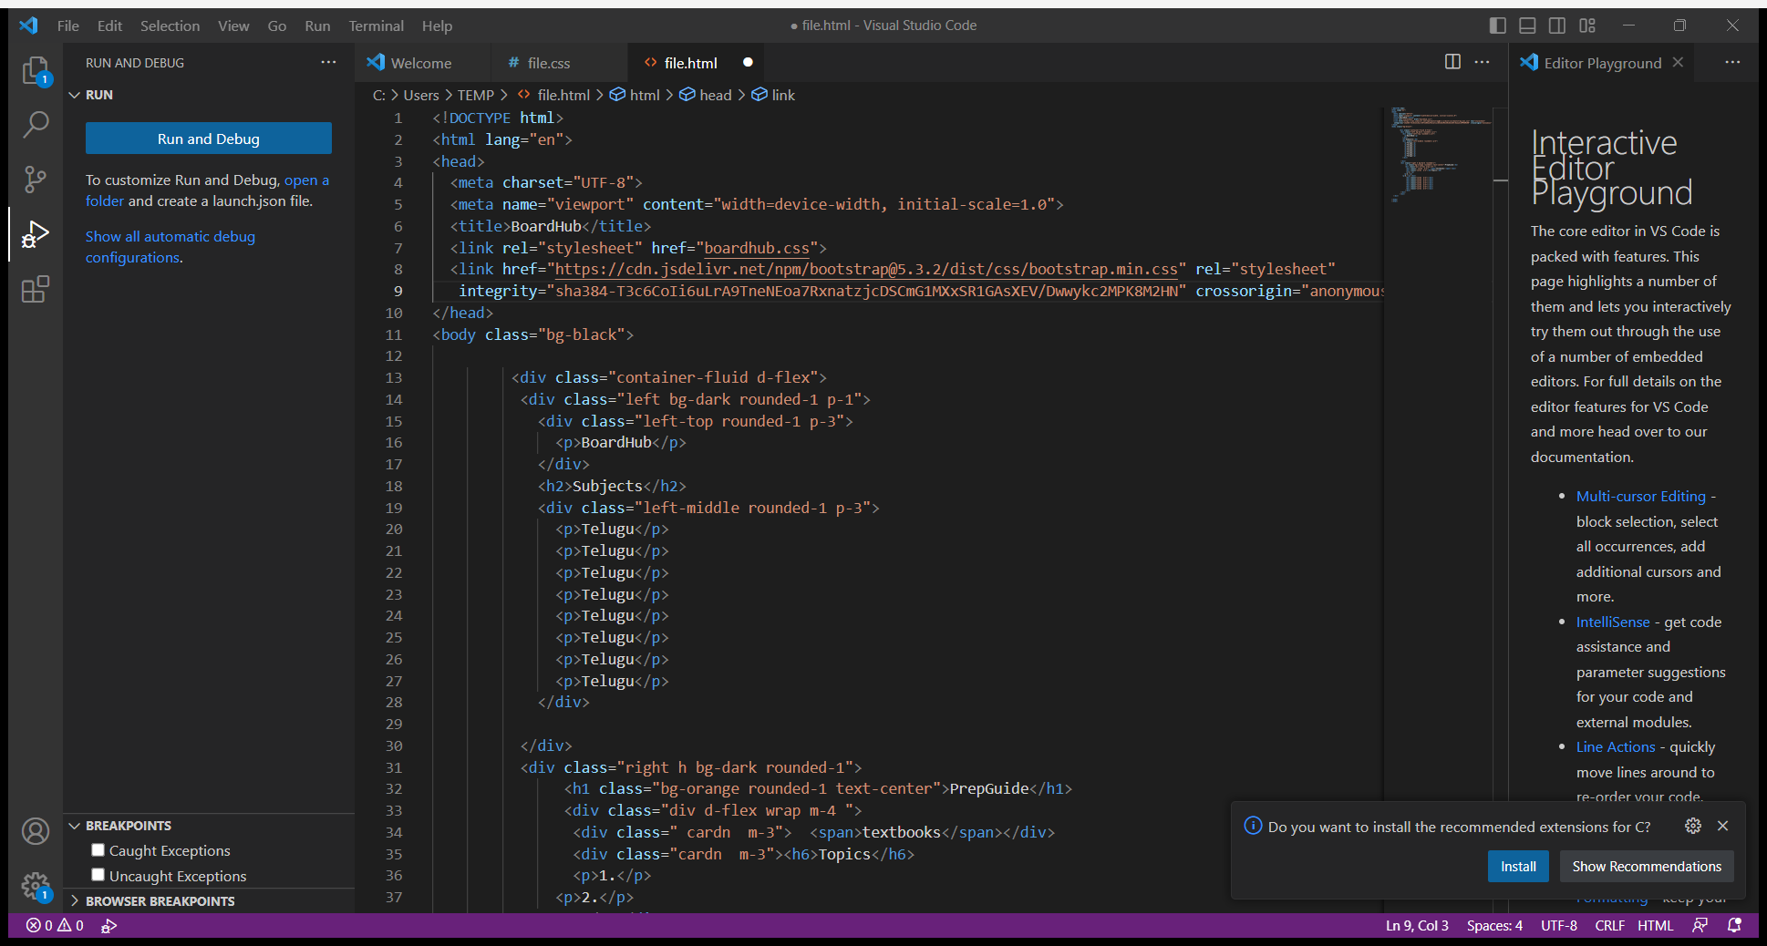
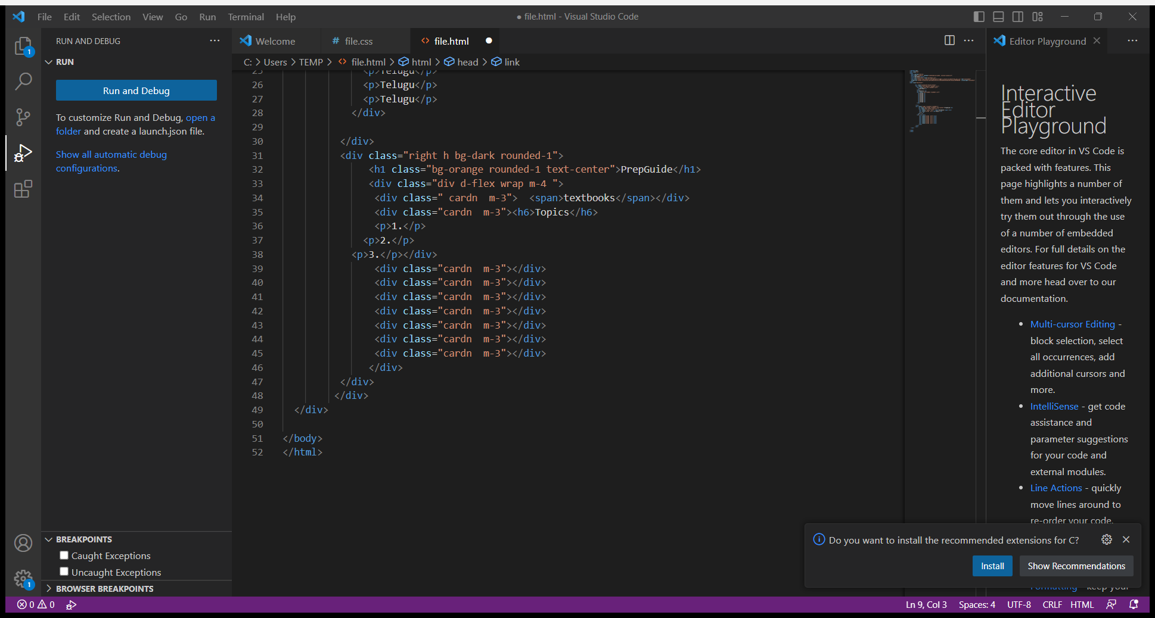

Slide 16
Output:

Slide 17
Advantages:
Centralized Access to Resources
Interactive Learning Tools
Personalized Learning Experience
Collaborative Learning Opportunities
Supportive Community and Mentoring
Enhanced Study Skills and Preparedness
Accessibility and Flexibility
Continuous Improvement and Feedback
Preparation for Higher Education and Career Readiness

Slide 18
Conclusion:
In conclusion, the Study Hub website for tenth-grade students represents a pivotal advancement in educational support, offering a comprehensive platform designed to enhance learning experiences and academic success. By consolidating a wide array of resources, interactive tools, and personalized learning features into a single accessible interface, the Study Hub addresses the diverse needs of students in today's educational landscape.

Slide 19
References:
Educational Standards and Curriculum Guidelines
Academic and Industry Experts
Khan Academy: https://www.khanacademy.org/
Coursera for High School: https://www.coursera.org/for/highschool
Quizlet: https://quizlet.com/

Slide 20


