Slide 1
Austin Bike Sharing
Team 1
Meeth Gala, Srilekha Chandrashekar, Tim Dwyer
Notes:
Main title: 40 pt. Arial
Presenter Name: 16 pt. Arial
Presenters Title: 16 pt. Arial Italic

Slide 2
Agenda
Business Overview
Dimensional Modeling Steps
Dimensional Model
ETL Overview
Sample Business Reports
Lessons Learned
Q & A

Slide 3
Business Overview – Topic Introduction
Bike Sharing - Austin, Texas
Heightened focus on reducing the negative impacts of cars (pollution and traffic), many large cities have created bike sharing services
Bike sharing has become increasingly popular across the United States (Pittsburgh)
Help Austin better understand how it can manage its bike sharing model. A few examples:
  People may want to use the service to commute to work. However, this could change if it is raining, or if they do not get out of work until after dark.
  It is important to track popular routes. For instance, people tend to enjoy riding bikes downhill more than uphill. This could lead to a high supply of bikes in a station at the bottom of a hill, and a high demand for bikes at the station on top of a hill. This would cause the servicers to have to transfer some bikes to the station on top of the hill.

Slide 4
Business Overview – Business Questions
1. What were total number of people who preferred bike sharing in Austin on a yearly basis?
Follow-up: Did the number increase or decrease for each year?
2. What were the top five starting stations used by bike riders in 2016?
  Follow-up: What were these different from the most popular five ending stations? Are these different?
3. Find total duration by subscriber_type and Bike Manufacturer in 2016.
4. What is the average time travelled on a rainy day in each year?
Follow-up: Compare this to result to the distance travelled on non- rainy days.

Slide 5
Agenda
Business Overview
Dimensional Modeling Steps
Dimensional Model
ETL Overview
Sample Business Reports
Lessons Learned
Q & A

Slide 6
Dimensional Modeling Steps
Four main steps:
Select the business process to model
  Bike sharing in Austin, Texas
What is the grain of the business?
Bike, Subscriber, Date, Time, Trip
What are the dimensions?
Station, Time, Date, Subscriber, Weather, Bike
What are the facts?
Duration of each bike ride

Slide 7
Agenda
Business Overview
Dimensional Modeling Steps
Dimensional Model
ETL Overview
Sample Business Reports
Lessons Learned
Q & A

Slide 8
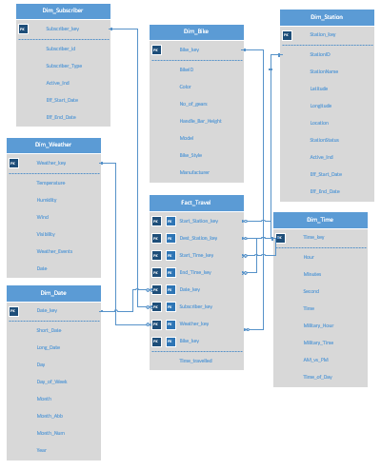
Dimensional Model – Final Model

Slide 9
Dimensional Model – Dimensions (part 1)
Bike Dimension:
Description: It contains all information about each individual bike, which is important to understand the supply and demand of each bike type. For example, if trail bikes are used significantly more than mountain bikes, the city should purchase more trail bikes in the future.
Attributes: Bike_key, BikeID, Color, No_of_gears, Handle_Bar_Height, Model, Bike_Style, Manufacturer
Hierarchies: Manufacturer, Model, Bike_Style
SCD type 2: None in this table
Subscriber Dimension:
Description: It contains what type of subscriber is bike riding on a trip. For example, are they a walkup, or do they have a Local365 pass? This information can help drive future marketing and sales strategies.
Attributes: Subscriber_key, Subscriber_id, Subscriber_Type, Active_Ind, Eff_Start_Date, Eff_End_Date
Hierarchies: None in this table
SCD type 2: Subscriber_Type

Slide 10
Dimensional Model – Dimensions (part 2)
Station Dimension:
Description: It contains all of the information specific to each station, where an individual can begin or end a bike ride. This information could be used to show which stations should be expanded in the future.
Attributes: Station_key, StationID, StationName, Latitude, Longitude, Location, StationStatus, Active_Ind, Eff_Start_Date, Eff_End_Date
Hierarchies: None in this table
SCD type 2: StationName
Weather Dimension:
Description: It contains the weather data for each trip and day. Weather data can help explain specific days that had significantly less riders than usual due to rain or another event.
Attributes: Weather_key, Temperature, Humidity, Wind, Visibility, Weather_Events, Date
Hierarchies: None in this table
SCD type 2: None in this table

Slide 11
Dimensional Model – Dimensions (part 3)
Date Dimension:
Description: It contains all of the dates from 12/21/2013 to 12/31/2018. This can be used to understand demand during different times of the year.
Attributes: Date_Key, Short_Date, Long_Date, Day, Day_of_Week, Month, Month_Abb, Month_Num
Hierarchies: Day,Month, Year
SCD type 2: None in this table
Time Dimension:
Description: It contains different time dimensions for a full 24 hour time period. This can help understand the demand for bikes during different times of the day.
Attributes: Time_Key, Hour, Minutes, Hour, Second, Time, Military_Hour, Milirtary_Time, AM_vs_PM, Time_of_Day
Hierarchies: Second, Minutes, Hour
SCD type 2: None in this table

Slide 12
Dimensional Model – Fact Table
Time_travelled:
Description:
  The amount of time an individual is using a bike.
Why is it useful?
  Understanding the duration of bike trips based on all of the dimensions noted above will provide insights into the demands of their customers and what gaps might need to be filled. This can directly influence their business plans for the future.
Additive?
  Additive

Slide 13
Dimensional Model – Number of Records
Dimension Tables:
Dim_Bike: 186 bikes x 1KB per row = 0.2MB
Dim_Weather: 1,319 rows x 1KB per row = 1.3MB
Dim_Time: 86,400 rows x 1KB per row = 86MB
Dim_Station: 72 rows x 1KB per row = 0.07MB
Dim_Subscriber: 52 rows x 1KB per row = 0.05MB
Dim_Date : 1,837 rows x 1KB per row = 1.8MB
Total Dimension Size = 88.42MB
Fact Table:
Fact_Travel: 284,400 rows x 1KB per row = 284.4MB
Total Fact = 284.4MB
Total Size = 372.82MB

Slide 14
Agenda
Business Overview
Dimensional Modeling Steps
Dimensional Model
ETL Overview
Sample Business Reports
Lessons Learned
Q & A

Slide 15
ETL Overview - Source Files (part 1)
Source Files:
austin_weather
  Source: https://www.kaggle.com/grubenm/austin-weather/data
  Layout: csv flat file
austin_bikeshare_trips
  Source: https://www.kaggle.com/ambarish/austin-bike-eda-heatmaps-timeseries/data
  Layout: csv flat file
austin_bikeshare_stations
  Source: https://www.kaggle.com/ambarish/austin-bike-eda-heatmaps-timeseries/data
  Layout: csv flat file

Slide 16
ETL Overview - Source Files (part 2)
Source Files:
bike_description_data
  Source: Created Excel file based on the bike IDs in austin_bikeshare_trips
  Layout: excel flat file
date data
  Source: Created Excel file
  Layout: excel flat file
time table
  Source: Created Excel file
  Layout: excel flat file

Slide 17
ETL Overview - Process
Prep the data
  The team used python to manipulate the data in a few cases and to create the dimension and fact stage tables in csvs
    The manipulations were mostly creating subsets from larger source files and then deduping business keys
    Completed for the subscriber and bike dimensions
  Save the created excel files as csvs
Load tables into SSIS and SQL Server
  The team then loaded the files one at a time into SSIS
  A Data Flow was created to load the data into SQL Server
  Completed for the dimensions first and then the fact table was built

Slide 18
ETL Overview - SCD type 2
StationName and Subscriber_Type are the two SCD 2 fields.
These were created leveraging SSIS’s Slowly Changing Dimension functionality.
Active_Ind designates which row is current with a value of 1. Uncurrent rows have Active_Ind of 0.
Eff_Start_date shows the date of creation.
Eff_End_Date represents the date when the row became stale.

Slide 19
ETL Overview - Tips/Lessons Learned
Make sure all of the data is cleaned before starting the process. This is typically a standard process in the business world.
Use NVARCHAR instead of VARCHAR in the creation scripts.
Make sure the data types and lengths match between SSIS and SQL Server.
See if the tables were populated more than once by checking for duplicate rows.

Slide 20
Agenda
Business Overview
Dimensional Modeling Steps
Dimensional Model
ETL Overview
Sample Business Reports
Lessons Learned
Q & A

Slide 21
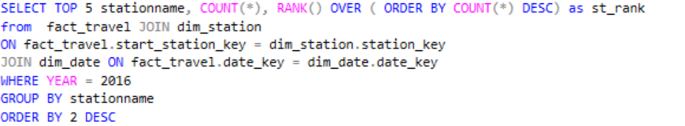
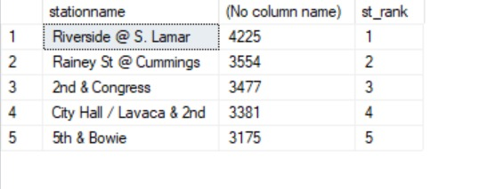
Business Report 1
Business Question: What were the most popular three starting stations used by biker riders in August 2016?
SQL Code:
Report Result:

Slide 22
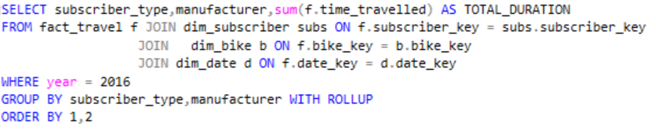
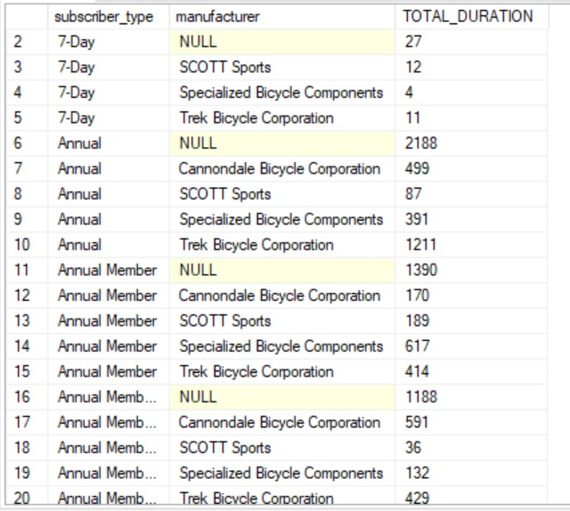
Business Report 2
Business Question: Find total duration by subrscriber_type and Bike Manufacturer in 2016.
SQL Code:
Report Result:

Slide 23
Business Reports
Additional Reports:
Comparison of round trip versus one-way bike rides
Determine the age group of most frequent bikers
Additional Data Source:
If the company started tracking customer_id for each individual customer, it would add a great amount value. They would be able to then track individual customer’s behaviors. With this key, they should also start tracking demographic information for each customer. For example, age, gender, and race.

Slide 24
Agenda
Business Overview
Dimensional Modeling Steps
Dimensional Model
ETL Overview
Sample Business Reports
Lessons Learned
Q & A

Slide 25
Lessons Learned
Clean the data before starting. This is typically a business standard
Leverage the data warehouse gaps to inform the business what data elements should be retroactively created (if possible), or should start being captured and added to the data warehouse immediately.
Allow more time for quality checks and validations. Finding data problems in the middle of ETL slows down the process significantly.
Start with a business wish list of dimensions and problems to allow for many solutions and insights for the consumer.

Slide 26
Agenda
Business Overview
Dimensional Modeling Steps
Dimensional Model
ETL Overview
Sample Business Reports
Lessons Learned
Q & A

