Slide 1
"Essential Python Libraries for AI Developers"

Slide 2
Agenda:
What is a library?
Why do AI developers use libraries?
What are the benefits of libraries ?
Different types of libraries:
Numpy
Pandas
TensorFlow
Sklearn
Pytorch
NLTK
LangChain
Comuter Vision

Slide 3
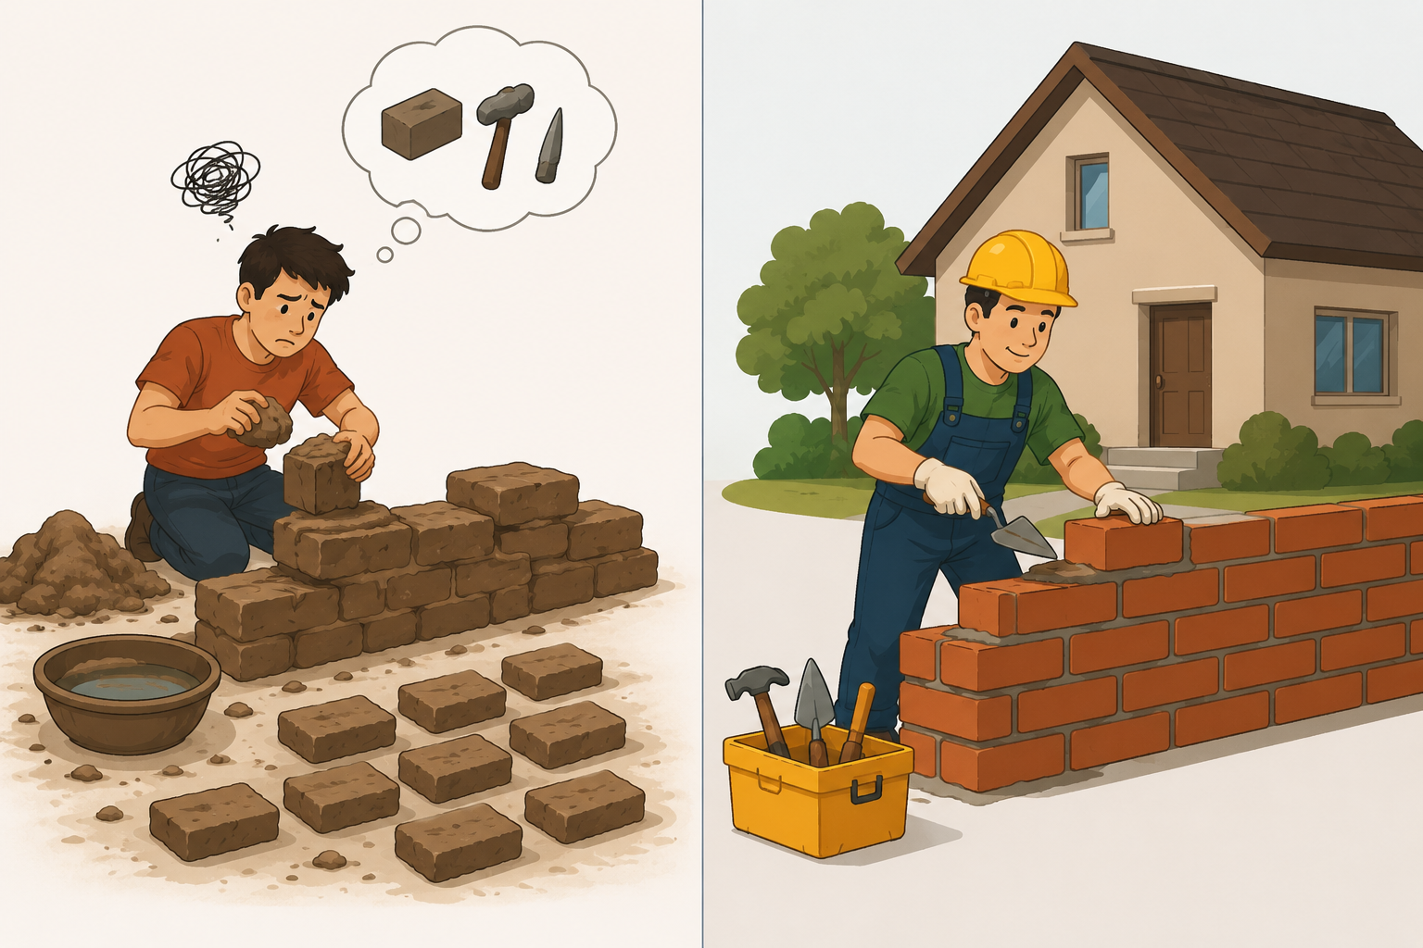
What is a library?
A library is a collection of pre-written, reusable code that helps developers perform specific tasks efficiently without writing everything from scratch.
Real-world example:
Without tools, you would need to make every brick, hammer, and nail yourself.
With tools, you can directly use them to build the house faster.
Ex:
# Without a library
numbers = [10, 20, 30, 40, 50]
sum = 0
for num in numbers:
sum += num
print(sum)
#With library
import numpy as np
numbers = np.array([10, 20, 30, 40, 50])
print(np.sum(numbers))

Slide 4
Why Do AI Developers Use Libraries?
Artificial Intelligence is much more than writing simple programs.
Processing Large Data
Mathematical Calculations
Neural Networks
Visualization
Processing Large Data:
AI models learn from data. The quality and quantity of data directly affect model performance.
Examples:
Netflix analyzes millions of viewing records.
Amazon processes millions of purchase histories.
Performing Complex Mathematical Calculations:
Machine Learning is built on mathematics.
Ex:- A = [1 2] B = [5 6]
[3 4] [7 8]
Using Libraries:
import numpy as np
A = np.array([[1,2],[3,4]])
B = np.array([[5,6],[7,8]])
print(np.dot(A,B))

Slide 5
Training Machine Learning Models
The main goal of Machine Learning is to teach computers to learn from data.
Training means:-
Providing data to a model.
Allowing it to learn patterns.
Using those patterns to make predictions.
Student Marks Dataset:
Hours Studied | Marks
2 | 40
4 | 60
6 | 80
The model learns the relationship between study hours and marks.

Slide 6
Building Neural Networks
Neural Networks are the foundation of modern AI systems.
To build a neural network manually, developers must:
Create neurons
Initialize weights
Calculate outputs
Compute errors
Perform backpropagation
Update weights
Building a neural network manually involves:
Matrix multiplications
Weight updates
Backpropagation
Gradient Descent

Slide 7
What are the benefits of libraries?
Faster Development:
Libraries provide ready-made functions that perform tasks instantly.
Developers don't need to write lengthy code.
Reduces Complexity:
AI involves complicated mathematical operations.
Libraries simplify these operations.
Code Reusability:
Libraries allow developers to reuse existing code.
Easy Learning:
Libraries provide simple and beginner-friendly syntax.
Scalability:
Libraries can handle both small and large projects.
Access to Advanced Technologies
Libraries provide access to advanced AI techniques.

Slide 8
Different Libraries
NumPy (Numerical Python):
Used for numerical computing and mathematical operations.
NumPy provides a powerful object called an Array
Installation: pip install numpy
Ex:-
Without NumPy:
numbers = [1,2,3]
result = []
for num in numbers:
result.append(num * 2)
print(result)
With NumPy:
import numpy as np
a = np.array([10, 20, 30, 40, 50])
print(a *2)

Slide 9
Different methods in NumPy
Category | Methods
Array Creation → | array(), zeros(), ones(), arange()
Math → | sum(), mean(), max(), min(), std()
Shape → | shape, ndim, size
Matrix → | dot(), matmul()
Statistics → | median(), percentile(), corrcoef()
Sorting → | sort(), where()

Slide 10
Pandas
Pandas is a powerful Python library used for data manipulation, data analysis, and data processing.
Without Pandas:
Reading large files is difficult
Filtering data requires many loops
Handling missing values is complicated
Data analysis takes more code
Data Manipulation:
Data Manipulation is the process of changing, organizing, and preparing raw data so that it becomes useful for analysis and machine learning.
Modifying means changing existing data values.
Name | Marks
Ram | 85
Ravi | 50
After modification:
Name | Marks
Ram | 85
Ravi | 90

Slide 11
Organizing Data
Organizing means arranging data in a structured format.
Ex:
Ram, 85, Hyderabad
Priya, 90, Chennai
Ravi, 80, Vijayawada
Organized Data
Name | Marks | City
Ram | 85 | Hyderabad
Priya | 90 | Chennai
Ravi | 80 | Vijayawada

Slide 12
Transforming Data
Transforming means converting data from one format into another.
13-07-2026
Transformed to:
July 13, 2026
Filtering Data
Filtering means selecting only the required information.
Name | Marks
Ram | 85
Ravi | 60
Priya | 95
Suppose we want only students scoring above 80:
Name | Marks
Ram | 85
Priya | 95

Slide 13
Data Analysis
Data Analysis is the process of examining data to discover useful information and patterns that help in decision-making.
Once data is cleaned and organized, it must be analyzed to understand what it tells us.
Installation : pip install pandas
import pandas as pd
data = {
"Name": ["Ram", "Ravi", "Priya"],
"Marks": [85, 90, 88]
}
df = pd.DataFrame(data)
print(df)
import pandas as pd
df = pd.read_csv("students.csv")
print(df)

Slide 14
Matplotlib
Matplotlib is a Python library that helps visualize data using graphs and charts, making it easier to understand patterns, trends, and relationships.
Installation: pip install matplotlib
Syntax:
import matplotlib.pyplot as plt
matplotlib → Main library
pyplot → Module used for plotting graphs
plt → Common alias
EX:
import matplotlib.pyplot as plt
x = [1,2,3]
y = [4,5,6]
plt.plot(x,y)
plt.xlabel("X Values")
plt.ylabel("Y Values")
plt.title("Simple Line Graph")
plt.show()

Slide 15
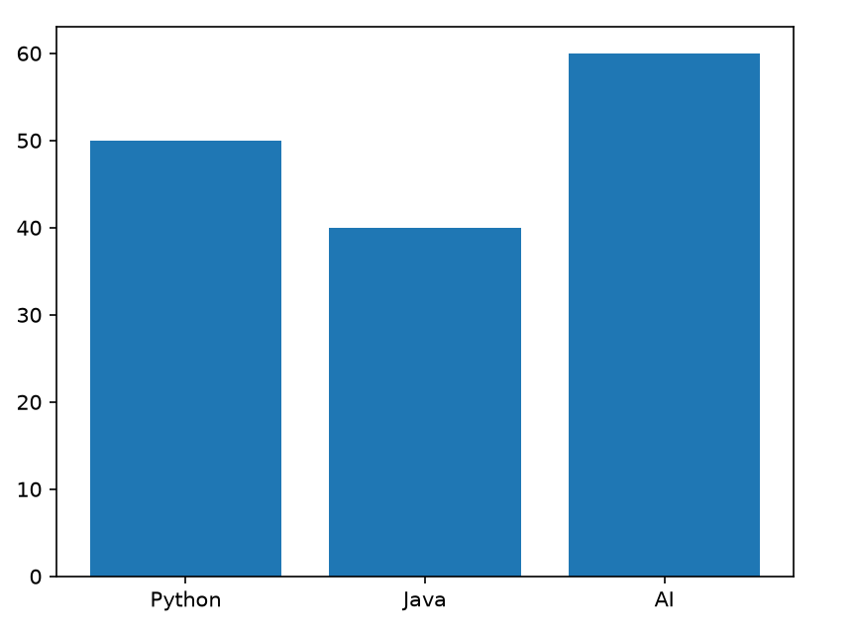
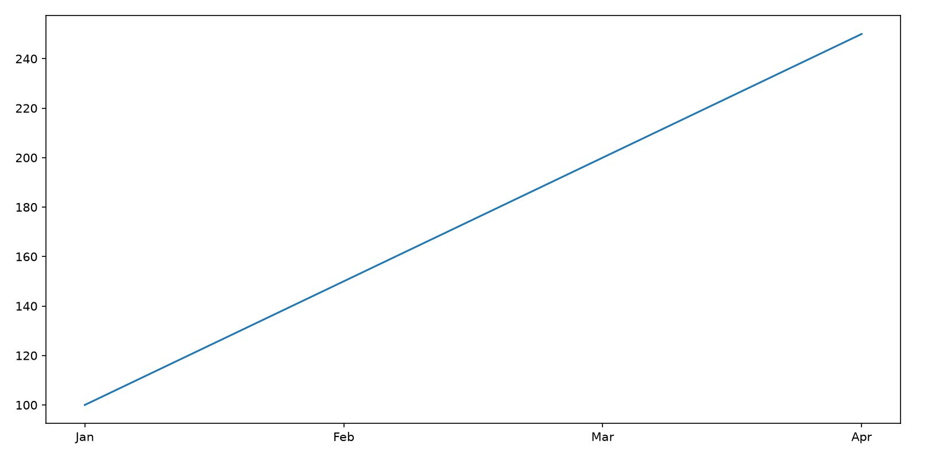
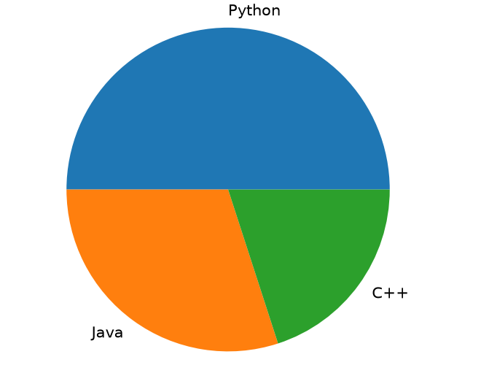
Features of Matplotlib
Line Charts:
Used to show trends over time.
plt.plot()
Bar Charts:
Used to compare categories.
plt.bar()
3. Pie Charts
Used to show proportions or percentages.
plt.pie()

Slide 16
Scikit-Learn (sklearn)
Scikit-Learn is a Python library that provides tools and algorithms for building, training, testing, and evaluating Machine Learning models.
Machine Learning Workflow Using Scikit-Learn
Dataset
↓
Data Preprocessing
↓
Train-Test Split
↓
Model Selection
↓
Model Training
↓
Prediction
↓
Evaluation

Slide 17
Major Algorithms in Scikit-Learn
Linear Regression: Used to predict continuous numerical values.
Syntax:
from sklearn.linear_model import LinearRegression
model = LinearRegression()
2. Decision Trees: Decision Trees make decisions using a tree-like structure.
Synatx:
from sklearn.tree import DecisionTreeClassifier
model = DecisionTreeClassifier()
3. Random Forest:
Random Forest is one of the most powerful Machine Learning algorithms.
It combines multiple Decision Trees to make better predictions.
Synatx:
from sklearn.ensemble import RandomForestRegressor
model = RandomForestRegressor()
4. Clustering:
Clustering groups similar data points together.
Syntax:
from sklearn.cluster import KMeans
model = KMeans(n_clusters=2)

Slide 18
TensorFlow:
The word TensorFlow comes from Tensor
A tensor is a mathematical structure used to store data.
TensorFlow is a Python library that helps developers build, train, and deploy Deep Learning and Artificial Intelligence models.
Used to build Artificial Intelligence applications such as Image Recognition , Natural Language Processing,
Neural Networks
Ex:-
Scalar (0D Tensor)
5
Vector (1D Tensor)
[1,2,3]
Matrix(2D Tensor)
[
[1,2],
[3,4]
]

Slide 19
Before TensorFlow, developers had to manually write:
Matrix calculations
Gradient calculations
Backpropagation algorithms
Weight updates
Neural network architectures
TensorFlow Workflow
Dataset
↓
TensorFlow
↓
Neural Network
↓
Training
↓
Prediction
↓
Evaluation

Slide 20
PyTorch
PyTorch is an open-source Deep Learning framework developed by Meta
Applications:
Computer vision: Teaching computers to understand images and videos.
Natural Language Processing(NLP): Allows computers to understand human language.
EX:
import torch
a = torch.tensor([1, 2, 3])
b = torch.tensor([4, 5, 6])
print(a + b)
import torch
import torch.nn as nn
model = nn.Sequential(
nn.Linear(1, 10),
nn.ReLU(),
nn.Linear(10, 1)
)
print(model)

Slide 21
Computer Vision
Computer Vision is a branch of Artificial Intelligence that allows computers to identify and understand objects in images and videos.
Human Vision
Eye
↓
Brain
↓
Recognize Object
Computer Vision
Camera
↓
OpenCV
↓
Recognize Object

Slide 22
WorkFlow:
Image / Video
↓
OpenCV
↓
Image Processing
↓
Feature Detection
↓
Object Recognition
↓
Output

Slide 23
NLTK(Natural Language Toolkit):
It is mainly used for text processing, tokenization, Lemmatization, and sentiment analysis
from nltk.tokenize import word_tokenize
text = "Artificial Intelligence is transforming the world"
tokens = word_tokenize(text)
print(tokens)
o/p: ['Artificial', 'Intelligence', 'is', 'transforming', 'the', 'world’]
Applications:
Chatbot
Text Classification

Slide 24
LangChain
LangChain is an open-source framework used to build applications powered by Large Language Models (LLMs) such as OpenAI GPT models , Gemini , Claude, Llama
What Can LLMs Do?
Answer questions
Write code
Summarize documents
Translate languages
Generate content
Ex:--
from langchain_openai import ChatOpenAI
# Load LLM
llm = ChatOpenAI(
api_key="YOUR_API_KEY"
)
# Ask a question
response = llm.invoke(
"What is Artificial Intelligence?"
)
# Display response
print(response.content)

