Slide 1


AirBnB New User Booking Prediction
OPIM 5671
Katie Lam
Srilekha Lava
Andre MacDonald

Slide 2
Agenda
Airbnb - Background of the company
Dataset overview & Challenge
Data Preparation
Exploratory data analysis (EDA)
Model Building and Interpretation
Business Insights

Slide 3
Airbnb
Airbnb
Airbnb
Online marketplace founded in 2008 Brian Chesky and Joe Gebbia
Community driven hospitality company
Over 4.5 million listings in 191 countries
As 2015 total funds raised was > $2.3 billion
Company valued at ~$30 billion

Slide 4
Dataset Overview
Data set from Kaggle.com
The company wants to predict where a new user will make their first booking
An accurate prediction will help personalize content, decrease wait time per booking and better forecast demand

Slide 5
Dataset Overview
Dataset consists of 213,451 rows and 16 columns
Column | Description
date_account_created | the date of account creation
timestamp_first_active | timestamp of the first activity
date_first_booking | date of first booking
gender
age
signup_method
signup_flow | the page a user came to signup up from
language | international language preference
affiliate_channel | what kind of paid marketing
affiliate_provider | where the marketing is e.g. google, craigslist, other
first_affiliate_tracked | whats the first marketing the user interacted with before the signing up
signup_app
first_device_type
first_browser
country_destination | this is the target variable you are to predict

Slide 6

DATA PREPARATION AND EDA

Slide 7
Data Preparation
Derived Variables Creation-
Days since First Date (Jan 1 , 2010)
First Active Date – Account Created Date
Week in Year, Day of Week, Month, Quarter, etc.
Missing & Outlier Analysis
Age < 6 were removed; Age > 105 capped to 105 (99% value); Missing values (41%) imputed with median
Linear Discriminant Analysis(LDA) used to impute Missing values (45%) in Gender
One-Hot Encoding of Categorical Variables

Slide 8
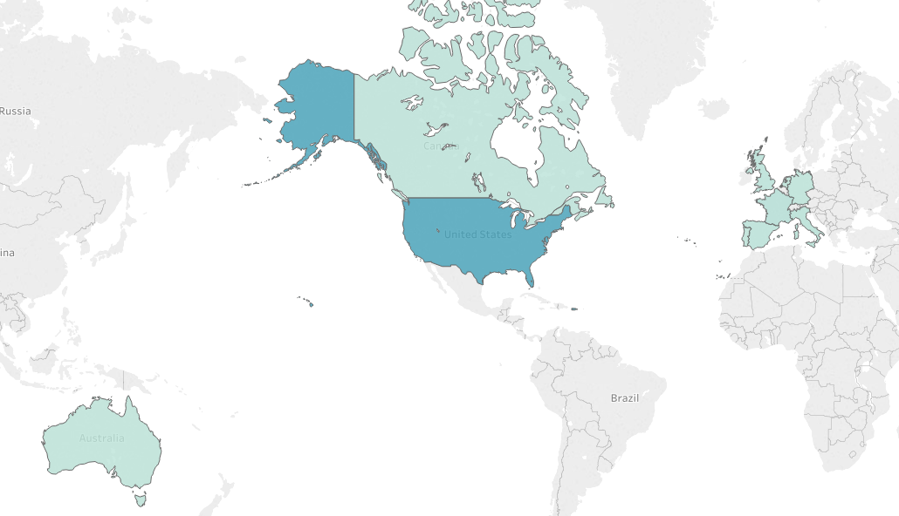

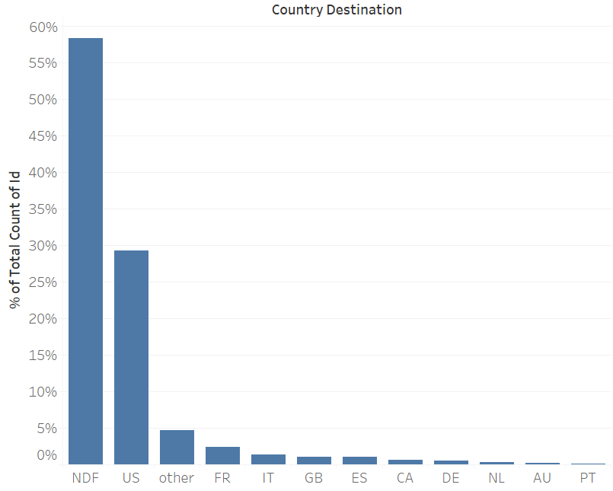
Majority of Actual Bookings were to U.S.
Notes:
Seasonal Data with peaks during December

Slide 9
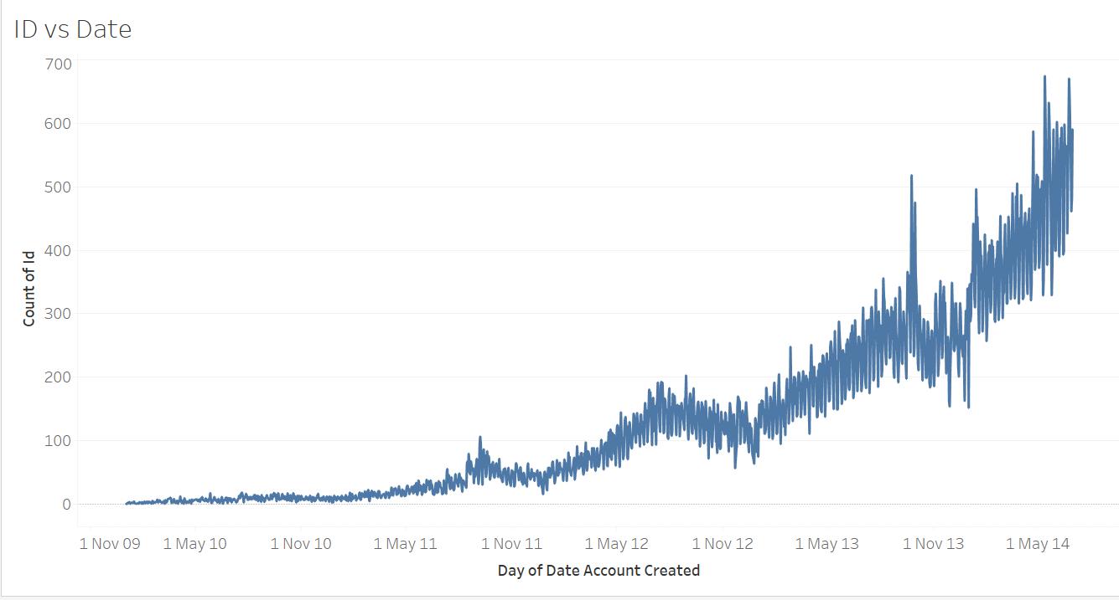
AirBnB became popular in 2014

Slide 10
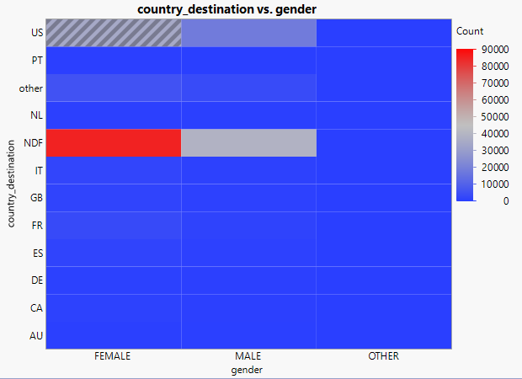
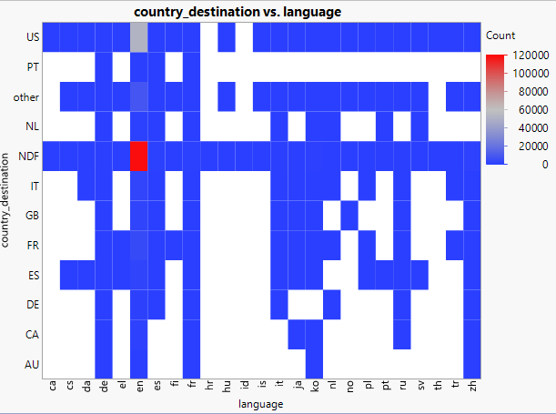
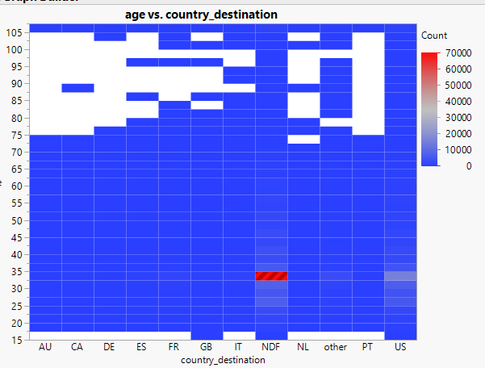
Majority AIRBNB account users booked vacation in U.S. are female
Preferred language is English
The highest booking are ranges from 30 to 35

Slide 11
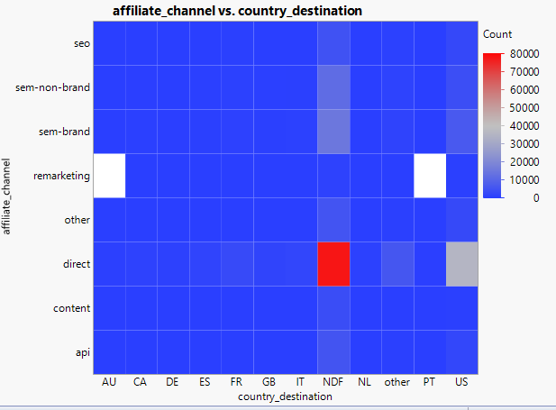
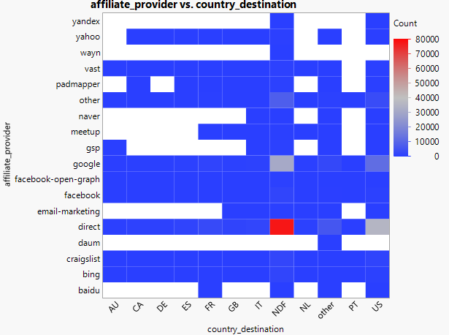
More people preferred direct marketing by AIRBNB and google

Slide 12
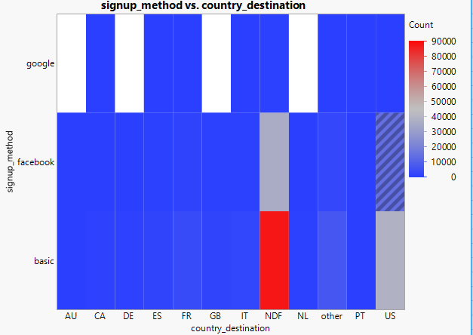
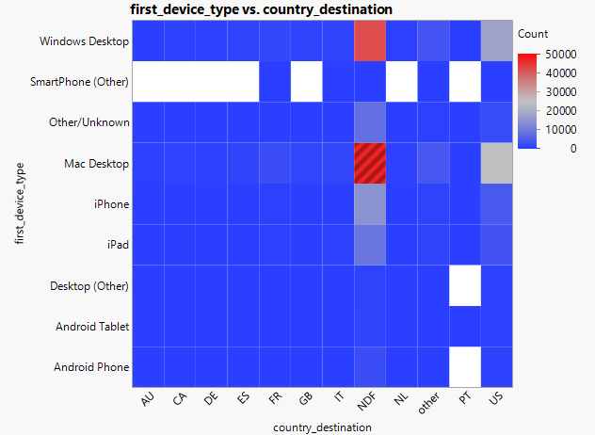
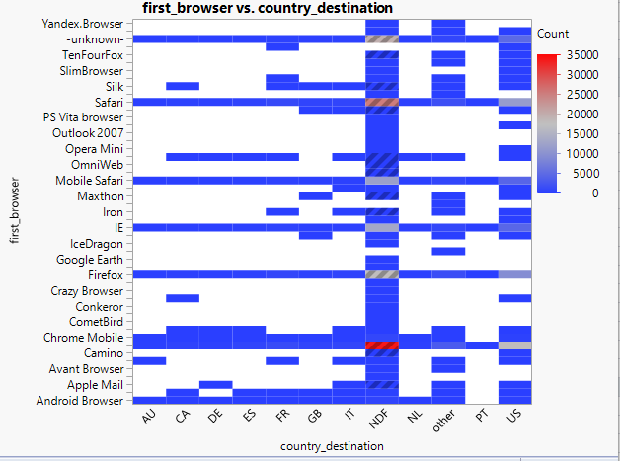
Most AIRBNB accounts created using Basic Apps or Facebook
Window desktop or Mac Desktop are mostly used for booking devices; Some other devices are iPhone and iPad.
Popular booking browsers are Chrome Mobile, Firefox, IE, Safari

Slide 13
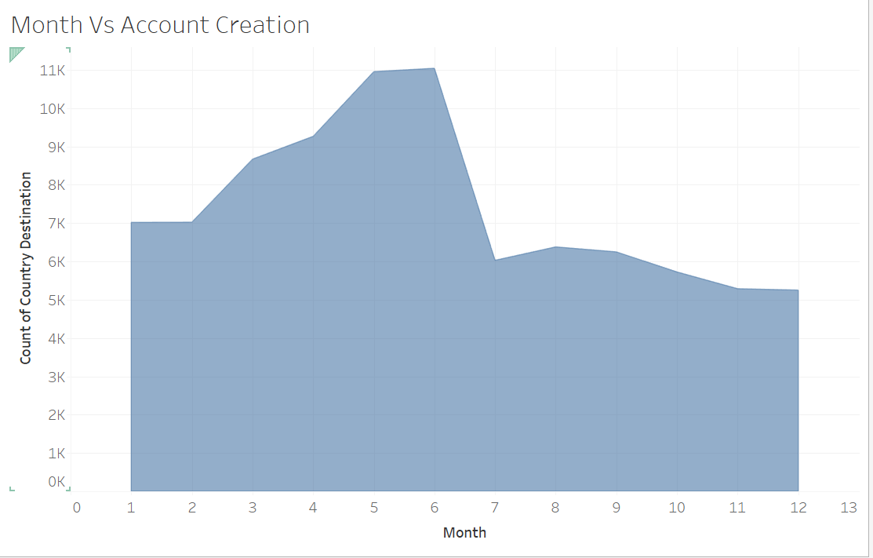
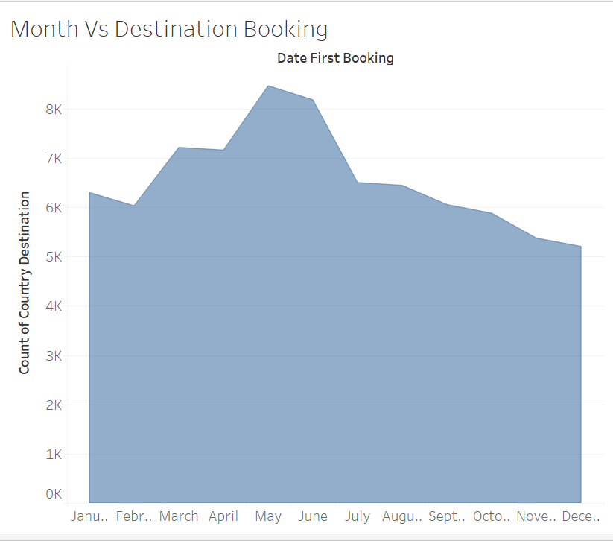
January to June are the highest date account creation & booking AIRBNB months
People tends to travel in Quarter 2 from March to June where June showed to be the highest booking month in the year

Slide 14

MODEL BUILDING & INTERPRETATION

Slide 15
Model Processing
Removed Multicollinear variables
ReSampled Dataset
Built Models on
Training (70% ) and Validation (30%) Set
Performed k-Fold Cross Validation on the models
Tuned Parameters
Chose best model on evaluation metric
Multicollinearity – Variables with Variance Inflation Factor > 5
Balanced dataset [Downsampled US, Other, NDF destination observations and Upsampled other Categories to 10,000]
Final Dataset – 120K observations & 96 features

Slide 16

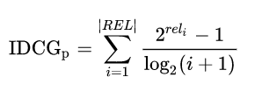

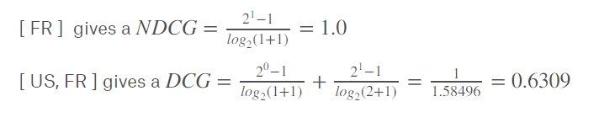
Model Evaluation Metric – Normalized Discounted Cumulative Gain @Rank 5 (NDCG@5)
DCG is a graded relevance scale which measures the usefulness/gain passed on its position
DCG is based on the assumption that highly relevant occurrences are more important when they appear early

Slide 17
Multi-class Classification Model Evaluation
Performed 10-Fold Cross Validation on each of the below models-
S.No. | Model | NDCG@5
1 | eXtreme Gradient Boosting (Learning Rate = 0.1, evaluation_metric = ndcg@5) | 67.84%
2 | Multinomial Logistic Regression (Solver – Limited Memory BFGS) | 67.5%
3 | Neural Network (Input Layer – 20 , 2 Hidden Layers – 10,8, Output – 12) | 66.35%
4 | Multinomial Naïve Bayes | 66.2%
5 | Random Forest (Max Depth = 4) | 66.18%

Slide 18

BUSINESS INSIGHTS

Slide 19
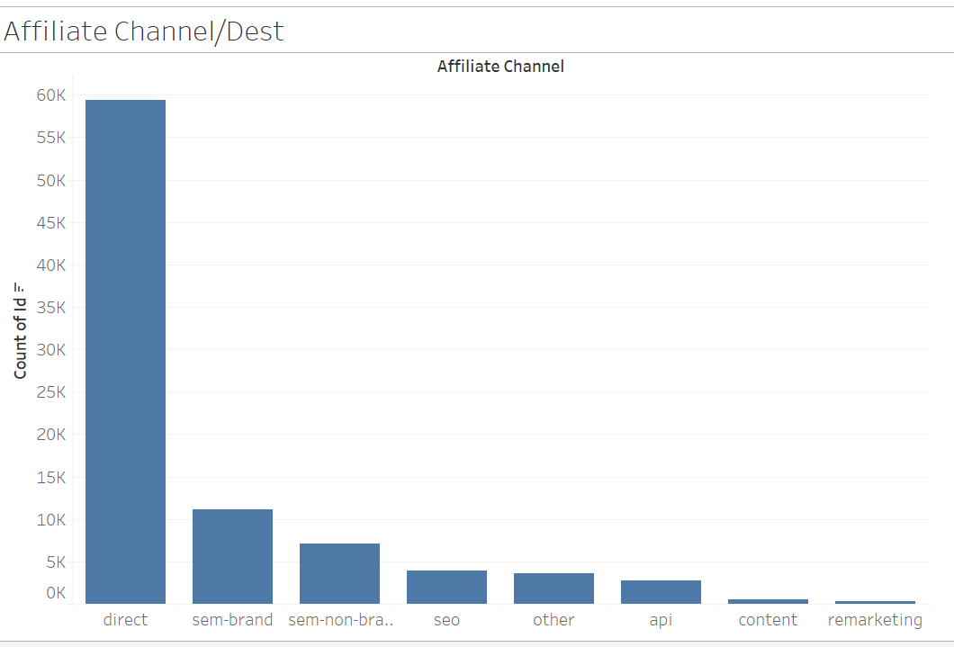
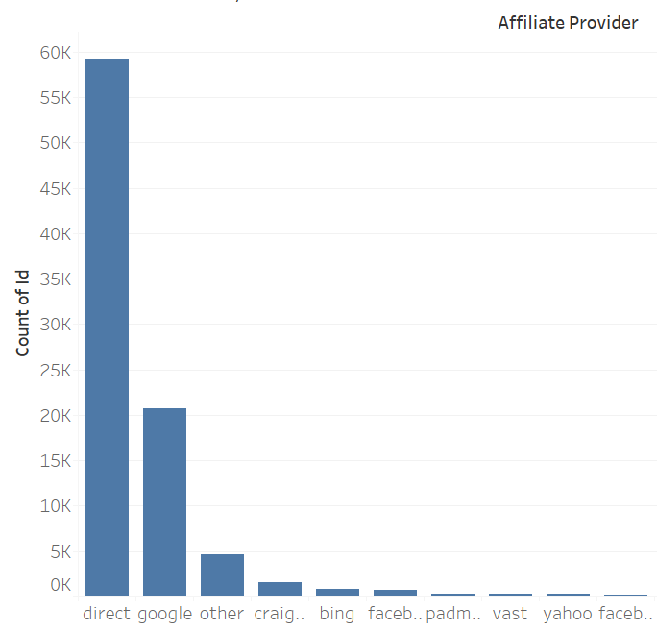
Feature Importance
Chi-Square Test of Significance
 | Affiliate Channel | Quarter | Affiliate Provider | Month | Year | Language | Signup App | First Device Type | Gender | Week Year | First Affiliate Tracked | WeekDay | Signup Method | First Browser
Country Destination - All Except "NDF" | 1.90E-110 | 1.63E-67 | 8.04e-62, | 3.30E-60 | 1.96E-57 | 3.50E-55 | 6.43E-44 | 4.33E-47 | 8.00E-37 | 3.29E-33 | 7.27E-29 | 2.05E-07 | 1.26E-05 | 0.01
Affiliate Channel [Direct] and Affiliate Provider[Direct, Google, Craiglist] influences Booking Destinations

Slide 20
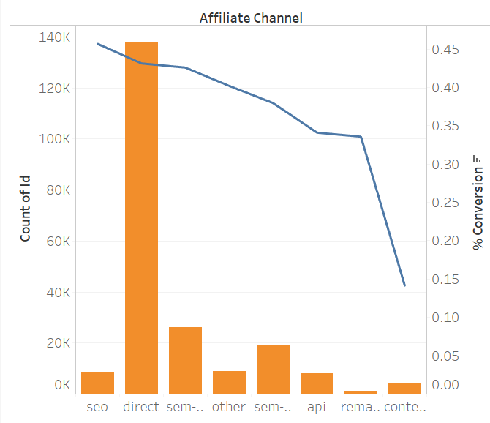
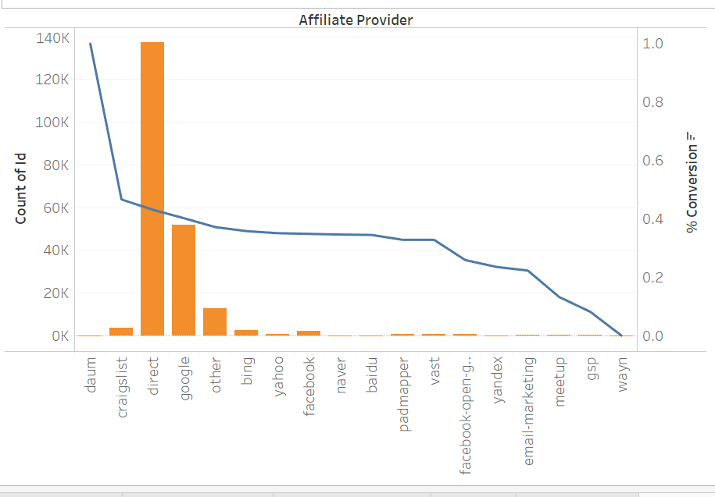

AirBnB should spend more on SEO rather then affiliate brand marketing for maximum booking
% Conversions are high in SEO Affiliate Channel and Craiglist Provider
% Conversions = # of Bookings/Total # of Account Created

Slide 21
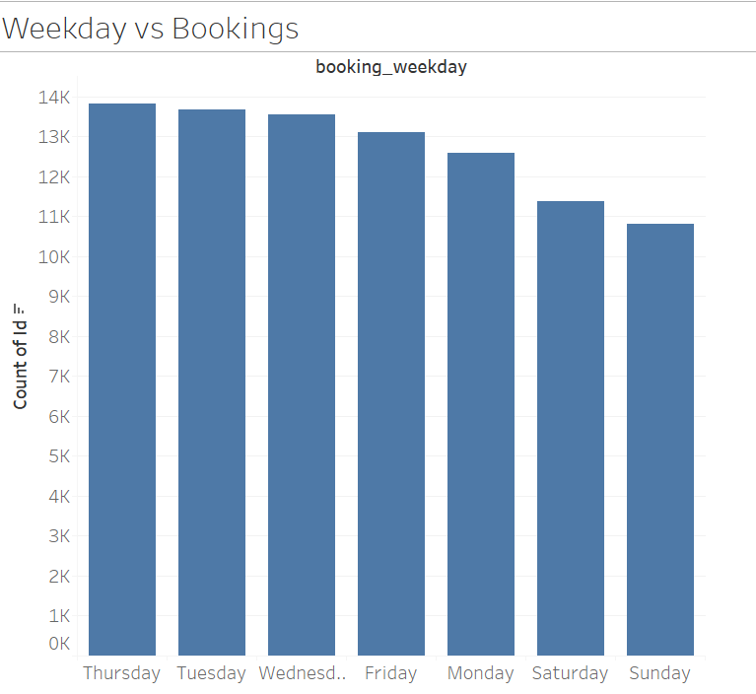
AirBnB should provide more promotions on Summer WeekDays

Slide 22
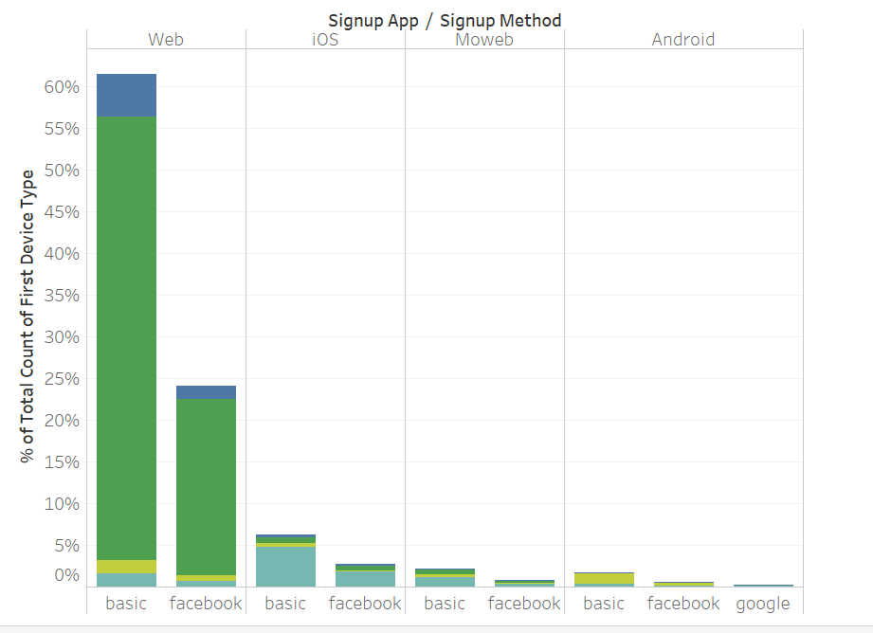
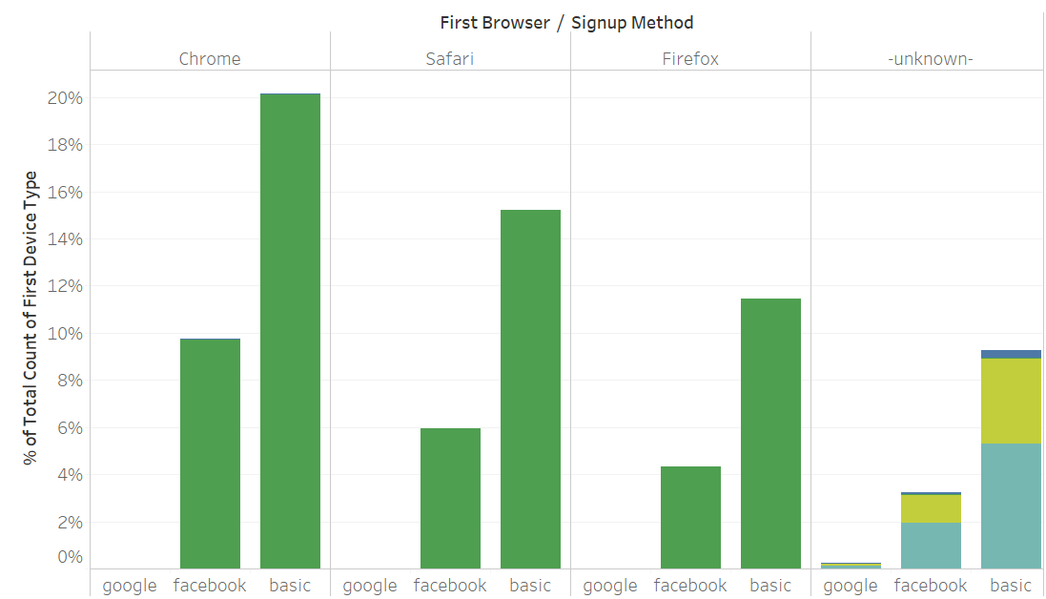
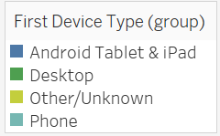
Customize features on AirBnB website for better customer experience

Slide 23


Questions

Slide 24



Team Members
Srilekha Lava
Data Scientist
Katie Lam
Business Analyst
Andre MacDonald
Project Manager

