Slide 1
Survival Analysis For
FermaLogis Company
PROJECT GROUP - 5
Presented By:
Divya Murli
Prachi Gupta
Priya Mudambi
Sneha Prabhu
Srilekha Lava
Subhashree Srinivisan
Vasanthapriya Raja

Slide 2
Data Summary
Type | Observations | Contribution in %
0 - No turnover | 1245 | 85%
1 - Retirement | 27 | 2%
2 - Voluntary Resignation | 105 | 7%
3 - Involuntary Resignation (Health problems, family matters etc.) | 54 | 4%
4 - Job Termination, Employee is Fired | 39 | 3%
Dataset has 76 variables with 19 categorical and 57 continuous.
Type variable is the target variable indicating whether an employee is currently active in company or not.

Slide 3
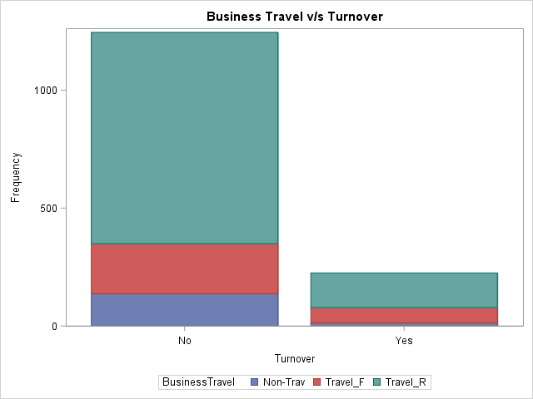
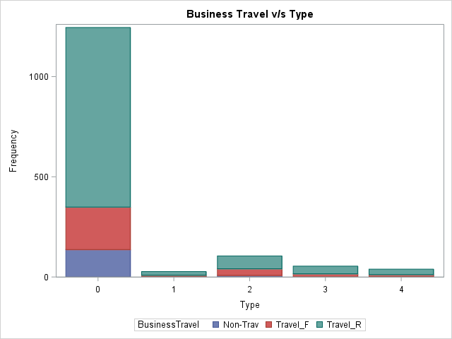
Exploratory Data Analysis
Variable: Business Travel
Observations
Employees who travel rarely contribute more to voluntary resignation and other categories as well

Slide 4
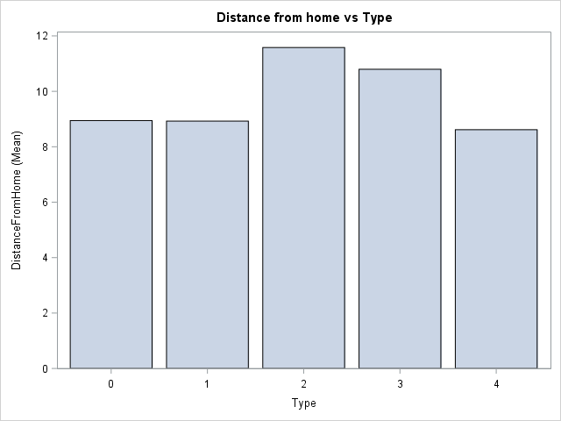
Exploratory Data Analysis
Variable: DistanceFromHome
Observations
As the distance from the house to office increases, people tend to leave the company more.
People tend to resign voluntarily from the company and this might due to various reasons such as traffic, hectic travel, etc

Slide 5
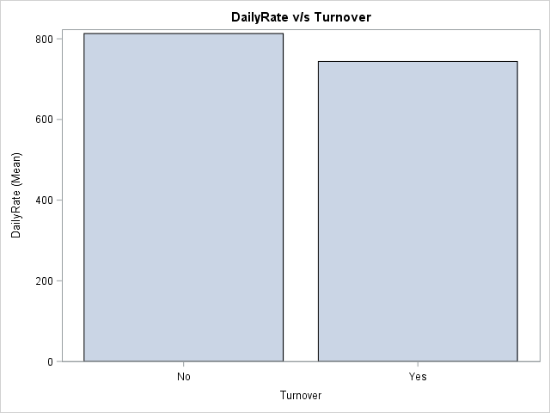
Exploratory Data Analysis
Variable: DailyRate
Observations
As the daily wages of employees increases, people are more satisfied with their job, hence they do not leave the company as compared to the people who are paid less on a daily basis

Slide 6
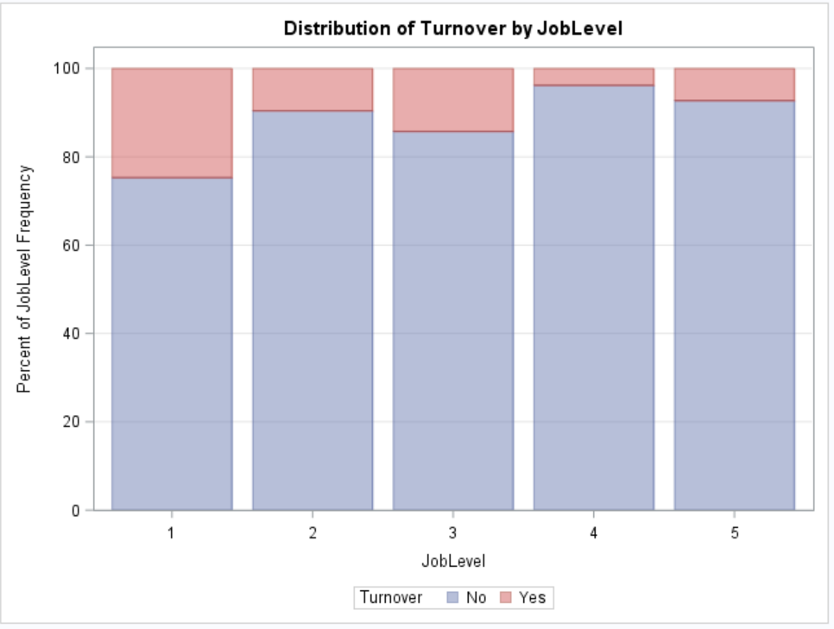
Exploratory Data Analysis
Variable: JobLevel
Observations
Job Levels 1 to 3 have higher turnover rate.
Also, all firing happens at job levels 1 to 3.

Slide 7
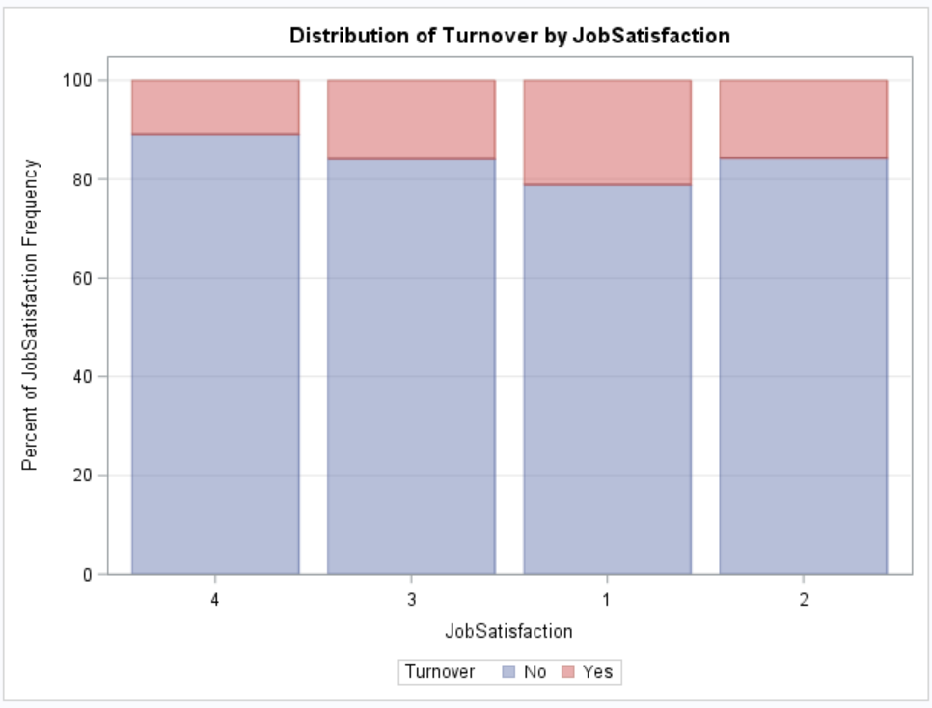
Exploratory Data Analysis
Variable: JobSatisfaction
Observations
Low job satisfaction levels correlate with high turnover rates.
Also, low job satisfaction (level 1 and 2) have very high voluntary attrition.
Job levels 3 and 4 are high on Retirement and Firing reasons of Attrition.

Slide 8
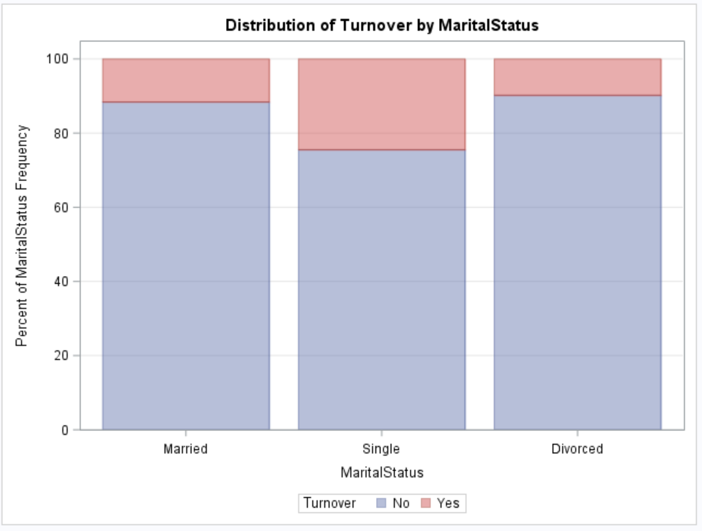
Exploratory Data Analysis
Variable: MaritalStatus
Observations
Single employees have higher turnover rate and they also have high voluntary attrition rate

Slide 9
Insignificant Variables
Variable | Reason for removal
EmployeeCount | We removed it because it just shows a numeric value of 1 for all the rows.
Over18 | It does not contribute to the model because this variable has a character ‘Y’ for all the rows in the dataset.

Slide 10
Identification Of Significant Variables
DistanceFromHome | Job Involvement | Marital Status | YearsatCompany
Daily Rate | Job Level | Stock Option Level | YearsSinceLastPromotion
Environment Satisfaction | Job Role | Total Working Years
Gender | Job Satisfaction | WorkLifeBalance
There were few variables which were very significant and directly contribute towards the target variable “Type”.

Slide 11
Feature Engineering
Parent Variable | Derived Variable | Range
Age | AgeBucket | Age <= 25 ; AgeBucket ='Young'; 25 < age <= 40; AgeBucket ='Mid-Age'; Age >40 then AgeBucket ='Old';
Monthly Income | IncomeBucket | MonthlyIncome <= 5000; IncomeBucket='Low Pay'; 5000 < MonthlyIncome <= 10000; IncomeBucket='Medium Pay'; MonthlyIncome >10000; IncomeBucket='High Pay';
DistanceFromHome | DistanceFromHomeBucket | DistanceFromHome <= 11; DistanceFromHomeBucket ='Near to office'; DistanceFromHome >11 ; DistanceFromHomeBucket ='Very Far';
40 bonus columns | YearsBonusRewarded | Summation of all the 40 bonus columns
YearsatCompany | Employee Type | YearsAtCompany < 5; EmployeeType = 'Junior'; else EmployeeType = 'Experienced';
Based on bonus column | BonusRewardRatio | YearsBonusRewarded/YearsAtCompany
We derived 5 new variables based on the existing variables to enable us to understand the effects of these variables on the target variable in a better way

Slide 12
Can we combine different event types together? Or do all need to be handled separately?

Slide 13
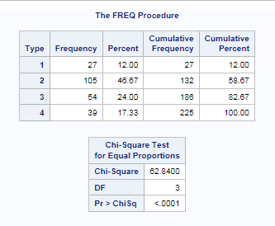
Hazard rate is not same for all event types
0 - No turnover
1 – Retirement
2 - Voluntary Resignation
3 - Involuntary Resignation (Health problems, family matters etc.)

Slide 14
Log-ratio test show that the event types need to be handled separately

Slide 15
Is there any difference in attrition between different employee groups or categories? Some examples….

Slide 16
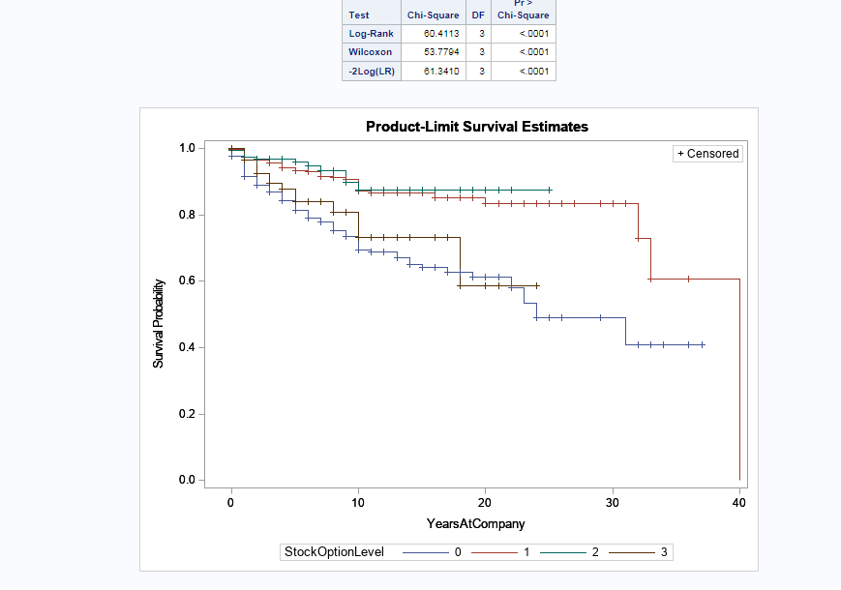
Stock Level Option
Notes:
Employees who had a decent amount of stock options (1 or 2) had a higher chance of survival versus those didn’t have any stock options at all or those who had a huge amount of stocks. The huge amount of stock options may not have benefit the employee since they didn’t gain much with

Slide 17
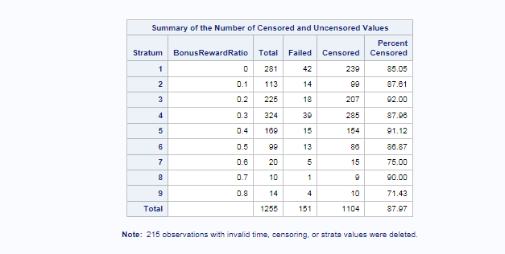
Bonus Reward Ratio
It is the ratio of Number of Years Bonus Rewarded to the Number of Years At Company
To use an example, those employees who stayed 10 years and were rewarded 8 times were the majority who left the company. This tell us that the bonus had to be re worked in order for the firm to lose their employees and money.

Slide 18
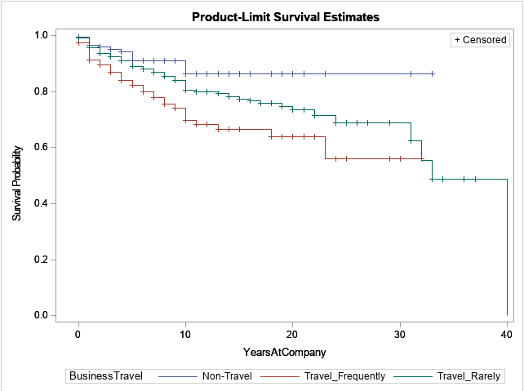
Business Travel
An employee who doesn’t travel have a higher chance of survival, followed by travelling rarely and last travelling frequently. In our graph, the ones who travelled frequently were the majority who left the firm.

Slide 19
General Effect of Covariates on Hazard
Covariates which increase hazard | Covariates which reduce hazard
Increased distance from Home | Increased Bonus
Greater # of Companies worked | High Environment Satisfaction
Frequent Travel | Increased Job Involvement
Male Employees | Great Job Satisfaction
Overtime Work | High Total Working Years
High and Low Payment | More training
 | More years with current manager
 | Employees with executive positions
 | Marketing and HR Education Field

Slide 20
Effect of Covariates on Turnover Type
Hazard of retirement increases with age, distance from home, frequent business travels, overtime work and the number of companies worked while the risk of retirement reduces with increased environment satisfaction and job involvement and with work involving no travel
Hazard of voluntary termination increases with overtime work, greater number of companies worked and increased distance from home. The company could prevent employees from leaving by providing high bonus, great environment and job satisfaction. The company could employ a lot of freshers and mid-senior level employees who are married or divorced.
Hazard of involuntary termination increases greatly with overtime work though they are highly satisfied with the job. These employees have a history of having worked in many companies. Hazard of involuntary termination is less among experienced employees.
Medical, Life Sciences professionals and senior employees are less likely to get fired. More trainings and greater number of years in the current role or with current manager reduces the hazard of getting fired. Employees with increased hazard of getting fired are the ones who have worked in greater number of companies.

Slide 21
Effect of Bonus on Attrition
As more bonus is given, hazard reduces by ~80%.
Hence we could infer that to prevent employees from leaving the employee, bonus needs to be given at increased intervals, possibly every year if the performance of the employee is good

Slide 22
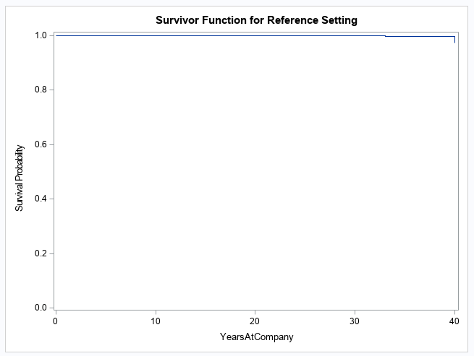
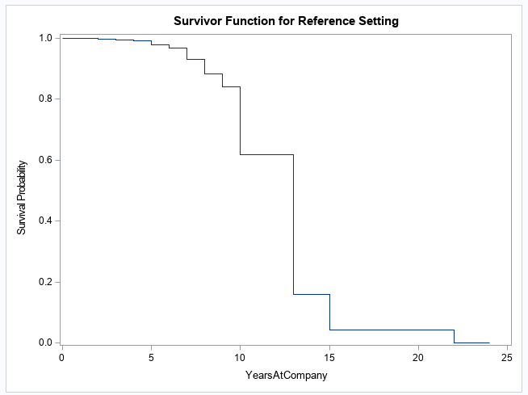
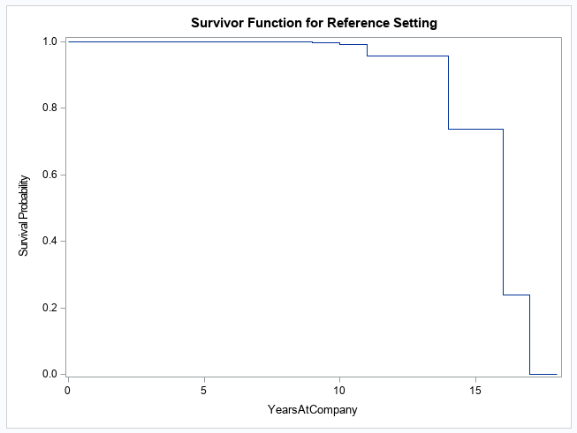
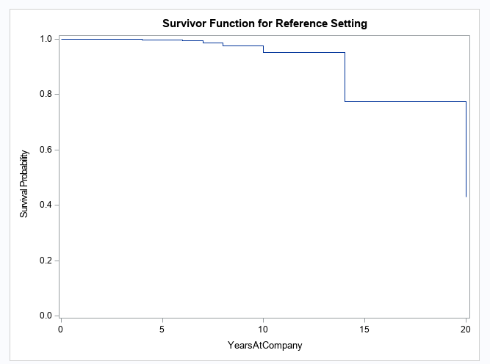
Survival Plots for Different Turnover Types
Type 1(Retirement)
Type 2 (Voluntary Termination)
Type 3 (Involuntary Termination)
Type 4 (Fired)
The survival probability drops rapidly for Type 2 and 3 as the years at company increases

Slide 23
Conclusion & Recommendations
After analyzing, we found that there could be certain benefits or perks which can be offered to the employees.
We observed that people who travel rarely churn more. Hence, more business travel opportunities must be given to people who belong to all types.
Also, we observed that people who live far also churn more. Hence, if they are given allowances like gasoline allowances or other travel vouchers to come to office daily, it would be really helpful to them.
We also observed that many people are leaving from the Research and Sales team. So the company needs to figure out better strategies to retain the employees who belong to these departments.

Slide 24
THANK YOU!

