Slide 1
COSC6364 - ADVANCED NUMERICAL ANALYSIS
SIGNAL RECONSTRUCTION FROM NON-UNIFORM FREQUENCY SAMPLING
Team AKS
Anirudh Kalva - 2288613
Venkata Kausik Renduchintala - 2260419
Srilekha Rayedi - 2287597

Slide 2
Outline
Abstract
Introduction
Methodology
Implementation
Results
Evaluation
Conclusion
Future Scope
References

Slide 3
Abstract
In the realm of signal processing, the challenge of reconstructing signals from incomplete frequency information has emerged as a critical obstacle in numerous practical applications.
Traditional methodologies often assume access to the full frequency spectrum, yet real-world constraints such as data acquisition limitations or resource scarcity frequently render this assumption untenable.
This project endeavors to employ robust techniques such as Inverse Non-uniform Fourier transform and Frequency domain interpolation tailored to efficiently utilize partial frequency data, thereby addressing the demand for accurate signal reconstruction.

Slide 4
Introduction
Signal reconstruction from sample values is a significant aspect of signal processing.
Uniform sampling, the widely recognized method, involves obtaining samples of continuous-time signals at evenly spaced time intervals.
A limitation of uniform sampling is its requirement for samples to adhere to a uniform grid.
Non-uniform sampling, on the other hand, extends beyond this constraint, allowing samples to be obtained at irregular intervals.
Yet, reconstructing signals from non-uniform samples presents challenges due to the lack of a uniform grid structure, making it difficult to employ time-invariant processes for reconstruction.
Non-uniform sampling is essential across various applications, including biomedical devices like wearable heartbeat detectors, time-interleaved analog-to-digital converters (TI-ADCs) and sensor networks.

Slide 5
Methodology
Inverse Non-uniform Fourier Transform (INUFT):
The Inverse Non-uniform Fourier Transform (INUFT) is a mathematical technique used to reconstruct a signal from its non-uniformly sampled frequency domain.
Iterative algorithms iteratively refine an initial estimate of the signal based on the observed frequency samples
Compressed sensing techniques exploit the sparsity or compressibility of the signal in a suitable domain to recover the signal from a limited number of non-uniform frequency measurements.

Slide 6
Frequency Domain Interpolation (FDI):
Frequency Domain Interpolation (FDI) is a technique used to reconstruct a signal by interpolating the missing frequency coefficients.
Two interpolation methods are employed in FDI:
Linear Interpolation is a simple method that estimates missing values by drawing straight lines between known data points in the frequency domain. For a given missing point, it uses the nearest known points on either side to predict the value.
In FDI, Polynomial Interpolation can be used to estimate missing frequency coefficients by fitting a polynomial function to the available frequency data points.

Slide 7
Implementation
Linear Interpolation:
Utilizes interp1d from scipy.interpolate.
Identify known values in each frequency bin and create linear interpolation functions.
Extrapolates for frequencies outside known data points to estimate missing components.
Polynomial Interpolation:
Fits a polynomial of specified degree to known data points using np.polyfit.
Coefficients from np.polyfit are used to evaluate the polynomial across the entire frequency bin.
Degree parameter controls complexity; higher degrees fit complex data but may overfit sparse data.

Slide 8
Implementation
Inverse Non-Uniform Fourier Transform (INUFT):
Generates random points to represent non-uniformly sampled frequencies.
Initializes NUFFT object and sets up NUFFT operation with generated points.
Forward NUFFT computes NUFFT matrix and applies it to input signal to obtain non-uniformly sampled frequency components.
Adjoint NUFFT reconstructs signal from non-uniformly sampled components using the transpose of NUFFT matrix.
Integrates Fourier analysis, linear algebra, and numerical methods to efficiently handle non-uniformly sampled signals in frequency domain, aiming to approximate original input signal.

Slide 9
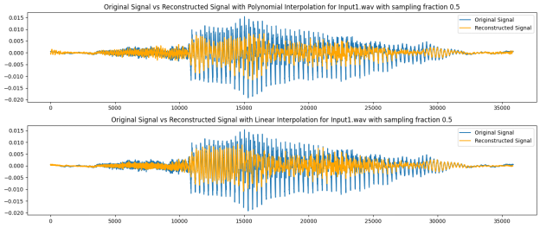
Results
Frequency Domain Interpolation

Slide 10
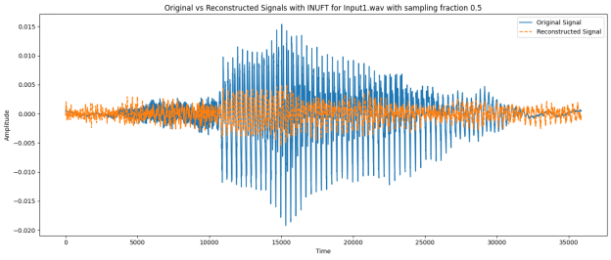
Results
Inverse Non Fourier Transform Interpolation

Slide 11
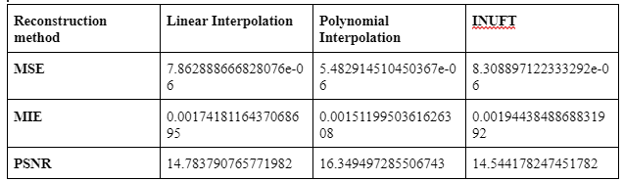
Results
Table illustrating comparisons of MSE, MIE, and PSNR of different interpolation methods with a sampling fraction of 0.5.

Slide 12
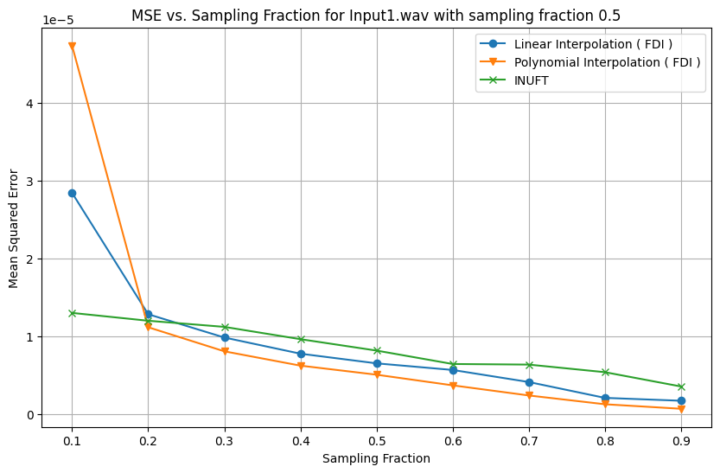
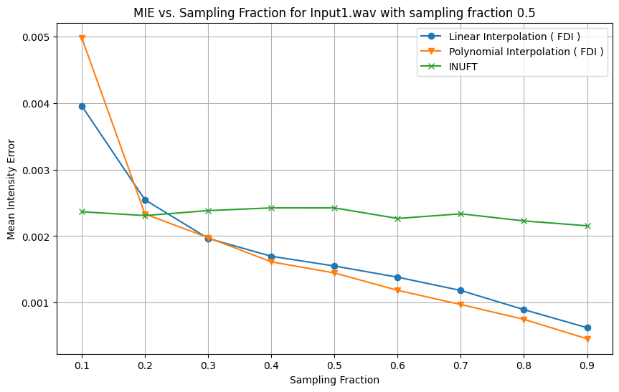
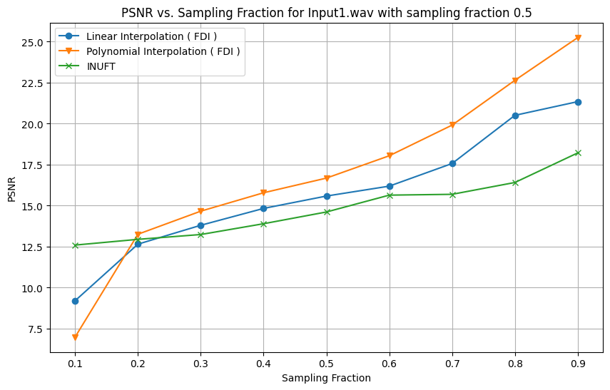
Evaluations

Slide 13
Evaluations
At higher sampling fractions (beyond 0.5), all three methods — linear interpolation, polynomial interpolation, and INUFT (Inverse Non-Uniform Fourier Transform) — tend to converge to similar MSE values, suggesting that once enough samples are provided, all methods are equally effective.
Similar to MSE, the MIE for all methods decreases as the sampling fraction increases.
The rate of improvement in PSNR slows down significantly after a sampling fraction of 0.5, similar to the trend seen in the MSE plot
Polynomial interpolation and INUFT consistently outperform linear interpolation across the board for all three metrics, which could be attributed to their ability to better model and estimate the missing information in the signal.
The difference in performance between polynomial interpolation and INUFT is marginal, suggesting that for this specific dataset and reconstruction task, both methods are nearly equally effective.

Slide 14
Conclusion
In this project, we successfully reconstructed signals from non-uniformly sampled frequency data using the Inverse Non-uniform Fourier Transform (INUFT) and Frequency Domain Interpolation (FDI) algorithms. Through careful dataset creation and algorithm implementation, we achieved promising results in signal reconstruction.
The evaluation of the reconstructed signals against their ground truth counterparts in the time domain yielded positive outcomes. The MSE, MIE and PSNR criteria indicated high fidelity and accuracy in the reconstructed signals.
Furthermore, the comparison between INUFT and FDI showcased their complementary strengths, providing valuable insights into their respective performance characteristics.

Slide 15
Future Scope
In the future, the project can be expanded in several ways to enhance signal reconstruction techniques from non-uniformly sampled frequency data:
Advanced Techniques: Implementing more advanced reconstruction methods beyond INUFT and FDI, such as deep learning-based approaches or graph signal processing techniques.
Noise Robustness: Developing strategies to improve the robustness of reconstruction algorithms against noise in the frequency domain, including denoising techniques.
Adaptive Sampling: Exploring adaptive sampling strategies to effectively select sampling points based on signal characteristics, improving reconstruction accuracy and efficiency.
Multi-dimensional Signals: Adapting to reconstruction algorithms to handle multi-dimensional signals like volumetric data, opening up new possibilities for application in various domains.

Slide 16
References
https://dspace.mit.edu/bitstream/handle/1721.1/57688/635954979-MIT.pdf?sequence=2&isAllowed=y
https://www.sciencedirect.com/science/article/abs/pii/0165168496000588

Slide 17
THANK YOU

