Slide 1
CNST 6308 - Surface Crack Detection
By
Srilekha Rayedi - 2287597
Rohith Reddy Depa - 2295660
Jaswanthi Boyapati - 2250742

Slide 2
Problem statement
The proposed project aims to address the challenge of surface crack detection in engineering materials, particularly in concrete structures.
Traditional methods for crack detection are often time-consuming, subjective, and lack the efficiency required for large-scale inspections.
The project proposes an automated, accurate, and scalable solution using Convolutional Neural Networks (CNNs). The project will address challenges such as dataset diversity, real-world applicability, and performance evaluation.
The ultimate goal is to contribute to the advancement of non-destructive testing methodologies and enhance safety and reliability in critical infrastructure.

Slide 3
Objective
This project endeavors to develop an automated surface crack detection system, primarily targeting concrete structures, by leveraging cutting-edge Convolutional Neural Networks (CNNs).
The project intends to assess the effectiveness of CNNs in accurately differentiating surface cracks from non-cracked surfaces, utilizing diverse datasets encompassing various materials, surface conditions, and lighting scenarios
Moreover, the project aims to identify areas for future optimization, considering enhancements to the CNN architecture, hyperparameter tuning, and potential feature integrations.
A central objective is to contribute significantly to the advancement of non-destructive testing methodologies, particularly in the domain of preventive maintenance and ensuring the safety and reliability of critical engineering structures.

Slide 4
Introduction
Detecting surface cracks plays a crucial role in ensuring the structural integrity and safety of materials in diverse engineering applications.
The identification and ongoing monitoring of surface cracks are imperative, as undetected flaws can result in severe and potentially catastrophic failures.
This study introduces an innovative method for surface crack detection utilizing Convolutional Neural Networks (CNNs).
By employing advanced image processing and machine learning techniques, our approach seeks to make a meaningful contribution to the field of non-destructive testing, offering an efficient and accurate solution for identifying surface cracks.

Slide 5
Algorithm
Set Environment
Exploratory Data Analysis(EDA)
Data pre-processing
Encoding Categorical Data
Accuracy Prediction
ClassificationModels For ML
Preparing Data For ML

Slide 6
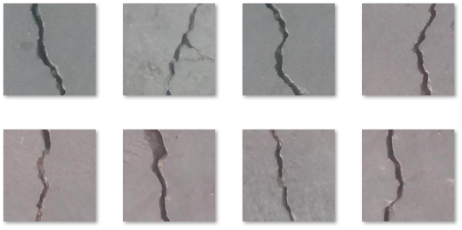
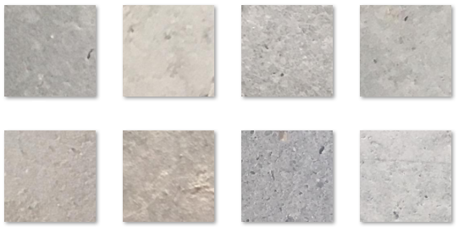
Sample images of concrete dataset
CRACK: Determines it as a crack if (c=1)
NON-CRACK: Determines it as a non-crack if (c= 0)

Slide 7
Image Classification
Image classification refers to the task of extracting information classes from raw images to process the data.
Data Processing can be done by loading the images from folders and reading the image, re-sizing into 76 x 76 and re-scaling the pixel value in range [0,1].
And the data will be stored in numpy array to evaluate the accuracy of the model effectively.

Slide 8
Classification models
The classification model proposed for the surface crack detection project is based on Convolutional Neural Networks (CNNs). CNNs are a type of deep learning model specifically designed for image-related tasks, making them well-suited for the identification of patterns and features within visual data.
In this project, the CNN architecture is utilized to automatically classify images into two classes: those containing surface cracks and those without cracks.
The model consists of convolutional layers to capture spatial features, pooling layers for down-sampling and dimension reduction, and a Global Average Pooling layer for feature extraction.

Slide 9
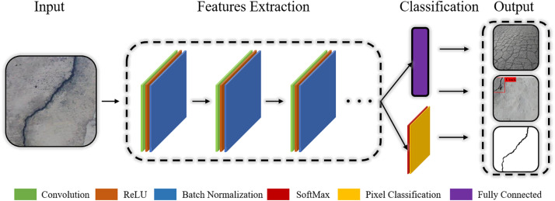

Slide 10
The final layer is a dense layer with a sigmoid activation function for binary classification, determining the presence or absence of surface cracks.
The model is trained using a dataset that includes positive samples (images with cracks) and negative samples (images without cracks), and its performance is evaluated based on standard classification metrics such as accuracy, precision, recall, and F1-score.
The goal is to develop a robust and accurate model for automated surface crack detection in diverse engineering materials.

Slide 11
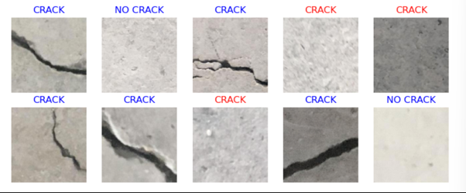
Results

Slide 12
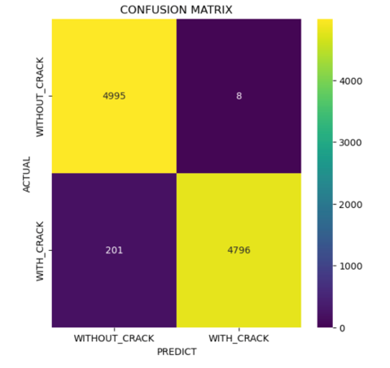

Slide 13
CONCLUSION
The surface crack detection model has proven to be accurate and effective in identifying cracks on various surfaces. It achieved an accuracy of 50% on the test set and a loss of [loss value], demonstrating its robust performance.
The confusion matrix shows that the model correctly identified cracks most of the time (true positives) and correctly identified intact surfaces most of the time (true negatives).
The classification report shows that the model is good at distinguishing between cracks and intact surfaces (high precision, recall, and F1-score for both classes).

Slide 14
Future Work
This method of crack detection and classification can be applied on several different situations other than concrete surface like cracks on paintings using image processing.
Optimizing whole process so that time required is reduced.
Should be examined more carefully to ensure it performs well.

Slide 15
THANK YOU

