Slide 1
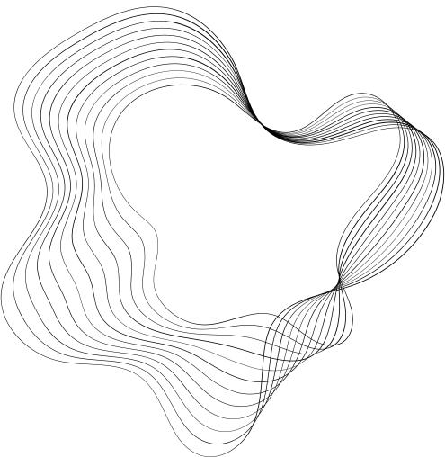

COSC 6334 - VISUALIZE GRAPHS WITH ADJACENCY MATRIX
Date : 11/21/2024
Srilekha Rayedi - 2287597
Venkata Sai Nikitha Kandikattu - 2282058
Sai Tejaswi Guntupalli -2296056
1

Slide 2
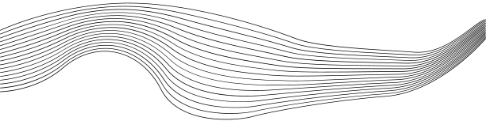
CONTENT
01
INTRODUCTION
02
PROBLEM STATEMENT
03
METHODOLOGY
04
ALGORITHM
05
RESULTS
06
CONCLUSION
07
FUTURE WORK
2

Slide 3

INTRODUCTION
Graphs are a way to represent relationships or connections between objects. They consist of:
Nodes (or vertices): These represent entities, like people in a social network, cities in a transportation system.
Edges (or links): These show the relationships or interactions between those entities.
Graphs are widely used because they help us visualize and analyze how things are connected in real-world systems.
Traditional node-link diagrams often fail to scale with large graphs as they become:
Cluttered and hard to interpret.
Computationally expensive to render.
3

Slide 4
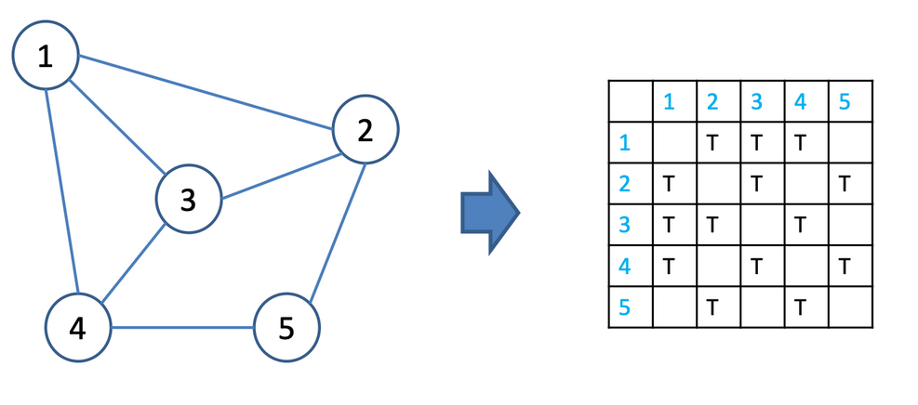
INTRODUCTION
Adjacency Matrix Representations
An adjacency matrix contains one row and one column for each node of a network.
Given two nodes i and j, the entry located at (i, j) and (j, i) in the matrix contain
information about the edge(s) between the two nodes.
Typically, each cell contains a boolean value indicating if an edge exists between the two nodes.
If the graph is undirected, the matrix is symmetric.
4

Slide 5
PROBLEM STATEMENT
Problem:
Node-link diagrams become cluttered and computationally expensive as graph size grows.
Solution:
Adjacency matrices provide:
A scalable and structured alternative.
Easier pattern detection, such as clusters and sparse regions.
Advantages of Adjacency Matrices:
Scalability: A structured representation that scales well with large graphs.
Cluster Detection: Dense submatrices highlight tightly connected communities.
Clarity: Heatmaps of adjacency matrices reveal patterns and relationships that are harder to see in node-link diagrams.
5

Slide 6
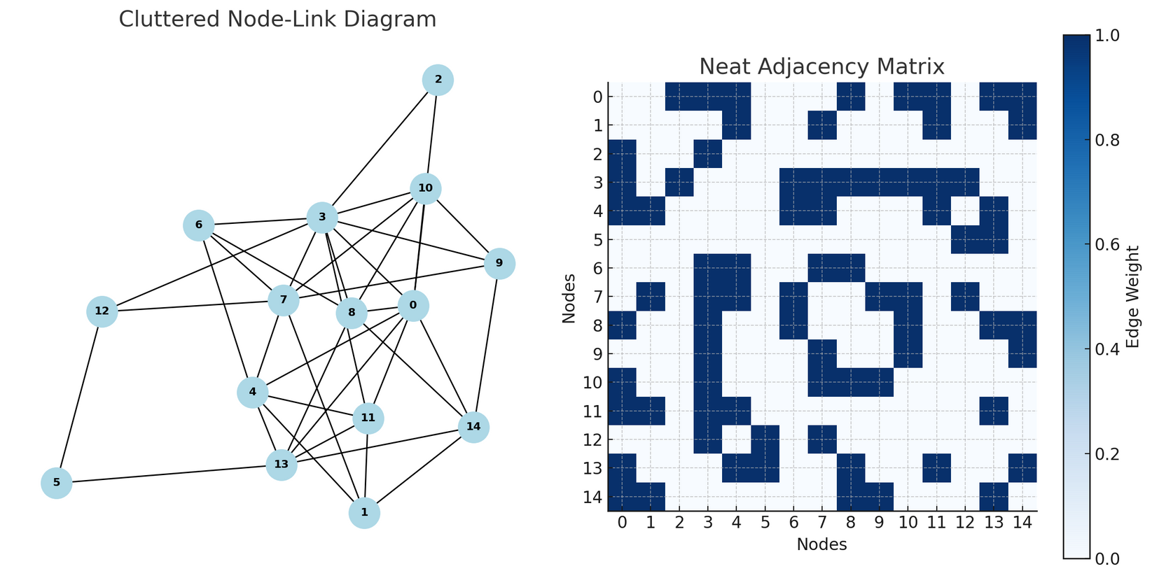
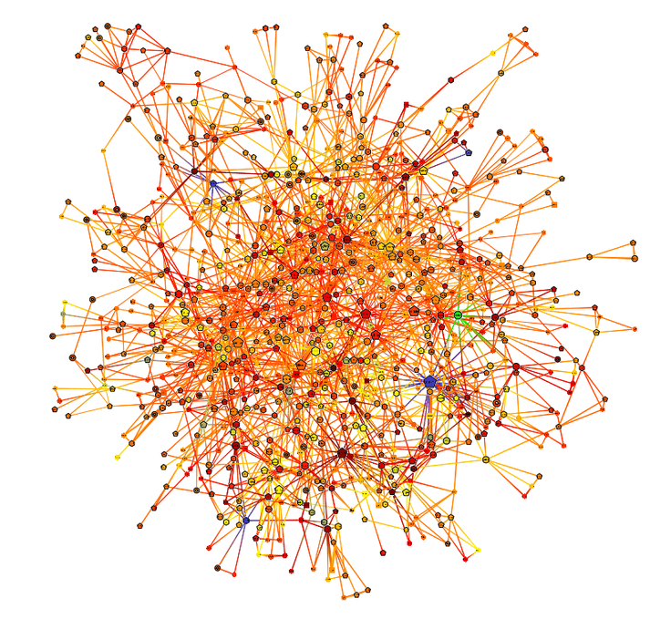
INTRODUCTION
Here is a comparison of a cluttered node-link diagram and a neat adjacency matrix:
6

Slide 7
REAL WORLD USAGE
Social Networks
Transportation Networks
Social platforms like Facebook and Twitter use adjacency matrices to analyze connections between users, identify communities, and study the spread of information or influence within a network.
In logistics and urban planning, adjacency matrices represent road networks, railways, or flight routes. They help optimize routes, detect bottlenecks, and analyze connectivity between hubs.
Cybersecurity
Recommendation Systems
Used in cybersecurity to map device communication, detect anomalies, and monitor traffic.
E-commerce platforms like Amazon and Netflix represent user-item relationships with adjacency matrices to identify patterns and recommend products or content.
7

Slide 8

METHODOLOGY
Data generation
↓
Data Preprocessing
↓
Visualization Rendering
↓
Interactive Features Integration
↓
User Interface Desgin
↓
Performance Optimization and Testing
8

Slide 9
METHODOLOGY
Algorithm
Data Generation
We used Python to generate synthetic adjacency matrices representing graphs of different sizes (100, 500, and 1000 nodes).
Input Parameters:
Graph size: Defines the number of nodes in the matrix.
Community density: Controls the probability of connections within clusters.
Inter-community density: Determines the sparsity of connections between different clusters.
Output:
Adjacency matrices with clear cluster structures are saved as text files (matrix_100.txt, matrix_500.txt, matrix_1000.txt).
9

Slide 10
METHODOLOGY
Steps:
Create an empty matrix of size NxN, where N is the number of nodes.
Populate the matrix with connections:
Within communities: High-density blocks are created to represent clusters.
Between communities: Sparse connections are added for realism.
Make the matrix symmetric (as most graphs are undirected) and remove self-loops (nodes do not connect to themselves).
Save the matrices as text files (matrix_100.txt, matrix_500.txt, matrix_1000.txt).
Performance Optimization:
Out-of-core Processing: Handles graphs that exceed memory limits by processing data in chunks.
Progressive Rendering: Ensures smooth rendering of large matrices by loading data incrementally.
10

Slide 11
METHODOLOGY
Visualization Rendering
Heatmap Representation:
Render the adjacency matrix as a heatmap using the VTK library.
Color-coding:
Blue cells: Represent edges (connections).
White cells: Represent no connections.
Rendering Challenges:
Large datasets (1000 nodes or more) require efficient algorithms.
We implemented optimization techniques in VTK to ensure smooth and responsive rendering.
11

Slide 12
VISUALIZATION AND INTERFACE DESIGN
Interactivity Integration
Implemented Features:
Panning: Enables users to navigate through clusters or sparse regions.
Tooltips: Hovering over a cell shows details about the corresponding nodes and their connections.
In Progress:
Zooming: Once completed, this will allow users to focus on smaller subgraphs or dense areas.
12

Slide 13
TEAM CONTRIBUTIONS
Srilekha Rayedi:
Focused on developing the graph rendering algorithms using the VTK library.
Created utility functions for analyzing graph metrics, such as cluster density and connected components.
Venkata Sai Nikitha Kandikattu:
Developed interactive features like panning, and dynamic filtering for exploring matrices.
Optimized rendering pipelines to handle large adjacency matrices efficiently.
Sai Tejaswi Guntupalli :
Managed data parsing to convert graph data into adjacency matrices for visualization.
Designed the user interface layout using Vuetify, incorporating tooltips and dynamic filtering for an intuitive user experience.
13

Slide 14
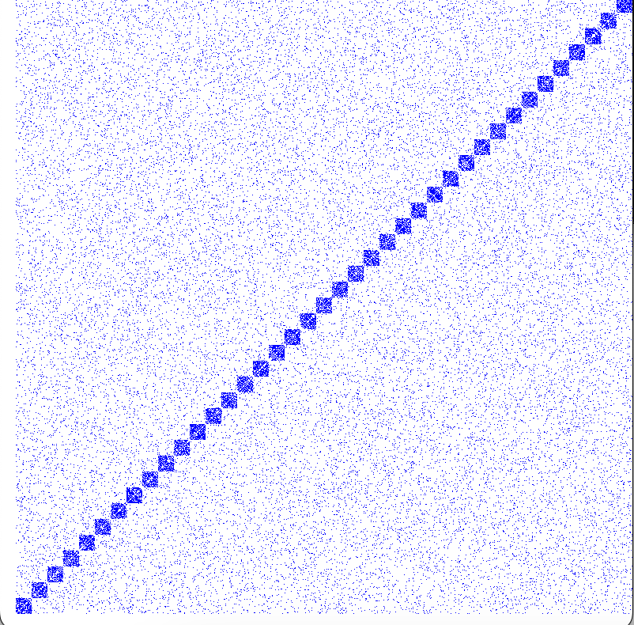

RESULTS
Key Observations:
Dense blocks = graph clusters (high connectivity).
Sparse regions = inter-cluster connections.
Scalability: Matrix scales to 1000 nodes without performance issues.
Interactivity: Panning implemented for exploring specific regions.
Visuals: Adjacency matrix heatmap with annotations.
14

Slide 15
RESULTS
Currently, the tool supports panning, enabling users to explore different sections of the matrix, which is particularly helpful for examining clusters or sparse regions.
Zooming functionalityis still being developed and will further improve exploration by focusing on smaller subgraphs or densely connected areas.
15

Slide 16
FUTURE WORK
Our project successfully addresses challenges in visualizing large graphs by leveraging adjacency matrices. Future enhancements include implementing zooming, dynamic graph visualization, and real-time analysis optimizations.
Incorporating dynamic graphs to visualize changes over time.
Automating insights like cluster detection using machine learning.
Optimizing rendering pipelines for real-time analysis of ultra-large datasets.
16

Slide 17

THANK YOU!
17

