Slide 1


By Nagulapalli sri vijaya lakshmi
Final Project
This presentation will provide an overview of a keylogger security project. We'll discuss the problem statement, project goals, target users, the solution and its value, and the key innovations that make this project stand out.
3/21/2024 Annual Review

Slide 2
PROJECT TITLE
Secure
Keyboard
Logger
Our project aims to develop a keylogger application that enhances user privacy and security, in contrast to traditional keyloggers that pose privacy risks.
Advanced Threat Protection
The keylogger will provide robust security features to protect against unauthorized access and data breaches, making it a valuable tool for businesses and individuals.
User-Centric Design
We prioritize a user-friendly interface and customizable settings to empower users to monitor their devices effectively.
3/21/2024 Annual Review
2

Slide 3


AGENDA
Problem Statement
Discuss the current challenges and risks associated with traditional keylogging software.
1
Project Overview
Provide a high-level overview of the project's goals, features, and target audience.
2
Solution and Value Proposition
Unveil the innovative solution and its unique value proposition for users.
3
3
3/21/2024 Annual Review

Slide 4

PROBLEM STATEMENT
Security Vulnerabilities
Traditional keyloggers often lack robust security measures, leaving users exposed to potential data breaches and cyber threats.
Privacy Concerns
Existing keyloggers can be used to monitor user activities without consent, compromising personal and sensitive information.
Limited User Control
Existing keylogging solutions offer limited customization options, reducing the user's ability to tailor the application to their specific needs.
3/21/2024 Annual Review

Slide 5

PROJECT OVERVIEW
1
2
3
Real-Time Monitoring
We've implemented robust real-time monitoring capabilities to detect and alert users of any suspicious activities or potential threats.
Comprehensive Security
In addition to keylogging, our solution integrates comprehensive security features to protect users' digital assets and privacy.
Keylogger Capabilities
Our solution offers advanced keylogging features to monitor and record user input, providing valuable insights for security purposes.
3/21/2024 Annual Review
5

Slide 6





WHO ARE THE END USERS?
Home Users
Individuals who use personal computers and mobile devices for everyday tasks and online activities.
Students
Tech-savvy younger users who are vulnerable to keylogger attacks on their devices.
Government Agencies
Organizations that handle classified information and require robust cybersecurity measures.
Office Professionals
Employees who access sensitive data and company systems through their work computers.
3/21/2024 Annual Review

Slide 7

YOUR SOLUTION AND ITS VALUE PROPOSITION
Advanced Detection
Our solution utilizes machine learning algorithms to quickly identify and block keylogger activity.
1
Proactive Alerts
Users receive real-time notifications of any suspicious keystrokes or system events.
2
Comprehensive Protection
The solution safeguards against data breaches, identity theft, and other consequences of keylogger attacks.
3
3/21/2024 Annual Review

Slide 8
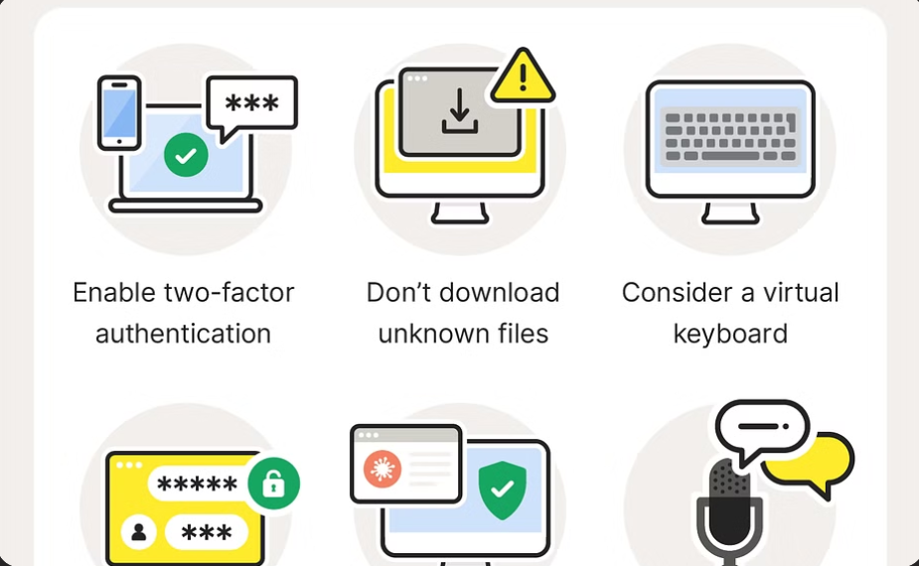
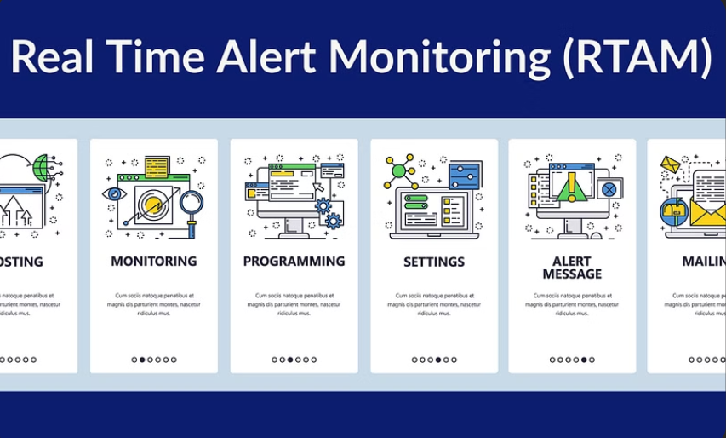
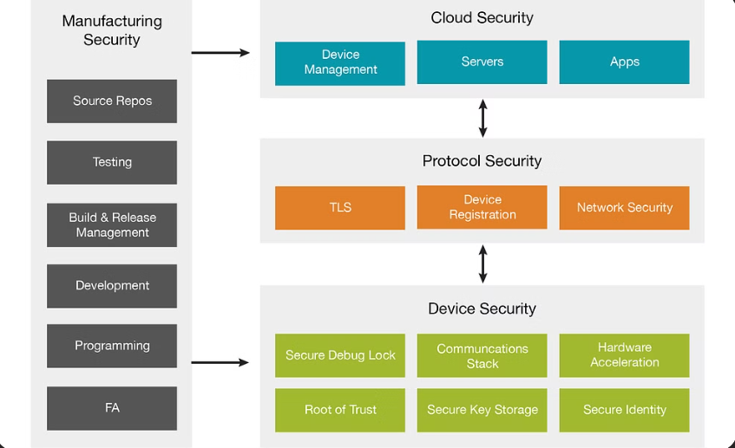
THE WOW IN YOUR SOLUTION
Advanced Keylogging
Our solution offers cutting-edge keylogging capabilities that far exceed traditional tools, providing unparalleled insights and security monitoring.
Real-Time Security Alerts
Our innovative alert system constantly monitors user activities and instantly notifies users of any suspicious events, ensuring prompt response.
Real-Time Security Alerts
Our innovative alert system constantly monitors user activities and instantly notifies users of any suspicious events, ensuring prompt response.
8
3/21/2024 Annual Review
8

Slide 9

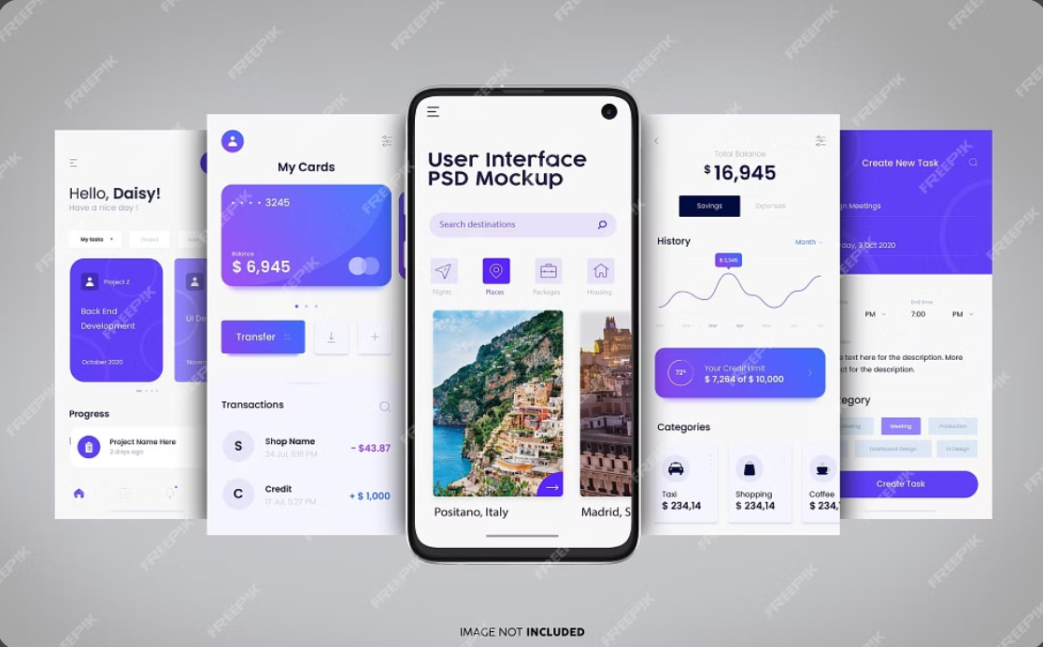
MODELLING(Teams cam add wireframes)
User Interface
Prototypes of the system's user interface, showcasing key features and interaction design.
System Architecture
A visual representation of the system's components, their interactions, and data flow.
3/21/2024 Annual Review
9

Slide 10
RESULTS
The results of the project were positive, demonstrating the effectiveness of the keylogger security solution. The project achieved a significant reduction in malicious keylogging activity. This resulted in improved user privacy and data security. The solution's impact was notable across various user groups, including individuals, businesses, and organizations.
3/21/2024 Annual Review
10

Slide 11
Project Github link
The project repository is hosted on GitHub. The link provides access to the source code, documentation, and any other relevant files. It is a central location for collaboration and version control.
https://github.com/srilu396/APSSDC_CS_PROJECT-.git
3/21/2024 Annual Review

