Slide 1
Intro to System Verilog Final Project
RISC 16-bit Processor
Team Members:
Sri L Venkata Satya Sai Anusha Pasumarthi
PSU ID : 953843689
Ram Gopal Kasireddy
PSU ID : 977511305

Slide 2
Starting point of the project:
We used an existing block diagram as a reference to the project from the following paper.
https://www.ijert.org/research/design-of-16-bit-risc-processor-IJERTV2IS70828.pdf
We made some changes to the block diagram as that was missing some details.
We developed the source code for the design and testbench in System Verilog.

Slide 3
What is RISC Processor?

Slide 4
RISC is known as Reduced Instruction Set Computer.
A common misunderstanding of the phrase "Reduced Instruction Set Computer" is the mistaken idea that instructions are simply eliminated, resulting in a smaller set of instructions.
The term "Reduced" in that phrase was intended to describe the fact that the amount of work any single instruction accomplishes is reduced at most a single data memory cycle compared to the "complex instructions" of CISC CPUs that may require number of data memory cycles in order to execute a single instruction.

Slide 5
Overview of the RISC Processor
FETCH UNIT
DECODE UNIT
Instruction Register
GPRS
EXECUTION
Program counter
Instruction
Memory
ALU
Control Unit

Slide 6
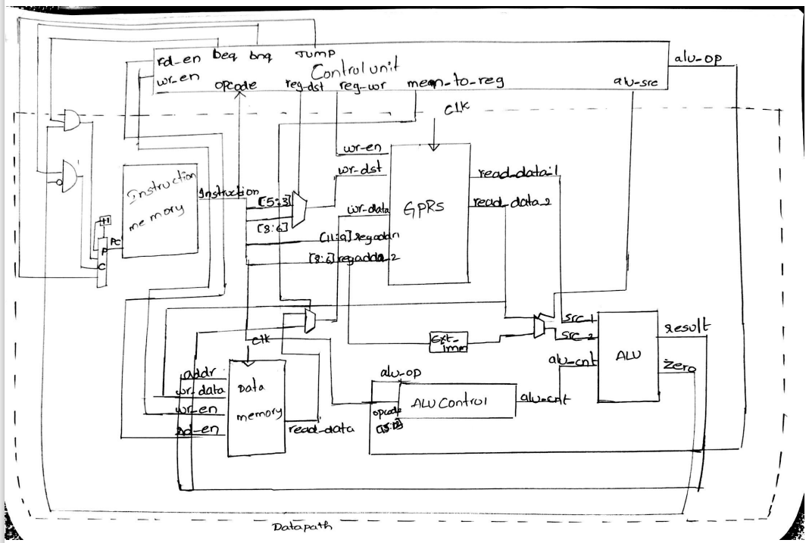
Architecture of RISC Processor:

Slide 7
OPERATIONS
OPCODE | OPERATION
0000(0) | LOAD
0001(1) | STORE
0010(2) | ADDITION
0011(3) | SUBTRACTION
0100(4) | INVERT
0101(5) | LOGICAL SHIFT LEFT
0110(6) | LOGICAL SHIFT RIGHT
0111(7) | AND
1000(8) | OR
1001(9) | INCREMENT
1010(10) | DECREMENT
1011(11) | BRANCH ON EQUAL(BEQ)
1100(12) | BRANCH NOT EQUAL(BNE)
1101(13) | JUMP

Slide 8
Instruction format of RISC Processor:
LOAD:
4bits 3bits 3bits 6bits
STORE:
4bits 3bits 3bits 6bits
ALU OPERATIONS: 4bits 3bits 3bits 3bits 3bits
BRANCH:
4bits 3bits 3bits 6bits
JUMP:
4bits 12bits
OPCODE[15:12] | SRC_REG[11:9] | DEST_REG[8:6] | OFFSET[5:0]
OPCODE[15:12] | SRC_REG-1[11:9] | SRC_REG-2[8:6] | OFFSET[5:0]
OPCODE[15:12] | SRC_REG-1[11:9] | SRC_REG-2[8:6] | DEST_REG[5:3] | OFFSET[2:0]
OPCODE[15:12] | SRC_REG-1[11:9] | SRC_REG-2[8:6] | OFFSET[5:0]
OPCODE[15:12] | OFFSET[11:0]

Slide 9
Instruction set of RISC Processor:
A. Memory Access Instructions
1. Load Word: (Opcode – 0000) LD dest_reg, dest_reg:=Mem16[src_1 + offset] 2. Store Word: (Opcode – 0001) ST src_2, Mem16[src_1 + offset]=src_2 B. Control Flow Instructions
1. Branch on Equal: (Opcode – 1011) BEQ reg1, reg2, offset Branch to (PC + 1 + (offset << 1)) when reg1 = reg2
2. Branch on Not Equal: (Opcode – 1100) BNE reg1, reg2, offset Branch to (PC + 1 + (offset << 1)) when reg1 != reg2
3. Jump: JMP offset Jump to offset (Opcode – 1101)

Slide 10
Instruction set of RISC Processor:
C. Data Processing Instructions
Add (+) (Opcode = 0010)
Subtract (-) (Opcode = 0011)
Invert (1‘s complement) (Opcode = 0100)
Logical Shift Left (<<) (Opcode = 0101)
Logical Shift Right (>>) (Opcode = 0110)
Bitwise AND(&) (Opcode = 0111)
Bitwise OR (|) (Opcode = 1000)
Increment (+1) (Opcode = 1001)
Decrement (-1) (Opcode = 1010)

Slide 11
Design Implementation:
We started by defining the input ports and output ports of each module.
Documented the requirements of each module.
Coded the design taking into consideration all the possible scenarios and exceptions.

Slide 12
Challenges when implementing design:
Understanding the architecture of RISC processor.
Connection issues while instantiating and connecting the modules.
Compilation errors while compiling the design.
Errors while calling the files in the design.
Faced little difficulty while implementing the control flow instructions.

Slide 13
Approach to overcome the challenges:
Redrawing the architecture (adding mux and wires ) to make it easier and simple.
We used Divide and Conquer methodology to understand the functionality.
To reduce the compilation errors, we went through the code line by line and rectified the mistakes likes not using colons, closing braces etc. and recompiled it again.

Slide 14
Test Plan & Testing Methodology:
We used systemverilog to code the design and testbench.
We started with a directed testbench by giving the inputs through the readmemb() to verify the functional of the design.
We wrote separate testbenches for each design module and followed the bottom-up approach while connecting them.
We then extended the testbench to randomize the input instructions.
Defined applicable constraints on the randomized inputs.
Implemented coverage to the appropriate bins.

Slide 15
Challenges faced in Verifying:
Due to the few connection issues that we faced; we were seeing some X’s on the outputs of the modules.
Initial randomization yielded in a lot of out-of-bound values. We resolved them using constraints.

Slide 16
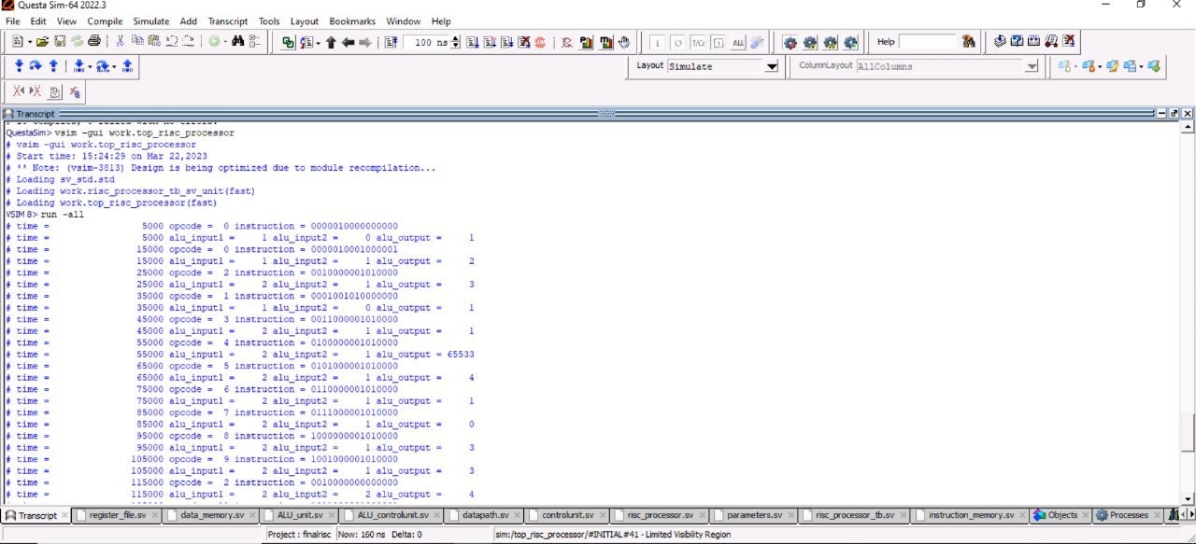
Results without randomization:

Slide 17
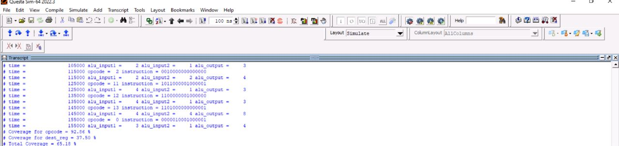
Results:

Slide 18
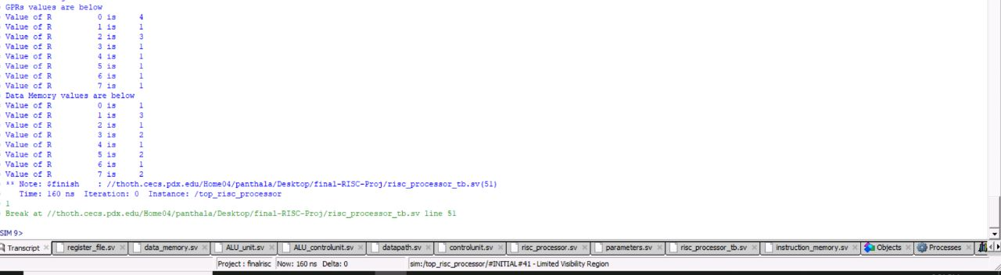
Results:

Slide 19
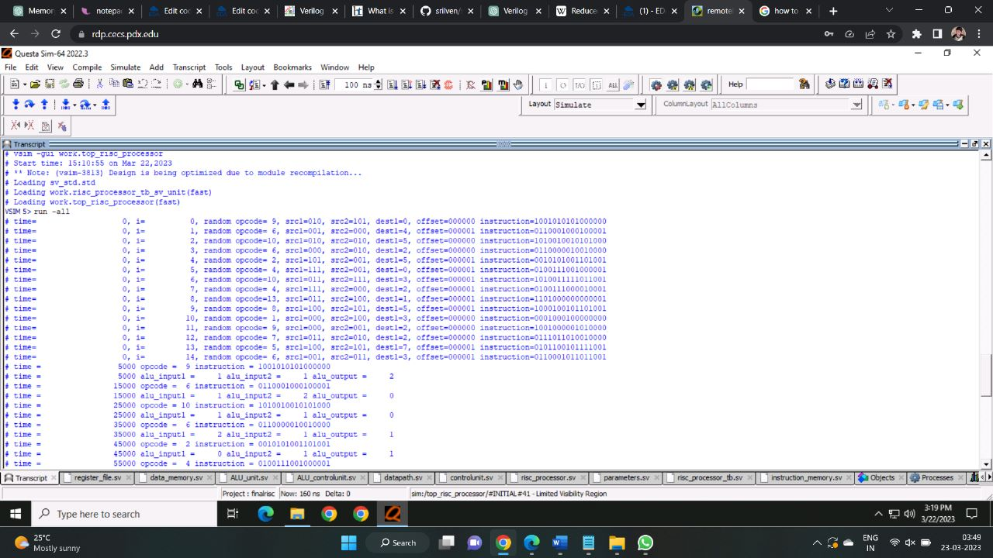
Results with randomization:

Slide 20
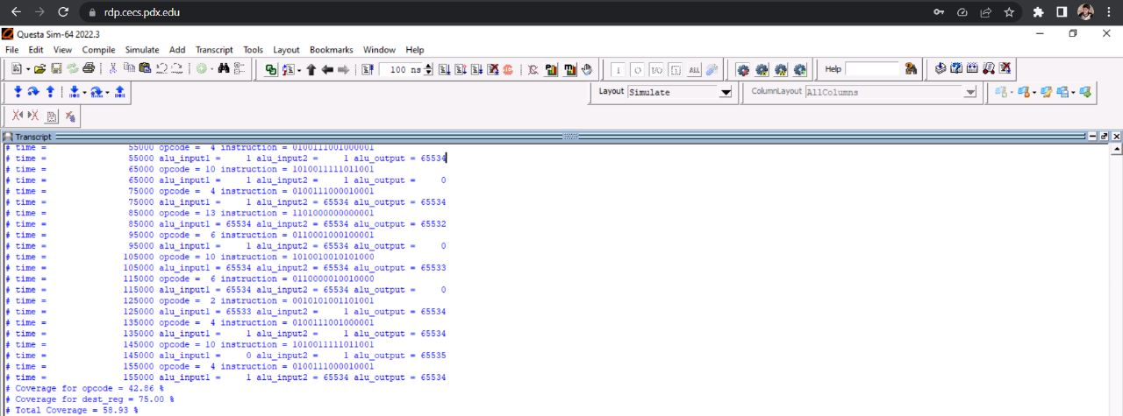
Results:

Slide 21
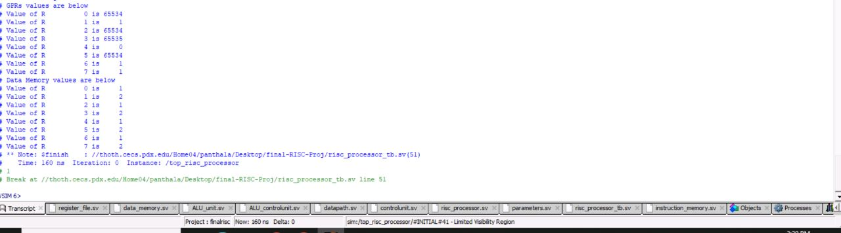
Results:

Slide 22
Github link:
https://github.com/srilven/svfinal_risc.git

Slide 23
Thank You

