Slide 1

PREDICTION OF HOUSE RENT
USING MULTIPLE LINEAR REGRESSION
Project Supervisor: Mrs. J. Refonaa, M.E.,(Ph.D)
Name of the Student: A. Sri Mahalakshmi
Register Number: 39110025

Slide 2
Presentation Outline
Course Certificate
Introduction
Objectives
System Architecture / Ideation Map
Module Implementation
Application Snapshots
Results and Discussions
Conclusion & Future work
References

Slide 3
Course Certificate

Slide 4
Introduction
The primary aim of this project is to use these machine learning techniques and curate them into ML model which can then serve the users.
Regression models with one dependent variable and more than one independent variables are called Multiple linear regression.
Problem Statement: Perform regression analysis on real estate valuation dataset to predict house rent.
Objective:
Predict last variable from the dataset using multiple linear regression algorithm.

Slide 5
Objectives
Objective:
The objective of multiple linear regression analysis is to use the independent variables(x) whose values are known to predict the value of the single dependent value(y).
Scope:
Prediction house rents are expected to help people who plan to buy a house so they can know the price range in the future, then they can plan their finance well. In addition, house rent predictions are also beneficial for property investors to know the trend of housing prices in a certain location.

Slide 6
Advantages and disadvantages
Pros:
Linear Regression model is simple to implement and easier to interpret the output coefficients.
It is very good algorithm for linearly seperable dataset.
Overfitting can be reduced by regularization.
Linear Regression gives relationship between dependent and independent variables.
Cons:
Prone to underfitting.
Sensitive to outliners.
linear regression is not a complete description of relationships among variables.

Slide 7
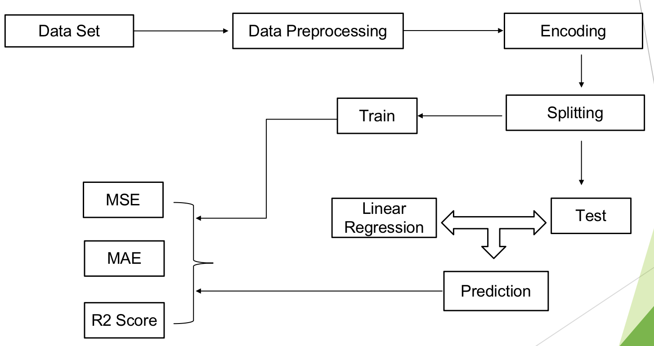
System Architecture / Ideation Map
↓

Slide 8
Project Implementation
MULTIPLE LINEAR REGRESSION
Multiple or multivariate linear regression is a case of linear regression with two or more independent variables.
x1,x2,...xp are independent variables
y is dependent variable
Formula and Calculation of Multiple Linear Regression:
yi = dependent variable
xi = explanatory variables
β0 = y-intercept (constant term)
βp = slope coefficients for each explanatory variable
ε = The model's error term

Slide 9
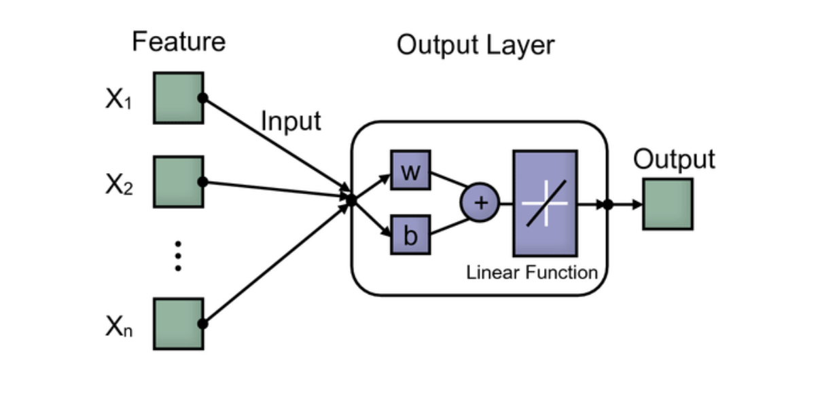
Linear regression

Slide 10
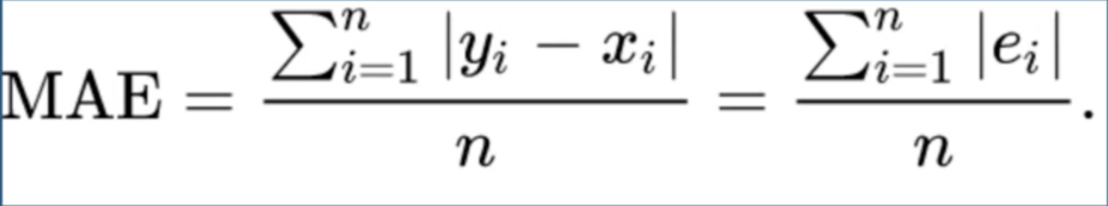
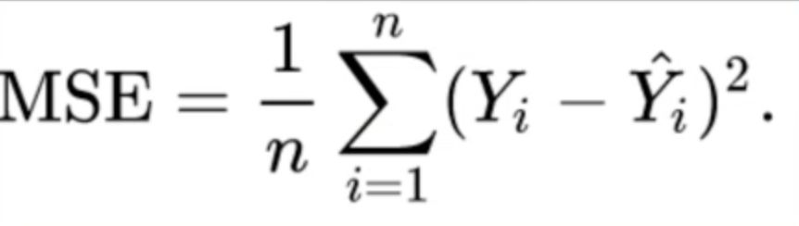
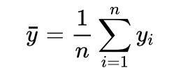
Project Implementation
MEASUREMENT TECHNIQUES
Mean Absolute Error: Less Sensitive to outliners
Mean Square Error: Very sensitive to outliners
where
R2 Score: R-squared (R2) is a statistical measure that represents the proportion of the variance for a dependent variable, which ranges between 0 and 1.

Slide 11
Module Implementation
Pandas : Used for data wrangling and analysis.
Numpy : Stands for Numerical Python.
Matplotlib :Matplotlib is a plotting library for the Python programming language.
Sklearn :The sklearn library contains a lot of efficient tools for machine learning and statistical modeling including classification, regression, clustering and dimensionality reduction.
Linear Regressor : Performs the task to predict a dependent variable value (y) based on a given independent variable (x).
Metrics : Metrics influences how the performance of machine learning algorithms is measured and compared.

Slide 12
Methodology
Import Libraries
Load the Dataset
Cleaning the Data
Data Visualization
Divide the dataset into independent and dependent variables
Splitting the Data into Training data and Testing data
Fit the Linear Regression Model
Predict the output
Get the Coefficients, Intercept
Apply metrics and get r2_score, mean absolute error and mean square error

Slide 13
Methodology
TRAIN TEST AND VALIDATION ANALYSIS
x_train,x_test,y_train,y_test = train_test_split (x , y , test_size=0.2 , random_state = 0)
Divide the total dataset into two subsets: ​
Training data is used for learning the parameters of the model.​
Test data is used to evaluate the fit machine learning model
This splitting can prevent your model from overfitting and to accurately evaluate our model
The random state parameter is used for initializing the internal random number generator, which will decide the splitting of data into train and test.Setting random_state a fixed valuewill guarantee that the same sequence of random numbers is generated each time.

Slide 14
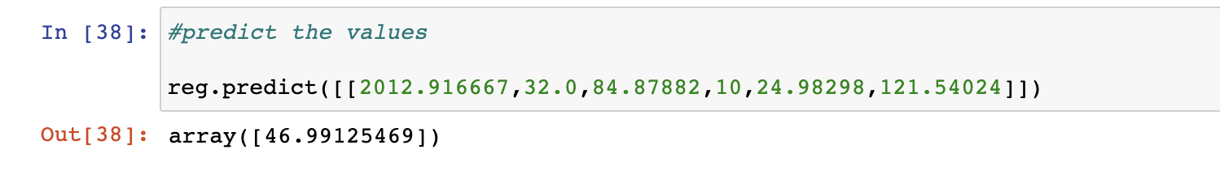
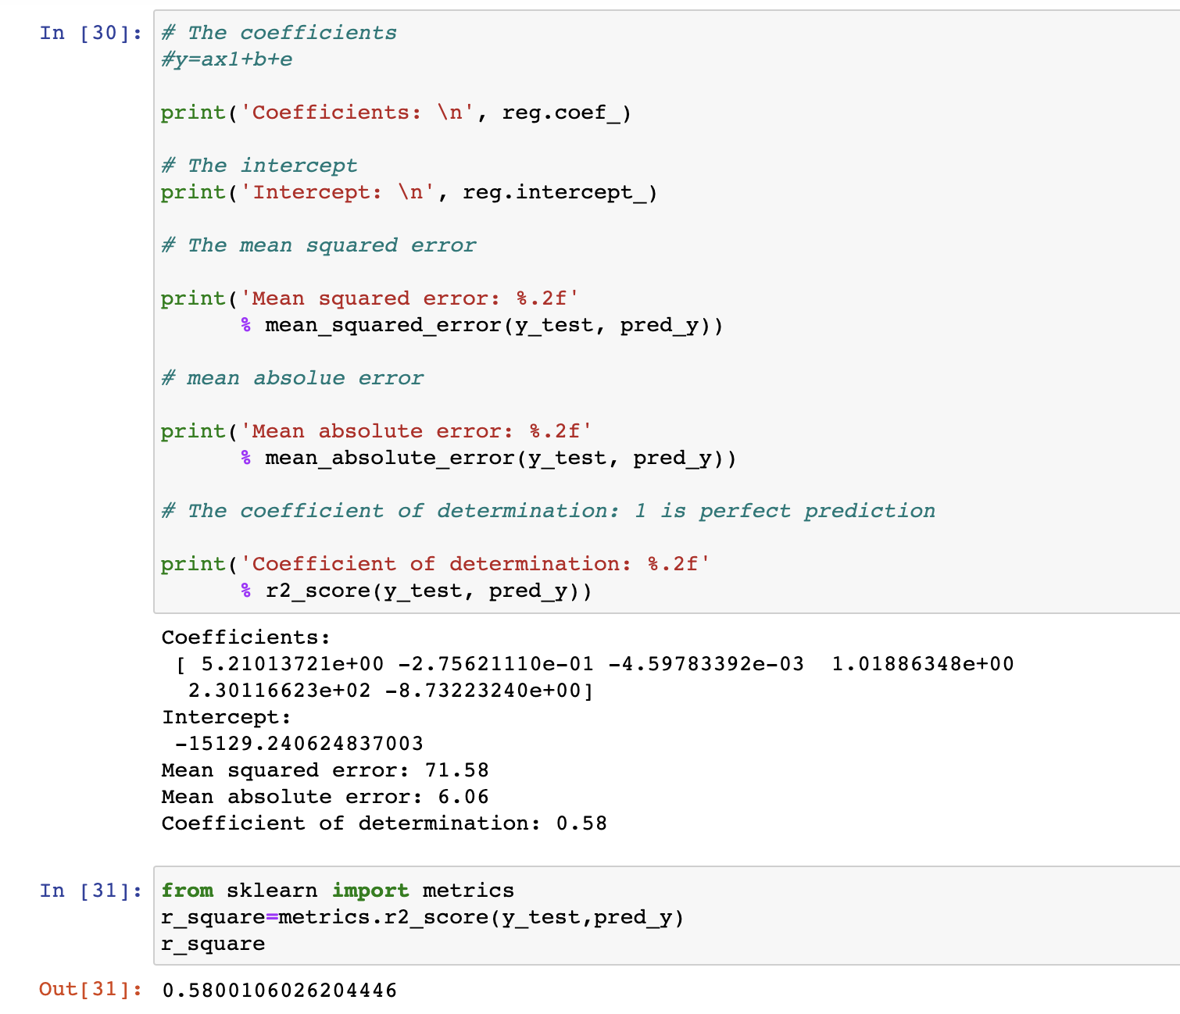
Results and Discussion

Slide 15
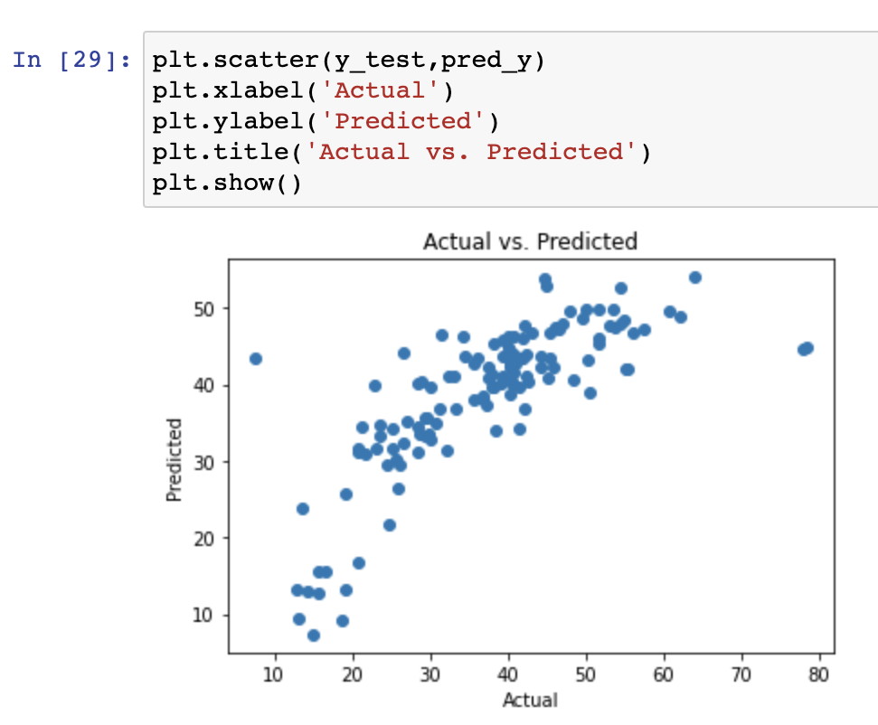
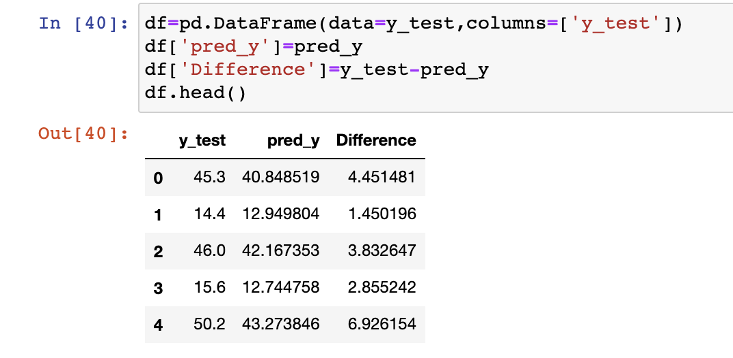
Performance Analysis
By comparing the predicted value and provided value we can identify how exactly our machine learning is working? and we can also plot that difference between the test value and predicted value using distplot() in seaborn

Slide 16
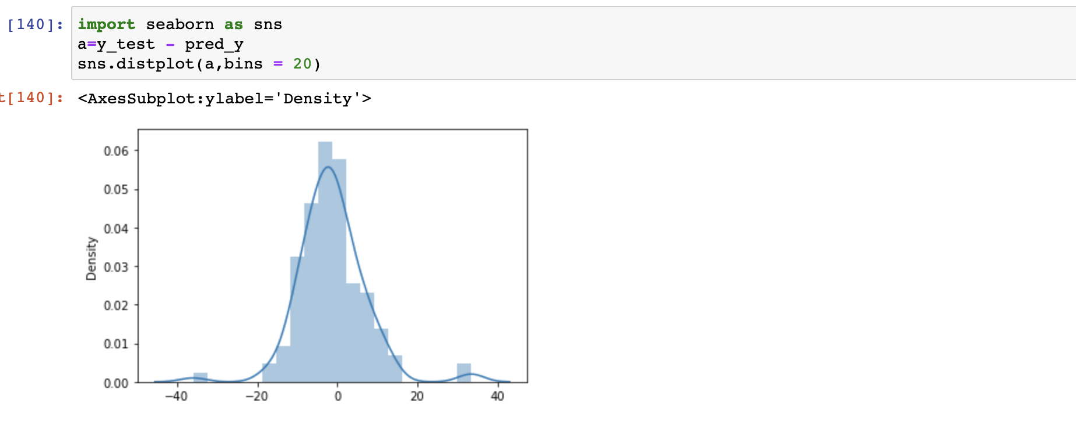
Performance Analysis
Distplot()
This function combines the matplotlib hist function (with automatic calculation of a good default bin size) with the seaborn kdeplot() and rugplot() functions. It can also fit scipy.stats distributions and plot the estimated PDF over the data.

Slide 17
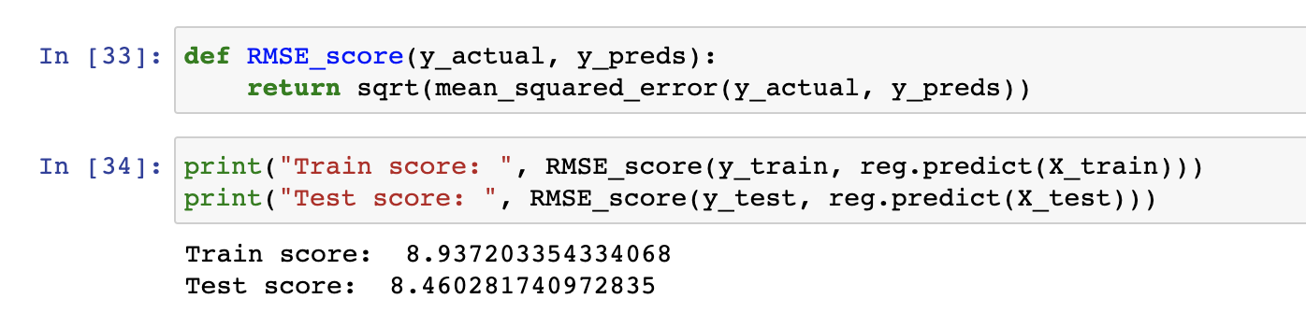

Performance Analysis
Root Mean Square Error (RMSE) is the standard deviation of the residuals (prediction errors). Residuals are a measure of how far from the regression line data points are; RMSE is a measure of how spread out these residuals are.

Slide 18
Conclusion
Multiple linear regression is used to evaluate predictors for a continuously distributed outcome variable. The procedure calculates coefficients for each of the independent variables (predictors) that best agree with the observed data in the sample.
The primary aim of this project is to use these machine learning techniques and curate them into ML model which can then serve the users.The main objective of a Buyer is to search for their dream house which has all the amenities they need.
Finally we build an ML model which can predict the price of a house with our required parameters.And our model got 58% of r2 score,which is a good model
Our objective of predicting the last variable of the dataset got achieved.our aim of predicting real estate house price using machine learning algorithm is succesfully completed.

Slide 19
References
Adichie, J. N. [1967], “Estimates of regression parameters based on rank tests,” Ann. Math. Stat., 38, 894–904.
Allen, D. M. [1971], “Mean square error of prediction as a criterion for selecting variables,” Technometrics, 13, 469–475.
Numpy reference;https://numpy.org/doc/1.20/user/index.html
Matplotlib references; https://matplotlib.org
https://archive.ics.uci.edu/ml/datasets.php
python modules;https://pypi.org/
https://docs.python.org/3/py-modindex.html
Andrews, D. F. [1974], “A robust method for multiple linear regression,” Technometrics, 16, 523–531.

