Slide 1
MIS FOR RETAIL
ANALYZING STORE SALES AND REVENUE ANALYSIS
T.SRI MAHESH BABU (192111632)
G.PRATEEK REDDY (192111408)

Slide 2

INTRODUCTION
This presentation will cover the essential aspects of designing a dashboard for retail management, focusing on sales analysis and strategic insights.
Retail Sales Insights – Develop an MIS to analyze store revenue, best-selling products, and seasonal trends for data-driven decision-making.
Data-Driven Strategy – Utilize BI, DBMS, and data mining to process one year of sales data (500+ products) for optimizing sales and pricing.
Dashboard & Reports – Create an interactive dashboard and detailed reports to enhance sales strategies and maximize revenue.

Slide 3
ABSTRACT
Purpose & Scope – This project aims to develop a Management Information System (MIS) for retail sales analysis, focusing on revenue trends, product performance, and seasonal variations using Business Intelligence and data mining techniques.
Methodology – The system will process one year of sales data across 500+ products, utilizing DBMS for efficient data storage and BI tools for visualization, trend detection, and reporting.
Expected Impact – The dashboard and reports will help optimize pricing strategies, improve inventory management, and enhance decision-making to maximize revenue and profitability.

Slide 4
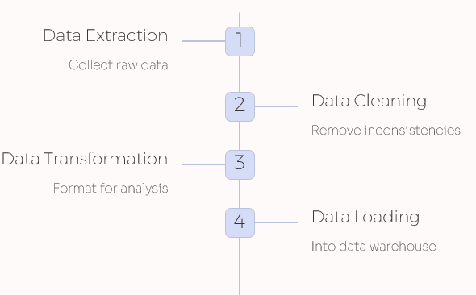
SYSTEM FLOW DIAGRAM

Slide 5
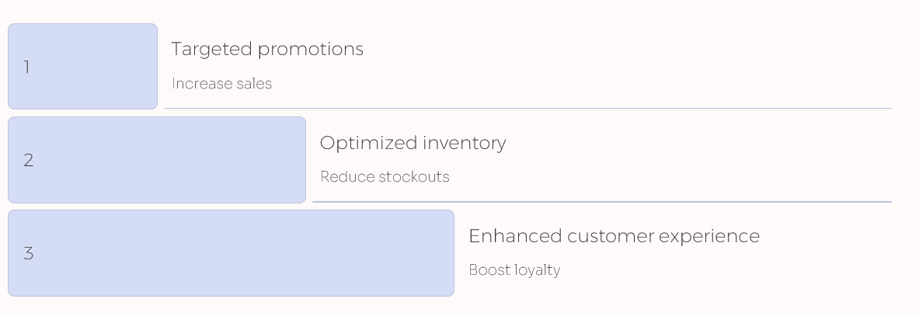
IMPROVED SALES STRATEGIES

Slide 6
SOFTWARE REQUIREMENTS
DBMS: MySQL / PostgreSQL / Microsoft SQL Server (for data storage and management)
BI Tools: Power BI / Tableau (for data visualization and dashboards)
Data Processing: Python (Pandas, NumPy, Matplotlib) / R (for analysis and data mining)
Web Framework: Flask / Django (for web-based MIS dashboard, if required)
Cloud Services: AWS / Google Cloud / Azure (for cloud storage and computing)
ETL Tools: Apache Nifi / Talend / SSIS (for data integration and transformation)
Reporting Tools: Microsoft Excel / Google Sheets (for generating business reports)

Slide 7
HARDWARE REQUIREMENTS
Server/Workstation (For Hosting Database & BI Tools)
Client/Workstation (For Data Analysis & Dashboard Visualization)
Networking & Cloud Infrastructure (If Using Cloud Services)
Peripheral Devices (For Report Generation & Presentation)

Slide 8
WORKING PROCESS
Data Collection & Storage – Gather sales data from POS systems and store it in a relational database (MySQL, PostgreSQL, or SQL Server).
Data Processing & Analysis – Clean and analyze data using SQL queries, Python/R, and data mining techniques to identify sales trends and optimize pricing.
Dashboard & Visualization – Develop an interactive dashboard using Power BI/Tableau to display key metrics like revenue, best-selling products, and seasonal trends.
Performance Optimization – Use AI/ML models for demand forecasting, pricing optimization, and refining sales strategies based on insights.
Deployment & Maintenance – Host on a local or cloud server (AWS/Azure/GCP), ensure data security, and perform regular updates for accuracy and efficiency.

Slide 9
✅ ADVANTAGES:
Improved Decision-Making – Provides data-driven insights for better sales strategies, inventory management, and pricing optimization.
Real-Time Monitoring – Enables real-time tracking of revenue, best-selling products, and seasonal trends via dashboards.
❌ DISADVANTAGES:
High Initial Cost – Setting up a robust MIS requires investment in hardware, software, and cloud services.
Complex Implementation – Requires expertise in BI tools, databases, and analytics, making it challenging for non-technical users.

Slide 10
ANALYTICS
Revenue Analysis – Track total sales, revenue growth, and profitability across different time periods (daily, monthly, yearly).
Best-Selling Product Insights – Identify top-performing products based on sales volume, revenue contribution, and customer demand.
Seasonal Sales Trends – Analyze sales fluctuations based on seasons, holidays, and promotional events to optimize inventory and marketing.
Customer Purchase Behavior – Segment customers based on buying patterns, frequency, and preferences to personalize marketing strategies.
Pricing and Discount Effectiveness – Evaluate the impact of discounts, promotions, and dynamic pricing on overall sales and profit margins.

Slide 11
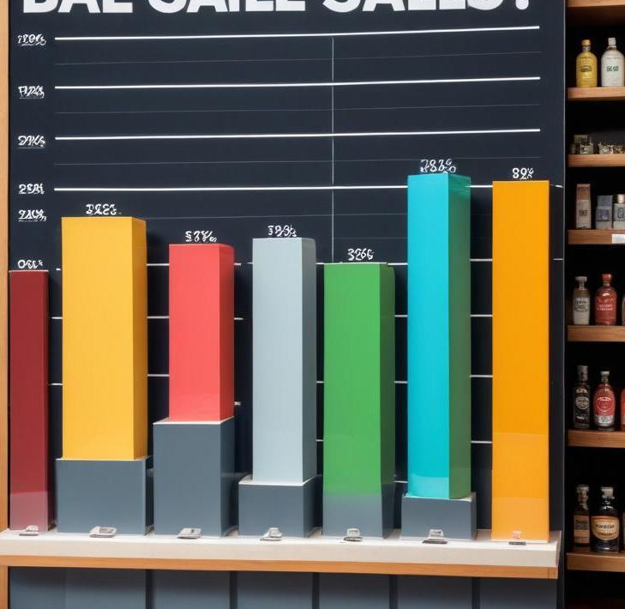
BEST-SELLING PRODUCTS IDENTIFICATION
Identifying best-selling products requires analyzing sales data to determine which items consistently perform well. Factors to consider include sales volume, profit margins, and customer preferences. This information enables retailers to optimize inventory levels, focus marketing efforts on popular products, and improve sales forecasts.

Slide 12
CONCLUSION
The MIS for retail sales and revenue analysis helps businesses optimize strategies by providing insights into sales trends, best-selling products, and seasonal patterns. Using BI tools, data mining, and dashboards, it enables data-driven decisions for improved pricing, demand forecasting, and operational efficiency. While the system’s success depends on data quality and maintenance, it ultimately boosts profitability and gives businesses a competitive edge in the retail market.

Slide 13
THANK
YOU

