Slide 1


Consumer Goods Ad-Hoc Insights
Atiq Hardware's
By Sriman M

Slide 2
AGENDA
Company & Problem Statement
Database Schema
Ad-Hoc request, queried results, visualizations & insights.

Slide 3
Company & Problem statemen
Leading computer hardware producers in India and well expanded in other countries.
Problem Statement There are not enough insights to make quick and smart data informed decisions.
Expand data analytics team by adding several junior data analysts.
Decided to conduct a SQL challenge to hire junior data analysts.
There are 10 ad-hoc requests for which the business needs insights.
Task is to write SQL queries to answer these requests.
Create presentation to show insights to Top-Level Management.
Problem Statement

Slide 4
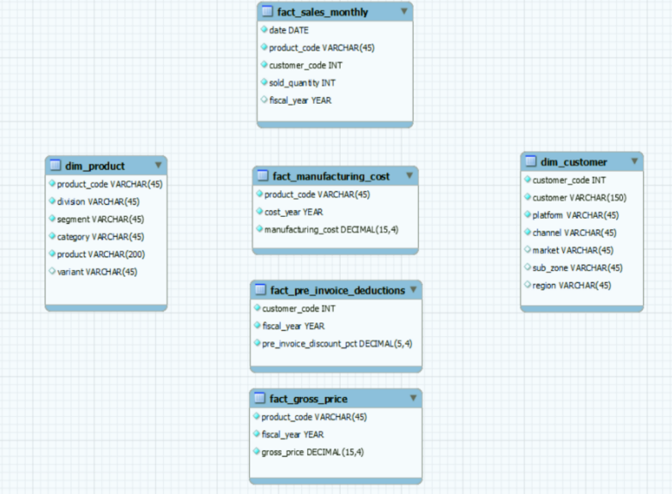
Database Schema

Slide 5
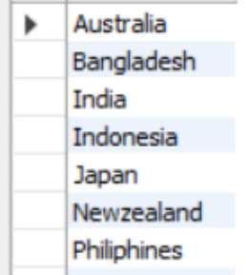
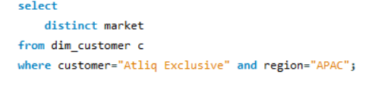
Request 1
Provide the list of markets in which customer "Atliq Exclusive" operates its business in the APAC region :

Slide 6
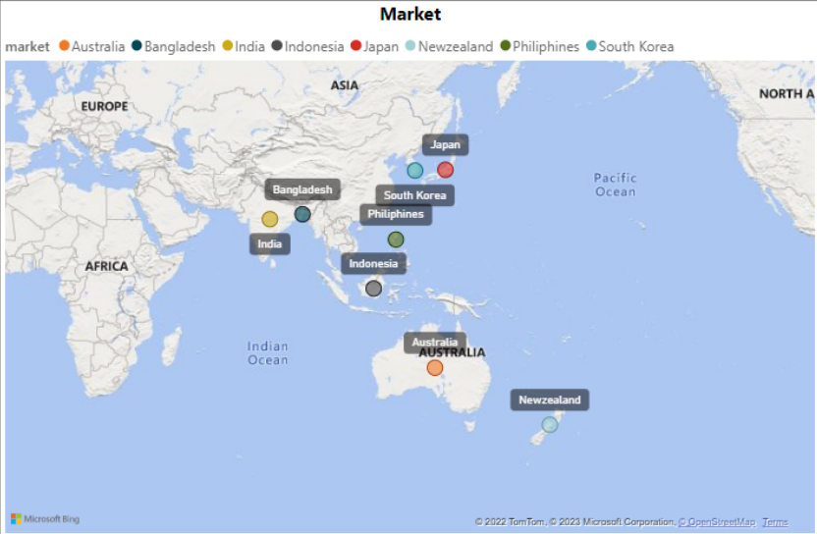
Atliq Exclusive operates in 8 markets in APAC region

Slide 7
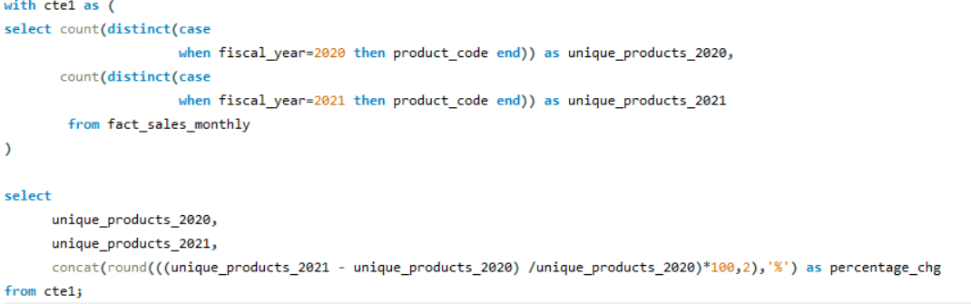

Request 2
What is the percentage of unique product increase in 2021 vs. 2020? The final output contains these fields:

Slide 8
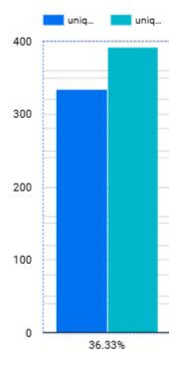
What is the percentage of unique product increase in
2021 vs. 2020?
Around 89 unique products were produced in 2021
There is 36.33% of increase in unique products from 2020 to 2021.

Slide 9
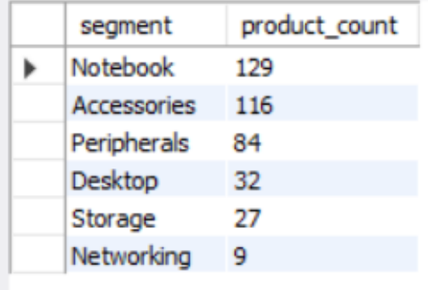
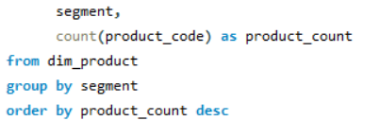
Request 3
Provide a report with all the unique product counts for each segment and sort them in descending order of product counts. The final output contains 2 fields :

Slide 10
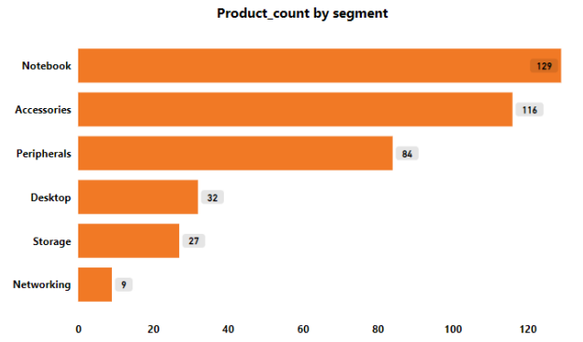
Report of Unique product counts under each segment.
Notebook segment has recorded maximum unique products around 129 followed by Accessories.
Whereas Storage & Networking has recorded least product count.

Slide 11
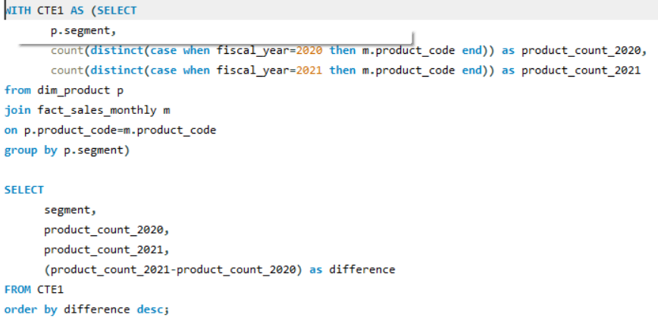
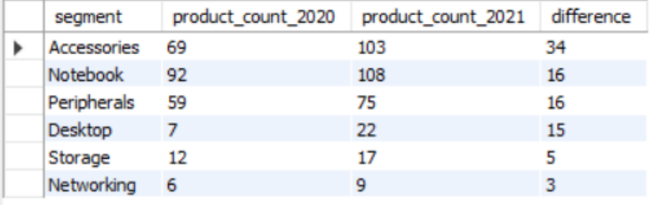
Request 4
Follow-up: Which segment had the most increase in unique products in 2021 vs 2020? The final output contains these fields:

Slide 12
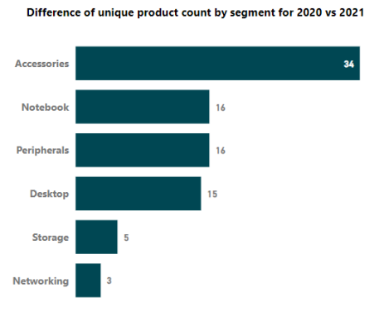
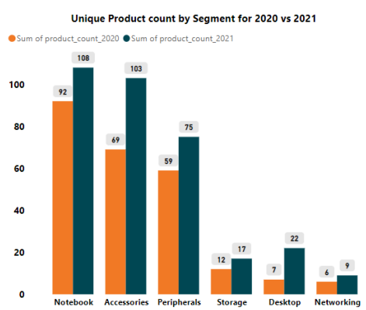
Which segment had the most increase in unique products in 2021 vs 2020?
Accessories segment has the most increase in unique products with a difference of 34 in 2021 vs 2020.

Slide 13
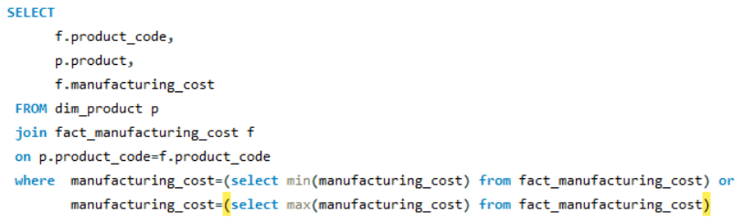
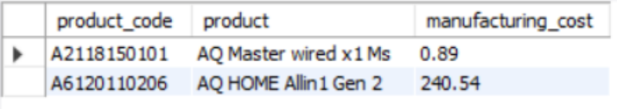
Request 5
Get the products that have the highest and lowest manufacturing costs. The final output should contain these fields:

Slide 14
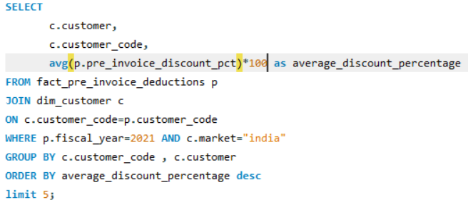
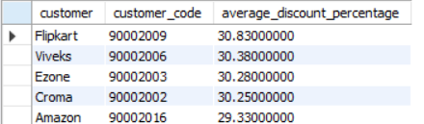
Request 6
Generate a report which contains the top 5 customers who received an average high pre_invoice_discount_pct for the fiscal year 2021 and in the Indian market. The final output contains these fields:

Slide 15
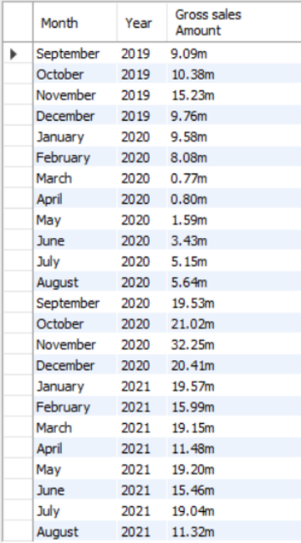
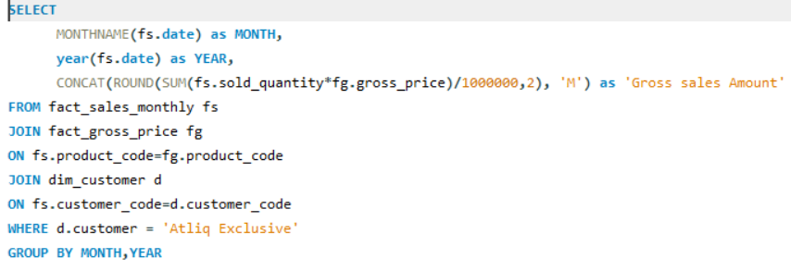
Request 7
Get the complete report of the gross sales amount for the customer “atliq exclusive” for each month.
Atliq Exclusive has recorded highest gross sales amount in the month of November 2020 that is 32.3M
Lowest gross sales amount was recorded in march 2020 that is 0.8M due to covid-19 crisis.

Slide 16
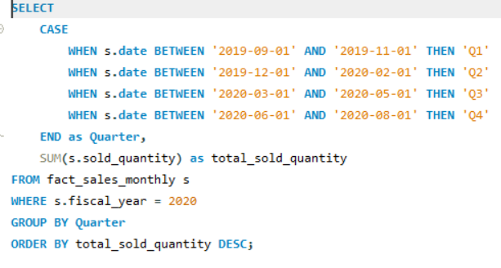
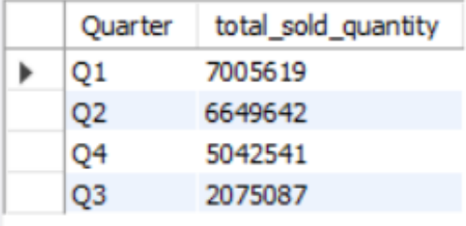
Request 8
In which quarter of 2020, got the maximum total_sold_quantity? The final output contains these fields sorted by the total_sold_quantity :

Slide 17
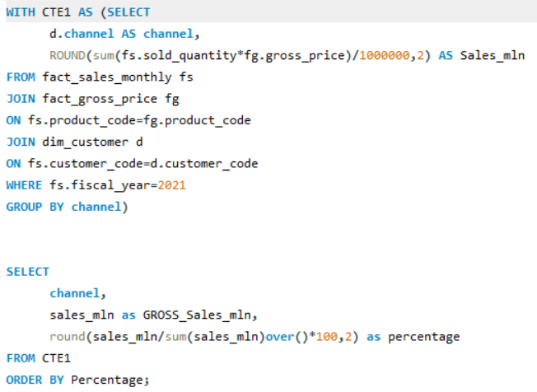

Request 9
Which channel helped to bring more gross sales in the fiscal year 2021 and the percentage of contribution? The final output contains these fields:

Slide 18
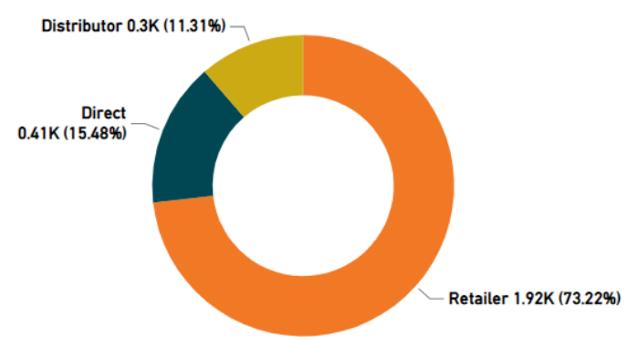
Which channel helped to bring more gross sales in the fiscal year 2021 and the percentage of contribution?
Retailers have majorly contributed in FY 2021 to bring more gross sales around 73.22%. Followed by Direct (15.48%) & Distributor (11.31%).

Slide 19
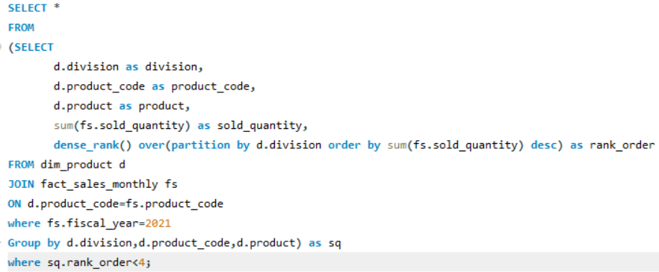
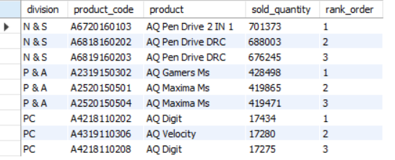
Request 10
Get the top 3 products in each division that have a high total_sold_quantity in the fiscal_year 2021?

Slide 20
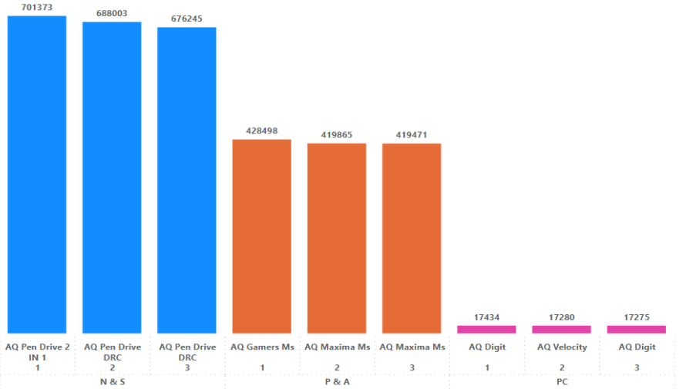
Which are the top 3 products in each division that have a high total_sold_quantity in the fiscal_year 2021?
AQ Pen Drive 2 IN 1, AQ Gamers Ms & AQ Digit are the top 3 selling products division wise in FY 2021.
In division N&S has recorded higher sales compared to P&A and PC.
Lowest sales are recorded by division PC.

Slide 21
Thank You
By Sriman M

