Slide 1

Health Care Systems
Nevada Health Science

Slide 2
History of Health Care
When and how did health care begin?
Hippocrates – 400 BC
Native Americans – herbal therapy
Various beliefs:
  Credited health & illness to moods of Gods.
  Others used reason to attempt to explain diseases.
  Religion – Greek temple of healing.
  Ancient peoples even performed surgery.

Slide 3
History of Health Care
Manuscripts and books were hand copied as medical knowledge increased.
Middle Ages (500 – 1500 AD)
  Reason began to replace people’s beliefs in spiritual or superstitious causes for disease.
  Doctors began to keep careful notes.
  Development of medicine as a science.
  Regulation of medical care – licensing, formal training (no women).
  Religious hospitals.

Slide 4

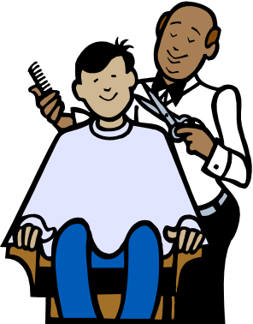
History of Health Care
Barber – Surgeon
  Middle Ages
  Cut hair, treat cataracts, practice blood-letting, treat injuries, amputate limbs, cauterized bleeds.
  Stripped pole – after operation, bandages, hung on staff/pole and placed outside as an advertisement. Twirled by the wind, they would form red/white spiral patterns.

Slide 5
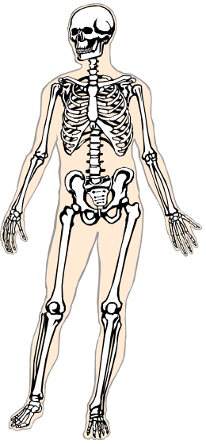

History of Health Care
Renaissance (1300 – 1600 AD)
  Scientific Method came into use
    Process used to acquire new knowledge instead of guessing or supernatural.
    Based on observation, taking careful notes.
  Microscope invented
  Study of human anatomy

Slide 6
History of Health Care
Industrial Revolution (1700 – 1800 AD)
  Introduction of machines
  Blood carried through body by vessels, discovery of capillaries
  Stethoscope invented
  Connection between health & environment
  Vaccinations
  Sterilization of equipment to avoid infection (medical asepsis)
  Discovery of pathogens, anesthesia

Slide 7
History of Health Care
Modern times (1900 – present)
  Hospitals were places for people to go to die
  Advances in engineering, chemistry, physics
  Antibiotics & other medications invented
  X-rays
  Organ transplants, artificial organs
  In vitro fertilization
  Research, technology, and computers

Slide 8
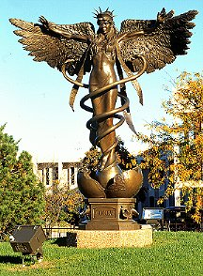
The Caduceus
Greek God of Healing – Asclepius
His symbol was the snake
Priest healers later adopted the symbol and has now become the symbol for physicians
Angel of healing

Slide 9
Medical Milestones
1518 – College of Physicians is established in London.
1628 – William Harvey describes the circulation of blood.
1816 – Rene Laennec invents the stethoscope.
1839 – First dental school founded in Baltimore.
1842 – Crawford Lang develops ether anesthesia.
1869 – Gregor Mendel develops the laws of heredity.
1893 – Aspirin is developed.

Slide 10
Medical Milestones
1910 – Marie Curie isolates radium, later used to treat cancer.
1922 – Frederick Banting treats diabetes with insulin.
1928 – Sir Alexander Fleming discovers penicillin.
1944 – First kidney dialysis machine.
1953 – First heart-lung machine is used for successful open-heart surgery.
1953 – First successful kidney transplant performed.

Slide 11
Medical Milestones
1963 – First human liver transplantation.
1964 – First human lung transplantation.
1967 – Christian Barnard performs the first successful heart transplantation.
1967 – First hospice founded in England.
1969 – Denton Cooley implants the first temporary artificial heart.
1972 – CT scan introduced.
1975 – Lyme disease reported for first time.

Slide 12
Medical Milestones
1978 – First test tube baby born in England.
1981 – AIDS is identified as a disease.
1981 – First successful surgery on a fetus.
1998 – Stem cells isolated from fetal tissues.
2000 - Human genome mapping project is completed.

Slide 13

Pioneers in Medicine
Without medical pioneers, there would be no medical advances, no technology evolution, no progress at all.
The theories or conclusions of the medical pioneers aren’t always popular.
  New and different ideas are often met with hostility, distrust, and contempt.
  Medical pioneers often deal with opposition and conflict, but they move forward with determination.

Slide 14
Pioneers in Medicine
We literally owe our lives to those that make the tough decisions affecting the medical field and medical practices.
Here are just a few:
  Alexander Fleming: penicillin.
  Joseph Lister: aseptic technique in surgery.
  Jane Addams: first social worker in US.
  Elizabeth Blackwell: First female physician.
  Clara Barton: Civil war nurse.
  Anthon van Leeuwenhook: invented microscope.
  Florence Nightingale: founded modern nursing.
  Harry Heimlich: Heimlich maneuver.
Notes:
• Pioneers in Medicine Assignment

Slide 15
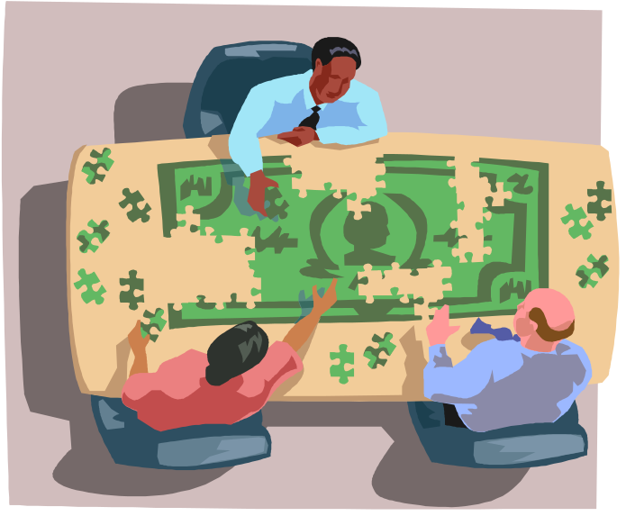
Trends in Health Care
“Explosive” development of technology
  Non-invasive diagnosis of soft tissue diseases/injuries
  Ultrasound technology
  Radiology
  Cancer treatments
  Mobile telephones
  Cameras – scopes
  Digital imaging
  VERY EXPENSIVE
Notes:
• Increased life expectancy

Slide 16
Trends in Health Care
Preventive Medicine – Wellness
  Link between diet, exercise, & good health
  Health care wellness centers for patients with chronic diseases (arthritis, diabetes, osteoporosis, etc.)
  Complimentary therapy, Holistic medicine
  Disease screenings
  Helps control costs, encourage positive choices

Slide 17

Trends in Health Care
Aging Population
  By 2005, one of every two adults will be 45 years or older
  Baby Boom (1946 – 1964)
  The elderly require more
  health services

Slide 18
Trends in Health Care
Underinsured & Uninsured
  16% (42 million) of US population do not have health insurance
  Many citizens have health insurance but the coverage is limited or the co-payments or deductibles are very high
  74% of the uninsured are in families with at least 1 full-time worker
  Among low-wage workers (<$7/hr), 45% are not even offered medical benefits

Slide 19
Trends in Health Care
Underinsured & Uninsured, cont.
  County hospitals, tax-supported hospitals
  Cost absorption
  Lack of care
  Underinsured – small companies have greater overhead costs for providing insurance and generally only offer a “one-size-fits-all” medical plan to employees

Slide 20
Trends in Health Care
Ambulatory/Outpatient Surgery
  Many procedures, from diagnosis to treatment can now be done without overnight hospitalization
  Technology, research, new medications
  Influenced by limits on insurance reimbursements (DRG’s)
  Overall cost of procedures is reduced

Slide 21

DRG’s
Diagnostic Related Groups
  Groups of procedures or tests related to a specific diagnosis
  Now a flat fee is paid based upon the diagnosis regardless of how long the patient stays or the services provided

Slide 22
Trends in Health Care
Home Health Care
  Common during late 1980’s
  Nurse or other skilled professional visits the home to assess patient’s condition and provide treatments and education
  Families and patients have to learn how to self-administer treatments or perform procedures done in the hospital in the past
  Health care workers evolved to become teachers and coaches

Slide 23

Trends in Health Care
Home Health Care, cont.
  Benefits:
    Exposed to fewer pathogens and germs
    Reduced stress/anxiety in familiar surroundings
    Lesser skilled workers can assist with personal activities leaving skilled workers to provide assessment, treatment & education – decreases costs

Slide 24
Health Care Facilities
Places that provide care or make it possible for some type of care to be delivered to patients
Hospitals
  Religious
  Private (generally for profit)
  Nonprofit – any profit returned to the institution to pay for updates, expansion
  Government - funded by taxes (Military, Veterans)
  Specialized – specialize in groups of patients or specific diseases/treatments (cancer, children, etc.)
Notes:
• Religious Hospitals – a patient need not be a member of a certain religion to receive care, however the care is given in accordance with the religious organization’s beliefs. Example – Catholic hospitals will not provide birth control, abortions, or other treatments that do not meet with their beliefs.
• Private Hospitals – generally expect to be for profit, has shareholders and people who expect a profit or return on their investments.

Slide 25
Health Care Facilities
Long-Term Care
  Provide nursing or other professional health care services on a regular basis
  Patients may not be safe to live alone or may have needs their family cannot meet
  Generally see doctors on a monthly basis
  Private, non-profit, state/federally funded
Assisted-Living Center
Skilled Nursing Facilities

Slide 26
Health Care Facilities
Private Offices
  Individual and group practices
Clinics
  Share office and support staff but have their own patients
  May specialize or combine different specialties – medical care plus allied health care
  Mobile clinics

Slide 27
Health Care Facilities
Laboratories
  Specimen testing
  May be part of a hospital or independent
Emergency Medical Services
  Provide care to ill and injured people as quickly as possible
  Moving out in to the communities (ex: Instacare, etc)

Slide 28
Health Care Facilities
Hospice
  Multidisciplinary care for patients who have a terminal illness – generally fewer than six months to live
  Focuses on the ill person & family, not the disease
  Goal is to reduce pain and other symptoms and provide emotional support
  Generally provided in patient’s home
  Hospice centers are available

Slide 29
Health Care Agencies
Government Agencies
  Mainly conduct research, oversee programs and establish health care policies
  Examples
    National Institutes of Health
    U.S. Department of Health & Human Services
    World Health Organization
    Local Health Departments
    Center for Disease Control & Prevention
    Food & Drug Administration

Slide 30
Local Health Departments
Provide immunizations, inspect restaurants, oversee protection of the environment
Collect statistics about communicable diseases
Health education, community health-related services

Slide 31
U.S. Dept of Health & Human Services (DHHS)
President appoints Secretary of Health & Human Services – advises on matters of health and welfare
Provide services to needy children & families, at-home services to elderly
Reduce medical errors & costs, and improve quality of health care

Slide 32
Centers for Disease Control & Prevention (CDC)
Agency of DHHS
Monitors and prevents the outbreak of diseases
International disease transmission, national health statistics, research
Ensure health and safety of the nation

Slide 33

Food & Drug
Administration (FDA)
Agency of DHHS
Ensure the safety of foods and cosmetics, and the safety and usefulness of medications and medical devices

Slide 34
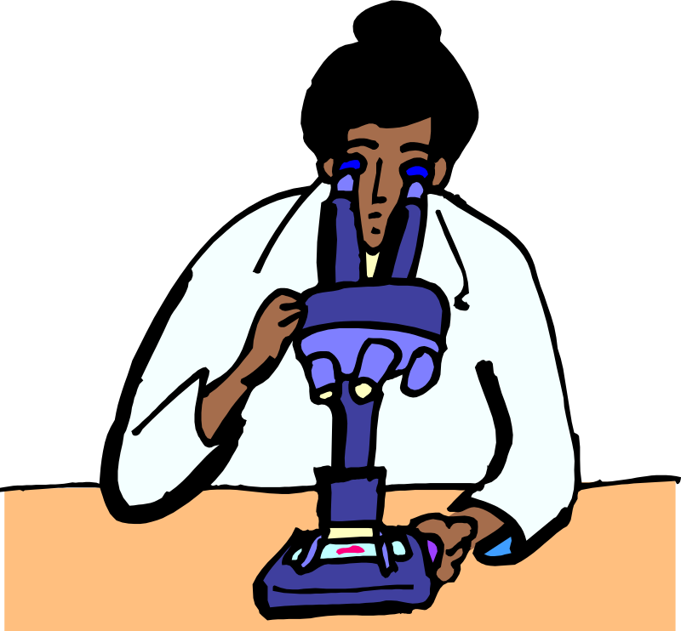
National Institutes of Health (NIH)
Agency of DHHS
World’s premier medical research organization
Cancer, Alzheimer’s, diabetes, arthritis, heart disease, and AIDS

Slide 35

World Health
Organization (WHO)
International agency sponsored by the United Nations
Directing & coordinating authority on international health
Goal is to help all people attain the highest possible levels of health
International health statistics

Slide 36
Volunteer & Non-Profit Health Agencies
Supported by private contributions & fund-raising
Most deal with a specific disease or group of diseases
Provide funding for research and promote education
May also provide services to patients
Great influence on laws & standards
Examples:
  American Lung Assoc
  March of Dimes
  American Heart Assoc
Notes:
• American Lung Assoc – oldest voluntary health organization in the US; fights lung disease in all forms with an emphasis on asthma, tobacco control, and environmental health
• March of Dimes – initially cared for victims of polio and fund research for it. Having accomplished this goal, the organization now is dedicated to improving the health of babies by preventing birth defects and reducing infant mortality.
• American Heart Assoc – reduce disability and death from cardiovascular diseases and stroke

Slide 37

Current World Health Issues
AIDS/HIV
Tuberculosis
Severe Acute Respiratory Syndrome (SARS)
Tobacco control
Traveler’s health
Polio
Maternal health
Road Safety

Slide 38
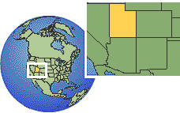
Utah Health Issues
Influenza & “Ask For A Mask”
Affordable prescriptions
Children’s health insurance
Smoking cessation programs
Student injuries at school
Diabetes
Maternal & infant health

Slide 39
National Health Care
The U.S. health care system is a mix of public and private programs with many people falling between the cracks.
There are enormous gaps in the insurance coverage available and level of benefits to people of similar circumstances.

Slide 40
National Health Care
Is health care a right or a privilege?
We assure a free, public education to all children – how about affordable access to at least basic health care?
Canada ,United Kingdom, Singapore guarantee all citizens universal health care – “medically necessary” services.
Health care services are available on the basis of need, not on the ability to pay for services.

Slide 41
National Health Care
Canada - Pros
  30 million citizens (comparable to Calif).
  Patient goes to physician of choice; no deductibles, co-payments, limits, or forms.
  *80 billion spent annually and 70% is publicly funded – no private insurance.
  Providers/facilities receive global operating budgets.
  No public awareness of actual costs.

Slide 42
National Health Care
Canada – Cons
  No limits on demand, patients seek as much health care as desired.
  No physician pay raises since 1993.
  Sharp decline in quality of services.
  Huge wait time for specialist care.
    Heart bypass = 18.2 week wait.
    Gynecologist = 11.6 week wait.
    Orthopedic Surgery = 20.7 week wait.
    General Surgery = 7.1 week wait.
  Rationing of care.

Slide 43
National Health Care
Is national health care the answer?
Other options?
  Medical savings account.
  Soft mandate that if you don’t take advantage of available insurance you lose tax benefits and other gov’t entitlements.
  “Pooling” to decrease insurance premiums and overhead.
  Sponsor “creative federalism” – experiment with strategies for providing health care.

Slide 44
Federal Initiatives – Pres. Bush
Health Care Initiatives
  Health Savings Accounts
    Out of pocket medical expenses, premiums during unemployment.
    Earn tax-free interest, rolled over year to year.
    $2600/individual, $5150/family.
  Health Care Tax Credit
    Tax credit to individuals without access to employer-based coverage.
    $1000/individual, $3000/family.
Notes:
George W. Bush, Jan 20, 2004

Slide 45
Federal Initiatives – Pres. Bush
Association Health Plans (AHPs)
  Allow individuals and groups to purchase health insurance from an association of which they are a member.
  Leverage volume through membership, similar to how large employers operate their health benefits programs.
  Goal is to offer small employers an alternative to costly insurance programs.

Slide 46
Federal Initiatives – Pres. Bush
Medical Malpractice Reform
  The lawsuit crisis in many states has little or nothing to do with increases in bad medical practices, but often results from exotic theories of legal liability, runaway juries, and absurd state tort rulings.
  Congress should strongly encourage states to reform their destructive medical malpractice system in ways that are consistent with the Constitutional principle of federalism.

Slide 47
Federal Initiatives – Pres. Bush
Medicare
  New Medicare law: Provision of a drug discount card, help for low income seniors, and an improvement of private plan competition.
  The coming Medicare crisis: Explosion of Medicare costs and un-funded liabilities, loss of retiree drug coverage (7 years).

Slide 48

Future of Health Care
The two areas of advancement that will have the greatest impact on the future of health care are:
  Digital Technology
  Genetics

Slide 49
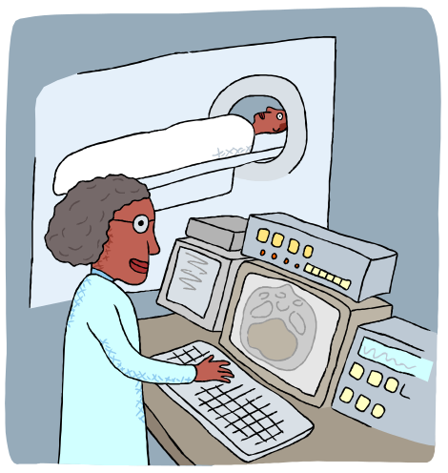
Future of Health Care
Digital Technologies
  Diagnostics/Imaging.
  Remote medical care.
  Even shorter hospital stays.
    Home monitoring.
  Robotic medicine.
  Injectable chips and computers.
    Remote control by thought alone.
    Restore hearing, sight.
    Movement for paralyzed.

Slide 50

Future of Health Care
Genetics
  Most illnesses are influenced by our genes.
  Predicting disease & response to meds.
  New vaccines.
  Human cloning, stem cells for replacement tissues.
  Universal code of life.
    Mix & match – scorpion into cabbage, etc.
  Designer babies.

Slide 51
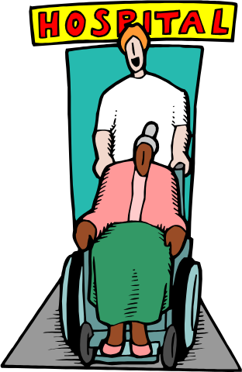
Future of Health Care
Get ready for the biggest shift in values as people ask profound questions about the meaning of life.
  We are more than just complex machines.
  Emphasis on quality of life.
  Emphasis on the unique value of every person.

