Slide 1
Prediction of Chronic Diseases: Methods, Findings and Recommendations
Presentation Date: 04-01-2025 Name: Naga Sri Manju Gajula ng56224n@pace.edu
Practical Data Science
MS in Data Science
Seidenberg School of Computer Science and information Systems
Pace University

Slide 2
Agenda
Executive Summary Project Plan Recap Data
Exploratory Data Analysis(EDA)
Methods
Findings
Recommendations

Slide 3
Executive Summary
Business Problem:
Chronic diseases cause most deaths and high healthcare costs, but traditional detection methods are slow and expensive. Predicting disease risk is challenging due to complex health data, requiring advanced analytical tools for better early detection.
Solution:
Use Machine Learning to Predict Disease Risk
Machine learning models can analyze health data and identify high-risk individuals early.
This helps doctors and patients take action sooner, improving prevention.
The approach is faster, more accurate, and scalable compared to traditional methods.

Slide 4
Project Plan Recap
Deliverable | Due Date | Status
Data & EDA | 03/25/25 | Complete
Methods, Findings, and Recommendations | 04/1/25 | Complete
Final Presentation | 04/22/25 | Not Started

Slide 5
Data

Slide 6
Data
Data Source: Centers for Disease Control and Prevention (CDC)
Sample Size: 1 million records
Data Attributes: 34 columns containing demographic, lifestyle, and health-related information.
Data Quality: Identified several columns (e.g., Response, StratificationCategory2, Stratification2, etc.) with 0 non-null values
Data Cleaning: Columns with 100% missing values were dropped to enhance data usability
Notes:
The dataset includes categorical (e.g., health conditions, risk factors) and continuous variables (e.g., age, BMI).
The info() function was used to assess missing values and dataset structure.

Slide 7
Exploratory Data Analysis(EDA)

Slide 8
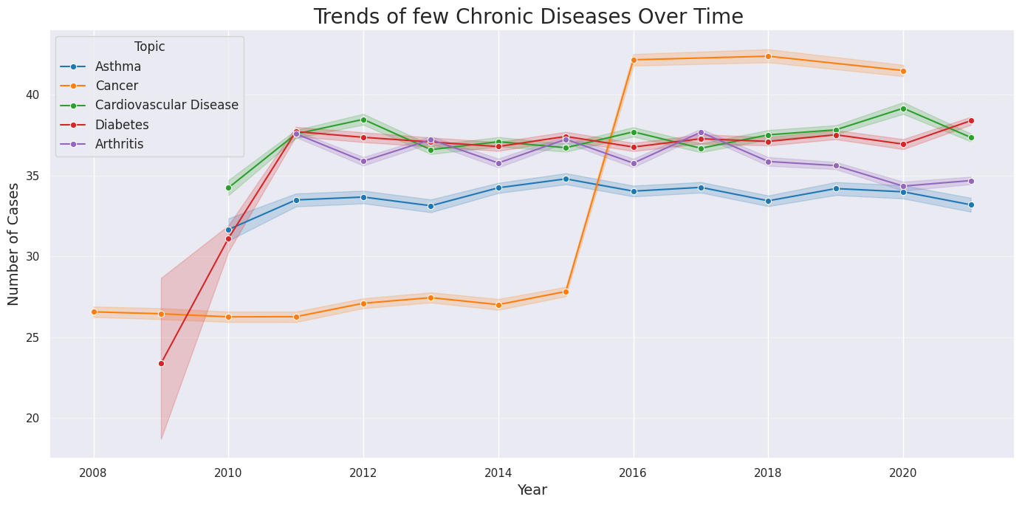
Trends of Filtered Chronic Diseases Over Time
Cancer: Sharp rise after 2015, peaking around 42 cases.
Asthma: Relatively stable, fluctuating around 33–35 cases.
Cardiovascular Disease: Consistent trend with minor variations (36–38 cases).
Diabetes: Initial fluctuation, followed by a gradual increase.
Arthritis: Stable with slight fluctuations near 35 cases.
Key Point: Cancer shows the most notable increase, while other diseases maintain consistent trends.

Slide 9
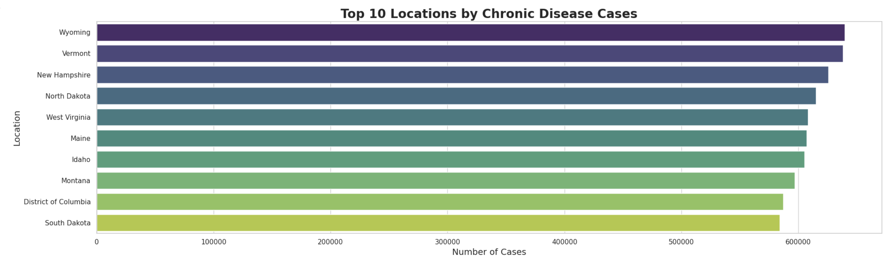
Top 10 Locations by Chronic Disease Cases
Bar plot helps to identify the Locations with most chronic Diseases.
We can observe that Wyoming state has high number of overall Chronic Disease Cases followed by Vermont and New Hampshire.

Slide 10
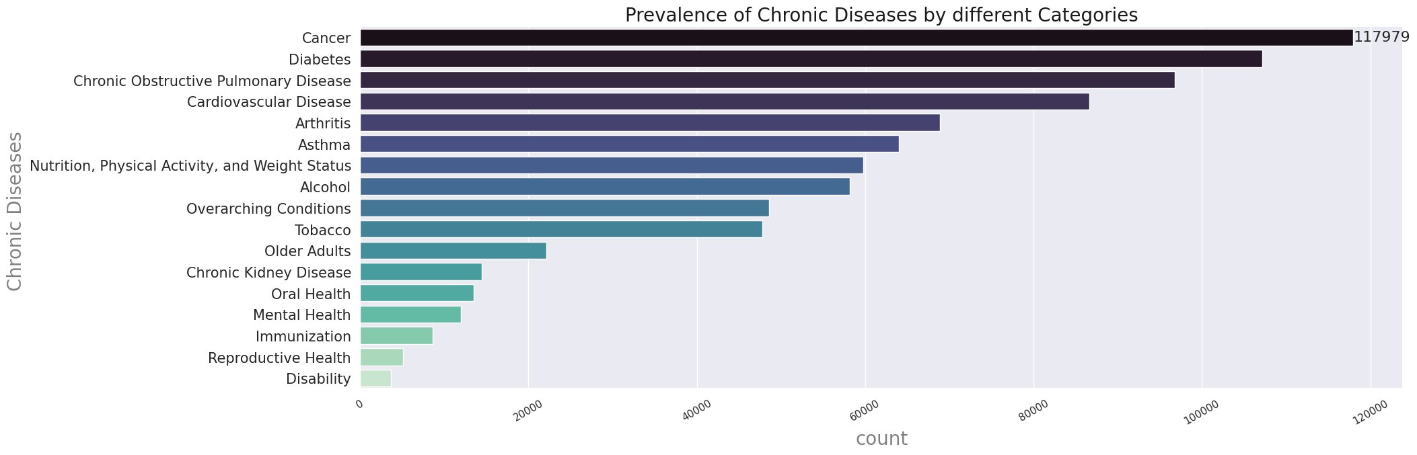
Prevalence Of Chronic Diseases by Different Categories
From the Bar graph we can see that Cancer has highest number of cases in US.
Followed to cancer Diabetes, Pulmonary Diseases are more prevalent in US.

Slide 11
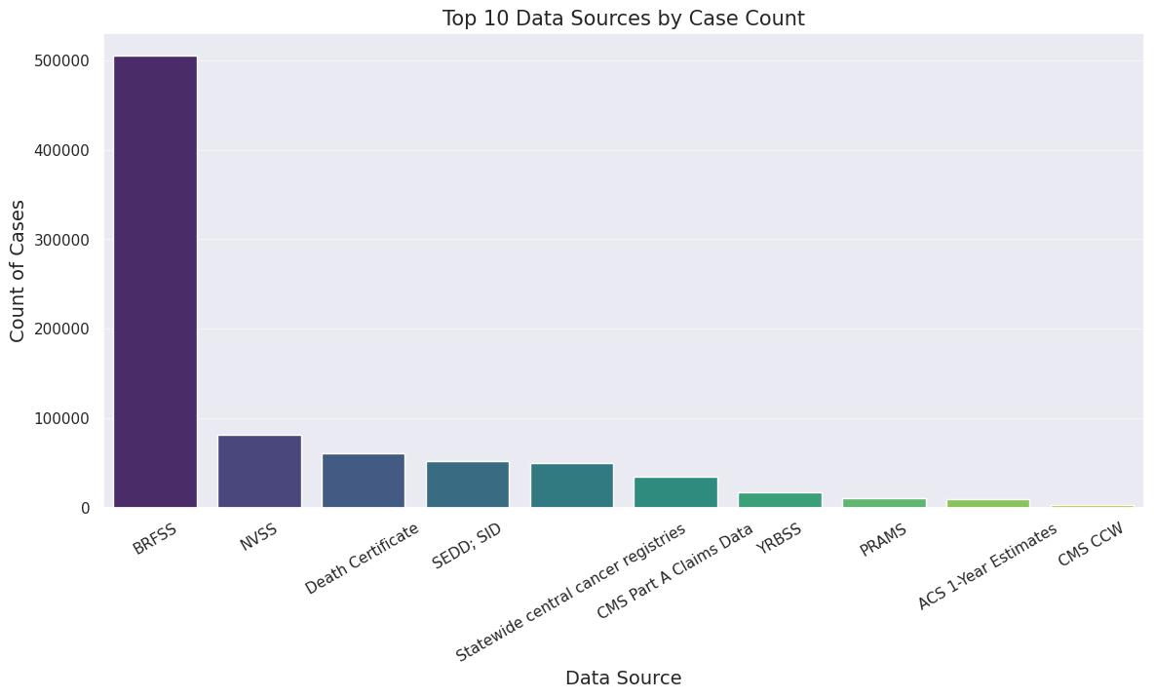
Service Ratings vs. Satisfaction (Box Plots)
BRFSS(Behavioral Risk Factor Surveillance System): A U.S. system that collects data through phone surveys on health behaviors and chronic conditions.
NVSS(National Vital Statistics System): A system that records data on births, deaths, and other vital events in the U.S.
We can observe that BRFSS plays very prominent role in collecting the data of Chronic Diseases in US. Followed by NVSS and Death Certificate .

Slide 12
Methods

Slide 13
What Are We Predicting?
Outcome Variable (Target Prediction)
Predicting the likelihood of an individual developing a chronic disease (e.g., Cancer, Diabetes, Cardiovascular Disease).
This helps in early detection and prevention efforts to reduce healthcare costs and improve patient outcomes.
2. Key Features (Predictor Variables) We selected features based on medical research and data analysis to identify the most influential risk factors: ✅ Demographic Factors (Age, Gender, Ethnicity) → Certain groups have higher risks. ✅ Lifestyle Factors (Smoking, Alcohol Consumption, Physical Activity) → Directly impact chronic disease development. ✅ Medical History (Existing Conditions, Family History) → Previous illnesses increase risk. ✅ Socioeconomic Status (Income, Education) → Affects access to healthcare and lifestyle choices.

Slide 14
Model Type & Why We Chose It
Model Used: Random Forest Regressor
What is it?
A machine learning model that makes predictions by combining multiple decision trees.
Think of it as asking multiple doctors for an opinion instead of just one — this increases accuracy and reduces errors.
Why This Model? ✅ Handles Complex Data Well – Can process both numeric and categorical variables efficiently. ✅ Interpretable – Helps us understand which factors contribute most to chronic disease risk. ✅ Prevents Overfitting – Since it averages multiple decision trees, it avoids making overly specific predictions. ✅ Performs Well with Medical Data – Used in healthcare analytics due to its reliability in predicting patient outcomes.

Slide 15
How the Model Works
Step 1️⃣: Data Preparation & Cleaning
Removed missing values, normalized data, and handled categorical variables.
Step 2️⃣: Splitting Data for Training & Testing
70% Training, 30% Testing to ensure the model learns patterns while being tested on unseen data.
Step 3️⃣: Building the Model
Used Random Forest Regressor to analyze risk factors and predict disease probability.
Step 4️⃣: Evaluating Performance
Assessed accuracy using R² Score and Mean Squared Error (MSE) to check how well the model predicts outcomes.

Slide 16
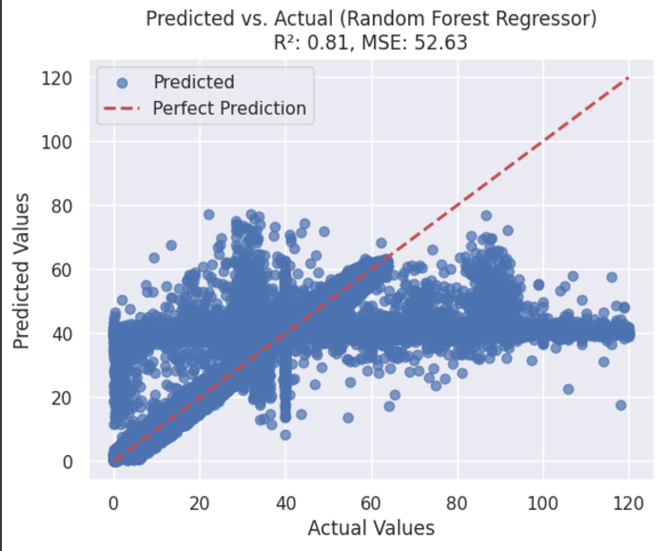
Predicted vs. Actual Values (Random Forest Regressor)
This scatter plot evaluates the performance of a Random Forest Regressor in predicting numerical values.
The x-axis represents the actual values (ground truth).
The y-axis represents the predicted values from the model.
Key Elements:
Blue Dots: Each point represents a single data instance, where the actual value (x) is plotted against the model’s predicted value (y).
Red Dashed Line: This is the ideal “perfect prediction” line, where Predicted = Actual. If all points fell on this line, the model would be making perfect predictions.

Slide 17
Observations
R² (Coefficient of Determination): 0.81, meaning the model explains 81% of the variance in the data.
MSE (Mean Squared Error): 52.63, which quantifies the average squared difference between actual and predicted values.
Most predictions are clustered around the perfect prediction line, indicating good model performance.
Some predictions deviate significantly, especially at higher actual values, showing potential model errors.

Slide 18
Model Findings

Slide 19
Findings:
1. Business Problem & Context
Chronic diseases (cancer, diabetes, pulmonary diseases) are leading causes of mortality and high healthcare costs.
Traditional diagnosis methods are slow, costly, and difficult to scale, leading to delays in early intervention.
Use machine learning to predict high-risk individuals based on demographic, lifestyle, and health data, enabling early detection and intervention.
2. Model Performance & Interpretation
Model Used: Random Forest Regressor
Data Split:
70% Training, 30% Testing to ensure generalization.
Performance Metrics:
R² = 0.81 → The model explains 81% of the variance in chronic disease risk, indicating strong predictive capability.
MSE = 52.63 → Some errors exist, suggesting room for improvement in prediction precision.

Slide 20
3.Visual Analysis & Key Findings
Scatter Plot: Predicted vs. Actual Values 📌 Most predictions align well with the perfect prediction line. 📌 Higher actual values show deviations → Model struggles slightly with extreme cases.
4.Business Impact & Insights
📌 Cancer cases increased significantly post-2015, while other chronic diseases remained stable. 📌 Wyoming, Vermont, and New Hampshire have the highest chronic disease rates. 📌 BRFSS is the key data source for tracking chronic disease trends.
Refer to model findings-Here

Slide 21
5.Limitations & Next Steps
📌 Non-findings: Some expected key factors may not be strong predictors. 📌 Model less accurate for extreme cases → Further tuning required.
Next Steps: ✅ Hyperparameter tuning to reduce errors. ✅ Explore alternative models (e.g., Gradient Boosting, Neural Networks). ✅ Conduct feature selection for better predictor refinement.
6.Final Verdict: Should This Model Be Used?
✅ Yes, with further refinements.
Strong R² → The model is useful for risk prediction.
Requires additional validation before real-world deployment.

Slide 22
Business Recommendations

Slide 23
Key Business Findings & Actionable Recommendations
📌 Finding #1: Cancer cases have significantly increased since 2015. 🔹 Business Impact: Cancer remains the leading cause of chronic disease deaths, requiring urgent action. 🔹 Actionable Recommendations: ✅ Expand early detection and screening programs, especially in high-risk areas. ✅ Increase public health funding for cancer research and prevention.
📌 Finding #2: Wyoming, Vermont, and New Hampshire have the highest chronic disease rates. 🔹 Business Impact: These states require targeted healthcare interventions due to higher disease prevalence. 🔹 Actionable Recommendations: ✅ Allocate additional healthcare resources (e.g., mobile clinics, screenings, public awareness campaigns). ✅ Strengthen local partnerships with health organizations to improve access to preventive care.

Slide 24
Technical Next Steps for Model Improvement
📌 Step 1: Enhance Model Accuracy & Generalization 🔹 Fine-tune hyperparameters and explore advanced models (e.g., Gradient Boosting, Neural Networks). 🔹 Analyze misclassified high-risk cases to understand and reduce prediction errors.
📌 Step 2: Expand Data Collection & Feature Engineering 🔹 Integrate additional health data, such as genetic factors, lifestyle habits, and wearable device data. 🔹 Collect real-time patient data to improve prediction accuracy and model adaptability.
📌 Step 3: Model Deployment & Monitoring 🔹 If performance improves, deploy the model for predictive healthcare screening. 🔹 Implement model monitoring systems to detect accuracy drift and improve reliability over time.

Slide 25
THANK YOU

