Slide 1
BIRLA INSTITUTE OF TECHNOLOGY AND SCIENCE, PILANI
Work Integrated Learning Programmes (WILP) Division
NSP 2 - Dissertation General Orientation Session
1st Semester 2026-27

Slide 2
Agenda
General Ideas on Dissertation / Project / Project Work
Organization Support
Institute Support
Grades
Student Details, Reports Submission & Viva Scheduling Process

Slide 3
Schedule
NSP 2 S1-26 Dissertation Calendar | Semester Start -24th October 2026 Semester End - 5th March 2027
Dissertation General Orientation | 1st August 2026,Saturday 7:30 pm to 9:00 PM IST
Dissertation Domain Orientation | To be decided
Submission of Student’ Project Details on the Elearn Taxila Portal | 21st September to 20th October 2026
Access of Viva portal to students with time lines | 24th October 2026
Submission of outline/ Abstract Report | 31st October to 7th November 2026
Student VIVA date selection | 12th November to 15th November 2026
Abstract VIVA & Grading Evaluation by BITS Faculty Panel | 20th November to 4th December 2026
Plagiarism Check Enablement | 13th December 2026
Mid-Semester Report submission | 18th December to 25th December 2026
Student VIVA date selection | 30th December 2026 to 2nd January 2027
Mid Semester VIVA & Grading Evaluation by BITS Faculty Panel | 7th January to 21st January 2027
Plagiarism Check Enablement | 26th January 2027
Final Dissertation | 31st January to 7th February 2027
Student VIVA date selection | 12th February to 15th February 2027
Final Viva to be conducted by the BITS examiner | 20th February to 5th March 2027

Slide 4
Problem Identification
  Non-trivial, analytical and application-oriented
  Preferably select an area of work that is considered vital to your employing organization.
  Should reduce cost (or) improve productivity (or) find new solutions to problems
  M.Tech level of Work
  Based on the courses studied in all previous semesters
  Worthy enough for 16 Weeks effort
  Effort should be equivalent to 4 Courses of M.Tech
  Original unpublished quality work
  Any attempt at plagiarism or use of unfair means will result in severe disciplinary action
  Reporting as per BITS requirements

Slide 5
The nature of project should be…
your individual effort
original
involve significant research and/ or development project
independently carried out
presentable
demonstrable
defendable
“Not the regular work as is”

Slide 6
Dissertation Process…
People involved
  Student, Supervisor, Additional Examiner, BITS Evaluator
  Qualification
    Supervisor should be B.E. / B.Tech. / M.Sc. / MBA / MCA with 5+ years of experience with Domain Expertise
    Additional Examiner qualification will be equivalent to that of the Supervisor’s qualification or even more like M.E. / M. Tech. / M.S. / MBA or he / she can be even a Ph.D. holder also
    Must work in the same organization
    Your subordinate can neither be your Supervisor nor your Additional Examiner. He / She should be in a position to give directions
“Not the regular work as is”

Slide 7
Dissertation Process…
BITS Evaluator
  Assigned by BITS
  Role
Technology Support
  Interactions with BITS evaluator during evaluation – MS Teams
  Submission of documents - Dissertation Management System (VIVA Portal)
Stages
  Submission of Outline Proposal in the portal & Review
  Assessment of Mid Semester Progress – Demo, Presentation, Report submission
  Final Evaluation – Demo, Presentation, Report submission

Slide 8
Modus Operandi
Registration
            Eligibility criteria :
              No invalid grades – E/RRA in any of the courses studied with minimum CGPA of 5.5
Upload of Documents / Review of Documents
Declaration of Results

Slide 9
Organization Supervisor
The Supervisor and Additional Examiner must be two different individuals preferably from the current employing organization.
The same person cannot act as both the Supervisor as well as the Additional Examiner for the same student.
In case you are unable to provide Supervisor and Additional Examiner from your current organization, we in principle approve the selection of either of them or both of them from another organization.
The student, in consultation with his/her Supervisor, identifies the topic of the Dissertation and prepares the detailed Dissertation Outline. Organizational member is expected to participate in the final review.

Slide 10
Role of Organization Supervisor
It is recommended that Supervisor and Additional Examiner participate in the Final Net Viva session along with the student.
Student should discuss with the Supervisor and Additional Examiner about their participation in the Final Net Viva session.
Viva session which will be conducted in MS Teams for review of outline, mid semester progress and final project evaluation.
Student should share the MS Teams invite for the Final Net Viva Session with the Supervisor and Additional Examiner.
If the Supervisor and Additional Examiner are unavailable for the Final Net Viva session, the faculty will still go ahead and conduct the viva session with the student without any changes.

Slide 11
Institute Support
BITS Evaluator will be appointed for every student to evaluate their progress.
OpenAthens eLibrary Access
Course handout containing the complete instructions & template pertaining to your Project Work will be uploaded on the eLearn Taxila portal, https://elearn.bits-pilani.ac.in/
BITS Evaluator will conduct viva and accept / reject outline, provide feedback/suggestion for mid semester Report submission and grade the final project.

Slide 12
Grades
The final grades for Dissertation are Non-Letter grades namely Excellent, Good, Fair and Poor.
Since no grade point are attached with Non-Letter grades, it does not affect CGPA computation.
Under the following conditions, students who appear for their final viva voce may also be graded RRA (Required to Register Again) after evaluation, under the following conditions:
  Student is unable to technically present/defend the work done.
  Technical knowledge/competence of the student is inadequate.
  The work report submitted is inadequate or incomplete.
  The work/report is found to be plagiarized.
  NOTE: Evaluation of grading is cumulative in nature.

Slide 13
Final Net Viva Session
The student should submit the Final Dissertation Report (pdf format) to the Supervisor and Additional Examiner, at least two weeks before the deadline. The Supervisor should evaluate the final report and conduct the pre-final seminar and viva-voce for the student, along with the additional examiner. The Supervisor and the Additional Examiner should jointly complete the pre-final evaluation sheet and recommend the pre-final grade for the Dissertation.
In addition to the pre-final evaluation done by the Supervisor and Additional Examiner, the student must be prepared to appear for an online NET Viva during outline, mid semester and defend the Dissertation / Project to the panel during final review. The final grade in Dissertation would be based on the Supervisor’s evaluation as well as the independent evaluation by BITS Faculty.
The outline review will be for 10 mins, mid semester review 15 mins and final viva for 30 mins. During the final viva each student will be required to make a technical presentation for about 20 minutes using Microsoft PowerPoint. The presentation will be followed by viva-voce for about 10 minutes. Students must be prepared to demonstrate their project during their presentation.

Slide 14
Student Details, Reports Submission & Viva Scheduling Process

Slide 15
Submitting Student Details on eLearn Taxila Portal
Employing Organization:
Degree Program:
Research Area:
Dissertation/Project/Project Work Title:
Supervisor's Name:
Supervisor's Email:
Supervisor's Qualification:
Supervisor's Designation & Address:
Supervisor's Phone No. (with STD code):
Additional Examiner's Name:
Additional Examiner's Email:
Additional Examiner's Qualification:
Additional Examiner's Designation & Address:
Additional Examiner's Phone No. (with STD code):

Slide 16
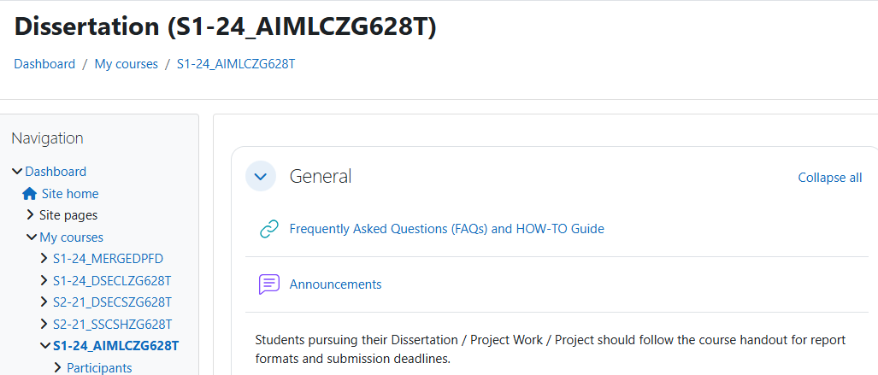
Steps for Submitting Student Details
Log in to the eLearn portal (https://elearn.bits-pilani.ac.in/) with your BITS eLearn Mail ID and password.
Click My Courses Link and then click on Dissertation Course Link to access the common Dissertation Course page.

Slide 17
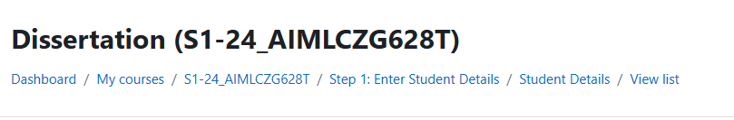
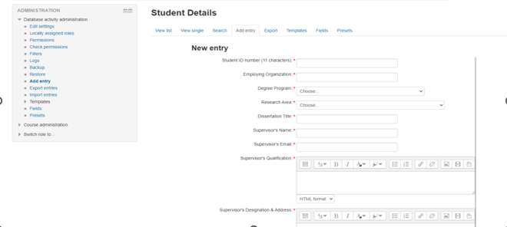
Steps for Submitting Student Details
In the Dissertation Course page, click on Student Details link under Step 1: Enter Student Details section to submit the Student Details

Slide 18
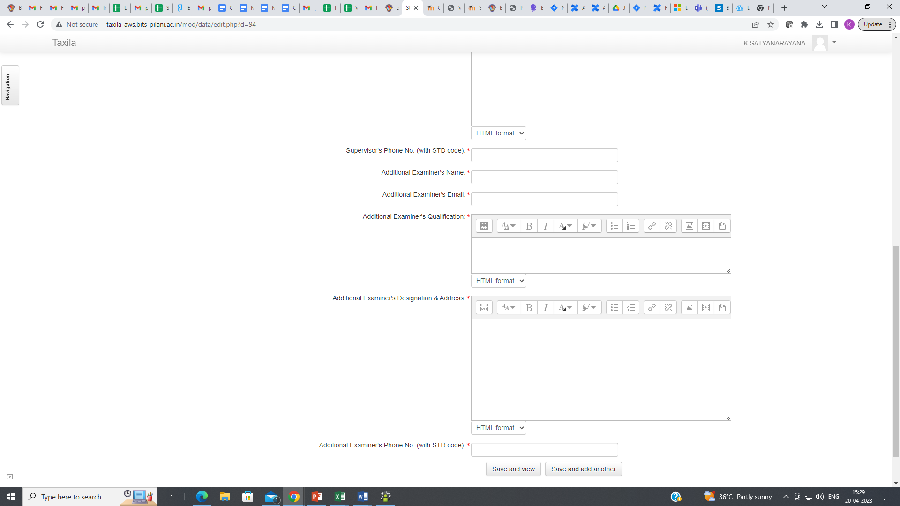
Steps for Submitting Student Details

Slide 19
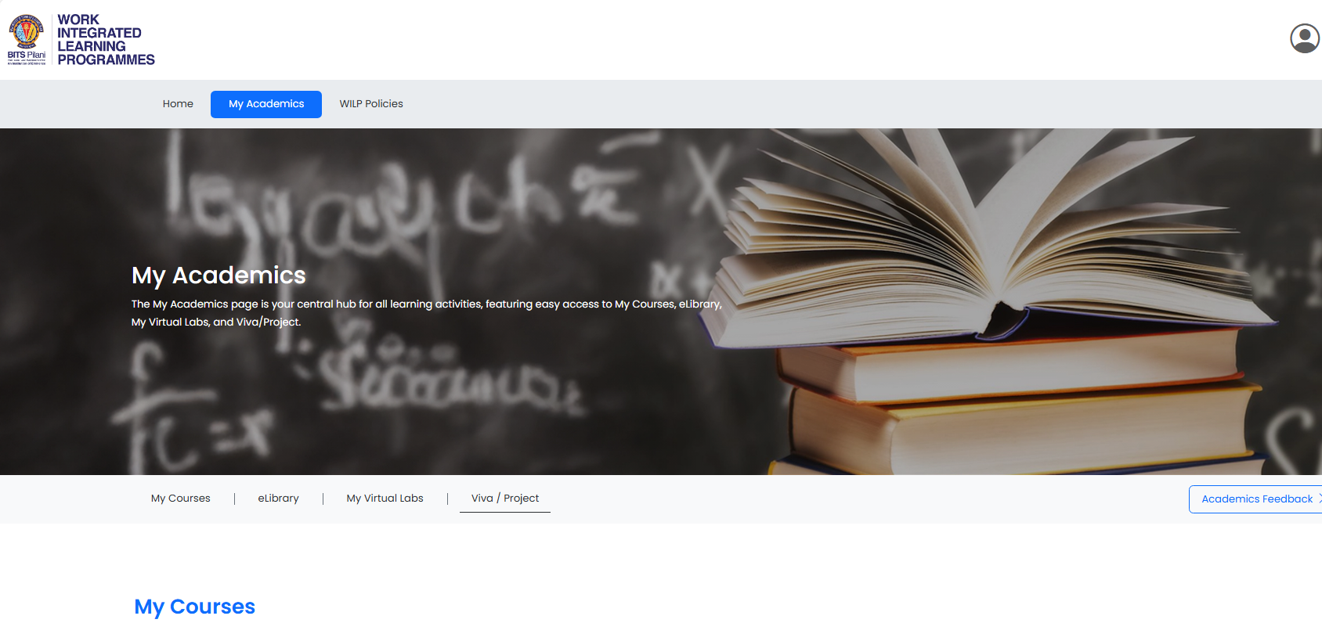
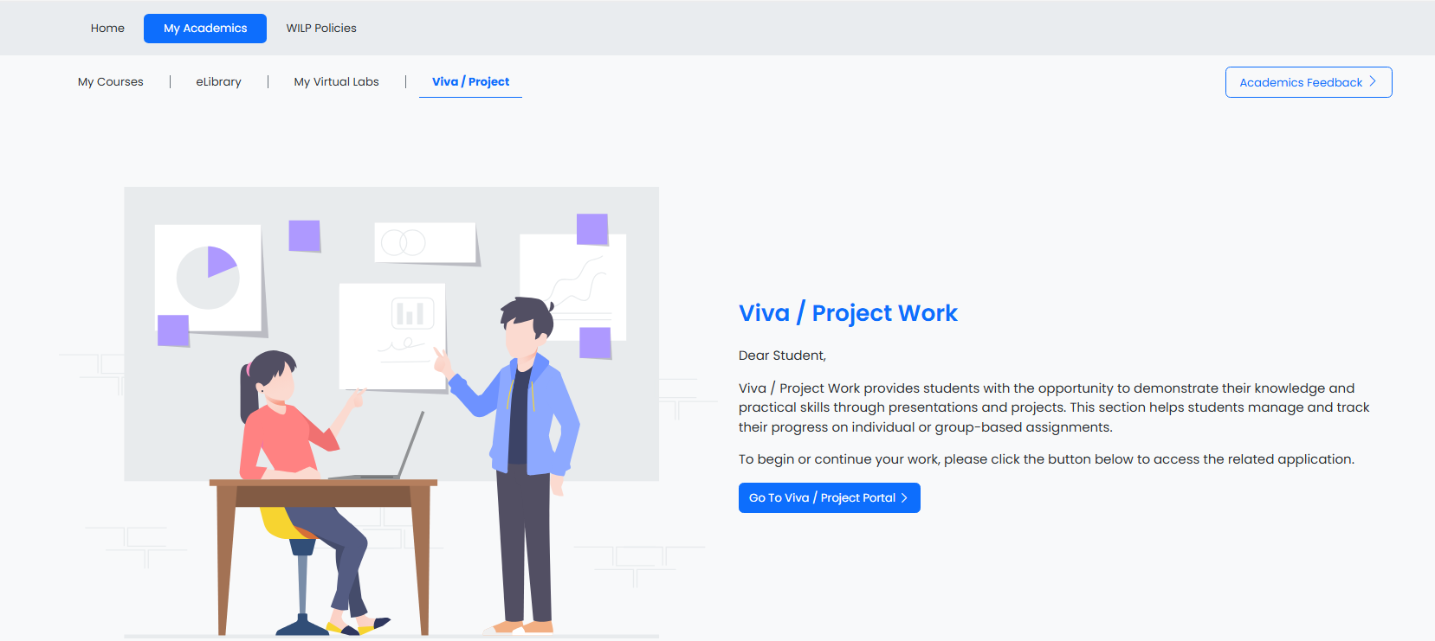
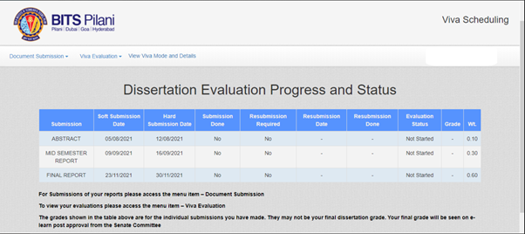
How to Login to VIVA Portal
Log in to the eLearn portal (https://elearn.bits-pilani.ac.in/) with your BITS e-Learn Mail ID and password.
Click on My Academics then Viva/Project Work then click on Go to VIVA/Project Portal Link to access the Viva Portal.
Then It will redirect you to VIVA Portal (https://viva.bits-pilani.ac.in/)

Slide 20
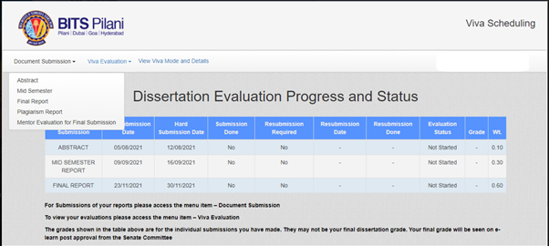
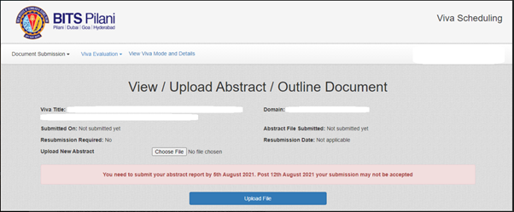
Steps for Submitting Abstract / Outline Report
You can submit the Abstract / Outline Report on the Viva Portal on or before the Hard Submission Deadline.
Click on the “Document Submission” link on the Top left of the screen of the Viva portal page to make the selection from the dropdown.
Click on “Abstract” option in the dropdown to view or upload the Abstract / Outline Report on the Viva portal.

Slide 21
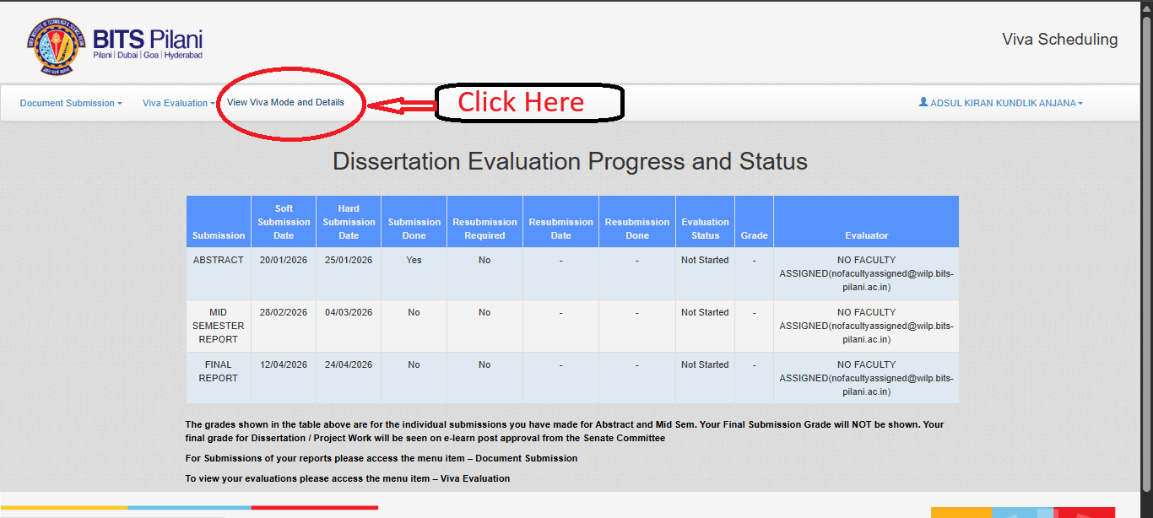
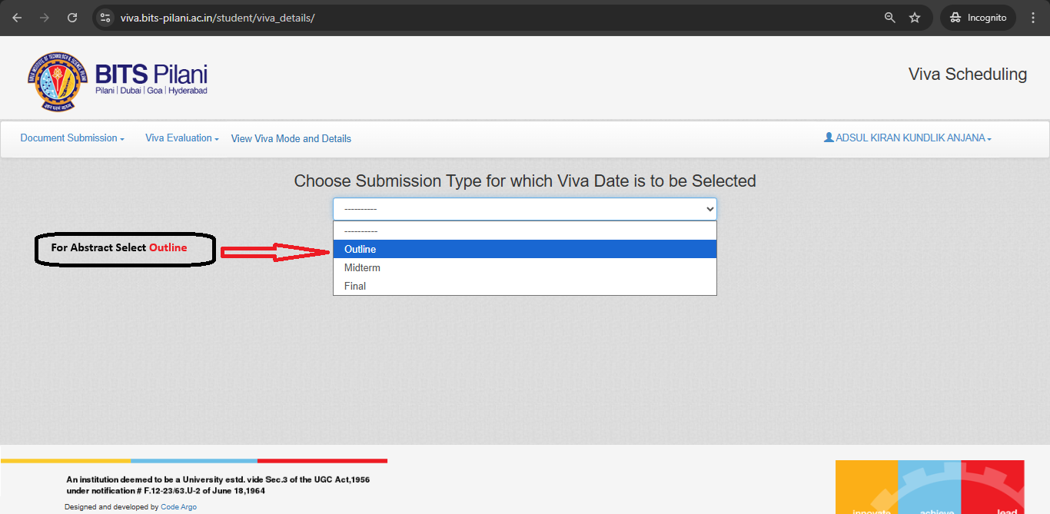
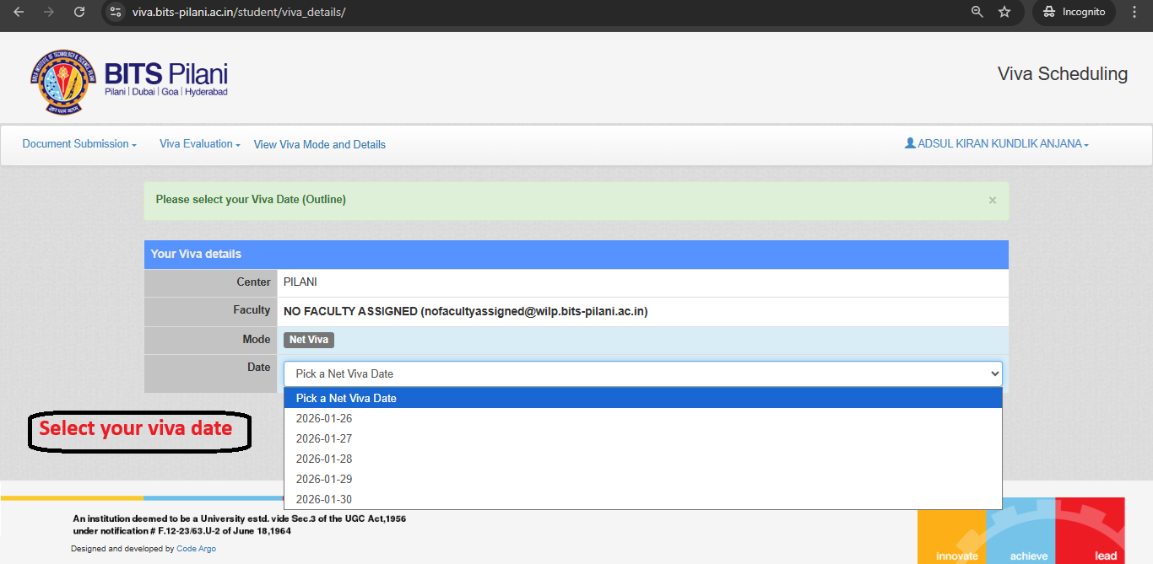

Abstract (Outline) VIVA Date Selection Process
Click on View VIVA Mode and Details
Then Choose Submission Type Outline
Then Select your VIVA date
NOTE:
You will be able to select your VIVA date if your Abstract (Outline) report is submitted

Slide 22
Self-Plagiarism Check for Mid-Semester Report Submission
Students have to mandatorily do the Self-Plagiarism Check for their Mid-Semester Report through the Turnitin Plagiarism Tool before uploading it on the Viva Portal.
Please refer to the below link for the guidelines for setting up the Turnitin Plagiarism Tool Account:
Turnitin Plagiarism Tool Account Setup Guidelines
Turnitin Plagiarism Tool Account will be activated 5 days before the Mid-Semester Report submission deadline, and the account access will remain till the Final Report submission deadline.
If the report similarity index generated through the Turnitin Plagiarism Tool is higher than the permissible limit of 25%, students have to rework and change their report content and "Resubmit" the report again before the given due date. Once students upload an updated report, the previously submitted report will be replaced with a newly submitted report.
The student account registration and login credential on Turnitin will be open 5 days before the Mid Semester report submission deadline and the access will remain till the final report submission deadline.
Plagiarism must not exceed 25%. Faculty will consider the Student Report for Evaluation only if the Plagiarism % is within the permissible limit of 25%.

Slide 23
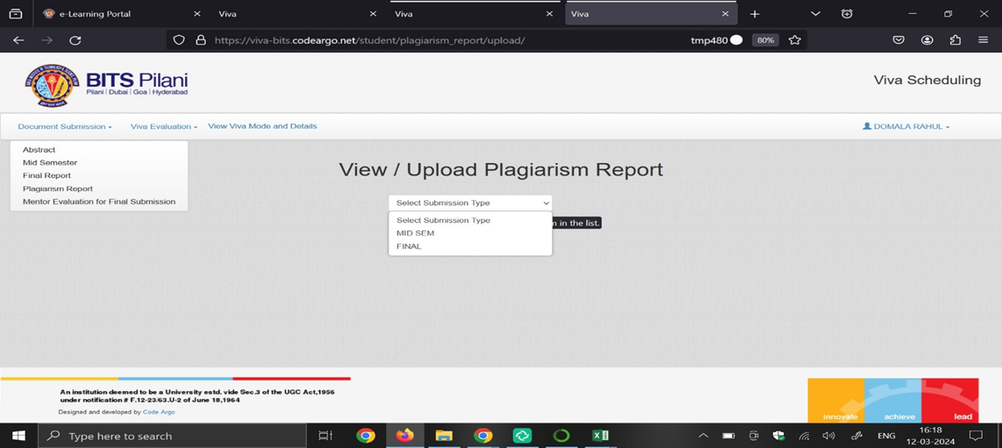
Steps For Submitting Mid-Semester Plagiarism Report On the Viva Portal.
Log in to the eLearn Portal using your BITS eLearn Mail ID and password at https://elearn.bits-pilani.ac.in/,
Navigate to the "Viva / Project Work" Section

Slide 24
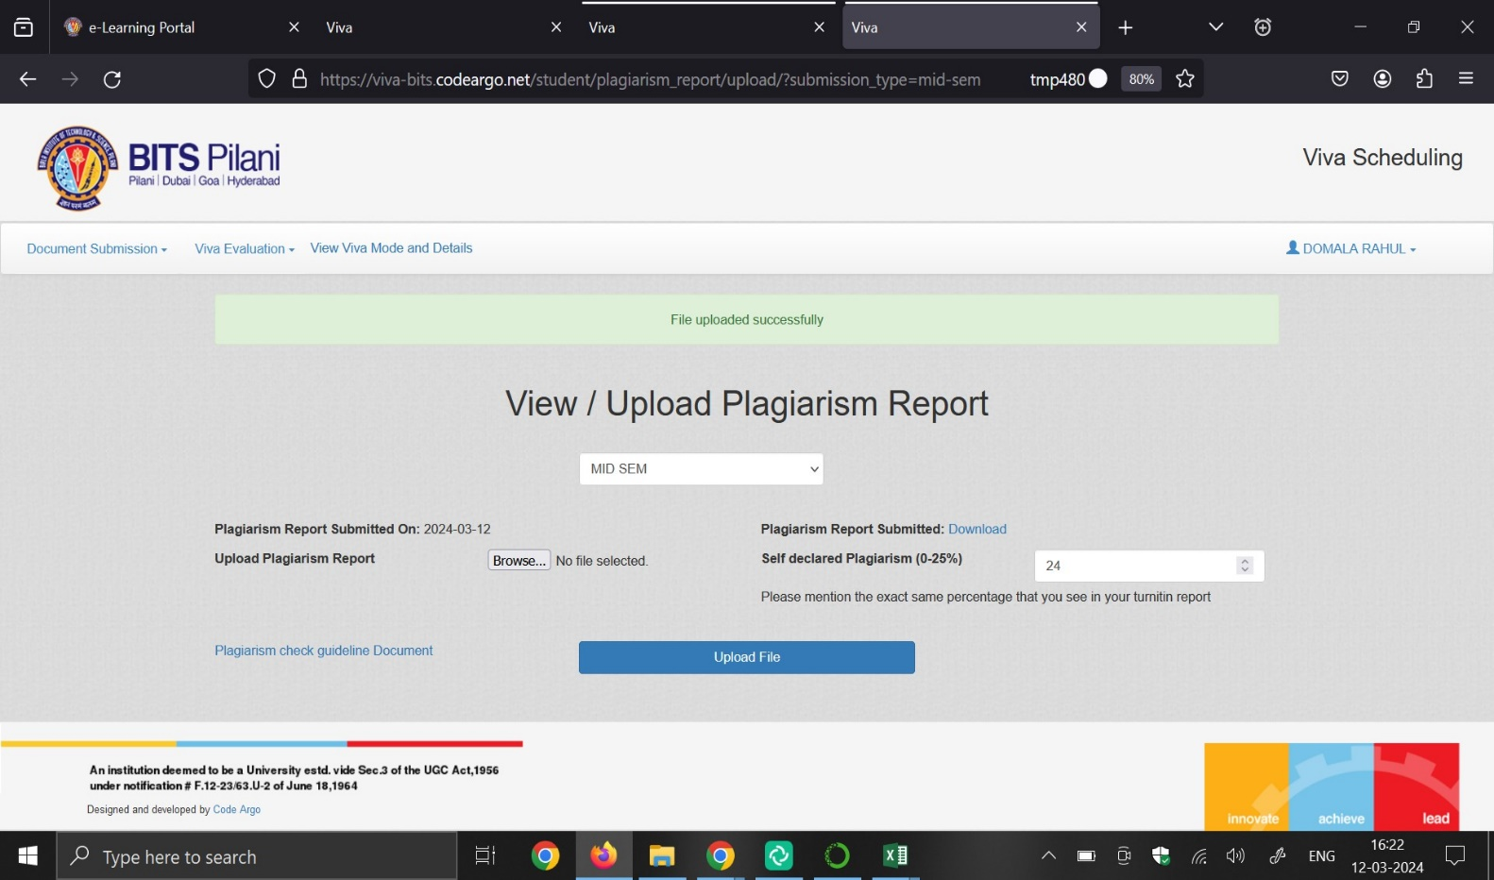
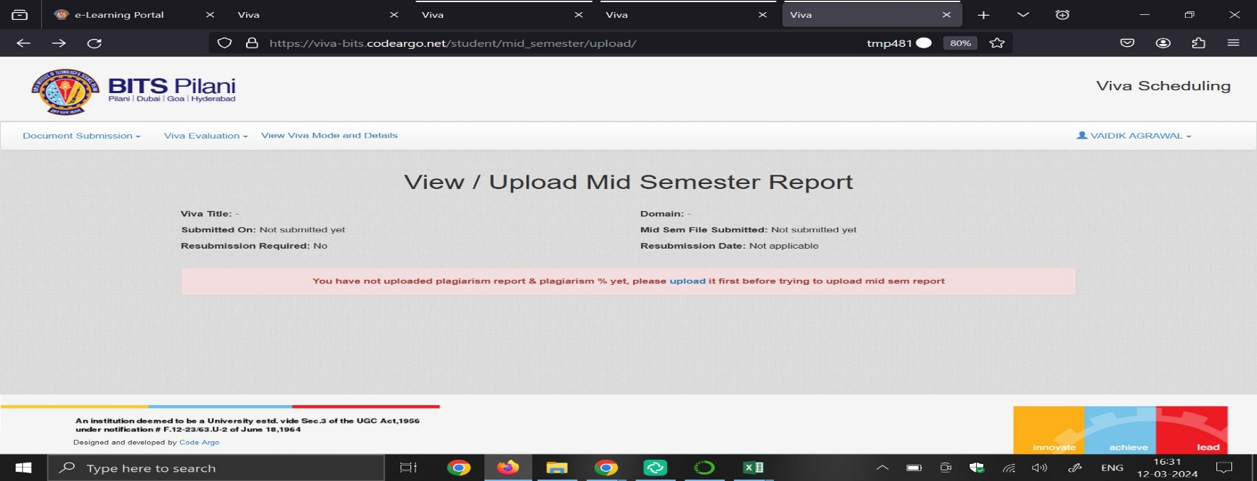
Steps For Submitting Mid-Semester Plagiarism Report On the Viva Portal.
Choose "Plagiarism Report" and select the "Mid-Semester/Final Report“,
Upload the Plagiarism Report file, Submit the Turnitin report on the Viva Portal.
Once completed, you will be able to proceed with uploading the Mid Semester /final Report.
You must upload the plagiarism report before submitting the rest of your report on the portal

Slide 25

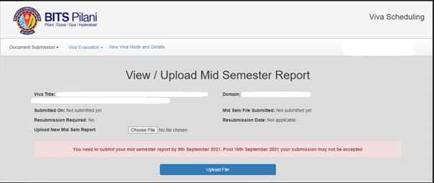
Steps for Submitting Mid-Semester Report
You can submit the Mid-Semester Report on the Viva Portal on or before the Hard Submission deadline.
Make sure that before Mid-Semester Report you should submit Mid-Semester Plagiarism Report. Without Plagiarism Report, portal will not allow you to submit Mid-Semester Report.
Click on the “Document Submission” link on the Top left of the screen of the Viva portal page to make the selection from the dropdown.
Click on “Mid Semester” option in the dropdown to view or upload the Mid-Semester Report on the Viva portal.

Slide 26
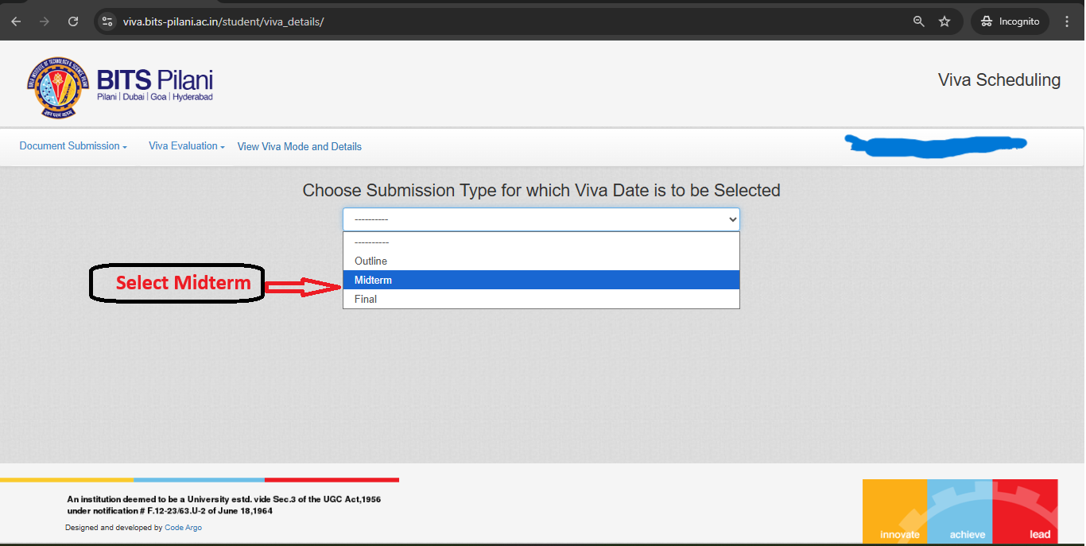
Mid-Semester VIVA Date Selection Process
Click on View VIVA Mode and Details
Then Choose Submission Type Midsem
Then Select your VIVA date
NOTE:
You will be able to select your VIVA date if your Mid-semester report is submitted

Slide 27
Self-Plagiarism Check for Final Report Submission
Students have to mandatorily do the Self-Plagiarism Check for their Final Report through the Turnitin Plagiarism Tool before uploading it on the Viva Portal.
If the report similarity index generated through the Turnitin Plagiarism Tool is higher than the permissible limit of 20%, students have to rework and change their report content and "Resubmit" the report again before the given due date. Once students upload an updated report, the previously submitted report will be replaced with a newly submitted report.
The student account registration and login credential on Turnitin will be open 5 days before the Mid Semester report submission deadline and the access will remain till the final report submission deadline.
Plagiarism must not exceed 20%. Faculty will consider the Student Report for Evaluation only if the Plagiarism % is within the permissible limit of 20% for Final Submission.

Slide 28

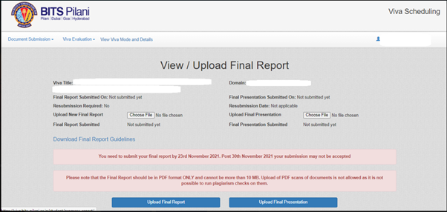
Steps for Submitting Final Report & Final Presentation
You can submit the Final Report and Final Presentation on the Viva portal on or before the Hard Submission deadline.
Make sure that before Final Report you should submit Final Plagiarism Report. Without Plagiarism Report, portal will not allow you to submit Final Report.
Click on the “Document Submission” link on the Top left of the screen of the Viva portal page to make the selection from the dropdown.
Click on “Final Report” option in the dropdown to view or upload the Final Report & Final Presentation on the Viva portal.

Slide 29
Steps for Submitting Mentor Evaluation for Final Submission
You have to Submit the Mentor Evaluation for Final Submission on the Viva portal after the getting your Final Report evaluated by your Supervisor and Additional Examiner.
Click on the “Document Submission” link on the Top left of the screen of the Viva portal home page to make the selection from the dropdown.
Please click on “Mentor Evaluation for Final Submission” option in the dropdown to view or upload the Mentor Evaluation for Final Submission on the Viva Portal.

Slide 30
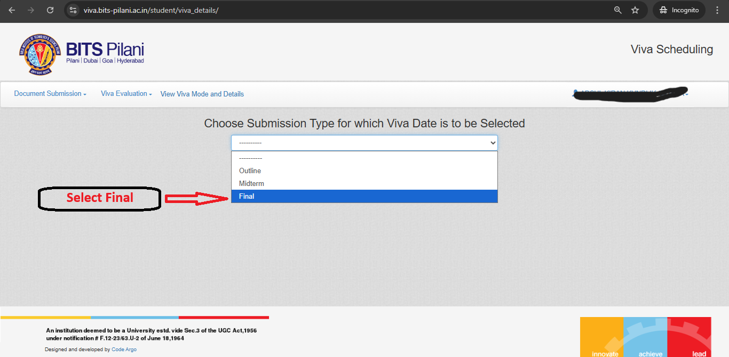
Final VIVA Date Selection Process
Click on View VIVA Mode and Details
Then Choose Submission Type Final
Then Select your VIVA date
NOTE:
You will be able to select your VIVA date if your Final report, Presentation & Mentor Evaluation forms are submitted

Slide 31
Important Points Viva Date Selection, Sharing on the Viva Portal & Support
Summary:-
Log in, navigate to the Viva section, select submission type, and book your date.
The viva link will be shared on the MS Teams account a day before the viva
Important Notes:
You are suggested to select / book the Viva Date for the upcoming Online Viva session’s with your Faculty Mentor as per your convenience based on the Available Date options given on the Viva portal.
Once VIVA link reflects in your teams account, It is your duty to share the link with your Supervisor & Additional Examiner so that they can join the VIVA session.
Reminders:
Double-check the date and time.
Contact support if you encounter any issues. (support@wilp.bits-pilani.ac.in)

Slide 32
Q & A Session

Slide 33
Thank You

