Slide 1
Heart Disease MLOps
End-to-End Machine Learning Operations Pipeline
Sriman Narayan Bharadwaj R
MLOps Assignment 01 (2026)
github.com/srimannarayanbharadwaj/MLOps-Assignment
Notes:
Introduce yourself, assignment name, and repository link.

Slide 2
Agenda
1. Project setup and repository structure
2. Data download and EDA
3. Model training and selection
4. MLflow experiment tracking
5. Model packaging
6. Unit tests and CI/CD
7. Docker containerization
8. Kubernetes deployment (Minikube)
9. Monitoring and conclusion
Notes:
Give a quick roadmap of what you will demonstrate live.

Slide 3
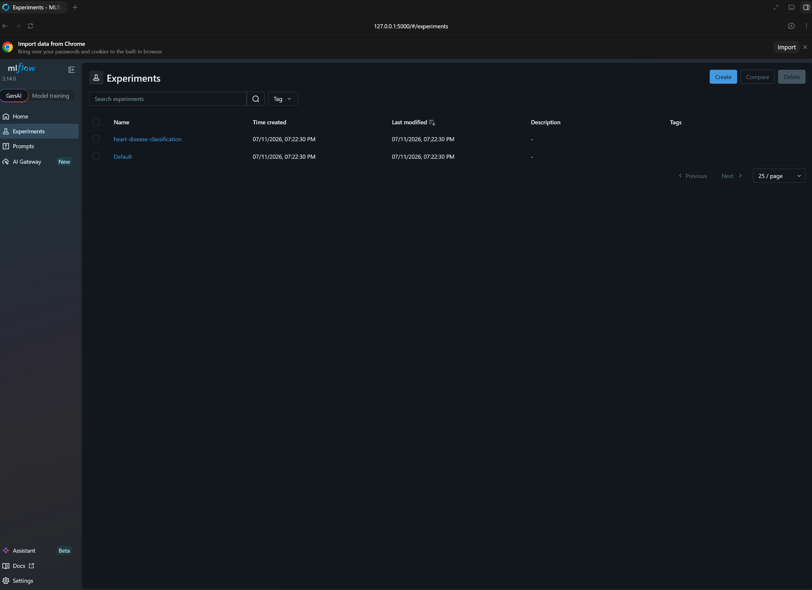
Phase 0: Project Setup
Environment and repository structure
Python 3.12 virtual environment (.venv312)
Pinned dependencies in requirements.txt
Folders: data, src, tests, models, k8s, screenshots
GitHub repo stores code, tests, CI, and deployment files
Goal: reproducible MLOps workflow from clean clone
Notes:
Show project folders live and mention Python 3.12 requirement.

Slide 4
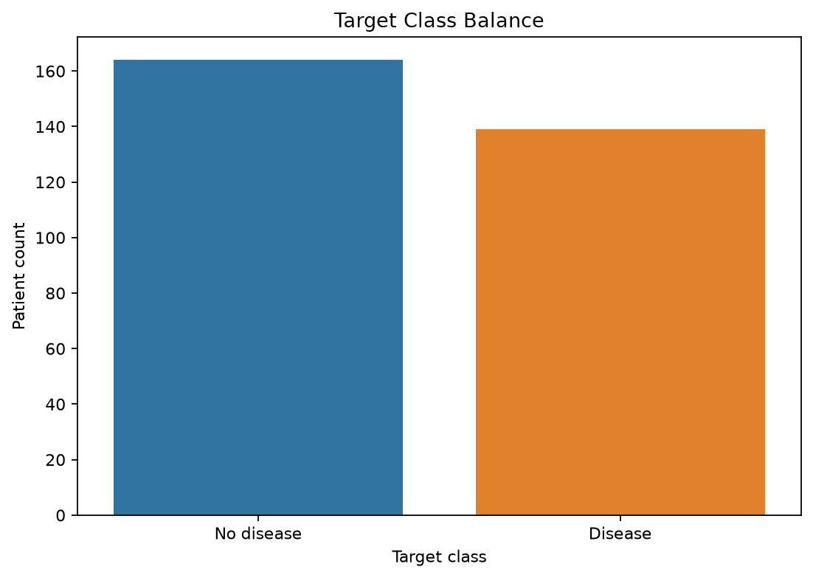
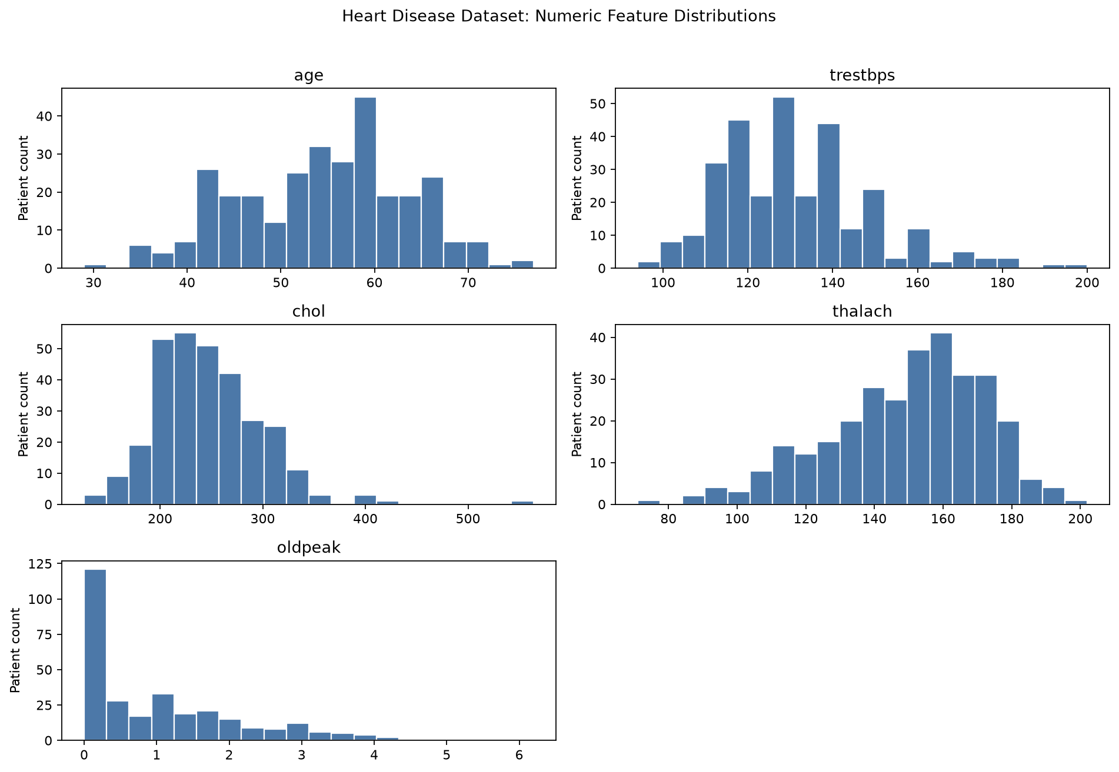
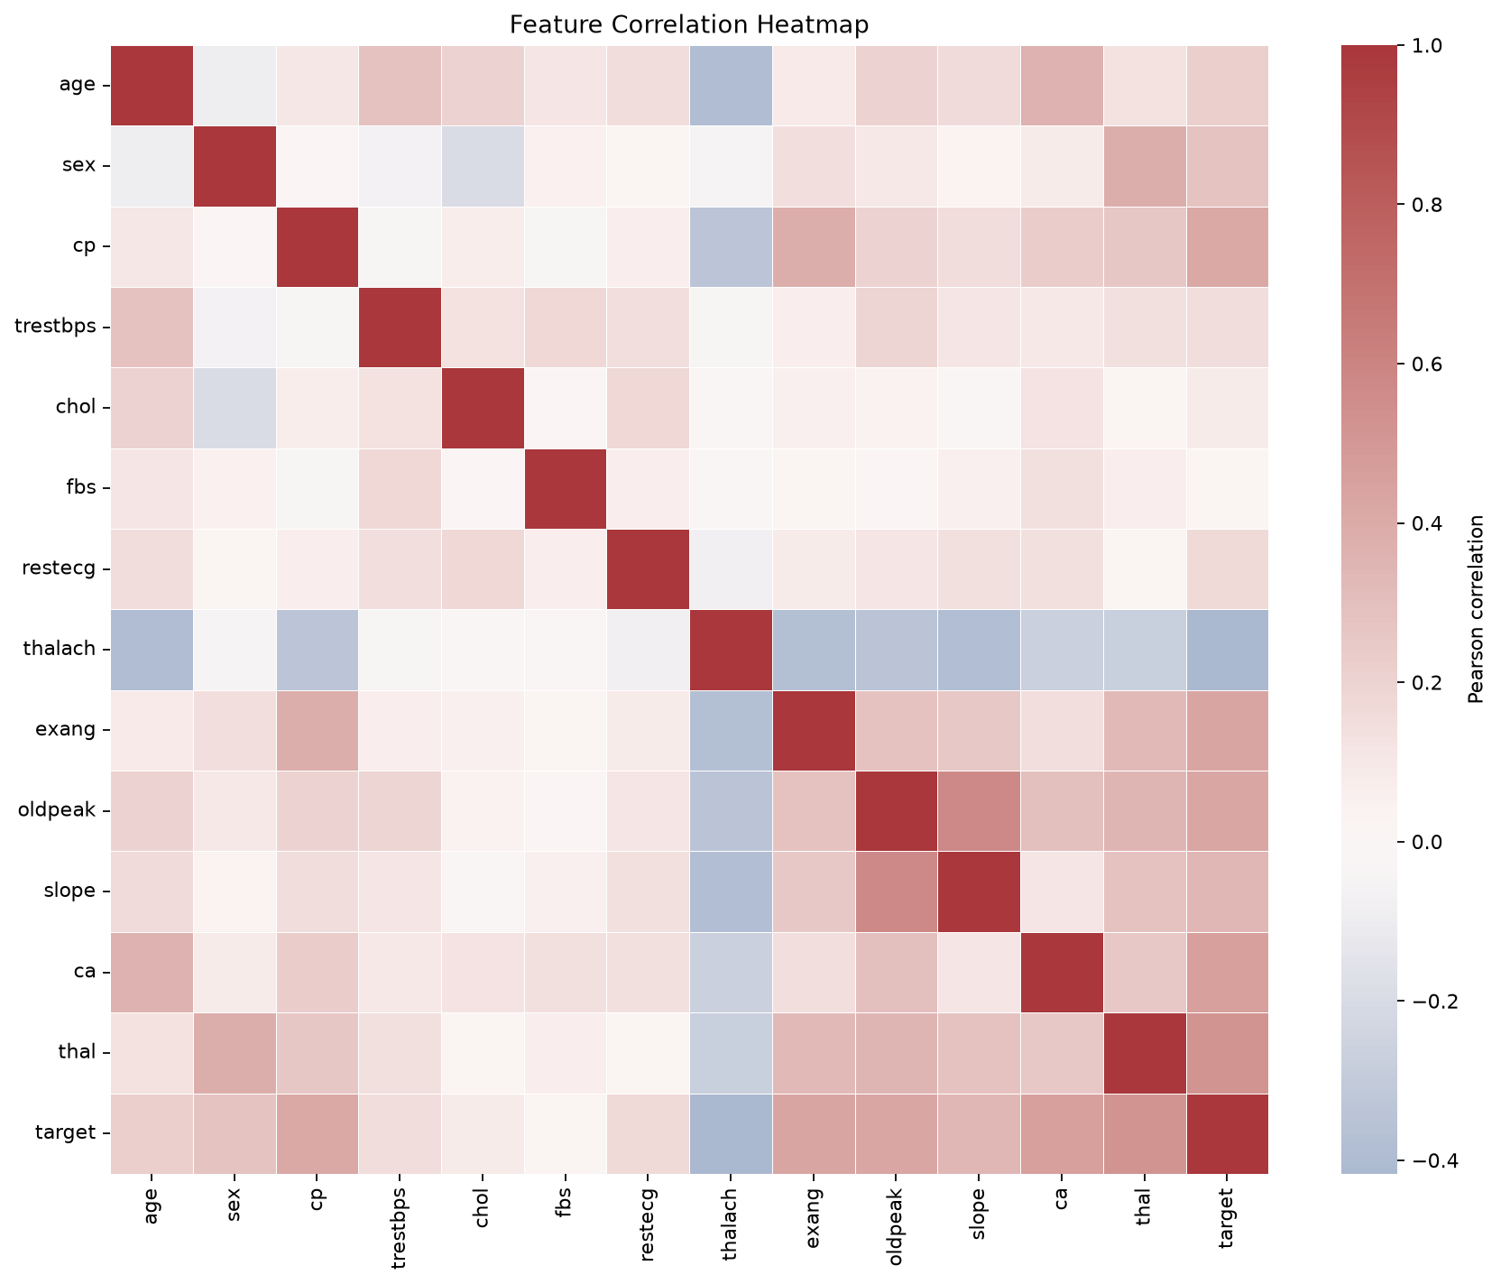
Phase 1: Data and EDA
UCI Cleveland Heart Disease dataset
303 rows, 13 clinical features + target
Missing '?' values handled in ca and thal
Target binarized: 0 = no disease, 1+ -> 1
Class balance: 164 vs 139
EDA: histograms, correlation heatmap, class chart
Notes:
Run data_download and explain what each EDA plot shows.

Slide 5
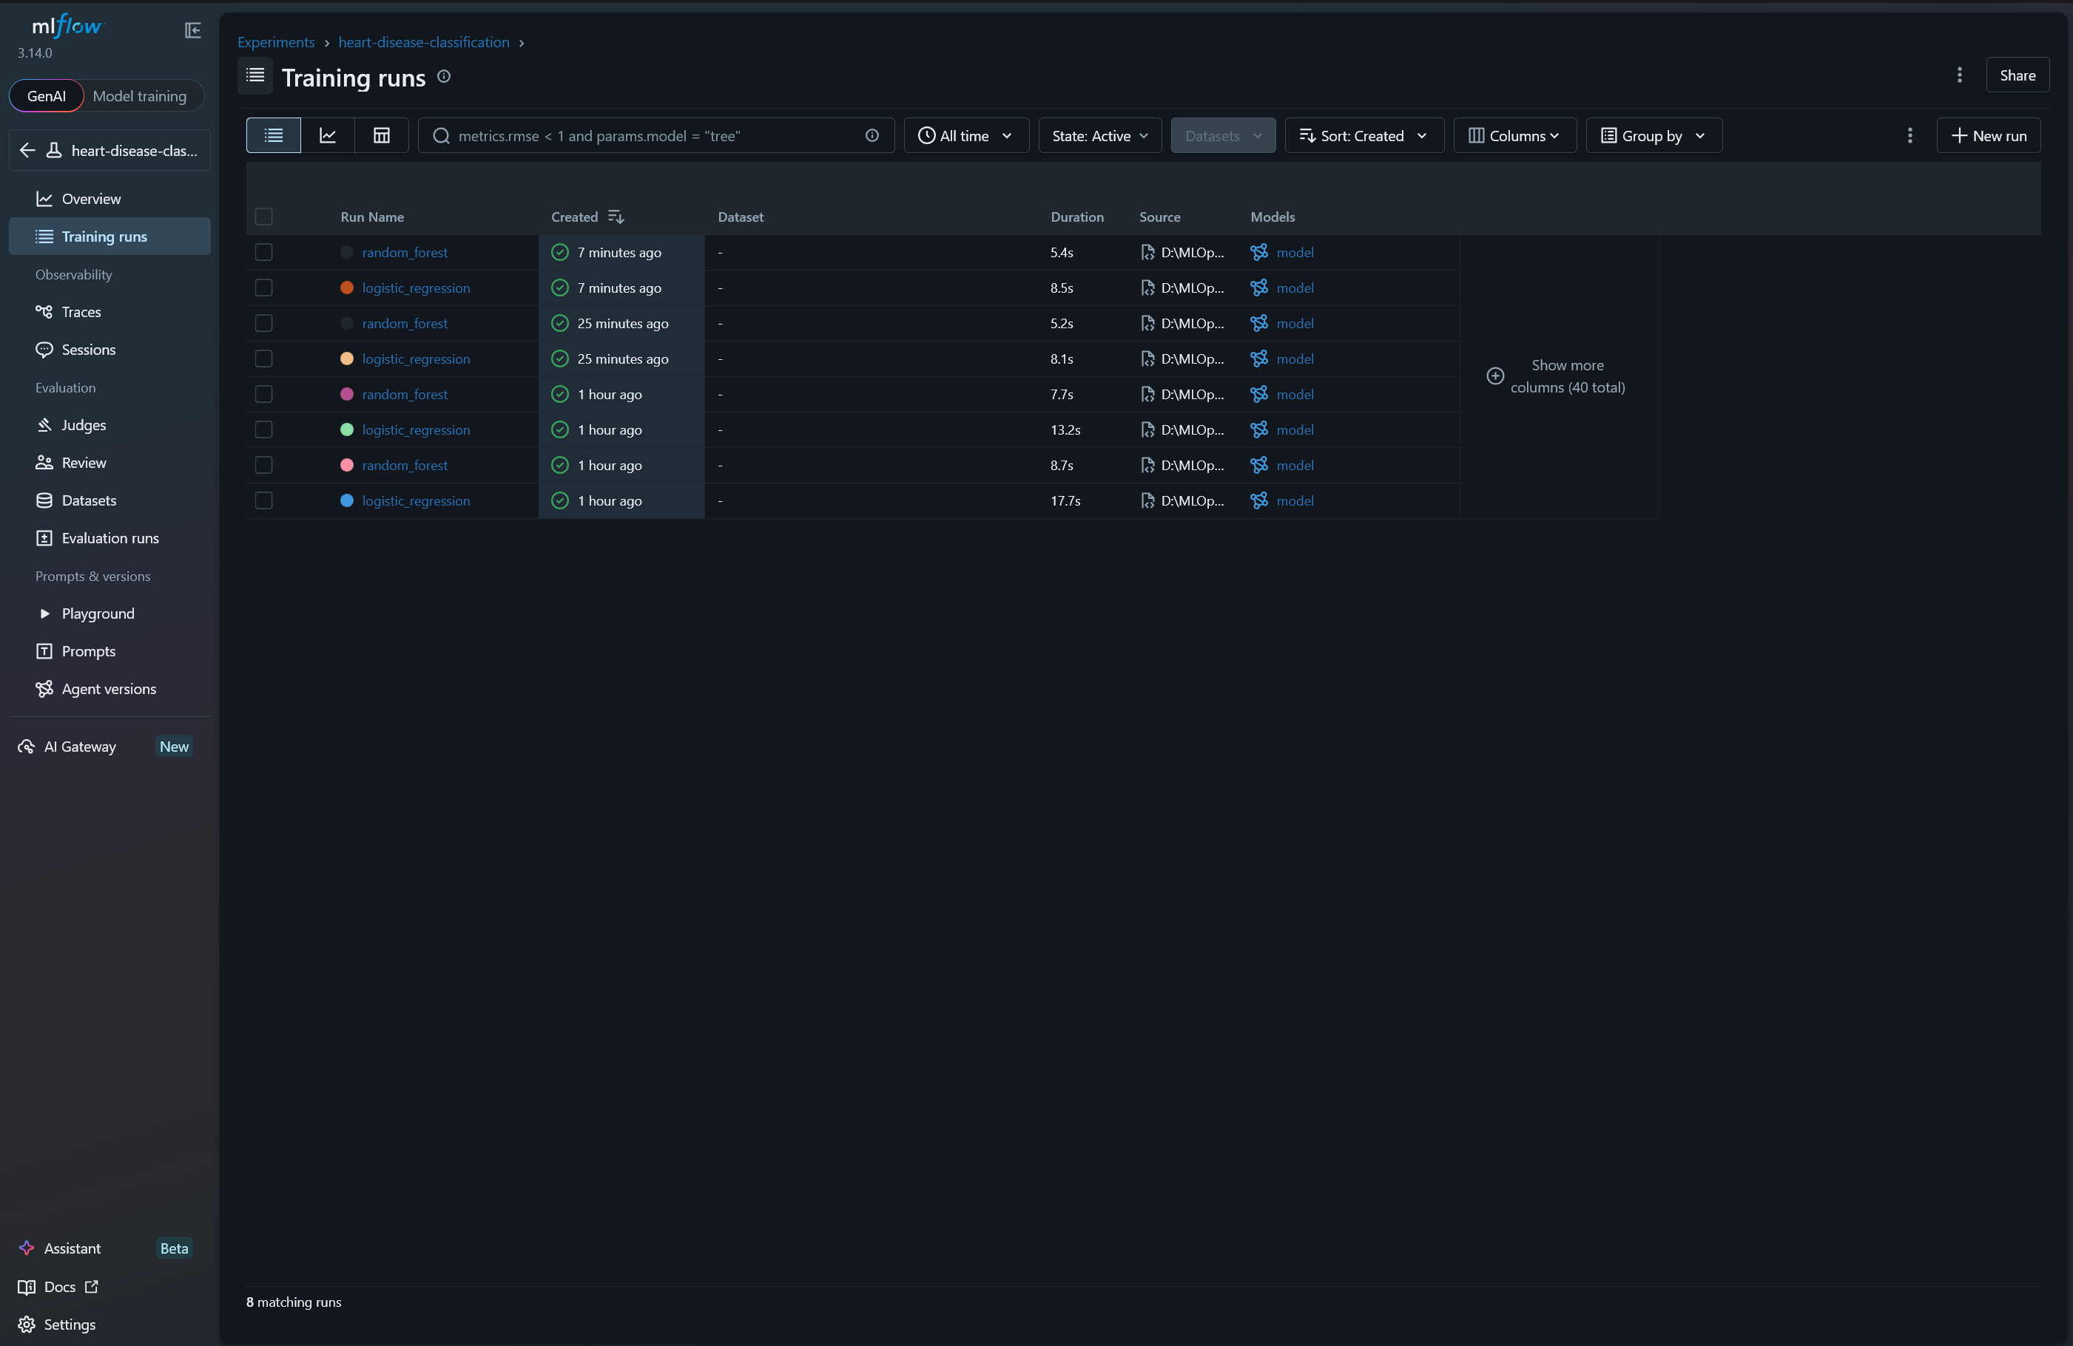
Phase 2: Feature Engineering and Models
Preprocessing + model comparison
Numeric features -> StandardScaler
Categorical features -> OneHotEncoder
Models: Logistic Regression vs Random Forest
Evaluation: 5-fold stratified cross-validation
Metrics: accuracy, precision, recall, ROC-AUC
Notes:
Show preprocessing pipeline and cross-validation results.

Slide 6
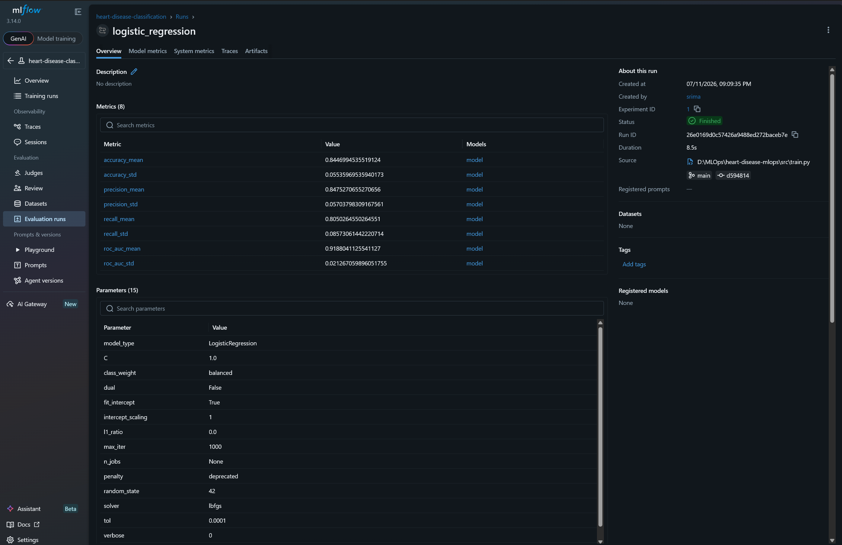
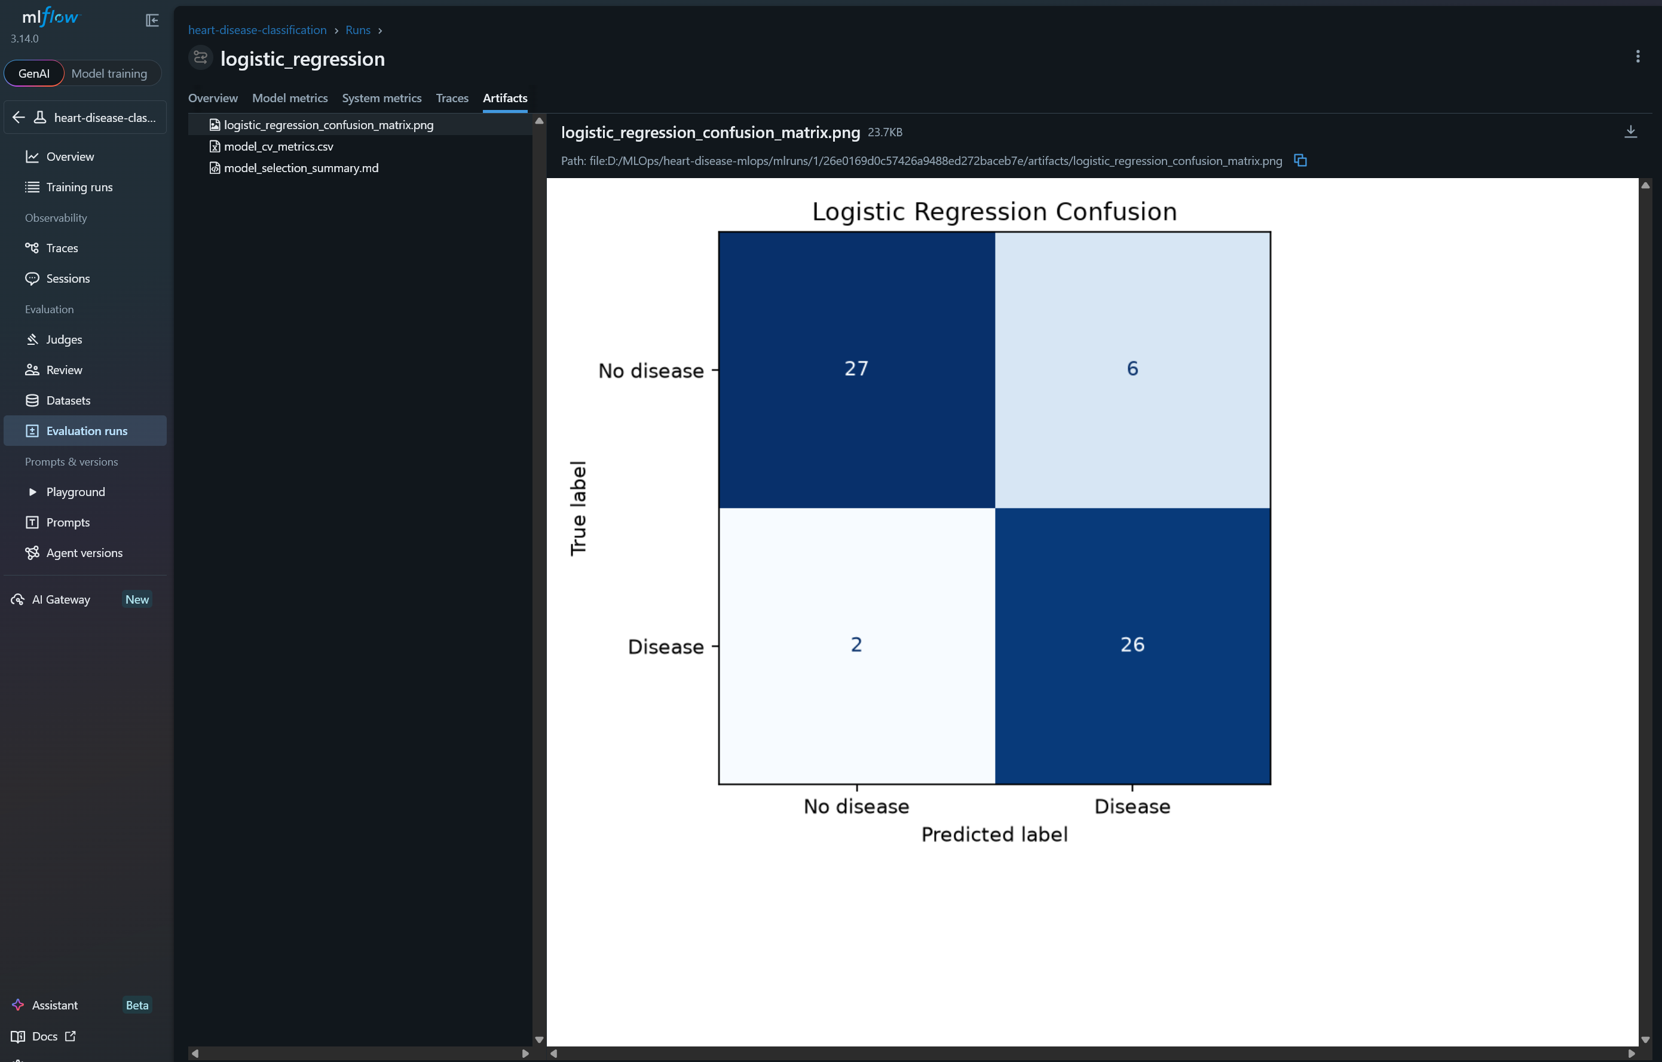
Model Comparison Results
5-fold Stratified Cross-Validation
Model | Accuracy | Precision | Recall | ROC-AUC
Logistic Regression | 0.8447 | 0.8475 | 0.8050 | 0.9188
Random Forest | 0.8416 | 0.8388 | 0.8127 | 0.9163
Selected model: Logistic Regression
Reason: highest ROC-AUC (0.9188)
Random Forest had slightly higher recall
Logistic Regression is easier to explain and deploy
Notes:
Walk through the metrics table and justify model selection.

Slide 7
Phase 3: MLflow Tracking
Experiment logging and comparison
Logged params, metrics, and artifacts per run
Compared logistic_regression vs random_forest
Saved confusion matrix and sklearn pipeline
MLflow UI used for experiment comparison
Experiment: heart-disease-classification
Notes:
Start mlflow ui and show runs table and artifacts.

Slide 8
Phase 4: Packaging
Reproducible model artifact
Saved full pipeline with joblib
Artifact: heart_disease_pipeline.joblib
Metadata: model_metadata.json
Sample input: sample_input.json
Fresh clone + requirements.txt reproduces model
Notes:
Run package_model and show saved artifacts.

Slide 9
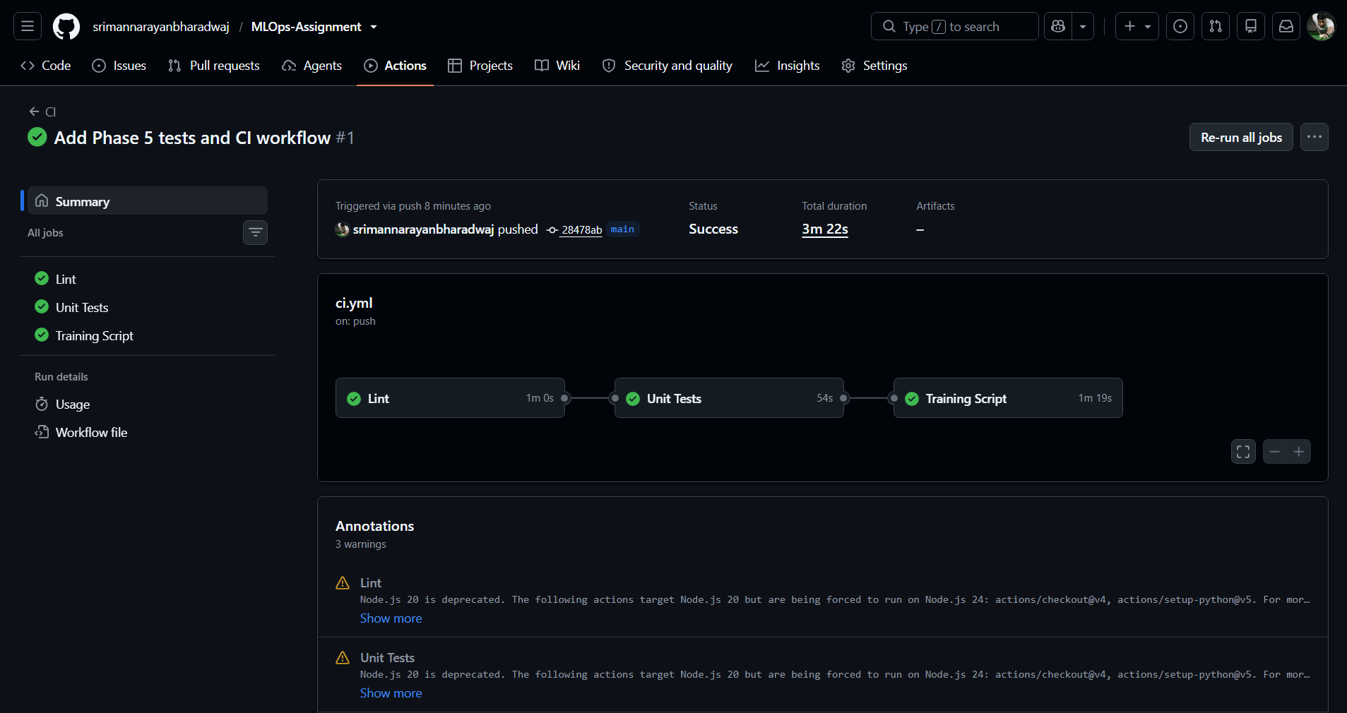
Phase 5: Tests and CI/CD
Automated quality checks on every push
test_data.py: null handling and target encoding
test_model.py: prediction shape and probabilities
test_api.py: /health and /metrics endpoints
GitHub Actions: lint -> pytest -> training job
CI ensures reproducibility and catches regressions
Notes:
Run pytest locally and show green Actions run in browser.

Slide 10
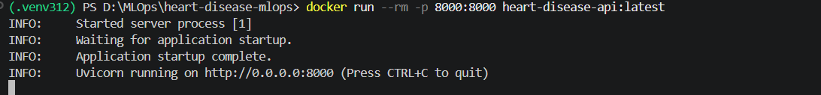
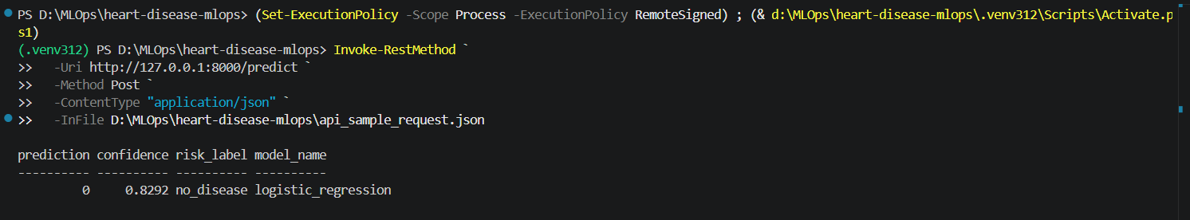
Phase 6: Docker + FastAPI
Containerized model serving
FastAPI endpoints: /health, /predict, /metrics
Dockerfile builds Python 3.12 image with model
docker build and docker run expose port 8000
Live prediction returns class + confidence
Example: prediction=0, confidence=0.8292
Notes:
Build image, run container, and call /predict live.

Slide 11
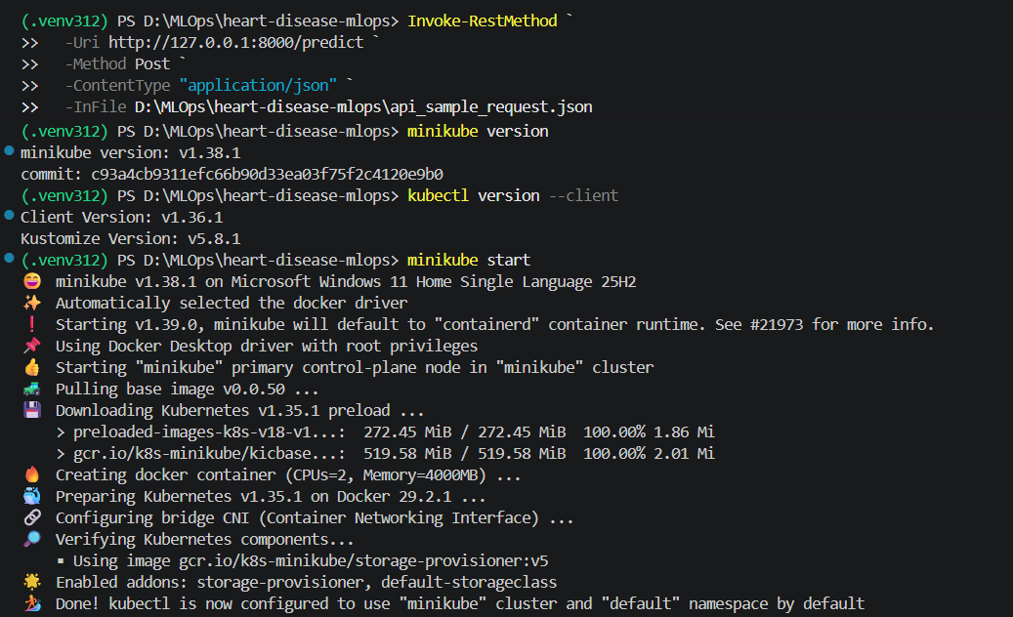
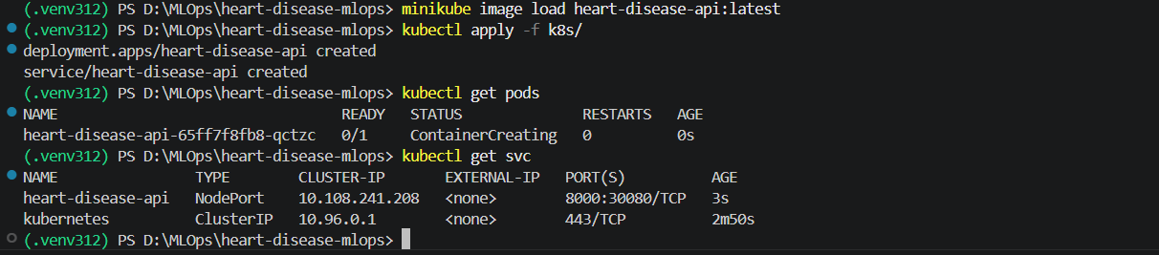
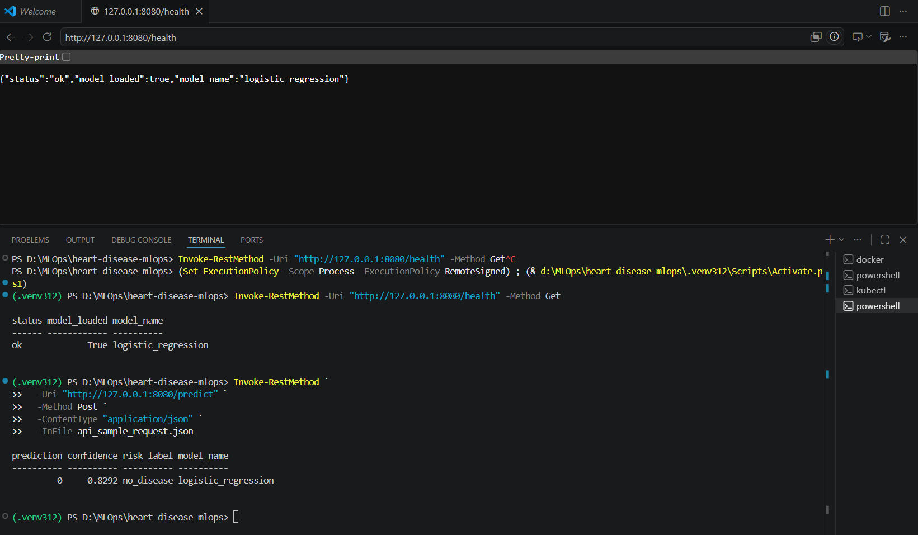
Phase 7: Kubernetes (Minikube)
Local cluster deployment
Deployment + Service YAML in k8s/
minikube image load imports local Docker image
kubectl apply deploys API to cluster
Readiness/liveness probes use /health
port-forward exposes service locally
Notes:
Show pod Running 1/1 and successful health response.

Slide 12
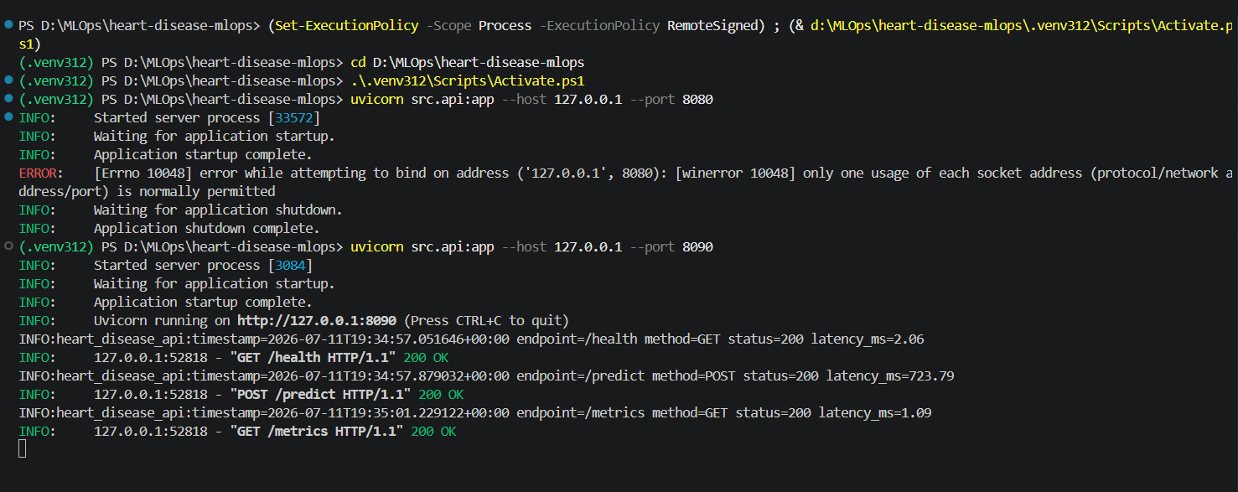
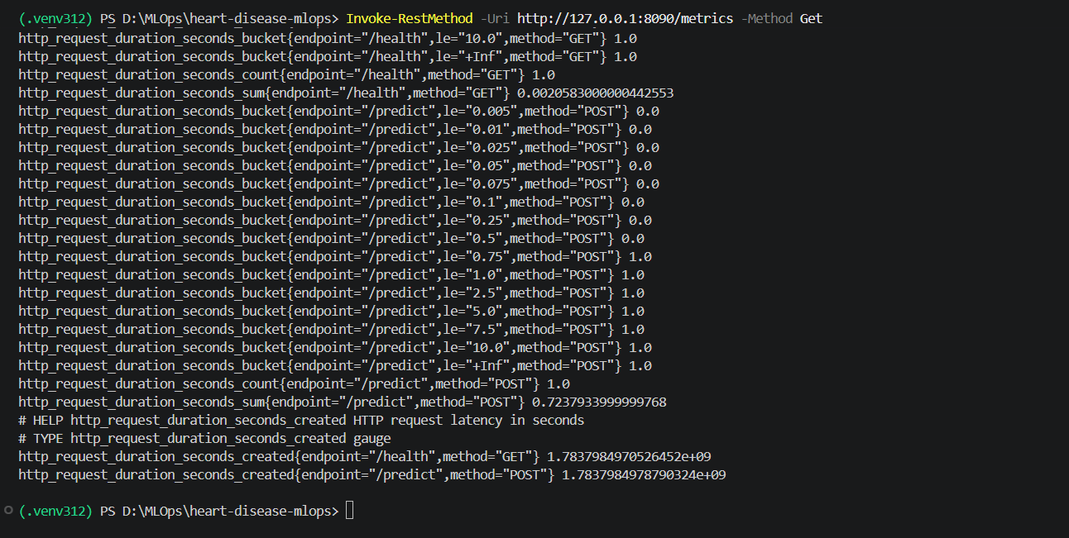
Phase 8: Monitoring
Logging and Prometheus metrics
Middleware logs timestamp, endpoint, latency
Logs help debug slow or failing requests
/metrics exposes Prometheus text format
Tracks request count and duration histograms
Supports production observability basics
Notes:
Start uvicorn, send requests, show logs and metrics.

Slide 13
System Architecture
End-to-end MLOps flow
UCI CSV | data_download.py -> cleaned dataset | eda.py + train.py -> MLflow + metrics | package_model.py -> joblib pipeline | FastAPI -> Docker -> Kubernetes | /predict /health /metrics GitHub Actions + pytest validate each stage
Notes:
Explain how each component connects from raw data to deployed API.

Slide 14
Challenges and Lessons Learned
Python 3.14 broke MLflow UI; Python 3.12 fixed it
Docker and Minikube port conflicts required alternate ports
Pinned requirements improved reproducibility across machines
MLflow simplified experiment comparison and artifact tracking
CI pipeline gave confidence that changes did not break the workflow
Notes:
Mention real issues you faced and how you solved them.

Slide 15
Conclusion
Project delivered end-to-end
Built full MLOps pipeline on UCI Cleveland Heart Disease data
Tracked experiments with MLflow and packaged the best model
Validated with pytest and GitHub Actions CI/CD
Deployed via Docker, Minikube/Kubernetes, and monitoring
Repository: github.com/srimannarayanbharadwaj/MLOps-Assignment
Thank you for watching
Notes:
Summarize all phases and repeat the GitHub repository link.

