Slide 1





Step I
Describing the problem and ER model with necessary assumptions
PROBLEM STATEMENT:
The following Entity Relationship(ER) model pictorially represents the working of a JoSAA (Joint Seat Allocation Authority) database which allots seats to students to premier institutes all over the country. JosAA is set up by the MHRD to allot seats in 100 institutes in India based on the RANK obtained in JEE Mains , CATEGORY and PREFERENCES. Several rounds of allotment take place to ensure that there aren't any vacancies. This database simulates the allotment results after one such round in this procedure.
GROUP MEMBERS:
MVS Srimanth (Btech, ECE 3rd year)
Souradeep Sarkar (Msc,Mathematics-2nd Year)
Course Instructor:
Dr. T Ramakrishnudu Assistant Professor .CSE Department.
P a g e 2

Slide 2
Legend for ER Diagram:
The -+ headed arrow directed towards an entity indicates cardinality one.
The -< headed arrow directed towards an entity indicates cardinality many.
( ) around an attribute marks it a compound/ composite attribute.
The 'o' beside an attribute means it is optional (can be NULL)
Other formalities follow according to standards mentioned.
Assumptions
We have made the following assumptions during the creation of our ER Diagram.
It is assumed that the student has obtained a unique rank in the JEE Mains
A college can be ranked by multiple organizations so that students can compare different institutes.
A region comprises of different colleges.
Students are also categorized into various regions for convenience in administration.
Administrators are allotted to each region who can log on to their regional part of the Database with their unique User id and password.
One student is given one username and password only.
An institute can have many branches.
Seats in a branch are divided into several categories ( EBC/ PWD/GEN)
Irrespective of the college allotted, all students belonging to a particular category and gender have to pay the same fee at the time of registration.
A student has the privilege to fill any number of preferences before allotment.
After all students have filled in their choices they are allotted 1 institute and branch or none.
They can change their status to FREEZE (Confirm option) or FLOAT (Wait for the next iteration).
In case all the preferences opted by a candidate are filled up, he will be allotted no seat.
Disclaimer: This mini project is not associated with JoSAA or with the MHRD or any of its associates in any respects. It is for student/course purpose only.
* ER Diagram overleaf *
P a g e 2

Slide 3
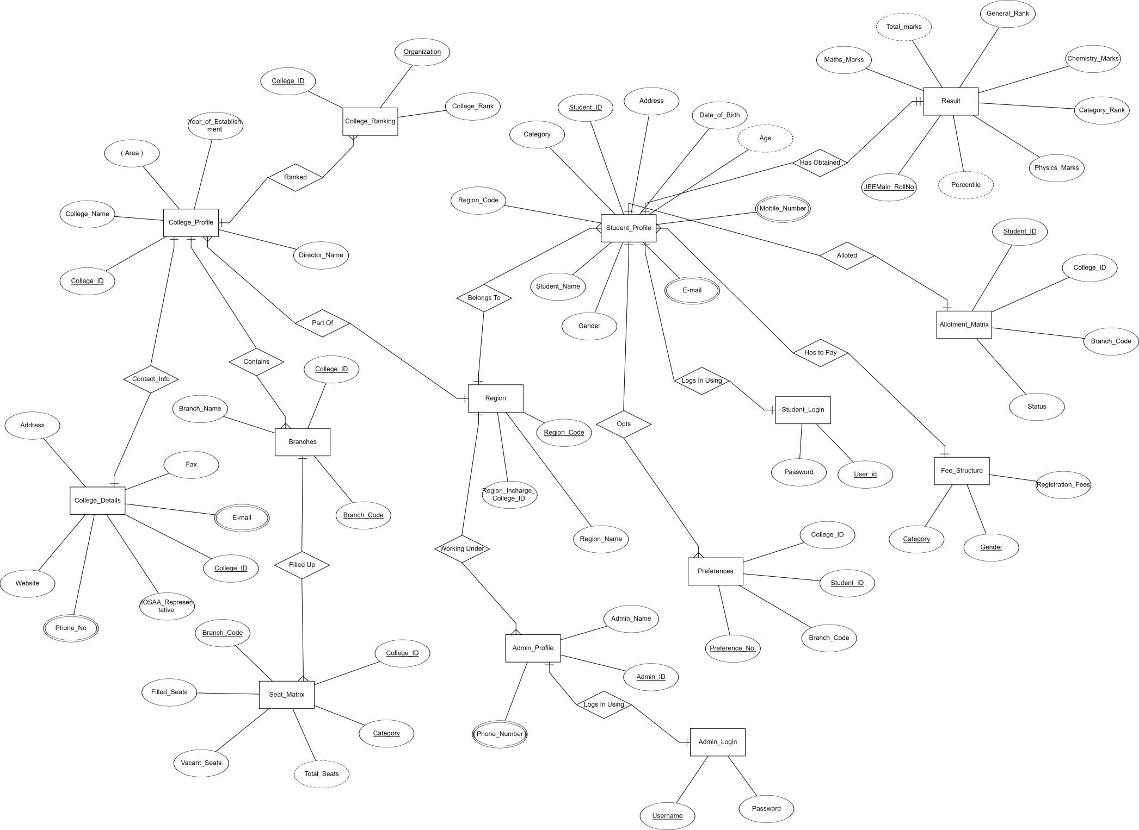

Slide 4
Step II:
Creating the Relational Schema from the ER Diagram and Normalizing the Tables so obtained
Overleaf are the expected tables that are created by observing the ER Model on the previous page.
Clearly the ER Model does not result in a 1NF Schema. This is due to non atomic attributes including Admin- Phone Number, StudentEmail_Id , Student Phone , College_Phone and College_Phone .(bearing multiple values)
So separate Relations to be created are:
StudentPhone (Student_ID,PhoneNumber)
StudentEmail(Student_ID,Email_ID)
CollegePhone (College_ID,PhoneNumber)
CollegeEmail(College_ID,Email_ID)
AdminPhone(Admin_ID,PhoneNumber)
AdminEmail(Admin_ID,Email_ID)
Now it is clear that the Relational Schema is at least in 1NF.
Checking for the Normal Form of Relations in Schema Overleaf
Based on our assumptions, the primary keys shown in the figure on the next page determine all the other attributes in all relational tables except in the ‘Branch_Details’ table.
(A detailed list of functional dependencies in all relations is given at the end)
So all the other relations are in BCNF. This will be satisfactory for the present. In ‘Branch_Details’ table, we have the following relations.
Branch_Code->Branch_Name
Branch_Code,College_ID->Branch_Name
Here there is a partial dependency on key attribute in first dependency.
So there is a need to decompose this relation into two smaller relations
BranchIndex(Branch_Code, Branch_Name )
CollegeBranches(College_ID,Branch_Code) Now the two relations are in BCNF and 3NF.
**Next page is the first set of relational tables followed by Functional Dependencies** (Schema I)
P a g e 4

Slide 5
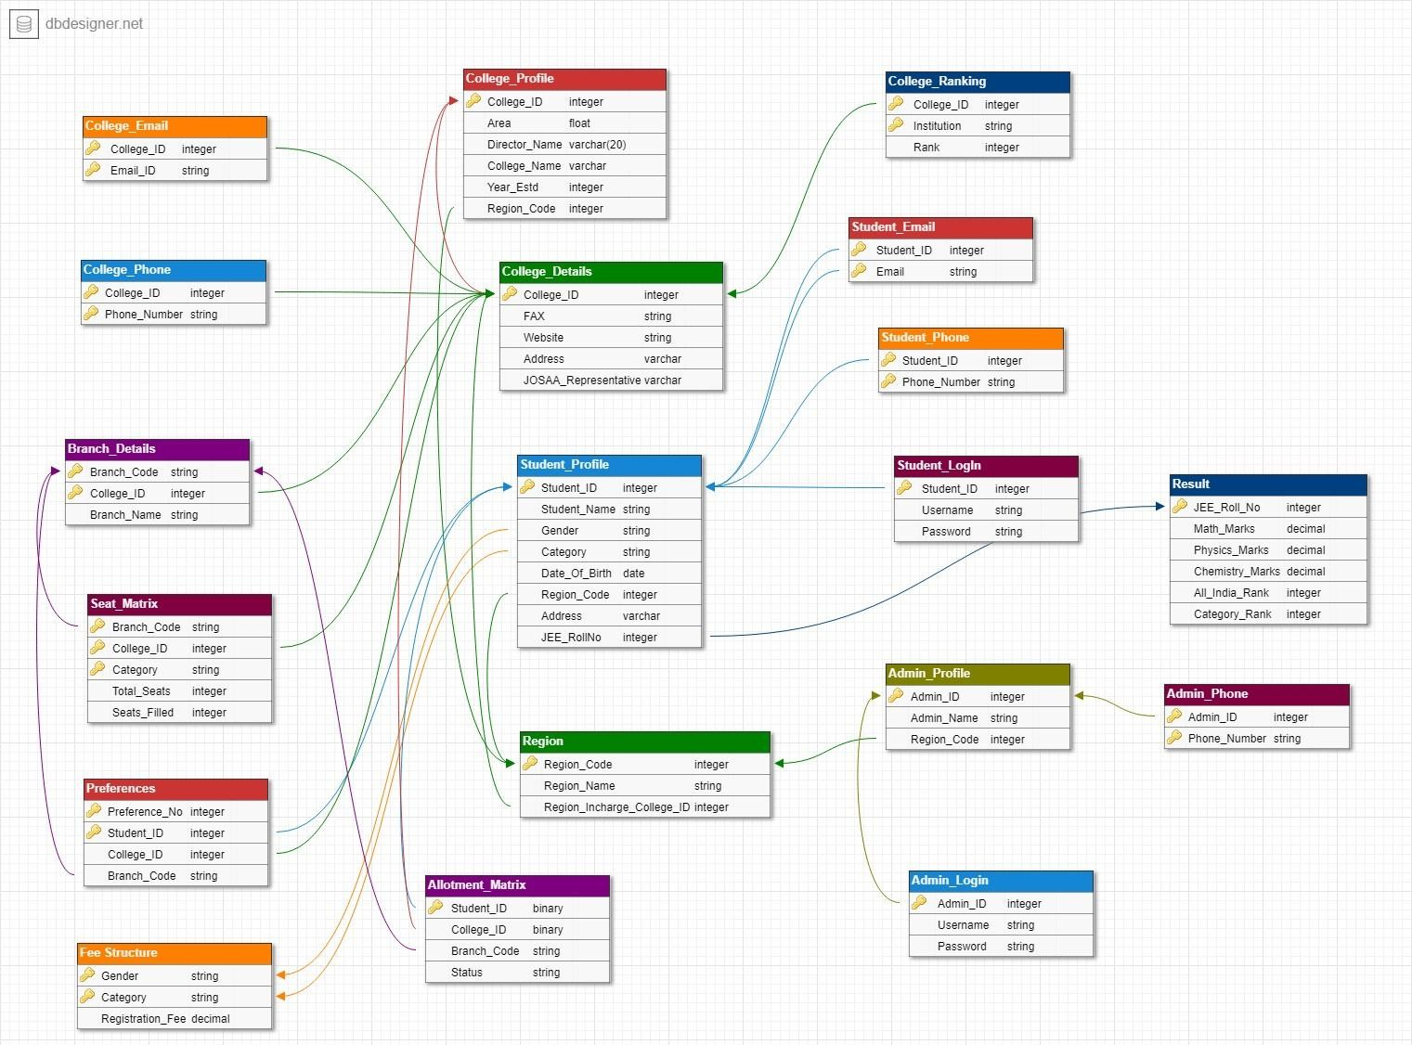

Slide 6
1. College_Profile (College_ID, Area, Director_Name, College_Name, Year_Estd, Region_Code)
FUNCTIONAL DEPENDENCIES:
College_ID→Area College_ID→Director_Name College_ID→College_Name College_ID→Year_Estd College_ID→Region_Code
2. College Details(College_ID, FAX, Website, Address, JOSAA_Representative)
FUNCTIONAL DEPENDENCIES:
College_ID→FAX College_ID→Website College_ID→Address College_ID→JOSAA_Representative
3. Student_Profile(Student_ID, Student_Name, Gender, Category, Date_of_Birth,
Region_Code, Address, JEE_Roll_No) FUNCTIONAL DEPENDENCIES:
Student_ID→Student_Name Student_ID→Gender Student_ID→Category Student_ID→Date_of_Birth Student_ID→Region_Code Student_ID→Address Student_ID→JEE_Roll_No
P a g e 6

Slide 7

4. Region(Region_Code,Region_Name,Region_Incharge_College_ID)
FUNCTIONAL DEPENDENCIES:
Region_Code→Region_Name Region_Code→ Region_Incharge_College_ID
^{5.} Allotment_Matrix(Student_ID,College_ID,Branch_Code,Status)
FUNCTIONAL DEPENDENCIES:
Student_ID→College_ID Student_ID→Branch_Code Student_ID→Status
6.
College_Ranking(College_ID,Institution, Rank)
FUNCTIONAL DEPENDENCIES:
{College_ID,Institution}→Rank
7.
Student_Email(Student_ID,Email)
8.
Student_Phone(Student_ID,Phone_Number)
9.
Student_Login(Student_ID,Username,Password)
FUNCTIONAL DEPENDENCIES:
Student_ID→Username Student_ID→Password
P a g e 6

Slide 8
Admin_Profile(Admin_ID,Admin_Name,Region_Code)
FUNCTIONAL DEPENDENCIES:
Admin_ID→Admin_Name Admin_ID→Region_Code
Admin_Profile(Admin_ID,Username,Password) FUNCTIONAL DEPENDENCIES:
Admin_ID→Username Admin_ID→Password
Result(JEE_Roll_No, Math_Marks,Physics_Marks,Chemistry_Marks,All_India_Rank,Category_Rank)
FUNCTIONAL DEPENDENCIES:
JEE_Roll_No→Math_Marks JEE_Roll_No→Physics_Marks
JEE_Roll_No→Chemistry_Marks JEE_Roll_No→All_India_Rank JEE_Roll_No→Category_Rank
13. Admin_Phone(Admin_ID,Phone_Number)
14. College_Email(College_ID,Email_ID)
15. College_Phone(College_ID ,Phone_Number)
FUNCTIONAL DEPENDENCIES:
College_ID→Phone_Number
P a g e 6

Slide 9
16. Branch_Details(Branch_Code,College_ID,Branch_Name)
FUNCTIONAL DEPENDENCIES:
{Branch_Code,College_ID}→ Branch_Name Branch_Code→Branch_Name
17. Seat_Matrix(Branch_Code,College_ID,Category,Total_Seats,Seats_Filled)
FUNCTIONAL DEPENDENCIES:
{Branch_Code,College_ID,Category}→Total_Seats
{Branch_Code,College_ID,Category}→Seats_Filled
18. Preferences(Preference_No,Student_ID,College_ID,Branch_Code)
FUNCTIONAL DEPENDENCIES:
{Preference_No,Student_ID}→College_ID
{Preference_No,Student_ID}→Branch_Code
19. Fee_Structure(Gender,Category,Registration_Fee)
FUNCTIONAL DEPENDENCIES:
{Gender,Category}→Registration_Fee
---------------------------------------------------------------------------------------------------------------------
P a g e 6

Slide 10
Denormalization for Less Redundancy
However the relational schema we developed earlier is in 3NF and BCNF, we still have redundancy.
In case of:
Insertions
Updations
Deletions
This is because one such relation College_Profile sharing a 1-1 relation with College_Details is unnecessary independently. Instead, we can have a merged relation as follows
College_Profile ( All attributes in College_Profile and College_Details)
The PK of this relation will be College_ID as it is the only unique identifier.
On similar note Student_Profile and Student_Login can be merged as:
Student_Profile(All Attributes of Student_Profile and Student_Login)
The PK of this relation will be Student_ID.
Also Admin_Profile and Admin_Login can be merged as :
Admin_Profile(All Attributes of Admin_Profile and Admin_Login)
The PK of this relation will be Admin_ID clearly.
Finally we have a relational schema with minimum redundancy.
This is an example where denormalization leads to better efficiency.
**Next page is the updated Relational schema along with the FD’s** (Schema II)
P a g e 1 0

Slide 11
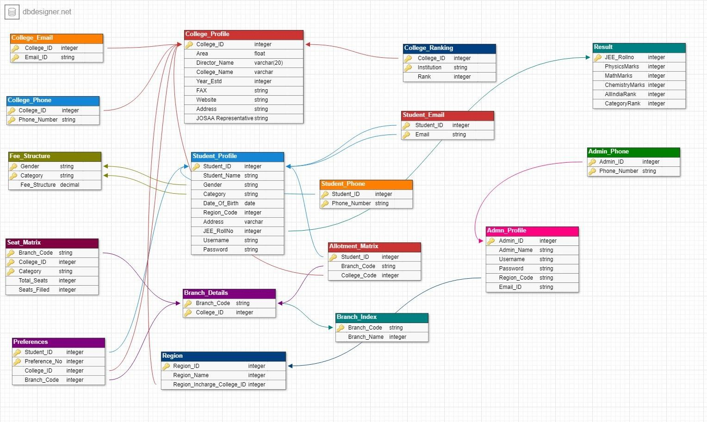

Slide 12
1. College_Profile (College_ID, Area, Director_Name, College_Name, Year_Estd, Region_Code,Websiite,Address,JOSAA_Representative,FAX)
FUNCTIONAL DEPENDENCIES:
College_ID→Area College_ID→Director_Name College_ID→College_Name College_ID→Year_Estd College_ID→Region_Code College_ID->FAX College_ID->Website
College_ID->JOSAA Representative College_ID->Address
2. Student_Profile(Student_ID, Student_Name, Gender, Category, Date_of_Birth,
Region_Code, Address, JEE_Roll_No,Username,Password) FUNCTIONAL DEPENDENCIES:
Student_ID→Student_Name Student_ID→Gender Student_ID→Category Student_ID→Date_of_Birth Student_ID→Region_Code Student_ID→Address Student_ID→JEE_Roll_No Student_ID->Username Student_ID->Password

Slide 13
3. Region(Region_Code,Region_Name,Region_Incharge_College_ID)
FUNCTIONAL DEPENDENCIES:
Region_Code→Region_Name Region_Code→ Region_Incharge_College_ID
4. Allotment_Matrix(Student_ID,College_ID,Branch_Code,Status)
FUNCTIONAL DEPENDENCIES:
Student_ID→College_ID Student_ID→Branch_Code Student_ID→Status
5. College_Ranking(College_ID,Institution, Rank)
FUNCTIONAL DEPENDENCIES:
{College_ID,Institution}→Rank
6. Student_Email(Student_ID,Email)
7. Student_Phone(Student_ID,Phone_Number)
Admin_Profile(Admin_ID,Admin_Name,Region_Code,Username,Password)
FUNCTIONAL DEPENDENCIES:
Admin_ID→Admin_Name Admin_ID→Region_Code Admin_ID->Username Admin_ID->Password
Result(JEE_Roll_No, Math_Marks,Physics_Marks,Chemistry_Marks,All_India_Rank,Category_Rank)

Slide 14
FUNCTIONAL DEPENDENCIES:
JEE_Roll_No→Math_Marks JEE_Roll_No→Physics_Marks
JEE_Roll_No→Chemistry_Marks JEE_Roll_No→All_India_Rank JEE_Roll_No→Category_Rank
10. Admin_Phone(Admin_ID,Phone_Number)
11. College_Email(College_ID,Email_ID)
College_Phone(College_ID ,Phone_Number)
FUNCTIONAL DEPENDENCIES:
College_ID→Phone_Number
nch_Details(Branch_Code,College_ID)
Branch_Index(Branch_Code,Branch_Name)
FUNCTIONAL DEPENDENCIES
Branch_Code->Branch_Name
15. Seat_Matrix(Branch_Code,College_ID,Category,Total_Seats,Seats_Filled)
FUNCTIONAL DEPENDENCIES:
{Branch_Code,College_ID,Category}→Total_Seats
{Branch_Code,College_ID,Category}→Seats_Filled
16. Preferences(Preference_No,Student_ID,College_ID,Branch_Code)

Slide 15
FUNCTIONAL DEPENDENCIES:
{Preference_No,Student_ID}→College_ID
{Preference_No,Student_ID}→Branch_Code
17. Fee_Structure(Gender,Category,Registration_Fee)
FUNCTIONAL DEPENDENCIES:
{Gender,Category}→Registration_Fee
---------------------------------------------------------------------------------------------------------------------

Slide 16
1/4

