Slide 1

Predictive Marketing Analytics for Term Deposit Subscriptions
Team Details:
Vaishnavi Koya – U01884267
Srimanth Madira – U01885136

Slide 2
Project Overview
Problem Statement: The challenge is understanding and foreseeing customer decisions regarding term deposit subscriptions. Identifying patterns and factors influencing these decisions will contribute to better-informed business strategies and decision-making processes.
Proposed Solution: To develop a classification model capable of predicting whether a customer is likely to subscribe to a term deposit based on their demographic and financial attributes.

Slide 3
Initial Hypothesis
Age-Investment Connection: Expect an inverse relationship between age and term deposit subscriptions, suggesting that older individuals exhibit a higher inclination for long-term investments.
Loan Impact: Suggest that customers with existing loans are less likely to subscribe to term deposits, indicating that the financial burden of loans influences investment decisions.
Call Duration Influence: Suggest that longer call durations positively correlate with term deposit subscription likelihood, indicating increased engagement during calls.

Slide 4
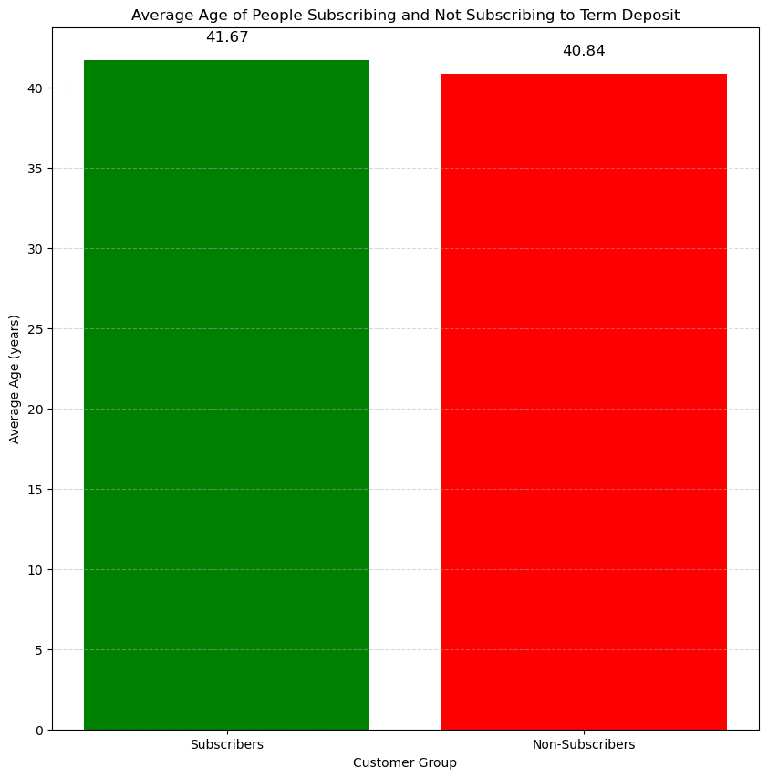
Key Insight 1
Average Age Insights:
Average Age of Subscribers: 41.67 years
Observation: Middle-aged individuals show a tendency to subscribe to term deposits.

Slide 5
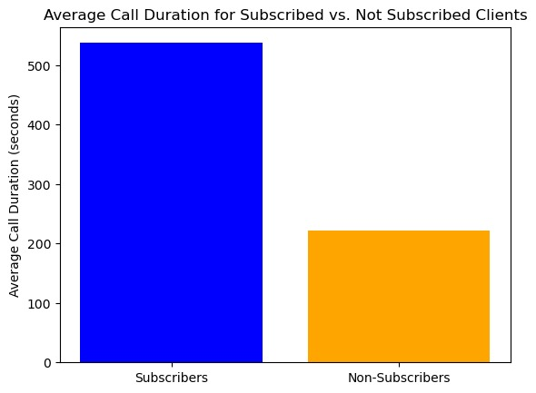
Key Insight 2
Average Call Duration Insights:
Average Call Duration for Subscribed Clients: 537.29 seconds
Average Call Duration for Not Subscribed Clients: 221.18 seconds
Observation: Subscribers tend to have significantly longer call durations compared to non-subscribers.

Slide 6
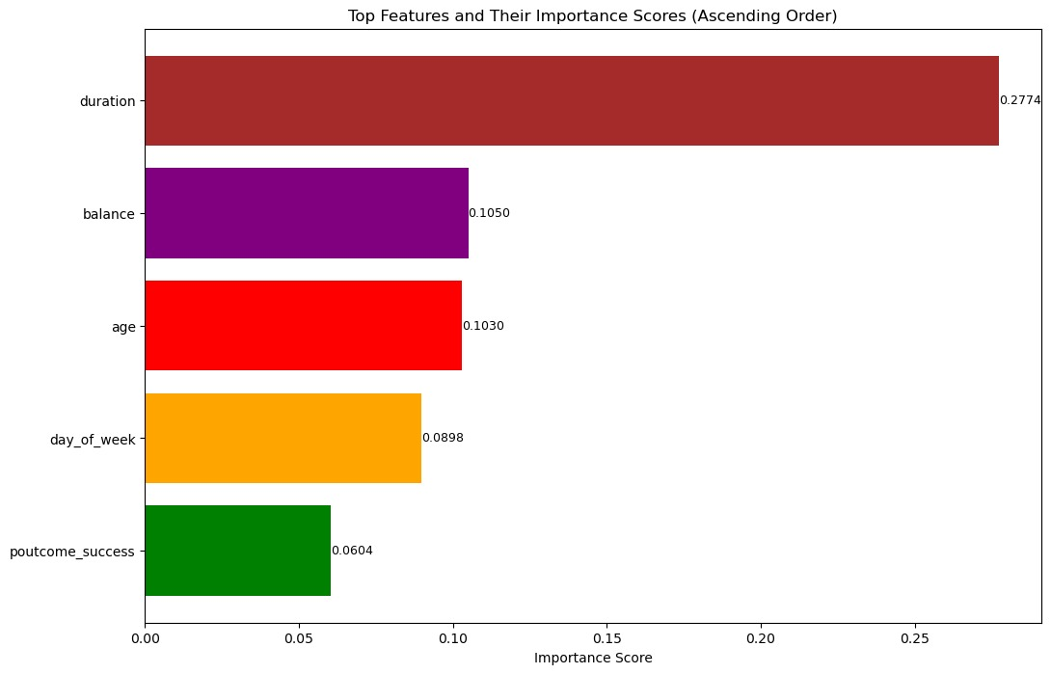
Feature Importance Analysis
Leveraged a Random Forest Classifier to quantify feature importance, highlighting key factors influencing term deposit subscriptions.

Slide 7
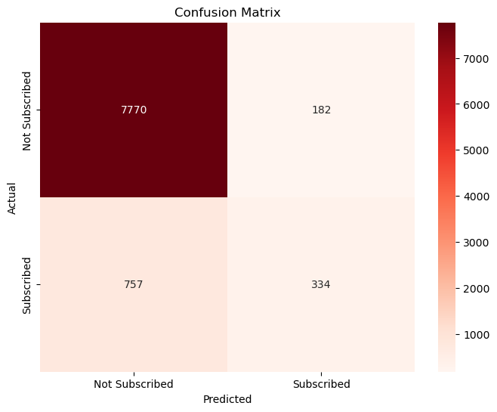
Model Implementation & Evaluation
Implemented Logistic Regression, a binary classification algorithm, using scikit-learn—a powerful Python machine learning library. The methodology involved standardizing numerical features and applying one-hot encoding to categorical variables for enhanced predictive performance.
Achieved an accuracy of 0.89 in model evaluation, indicating its effectiveness in predicting term deposit subscriptions.

Slide 8
Future Steps
Comprehensive Feature Analysis:
Conduct an in-depth analysis of the dataset to identify additional features that may have significant influence on the target variable ('y').
Implementation of Advanced Techniques:
Explore advanced ML techniques (ensemble methods, gradient boosting) for potential performance gains.
Investigate the integration of deep learning models to unlock further improvements.
Hyperparameter Optimization:
Refine your machine learning model by precisely tuning hyperparameters. Utilize grid or randomized search methods to identify optimal combinations, leading to substantial accuracy enhancements.
This analysis could involve exploring correlations, conducting statistical tests, and considering domain knowledge.
Fine-tune crucial parameters, such as regularization strength or learning rate, for improved overall model performance.

