Slide 1




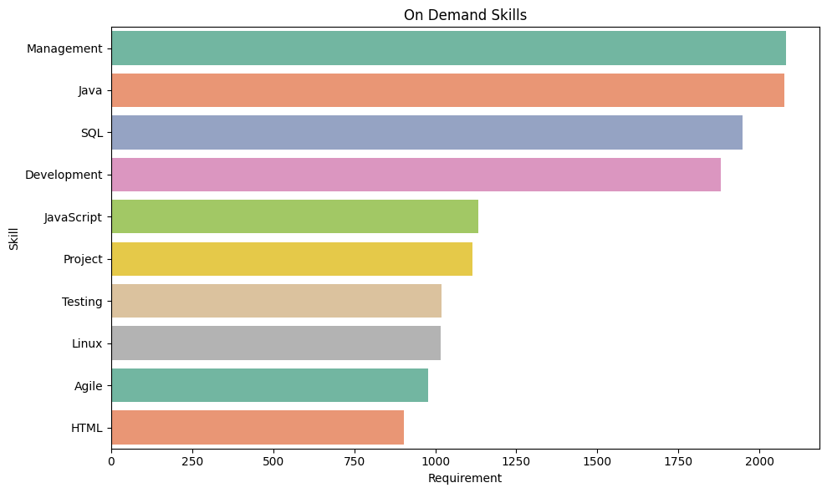
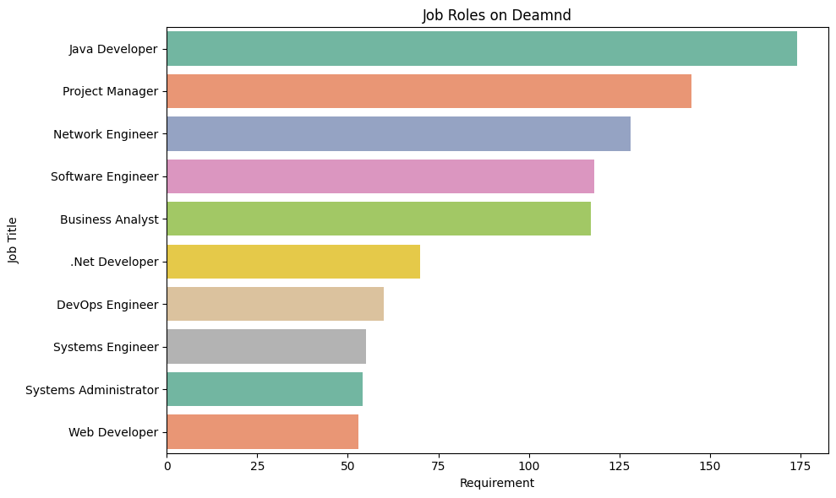
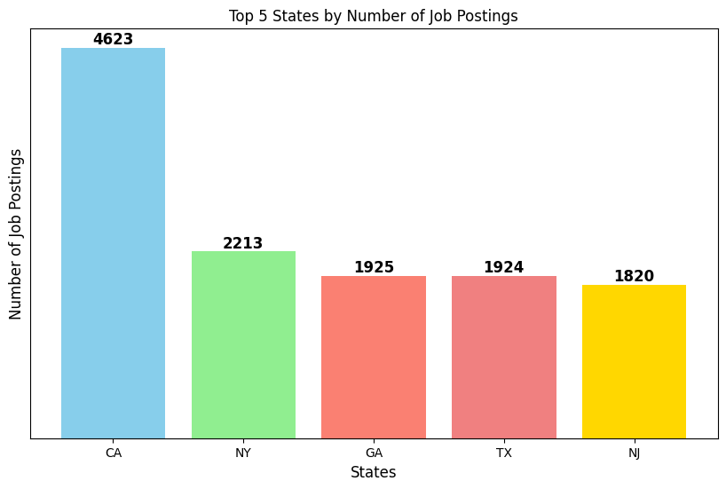
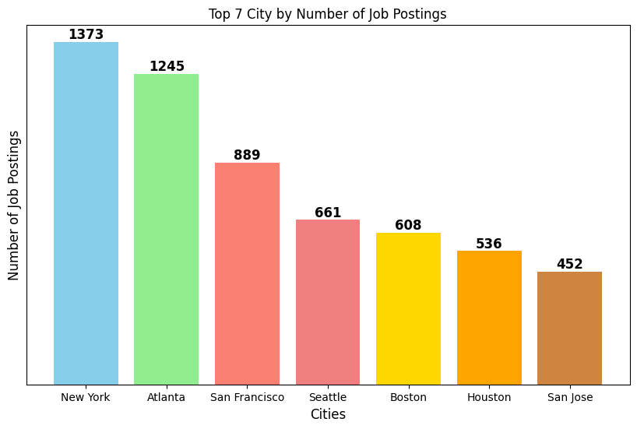
Job Navigator – Recommendation, Insights, Roadmap
Student: Srimanth Madira
Analytics Capstone Project, Pace University
Web application offering personalized job recommendations based on user skills.
Uses NLP techniques (Cosine similarity, TF-IDF) to match skills with job descriptions.
Provides additional features like Job Insights and Career Roadmaps.
Introduction
Data Preparation
Top 5 On Demand Skills
Conclusion
Dropped Unnecessary Columns: Removed irrelevant fields like job id and postdate to focus on essential data.
Handled Missing Values: Imputed missing data with the most frequent value to maintain consistency.
Skill Extraction and Cleanup: Split skills, flattened nested lists, removed unwanted keywords, and eliminated special characters to clean the skills data.
Address Parsing: Split job locations into city and state, filling missing states with a predefined dictionary.
Removed Invalid Rows: Removed rows with missing or irrelevant skills and logged them for reference.
Personalized Recommendations: The system leverages TF-IDF and cosine similarity to provide highly relevant job matches, helping users identify skill gaps and explore suitable career options.
Enhanced Usability: Features like career roadmaps and job insights add significant value, empowering job seekers to make informed decisions about their career paths.
Develop an interface that tailors job suggestions to the user's skills.
Identify key skills that enhance job.
Empower job seekers to make informed career decisions.
Objective
Top 5 On Demand Roles
Future Scope
Insights
Real-Time Data Integration: Use APIs from LinkedIn or Glassdoor to reflect current job market trends.
Advanced NLP Models: Implement BERT or GPT for better skill matching and more accurate recommendations.
User Feedback: Add a feedback system to refine recommendations based on user interactions.
Skill Gap Analysis: Suggest relevant courses or certifications to help users upskill for desired roles.
Top 5 States with Job Postings
Methods
Technology Stack: The web app uses Python and Flask for the backend, HTML and CSS for the frontend.
Recommendation Algorithm: The system matches user skills with job descriptions using similarity methods: Cosine Similarity, Cosine Similarity with TF-IDF, and Jaccardian Similarity.
Cosine Similarity: Measures the angle between vectors to assess document similarity, but had limitations in capturing nuanced relationships.
Cosine Similarity with TF-IDF: Improved accuracy by highlighting significant words, enhancing semantic understanding and recommendation quality.
Jaccardian Similarity: Based on set intersection/union, but struggled with capturing semantic relationships, less effective than TF-IDF.
Workflow: The process includes data collection, preprocessing (tokenization, stop-word removal, TF-IDF), similarity calculation, and job recommendation generation.
Sources
Limitations
Cheng, H., Lee, S., & Smith, J. (2019). Improving Job Recommendations Using Cosine Similarity and TF-IDF. Journal of Artificial Intelligence and Job Matching, 34(2), 215-230.
Kuhn, A., & O'Rourke, P. (2021). Natural Language Processing for Job Matching: An Overview. Career Development Journal, 29(4), 321-335.
Singh, M., & Gupta, V. (2020). Integrating Job Preferences into Career Recommendation Systems. Journal of Career Development and Technology, 13(1), 45-58.
Johnson, L., & Ellis, R. (2018). Leveraging Data Analytics for Personalized Job Recommendations: A Review of Recent Advances. International Journal of Data Science and Career Planning, 12(3), 78-92.
Kumar, P., & Sharma, V. (2017). Cosine Similarity Based Recommendation Systems: A Comprehensive Survey. Journal of Computational Intelligence, 18(4), 402-418.
Top 7 Cities with Job Postings
Dataset Limitation: Relies on the quality and recency of the dataset, affecting recommendations.
Skill Overlap: Common skills lead to generalized job suggestions.
User Input Issues: Misspelled or non-standard terms reduce accuracy.
Static Data: No real-time job postings or trends.
Match Threshold: Relevance threshold may exclude or include irrelevant jobs.
RESEARCH POSTER PRESENTATION TEMPLATE © 2019
www.PosterPresentations.com

