Slide 1
TEXT TO IMAGE USING STACK-GAN
PRESENTED BY: SRIMATHI S
REGISTER NO:711721243107
DEPARTMENT:ARTIFICIAL INTELLIGENCE AND DATA SCIENCE
3/21/2024 Annual Review

Slide 2
PROJECT TITLE TEXT TO IMAGE USING STACK-GAN
3/21/2024 Annual Review

Slide 3


AGENDA 1. Problem statement 2. Project overview 3. Who are the end users? 4. Solution and its value proposition 5. The wow in my solution 6. Modelling 7. Result 8.Conclusion
3/21/2024 Annual Review

Slide 4

PROBLEM STATEMENT The goal of this project is to create a text-to-image model using Stack-GAN that can generate high-quality images from textual descriptions. The problem is that current text-to-image models are limited in their ability to generate realistic and diverse images, and often produce images that are overly simplistic or lacking in detail. This can be a major challenge for applications such as product design, advertising, and entertainment, where high-quality images are essential for success.
3/21/2024 Annual Review

Slide 5

PROJECT OVERVIEW The Text-to-Image Generation using Stack-GAN project is a cutting-edge technology that uses Generative Adversarial Networks (GANs) to generate images from textual descriptions. This project leverages the power of deep learning to create realistic and diverse images that can be used in a variety of applications, such as advertising, entertainment, and education.
3/21/2024 Annual Review

Slide 6

WHO ARE THE END USERS?
E-commerce Platform Developer
Content Creator
Virtual Environment Creator
Interior Designer
Architect
3/21/2024 Annual Review

Slide 7

SOLUTION AND ITS VALUE PROPOSITION
Solution:
The Stack-GAN model architecture comprises Stage-I and Stage-II generators, along with a discriminator, all integrated with conditional GANs to incorporate text embeddings. Preprocessing involves tokenizing, embedding, and resizing/normalizing textual descriptions and images. Stage-I generator is trained to produce low-resolution images from text, serving as an initial approximation. Stage-II generator refines these low-res images into high-res ones for greater quality. Meanwhile, the discriminator learns to distinguish real from generated images, providing feedback for improvement. Adversarial training optimizes both generators and discriminator concurrently.
Value Proposition:
Realistic image generation
Flexibility and customization
Efficient and scalable
3/21/2024 Annual Review

Slide 8

THE WOW IN MY SOLUTION
By utilizing a two-stage generation process, Stack-GAN aims to address the challenge of generating high-quality images from text descriptions. The refinement stage allows for fine-tuning of details and textures, resulting in images that closely match the provided textual descriptions.
3/21/2024 Annual Review

Slide 9
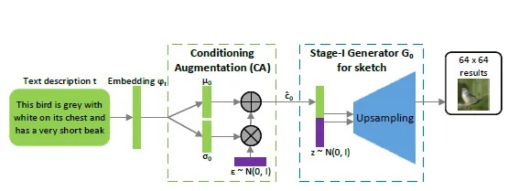
MODELLING
Data Collection: Gather a dataset containing pairs of text descriptions and corresponding images. This dataset could be specific to your application domain, such as birds, flowers, or scenes.
Preprocessing:
Tokenize and encode the text descriptions.
Resize and normalize the images to a fixed size suitable for processing.
Model Architecture Design:
Implement a Stack-GAN architecture consisting of Stage-I and Stage-II generators.
Design the generators to take text embeddings as input and generate images.
Use conditional GANs to condition the generation process on the text descriptions.
3/21/2024 Annual Review

Slide 10
4.Training:
Train the Stack-GAN model using the text-image pairs from the dataset.
Utilize adversarial training to train the generators and discriminators simultaneously.
Use techniques like minibatch discrimination and feature matching to stabilize training.
5.Evaluation:
Evaluate the quality and diversity of generated images using metrics like Inception Score (IS) and Fréchet Inception Distance (FID).
Conduct qualitative assessment by visually inspecting the generated images.
6.Fine-tuning and Optimization:
Adjust model hyperparameters based on evaluation results to improve performance.
Fine-tune on specific datasets or adjust architecture as needed.
7.Deployment:
Once trained, deploy the Stack-GAN model in applications where text-to-image generation is required.
3/21/2024 Annual Review

Slide 11
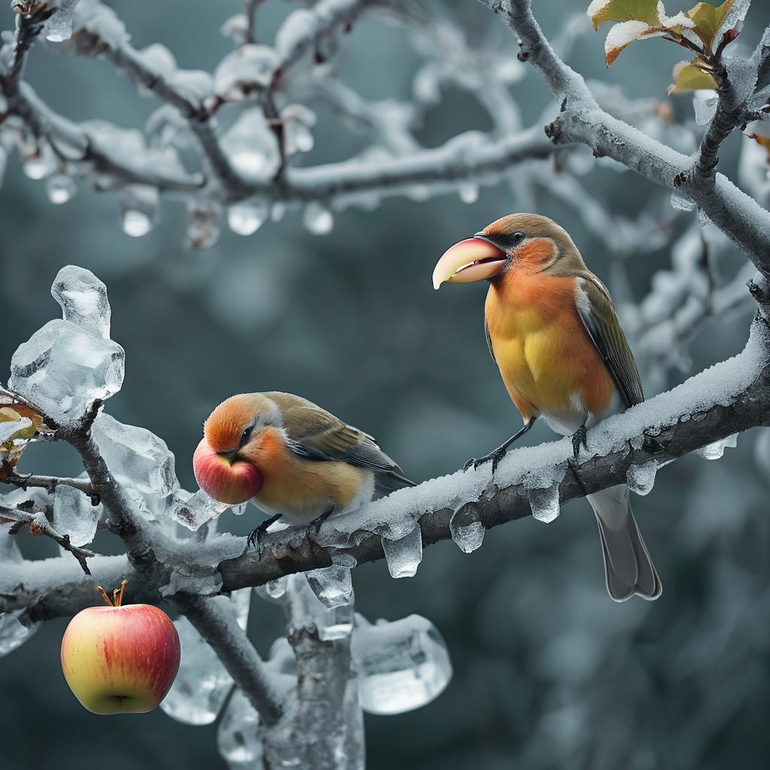
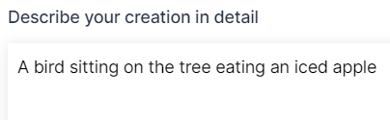
RESULT
3/21/2024 Annual Review

Slide 12
CONCLUSION
My project on building a text-to-image generation system using Stack-GAN highlights the power and effectiveness of this state-of-the-art model. Stack-GAN offers a hierarchical architecture with Stage-I and Stage-II generators, allowing for the generation of high-quality images from textual descriptions.
By incorporating text embeddings and utilizing conditional GANs, Stack-GAN ensures that the generated images are semantically relevant to the input text, resulting in coherent and interpretable results.
Through preprocessing, training, and evaluation steps, we can fine-tune the model to produce images that closely match the provided descriptions, achieving impressive levels of realism and diversity.

