Slide 1
E-Commerce Analysis by V. S. Srimathi

Slide 2
CONTENT
Problem Statement
Tools used
Approaches
EDA
Conclusion

Slide 3
Problem Statement
The project aims to provide actionable insights that can inform strategic decisions and optimizations for businesses
operating in the e-commerce sector, as well as enhance the shopping experience for consumers to their
preferences and needs.

Slide 4
Tools used
Programming Languages:
Python: Widely used for its extensive libraries and frameworks, including TensorFlow, PyTorch, scikit-learn, and more.
Data Processing and Analysis:
NumPy: Essential for numerical computing in Python, providing support for large, multi-dimensional arrays and matrices.
pandas: A data manipulation and analysis library for Python, commonly used for handling structured data.
Visualization:
Matplotlib: A plotting library for creating static, animated, and interactive visualizations in Python.
Seaborn: Built on top of Matplotlib, Seaborn provides a high-level interface for drawing attractive statistical graphics.
Jupyter Notebooks:
Interactive notebooks that allow combining live code, equations, visualizations, and narrative text. Popular for data exploration and analysis.
Version Control:
Git: Widely used for version control and collaborative development of machine learning projects.

Slide 5
APPROACHES
Define Business case/Problem Statement
Import basic Libraries
Load Data
Domain Analysis
Basic Checks
Exploratory Data Analysis

Slide 6
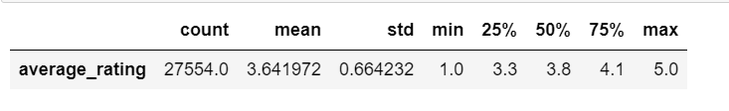
Descriptive Statistics
The count indicates the number of data points or observations in the dataset, which in this case is 27,554.
The mean (average) rating is approximately 3.64 out of 5, suggesting that, on average, the ratings are positive.
The standard deviation is 0.66, indicating the dispersion or variability of ratings around the mean.
The minimum rating is 1.0, and the maximum rating is 5.0, indicating that the ratings range from 1 to 5.
The median (50th percentile) rating is 3.8, which suggests that half of the ratings are below 3.8 and half are above.
The 25th percentile (Q1) is 3.3, indicating that 25% of the ratings are below 3.3.
The 75th percentile (Q3) is 4.1, indicating that 75% of the ratings are below 4.1.

Slide 7
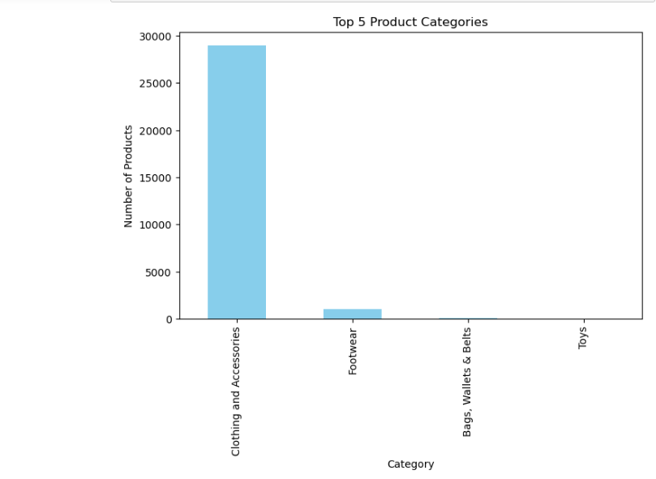
Top 5 Product Categories
It is evident from the data that the most popular category is Clothing and Accessories, followed by Footwear.

Slide 8
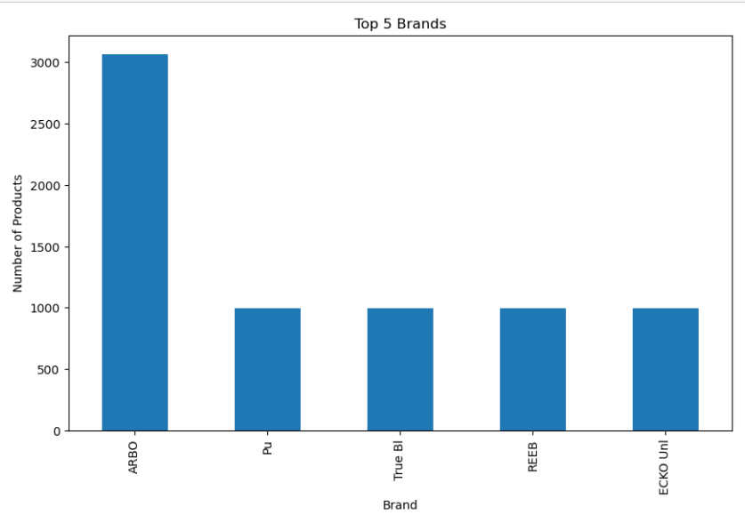
Top 5 Brands
It is clear from the data that the top 5 brands are here, among them ARBO is the top most of all.

Slide 9
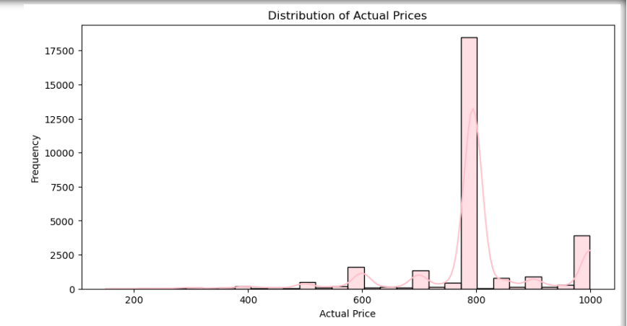
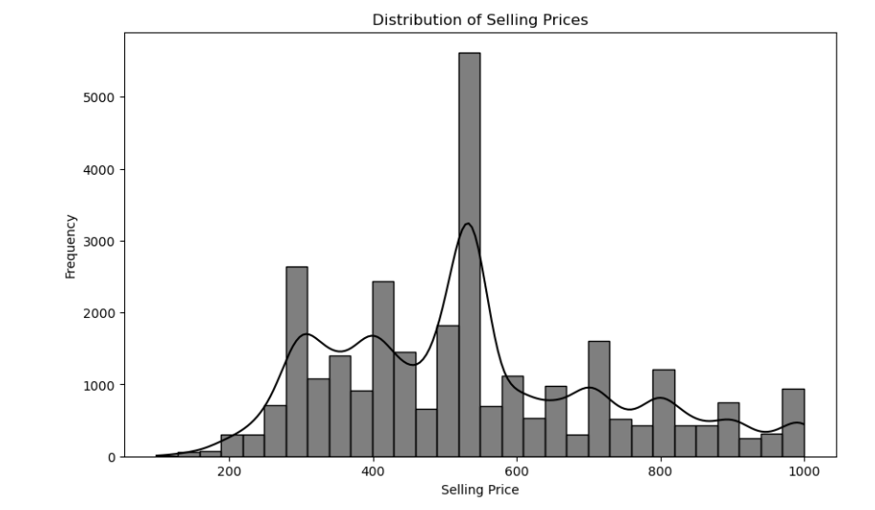
Actual_price
selling prices
The most common price point is around $500. This suggests that there were a lot of items that sold in this price range. The distribution is also somewhat skewed to the right, which means that there are more items sold at lower prices than at higher prices.
The distribution appears to be somewhat symmetrical, which means that there are about the same number of products sold at lower prices as there are sold at higher prices. The price range with the most products sold is between $200 and $400. There are also a few products that sold for much higher prices (around $800).

Slide 10
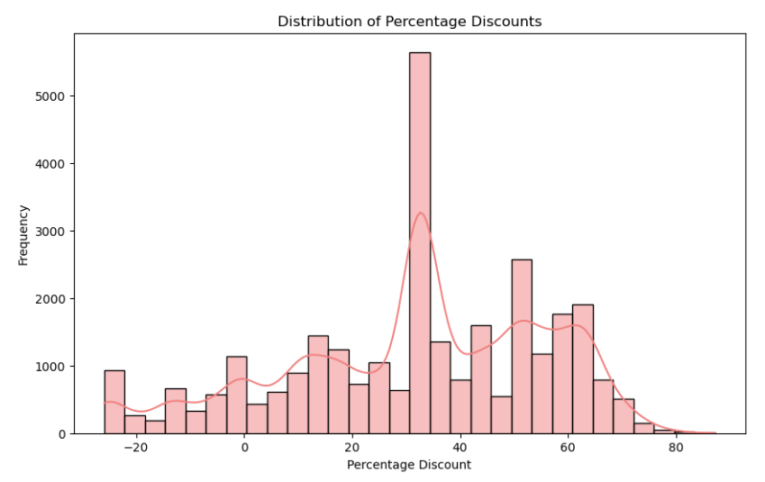
Percentage Discounts
* The most frequent discounts are between 20% and 40%. This suggests that a significant portion of the items were sold at a discount within this range.
* The graph slopes off to the right, indicating that some items were discounted by more than 40%. There are even a few discounts exceeding 60%.
* Fewer items were discounted less than 20%. There’s a small peak around 0%, indicating a small number of items that were sold at no discount (full price).

Slide 11
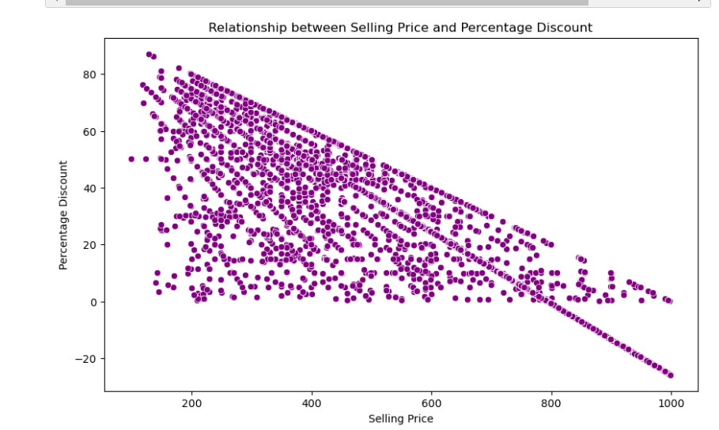
Relationship between Selling Price and Percentage Discount
The graph you sent shows a negative correlation between the selling price and the percentage discount. This means that as the percentage discount increases, the selling price decreases. This is a logical relationship because a higher discount means a larger reduction in price from the original price.

Slide 12
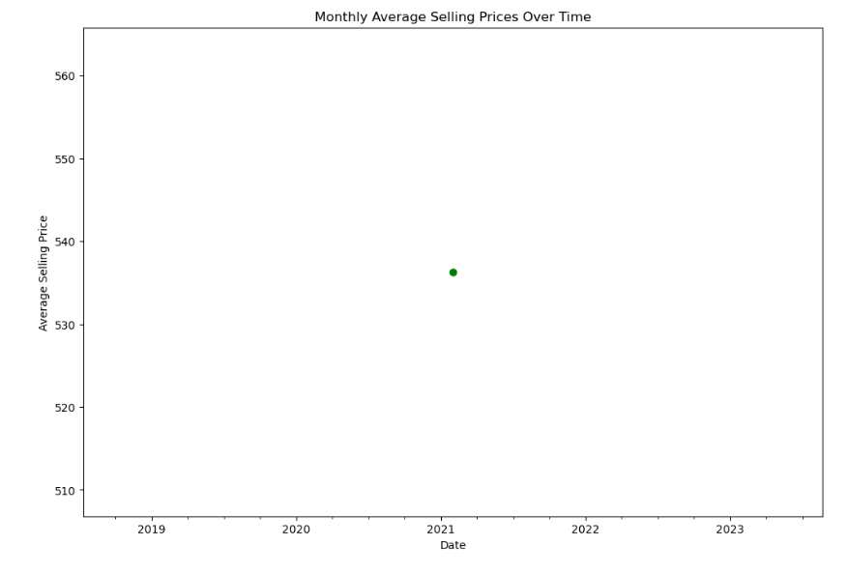
Time-based analysis of pricing trends
The average selling price appears to be increasing over time. There are fluctuations in the average selling price from month to month, but the overall trend is upward. we can see that in the year 2021 the selling is at top.

Slide 13
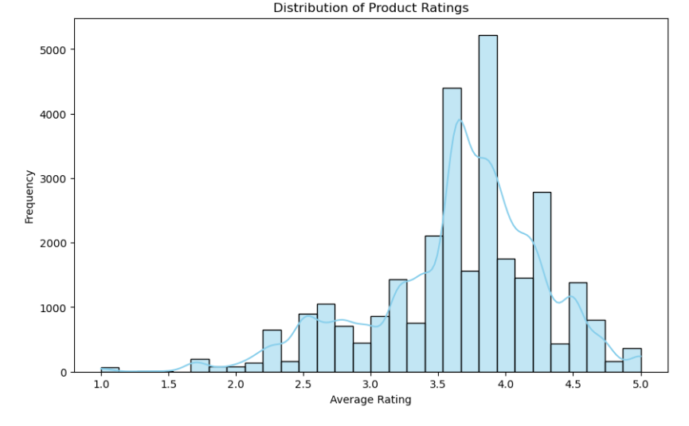
Product Ratings
* The most frequent rating is 4.0, followed by 5.0. This suggests that most people who rated the product gave it a positive review.
* There are very few ratings of 1.0 or 2.0. This suggests that very few people who used the product disliked it.
* The distribution is centered around the average rating, which means that there is not a strong skew towards positive or negative reviews.

Slide 14
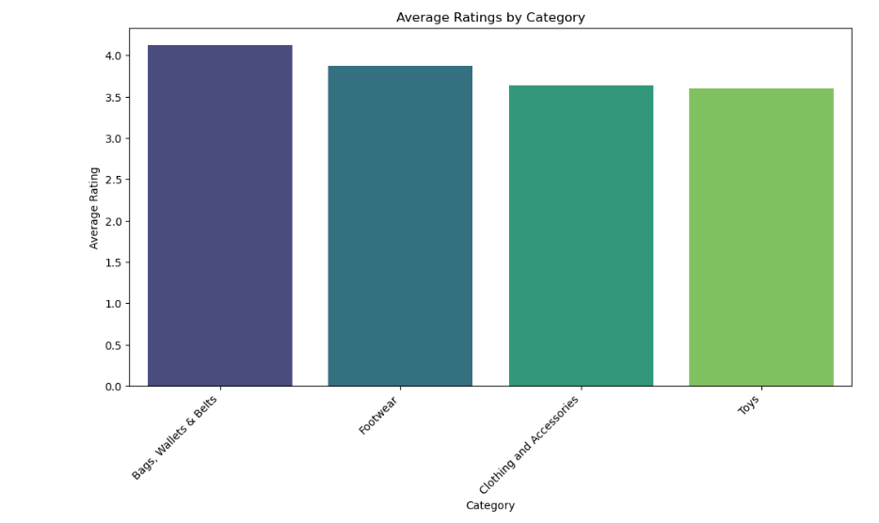
Average ratings by category
* The category with the highest average rating is "Bags, Wallets & Belts" at 4.0. This suggests that customers are most satisfied with products in this category.
* On the other hand, the category with the lowest average rating is "Toys".

Slide 15
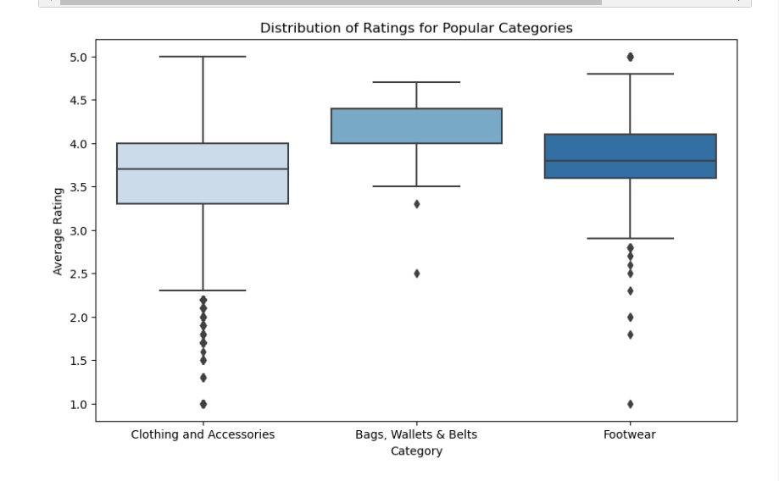
Distribution of Ratings for Popular Categories
* ”Clothing and Accessories” category, some items received much higher ratings than others, whereas ratings in the ”Footwear” category appear to be more clustered around the average.
* The ”Bags, Wallets & Belts” category has the highest average rating, followed by ”Clothing and Accessories” and ”Footwear”. This suggests that customers are generally more satisfied with bags, wallets, and belts than with the other two categories.

Slide 16
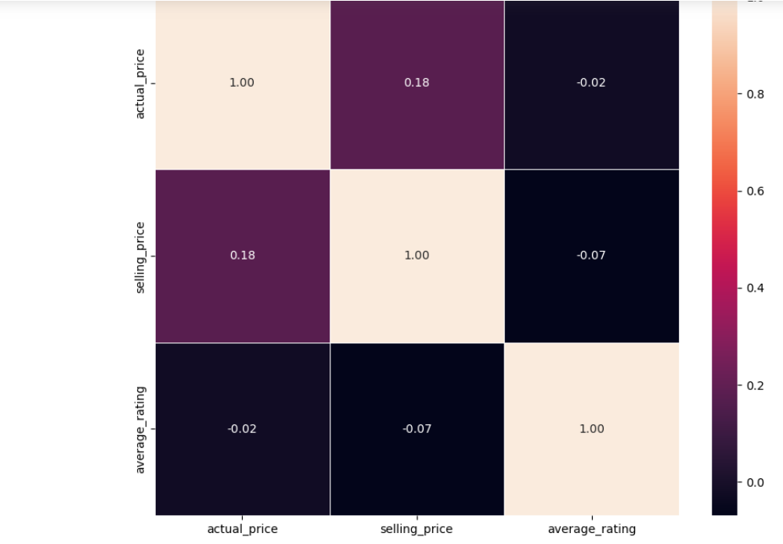
Correlation Matrix
There seems to be a positive correlation between the two variables.
This means that as the average rating increases, the actual price also tends to increase.
There may be some highly-rated products that are available at a lower price point, and there may be some lower-rated products that are more expensive.

