Slide 1
Digital Portfolio
STUDENT NAME: SRIMATHI M
REGISTER NO AND NMID: 2428C0220 & asbruaj2428c0220
DEPARTMENT : School of Computer science COLLEGE :AVP College of Arts and Science Afﬁliated by Bharathiyar University

Slide 2
PROJECT TITLE
STUDENT DIGITAL PORTFOLIO

Slide 3
AGENDA
Problem Statement
Project Overview
End Users
Tools and Technologies
Portfolio design and Layout
Features and Functionality
Results and Screenshot
Conclusion
Github Link

Slide 4
Problem Statement
Students need a simple, organized way to showcase their skills and achievements digitally, as traditional methods are often scattered and hard to access. A digital portfolio helps students present their work clearly, track their growth, and share their accomplishments with teachers and potential employers.

Slide 5
Project Overview
This project is a responsive and interactive digital portfolio for a Web Developer and Designer skilled in HTML, CSS, JavaScript, PHP, and Java. It features responsive layouts, e-commerce storefronts, interactive forms with validation, event countdown widgets, and prototype landing pages. The portfolio includes smooth scroll navigation, fade-in animations, and a contact form with validation. It highlights key academic qualifications and professional testimonials, effectively showcasing skills, projects, and achievements in a clean and user-friendly website.

Slide 6
The End Users
Students looking to showcase their skills, projects, and achievements
Educators and academic assessors evaluating student progress
Potential employers seeking to review candidate portfolios
Peers and collaborators interested in learning about the student’s work
Clients or stakeholders reviewing project demonstrations and prototypes

Slide 7
Tools And Techniques
Tools:
HTML, CSS for responsive and styled webpage layouts
JavaScript for interactivity, animations, and form validation
APIs integration for custom event countdown widgets
Code editors and version control systems for development workflow
Techniques:
Responsive web design for multi-device compatibility
Scroll-triggered animations to enhance user engagement
Smooth scrolling navigation for better user experience
Client-side form validation with user feedback
Modular and organized code structure for maintainability

Slide 8
Portfolio Design And Layout
Clean and modern design focused on readability and ease of navigation
Responsive layout ensuring compatibility across desktops, tablets, and mobiles
Use of fade-in animations triggered by scrolling to create dynamic user engagement
Organized sections for skills, project highlights, academic qualifications, and testimonials
Smooth scrolling navigation for seamless movement between sections
Simple, intuitive contact form integrated for easy communication

Slide 9
Features And Functionality
Responsive design for optimal viewing on all devices
Scroll-triggered fade-in animations for engaging content display
Smooth scrolling navigation between sections
Contact form with client-side validation and submission feedback
Sections for showcasing skills, portfolio highlights, academic background, and testimonials
Integration of custom widgets, such as event countdown timers
Clean, modular code structure for easy maintenance and updates

Slide 10
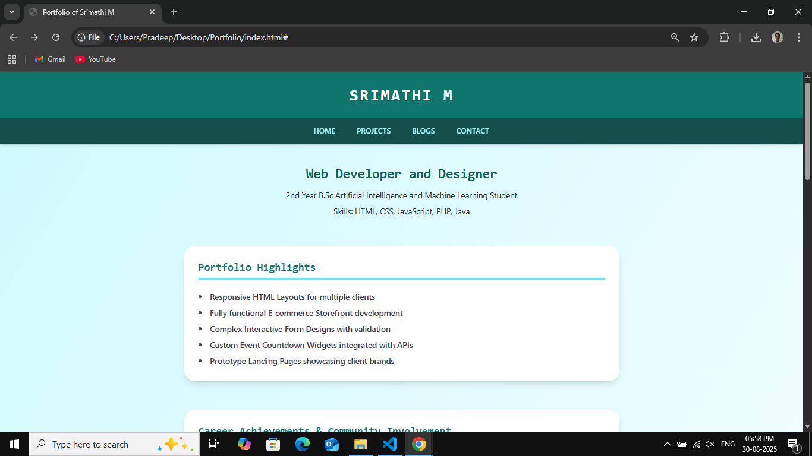
Results And Screenshots

Slide 11
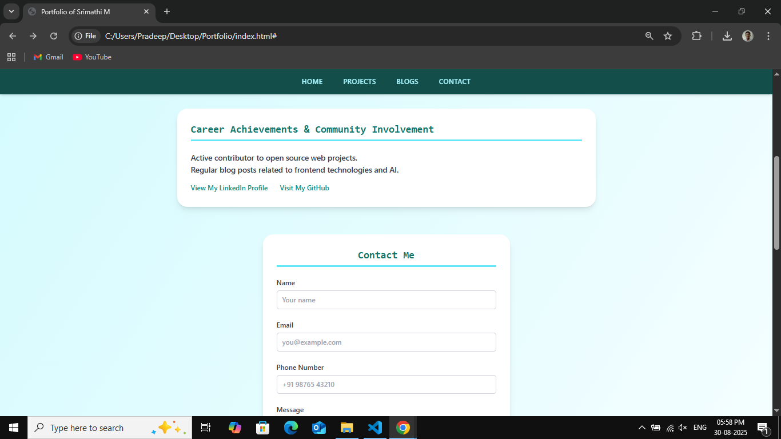
Results And Screenshots

Slide 12
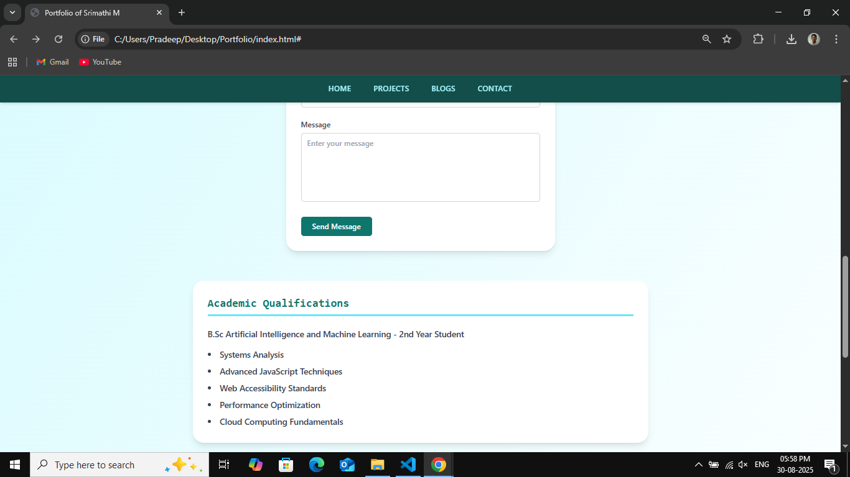
Results And Screenshots

Slide 13
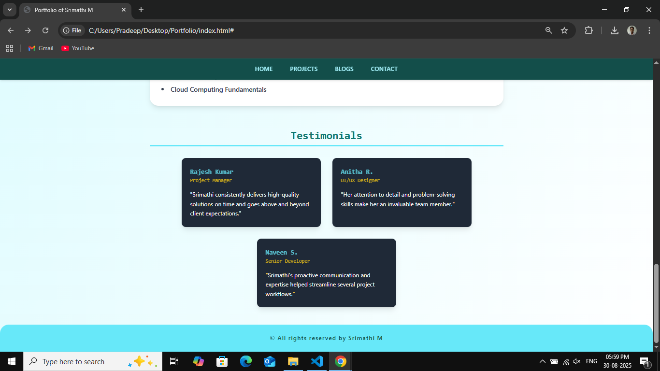
Results And Screenshots

Slide 14
GitHub link
https://github.com/srimathimaharajan9-rgb

Slide 15
Conclusion
This digital portfolio showcases a web developer’s skills and projects through a clean, responsive design with smooth navigation and engaging animations. It includes a validated contact form and highlights technical abilities, academic qualifications, and professional testimonials, providing a strong platform for career growth.

