Slide 1

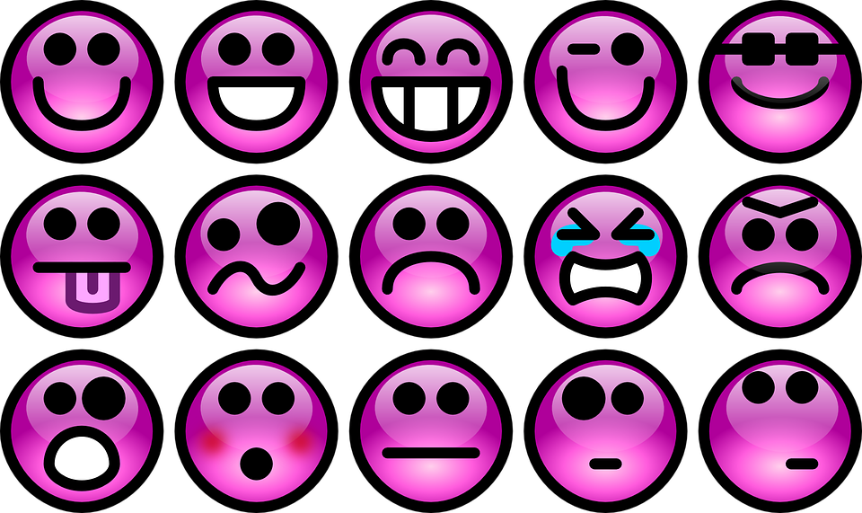
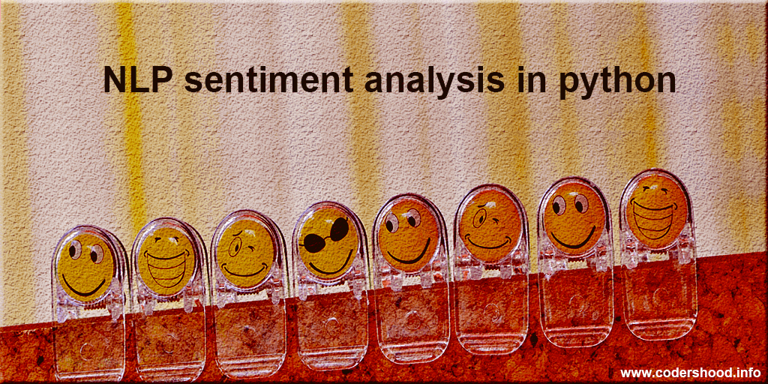
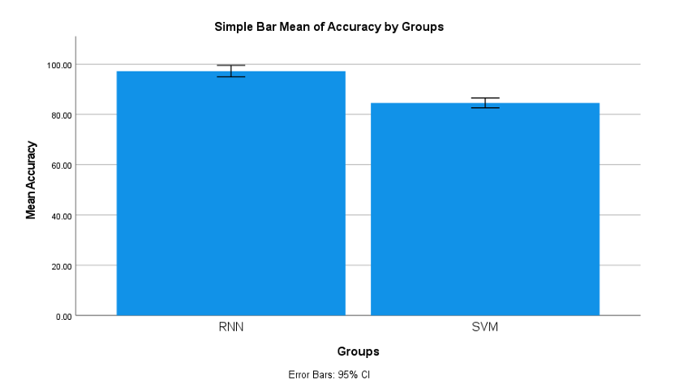
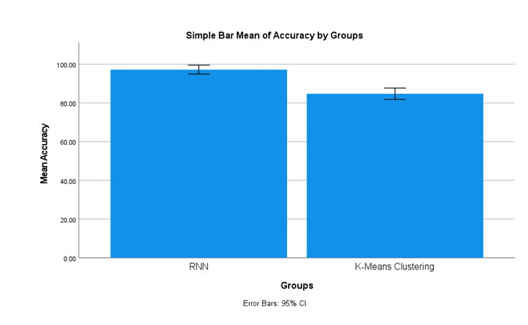

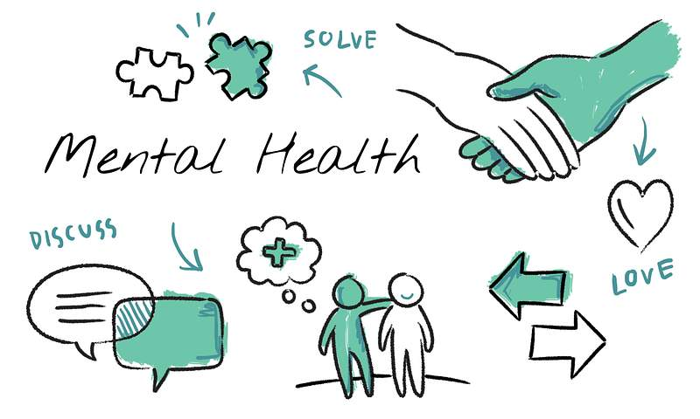
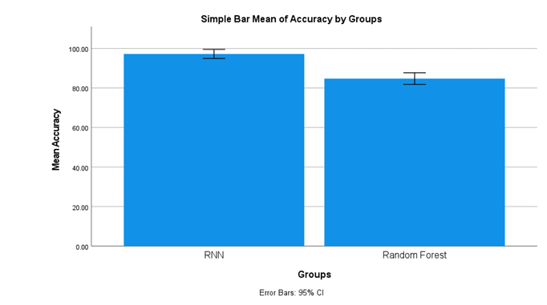
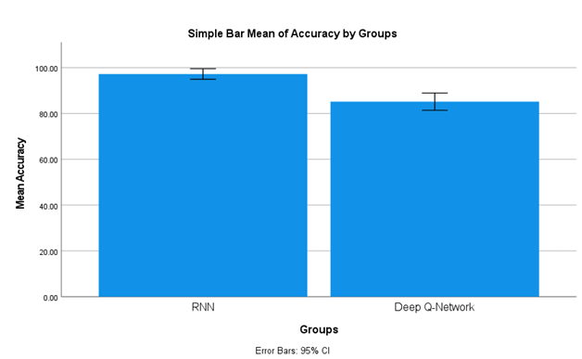
Register No: 192221148
Students Name: Srimathi S
Guided By Dr. Hyils Sharon Magdalene A
Enhancing Adaptive Traffic Light Timing Using Random Forests in Comparison with Decision Trees
Enhancing User Behavior Analysis Using RNN and K-Means Clustering for Personalized Mental Health Support
Comparing RNN and SVM for Improving Sentiment Analysis in AI-Powered Mental Health Chatbots
Advancing Adaptive Traffic Light Timing Using Random Forests in Comparison with K-Nearest Neighbors (KNN)
INTRODUCTION
INTRODUCTION
SVMs are fast and interpretable but struggle with understanding emotional context in sequential data.
SVMs were effective in early chatbots with small, labeled datasets but lack depth in complex dialogues.
RNNs capture temporal dependencies, making them better suited for detecting sentiment in mental health chatbots.
Traditional mental health systems lack personalization, relying on static profiles and generic recommendations.
K-Means segments users by static traits but can't capture changing emotional patterns.
Combining RNN with K-Means enables dynamic user analysis,mental health support.
Fig.1. Ai Powered Mental Health Chatbox
Fig.1. Ai Powered Mental Health Chatbox
MATERIALS AND METHODS
MATERIALS AND METHODS
Text here
Data Collection
Feature Extraction
Data Preprocessing
Model Development
RNN
Model Development
Performance Analysis
Data Collection
Feature Extraction
Data Preprocessing
Model Development
RNN
Model Development
Performance Analysis
SVM
K-means Clustering
Fig.2.Flow chart representing AI Powered mental health chatbox
Fig.2.Flow chart representing AI Powered mental health chatbox
RESULTS
Table 1: Significance table
RESULTS
Table 1: Significance table
Group statistics
 | Group | N | Mean | St.Deviation | Std.Error Mean
accuracy | RNN | 10 | 97.2540 | 1.85340 | .82886
 | SVM | 10 | 84.5780 | 1.57723 | .70536
Group statistics
 | Group | N | Mean | St.Deviation | Std.Error Mean
accuracy | RNN | 10 | 97.2540 | 1.85340 | .82886
 | K MEANS | 10 | 84.7780 | 2.38090 | 1.06477
Fig 3: RNN VS SVM
RNN (97%) significantly outperforms SVM (84.5%) in high-frequency trading prediction (p = 0.005) for improving sentiment analysis.
Fig 3: RNN VS KMEANS
RNN (97%) significantly outperforms K-Means (85%) in high-frequency trading prediction (p = 0.005) for improving sentiment analysis.
DISCUSSION AND CONCLUSION
DISCUSSION AND CONCLUSION
RNNs (97.25%) outperform SVMs (84.57%) in sentiment analysis for mental health chatbots (p = 0.005), thanks to their ability to model sequential context.
RNNs capture emotional shifts more effectively, while SVMs are faster and perform well on small, labeled datasets.
Future models should combine RNN’s contextual understanding with SVM’s efficiency for improved performance.
RNNs (97.25%) significantly outperform K-Means (84.77%) in modeling user behavior (p = 0.005), due to their strength in handling emotional data.
RNNs track evolving emotional states, while K-Means offers quick unsupervised clustering but lacks temporal awareness.
Hybrid models combining RNN’s time-series learning with K-Means’ clustering could enhance real-time, personalized interventions.
BIBLIOGRAPHY
BIBLIOGRAPHY
Dhyani, A., & Kumar, R. (2020). An intelligent chatbot using deep learning with Bidirectional RNN and attention model. Materials Today: Proceedings.
Li, X., Li, C., & Wu, Z. (2020). BiERU: Bidirectional Emotional Recurrent Unit for Conversational Sentiment Analysis. Proceedings of the 28th International Conference on Computational Linguistics.
Fatima, M., Zafar, B., & Mehmood, T. (2021). DASentimental: A sentiment analysis model for mental health monitoring.
Zhang, C. (2022). Application of K-means Clustering Algorithm in Mental Health Education Evaluation of College Students. In Innovative Computing (IC).
Zhou, J., Lamichhane, B., Ben-Zeev, D., Campbell, A., & Sano, A. (2021).
Joshi, D. & Patwardhan, M. (2020). An analysis of mental health of social media users using unsupervised approach. Computers in Human Behavior Reports
Improving Mental Health Assessment A Study Comparing RNN and Random Forest for Early Stress Detection
Enhancing Conversational AI Evaluating RNN and Deep Q-Network (DQN) for Emotional Intelligence in Chatbots
INTRODUCTION
INTRODUCTION
Traditional stress detection methods miss subtle temporal changes critical for early intervention.
Random Forest handles complex data well but lacks the ability to track time-based stress patterns.
RNNs process sequential data, making them more effective for early and accurate stress detection.
Traditional conversational AI lacks emotional intelligence, resulting in mechanical interactions.
RNNs capture dialogue flow and temporal context but struggle with real-time adaptability.
Combining both DQN and RNN,enable more emotionally aware interactions.
Fig.1. Ai Powered Mental Health Chatbox
Fig.1. Ai Powered Mental Health Chatbox
-
MATERIALS AND METHODS
MATERIALS AND METHODS
Data Collection
Feature Extraction
Data Preprocessing
Model Development
RNN
Model Development
Performance Analysis
Data Collection
Feature Extraction
Data Preprocessing
Model Development
RNN
Model Development
Performance Analysis
Random Forest
Deep Q-Network
Fig.2. Ai Powered Mental Health Chatbox
Fig.2. Ai Powered Mental Health Chatbox
Table 1: Significance table
Fig 1: RNN VS Random forerst
RESULTS
Group statistics
 | Group | N | Mean | St.Deviation | Std.Error Mean
accuracy | RNN | 10 | 97.25 | 1.85340 | .82886
 | RF | 10 | 84.7780 | 2.38090 | 1.06477
RESULTS
Table 1: Significance table
Group statistics
 | Group | N | Mean | St.Deviation | Std.Error Mean
accuracy | RNN | 10 | 97.25 | 1.85340 | .82886
 | DQN | 10 | 85.1780 | 3.03079 | 35541
Fig 3: RNN VS Random forest
RNN (97%) significantly outperforms RF (84.7%) in high-frequency trading prediction (p = 0.005) for the analysis of mental health.
Fig 3: RNN VS DQN
RNN (97%) significantly outperforms DQN (85.1%) in high-frequency trading prediction (p = 0.005) for mental health analysis.
DISCUSSION AND CONCLUSION
DISCUSSION AND CONCLUSION
RNN (97.25%) significantly outperforms Random Forest (84.77%) in early stress detection (p = 0.005) due to its ability to process time-based data.
Random Forest is effective but struggles with temporal patterns, unlike RNNs.
Future work can explore hybrid models and integrate diverse data (e.g., speech, heart rate) for improved stress prediction.
RNN (97.25%) outperforms DQN (85.17%) in emotional cue detection for chatbots (p = 0.005) due to better handling of sequential data.
RNNs capture user sentiment over time, while DQNs focus on goal-oriented tasks with less emotional depth.
Combining both can create adaptive, emotionally aware chatbots.
BIBLIOGRAPHY
BIBLIOGRAPHY
Al-Shargie, F., Tang, T. B., & Kiguchi, M. (2020). Mental stress assessment using simultaneous measurement of EEG and fNIRS. Biomedical Optics Express, 11(3), 1070–1086.
PeerJ Computer Science. (2023). A hybrid deep learning model for perinatal depression detection. PeerJ Comput. Sci., 9:e1402.
Sifaunnufus, M., Hossain, M. S., & Alhumyani, H. A. (2024). EEG-Based Stress Detection Using Random Forest Classifier.
Rani, M. U., Stalin, M. S., Kumar, V., Kumar, C. A., Sandhyarani, M., & Kosuri, U. (2024). Advancing Emotional Intelligence in Chatbots through Deep Learning: A Framework for Real‑Time Sentiment and Emotion Recognition. Frontiers in Health Informatics, 13(3).
Zhang, X., Zhao, Z., & Cheng, Y. (2021). Emotion‑Sensitive Deep Dyna‑Q Learning for Task‑Completion Dialogue Policy. Neurocomputing, 459.
Emotionally Intelligent Chatbots: A Systematic Literature Review.(2022).

