Slide 1
LWS Extreme Team, NRL Meeting, Sept 17, 2019
Agenda/issues
1. Event selection (see GOES data). Larger team picked Nov 20, 2003.
Less exciting than Nov 4. But we also need to validate spectra.
2. Flare spectra updates, both X ray and EUV. Both Flare and Background (Jeff)
How to get something quickly into atmos/ionos models? (team discuss resolution?)
3. NRLFLARE vs. FISM (Jeff)
4. Extrapolation to super flares- how to do so? (Jeff?)
5. Photoelectron updates (VA Tech, Srimoyee)
6. Atmospheric models (little to report; currently updating OASIS D-region code to
use more modern Lya param and run with new gtd8 (NRLMSIS2))
7. Prep for leading discussion on the phone next Tuesday and then full in-person meeting
in Portsmouth NH

Slide 2
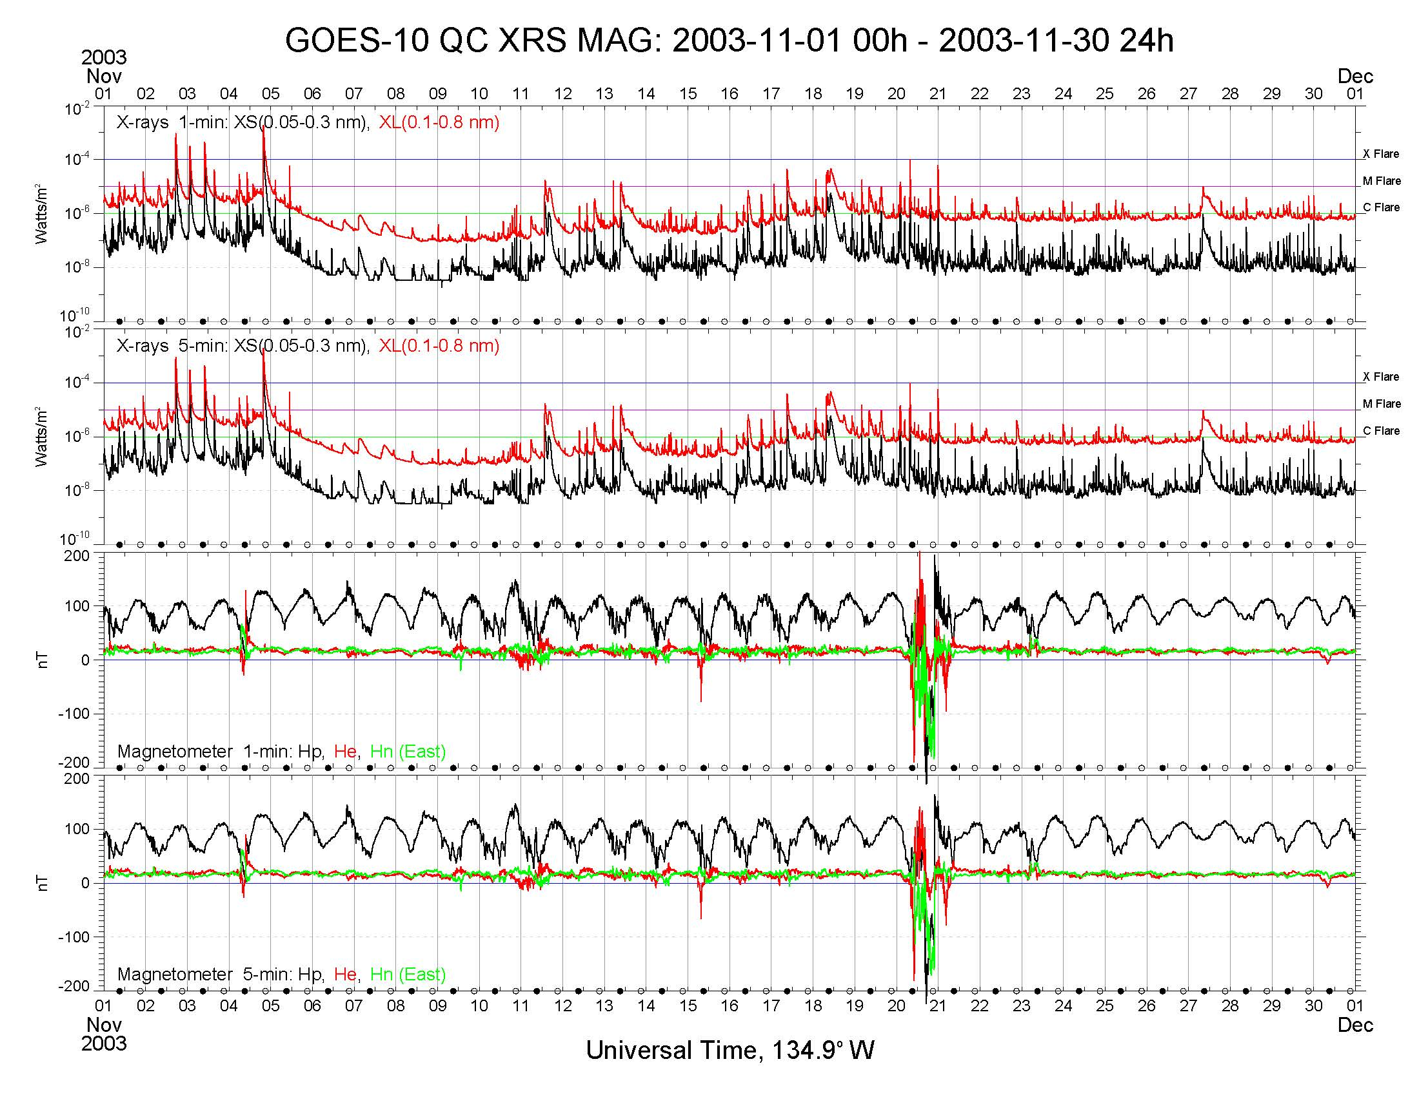

Slide 3
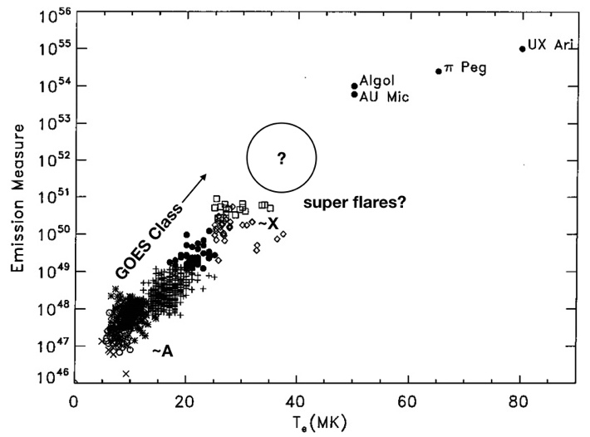
From the proposal regarding extrapolation

