Slide 1
Solar flux binning and Absorption/Ionisation Cross-sections

Slide 2
Maximum ionisation derivation
5/17/20

Slide 3
Cross-section for maximum absorption as a function of altitude & sampling for vertical resolution
5/17/20

Slide 4
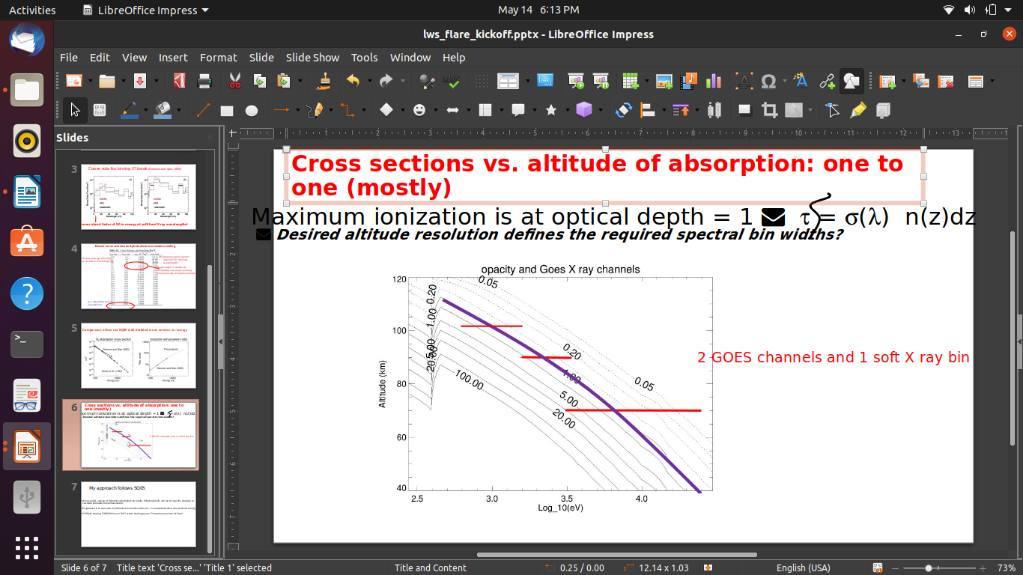
Cross sections vs. altitude of absorption: one to one (mostly) (Dave’s Slide*)
Maximum ionization is at optical depth = 1
Desired altitude resolution defines the required spectral bin widths?
5/17/20

Slide 5
First new energy binnings for NRL- May 2019
1. Bins were created for wavelength bins up to Auger edge for O/O2 (23 angstrom)
2. Energy series:
a0 = ln(12397/23) (in log eV)
d=0.1 eV (bin size)
n=40=number of bins
an = a0 + (n-1)*d
3. Added 30-40 angstrom bin for Auger edge (30 A) of N2
4. Rest of the bins from 44 A was taken from EUVAC bins
5. Total number of bins =156
; code for new solar flux bins in x-ray range
; has the Auger wavelengths as the edges of the bins
wv=[23.,23.,30.,43.6] ;wv in angstrom 0-O, 1-O2, 2-N2, 3-C; Auger edges
en=12397./wv ; in eV
;print, en
;Setting up new energy bins.........................
;#1
a_1=alog(en[0]) ;binning is made with log(energy) bins
d=0.1 ;difference in energy bins 0.1 log eV
n=40
en_series_1=a_1+findgen(n)*d
wv_series_1=exp(alog(12397.)-en_series_1)
;print, en_series_1
wv_1=reverse(wv_series_1)
;print,wv_1
5/17/20

Slide 6
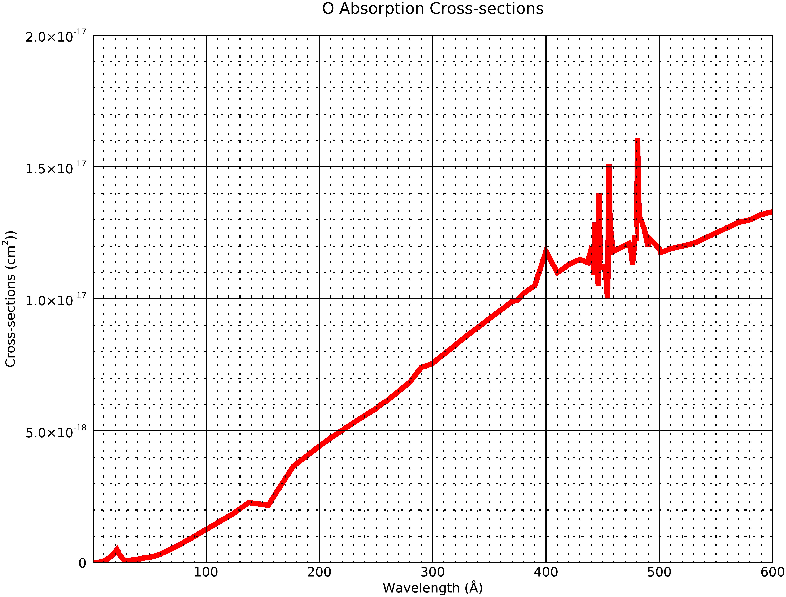
Henkey and Fennelly Absorption Cross-sections
5/17/20

Slide 7
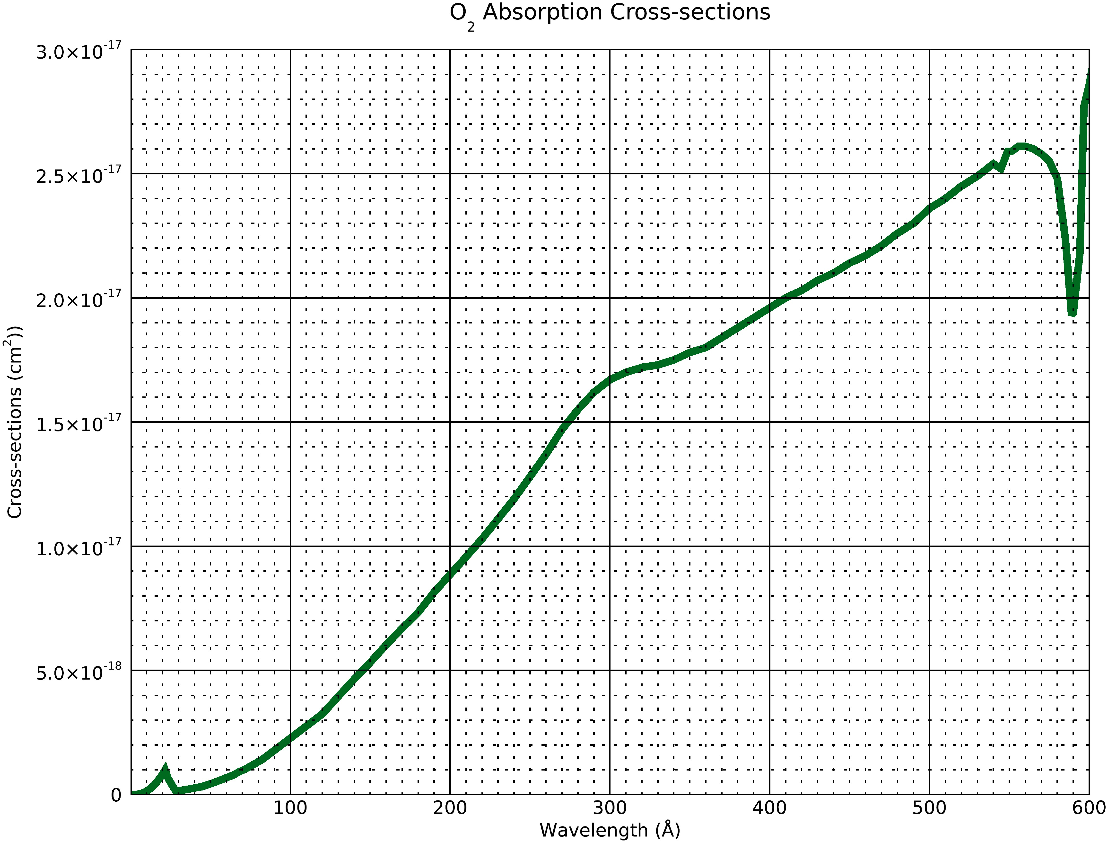
Henkey and Fennelly Absorption Cross-sections
5/17/20

Slide 8
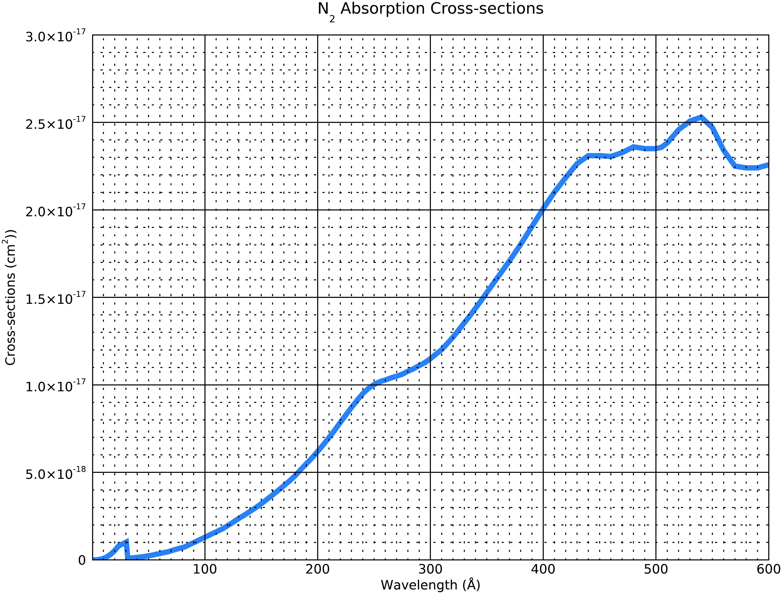
Henkey and Fennelly Absorption Cross-sections
5/17/20

Slide 9
New energy binnings for NRL- May 2020- Method
1. In the wavelength range up to about 500 angstrom, the cross-sections are increasing with wavelength.
2. So I used the resolution derived in slide 3 to get the cross-section resolution we need for a vertical resolution of 3.5 , 5 and 7 km.
3. I matched the cross-sections obtained from the formula to the cross-sections closest to the ones provided in the Henke+ Fennelly data and from there I got the wavelengths for the corresponding cross-section.
4. Also I used the msis model to get the density at lowest altitude n0 for the three species, and I assumed the reference altitude to be z0=0. So I am getting some negative altitudes for tau=1 since ln value is a fraction at these points
5.n0= 3.254866944e9 for O
n0= 1.380881780e15 for O2
n0= 5.147358317e15 for N2
5/17/20

Slide 10
New energy binnings for NRL- May 2020- RESULTS
O data for Vertical resolution of 7.00000 km
calculated cross-section (cm2) | H+F cross-section(cm2) | H+F wavelength (A) | H+F energy (eV) | Altitude(Tau=1) (km)
4.25119981722862E-24 | 4.2512E-24 | 0.4 | 30992.5 | -129.168116913143
1.15559588613912E-23 | 1.28333E-23 | 0.6 | 20661.7 | -122.168117125718
3.14123523642443E-23 | 2.39661E-23 | 0.7 | 17710 | -115.168117263678
8.53876229311119E-23 | 3.95893E-23 | 0.8 | 15496.2 | -108.168117566162
2.32107622052272E-22 | 2.9227E-22 | 1.5 | 8264.67 | -101.168117618538
6.30933878416319E-22 | 7.67873E-22 | 2.1 | 5903.33 | -94.1681182049485
1.71505606220228E-21 | 1.74565E-21 | 2.7 | 4591.48 | -87.1681183455806
4.6620057310122E-21 | 5.95168E-21 | 4.2 | 2951.67 | -80.1681183420682
1.2672645024307E-20 | 1.26473E-20 | 5.4 | 2295.74 | -73.1681185842693
3.44478187744574E-20 | 2.73671E-20 | 7.1 | 1746.06 | -66.1681189731298
9.36388784085687E-20 | 9.6E-20 | 33.74 | 367.427 | -59.1681190774948
2.54536852650474E-19 | 2.53E-19 | 54.7 | 226.636 | -52.1681193240358
6.91902897028093E-19 | 6.92E-19 | 77.3 | 160.375 | -45.1681193665764
1.88078699468953E-18 | 1.887E-18 | 125 | 99.176 | -38.1681196544988
5.11250884219845E-18 | 5.107E-18 | 223.26 | 55.5272 | -31.1681200223568
1.38972402217174E-17 | 1.3845E-17 | 456 | 27.1864 | -24.1681198520401
5/17/20

Slide 11
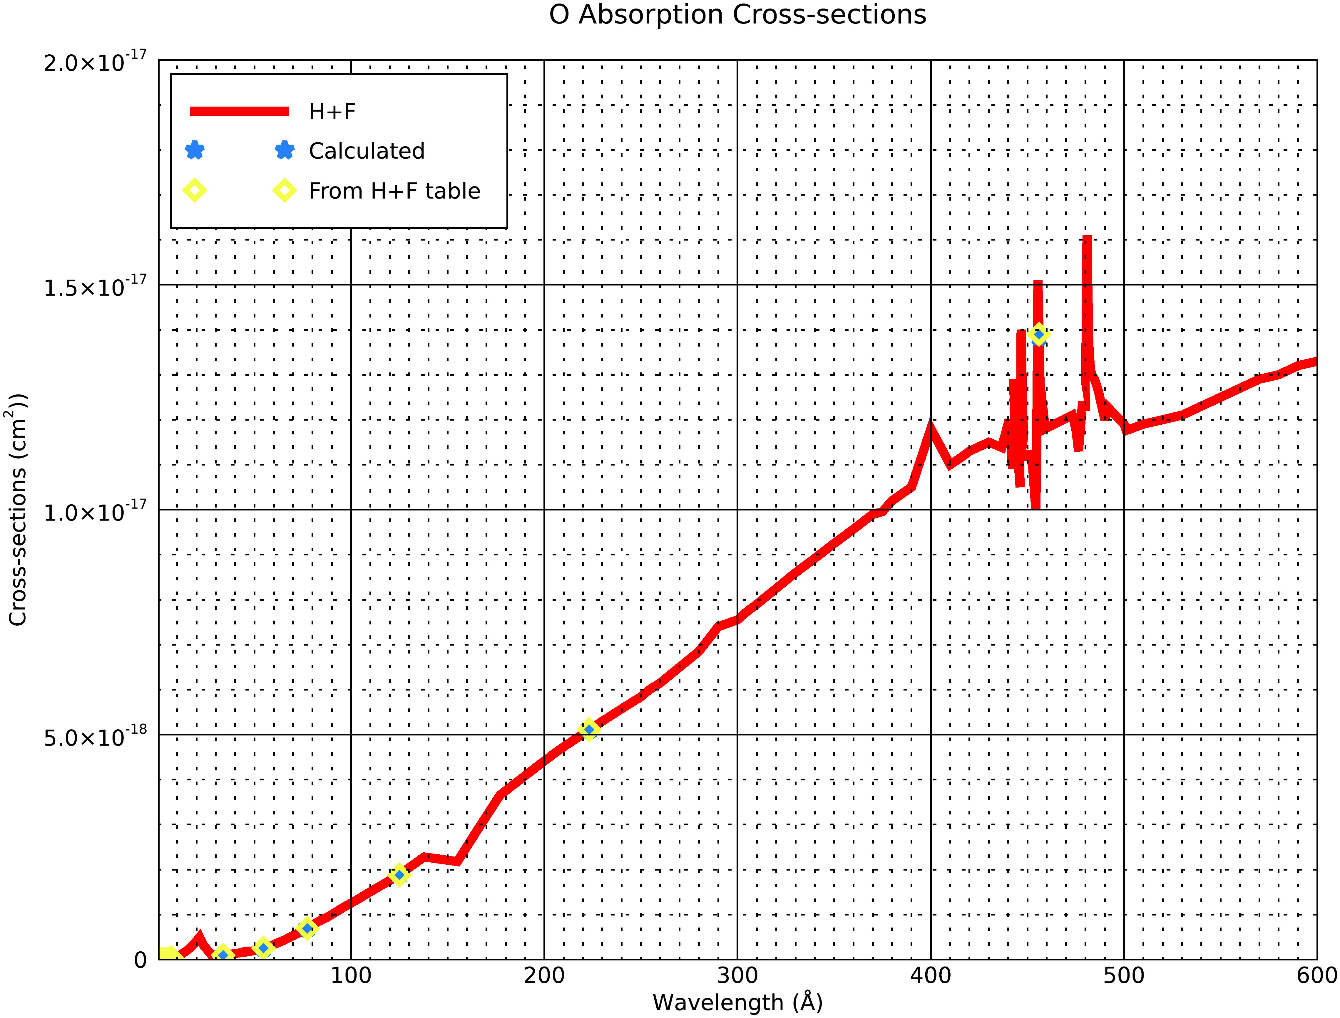
Plots of Calulated Cross-sections for Verification- Vertical Resolution =7 km
5/17/20

Slide 12
New energy binnings for NRL- May 2020-Results
O2 data for Vertical resolution of 7.00000 km
calculated cross-section (cm2) | H+F cross-section | H+F wavelength | H+F energy | Altitude(Tau=1)
8.50239963445724E-24 | 8.5024E-24 | 0.4 | 30992.5 | -33.609516660177
2.31119177227825E-23 | 2.56666E-23 | 0.6 | 20661.7 | -26.609516872752
6.28247047284886E-23 | 4.79323E-23 | 0.7 | 17710 | -19.6095170107128
1.70775245862224E-22 | 7.91786E-23 | 0.8 | 15496.2 | -12.6095173131964
4.64215244104544E-22 | 5.8454E-22 | 1.5 | 8264.67 | -5.60951736557203
1.26186775683264E-21 | 1.53575E-21 | 2.1 | 5903.33 | 1.39048204801714
3.43011212440456E-21 | 3.4913E-21 | 2.7 | 4591.48 | 8.39048190738504
9.3240114620244E-21 | 1.19034E-20 | 4.2 | 2951.67 | 15.3904819108974
2.53452900486139E-20 | 2.52946E-20 | 5.4 | 2295.74 | 22.3904816686963
6.88956375489147E-20 | 5.47342E-20 | 7.1 | 1746.06 | 29.3904812798358
1.87277756817137E-19 | 1.9E-19 | 33.74 | 367.427 | 36.3904811754708
5.09073705300949E-19 | 4.98E-19 | 52.91 | 234.304 | 43.3904809289298
1.38380579405619E-18 | 1.379E-18 | 81.58 | 151.961 | 50.3904808863892
3.76157398937905E-18 | 3.783E-18 | 127.65 | 97.1171 | 57.3904805984668
1.02250176843969E-17 | 1.0234E-17 | 219.09 | 56.5841 | 64.3904802306088
2.77944804434349E-17 | 2.77E-17 | 596.7 | 20.7759 | 71.3904804009255
5/17/20

Slide 13
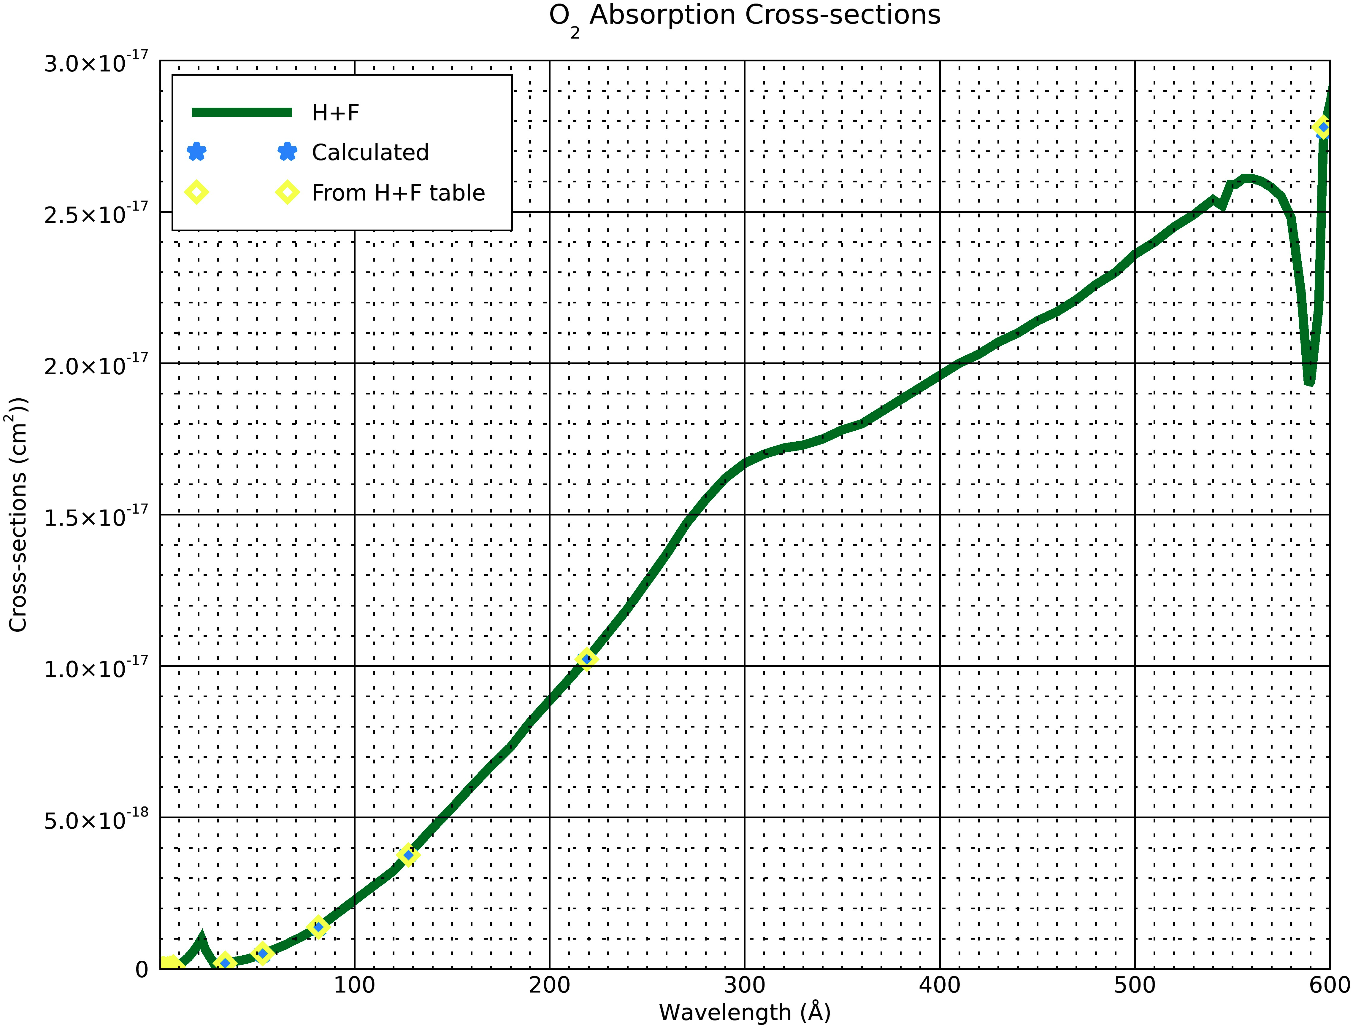
Plots of Calulated Cross-sections for Verification- Vertical Resolution =7 km
5/17/20

Slide 14
New energy binnings for NRL- May 2020- Results
N2 data for Vertical resolution of 7.00000 km
calculated cross-section (cm2) | H+F cross-section | H+F wavelength | H+F energy | Altitude(Tau=1)
4.53569974168341E-24 | 4.5357E-24 | 0.4 | 30992.5 | -28.7977705283576
1.23293098127496E-23 | 1.3863E-23 | 0.6 | 20661.7 | -21.7977707409326
3.35145381609121E-23 | 2.60512E-23 | 0.7 | 17710 | -14.7977708788933
9.11019561353112E-23 | 4.32171E-23 | 0.8 | 15496.2 | -7.79777118137694
2.47640790046784E-22 | 3.18662E-22 | 1.5 | 8264.67 | -0.797771233752545
6.73157403177013E-22 | 5.1172E-22 | 1.8 | 6887.22 | 6.20222817983662
1.82983149998689E-21 | 1.93988E-21 | 2.7 | 4591.48 | 13.2022280392045
4.97399771805209E-21 | 3.57739E-21 | 3.4 | 3646.18 | 20.2022280427169
1.35207271439585E-20 | 1.47934E-20 | 5.4 | 2295.74 | 27.2022278005158
3.6753144861283E-20 | 3.29362E-20 | 7.1 | 1746.06 | 34.2022274116553
9.99054043256299E-20 | 9.62964E-20 | 10.4 | 1192.02 | 41.2022273072903
2.71571035578443E-19 | 2.66E-19 | 52.91 | 234.304 | 48.2022270607493
7.3820660666244E-19 | 7.39E-19 | 81.94 | 151.294 | 55.2022270182087
2.0066535220017E-18 | 1.996E-18 | 121.15 | 102.328 | 62.2022267302863
5.4546495182225E-18 | 5.412E-18 | 188.7 | 65.6969 | 69.2022263624283
1.48272750267589E-17 | 1.4832E-17 | 345.13 | 35.9198 | 76.202226532745
5/17/20

Slide 15
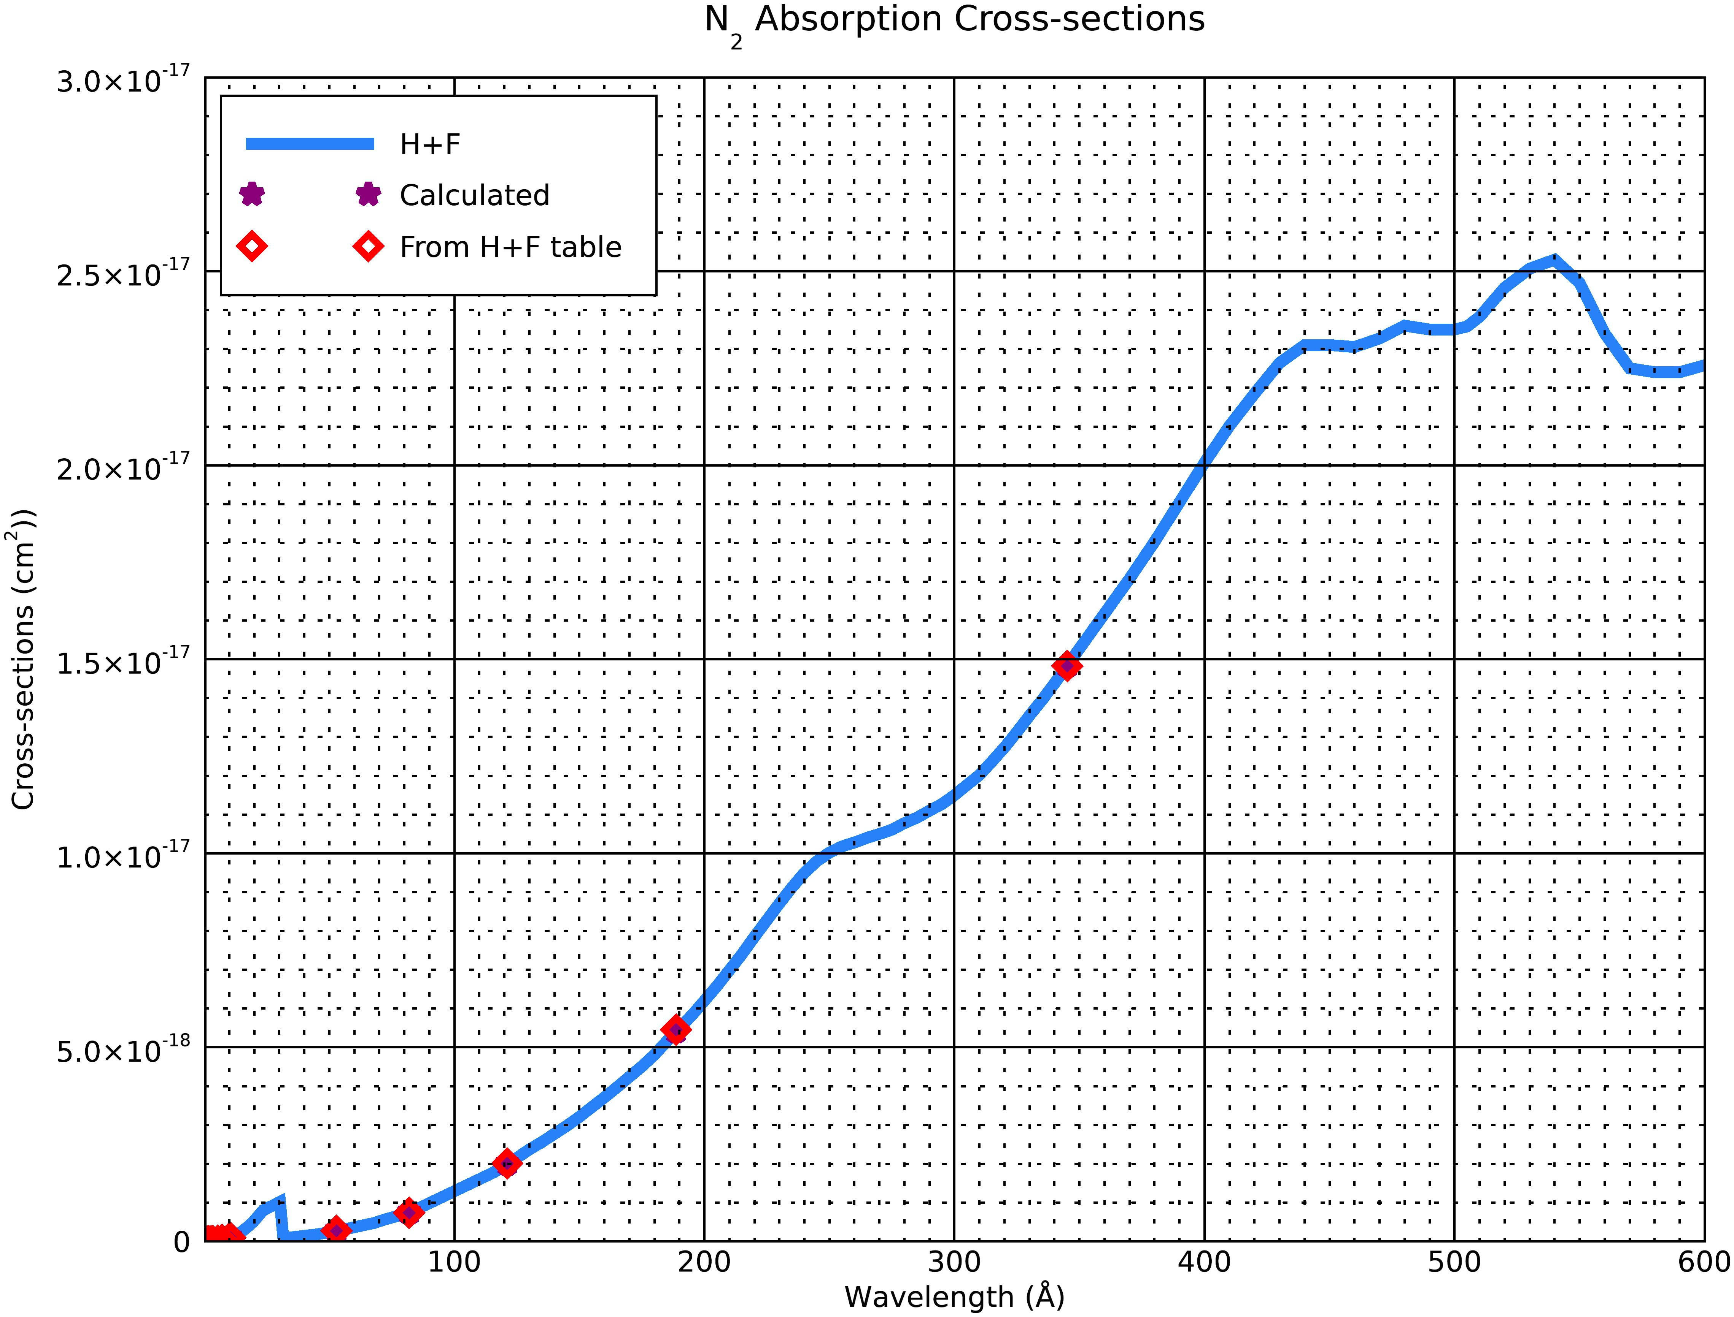
Plots of Calulated Cross-sections for Verification- Vertical Resolution =7 km
5/17/20

Slide 16
O data for Vertical resolution of 5.00000 km
calculated cross-section (cm2) | H+F cross-section | H+F wavelength | H+F energy | Altitude(Tau=1)
4.25119981722862E-24 | 4.2512E-24 | 0.4 | 30992.5 | -129.168116913143
8.6840406216736E-24 | 7.22704E-24 | 0.5 | 24794 | -124.168117175996
1.77391250987023E-23 | 1.28333E-23 | 0.6 | 20661.7 | -119.168117080691
3.62361860107661E-23 | 3.95893E-23 | 0.8 | 15496.2 | -114.168118052601
7.4020637186291E-23 | 3.95893E-23 | 0.8 | 15496.2 | -109.168118137817
1.51203954009559E-22 | 1.52246E-22 | 1.3 | 9536.15 | -104.168118384534
3.08868420107083E-22 | 2.9227E-22 | 1.5 | 8264.67 | -99.1681181551694
6.30933813548158E-22 | 7.67873E-22 | 2.1 | 5903.33 | -94.168118924639
1.28882553755841E-21 | 1.31256E-21 | 2.5 | 4958.8 | -89.168119157765
2.63271869511259E-21 | 3.1884E-21 | 3.4 | 3646.18 | -84.1681194749876
5.37792552816242E-21 | 5.95168E-21 | 4.2 | 2951.67 | -79.1681197597031
1.09856338034771E-20 | 1.26473E-20 | 5.4 | 2295.74 | -74.1681199220451
2.2440651546149E-20 | 1.75628E-20 | 6.1 | 2032.3 | -69.1681199246168
4.58401230167005E-20 | 4.2512E-20 | 8.3 | 1493.61 | -64.1681204393884
9.36388618023194E-20 | 9.6E-20 | 33.74 | 367.427 | -59.1681203188997
1.91278617426379E-19 | 1.93E-19 | 49.22 | 251.869 | -54.1681210656789
3.90730000438887E-19 | 3.91E-19 | 63.16 | 196.279 | -49.1681212330257
7.98154728260019E-19 | 7.95E-19 | 81.16 | 152.748 | -44.1681214154604
1.63041218290386E-18 | 1.643E-18 | 115.39 | 107.436 | -39.1681217880144
3.33048691731273E-18 | 3.331E-18 | 172.17 | 72.0044 | -34.1681221755784
6.80327584030749E-18 | 6.794E-18 | 278.4 | 44.5295 | -29.1681221167805
1.38972349077177E-17 | 1.3845E-17 | 456 | 27.1864 | -24.168122528687

Slide 17

Plots of Calulated Cross-sections for Verification- Vertical Resolution =5 km
5/17/20

Slide 18
O2 data for Vertical resolution of 5.00000 km
calculated cross-section (cm2) | H+F cross-section | H+F wavelength | H+F energy | Altitude(Tau=1)
8.50239963445724E-24 | 8.5024E-24 | 0.4 | 30992.5 | -33.609516660177
1.73680812433472E-23 | 1.44541E-23 | 0.5 | 24794 | -28.6095169230303
3.54782501974047E-23 | 2.56666E-23 | 0.6 | 20661.7 | -23.609516827725
7.24723720215322E-23 | 7.91786E-23 | 0.8 | 15496.2 | -18.6095177996356
1.48041274372582E-22 | 7.91786E-23 | 0.8 | 15496.2 | -13.6095178848511
3.02407908019117E-22 | 3.04492E-22 | 1.3 | 9536.15 | -8.60951813156806
6.17736840214167E-22 | 5.8454E-22 | 1.5 | 8264.67 | -3.60951790220381
1.26186762709632E-21 | 1.53575E-21 | 2.1 | 5903.33 | 1.39048132832659
2.57765107511682E-21 | 2.62512E-21 | 2.5 | 4958.8 | 6.39048109520068
5.26543739022518E-21 | 6.3768E-21 | 3.4 | 3646.18 | 11.390480777978
1.07558510563248E-20 | 1.19034E-20 | 4.2 | 2951.67 | 16.3904804932625
2.19712676069541E-20 | 2.52946E-20 | 5.4 | 2295.74 | 21.3904803309206
4.48813030922979E-20 | 3.51255E-20 | 6.1 | 2032.3 | 26.3904803283488
9.1680246033401E-20 | 8.5024E-20 | 8.3 | 1493.61 | 31.3904798135772
1.87277723604639E-19 | 1.9E-19 | 33.74 | 367.427 | 36.390479934066
3.82557234852758E-19 | 3.84E-19 | 47.7 | 259.895 | 41.3904791872867
7.81460000877774E-19 | 7.81E-19 | 64.11 | 193.371 | 46.39047901994
1.59630945652004E-18 | 1.599E-18 | 86.23 | 143.767 | 51.3904788375052
3.26082436580773E-18 | 3.268E-18 | 120.4 | 102.965 | 56.3904784649512
6.66097383462546E-18 | 6.68E-18 | 169.7 | 73.0524 | 61.3904780773872
1.3606551680615E-17 | 1.3655E-17 | 259.5 | 47.7726 | 66.3904781361852

Slide 19

Plots of Calulated Cross-sections for Verification- Vertical Resolution =5 km
5/17/20

Slide 20
N2 data for Vertical resolution of 5.00000 km
calculated cross-section (cm2) | H+F cross-section | H+F wavelength | H+F energy | Altitude(Tau=1)
4.53569974168341E-24 | 4.5357E-24 | 0.4 | 30992.5 | -28.7977705283576
9.26519629702341E-24 | 7.76884E-24 | 0.5 | 24794 | -23.7977707912108
1.89262675449412E-23 | 1.3863E-23 | 0.6 | 20661.7 | -18.7977706959056
3.86611936852614E-23 | 4.32171E-23 | 0.8 | 15496.2 | -13.7977716678161
7.89742659482821E-23 | 4.32171E-23 | 0.8 | 15496.2 | -8.79777175303157
1.61322865221083E-22 | 1.65611E-22 | 1.3 | 9536.15 | -3.79777199974858
3.29538594637769E-22 | 3.18662E-22 | 1.5 | 8264.67 | 1.20222822961567
6.73157333967728E-22 | 5.1172E-22 | 1.8 | 6887.22 | 6.20222746014607
1.37507666284892E-21 | 1.45608E-21 | 2.5 | 4958.8 | 11.2022272270202
2.80890619560004E-21 | 3.57739E-21 | 3.4 | 3646.18 | 16.2022269097975
5.73782849021212E-21 | 6.79192E-21 | 4.2 | 2951.67 | 21.202226625082
1.17208173096748E-20 | 9.95528E-21 | 4.7 | 2637.66 | 26.20222646274
2.39424307953205E-20 | 2.07479E-20 | 6.1 | 2032.3 | 31.2022264601683
4.89078479169503E-20 | 5.16372E-20 | 8.3 | 1493.61 | 36.2022259453967
9.99053866080528E-20 | 9.62964E-20 | 10.4 | 1192.02 | 41.2022260658854
2.0407941591792E-19 | 2.09E-19 | 47.7 | 259.895 | 46.2022253191062
4.16878537413456E-19 | 4.17E-19 | 63.72 | 194.554 | 51.2022251517594
8.51569051193736E-19 | 8.53E-19 | 85.69 | 144.673 | 56.2022249693247
1.73952306049341E-18 | 1.732E-18 | 114.24 | 108.517 | 61.2022245967707
3.55337064828514E-18 | 3.596E-18 | 157.73 | 78.5963 | 66.2022242092067
7.25856647491105E-18 | 7.3E-18 | 213.78 | 57.9895 | 71.2022242680046
1.48272693571343E-17 | 1.4832E-17 | 345.13 | 35.9198 | 76.2022238560981

Slide 21

Plots of Calulated Cross-sections for Verification- Vertical Resolution =5 km
5/17/20

Slide 22
O data for Vertical resolution of 3.50000 km
calculated cross-section (cm2) | H+F cross-section | H+F wavelength | H+F energy | Altitude(Tau=1)
4.25119981722862E-24 | 4.2512E-24 | 0.4 | 30992.5 | -129.168116913143
7.00904334108649E-24 | 7.22704E-24 | 0.5 | 24794 | -125.668117136429
1.15559588613912E-23 | 1.28333E-23 | 0.6 | 20661.7 | -122.168117125718
1.90525533297404E-23 | 2.39661E-23 | 0.7 | 17710 | -118.668117804818
3.14123503371143E-23 | 2.39661E-23 | 0.7 | 17710 | -115.168117715409
5.17902088527958E-23 | 3.95893E-23 | 0.8 | 15496.2 | -111.668117892562
8.53876148225917E-23 | 3.95893E-23 | 0.8 | 15496.2 | -108.168118230891
1.407803702597E-22 | 1.52246E-22 | 1.3 | 9536.15 | -104.668118556708
2.32107589618191E-22 | 2.9227E-22 | 1.5 | 8264.67 | -101.168118596699
3.82680700759364E-22 | 3.69323E-22 | 1.7 | 7292.35 | -97.6681189503761
6.30933813548158E-22 | 7.67873E-22 | 2.1 | 5903.33 | -94.168118924639
1.04023394270409E-21 | 9.99032E-22 | 2.3 | 5390 | -90.6681193021281
1.71505580272963E-21 | 1.74565E-21 | 2.7 | 4591.48 | -87.1681194046181
2.82764881710307E-21 | 3.1884E-21 | 3.4 | 3646.18 | -83.6681198138148
4.66200469312162E-21 | 5.95168E-21 | 4.2 | 2951.67 | -80.1681199004608
7.68634571094801E-21 | 8.63525E-21 | 4.7 | 2637.66 | -76.6681204384196
1.26726419106352E-20 | 1.26473E-20 | 5.4 | 2295.74 | -73.1681203041711
2.08936528025027E-20 | 1.75628E-20 | 6.1 | 2032.3 | -69.6681207971769
3.44478083955516E-20 | 2.73671E-20 | 7.1 | 1746.06 | -66.168121082185
5.67948339082258E-20 | 6.4E-20 | 28.47 | 435.441 | -62.6681211465863
9.36388451960701E-20 | 9.6E-20 | 33.74 | 367.427 | -59.1681215603047
1.5438434732507E-19 | 1.57E-19 | 43.76 | 283.295 | -55.668121946318
2.54536769619228E-19 | 2.53E-19 | 54.7 | 226.636 | -52.1681216074726
4.19660145870096E-19 | 4.17E-19 | 64.6 | 191.904 | -48.668122280958
6.91902631328104E-19 | 6.92E-19 | 77.3 | 160.375 | -45.1681220546708
1.14075447105567E-18 | 1.142E-18 | 95.37 | 129.988 | -41.6681227570818
1.88078619758956E-18 | 1.887E-18 | 125 | 99.176 | -38.168122621183
3.10089210308368E-18 | 3.091E-18 | 168.55 | 73.5509 | -34.668122861646
5.11250671659855E-18 | 5.107E-18 | 223.26 | 55.5272 | -31.1681229327092
8.4290977902087E-18 | 8.425E-18 | 325 | 38.1446 | -27.6681235805024

Slide 23
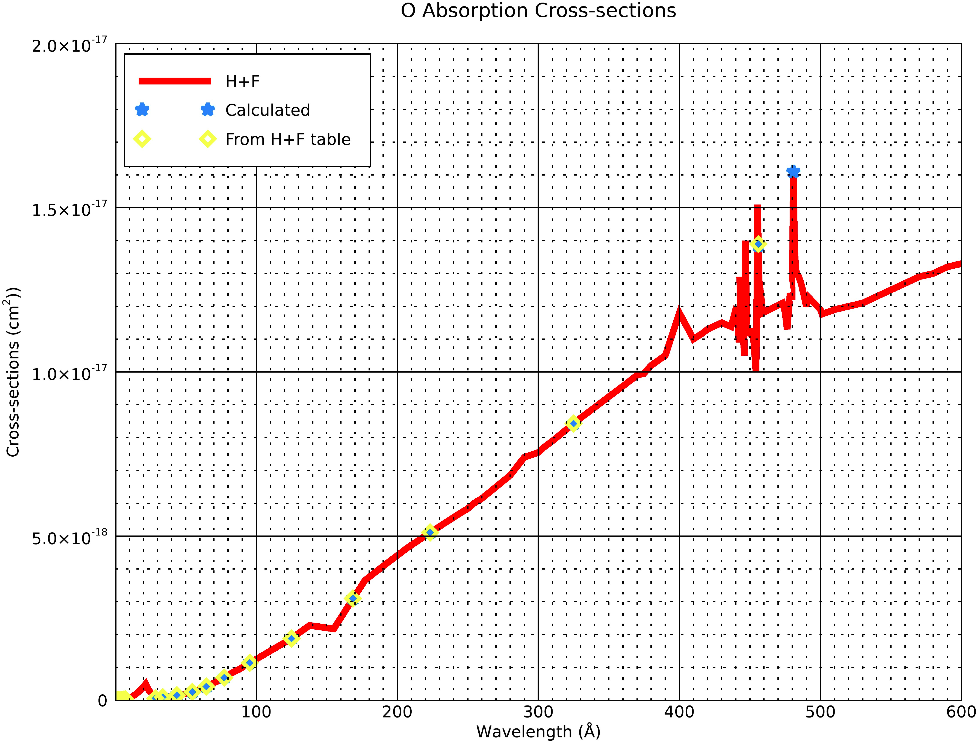
Plots of Calulated Cross-sections for Verification- Vertical Resolution =3.5 km
5/17/20

Slide 24
O2 data for Vertical resolution of 3.50000 km
calculated cross-section (cm2) | H+F cross-section | H+F wavelength | H+F energy | Altitude(Tau=1)
8.50239963445724E-24 | 8.5024E-24 | 0.4 | 30992.5 | -33.609516660177
1.4018086682173E-23 | 1.44541E-23 | 0.5 | 24794 | -30.1095168834634
2.31119177227825E-23 | 2.56666E-23 | 0.6 | 20661.7 | -26.609516872752
3.81051066594807E-23 | 4.79323E-23 | 0.7 | 17710 | -23.1095175518524
6.28247006742285E-23 | 4.79323E-23 | 0.7 | 17710 | -19.609517462443
1.03580417705592E-22 | 7.91786E-23 | 0.8 | 15496.2 | -16.1095176395966
1.70775229645184E-22 | 7.91786E-23 | 0.8 | 15496.2 | -12.6095179779256
2.81560740519401E-22 | 3.04492E-22 | 1.3 | 9536.15 | -9.10951830374226
4.64215179236382E-22 | 5.8454E-22 | 1.5 | 8264.67 | -5.60951834373284
7.65361401518727E-22 | 7.38646E-22 | 1.7 | 7292.35 | -2.10951869741043
1.26186762709632E-21 | 1.53575E-21 | 2.1 | 5903.33 | 1.39048132832659
2.08046788540818E-21 | 1.99806E-21 | 2.3 | 5390 | 4.89048095083753
3.43011160545927E-21 | 3.4913E-21 | 2.7 | 4591.48 | 8.39048084834756
5.65529763420614E-21 | 6.3768E-21 | 3.4 | 3646.18 | 11.8904804391508
9.32400938624324E-21 | 1.19034E-20 | 4.2 | 2951.67 | 15.3904803525049
1.5372691421896E-20 | 1.72705E-20 | 4.7 | 2637.66 | 18.890479814546
2.53452838212704E-20 | 2.52946E-20 | 5.4 | 2295.74 | 22.3904799487945
4.17873056050053E-20 | 3.51255E-20 | 6.1 | 2032.3 | 25.8904794557887
6.88956167911031E-20 | 5.47342E-20 | 7.1 | 1746.06 | 29.3904791707806
1.13589667816452E-19 | 1.27E-19 | 28.47 | 435.441 | 32.8904791063794
1.8727769039214E-19 | 1.9E-19 | 33.74 | 367.427 | 36.3904786926609
3.0876869465014E-19 | 3.09E-19 | 43.76 | 283.295 | 39.8904783066476
5.09073539238456E-19 | 4.98E-19 | 52.91 | 234.304 | 43.390478645493
8.39320291740192E-19 | 8.41E-19 | 65.85 | 188.261 | 46.8904779720077
1.38380526265621E-18 | 1.379E-18 | 81.58 | 151.961 | 50.3904781982949
2.28150894211133E-18 | 2.294E-18 | 100.54 | 123.304 | 53.8904774958838
3.76157239517912E-18 | 3.783E-18 | 127.65 | 97.1171 | 57.3904776317827
6.20178420616735E-18 | 6.307E-18 | 164.13 | 75.5316 | 60.8904773913196
1.02250134331971E-17 | 1.0234E-17 | 219.09 | 56.5841 | 64.3904773202564
1.68581955804174E-17 | 1.6814E-17 | 303.8 | 40.8065 | 67.8904766724632

Slide 25

Plots of Calulated Cross-sections for Verification- Vertical Resolution =3.5 km
5/17/20

Slide 26
N2 data for Vertical resolution of 3.50000 km
calculated cross-section (cm2) | H+F cross-section | H+F wavelength | H+F energy | Altitude(Tau=1)
4.53569974168341E-24 | 4.5357E-24 | 0.4 | 30992.5 | -28.7977705283576
7.47810440308554E-24 | 7.76884E-24 | 0.5 | 24794 | -25.2977707516439
1.23293098127496E-23 | 1.3863E-23 | 0.6 | 20661.7 | -21.7977707409326
2.0327593369264E-23 | 2.60512E-23 | 0.7 | 17710 | -18.297771420033
3.35145359981219E-23 | 2.60512E-23 | 0.7 | 17710 | -14.7977713306236
5.52561269793457E-23 | 4.32171E-23 | 0.8 | 15496.2 | -11.2977715077772
9.11019474841505E-23 | 4.32171E-23 | 0.8 | 15496.2 | -7.79777184610611
1.5020171162815E-22 | 1.65611E-22 | 1.3 | 9536.15 | -4.29777217192278
2.47640755442141E-22 | 3.18662E-22 | 1.5 | 8264.67 | -0.797772211913358
4.08290560360675E-22 | 4.02398E-22 | 1.7 | 7292.35 | 2.70222743440905
6.73157333967728E-22 | 5.1172E-22 | 1.8 | 6887.22 | 6.20222746014607
1.10984875518956E-21 | 1.10252E-21 | 2.3 | 5390 | 9.70222708265701
1.82983122314975E-21 | 1.93988E-21 | 2.7 | 4591.48 | 13.202226980167
3.01688148304135E-21 | 3.57739E-21 | 3.4 | 3646.18 | 16.7022265709703
4.97399661070352E-21 | 3.57739E-21 | 3.4 | 3646.18 | 20.2022264843243
8.20073338222046E-21 | 6.79192E-21 | 4.2 | 2951.67 | 23.7022259463655
1.35207238219128E-20 | 1.47934E-20 | 5.4 | 2295.74 | 27.202226080614
2.22919033904441E-20 | 2.07479E-20 | 6.1 | 2032.3 | 30.7022255876082
3.67531337877973E-20 | 3.29362E-20 | 7.1 | 1746.06 | 34.2022253026001
6.0595672883338E-20 | 5.16372E-20 | 8.3 | 1493.61 | 37.7022252381988
9.99053688904757E-20 | 9.62964E-20 | 10.4 | 1192.02 | 41.2022248244804
1.64716097663641E-19 | 1.71E-19 | 43.76 | 283.295 | 44.7022244384671
2.71570946990558E-19 | 2.66E-19 | 52.91 | 234.304 | 48.2022247773125
4.47744753729005E-19 | 4.45E-19 | 65.85 | 188.261 | 51.7022241038271
7.38206323181206E-19 | 7.39E-19 | 81.94 | 151.294 | 55.2022243301143
1.21709634506534E-18 | 1.217E-18 | 97.51 | 127.136 | 58.7022236277033
2.006652671558E-18 | 1.996E-18 | 121.15 | 102.328 | 62.2022237636021
3.30841082885481E-18 | 3.317E-18 | 152.15 | 81.4788 | 65.7022235231391
5.45464725037263E-18 | 5.412E-18 | 188.7 | 65.6969 | 69.2022234520759
8.99319211360838E-18 | 9.025E-18 | 233.84 | 53.0149 | 72.7022228042827
1.48272670892844E-17 | 1.4832E-17 | 345.13 | 35.9198 | 76.202222785439

Slide 27
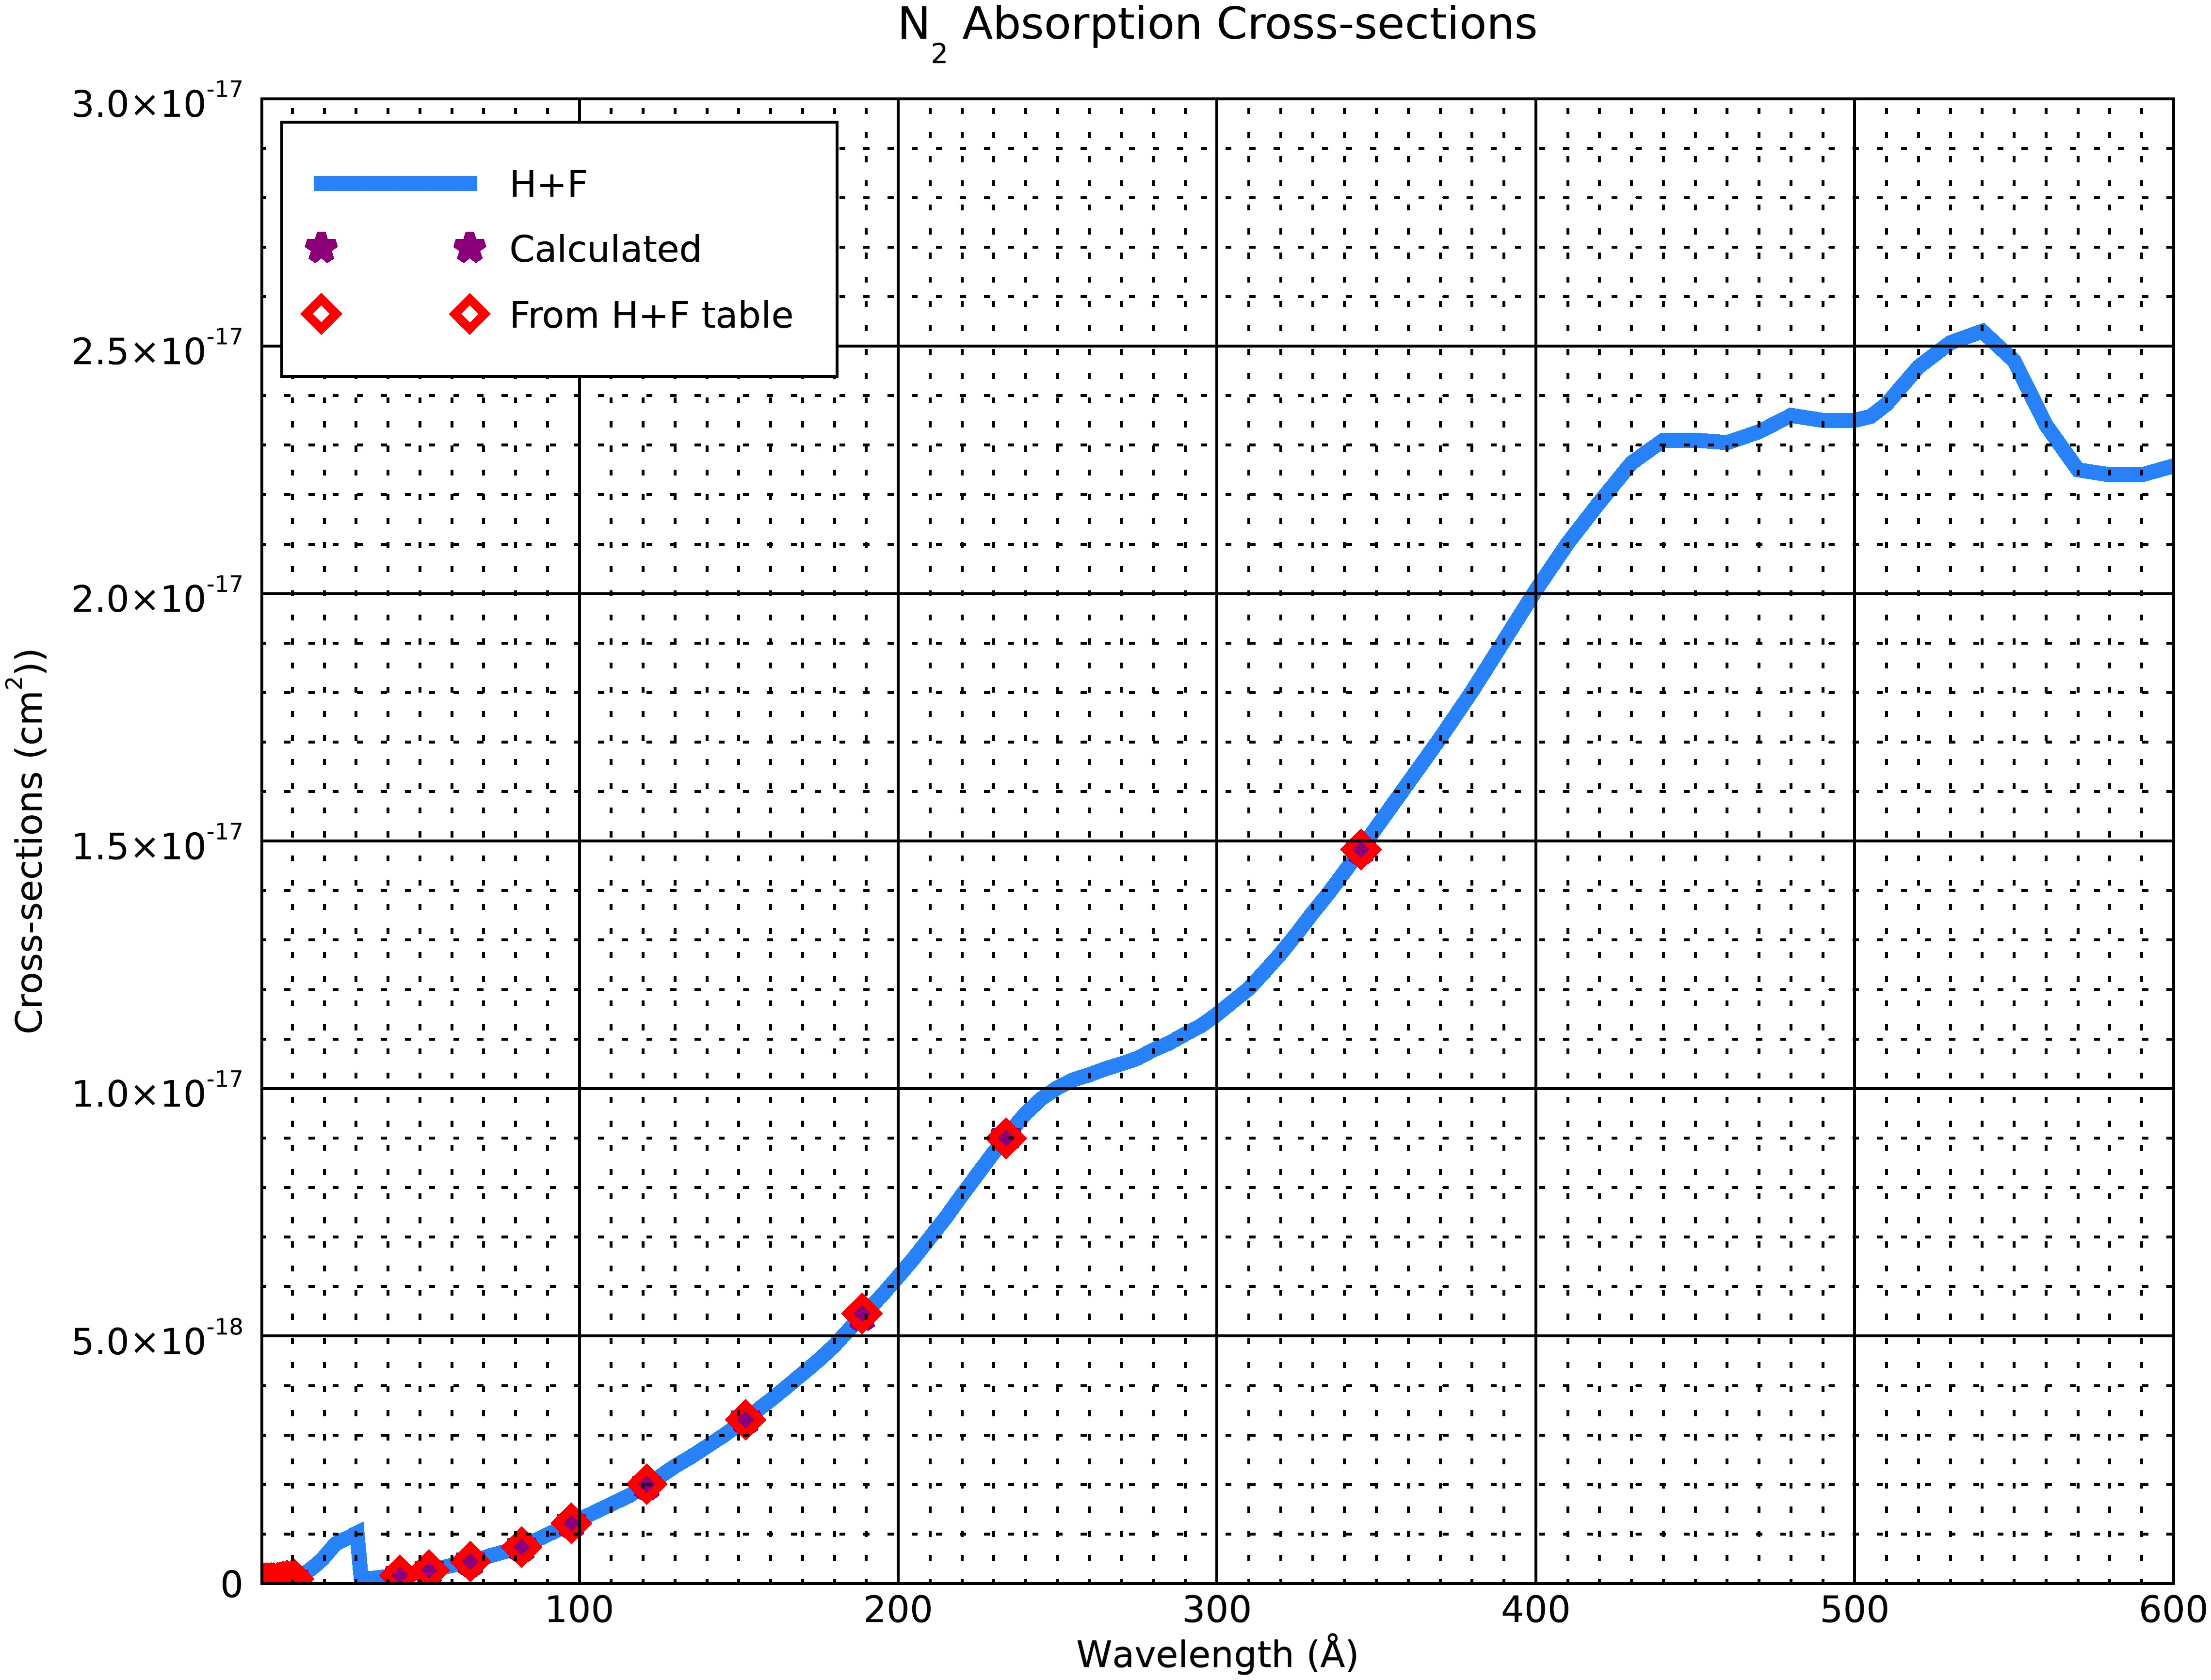
Plots of Calulated Cross-sections for Verification- Vertical Resolution =3.5 km
5/17/20

