Slide 1
Photoionsation and Photoelectron ionosation rate calcualtions for NRL new bins for X-rays

Slide 2
NRL Spectra
The binning procedure for xray flare ionization parameterization (Done by Dave) as below:
“Break up the three shortest wavelength bins of Solomon and Qian into 12 higher resolution bins. Bins to be expanded are the 0.5-4 A, 4-8A and 8-18A”
The selection of bins gives roughly 5 km resolution between 60-100 km.
Note: The Auger edges are not resolved here. The Audger edge for N₂ is around 30 A and O and O₂ is 23 A
wave_low | wave_low
0.5 | 1
1 | 1.5
1.5 | 2
2 | 2.5
2.5 | 3
3 | 4
4 | 5
5 | 6
6 | 8
8 | 10
10 | 14
14 | 18
18 | 32
32 | 70
70 | 155
155 | 224
224 | 290
290 | 320
320 | 540
6/5/20

Slide 3
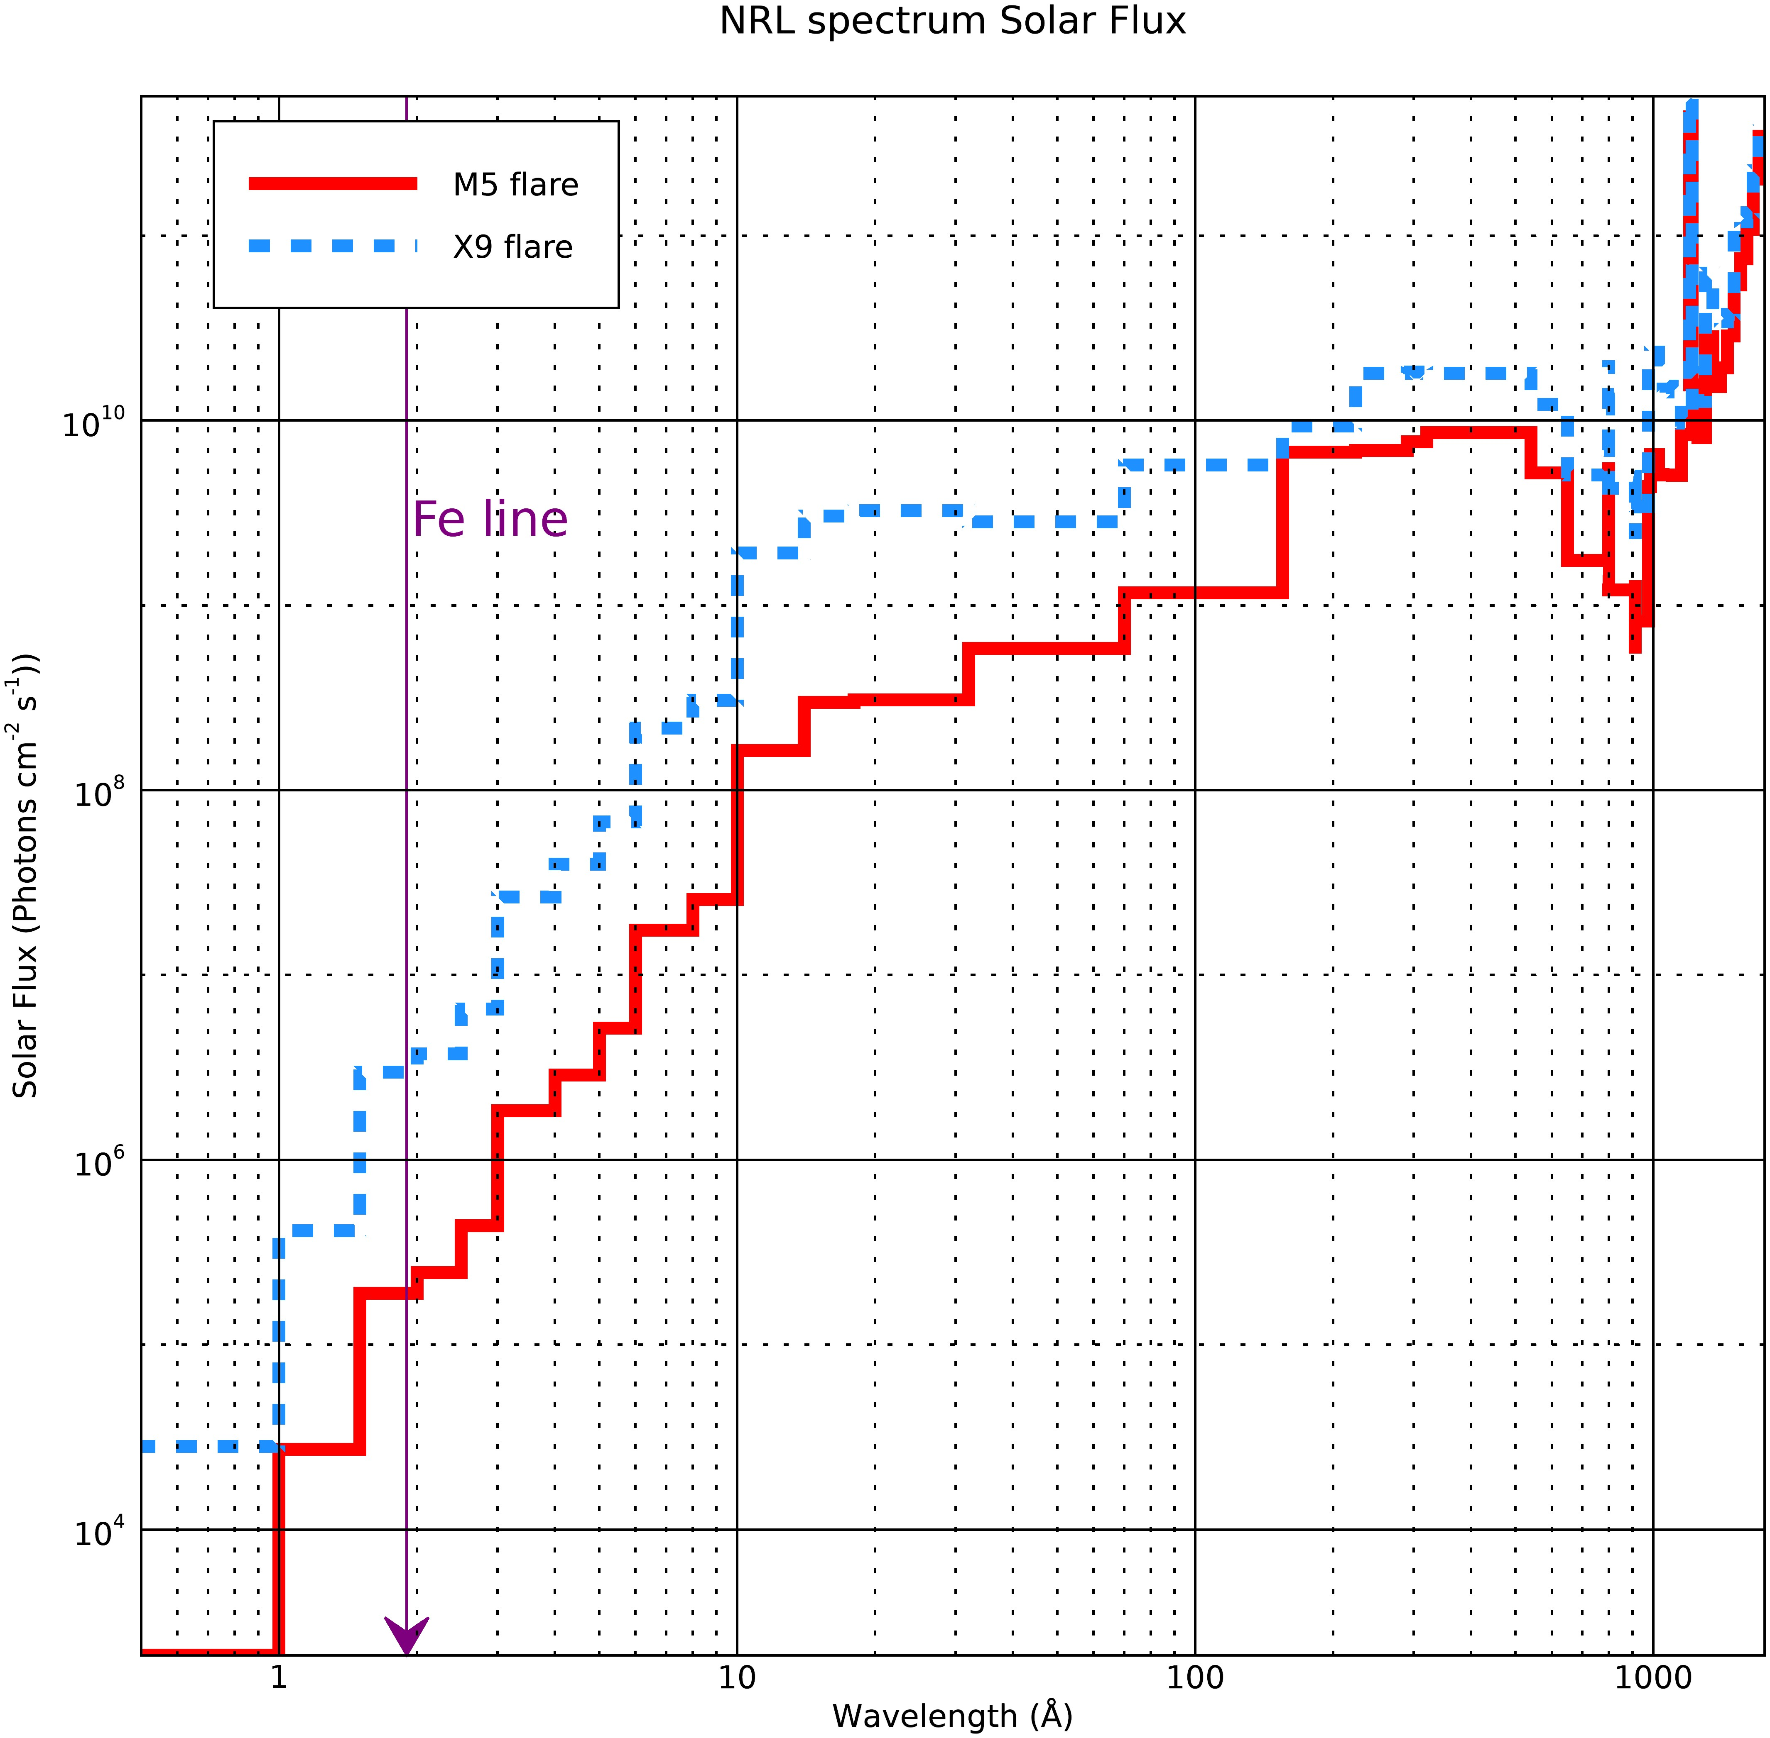
NRL Spectra
1.This is the NRL spectra for two flares m5 and x9.
2. In the plot on the right side, I have simply plotted the two spectra.
6/5/20

Slide 4
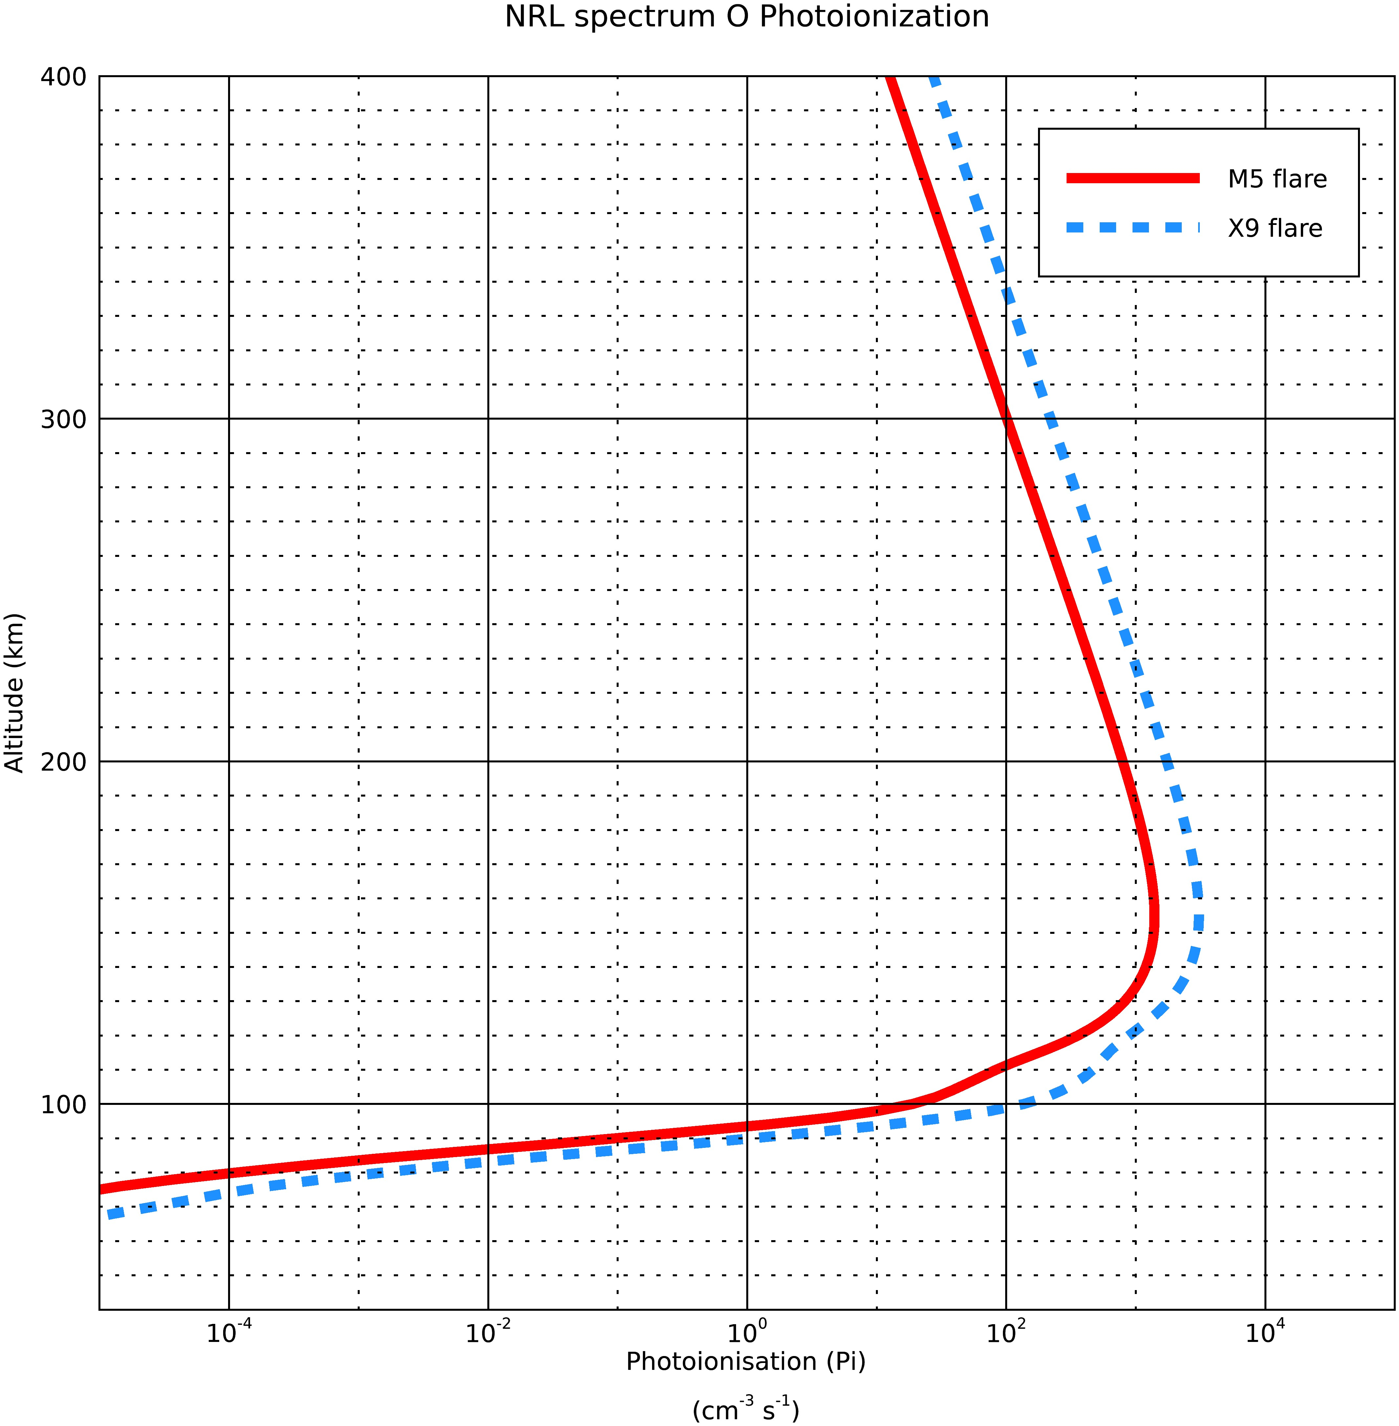
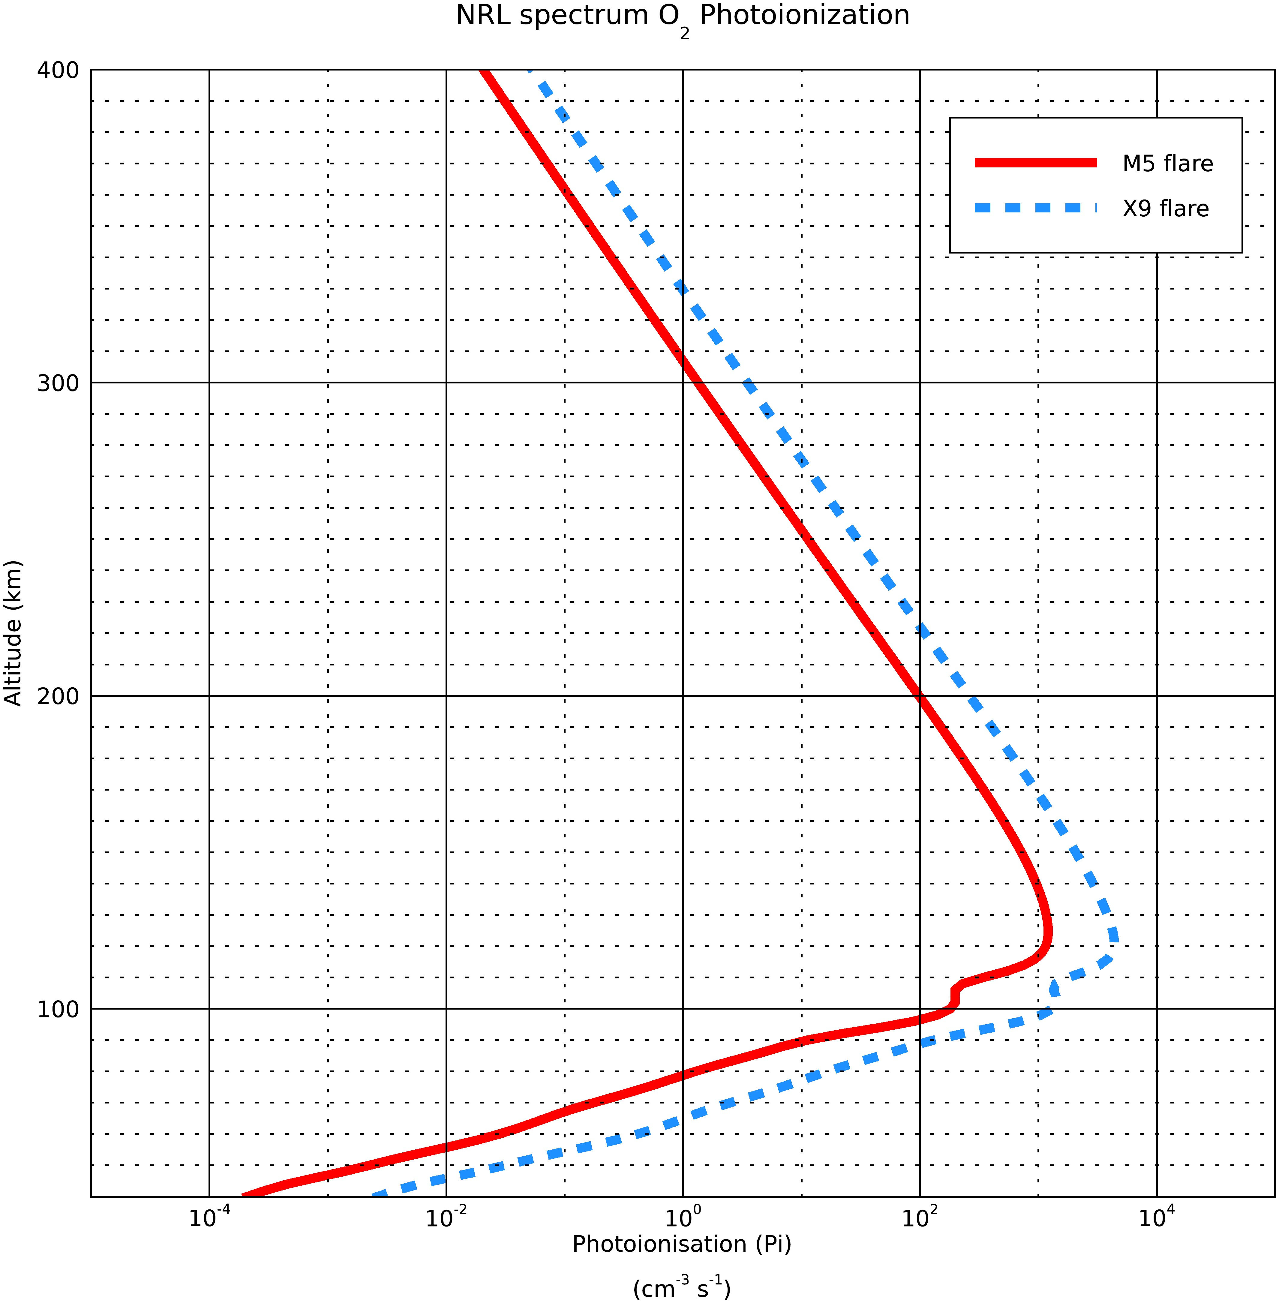
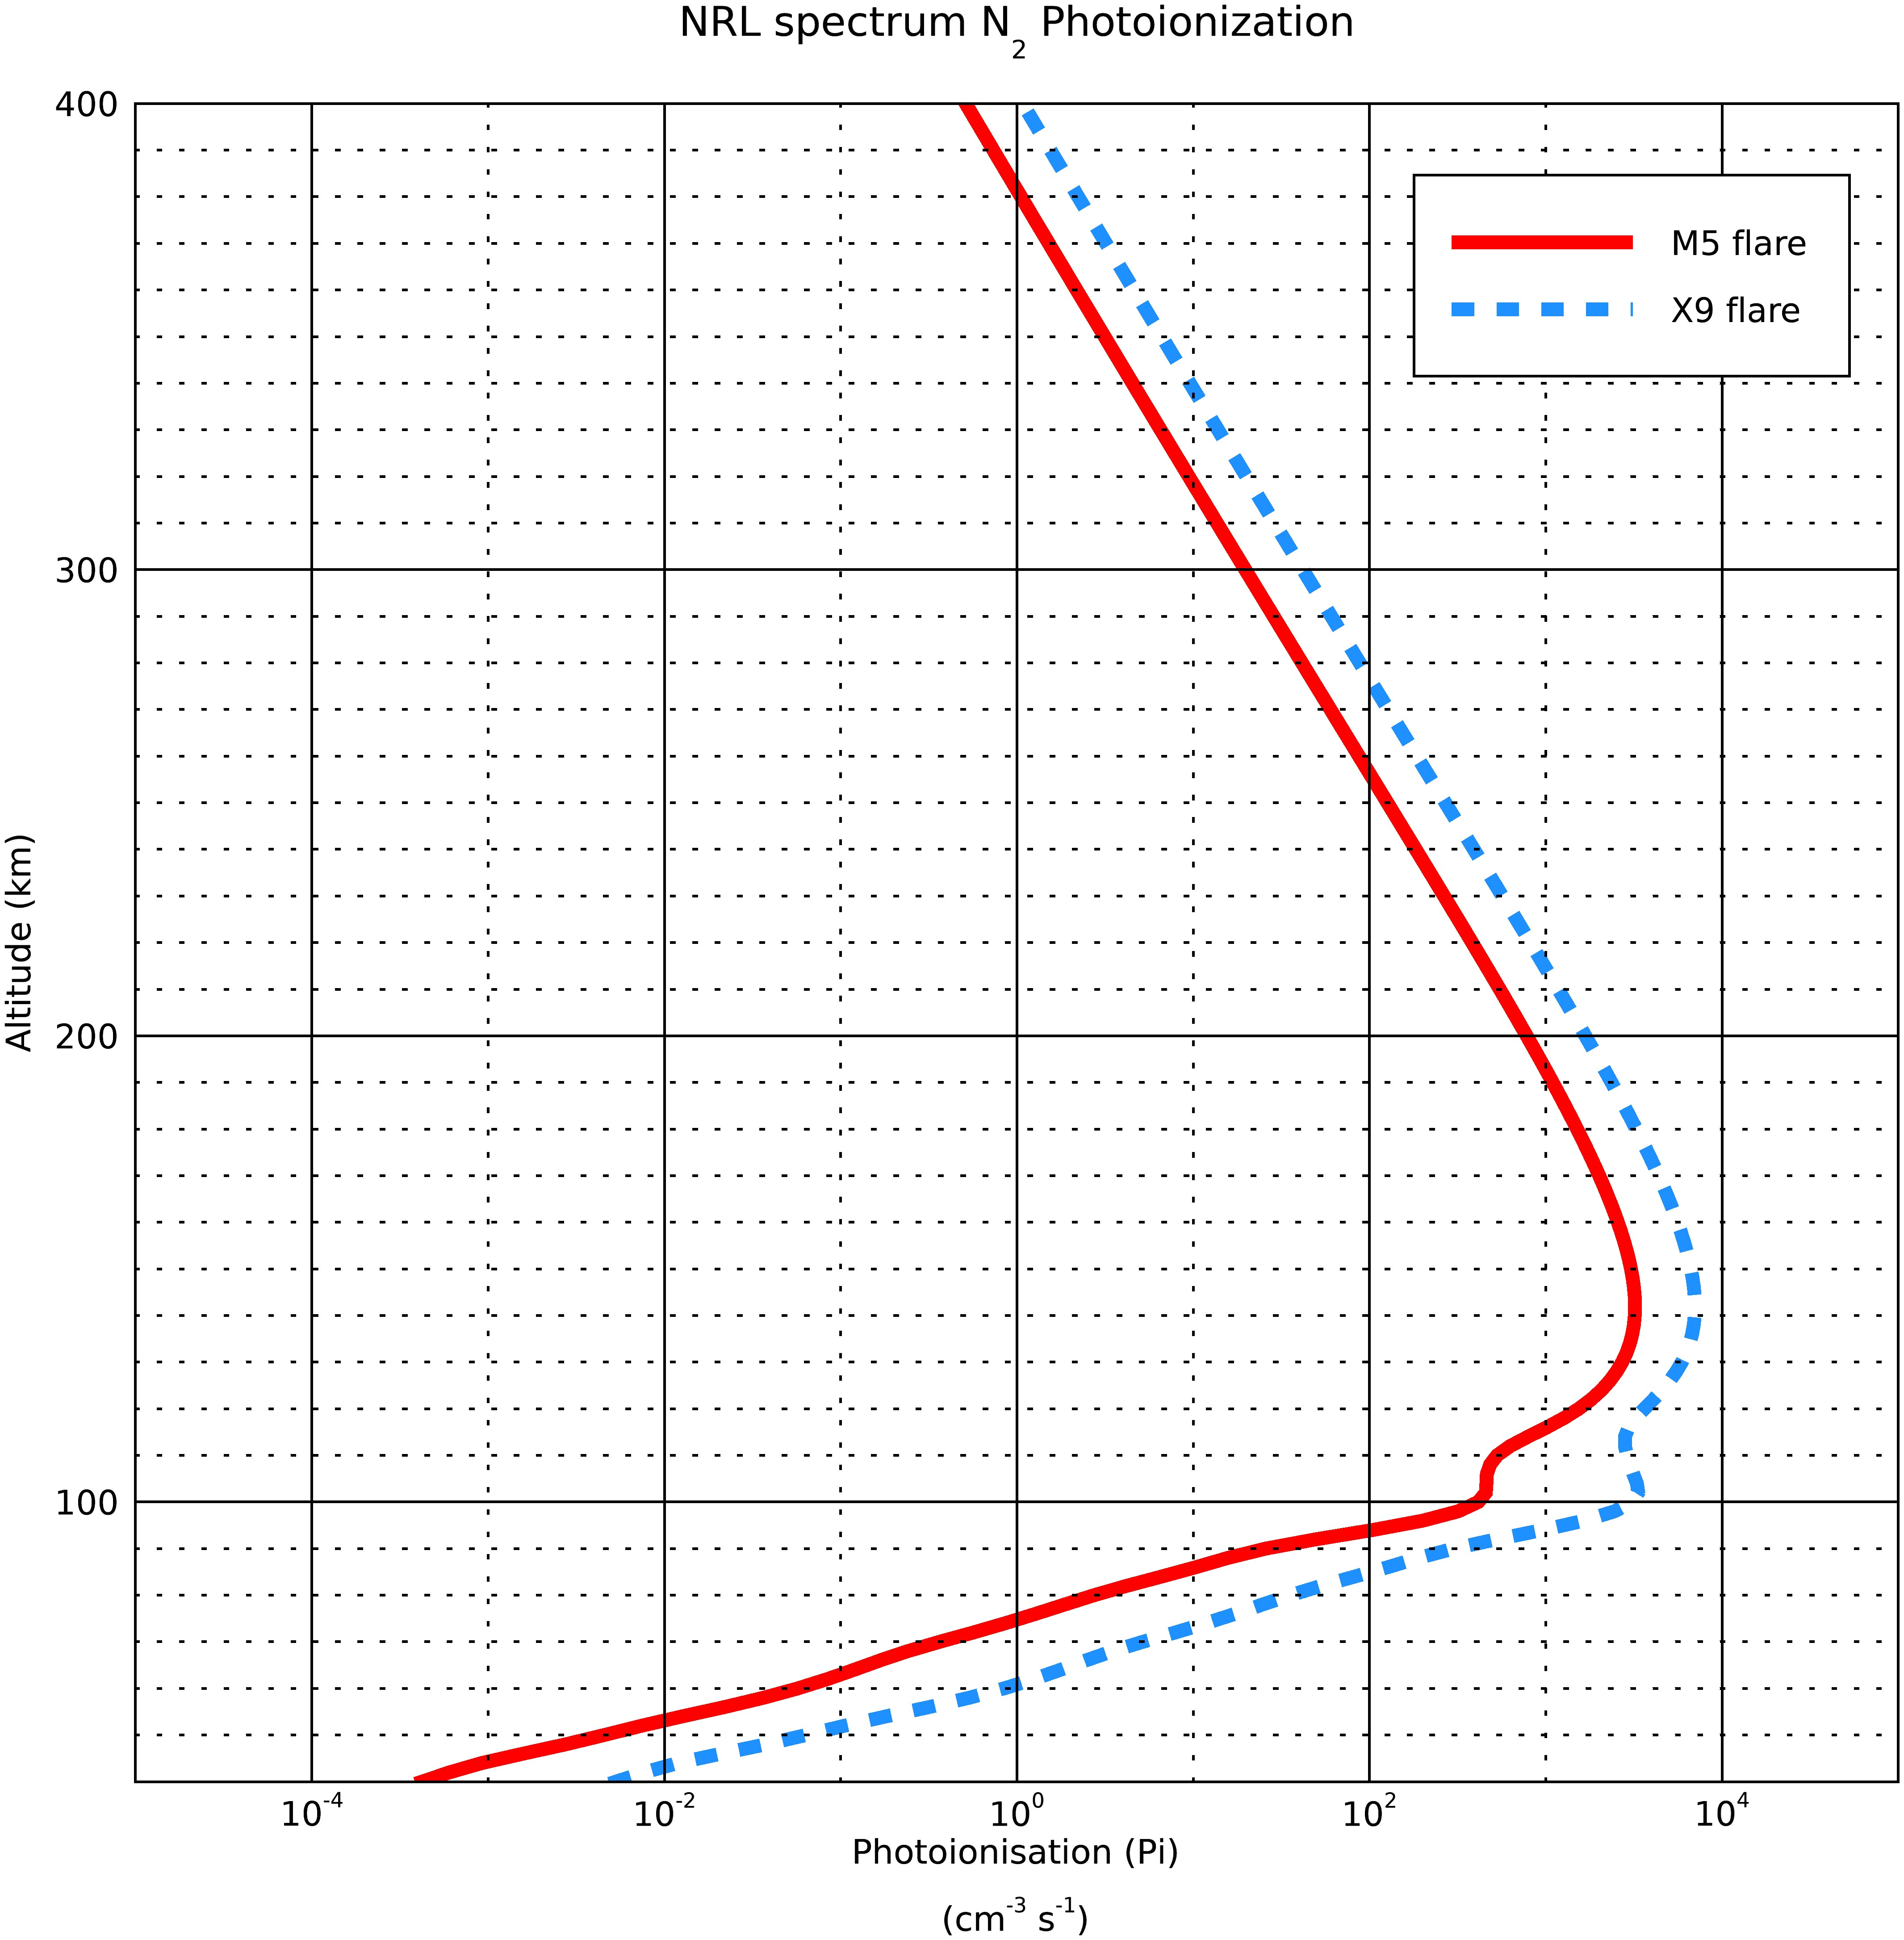
Photoionsation rates for the two spectra
6/5/20

Slide 5
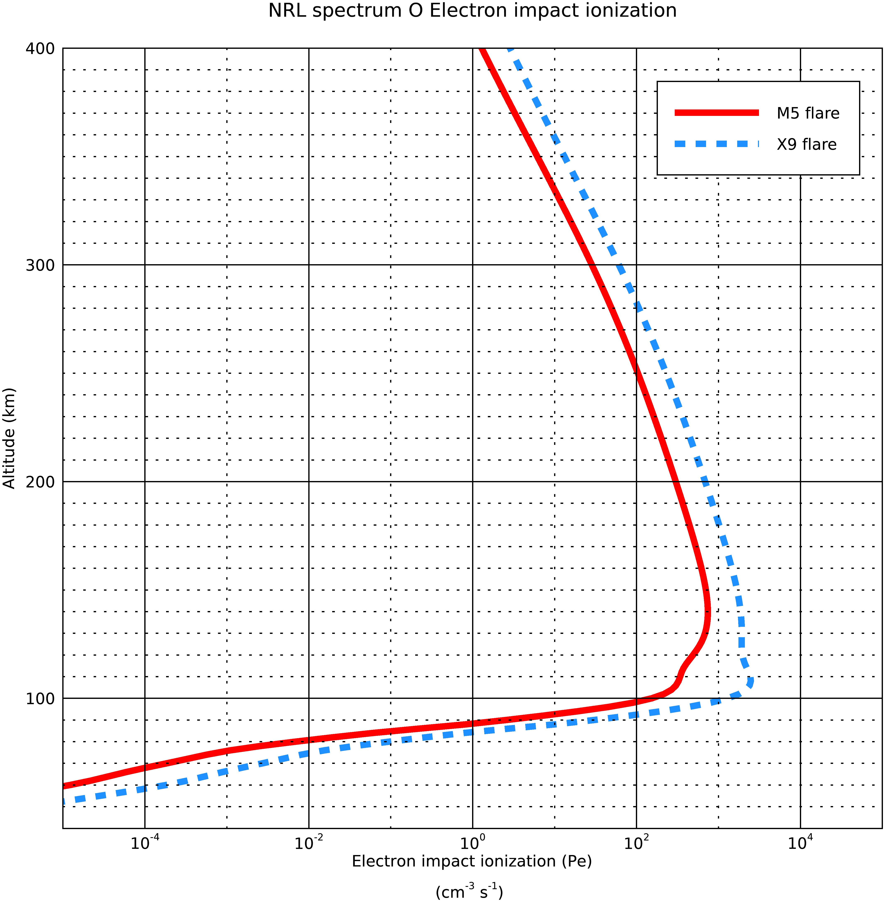
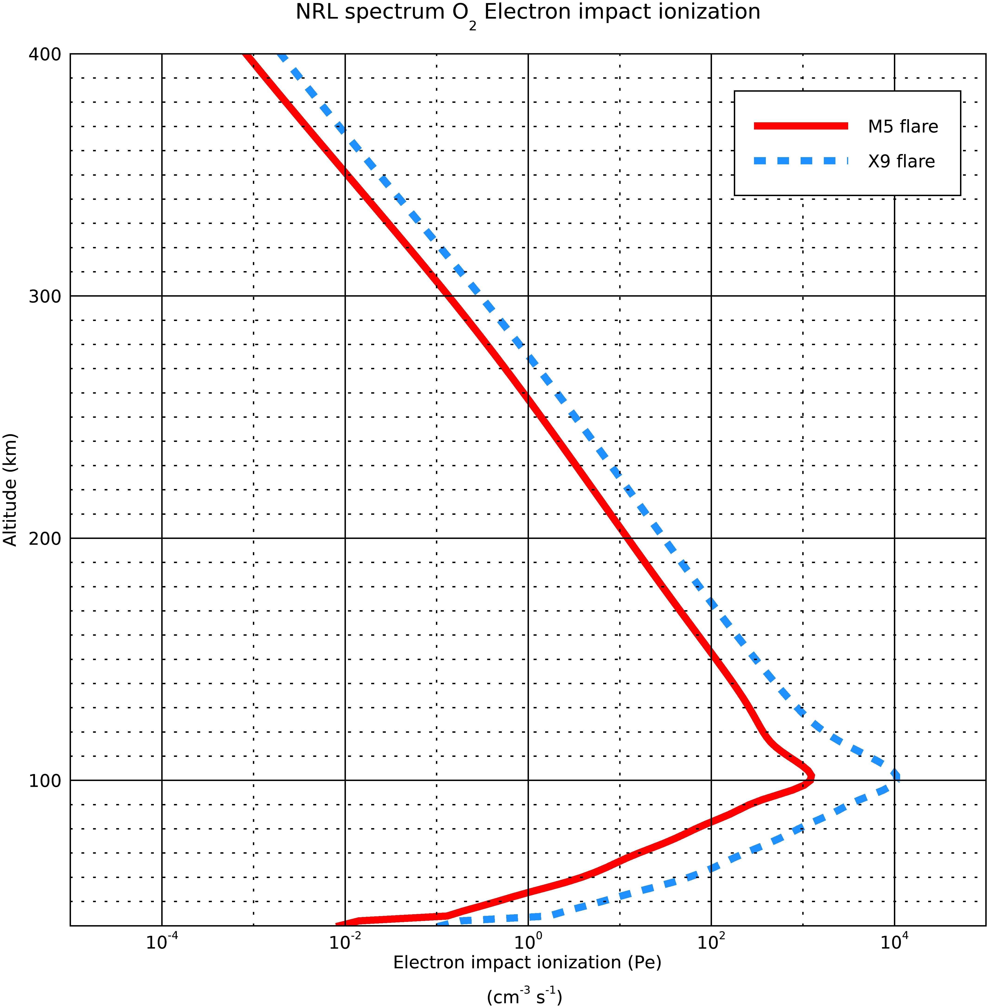
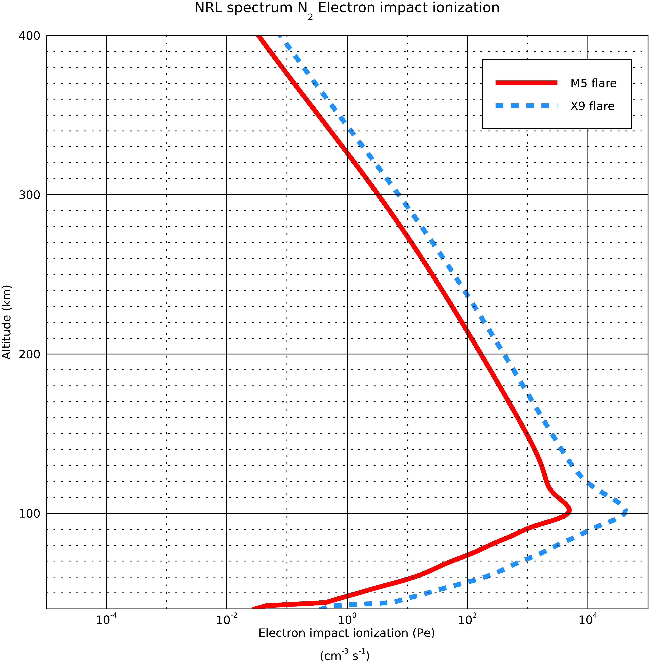
Photoelectron ionisation rates for the two spectra
6/5/20

Slide 6
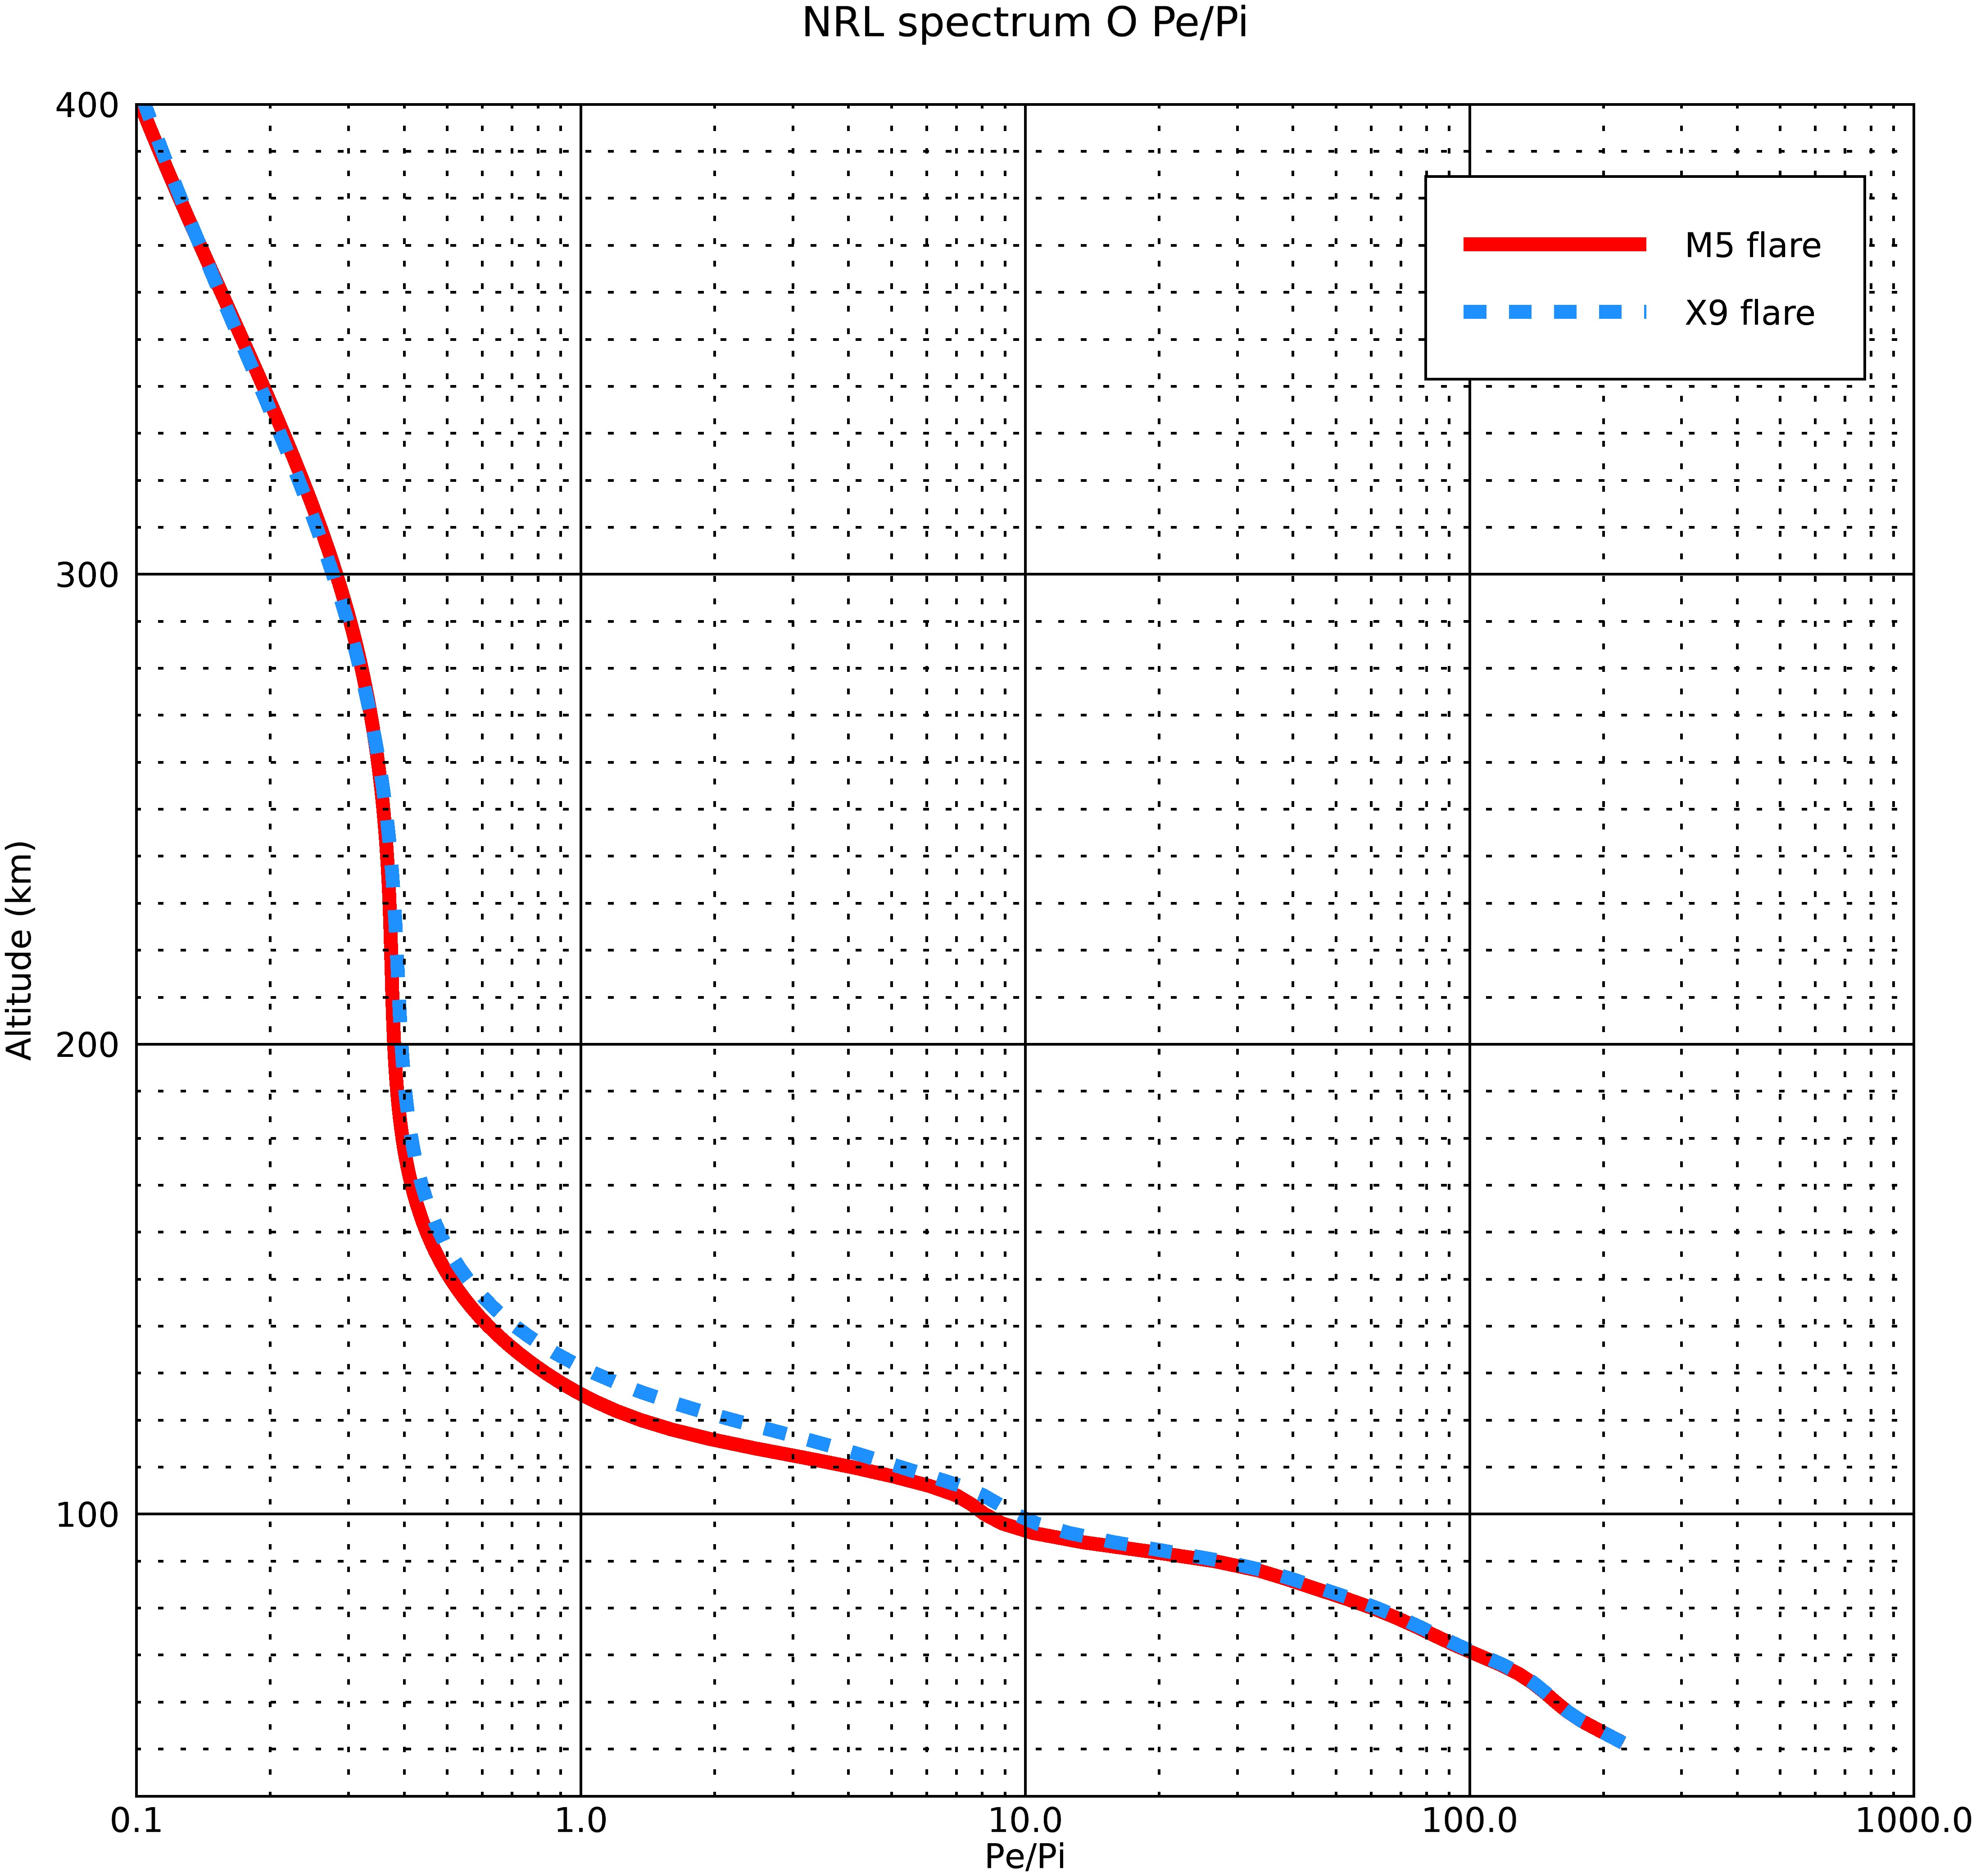
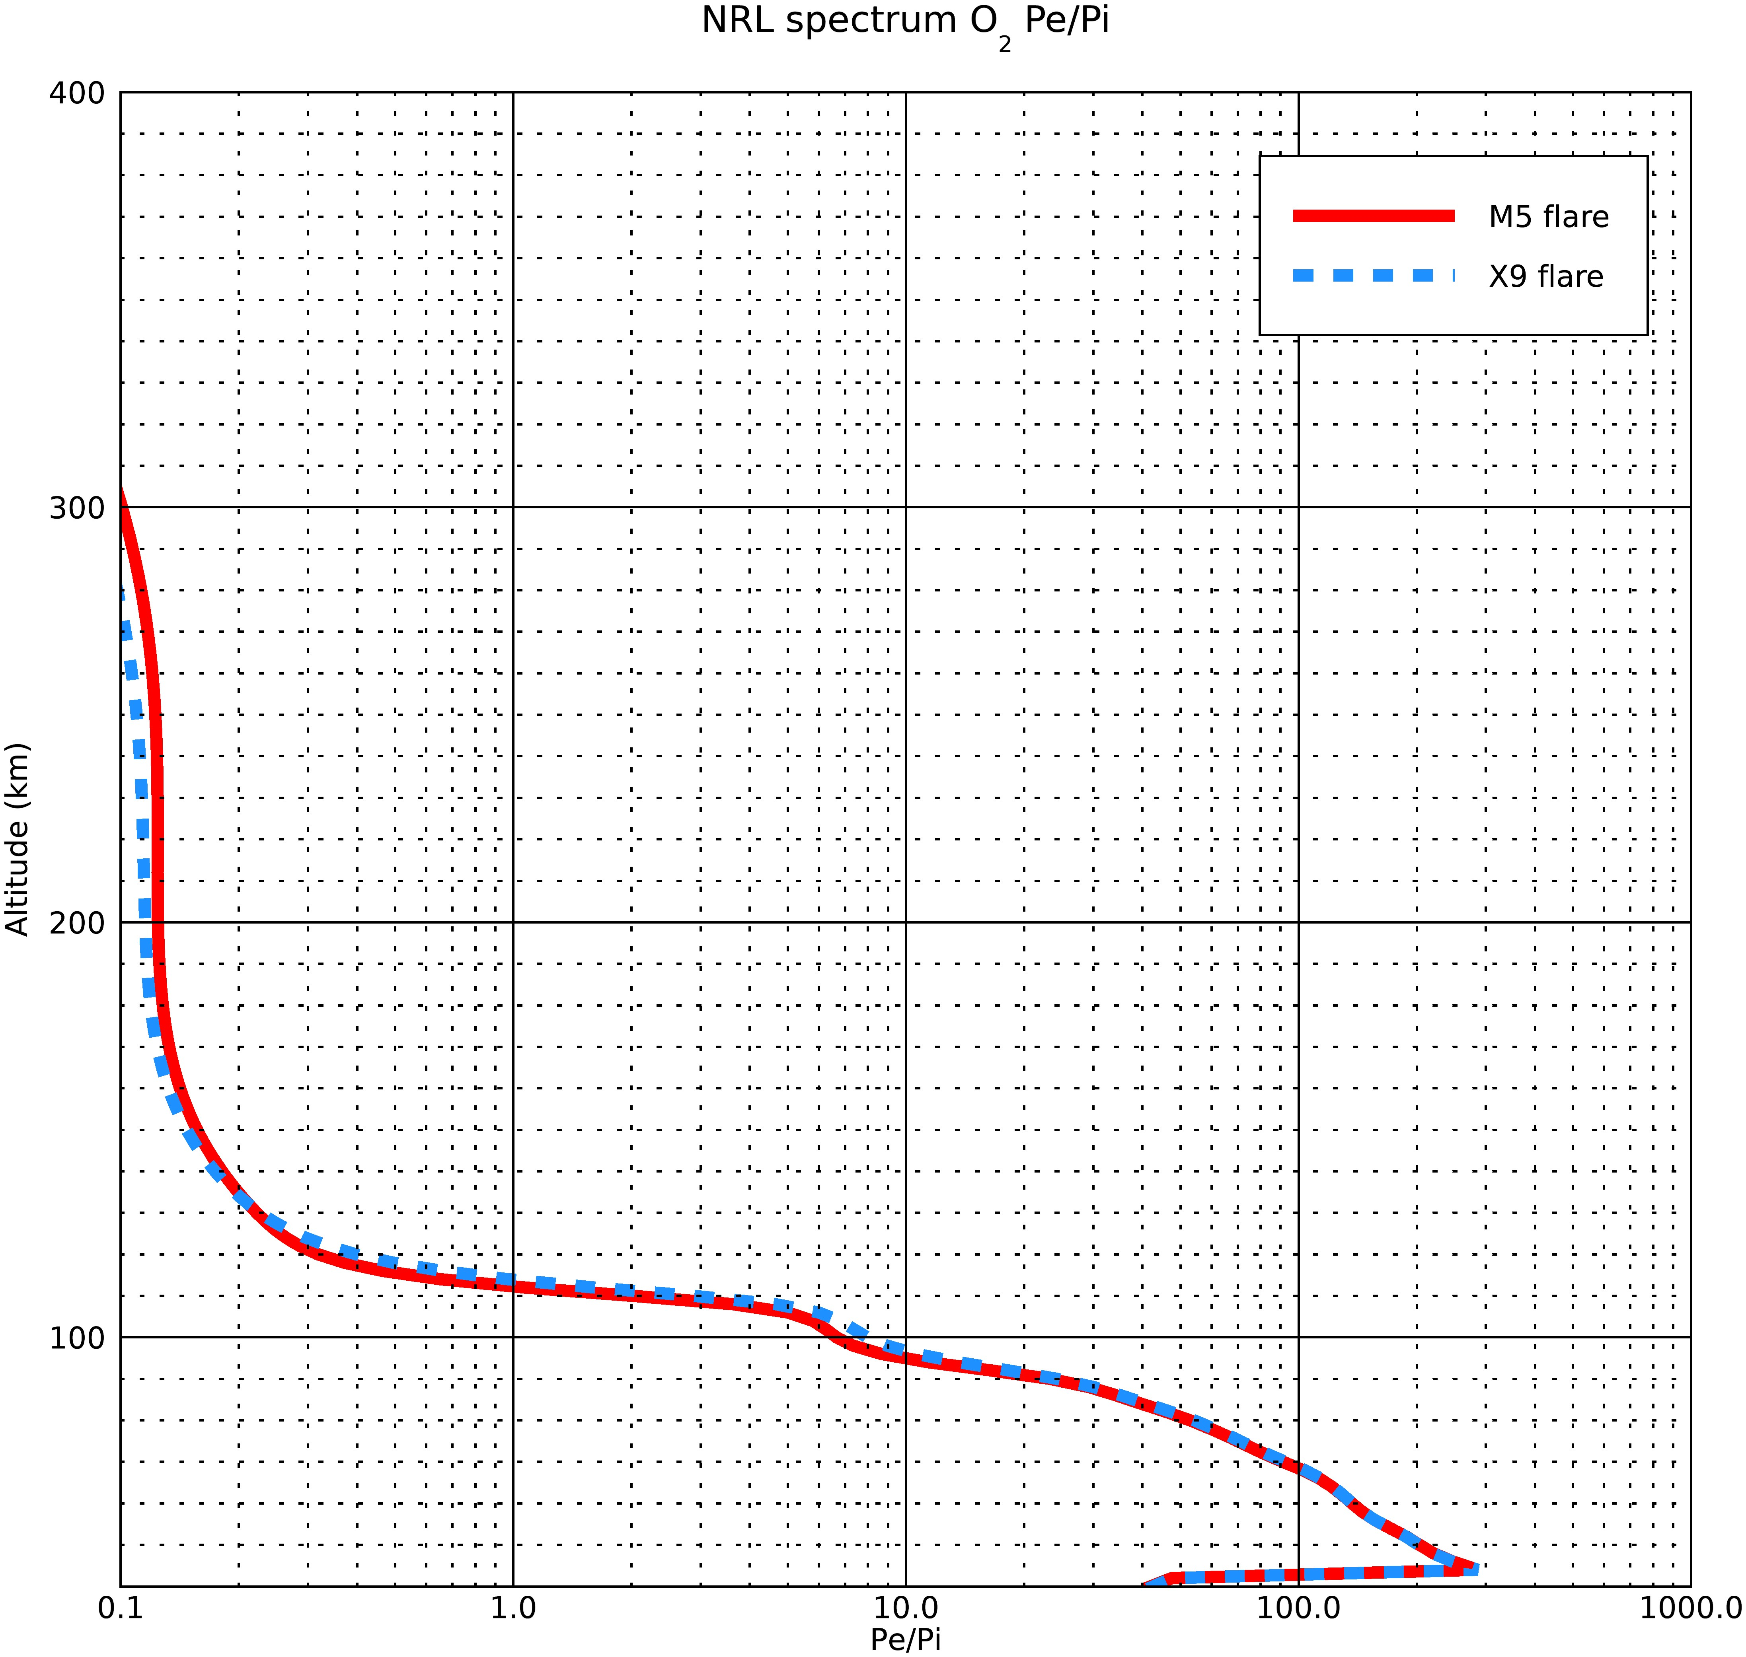
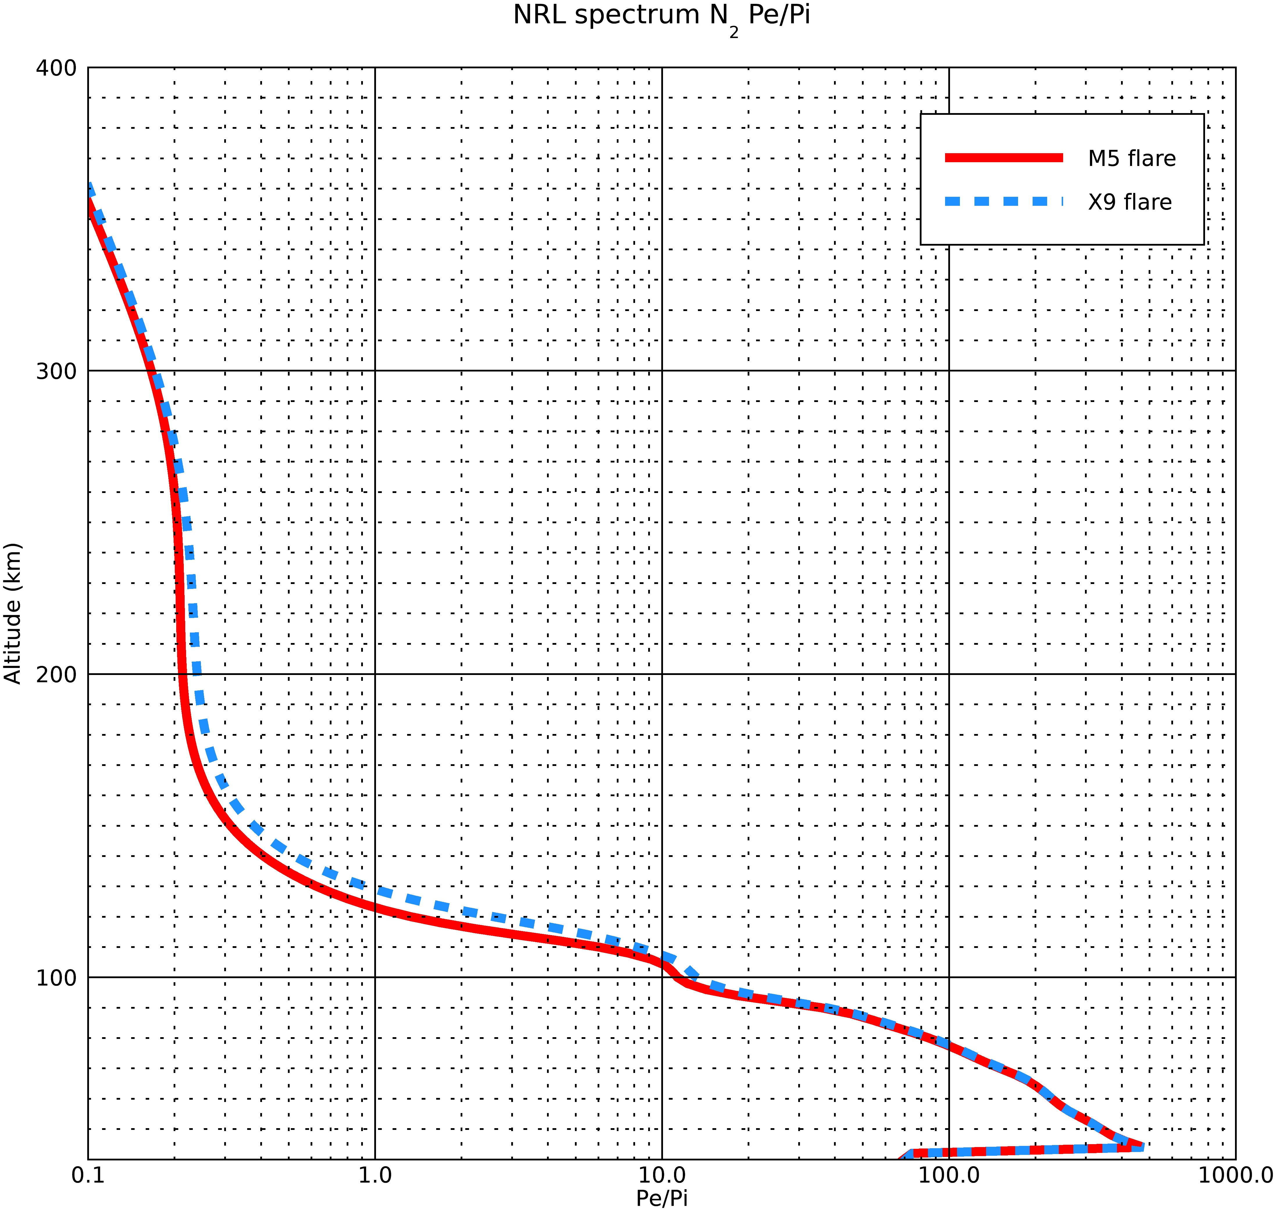
Pe/Pi ratios for the two spectra
6/5/20

Slide 7
Explanation of plots of slides 3-5
1. These are the normal 3 plots that I always do:
a. Photoionisation rates (Pi)
b. Photoelectron ionisation rates (Pe)
c. Pe/Pi ratios
2. Basically, the x9 flare is stronger than the m5 flare, so the Pi and the Pe are larger for the x9, which is expected
3. Last time, there was a problem when I was checking with SQ’05 and SQ’05 + Fe line (supplied by Dave). I was supposed to get more Pe and Pi for the latter case,since there was an added Fe line, but I did not.
That was mainly because the NRL spectra did not have the same binning as the SQ’05 paper, but I had taken the cross-sections given in the paper and so the results were not correct.
4. Here the results are correct because with more solar flux, I am getting increased photoionisation and photoelectron production.
6/5/20

Slide 8
Comparisons of the model data with calculated N₂ results
Calculated | Results
Bin # | λ min (A) | λ max (A) | Mean λ (A) | Mean σN2abs (mega-barns) | Alt of tau=1 (km)
1 | 0.5 | 1 | 0.75 | 2.48e-5 | 43
2 | 1 | 1.5 | 1.25 | 1.47e-4 | 55.5
3 | 1.5 | 2 | 1.75 | 4.57e-4 | 63.5
4 | 2 | 2.5 | 2.25 | 1.02e-3 | 69.1
5 | 2.5 | 3 | 2.75 | 1.9e-3 | 73.3
6 | 3 | 4 | 3.5 | 4.0e-3 | 78.7
7 | 4 | 5 | 4.5 | 8.55e-3 | 84
8 | 5 | 6 | 5.5 | 1.55e-2 | 88.1
9 | 6 | 8 | 7 | 3.12e-2 | 93
10 | 8 | 10 | 9 | 6.32e-2 | 98
11 | 10 | 14 | 12 | 0.14 | 103.5
12 | 14 | 18 | 16 | 0.30 | 109
Model Results
σN2abs (mega-barns) | Alt of tau=1 (km) | Exact value of optical depth tau
3.38E-05 | 46 | 1.12
1.49E-04 | 58 | 1.02
4.55E-04 | 64 | 1.32
1.03E-03 | 70 | 1.21
2.04E-03 | 74 | 1.26
3.91E-03 | 78 | 1.25
8.59E-03 | 82 | 1.39
1.56E-02 | 86 | 1.22
3.15E-02 | 90 | 1.17
6.43E-02 | 94 | 1.15
1.41E-01 | 98 | 1.24
3.02E-01 | 102 | 1.31
Altitued Difference (km)
3
2.5
0.5
0.9
0.7
0.7
2
2.1
3
4
5.5
7
6/5/20

Slide 9
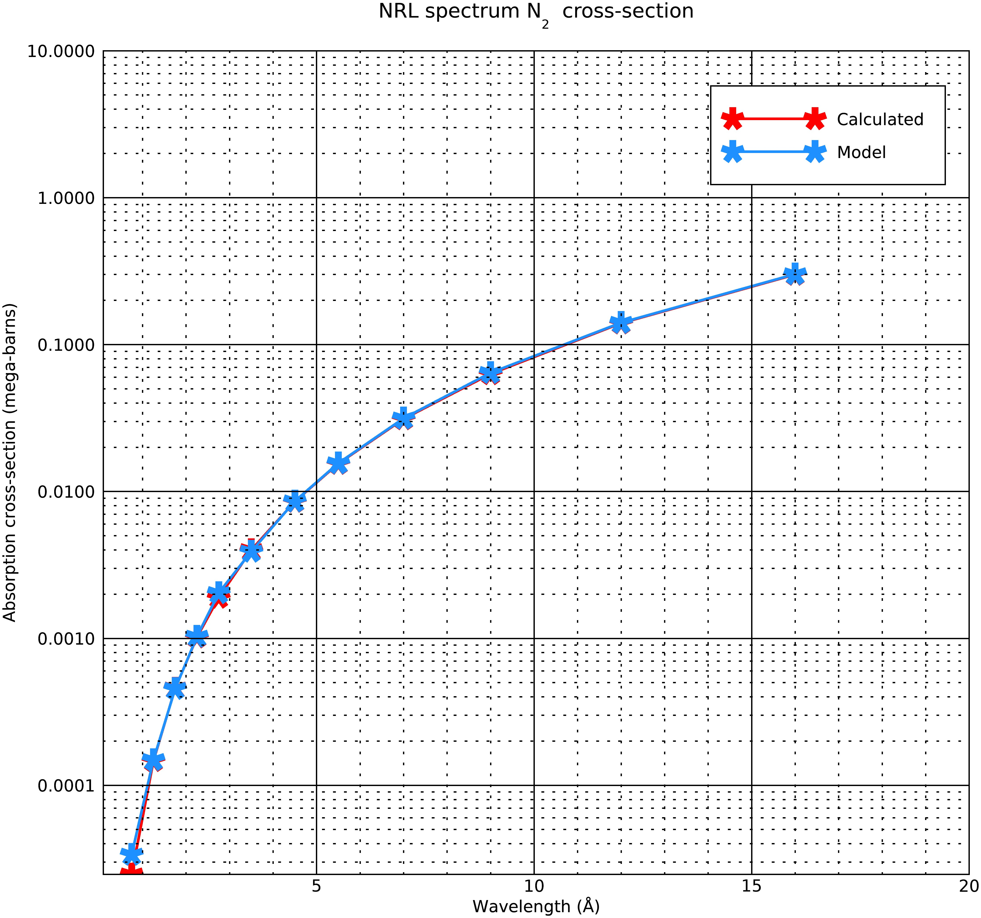
Calculated and Model N2 absorption cross-sections
The plot on the right is the calculated (red) and the model (blue) N2 absorption cross-sections
The model calculates the cross-sections at these wavelengths by interpolating the Henke +Fennelly data at the solar flux wavelength bins
The calculated cross-sections are average values at the solar flux wavelengths
The values are almost equal

Slide 10
Appendix
Results of the Model- M5 flare
O2 data
Bin # | λ min (A) | λ max (A) | Mean λ (A) | Mean σσO2abs (mega-barns) | Alt of tau=1 (km) | pe/pi
1 | 0.5 | 1 | 0.75 | 6.21E-05 | 46 | 334.877
2 | 1 | 1.5 | 1.25 | 2.73E-04 | 58 | 186.124
3 | 1.5 | 2 | 1.75 | 8.33E-04 | 64 | 130.287
4 | 2 | 2.5 | 2.25 | 1.88E-03 | 70 | 100.683
5 | 2.5 | 3 | 2.75 | 3.66E-03 | 74 | 81.520
6 | 3 | 4 | 3.5 | 6.95E-03 | 78 | 64.217
7 | 4 | 5 | 4.5 | 1.50E-02 | 82 | 48.234
8 | 5 | 6 | 5.5 | 2.66E-02 | 86 | 37.864
9 | 6 | 8 | 7 | 5.25E-02 | 90 | 28.250
10 | 8 | 10 | 9 | 1.05E-01 | 94 | 19.553
11 | 10 | 14 | 12 | 2.25E-01 | 98 | 12.568
12 | 14 | 18 | 16 | 4.71E-01 | 102 | 6.803
N2 data
Bin # | λ min (A) | λ max (A) | Mean λ (A) | Mean σσN2abs (mega-barns) | Alt of tau=1 (km) | pe/pi
1 | 0.5 | 1 | 0.75 | 3.38E-05 | 46 | 556.789
2 | 1 | 1.5 | 1.25 | 1.49E-04 | 58 | 311.116
3 | 1.5 | 2 | 1.75 | 4.55E-04 | 64 | 217.68
4 | 2 | 2.5 | 2.25 | 1.03E-03 | 70 | 166.902
5 | 2.5 | 3 | 2.75 | 2.04E-03 | 74 | 134.385
6 | 3 | 4 | 3.5 | 3.91E-03 | 78 | 104.992
7 | 4 | 5 | 4.5 | 8.59E-03 | 82 | 77.55
8 | 5 | 6 | 5.5 | 1.56E-02 | 86 | 59.915
9 | 6 | 8 | 7 | 3.15E-02 | 90 | 43.827
10 | 8 | 10 | 9 | 6.43E-02 | 94 | 29.973
11 | 10 | 14 | 12 | 1.41E-01 | 98 | 19.07
12 | 14 | 18 | 16 | 3.02E-01 | 102 | 10.289
6/5/20

Slide 11
Appendix
Results of the Model- X9 flare
O2 data
Bin # | λ min (A) | λ max (A) | Mean λ (A) | Mean σσO2abs (mega-barns) | Alt of tau=1 (km) | pe/pi
1 | 0.5 | 1 | 0.75 | 6.21E-05 | 46 | 334.877
2 | 1 | 1.5 | 1.25 | 2.73E-04 | 58 | 186.125
3 | 1.5 | 2 | 1.75 | 8.33E-04 | 64 | 130.288
4 | 2 | 2.5 | 2.25 | 1.88E-03 | 70 | 100.687
5 | 2.5 | 3 | 2.75 | 3.66E-03 | 74 | 81.5237
6 | 3 | 4 | 3.5 | 6.95E-03 | 78 | 64.220
7 | 4 | 5 | 4.5 | 1.50E-02 | 82 | 48.237
8 | 5 | 6 | 5.5 | 2.66E-02 | 86 | 37.864
9 | 6 | 8 | 7 | 5.25E-02 | 90 | 28.252
10 | 8 | 10 | 9 | 1.05E-01 | 94 | 19.552
11 | 10 | 14 | 12 | 2.25E-01 | 98 | 12.565
12 | 14 | 18 | 16 | 4.71E-01 | 102 | 6.802
N2 data
Bin # | λ min (A) | λ max (A) | Mean λ (A) | Mean σσN2abs (mega-barns) | Alt of tau=1 (km) | pe/pi
1 | 0.5 | 1 | 0.75 | 3.38E-05 | 46 | 556.789
2 | 1 | 1.5 | 1.25 | 1.49E-04 | 58 | 311.116
3 | 1.5 | 2 | 1.75 | 4.55E-04 | 64 | 217.68
4 | 2 | 2.5 | 2.25 | 1.03E-03 | 70 | 166.908
5 | 2.5 | 3 | 2.75 | 2.04E-03 | 74 | 134.391
6 | 3 | 4 | 3.5 | 3.91E-03 | 78 | 104.998
7 | 4 | 5 | 4.5 | 8.59E-03 | 82 | 77.554
8 | 5 | 6 | 5.5 | 1.56E-02 | 86 | 59.918
9 | 6 | 8 | 7 | 3.15E-02 | 90 | 43.829
10 | 8 | 10 | 9 | 6.43E-02 | 94 | 29.971
11 | 10 | 14 | 12 | 1.41E-01 | 98 | 19.066
12 | 14 | 18 | 16 | 3.02E-01 | 102 | 10.286
6/5/20

Slide 12
Conclusions
The main result that I wanted to check if the altitudes of unit optical depth from the calculations are close to that obtained from the model. In the calculations, it is assumed that the all the atmosphere is N₂ and also the solar zenith angle is zero degree. The model has a zenith angle of 1 degree. That hardly changes the altitudes.
Most of the tau=1 altitudes from the model are about 3km off from the calculated values. Not sure if this accuracy will suffice.
I also added the pe/pi ratios for N₂ and O₂ for both the M5 and X9 flares. If you compare, them, they are equal for both of the flare conditions for each species.
Also, the plots of the spectra are added in the beginning. The X9 is the stronger flare and so the photo-ionisation and photo-electron ionisation rates are greater in the X9 flare case.
Lastly, you can see that the pe/pi ratios for all the three species (slide 5) remain constant for the m5 and x9 flare conditions, which is the ultimate goal.
6/5/20

