Slide 1
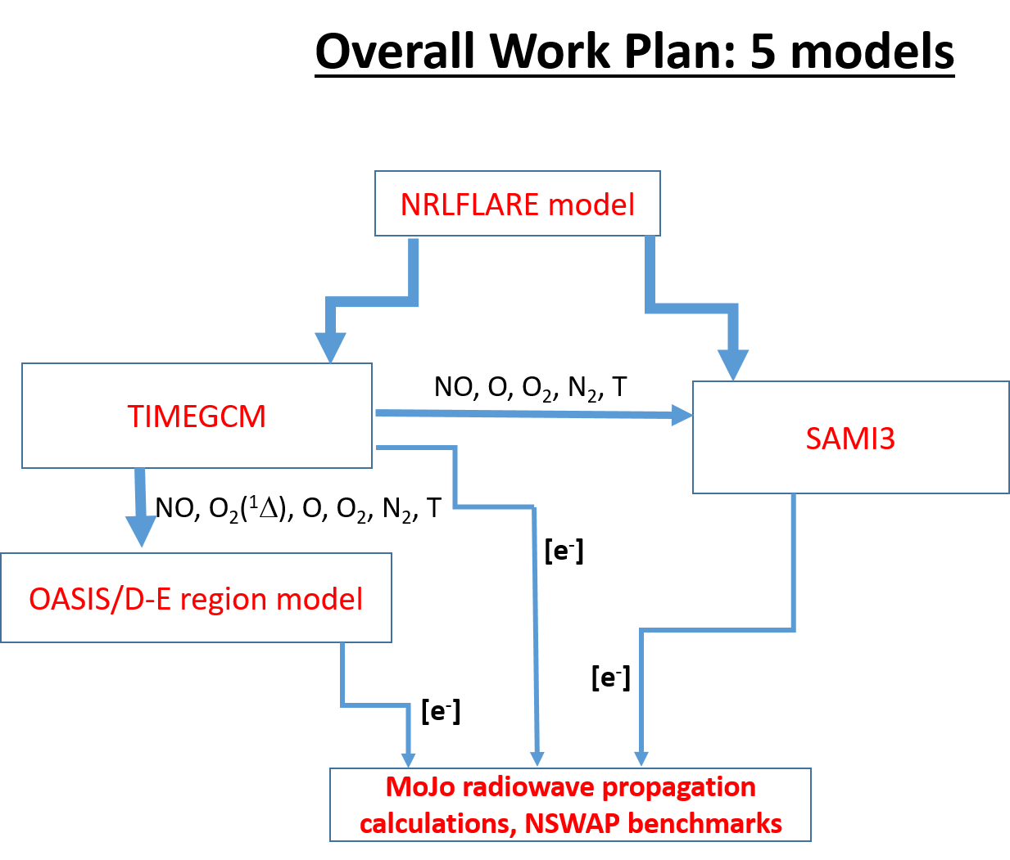

Slide 2
Solar flux needs for TIMEGCM (MLT and part of I) and OASIS (D-region: 60-90 km)
EUV/Xray ionization in 37 wavelength bins in current models.
Scaling by something called EUVAC.
Flares not considered
My task for year 1 → revise the binning and use new solar spectra
to accommodate Xray variability.

Slide 3
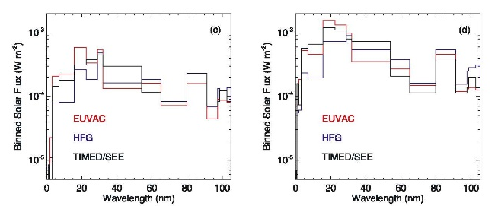
Coarse solar flux binning: 37 bands (Solomon and Qian, 2005)
4 bins cover about factor of 50 in energy at soft/hard X ray wavelengths!

Slide 4
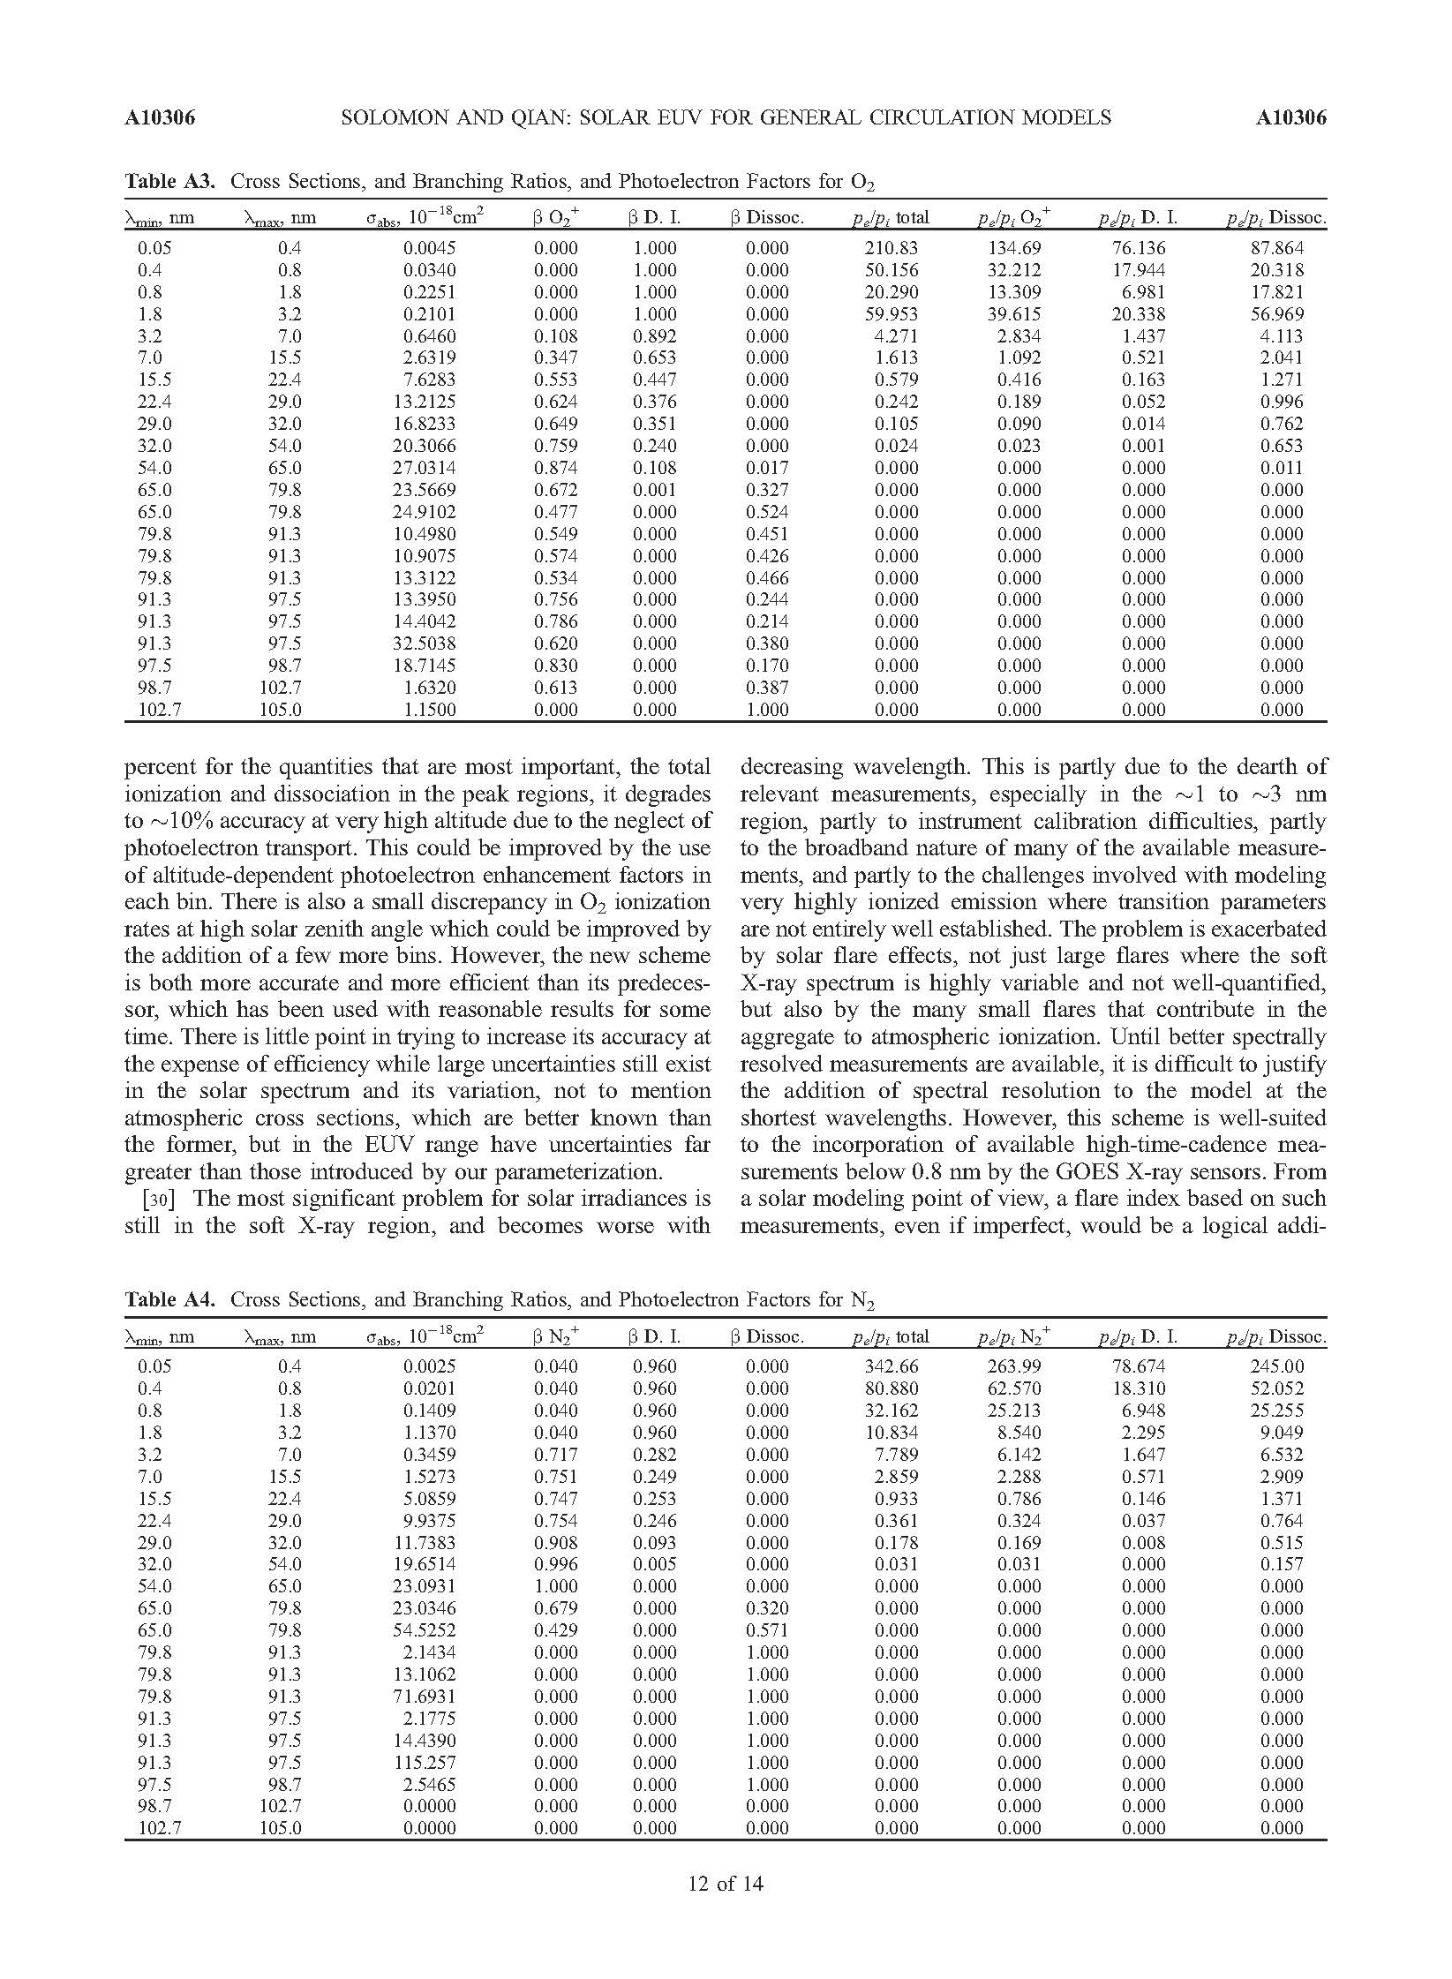
Binned cross sections and photoelectron ionization scaling
For N₂
Coarse energy binning
at shortest wavelengths
Multiple ionization factors
required for shortest
wavelengths
Auger edge in ionization.
Otherwise cross sections vary
monotonically at highest energies
Ly α absorption by O₂
included here

Slide 5
Comparison of low res SQ05 with detailed cross section vs. energy

Slide 6
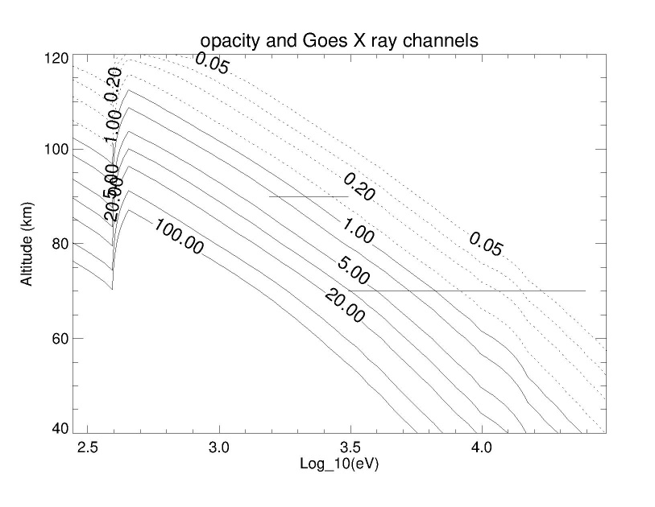
Cross sections vs. altitude of absorption: one to one (mostly)
Maximum ionization is at optical depth = 1 → τ = σ(λ) n(z)dz
→ Desired altitude resolution defines the required spectral bin widths?
2 GOES channels and 1 soft X ray bin

Slide 7
My approach follows SQ05
Vtech has an IDL version of Solomon’s photoelectron model- following SQ05, will run for specific energies to
calculate photoelectron enhancement.
SQ05 approach is to use value of photoelectron enhancement at τ = 1 as representative of a particular energy bin
FUV? Effects heating. TIMEGCM has an F107 scaled heating param. Timescales too short for flare?

