Slide 1
Photoionsation and Photoelectron ionosation rate calcualtions for NRL new bins for X-rays

Slide 2
Theoritical Calculation of altitude of unit optical depth (referred here as “Table data”)
Calculated | Results
Bin # | λ min (A) | λ max (A) | Mean λ (A) | Mean σN2abs (mega-barns) | Alt of tau=1 (km)
1 | 0.5 | 1 | 0.75 | 2.48e-5 | 43
2 | 1 | 1.5 | 1.25 | 1.47e-4 | 55.5
3 | 1.5 | 2 | 1.75 | 4.57e-4 | 63.5
4 | 2 | 2.5 | 2.25 | 1.02e-3 | 69.1
5 | 2.5 | 3 | 2.75 | 1.9e-3 | 73.3
6 | 3 | 4 | 3.5 | 4.0e-3 | 78.7
7 | 4 | 5 | 4.5 | 8.55e-3 | 84
8 | 5 | 6 | 5.5 | 1.55e-2 | 88.1
9 | 6 | 8 | 7 | 3.12e-2 | 93
10 | 8 | 10 | 9 | 6.32e-2 | 98
11 | 10 | 14 | 12 | 0.14 | 103.5
12 | 14 | 18 | 16 | 0.30 | 109
6/21/20

Slide 3
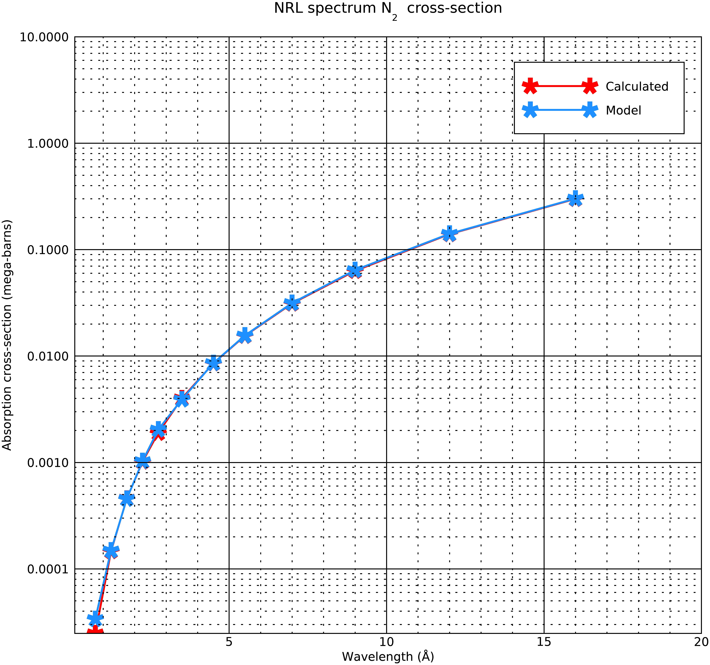
Calculated and Model N2 absorption cross-sections
The red line is the table (slide 2) N₂ cross-sections and the blue line is the photoelectron model N₂ absorption cross-sections
The model calculates the cross-sections at these wavelengths by interpolating the Henke +Fennelly data at the solar flux wavelength bins
The slide 2 cross-sections are average values at the solar flux wavelengths
The cross-section of the first bin is different in the model and the table.
Changing the cross-sections only changes the altitude of unit optical depth in the first bin by 1 km.
From the Henke + Fennelly data, and the model value is more accurate than the table value.

Slide 4
NRL Spectra- Binning Procedure
The binning procedure for xray flare ionization parameterization (Done by NRL) as below:
“Break up the three shortest wavelength bins of Solomon and Qian into 12 higher resolution bins. Bins to be expanded are the 0.5-4 A, 4-8A and 8-18A”
The selection of bins gives roughly 5 km resolution between 60-100 km.
wave_low | wave_low
0.5 | 1
1 | 1.5
1.5 | 2
2 | 2.5
2.5 | 3
3 | 4
4 | 5
5 | 6
6 | 8
8 | 10
10 | 14
14 | 18
18 | 32
32 | 70
70 | 155
155 | 224
224 | 290
290 | 320
320 | 540
6/21/20

Slide 5
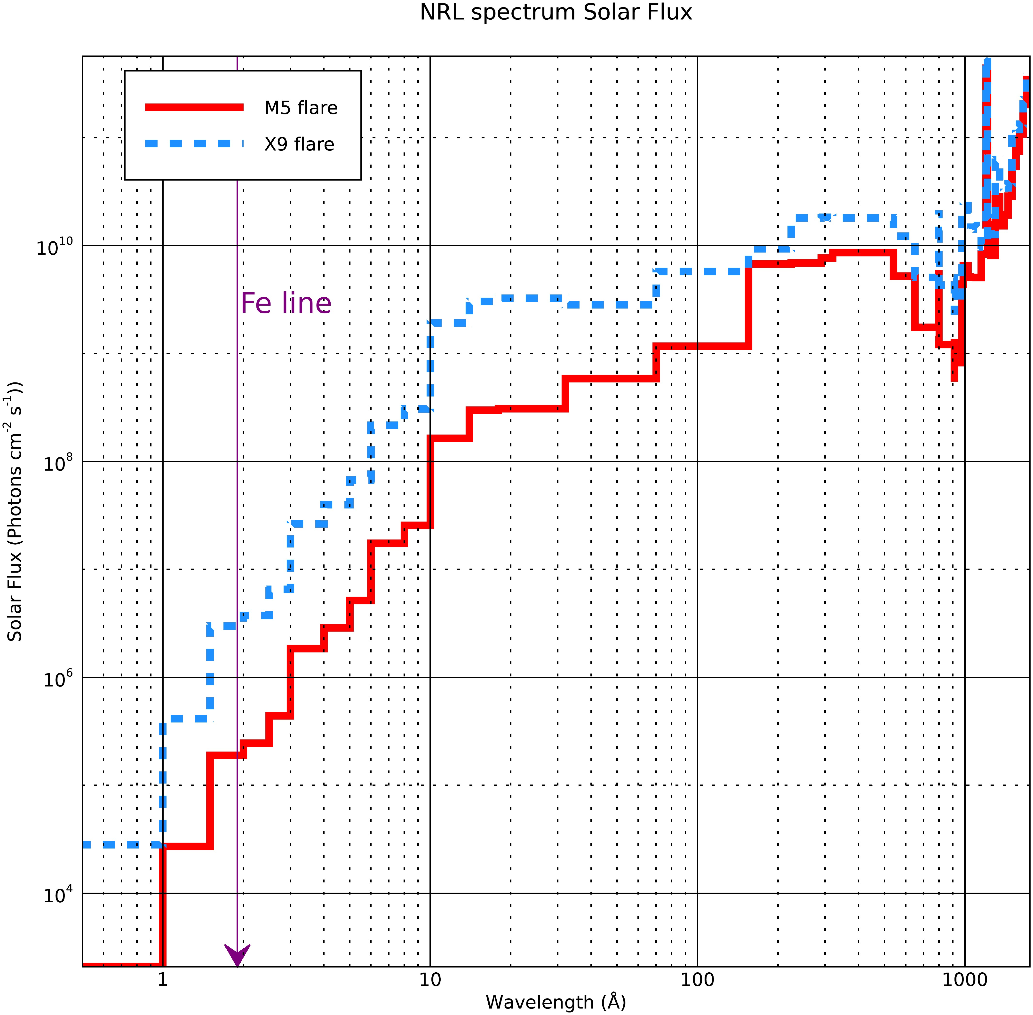
NRL Spectra
This is the NRL spectra for two flares m5 and x9.
6/21/20

Slide 6
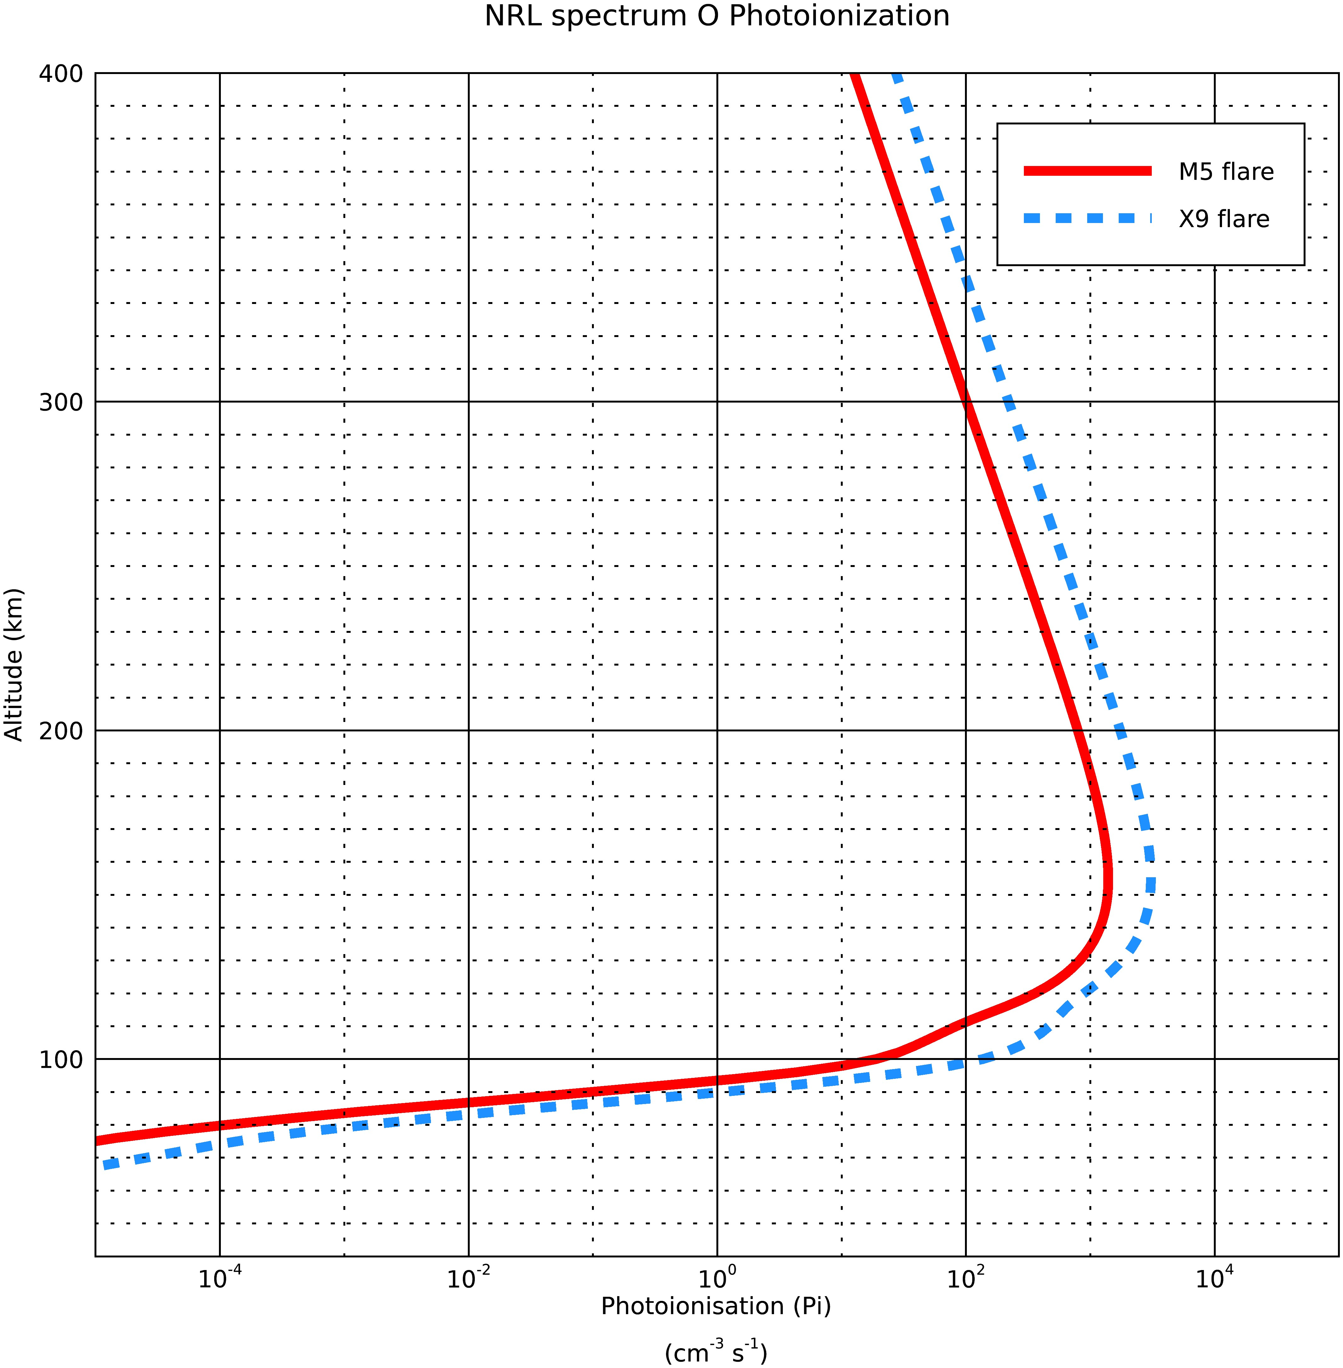
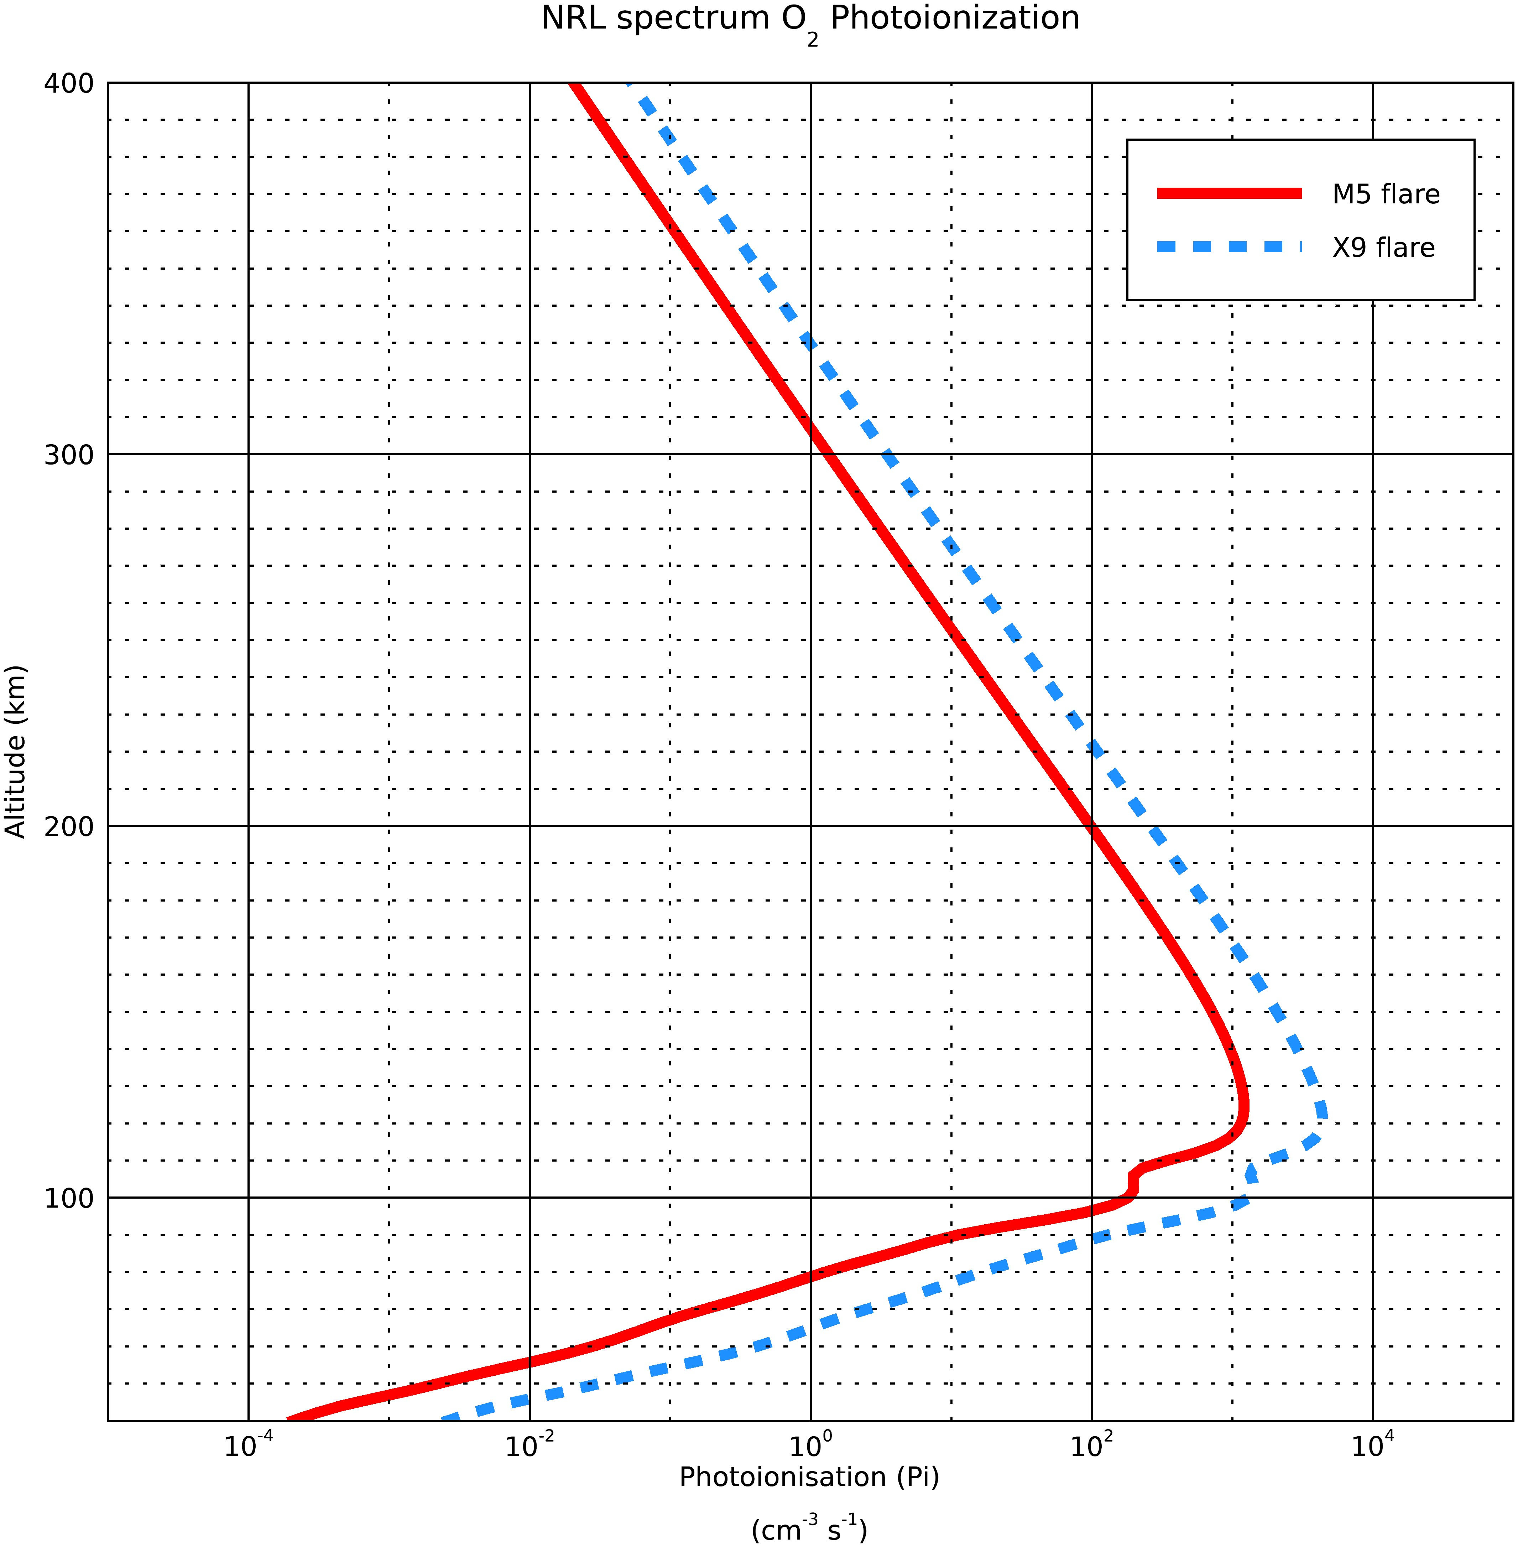
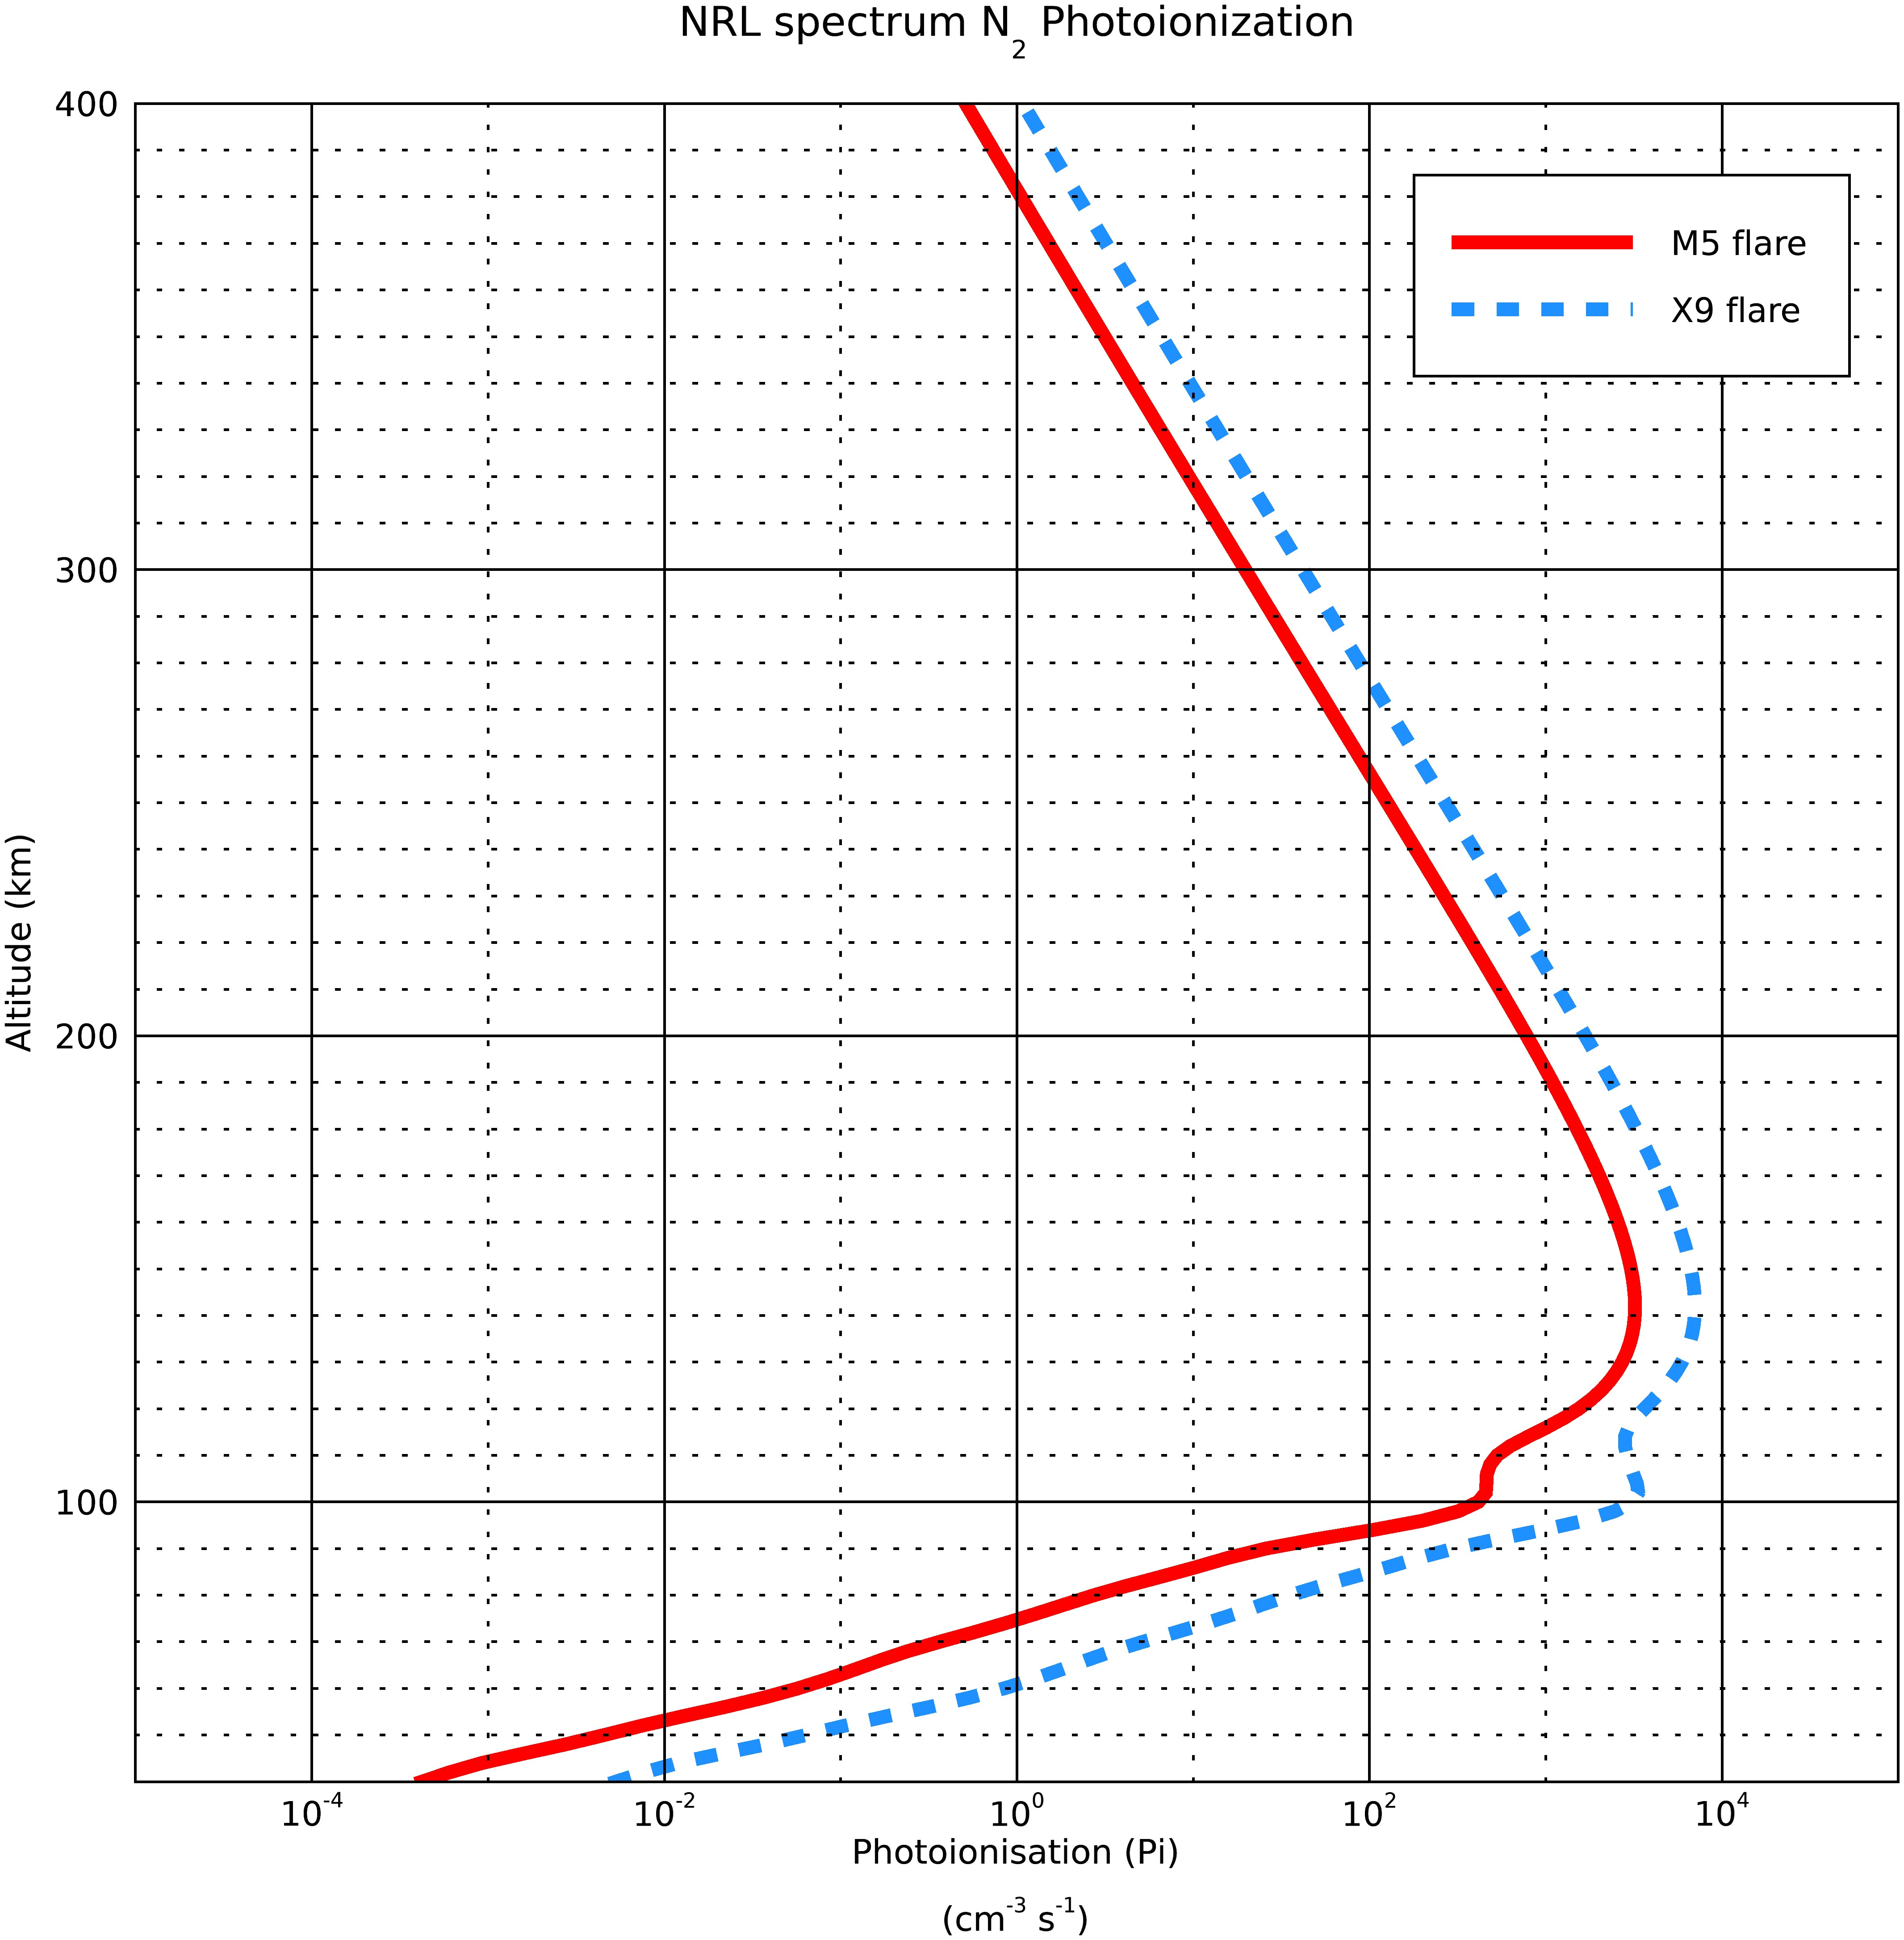
Photoionsation rates for the two spectra
If we take the altitude bin in the model to be ∆z= 0.5 to 1 km, the deviation in calculating the altitude of unit optical depth is minimum, so ∆z= 1 km in the model.
6/21/20

Slide 7
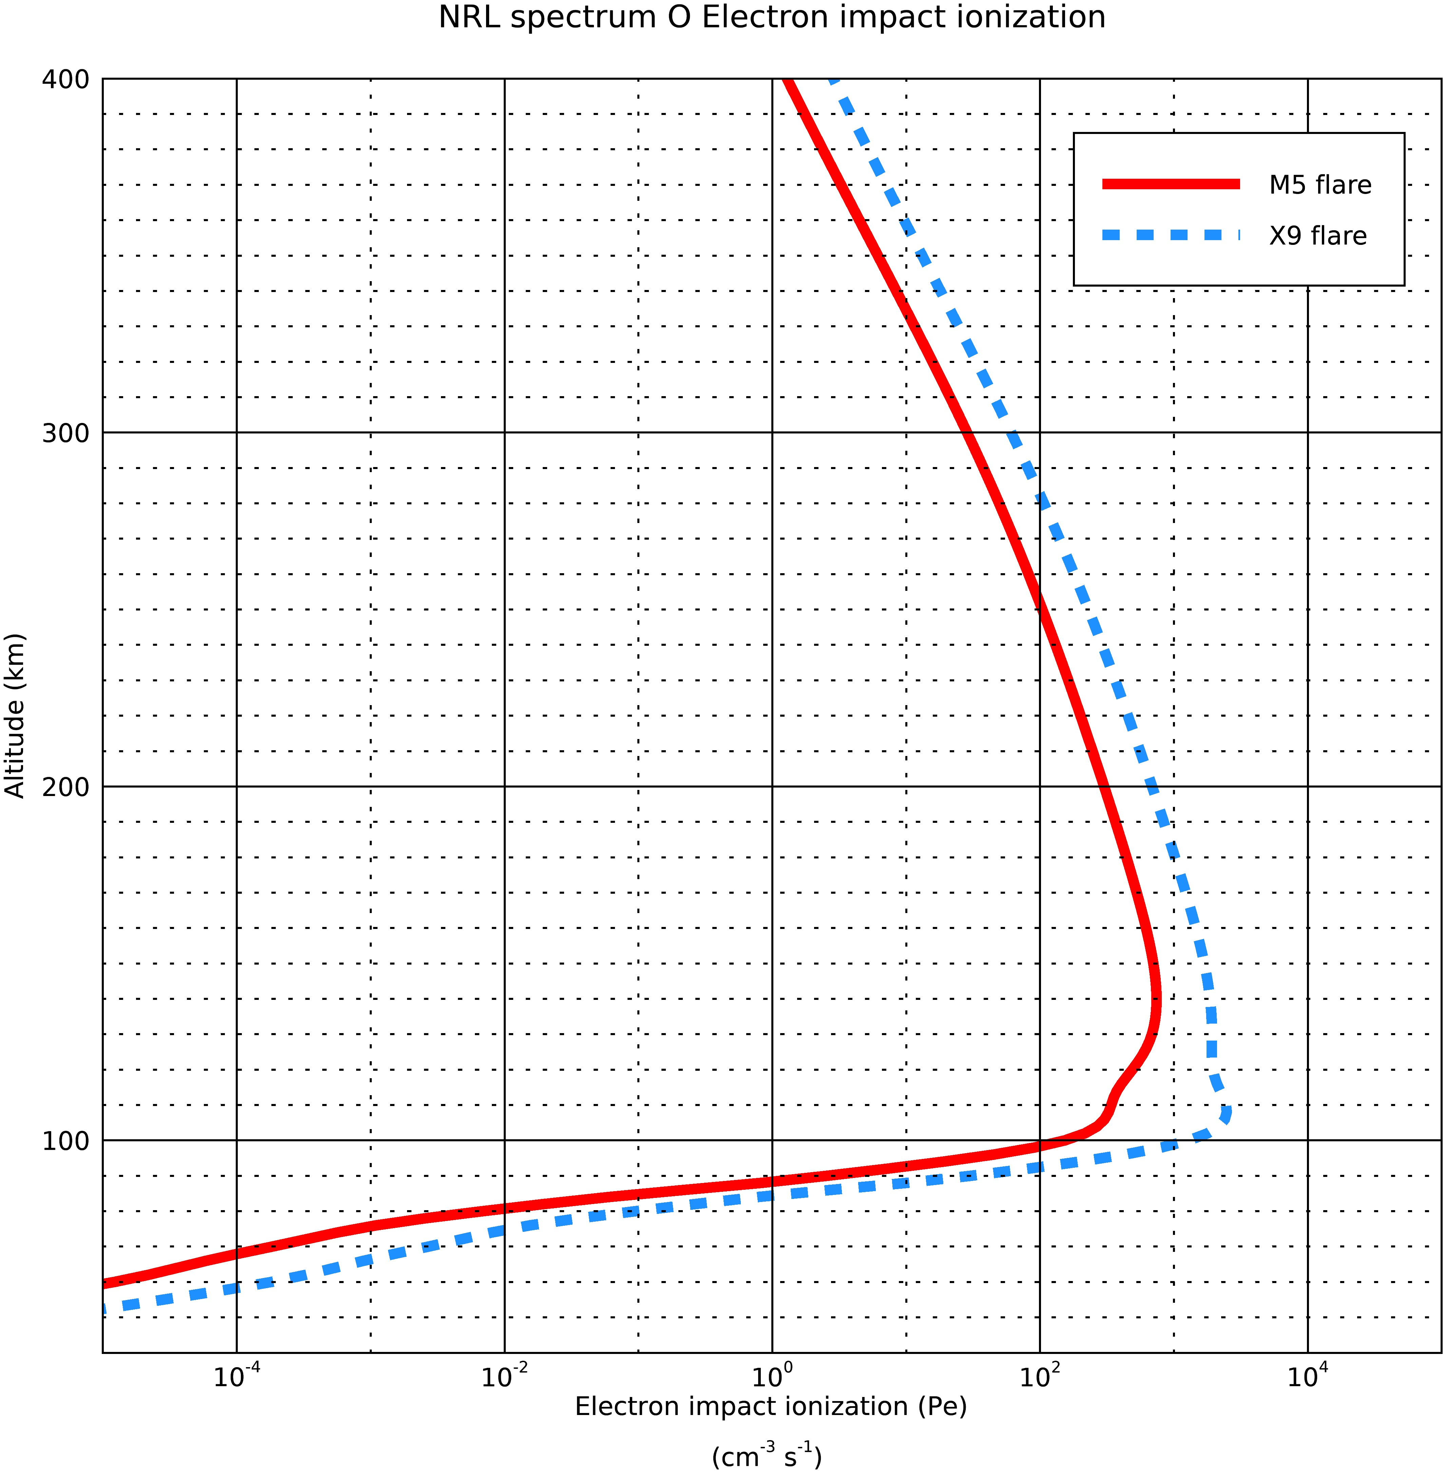
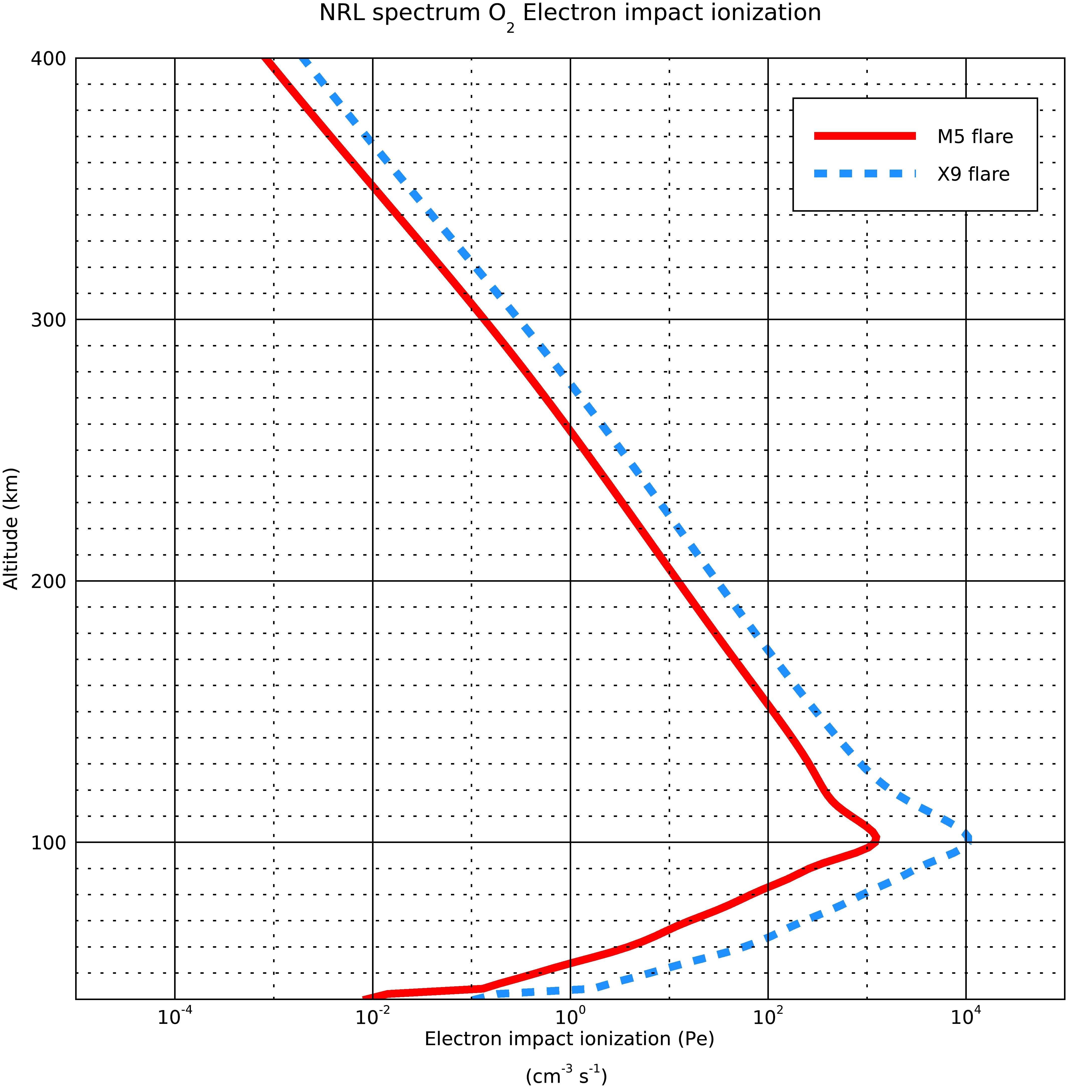
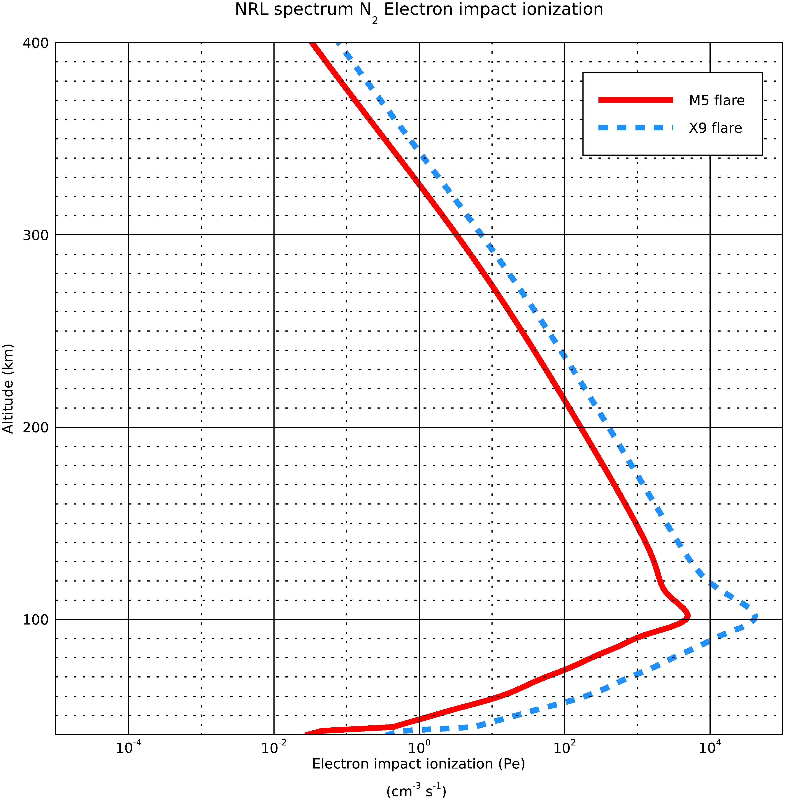
Photoelectron ionisation rates for the two spectra
6/21/20

Slide 8
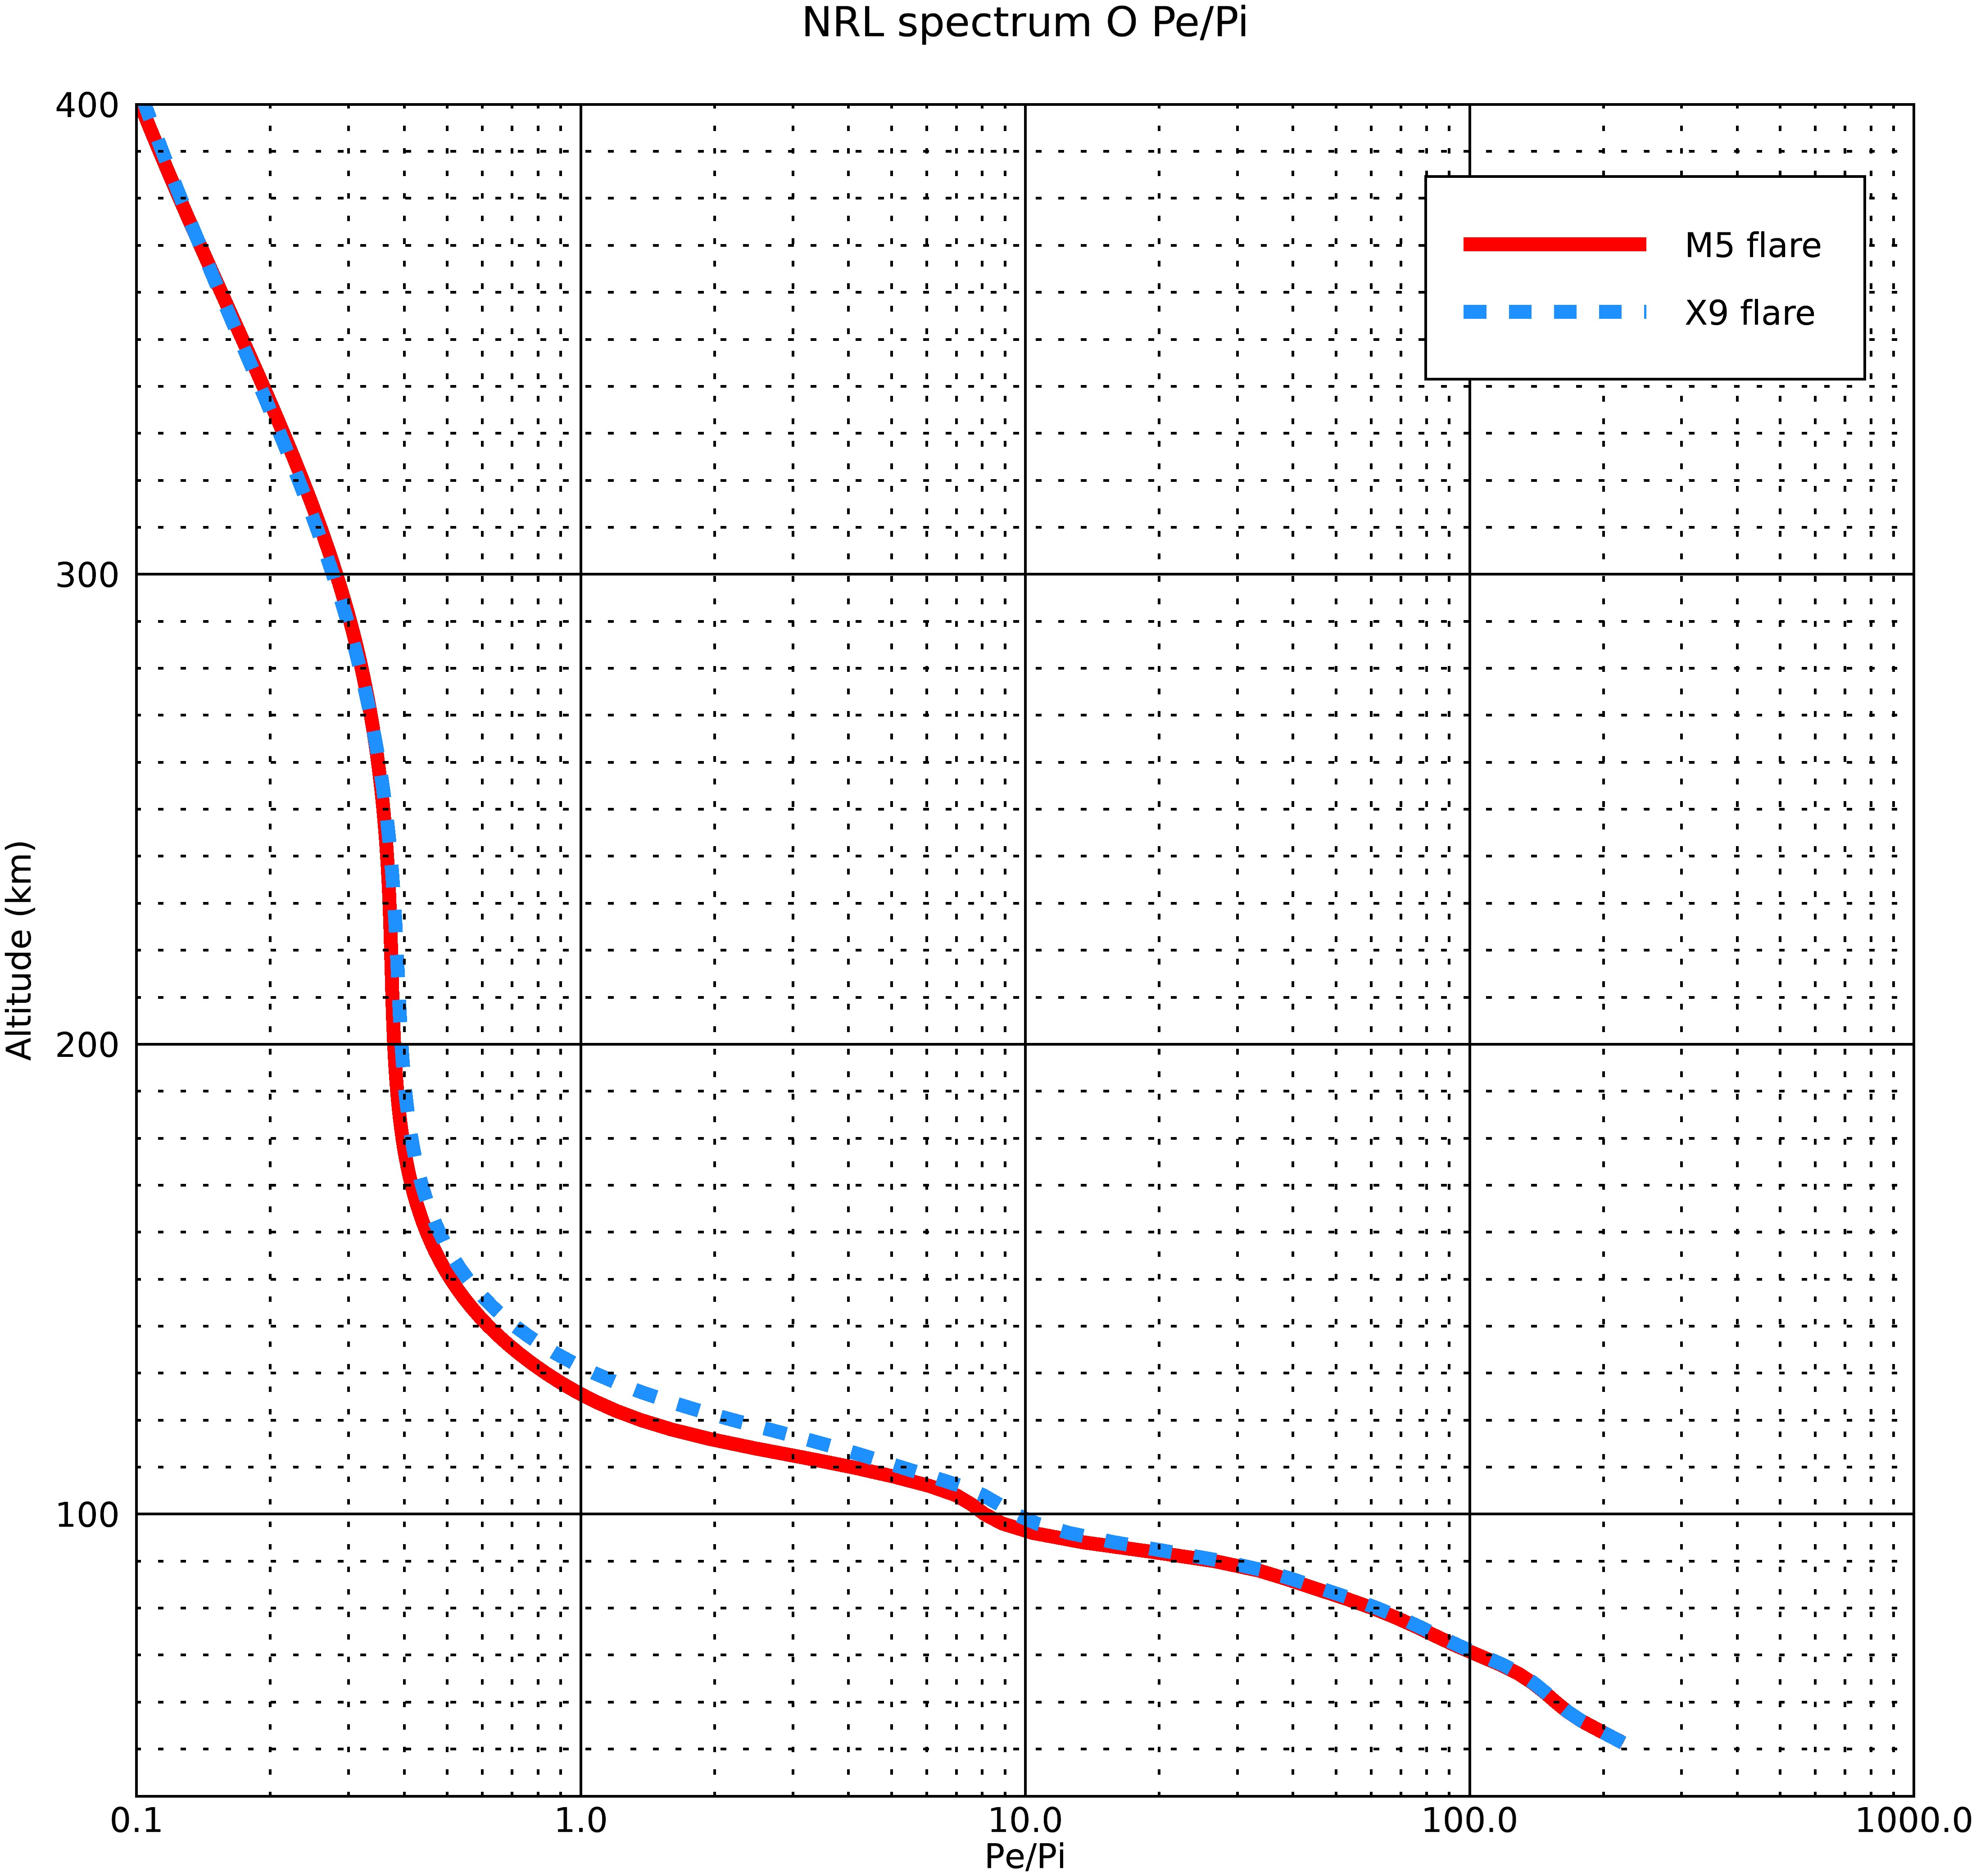
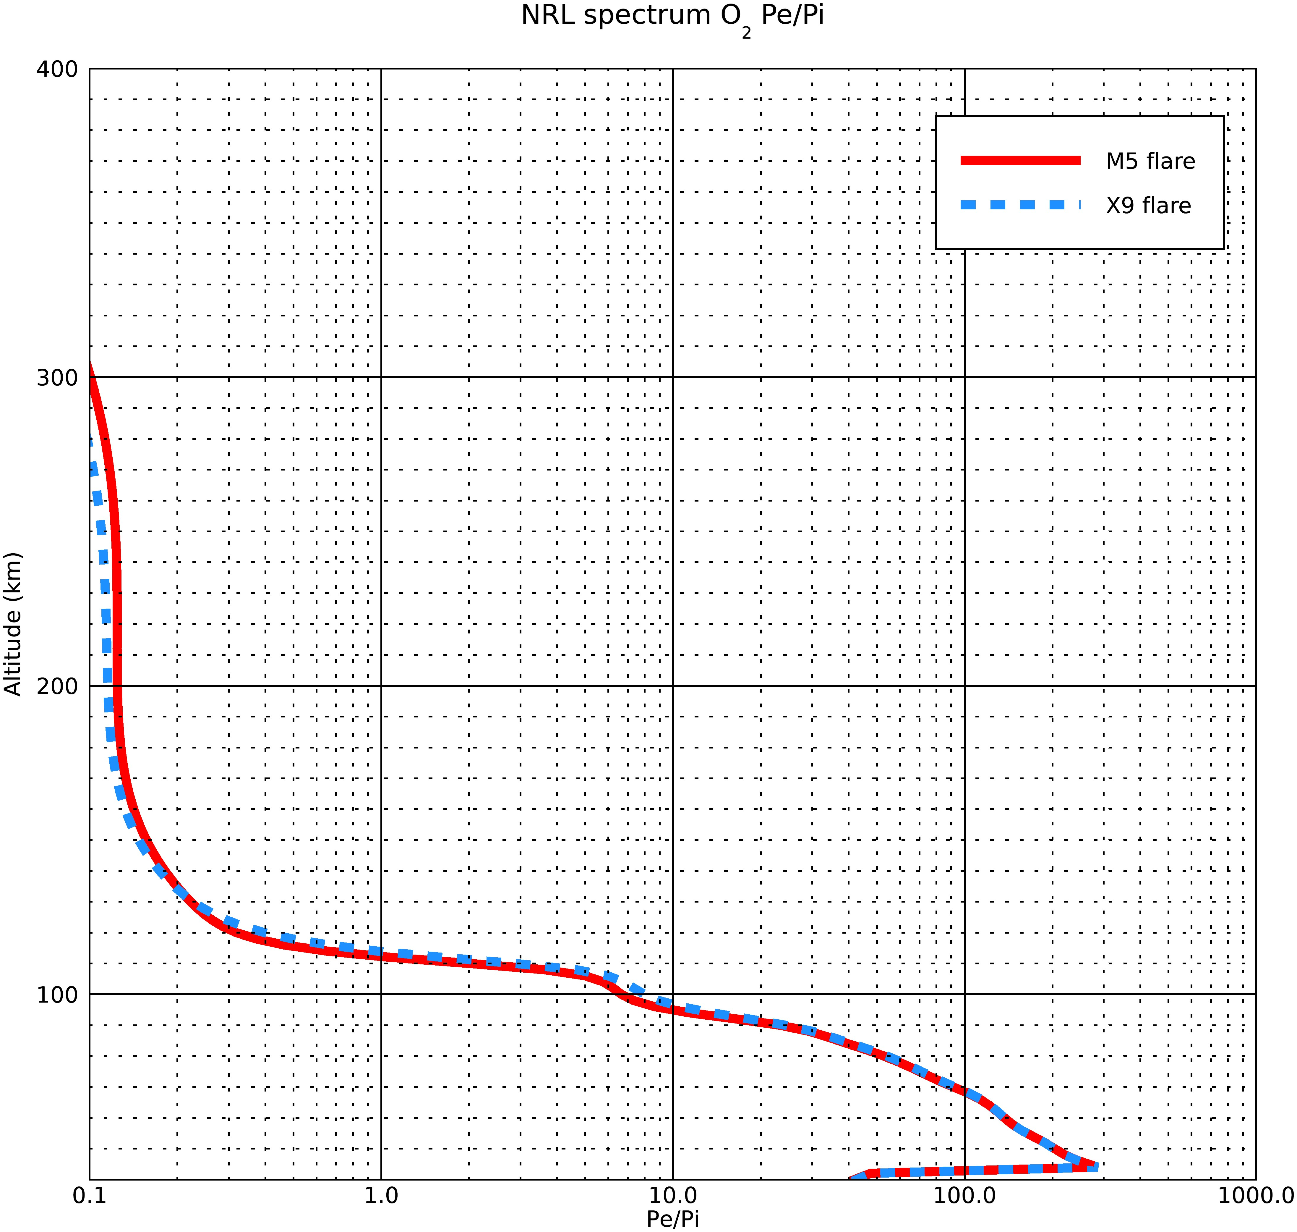
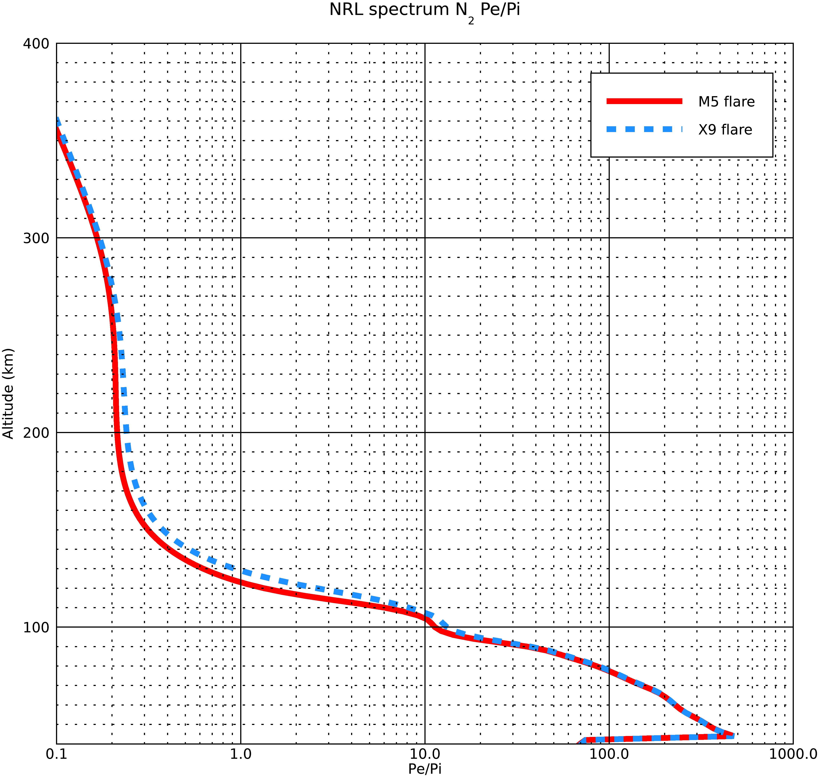
Pe/Pi ratios for the two spectra
6/21/20

Slide 9
Explanation of plots of slides 6-8
These are the 3 plots :
Photoionisation rates (Pi)
Photoelectron ionisation rates (Pe)
Pe/Pi ratios
Basically, the x9 flare is stronger than the m5 flare, so the Pi and the Pe are larger for the x9, which is expected
With increased solar flux from the M5 to X9 flare, there is an increase in photoionisation and photoelectron production.
6/21/20

Slide 10
Results of the Model- M5 flare
O2 data
Bin # | λ min (A) | λ max (A) | Mean λ (A) | Mean σσO2abs (mega-barns) | Alt of tau~ 1 (km) | pe/pi
1 | 0.5 | 1 | 0.75 | 6.21E-05 | 46 | 334.877
2 | 1 | 1.5 | 1.25 | 2.73E-04 | 58 | 186.124
3 | 1.5 | 2 | 1.75 | 8.33E-04 | 65 | 130.288
4 | 2 | 2.5 | 2.25 | 1.88E-03 | 71 | 100.69
5 | 2.5 | 3 | 2.75 | 3.66E-03 | 75 | 81.527
6 | 3 | 4 | 3.5 | 6.95E-03 | 79 | 64.223
7 | 4 | 5 | 4.5 | 1.50E-02 | 83 | 48.239
8 | 5 | 6 | 5.5 | 2.66E-02 | 87 | 37.862
9 | 6 | 8 | 7 | 5.25E-02 | 90 | 28.251
10 | 8 | 10 | 9 | 1.05E-01 | 94 | 19.552
11 | 10 | 14 | 12 | 2.25E-01 | 99 | 12.552
12 | 14 | 18 | 16 | 4.71E-01 | 103 | 6.794
N2 data
Bin # | λ min (A) | λ max (A) | Mean λ (A) | Mean σσN2abs (mega-barns) | Alt of tau~ 1 (km) | pe/pi
1 | 0.5 | 1 | 0.75 | 3.38E-05 | 46 | 556.789
2 | 1 | 1.5 | 1.25 | 1.49E-04 | 58 | 311.116
3 | 1.5 | 2 | 1.75 | 4.55E-04 | 65 | 217.68
4 | 2 | 2.5 | 2.25 | 1.03E-03 | 71 | 166.914
5 | 2.5 | 3 | 2.75 | 2.04E-03 | 75 | 134.397
6 | 3 | 4 | 3.5 | 3.91E-03 | 79 | 105.002
7 | 4 | 5 | 4.5 | 8.59E-03 | 83 | 77.558
8 | 5 | 6 | 5.5 | 1.56E-02 | 87 | 59.911
9 | 6 | 8 | 7 | 3.15E-02 | 90 | 43.828
10 | 8 | 10 | 9 | 6.43E-02 | 94 | 29.971
11 | 10 | 14 | 12 | 1.41E-01 | 99 | 19.047
12 | 14 | 18 | 16 | 3.02E-01 | 103 | 10.275
6/21/20

Slide 11
Results of the Model- X9 flare
O2 data
Bin # | λ min (A) | λ max (A) | Mean λ (A) | Mean σσO2abs (mega-barns) | Alt of tau~ 1 (km) | pe/pi
1 | 0.5 | 1 | 0.75 | 6.21E-05 | 46 | 334.877
2 | 1 | 1.5 | 1.25 | 2.73E-04 | 58 | 186.124
3 | 1.5 | 2 | 1.75 | 8.33E-04 | 65 | 130.287
4 | 2 | 2.5 | 2.25 | 1.88E-03 | 71 | 100.69
5 | 2.5 | 3 | 2.75 | 3.66E-03 | 75 | 81.527
6 | 3 | 4 | 3.5 | 6.95E-03 | 79 | 64.223
7 | 4 | 5 | 4.5 | 1.50E-02 | 83 | 48.239
8 | 5 | 6 | 5.5 | 2.66E-02 | 87 | 37.862
9 | 6 | 8 | 7 | 5.25E-02 | 90 | 28.251
10 | 8 | 10 | 9 | 1.05E-01 | 94 | 19.552
11 | 10 | 14 | 12 | 2.25E-01 | 99 | 12.552
12 | 14 | 18 | 16 | 4.71E-01 | 103 | 6.794
N2 data
Bin # | λ min (A) | λ max (A) | Mean λ (A) | Mean σσN2abs (mega-barns) | Alt of tau~ 1 (km) | pe/pi
1 | 0.5 | 1 | 0.75 | 3.38E-05 | 46 | 556.789
2 | 1 | 1.5 | 1.25 | 1.49E-04 | 58 | 311.116
3 | 1.5 | 2 | 1.75 | 4.55E-04 | 65 | 217.68
4 | 2 | 2.5 | 2.25 | 1.03E-03 | 71 | 166.914
5 | 2.5 | 3 | 2.75 | 2.04E-03 | 75 | 134.397
6 | 3 | 4 | 3.5 | 3.91E-03 | 79 | 105.002
7 | 4 | 5 | 4.5 | 8.59E-03 | 83 | 77.558
8 | 5 | 6 | 5.5 | 1.56E-02 | 87 | 59.911
9 | 6 | 8 | 7 | 3.15E-02 | 90 | 43.828
10 | 8 | 10 | 9 | 6.43E-02 | 94 | 29.971
11 | 10 | 14 | 12 | 1.41E-01 | 99 | 19.047
12 | 14 | 18 | 16 | 3.02E-01 | 103 | 10.275
6/21/20

Slide 12
Comparisons of the model data with calculated N₂ results
Calculated | Results
Bin # | λ min (A) | λ max (A) | Mean λ (A) | Mean σN2abs (mega-barns) | Alt of tau=1 (km)
1 | 0.5 | 1 | 0.75 | 2.48e-5 | 43
2 | 1 | 1.5 | 1.25 | 1.47e-4 | 55.5
3 | 1.5 | 2 | 1.75 | 4.57e-4 | 63.5
4 | 2 | 2.5 | 2.25 | 1.02e-3 | 69.1
5 | 2.5 | 3 | 2.75 | 1.9e-3 | 73.3
6 | 3 | 4 | 3.5 | 4.0e-3 | 78.7
7 | 4 | 5 | 4.5 | 8.55e-3 | 84
8 | 5 | 6 | 5.5 | 1.55e-2 | 88.1
9 | 6 | 8 | 7 | 3.12e-2 | 93
10 | 8 | 10 | 9 | 6.32e-2 | 98
11 | 10 | 14 | 12 | 0.14 | 103.5
12 | 14 | 18 | 16 | 0.30 | 109
N2 data
Bin # | λ min (A) | λ max (A) | Mean λ (A) | Mean σσN2abs (mega-barns) | Alt of tau~ 1 (km)
1 | 0.5 | 1 | 0.75 | 3.38E-05 | 46
2 | 1 | 1.5 | 1.25 | 1.49E-04 | 58
3 | 1.5 | 2 | 1.75 | 4.55E-04 | 65
4 | 2 | 2.5 | 2.25 | 1.03E-03 | 71
5 | 2.5 | 3 | 2.75 | 2.04E-03 | 75
6 | 3 | 4 | 3.5 | 3.91E-03 | 79
7 | 4 | 5 | 4.5 | 8.59E-03 | 83
8 | 5 | 6 | 5.5 | 1.56E-02 | 87
9 | 6 | 8 | 7 | 3.15E-02 | 90
10 | 8 | 10 | 9 | 6.43E-02 | 94
11 | 10 | 14 | 12 | 1.41E-01 | 99
12 | 14 | 18 | 16 | 3.02E-01 | 103
Altitued Difference (km)
3
2.5
1.5
1.9
1.5
0.3
1
1.1
3
4
4.5
6
Model Results
6/21/20

Slide 13
Conclusion And Assumptions Made
The MSIS value for n₀= 1.9 E19 cm³, however, we have assumed n₀= 2.7E19 cm³
Scale height H= 7km in calculation of table in slide 2, however, in the model scale height changes for the altitudes of unit optical depth.
The difference in altitude of unit optical depth between the model data and the calculated data is due to the difference in the assumptions made in its calculations and the different values calculated by the model.
An altitude binning of ∆z= 0.5 to 1 km is good for getting the correct altitude of optical depth.
The N₂ cross-section of the first bin in the model is significantly different than that given in the table of slide 2, which causes a difference of about 1km in the altitude of unit optical depth calculation.
In the calculations, it is assumed that the all the atmosphere is N2 and also the solar zenith angle is zero degree. The model has a zenith angle of 1 degree, which does not cause any appreciable changes in the altitudes.
The pe/pi ratios for N₂ and O₂ for both the M5 and X9 flares are also given in the tables in slides 10 and 11. They are equal for both of the flare conditions for each species and bin.
Also, the plots of the spectra are added in the beginning. The X9 is the stronger flare and so the photo-ionisation and photo-electron ionisation rates are greater in the X9 flare case.
6/21/20

