Slide 1
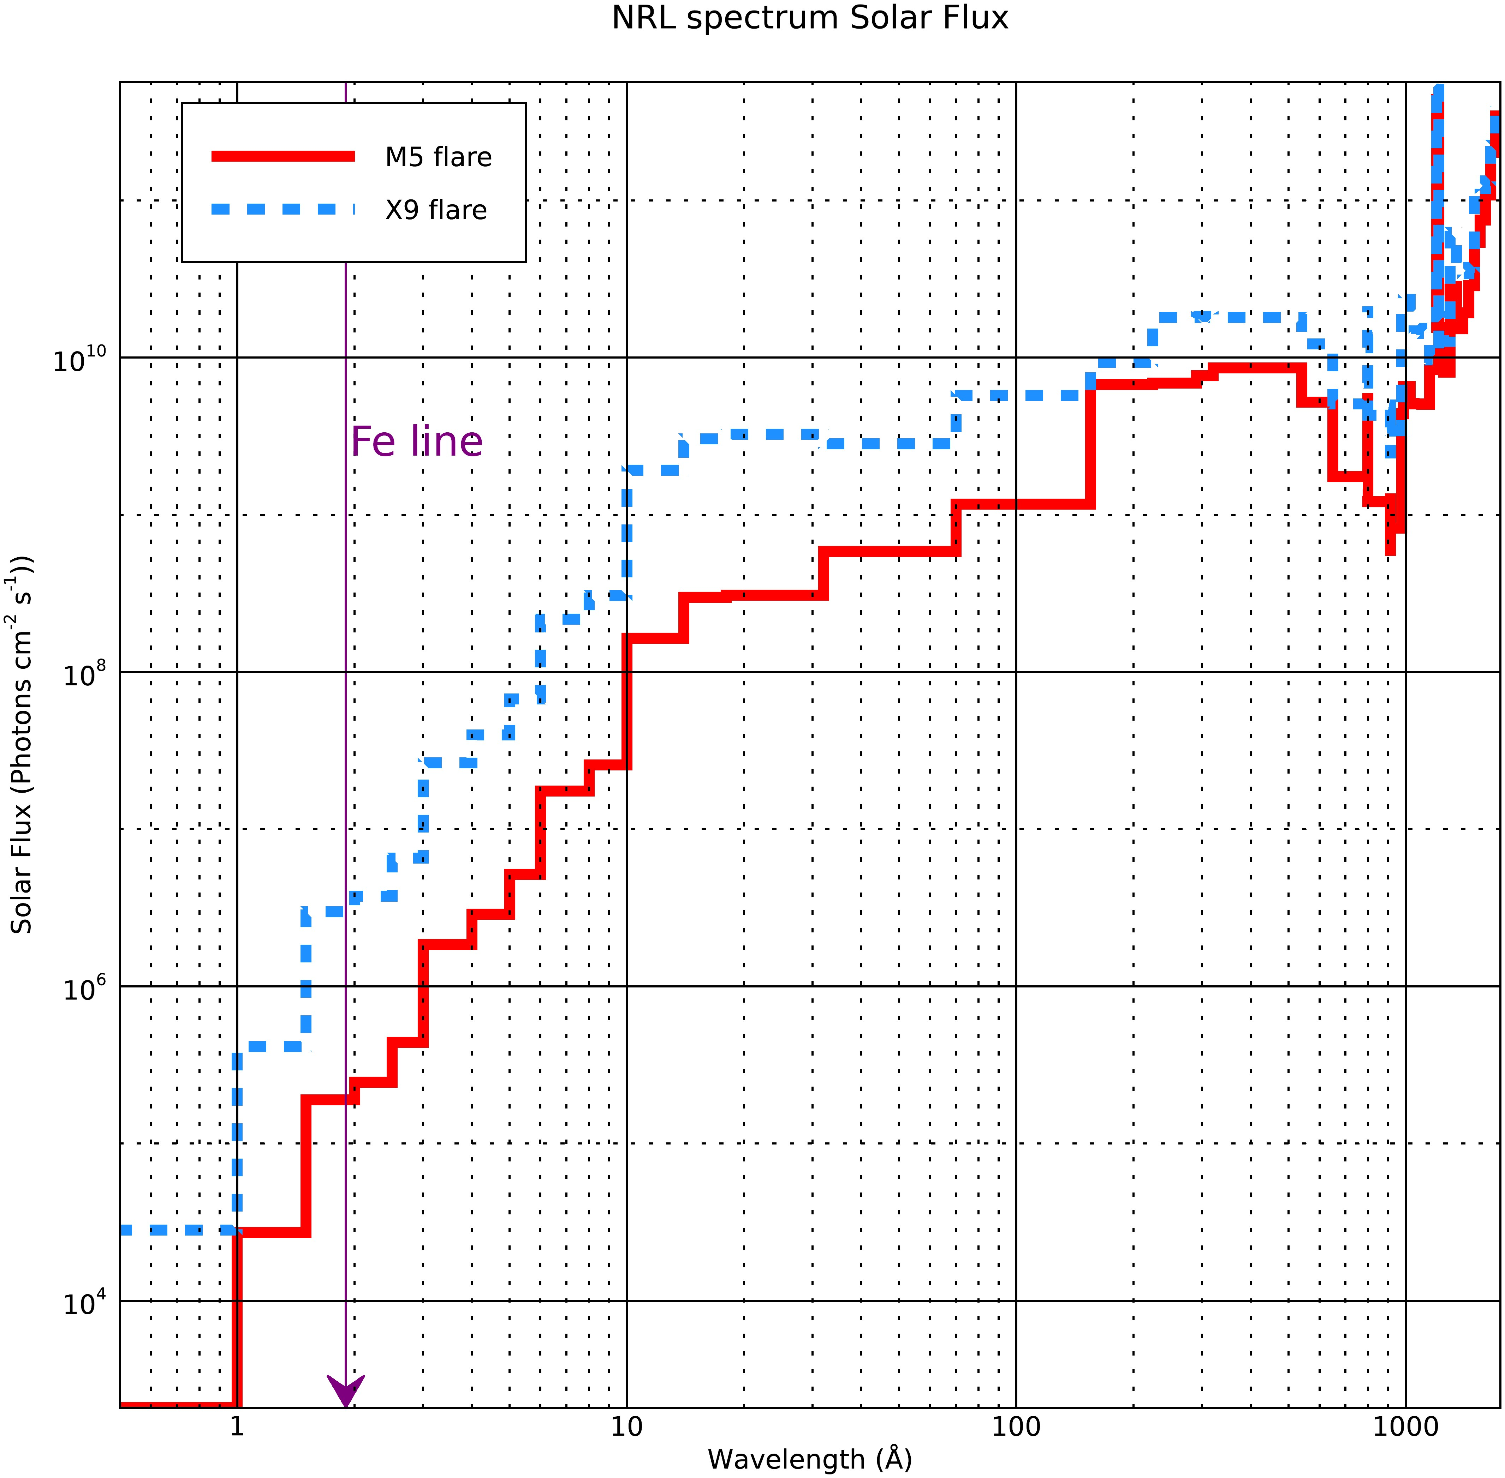
NRL Spectra

Slide 2
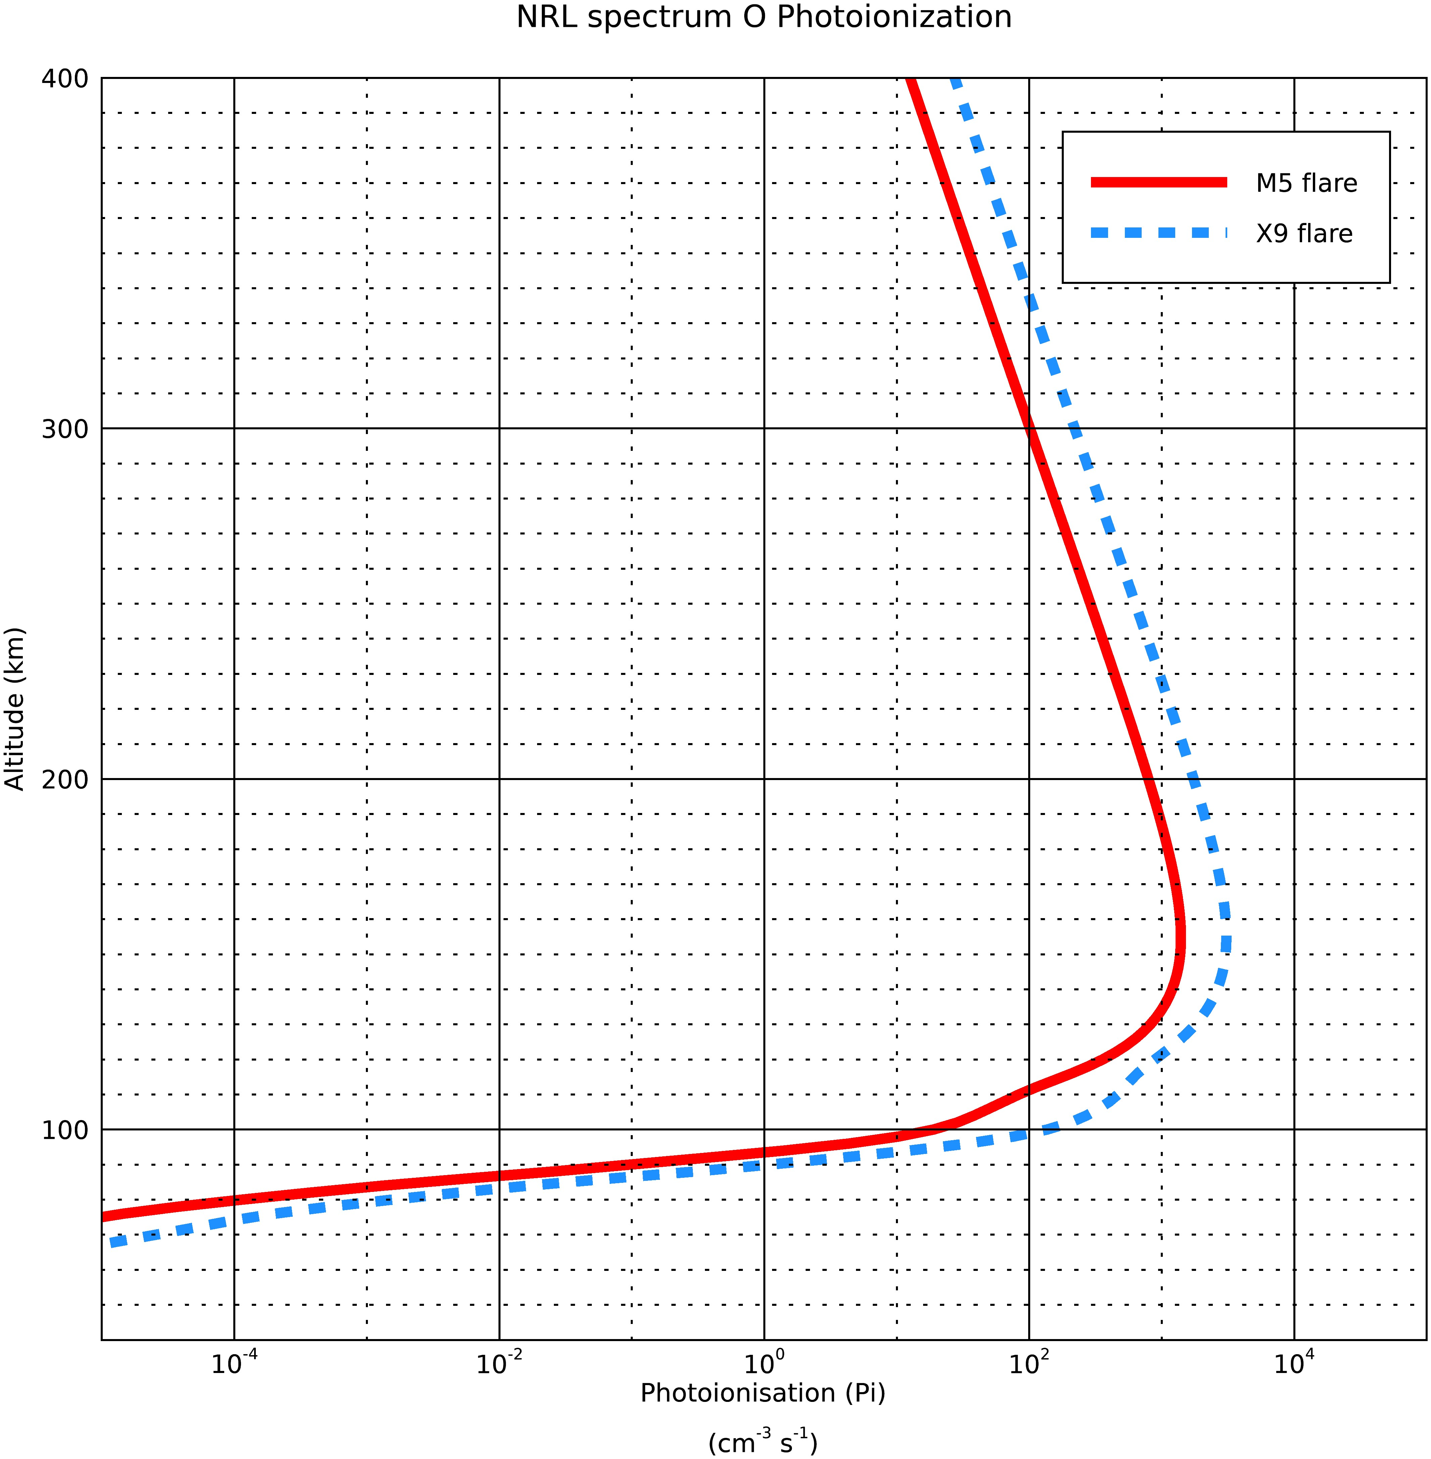
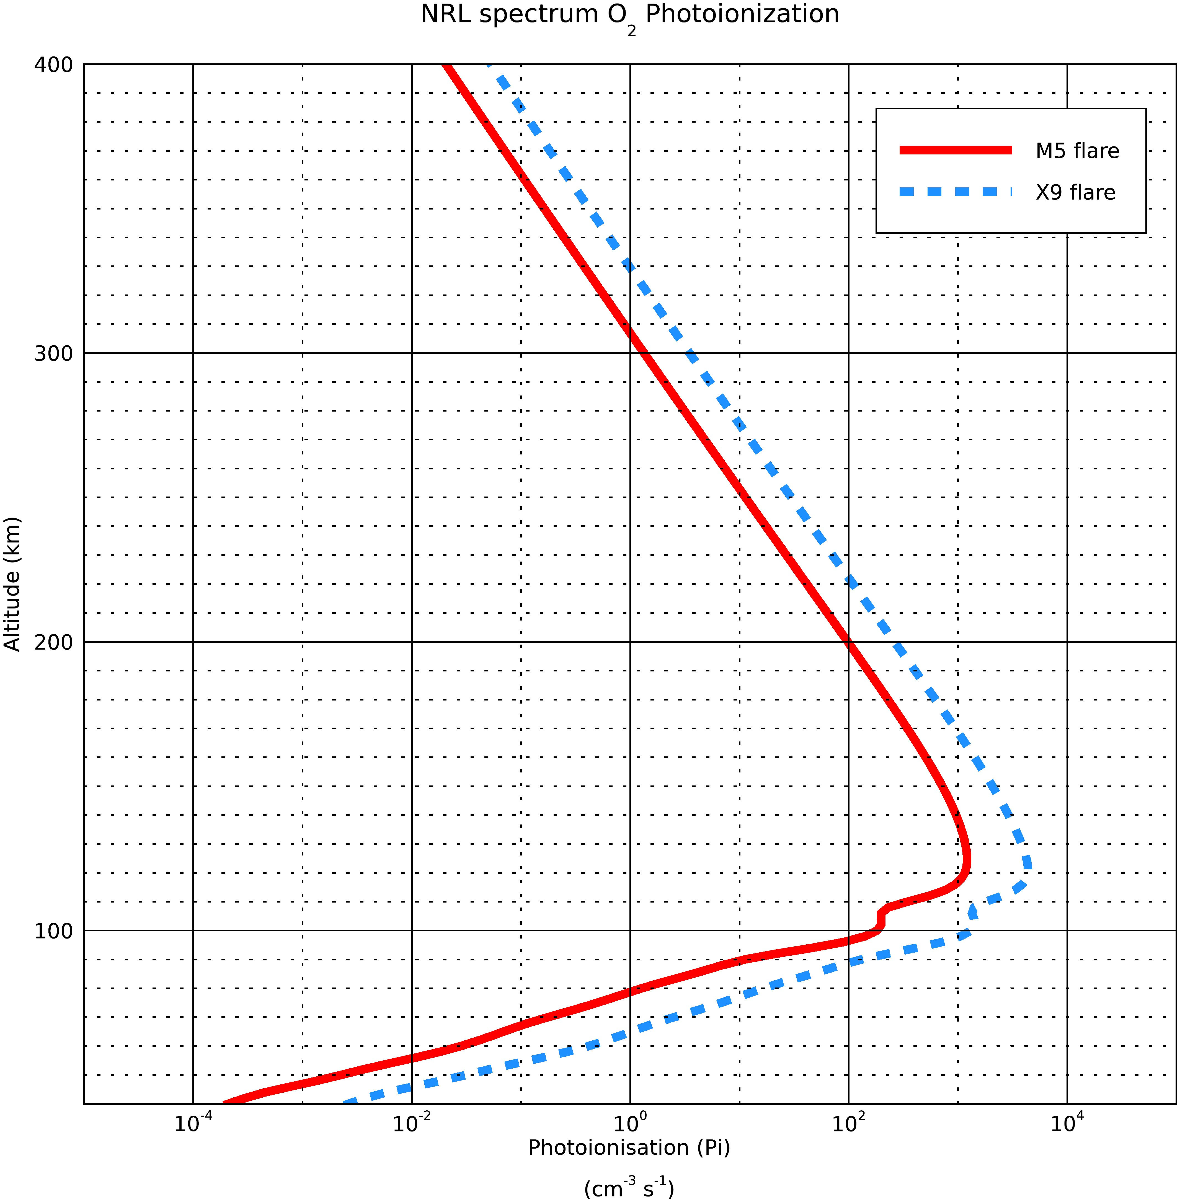
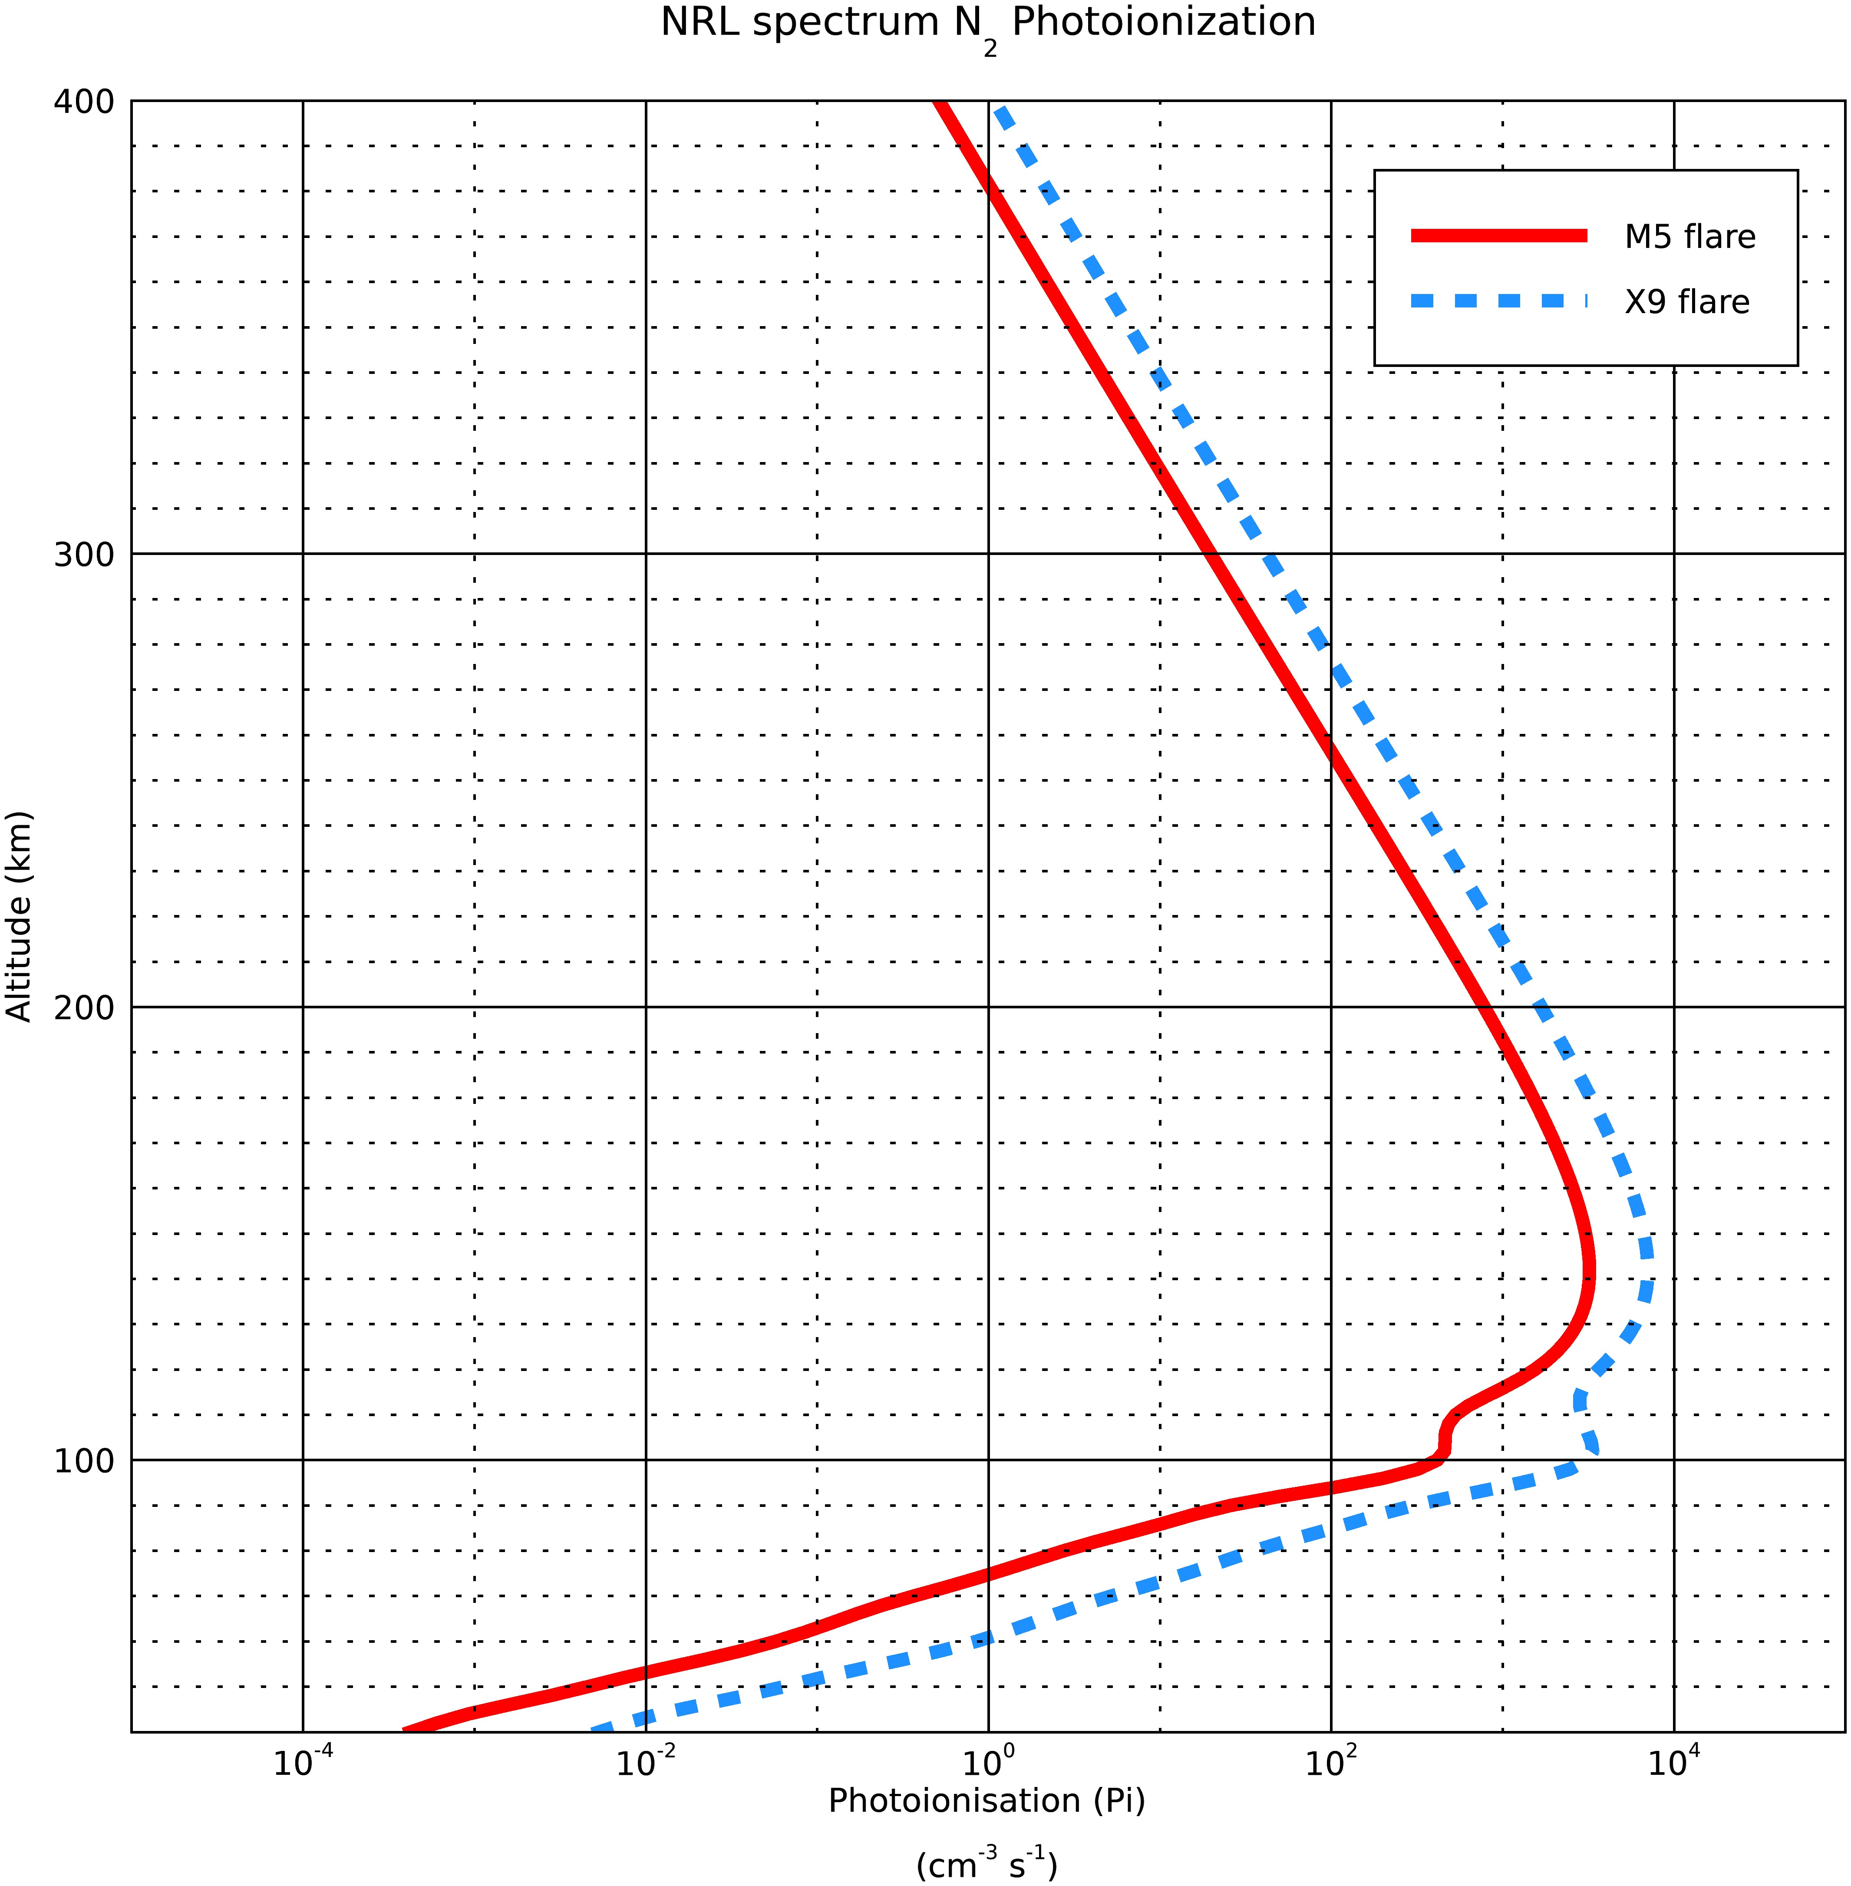
Photoionsation rates for the two spectra

Slide 3
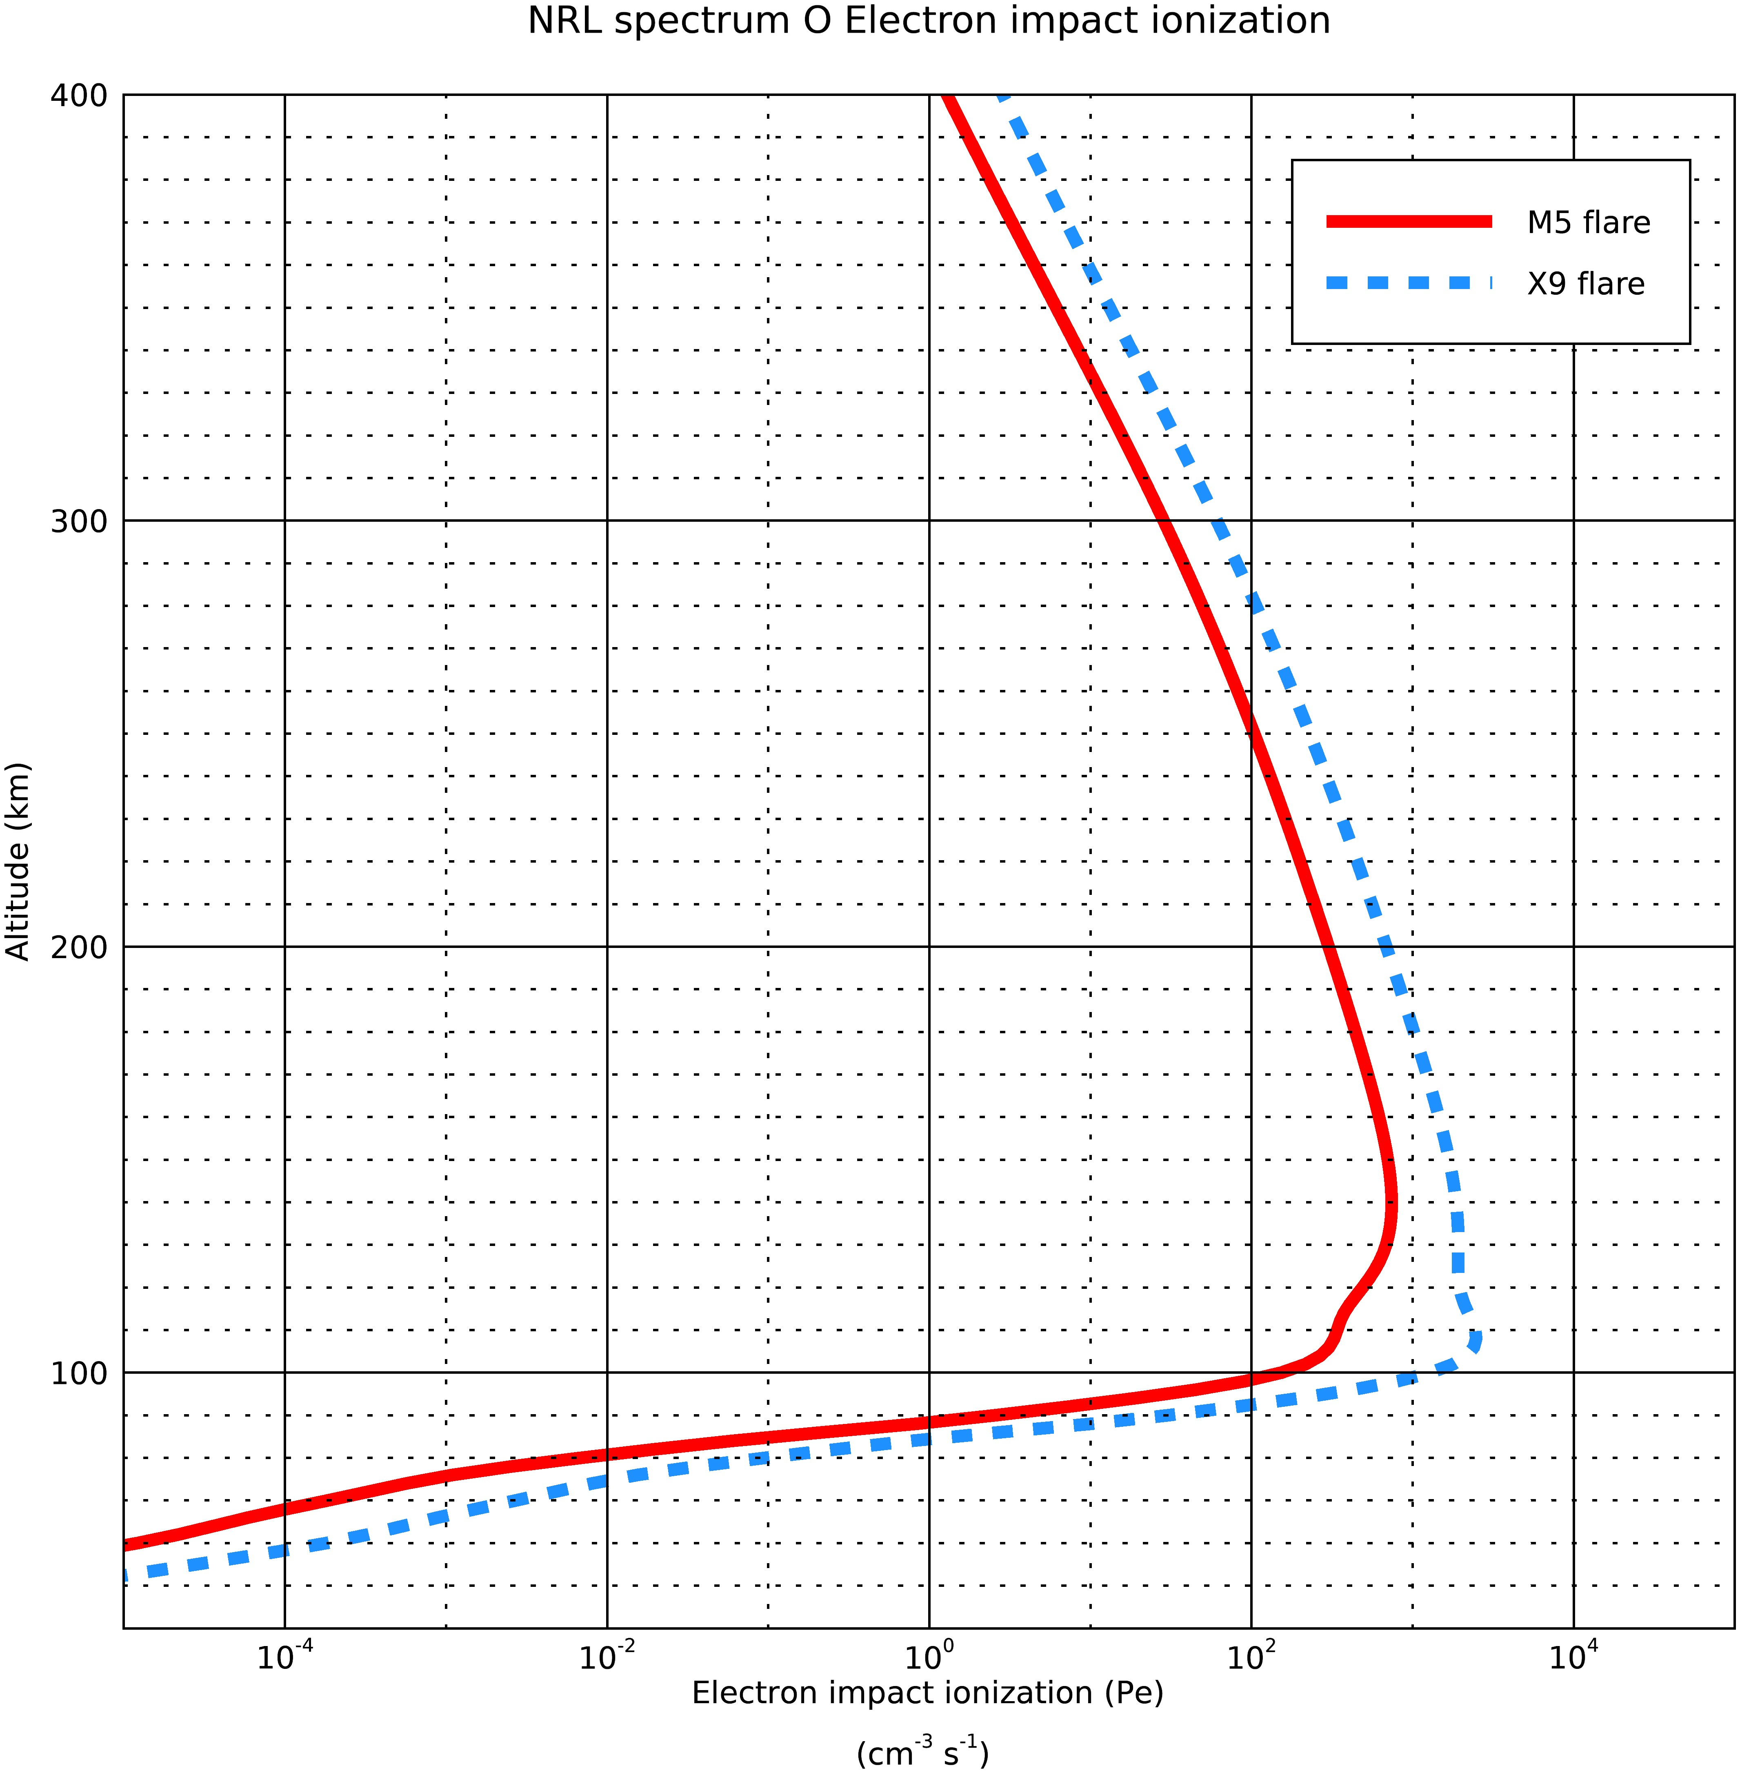
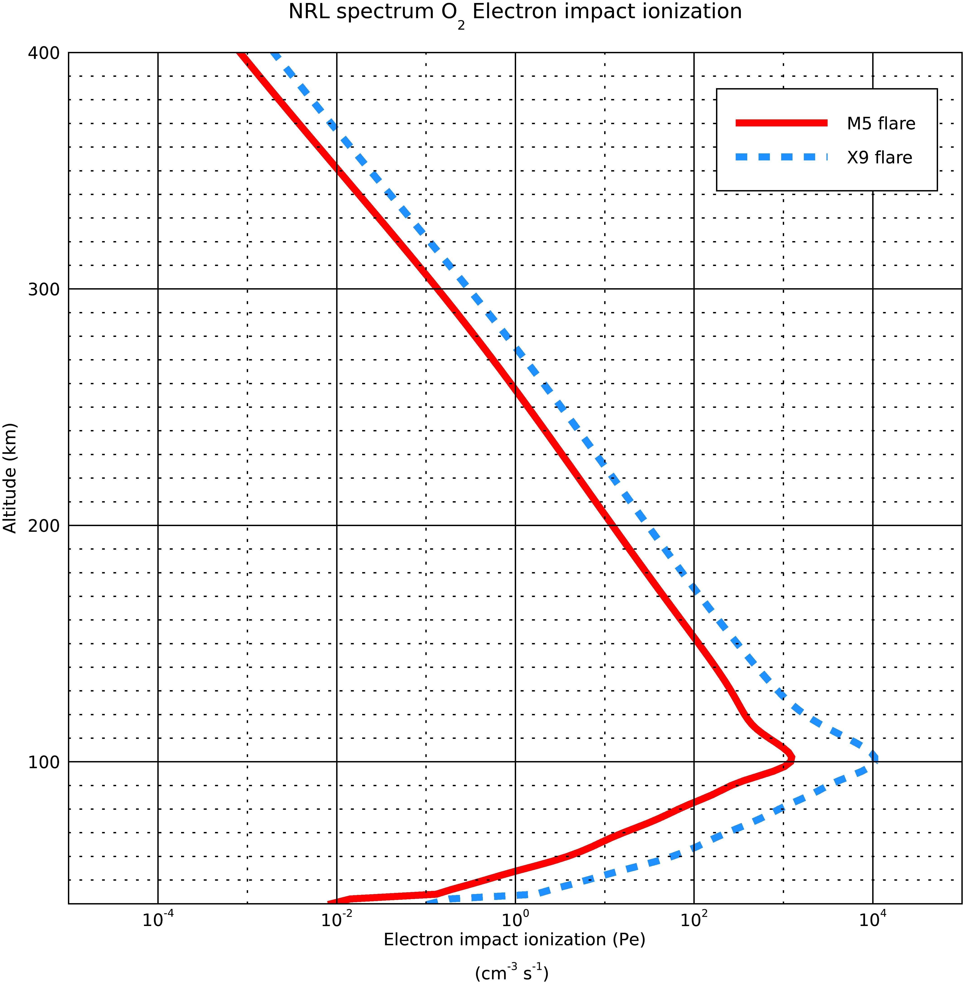
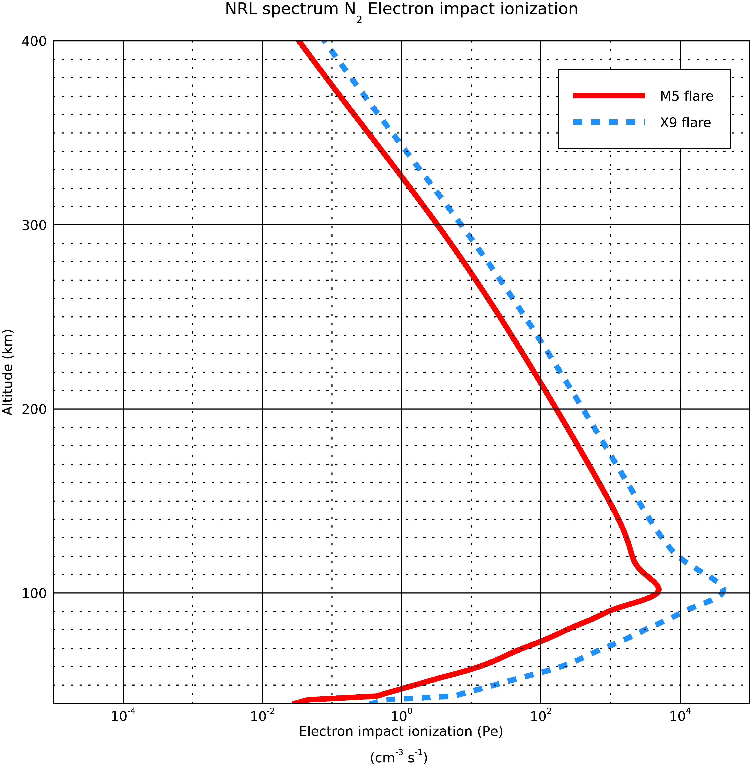
Photoelectron ionisation rates for the two spectra

Slide 4
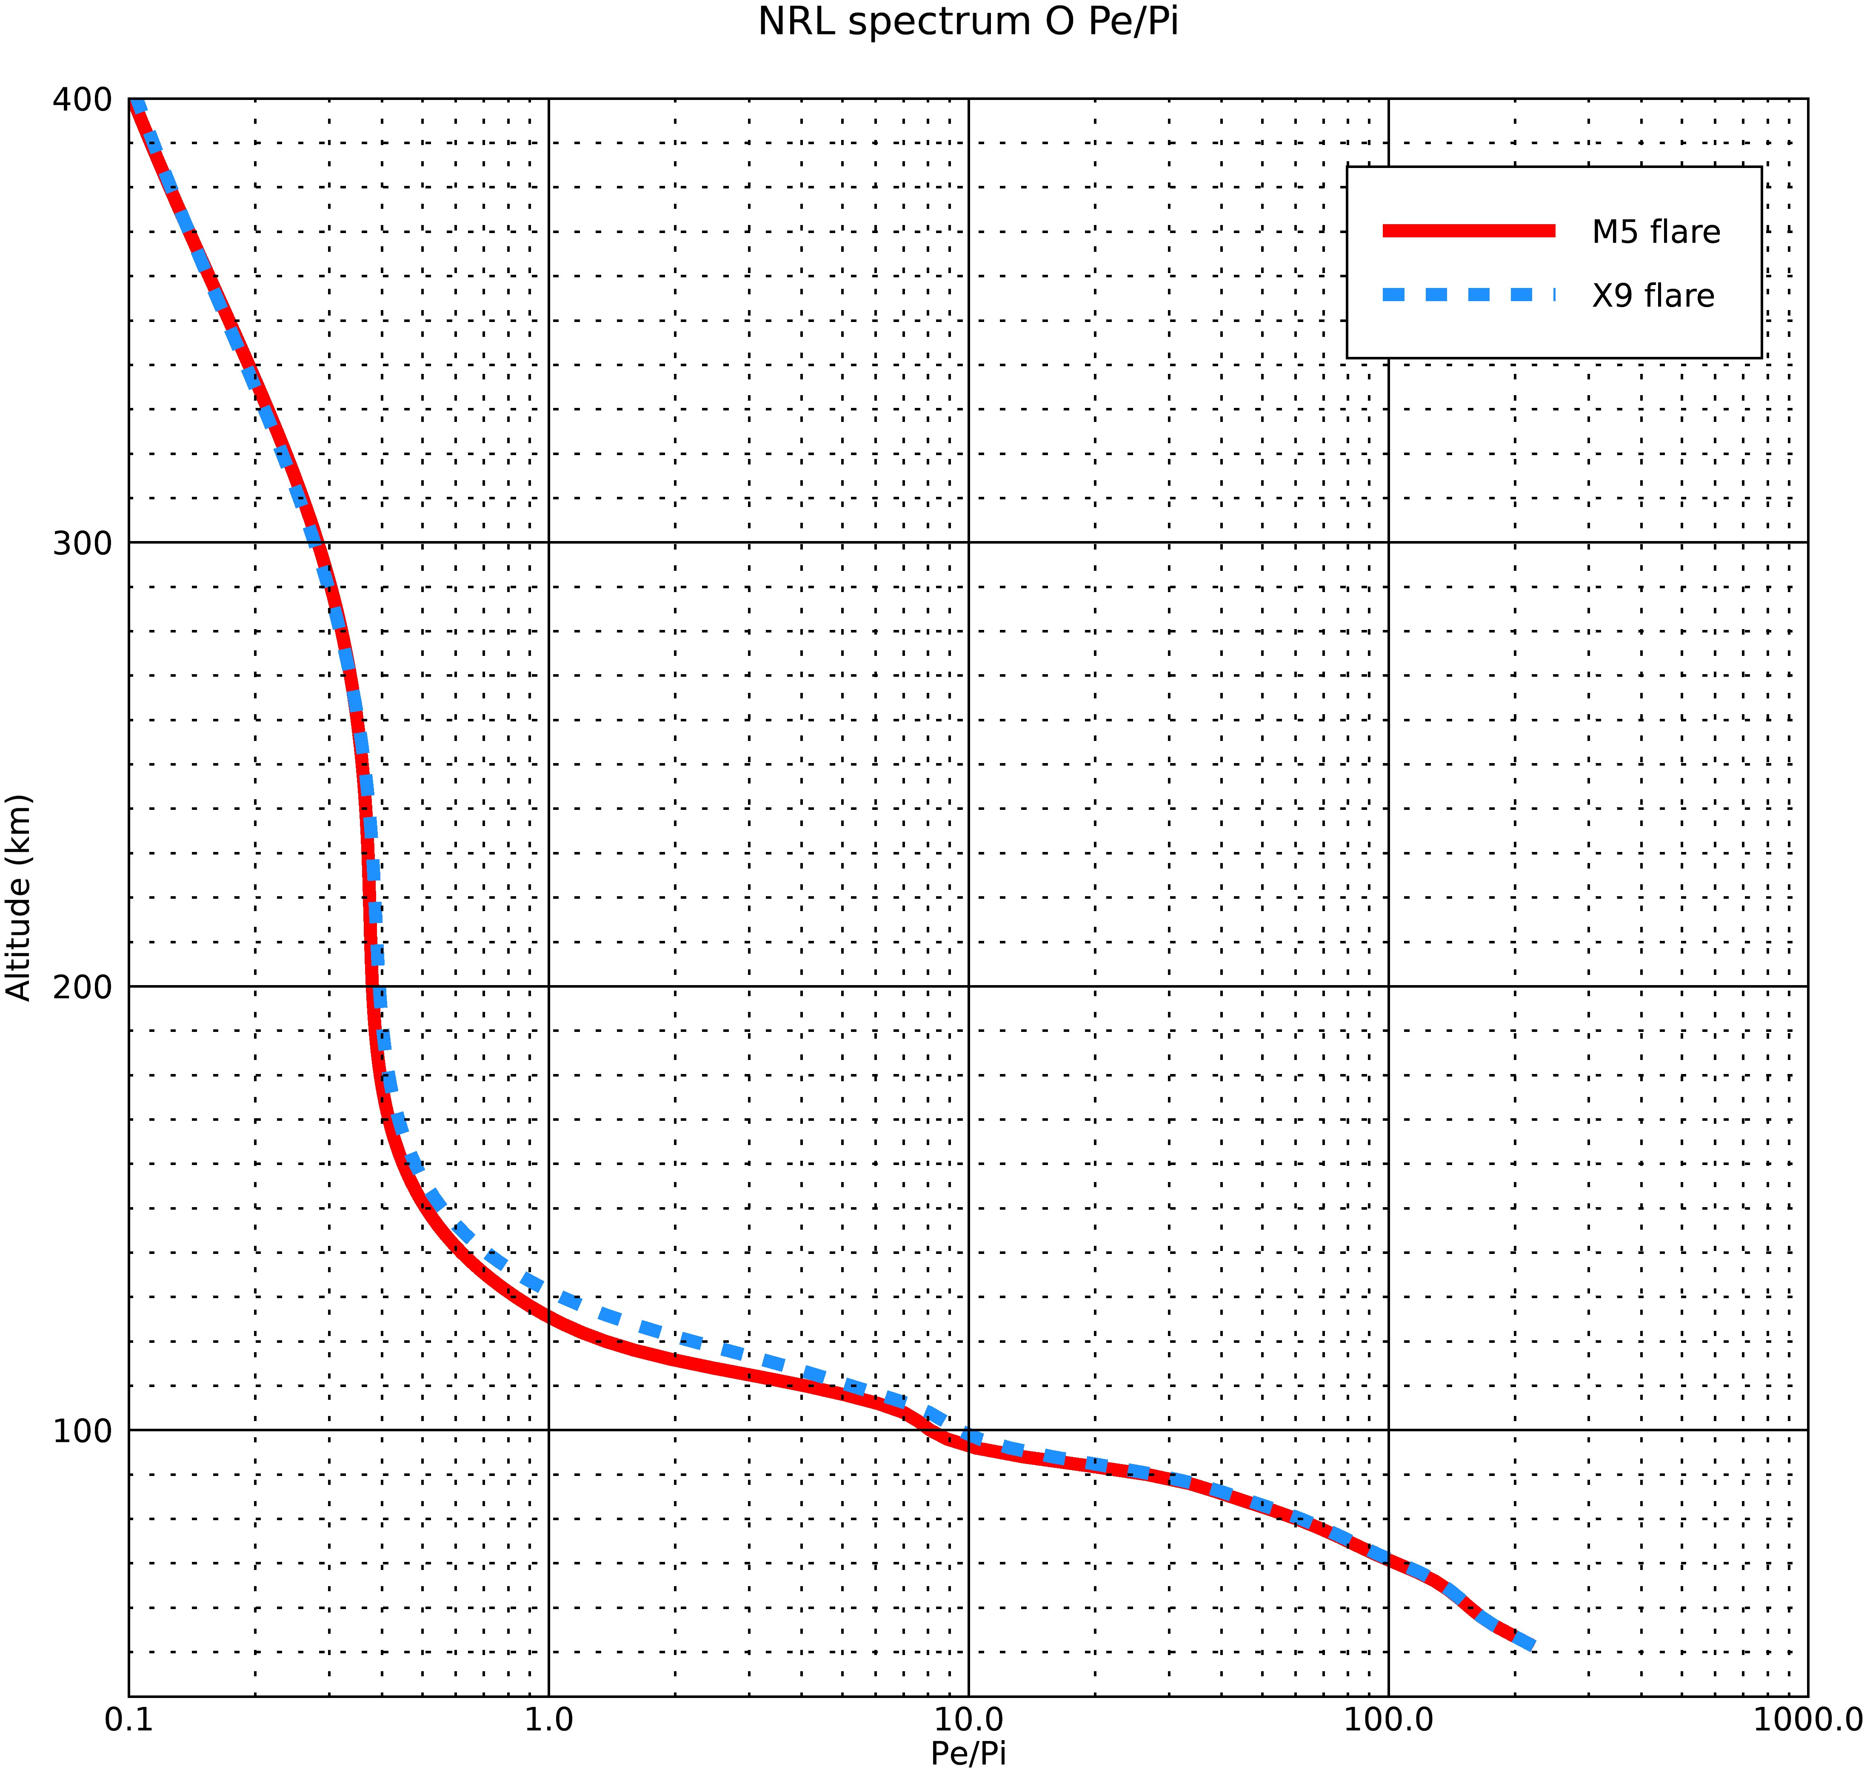
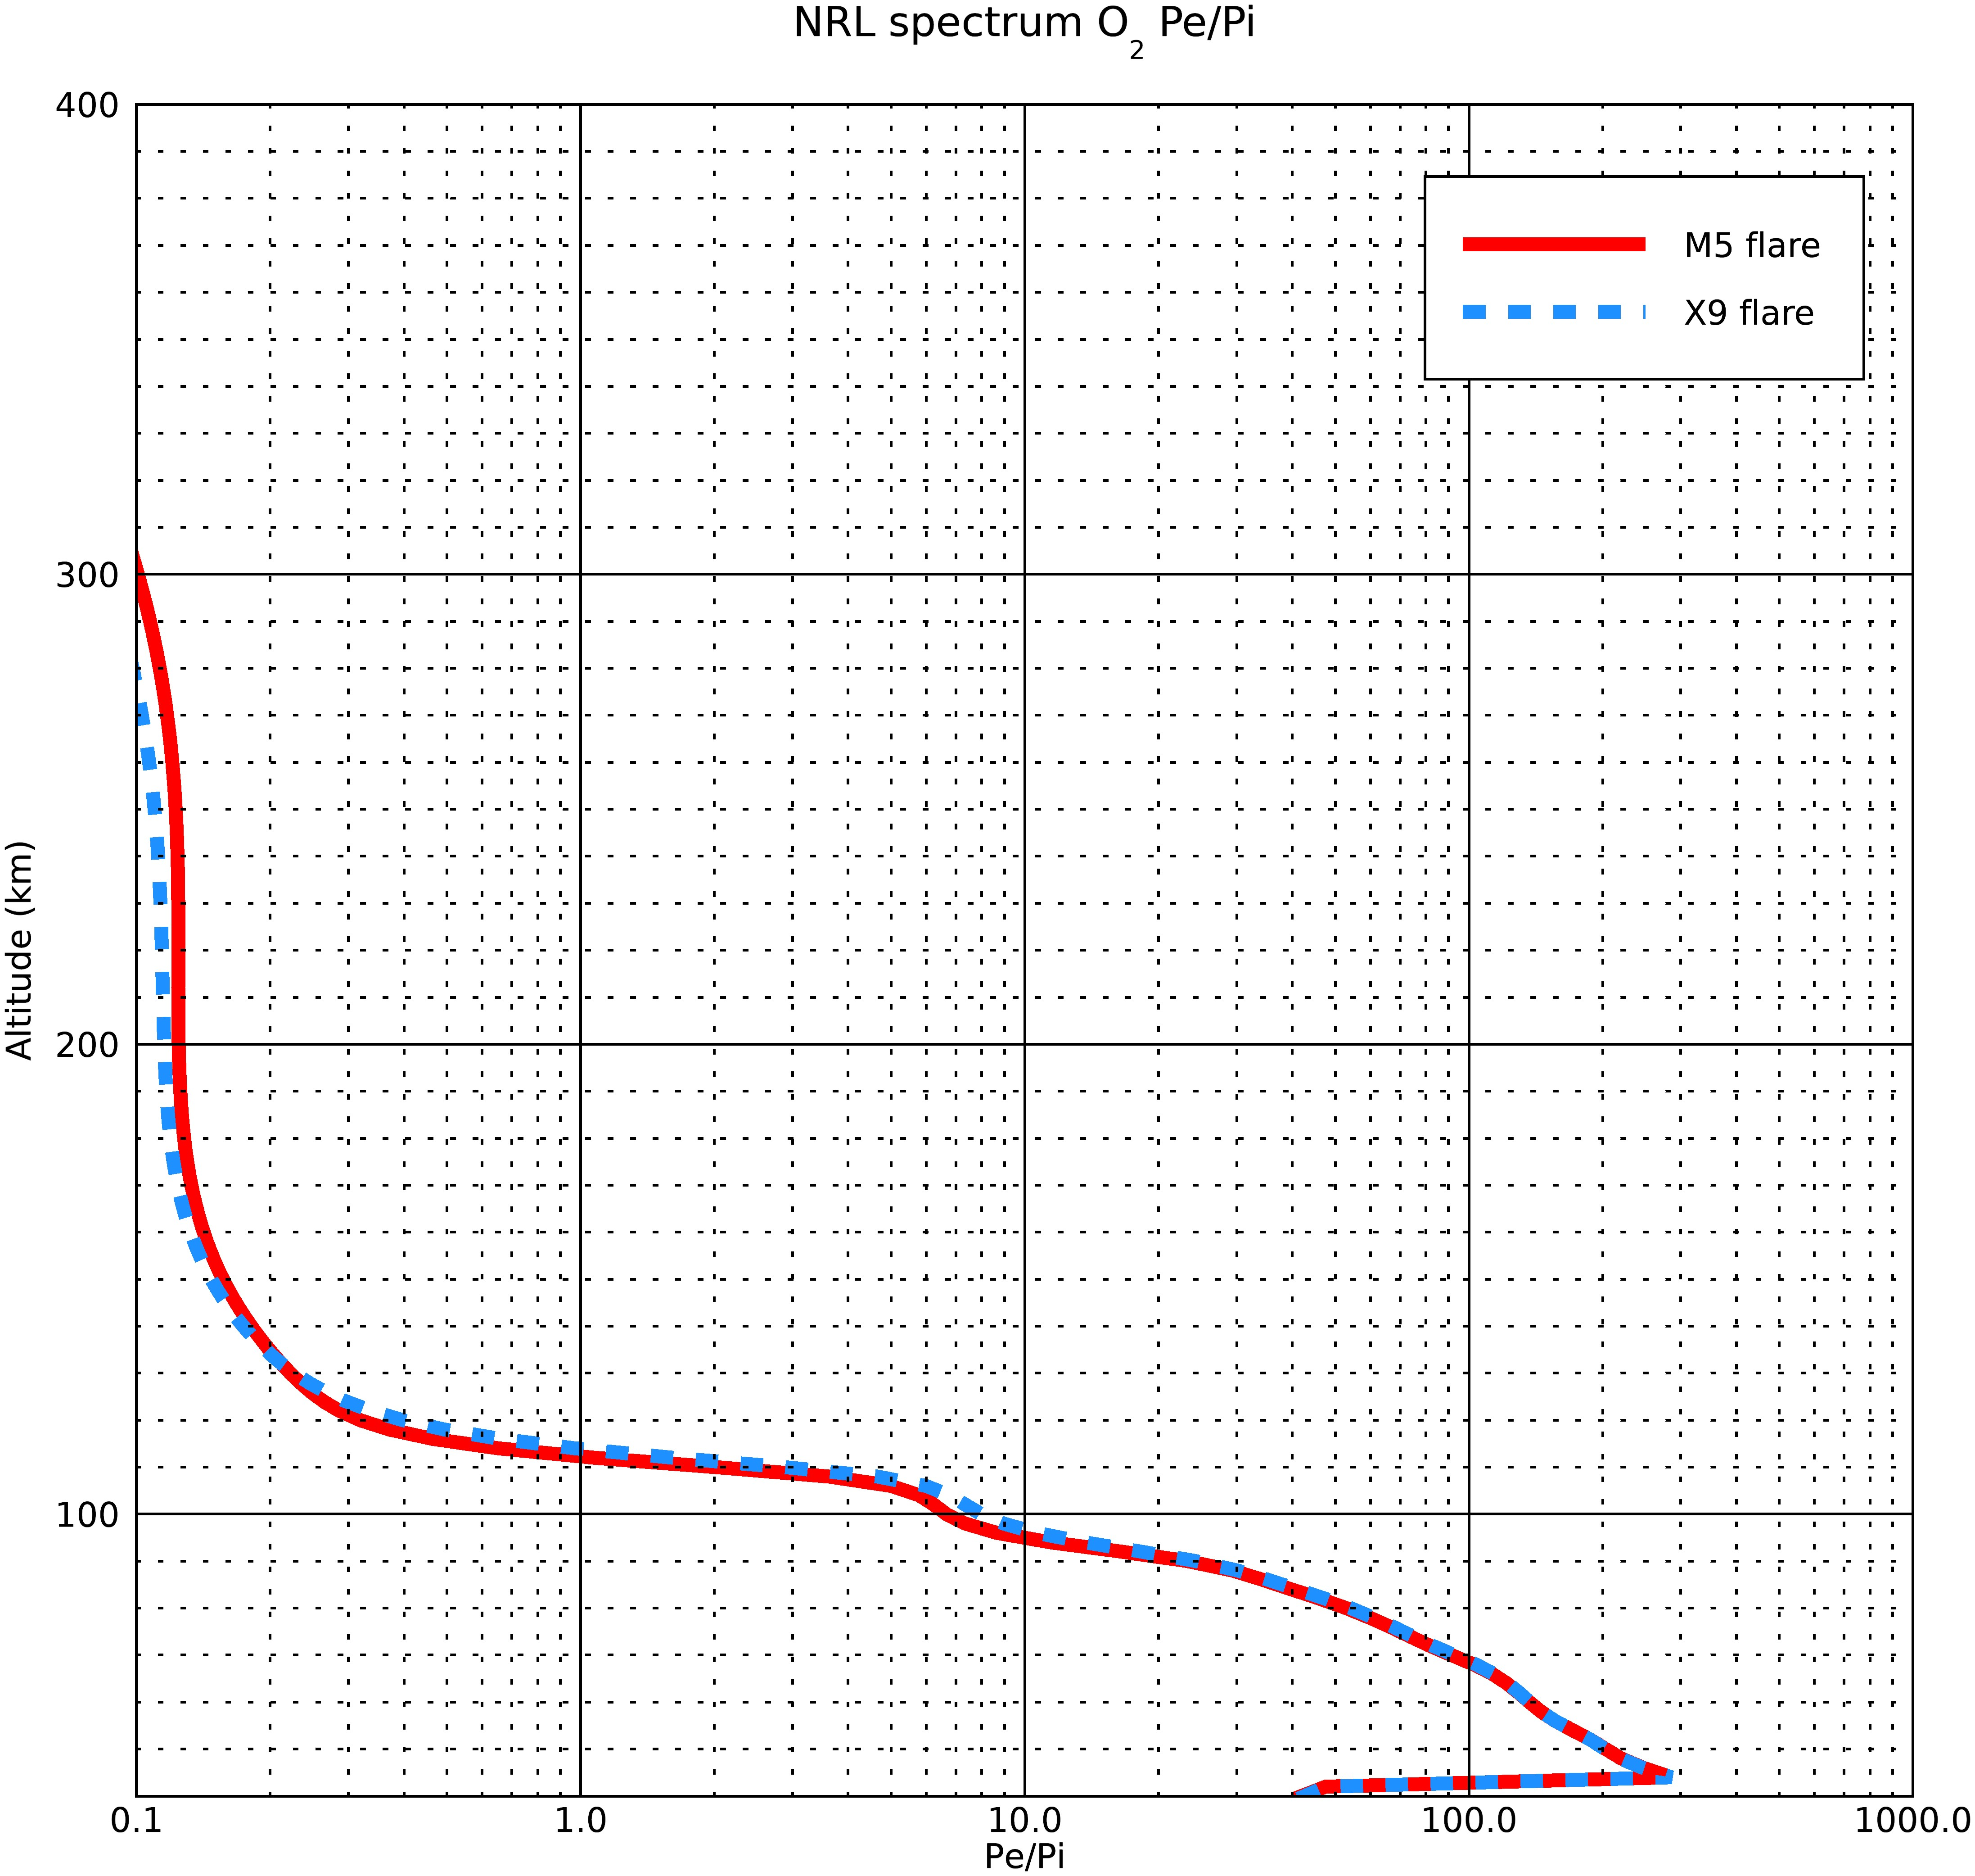
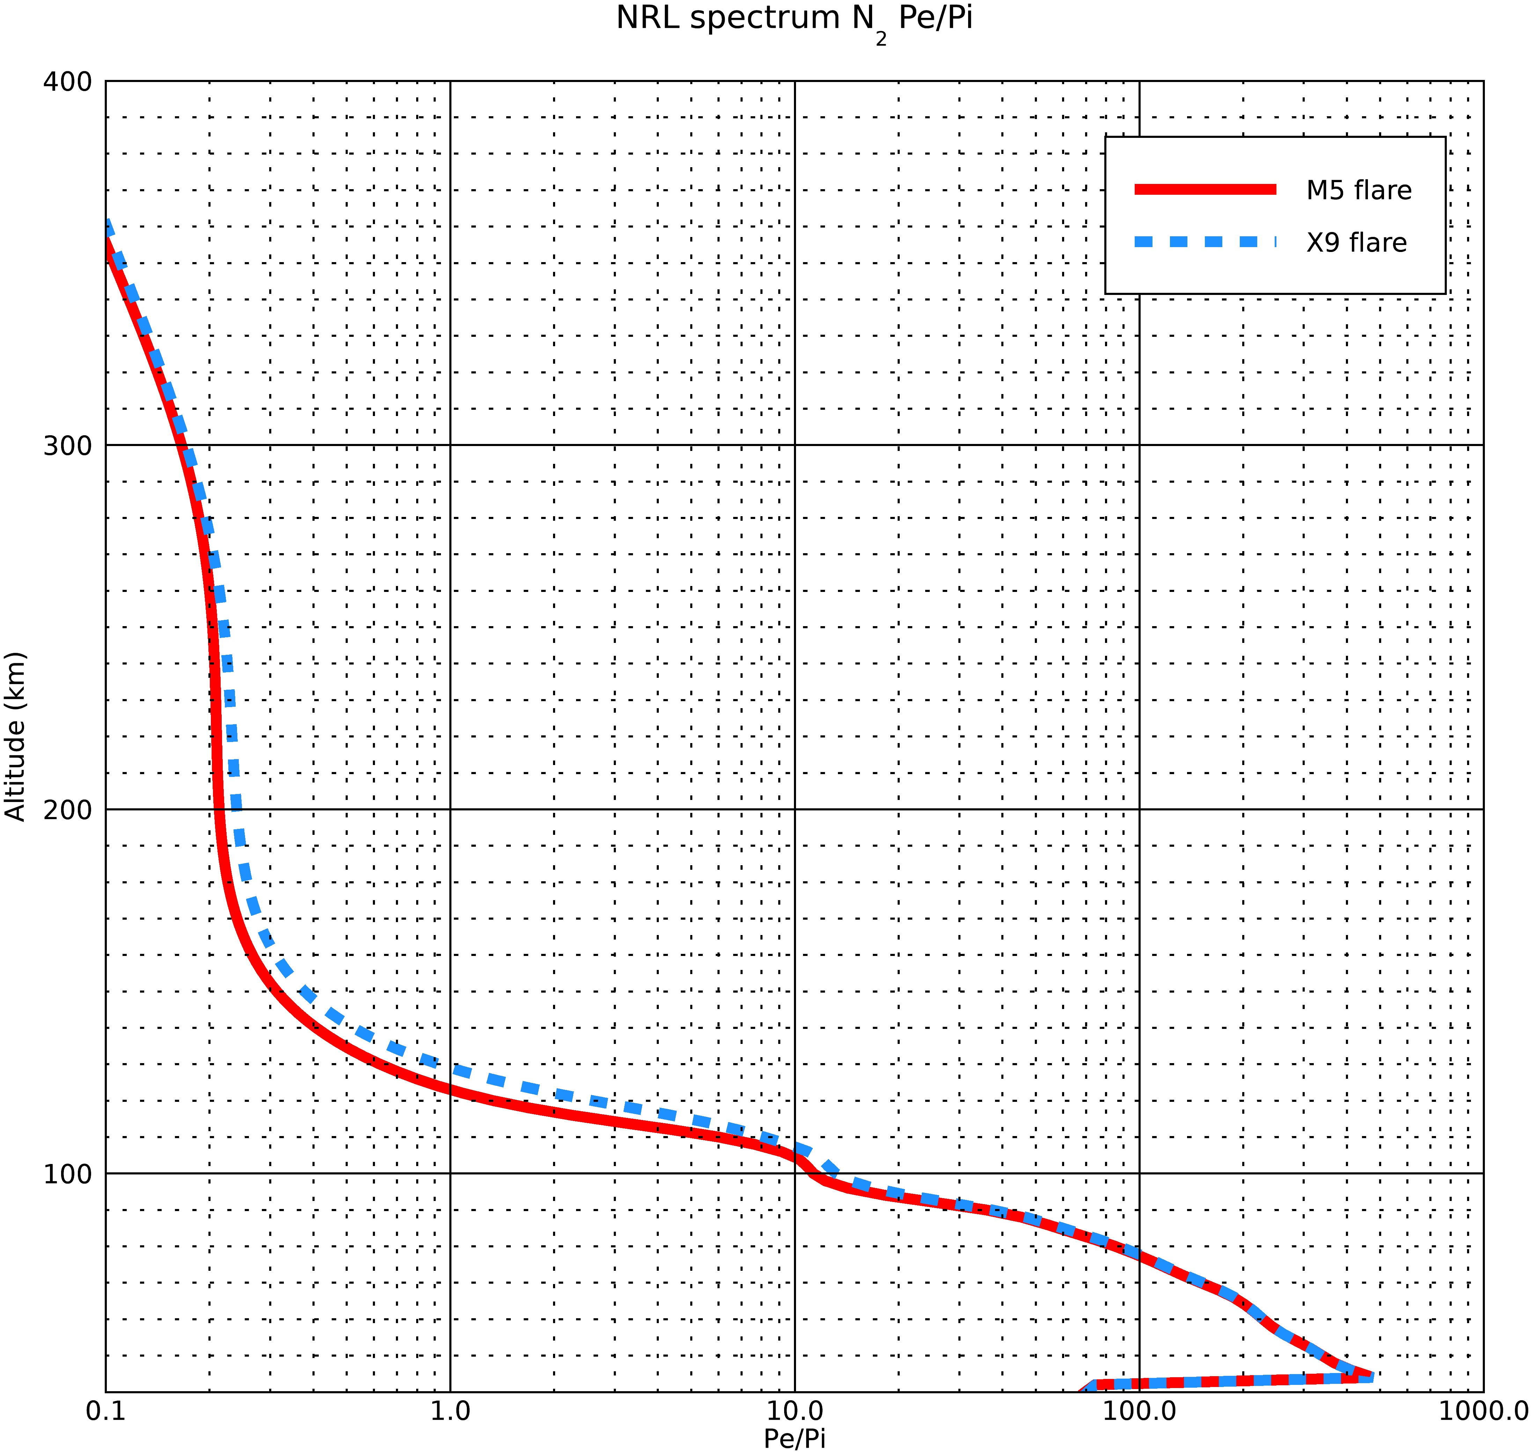
Pe/Pi ratios for the two spectra

Slide 5
Results of the Model- M5 flare
O2 data
Bin # | λ min (A) | λ max (A) | Mean λ (A) | Mean σσO2abs (mega-barns) | Alt of tau~ 1 (km) | pe/pi
1 | 0.5 | 1 | 0.75 | 6.21E-05 | 46 | 334.877
2 | 1 | 1.5 | 1.25 | 2.73E-04 | 58 | 186.124
3 | 1.5 | 2 | 1.75 | 8.33E-04 | 65 | 130.288
4 | 2 | 2.5 | 2.25 | 1.88E-03 | 71 | 100.69
5 | 2.5 | 3 | 2.75 | 3.66E-03 | 75 | 81.527
6 | 3 | 4 | 3.5 | 6.95E-03 | 79 | 64.223
7 | 4 | 5 | 4.5 | 1.50E-02 | 83 | 48.239
8 | 5 | 6 | 5.5 | 2.66E-02 | 87 | 37.862
9 | 6 | 8 | 7 | 5.25E-02 | 90 | 28.251
10 | 8 | 10 | 9 | 1.05E-01 | 94 | 19.552
11 | 10 | 14 | 12 | 2.25E-01 | 99 | 12.552
12 | 14 | 18 | 16 | 4.71E-01 | 103 | 6.794
N2 data
Bin # | λ min (A) | λ max (A) | Mean λ (A) | Mean σσN2abs (mega-barns) | Alt of tau~ 1 (km) | pe/pi
1 | 0.5 | 1 | 0.75 | 3.38E-05 | 46 | 556.789
2 | 1 | 1.5 | 1.25 | 1.49E-04 | 58 | 311.116
3 | 1.5 | 2 | 1.75 | 4.55E-04 | 65 | 217.68
4 | 2 | 2.5 | 2.25 | 1.03E-03 | 71 | 166.914
5 | 2.5 | 3 | 2.75 | 2.04E-03 | 75 | 134.397
6 | 3 | 4 | 3.5 | 3.91E-03 | 79 | 105.002
7 | 4 | 5 | 4.5 | 8.59E-03 | 83 | 77.558
8 | 5 | 6 | 5.5 | 1.56E-02 | 87 | 59.911
9 | 6 | 8 | 7 | 3.15E-02 | 90 | 43.828
10 | 8 | 10 | 9 | 6.43E-02 | 94 | 29.971
11 | 10 | 14 | 12 | 1.41E-01 | 99 | 19.047
12 | 14 | 18 | 16 | 3.02E-01 | 103 | 10.275

Slide 6
Results of the Model- X9 flare
O2 data
Bin # | λ min (A) | λ max (A) | Mean λ (A) | Mean σσO2abs (mega-barns) | Alt of tau~ 1 (km) | pe/pi
1 | 0.5 | 1 | 0.75 | 6.21E-05 | 46 | 334.877
2 | 1 | 1.5 | 1.25 | 2.73E-04 | 58 | 186.124
3 | 1.5 | 2 | 1.75 | 8.33E-04 | 65 | 130.287
4 | 2 | 2.5 | 2.25 | 1.88E-03 | 71 | 100.69
5 | 2.5 | 3 | 2.75 | 3.66E-03 | 75 | 81.527
6 | 3 | 4 | 3.5 | 6.95E-03 | 79 | 64.223
7 | 4 | 5 | 4.5 | 1.50E-02 | 83 | 48.239
8 | 5 | 6 | 5.5 | 2.66E-02 | 87 | 37.862
9 | 6 | 8 | 7 | 5.25E-02 | 90 | 28.251
10 | 8 | 10 | 9 | 1.05E-01 | 94 | 19.552
11 | 10 | 14 | 12 | 2.25E-01 | 99 | 12.552
12 | 14 | 18 | 16 | 4.71E-01 | 103 | 6.794
N2 data
Bin # | λ min (A) | λ max (A) | Mean λ (A) | Mean σσN2abs (mega-barns) | Alt of tau~ 1 (km) | pe/pi
1 | 0.5 | 1 | 0.75 | 3.38E-05 | 46 | 556.789
2 | 1 | 1.5 | 1.25 | 1.49E-04 | 58 | 311.116
3 | 1.5 | 2 | 1.75 | 4.55E-04 | 65 | 217.68
4 | 2 | 2.5 | 2.25 | 1.03E-03 | 71 | 166.914
5 | 2.5 | 3 | 2.75 | 2.04E-03 | 75 | 134.397
6 | 3 | 4 | 3.5 | 3.91E-03 | 79 | 105.002
7 | 4 | 5 | 4.5 | 8.59E-03 | 83 | 77.558
8 | 5 | 6 | 5.5 | 1.56E-02 | 87 | 59.911
9 | 6 | 8 | 7 | 3.15E-02 | 90 | 43.828
10 | 8 | 10 | 9 | 6.43E-02 | 94 | 29.971
11 | 10 | 14 | 12 | 1.41E-01 | 99 | 19.047
12 | 14 | 18 | 16 | 3.02E-01 | 103 | 10.275

