Slide 1
Verification of calculated and model values of altitude of optical depth

Slide 2
Theoritical Calculation of altitude of unit optical depth- Table data
Calculated | Results
Bin # | λ min (A) | λ max (A) | Mean λ (A) | Mean σN2abs (mega-barns) | Alt of tau=1 (km)
1 | 0.5 | 1 | 0.75 | 2.48e-5 | 43
2 | 1 | 1.5 | 1.25 | 1.47e-4 | 55.5
3 | 1.5 | 2 | 1.75 | 4.57e-4 | 63.5
4 | 2 | 2.5 | 2.25 | 1.02e-3 | 69.1
5 | 2.5 | 3 | 2.75 | 1.9e-3 | 73.3
6 | 3 | 4 | 3.5 | 4.0e-3 | 78.7
7 | 4 | 5 | 4.5 | 8.55e-3 | 84
8 | 5 | 6 | 5.5 | 1.55e-2 | 88.1
9 | 6 | 8 | 7 | 3.12e-2 | 93
10 | 8 | 10 | 9 | 6.32e-2 | 98
11 | 10 | 14 | 12 | 0.14 | 103.5
12 | 14 | 18 | 16 | 0.30 | 109
6/21/20

Slide 3
Effect of altitude bin ∆z
If we take the altitude bin in the model to be ∆z= 0.5 to 1 km, the deviation in calculating the altitude of unit optical depth is minimum, so ∆z= 1 km in the model.
Calculated | Results
Bin # | λ min (A) | λ max (A) | Mean λ (A) | Mean σN2abs (mega-barns) | Alt of tau=1 (km)
1 | 0.5 | 1 | 0.75 | 2.48e-5 | 43
2 | 1 | 1.5 | 1.25 | 1.47e-4 | 55.5
3 | 1.5 | 2 | 1.75 | 4.57e-4 | 63.5
4 | 2 | 2.5 | 2.25 | 1.02e-3 | 69.1
5 | 2.5 | 3 | 2.75 | 1.9e-3 | 73.3
6 | 3 | 4 | 3.5 | 4.0e-3 | 78.7
7 | 4 | 5 | 4.5 | 8.55e-3 | 84
8 | 5 | 6 | 5.5 | 1.55e-2 | 88.1
9 | 6 | 8 | 7 | 3.12e-2 | 93
10 | 8 | 10 | 9 | 6.32e-2 | 98
11 | 10 | 14 | 12 | 0.14 | 103.5
12 | 14 | 18 | 16 | 0.30 | 109
Model Results
σN2abs (mega-barns) | Alt of tau=1 (km) | Exact value of optical depth tau
3.38E-05 | 46 | 1.12
1.49E-04 | 58 | 1.02
4.55E-04 | 65 | 1.32
1.03E-03 | 71 | 1.21
2.04E-03 | 75 | 1.26
3.91E-03 | 79 | 1.25
8.59E-03 | 83 | 1.39
1.56E-02 | 87 | 1.22
3.15E-02 | 90 | 1.17
6.43E-02 | 94 | 1.15
1.41E-01 | 99 | 1.24
3.02E-01 | 103 | 1.31
Altitued Difference (km)
3
2.5
1.5
1.9
1.7
0.3
1
1.1
3
4
4.5
6
6/21/20

Slide 4
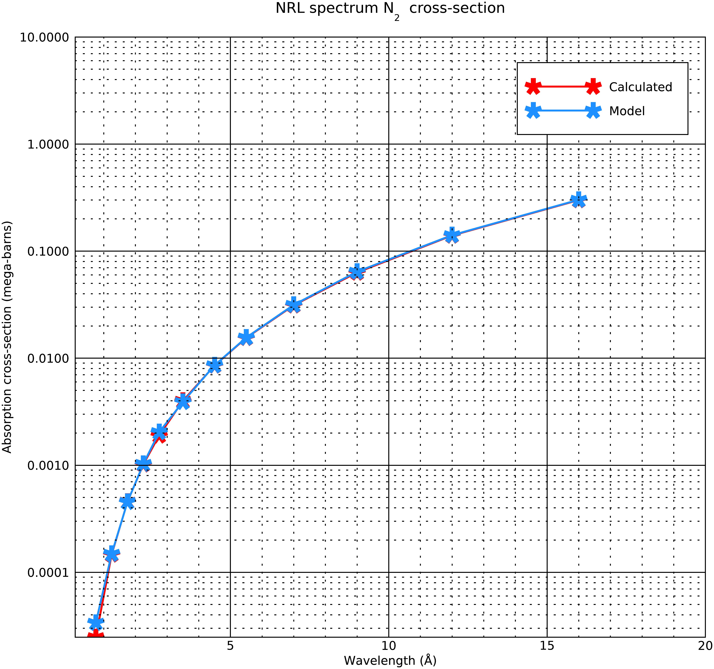
N₂ Cross-sections
I changed the cross-sections of N₂ in the model to the one from the table.
The cross-section of the first bin is different in the model and the table.
Changing the cross-sections only changes the altitude of unit optical depth in the first bin.
I checked the Henke + Fennelly data, and the model value is more accurate than the table value.
6/21/20

Slide 5
N₂ Cross-sections
Calculated | Results
Bin # | λ min (A) | λ max (A) | Mean λ (A) | Mean σN2abs (mega-barns) | Alt of tau=1 (km)
1 | 0.5 | 1 | 0.75 | 2.48e-5 | 43
2 | 1 | 1.5 | 1.25 | 1.47e-4 | 55.5
3 | 1.5 | 2 | 1.75 | 4.57e-4 | 63.5
4 | 2 | 2.5 | 2.25 | 1.02e-3 | 69.1
5 | 2.5 | 3 | 2.75 | 1.9e-3 | 73.3
6 | 3 | 4 | 3.5 | 4.0e-3 | 78.7
7 | 4 | 5 | 4.5 | 8.55e-3 | 84
8 | 5 | 6 | 5.5 | 1.55e-2 | 88.1
9 | 6 | 8 | 7 | 3.12e-2 | 93
10 | 8 | 10 | 9 | 6.32e-2 | 98
11 | 10 | 14 | 12 | 0.14 | 103.5
12 | 14 | 18 | 16 | 0.30 | 109
Alt of tau=1 (km) | Exact value of optical depth tau
45 | 1.12
58 | 1.02
65 | 1.32
71 | 1.21
75 | 1.26
79 | 1.25
83 | 1.39
87 | 1.22
90 | 1.17
94 | 1.15
99 | 1.24
103 | 1.31
Altitued Difference (km)
2
2.5
1.5
1.9
1.7
0.3
1
1.1
3
4
4.5
6
This bin changed
6/21/20

Slide 6
Estimation of n₀ from the model
In the table (slide 2), it was assumed n₀= 2.7E19 cm³
I used the formula from slide 2, to get an estimation of n₀ of the model.
This combination of scale height and density gives the same value of altitude of unit optical depth as in slide 5
n₀ (cm³) | Height of unit optical depth (km) | Scale Height (km)
1.63e+19 | 45 | 7.82
3.01e+19 | 58 | 7.19
5.72e+19 | 65.5 | 6.70
1.13e+20 | 71 | 6.34
1.86e+20 | 75 | 5.95
2.45e+20 | 79 | 5.60
6.31e+20 | 83.5 | 5.27
1.84e+21 | 87 | 5.27
1.58e+21 | 90.5 | 5.30
9.81e+20 | 94.5 | 5.45
1.19e+21 | 99 | 5.40
5.36e+20 | 103 | 5.62
6/21/20

Slide 7
Estimation of altitude of unit optical depth using constant n₀
n₀ (cm³) | Height of unit optical depth (km) | Scale Height (km)
2.7e+19 | 48.9 | 7.82
2.7e+19 | 57 | 7.19
2.7e+19 | 60.5 | 6.70
2.7e+19 | 62 | 6.34
2.7e+19 | 63 | 5.95
2.7e+19 | 65.9 | 5.60
2.7e+19 | 65.9 | 5.27
2.7e+19 | 64.8 | 5.30
2.7e+19 | 68.9 | 5.30
2.7e+19 | 74.9 | 5.45
2.7e+19 | 78.5 | 5.40
2.7e+19 | 86.2 | 5.62
However, if I use n₀= 2.7E19 cm³ , the model’s scale height, and the formula for altitude of unit optical height derived in slide 2, the altitude is very different (column2 of table on the right)
So the correct scale height and density is required to get the correct altitude.
6/21/20

Slide 8
Calculation of altitudes with MSIS values of n₀
The MSIS value for n₀= 1.9 E19 cm³
Taking scale height H= 7km and the formula for altitude of unit optical height derived in slide 2, and calculating the altitude of unit optical depth.
The altitudes are different than the ones calculated in the table with n₀= 2.7E19 cm³
Calculated | Results
Bin # | λ min (A) | λ max (A) | Mean λ (A) | Mean σN2abs (mega-barns) | Alt of tau=1 (km) n0= 2.7 E19
1 | 0.5 | 1 | 0.75 | 2.48e-5 | 43
2 | 1 | 1.5 | 1.25 | 1.47e-4 | 55.5
3 | 1.5 | 2 | 1.75 | 4.57e-4 | 63.5
4 | 2 | 2.5 | 2.25 | 1.02e-3 | 69.1
5 | 2.5 | 3 | 2.75 | 1.9e-3 | 73.3
6 | 3 | 4 | 3.5 | 4.0e-3 | 78.7
7 | 4 | 5 | 4.5 | 8.55e-3 | 84
8 | 5 | 6 | 5.5 | 1.55e-2 | 88.1
9 | 6 | 8 | 7 | 3.12e-2 | 93
10 | 8 | 10 | 9 | 6.32e-2 | 98
11 | 10 | 14 | 12 | 0.14 | 103.5
12 | 14 | 18 | 16 | 0.30 | 109
Alt of tau=1 (km) (n0= 1.9 E19)
40.6
53.
61
66.6
71
76
81.5
85.6
90.6
95.5
101
106
Model Results
Alt of tau=1 (km)
46
58
65
71
75
79
83
87
90
94
99
103
6/21/20

Slide 9
Conclusion
The difference in altitude of unit optical depth between the model data and the calculated data is due to the difference in the assumptions made in its calculations and the different values calculated by the model.
An altitude binning of ∆z= 0.5 to 1 km is good for getting the correct altitude of optical depth.
The N₂ cross-section of the first bin in the model is more accurate than that given in the theoretical table.
6/21/20

