Slide 1

Atmospheric Chemistry and Energetics (ACE) Photoelectron Model
Srimoyee samaddar

Slide 2
Spectra
July 23, 2016 flare, time 2000 sec
November 4, 2003 flare, time 10000 sec
Spectral bins are from 0.465564 – 1750 Angstrom
Added EUVAC spectra to NRL spectra for wavelength bins longward of 500 A
Flare spectra consists of superimposed background spectra

Slide 3
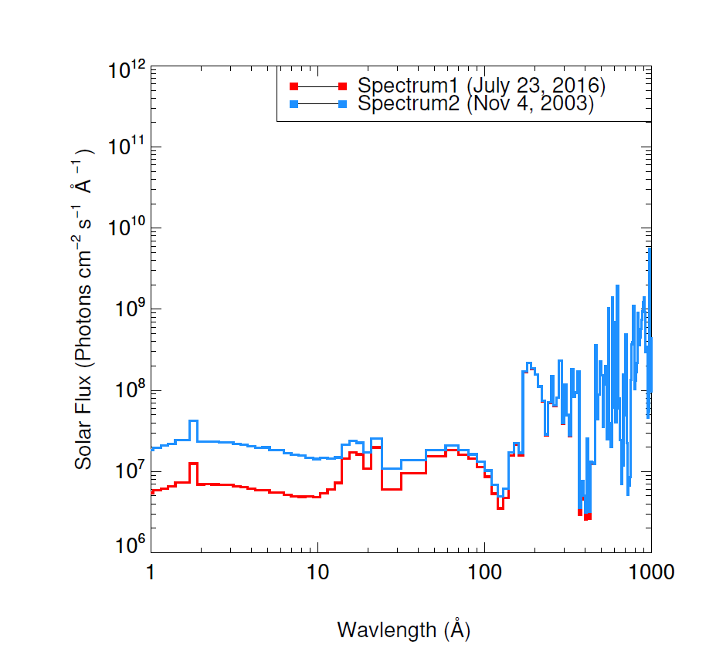
Solar Spectra
Spectrum 1- July 23, 2016 ‘spectrum2000’ in Jeff’s file
Spectrum 2- Nov 4, 2003 ‘spectrum10000’ in Jeff’s file
Number in ‘spectrum*’ in seconds

Slide 4
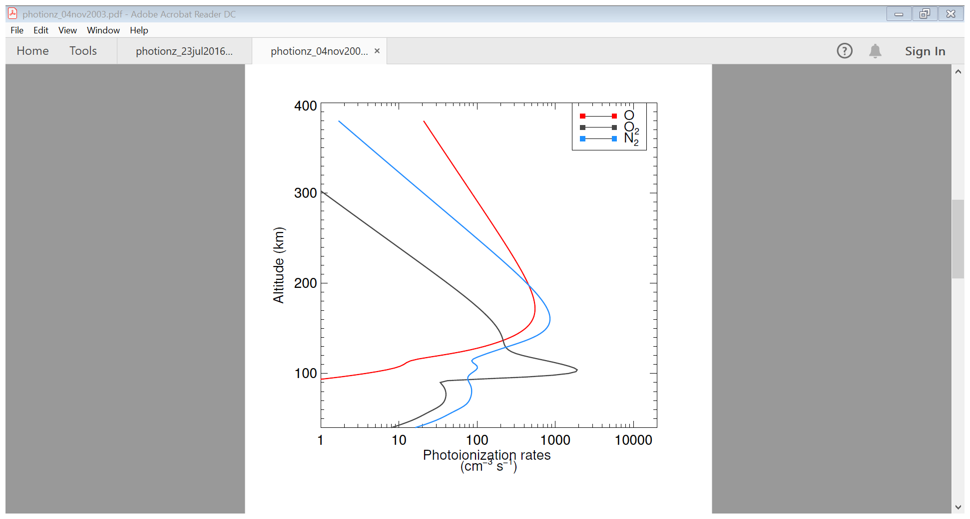
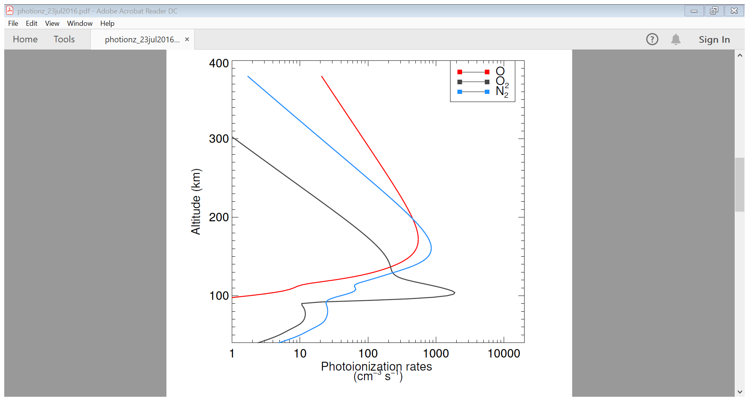
Photoionization Rates
July 23, 2016
Nov 4, 2003

Slide 5
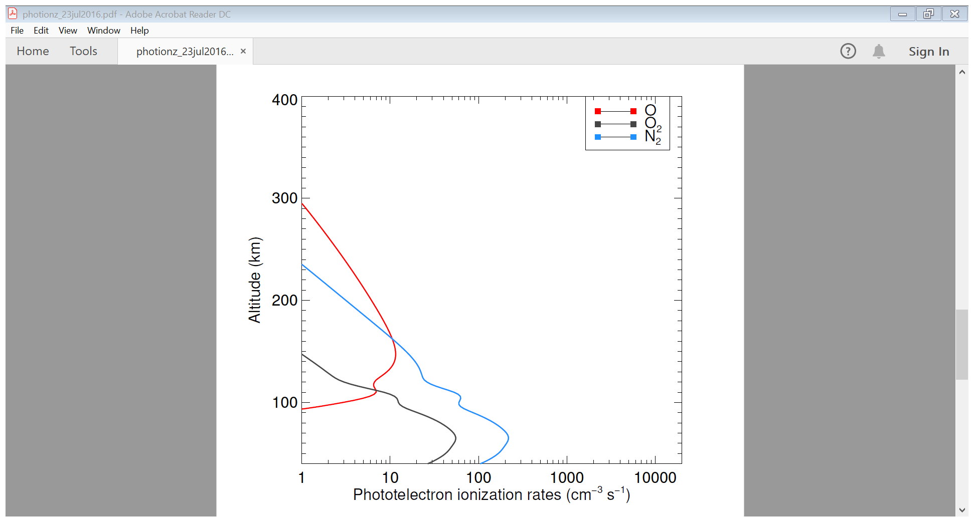
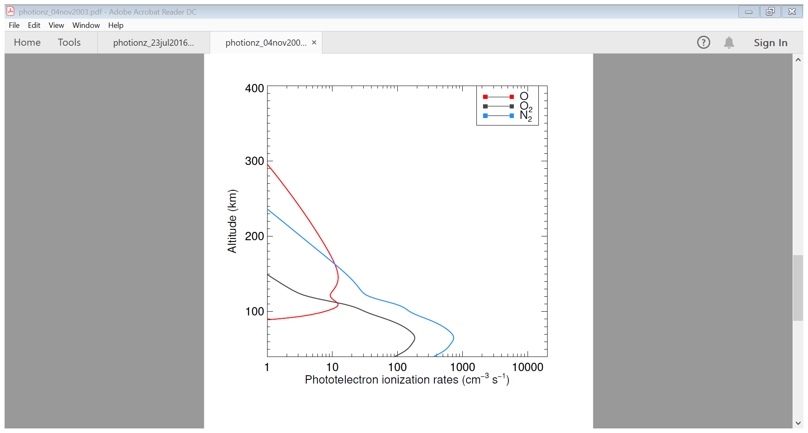
Photoelectron Ionization Rates
July 23, 2016
Nov 4, 2003

Slide 6
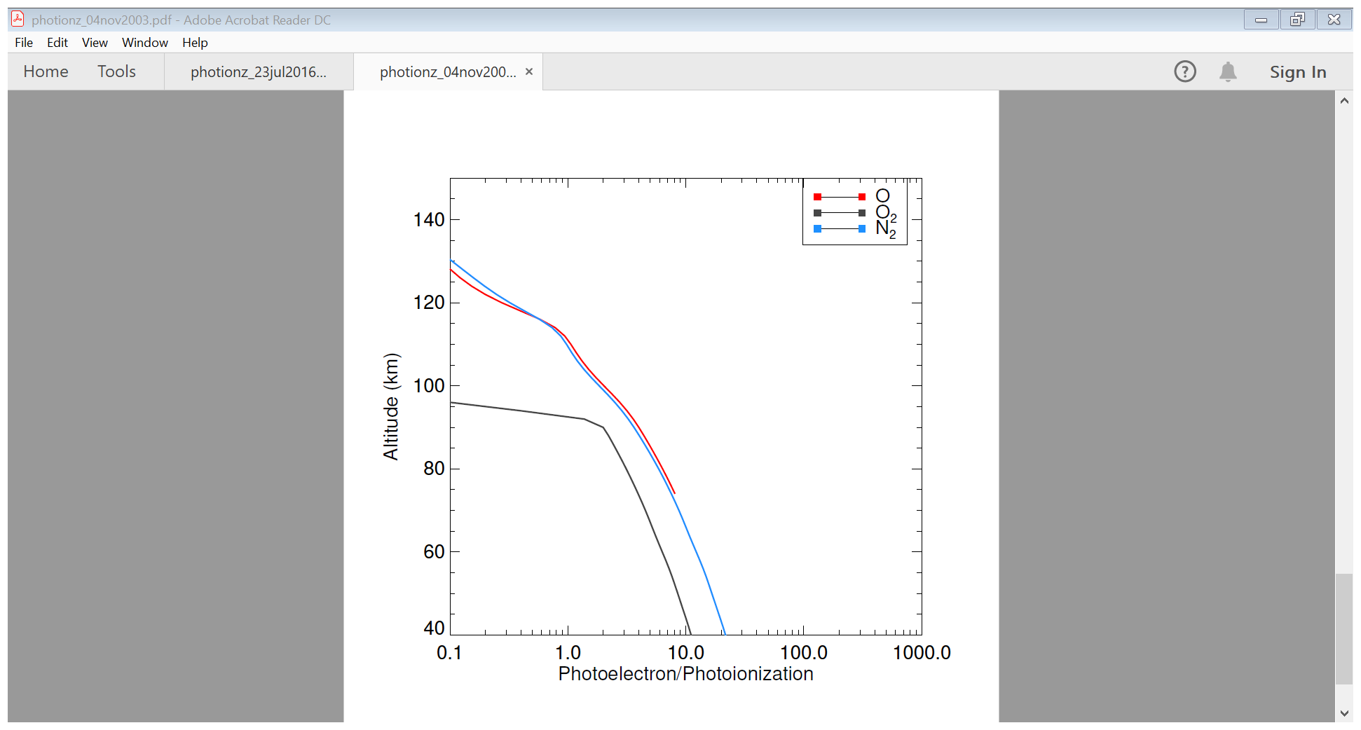
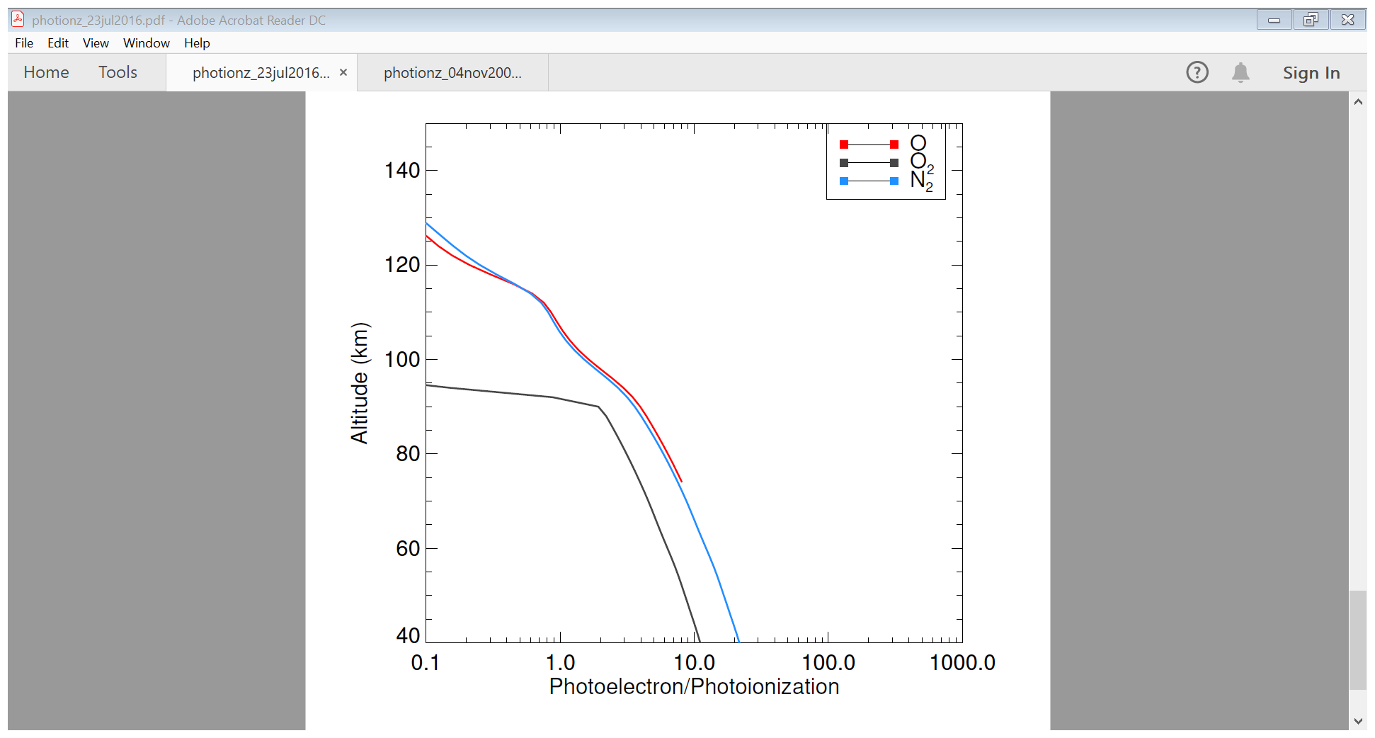
Nov 4, 2003
Pe/Pi
July 23, 2016

Slide 7
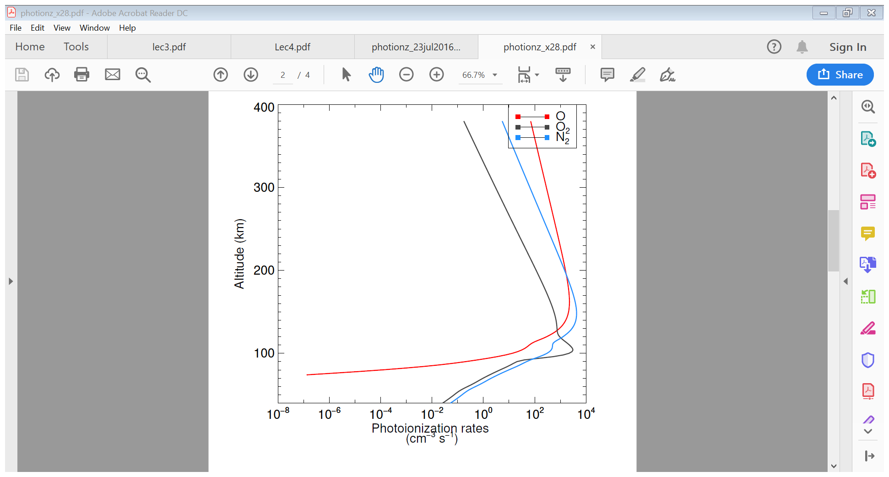
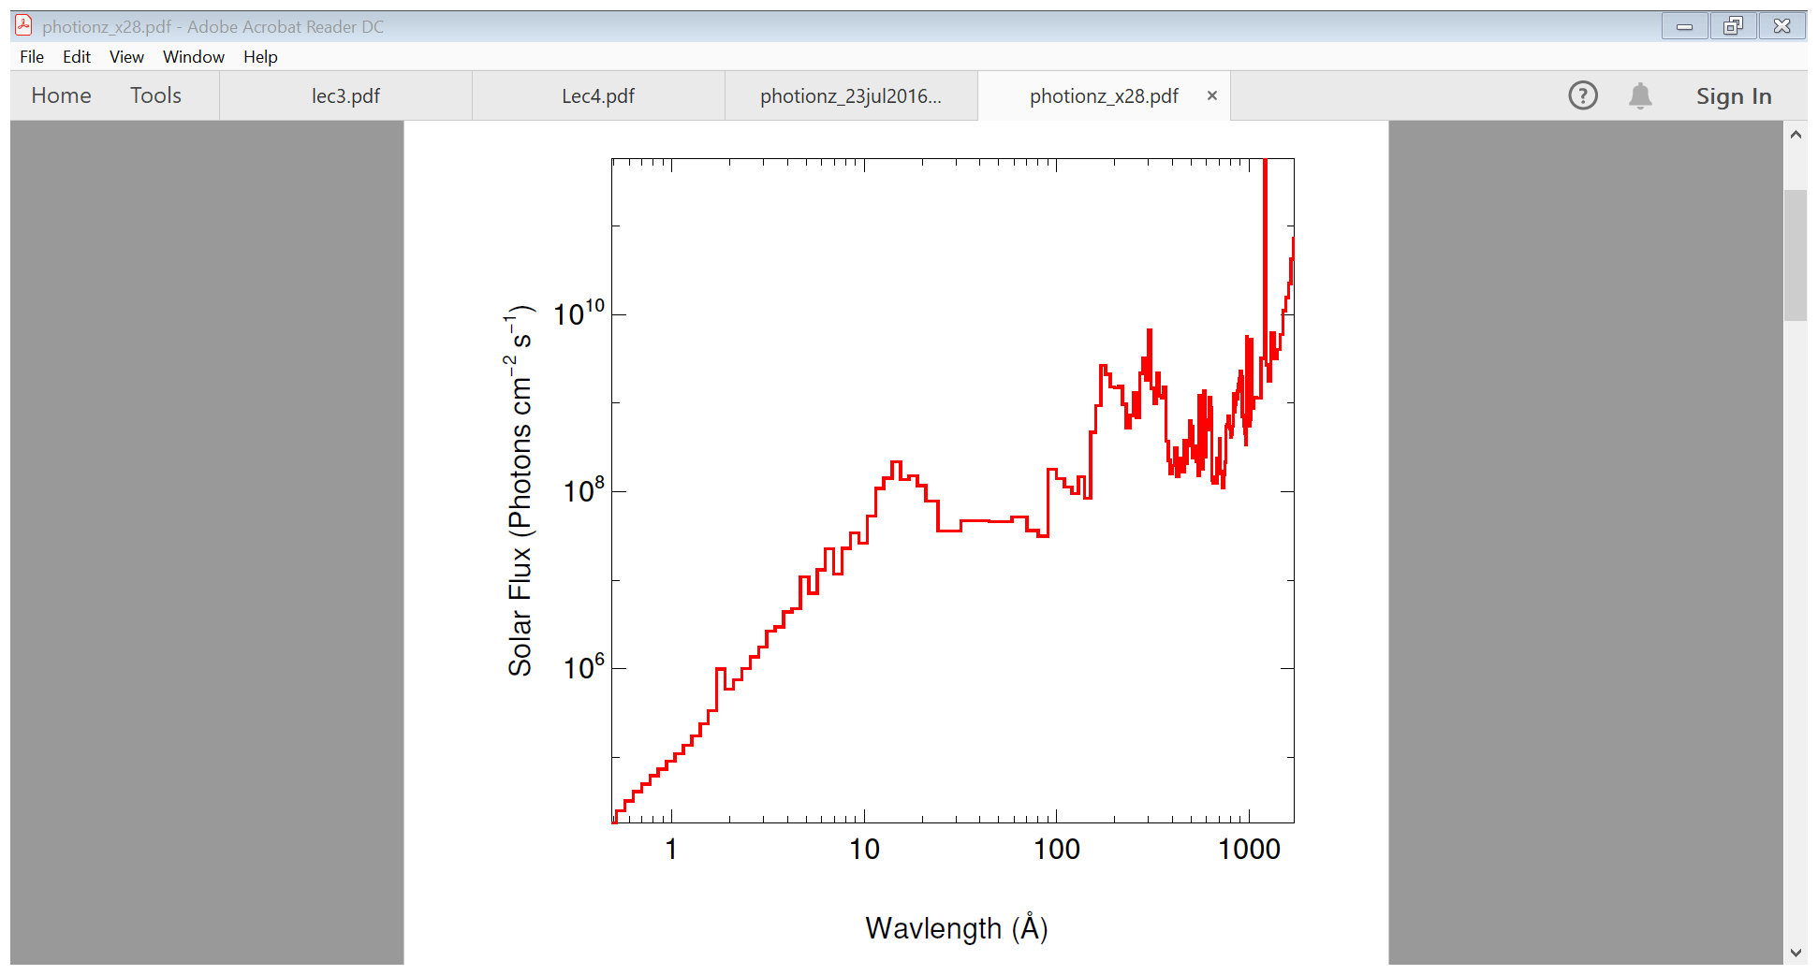
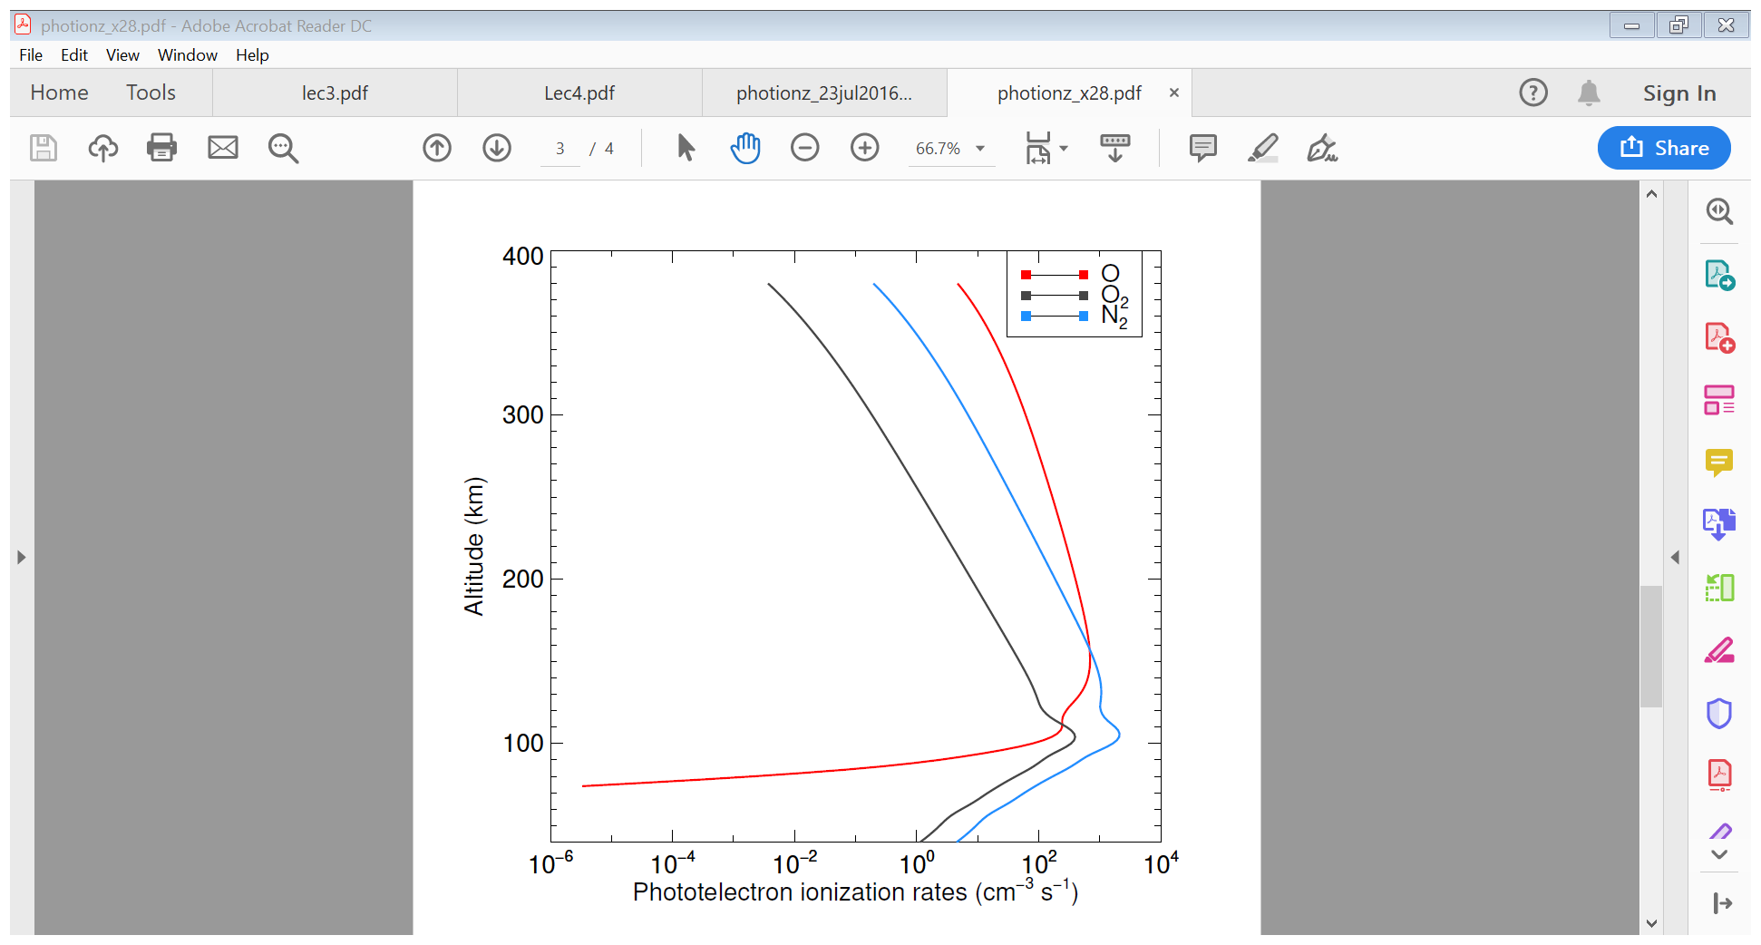
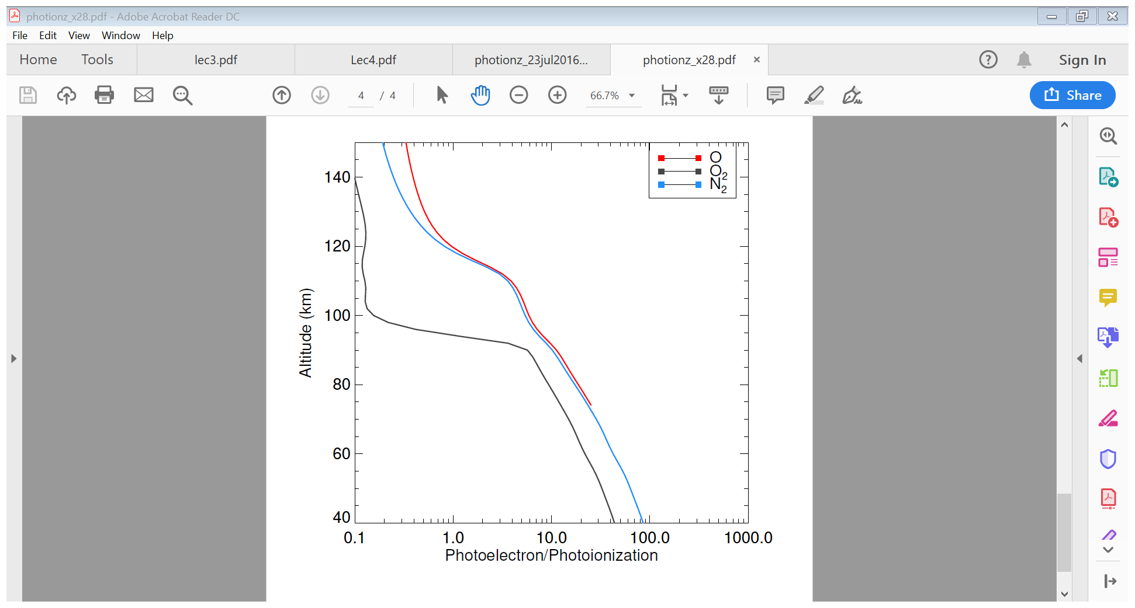
X28

