Slide 1
Angular2

Slide 2

Purpose of AngularJS
→Created in 2009 by Google and first released in 2010 October.

Slide 3
Salient Features
To simplify the front-end development methodology.
The main goal of this technology to achieve single page application.
It maintains MVC architecture.
Continues…

Slide 4
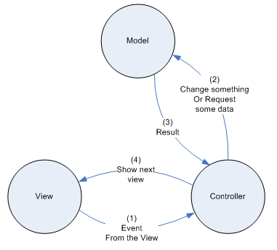

Slide 5
4. It contains POJO(plain old java objects).
5. It is very ease of use.
6. Utmost goal is to create a Hybrid Application.

Slide 6
Drawbacks of AngularJS
Angular is big and complicated. With multiple ways to do the same thing it is hard to new programmers to adopt is easily.
The lifecycle of Angular application is complex.

Slide 7

Introduction of Angular2

Slide 8
Main Goals
TO overcome the difficulties facing by new Programmers to figure out difference between Controllers and Services etc…
Components concept introduced for replacement of view and model in Angular2.
New Scripting methodology is introduced called as TypeScript.
Continues…

Slide 9
4. The new Angular version will be focused on the development of mobile apps.
5. New way of reusability is came to focus called as templating.
6. Improved Dependency Injection.
Ex: POJO

Slide 10
7. High priority given to abstraction.
8. Angular 2 uses camelCase syntax for built-in directives.
Ex: ng-model is now ngModel

Slide 11
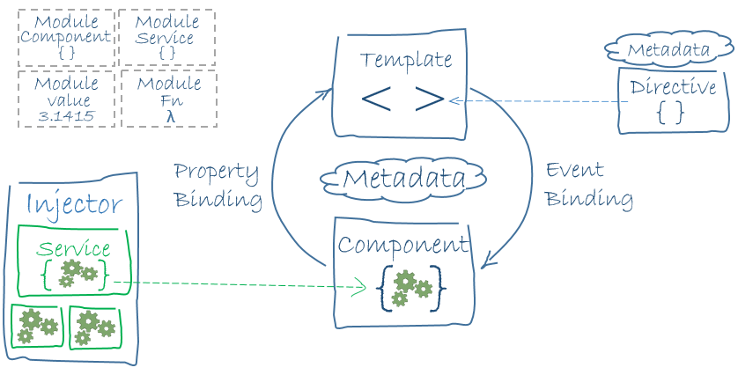
Architecture

Slide 12
DEMO PROGRAM

Slide 13


