Slide 1
Overview on Python Programming
Session By : Udai Krishnan K

Slide 2
About me
Udai Krishnan
Approx 14 years of IT experience working with different technologies
MCPD EA .NET Certified
Coding experience: C# .NET, Python, VB.NET , Java
ASP, ASP.Net
Sql Server, Mongo DB, MySql
DW, DM
K2 blackpearl, SSIS, SSRS, Jasper

Slide 3
Python fundamentals
Day 1:
Python Introduction, Installation, Control Structures
Day 2:
More Data types, UDF, Lambda
Day 3:
Exception handling, File operations, Functional programming
Day 4:
Object Oriented programming, RE, packaging, DB connectivity

Slide 4
Python fundamentals – Day 1
Python Introduction
Installation instructions
Data types
Arithmetic/Logical operators
Control structures: If else statement
Control structures: Loop – For & While
String data type revisit

Slide 5
Python
General purpose high level programming language
Simple and easy to understand and use
Python programs are readable, Fewer lines of code
Multi-Paradigm – Structured, OOO, Functional
Python 2.0 Oct 2000/Python 3.0 Dec 2008
Examples
YouTube
DropBox
Google
Instagram
Spotify
Reddit
Wikipedia
Yahoo!
NASA

Slide 6
Comments
Comments start with # and extend to physical end of line
# This is a comment in Python
# Proper comments improve the readability of code

Slide 7
Data Types and Variables
Some basic data types in Python
Integer
Float
String
Variables need not be declared; use when needed
a = 10
b = 20.56
c = "Hello World!"

Slide 8
Output Operation
The function print() is used for printing on console
a = 10
print(a)
b = 20.56
print(b)
c = "Hello World!"
print(c)
# print function can accept multiple parameters
print(a, b, c)
print("Value of a is", a)

Slide 9
Data Types and Variables
The data type of a variable can change during execution
a = 10 # a is integer
a = 20.56 # a becomes float
a = "Hello World!” # a becomes string
Complex numbers can be stored in data type complex
a = 10 + 20j
print(a) #Prints (10+20j)
Program: Write a program to create an integer, float and string and print their values on the console

Slide 10
Data Types and Variables
Strings can be represented in multiple ways
a = "Hello"
b = 'Hello'
c = '''Hello'''
d = """Hello"""
a = "He'lo" # This string can have ' in it
b = 'He"lo' # This string can have " in it
c = '''He'l"lo''' # This string can have ' and " in it
d = """He'l"lo""" # This string can have ' and " in it
c = '''Hello
UST
Global'''# Triple quoted string can span multiple lines also

Slide 11
Data Types and Variables
str = "Hello"
print(len("Hello")) #Prints 5

Slide 12
Input Operation
The function input() is used for reading strings from console
a = input()
The string parameter of input() function acts as a prompt to the user
name = input("Enter your name ")
String can be converted to other data types
age = int(input("Enter your age "))
height = float(input("Enter your height "))

Slide 13
Arithmetic Operators
The arithmetic operators are
+ Addition
- Subtraction
* Multiplication
/ Division, result is float
% Modulus, reminder of a division
// Truncation or Floor Division, result is an int
** Exponentiation
Write a program to read 2 integers from the user and print their sum
Arithmetic operators +, -, * and / work for complex type

Slide 14
Relational and Logical Operators
The relational operators are
< Less than
> Greater than
<= Less than or equal to
>= Greater than or equal to
== Equal to
!= Not equal to
The logical operators are
and
or
not
The result of these operations is of boolean type - True or False

Slide 15
The if Statement
if a > b:
print(a)
print("Hello")
if a > b:
print(a)
print("Hello")
else:
print(b)
print("Welcome")
if a > b:
print(a)
elif b > c:
print(b)
else:
print(c)
if a > b and a > c:
print(a)
Write a program to read 2 integers from the user and print the largest among them

Slide 16
Loops
Used for repetition
for
Fixed number of repetitions
while
Unknown number of repetitions

Slide 17
The for Loop
The range() function
Creates a sequences of numbers
Used in for loops to control the number of iterations
start: Starting number of the sequence.
stop: Generate numbers up to, but not including this number.
step: Difference between each number in the sequence.
range(5) # Create a sequence of numbers 0, 1, 2, 3, 4
range(1, 5) # Create a sequence of numbers 1, 2, 3, 4
range(1, 10, 2) # Create a sequence of numbers 1, 3, 5, 7, 9
a = range(5)
for i in a:
print(i) # Prints 0, 1, 2, 3, 4
Write a program to print all numbers from 1 to 10

Slide 18
The while Loop
sum = 0
a = int(input("Enter number "))
while a !=0:
sum = sum + a
a = int(input("Enter number "))
print("Sum is ", sum)
Write a program to print some integers. The last integer will be 0

Slide 19
The break Statement
The break statement terminates the current loop
Can we used with for and while loops
sum = 0
while True:
x = input("Enter number ")
if x != "":
sum = sum + int(x)
else:
break;
print(sum)

Slide 20
Conditional operator
The Ternary operator
[on_true] if [expression] else [on_false]
a, b = 10, 15
min = a if a < b else b
print(min)

Slide 21
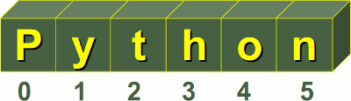
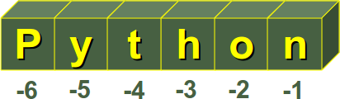
Strings Revisited
String is a “sequence type” and is indexed
a = "Python"
print(a[0]) # Prints P
print(a[1]) # Prints y
print(a[-1]) # Prints n
print(a[-2]) # Prints o
print(a[2:4]) # Prints th
print(a[:4]) # Prints Pyth
print(a[3:]) # Prints hon
Image Source: http://www.python-course.eu/python3_variables.php

Slide 22
String Operators
a = "Python"
b = "Hello"
c = b + a
print(c) # Prints Hello Python
print (a * 3) # Prints PythonPythonPython
if "P" in a:
print("Present“) # Prints Present
if "P" not in b:
print("Present") # Prints Present

Slide 23
String Methods
capitalize()
count(str)
find(str)
join(seq)
lower()
split(str)
title()
upper()
Write a program to read a word and print it in upper case
Write a program to read a sentence and a word. The program should print how many times the word is repeated in the sentence
Write a program to read a word. Print the word with a comma in between each letter, For example, if the word is Hello, the program should print H,e,l,l,o

Slide 24
Python fundamentals – Day 2
More data types
Lists
Tuples
Dictionary
User Defined Functions

Slide 25
List
List is a sequence type and indexed
a = [1, 2, 3, 4]
print(a) # Prints [1, 2, 3, 4]
b = [1, 45.67, "Hello", 7]
print(b) # Prints [1, 45.67, ‘Hello‘, 7]
print(b[0]) # Prints 1
print(b[2]) # Prints Hello
c = list(range(1, 6))
print(c) # Prints [1, 2, 3, 4, 5]
x = [] # Empty list
print(x) # Prints []

Slide 26
List
a = [1, 2, 3, 4]
for i in a:
print(i) # Prints all elements of a
b = [1, 45.67, "Hello", 7]
for x in b:
print(x) # Prints all elements of b
b[0] = 2
del b[1]
print(b) # Prints [2, ‘Hello‘, 7]

Slide 27
List
a = [1, 2, "Hello"]
b = [1.2, "Welcome", 0, 9, 8]
c = a + b
print(c) # Prints [1, 2, ‘Hello‘, 1.2, ‘Welcome‘, 0, 9, 8]
d = a * 2
print(d) # Prints [1, 2, ‘Hello‘, 1, 2, ‘Hello‘]
if "Hello" in a:
print("Present") # Prints Present
if 3 not in a:
print("Present") # Prints Present

Slide 28
List
a = [1, 2, "Hello", 67, 4]
print(a[2:4]) # Prints [‘Hello‘, 67]
print(a[:4]) # Prints [1, 2, ‘Hello‘, 67]
print(a[2:]) # Prints [‘Hello‘, 67, 4]
print(a[-1]) # Prints 4
print(a[-4:-1]) # Prints [2, ‘Hello‘, 67]

Slide 29
List Functions and Methods
Functions
len(list)
max(list)
min(list)
Methods
append(obj)
extend(seq)
remove(obj)
reverse()
sort()
Write a program to read a list of integers. The program should print the integers in the sorted order

Slide 30
Tuple
Tuple is a sequence type and indexed
Similar to List, but immutable
a = (1, 25, 78)
print(a) # Prints (1, 25, 78)
print(a[0]) # Prints 1
print(a[1]) # Prints 25
# a[1] = 100 Error, tuple is immutable
b = (1, 4.3, "Hello", 7)
print(b[-1]) # Prints 7
print(b[1:3]) # Prints (4.3, ‘Hello‘)
print(b[-3:-1]) # Prints (4.3, ‘Hello‘)
print(b[2:]) # Prints (‘Hello‘, 7)
print(b[:3]) # Prints (1, 4.3. ‘Hello‘)

Slide 31
Tuple
a = (1, 25, 78)
b = (45, "Hello", 12.45)
c = a + b
print(c) # Prints (1, 25, 78, 45, ‘Hello‘, 12.45)
d = a * 3
print(d) # Prints (1, 25, 78, 1, 25, 78, 1, 25, 78)
e = () # An empty tuple
print(e) # Prints ()
f = (4,) # A tuple with 1 element. The , is mandatory
print(f) # Prints (4,)
if 1 in a:
print("Present") # Prints Present
if 5 not in a:
print("Present") # Prints Present

Slide 32
Tuple Functions
Functions
len(tuple)
max(tuple)
min(tuple)
Write a program to read integers from the keyboard till the user hits enter. The program should store all these integers in a tuple and print the tuple

Slide 33
Dictionary
An unordered set of key: value pairs
Keys should be unique
score = {"Jack": 43, "Tom": 35, "Margret": 47}
#Jack, Tom and Margret are keys
#43, 35 and 47 are values
print(score) # Prints {‘Jack‘: 43, ‘Tom‘: 35, ‘Margret‘: 47}
print(score["Jack"]) # Prints 43
print(score["Margret"]) # Prints 47
score["Margret"] = 42
print(score) # Prints {‘Jack‘: 43, ‘Tom‘: 35, ‘Margret‘: 42}

Slide 34
Dictionary
keys = score.keys()
for k in keys:
print(k, score[k]) # Prints keys and corresponding values
del score["Tom"]
print(score) # Prints {‘Jack‘: 43, ‘Margret‘: 47}
Write a program to create a dictionary with the names and phone numbers of some people – you can hardcode this. Write a program that accepts a name from the user and prints the corresponding phone number

Slide 35
More about data types and variables
Python has immutable and mutable data types
Integer, float, string and tuple are immutable
List and Dictionary are mutable
x = 10 #x is an integer and hence immutable
x = 20
#The earlier integer object 10 is NOT changed to 20
#x is pointing to a new integer object 20
y = [1, 12, 7]
y[0] = 20 #Lists are mutable
#y is pointing to the earlier list itself

Slide 36
More about data types and variables
The id function returns a unique integer to identify an object
Integer, float, string and tuple are immutable
List and Dictionary are mutable
x = 10
print(id(x)) #Prints the unique id of x
x = 20
print(id(x)) #Prints a new id
y = [1, 12, 7]
print(id(y)) #Prints the unique id for y
y[0] = 20
print(id(y)) #Prints the same id printed earlier

Slide 37
User Defined Functions
A function is a block of code
Provides better modularity
Improves code reusability
def print_message():
print("Hello World!")
return
print_message() # Prints Hello World!
print_message() # Prints Hello World!
print_message() # Prints Hello World!

Slide 38
User Defined Functions
def print_wish(name):
print("Hello", name)
return
print_wish("Jack") # Prints Hello Jack
print_wish("Tom") # Prints Hello Tom
print_wish("Margret") # Prints Hello Margret
def add(a, b):
return a + b
c = add(5, 4)
print(c)
print(add(5.6, 78.56))

Slide 39
User Defined Functions
Write a function that accepts the radius of a circle and returns the area

Slide 40
Global and Local Variables
a = 10 #Global variable
def test():
x = 20
print(x)
print(a) #Prints 10, a is a global variable
return
print(a) #Prints 10, a is a global variable
test()
#print(x) Error, x is a local variable

Slide 41
Global and Local Variables
a = 10
def test():
a = 20 #This is a new local variable
print(a) #Prints 20, the local variable
return
print(a) #Prints 10, a is a global variable
test()
print(a) #Prints 10, a is a global variable

Slide 42
Passing Parameters
Passing an immutable type
def test(x):
print(id(x)) #Prints the same id as the argument
x = 20
#Integer is immutable
#Creates a new object 20 and points to that
print(id(x)) #Prints a new id
return
a = 10
print(id(a)) #Prints id of a
test(a)
print(a) #Prints 10 itself
print(id(a)) #Prints the same id printed earlier

Slide 43
Passing Parameters
Passing a mutable type
def test(x):
print(id(x)) #Prints the same id as the argument
x[0] = 20 #The list element is changed; lists are mutable
print(id(x)) #Prints the same id as earlier
return
a = [10, 30, 40]
print(id(a)) #Prints id of a
test(a)
print(a) #Prints [20, 30, 40]
print(id(a)) #Prints the same id printed earlier

Slide 44
User Defined Functions
Write a function that accepts a list of integers and returns the largest integer among them
Write a function that accepts a list of integers and another integer x. If x is not present in the list x should be added. The function should return True if x was already in the list or else return False

Slide 45
Keyword Arguments
def test(length, breadth, height, weight):
print("Length:", length)
print("Breadth:", breadth)
print("Height:", height)
print("Weight:", weight)
return
test(10, 20, 5, 7)
#Caller should remember the sequence. Also not readable
test(length = 10, breadth = 20, height = 5, weight = 7)
#Readable
test(weight = 7, height = 5, length = 10, breadth = 20)
#No need to remember the sequence

Slide 46
Default Arguments
Some parameters can have default values
def test(x, y, scale = 1):
x = x * scale;
y = y * scale
return x * y
print(test(3, 5, 2))
print(test(3, 5))
def test(a, b = 5, c = 10):
print(a)
print(b)
print(c)
return
test(3, 7, 2)
test(3, 7)
test(3)
Default arguments should follow all non-default arguments in sequence

Slide 47
Variable Length Arguments
Functions can be written to take varying number of parameters
def test(*t):
print(t)
for x in t:
print(x)
return
test()
test(3)
test(3, 4)
test(45, 67, "Hello", 4.5)

Slide 48
Variable Length Arguments
def test(a, *t):
print(a)
print(t)
for x in t:
print(x)
return
test(7)
test(3, 67)
test(3, 4, 89, "Hello")
test(45, 67, "Hello", 4.5)

Slide 49
Python fundamentals – Day 3
Handling exceptions
File operations
Functional programming

Slide 50
Exceptions
a = int(input("Enter the numerator "))
b = int(input("Enter the denominator "))
try:
c = a/b;
except ZeroDivisionError:
b = 1
c = a
Finally:
print("Always run")

Slide 51
Exceptions
a = [23, 45, 67, 32, 45]
i = int(input("Enter the index of numerator "))
b = int(input("Enter the denominator "))
try:
c = a[i]/b;
except ZeroDivisionError:
b = 1
c = a[i]
except IndexError:
print("The entered index is wrong. Try again")
Exit()
Except (ValueError, TypeError):
Print("Common Error")
Except:
Print("Catch all")
print(c)

Slide 52
Exceptions
ImportError: Import Fails
IndexError: Index out of range
NameError: Unknown variable used
TypeError: Inappropriate type
ValueError: Type correct but value out of range
ZeroDivisionError: Divide by zero
OSError
Custom errors created by third party libraries

Slide 53
Exceptions
Print(1)
Raise ValueError
Print(3)
Print(1)
Raise NameError(“Wrong Name”)
Print(3)
Raise can rethrow the same exception

Slide 54
Functional Programming
def double(func, arg):
return func(func(arg))
def add(a):
return a+a
print(double(add,3))
Pure function – no side effect

Slide 55
Lambda
# Named Function
def square(a):
return a**2
print (square(3))
# Lambda
print((lambda a: a**2) (3))
# Assign lambda to variable
sq = lambda a:a**2
print(sq(5))

Slide 56
Recursion
def double(func, arg):
return func(func(arg))
def add(a):
return a+a
print(double(add,3))
Pure function – no side effect

Slide 57
Files
f = open("test.txt", "w")
f.write("Hello")
f.write("Welcome");
f.write("Bye")
f.close()
f = open("test.txt", "r")
s = f.read()
while s != "":
print(s)
s = f.read()
f.close()

Slide 58
Files
Write a program that accepts a sentence from the user. The program should create a csv file with the words as values
Write a program that reads the data from the file created by the previous program and prints all the words

Slide 59
Python fundamentals – Day 4
Object Oriented Programming
Regular expressions
Packaging

Slide 60
Object Oriented Programming
Object - Refers to a particular instance of a class where the object can be a combination of variables, functions, and data structures.
Class - An extensible program-code-template for creating objects, providing initial values for state (member variables) and implementations of behavior (member functions or methods).
Instance Data & Methods
Abstraction - hiding all but the relevant data about an object in order to reduce complexity and increase efficiency
Encapsulation - refers to the bundling of data with the methods that operate on that data
Polymorphism - In object-oriented programming, polymorphism refers to a programming language's ability to process objects differently depending on their data type or class.

Slide 61
Object Oriented Programming
class Person:
def __init__(self):
self.__name = ""
self.__age = 0
def set_name(self, s):
self.__name = s
def get_name(self):
return self.__name
def set_age(self, a):
self.__age = a
def get_age(self):
return self.__age

Slide 62
Object Oriented Programming
p = Person()
print(p.get_name())
print(p.get_age())
p.set_name("Tom")
p.set_age(12)
print(p.get_name())
print(p.get_age())

Slide 63
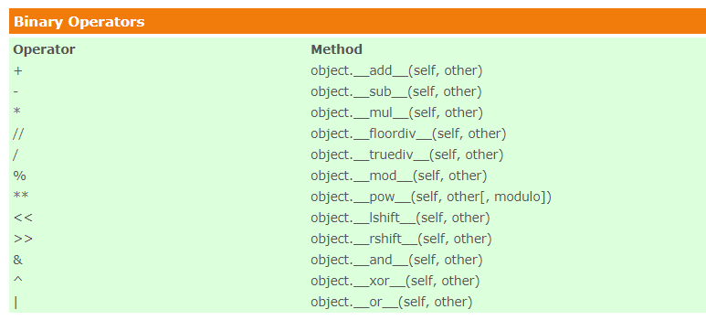
Magic functions

Slide 64
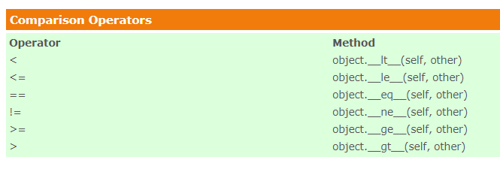
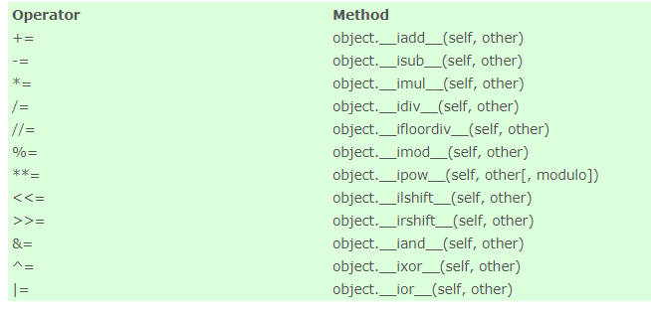
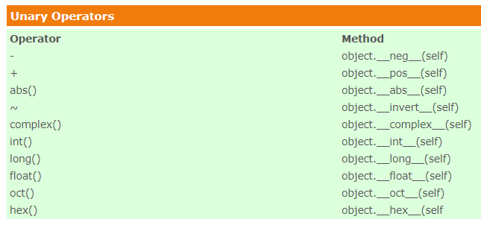
More Magic Functions

Slide 65
Exercises
Write a program to read a string from the user and print it in reverse
Write a program that reads a comma separated string of words and creates a list and tuple with those words
Write a program to read a string and check if it is palindrome
Write a program to accept a single digit integer n from the user and print the value of n + nn + nnn
Write a program to read strings from the keyboard till the user hits enter and print the concatenated string
Write a program to read a string and an integer n from the keyboard and convert first n characters to lower case
Write a program to clone a list
Write a program to find the second largest number from a list of integers

