Slide 1
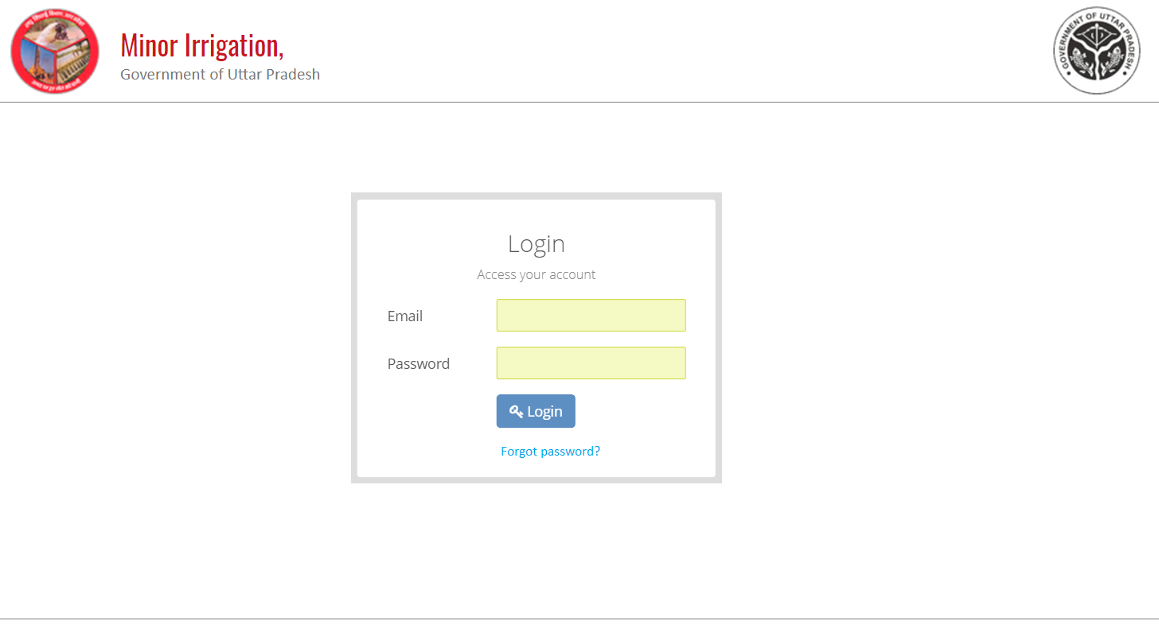

Slide 2
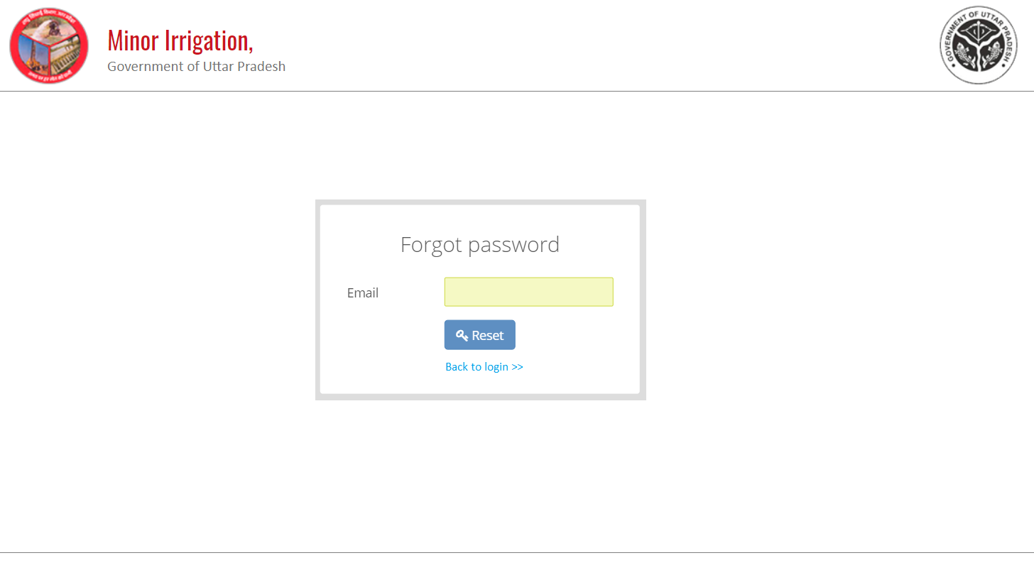

Slide 3
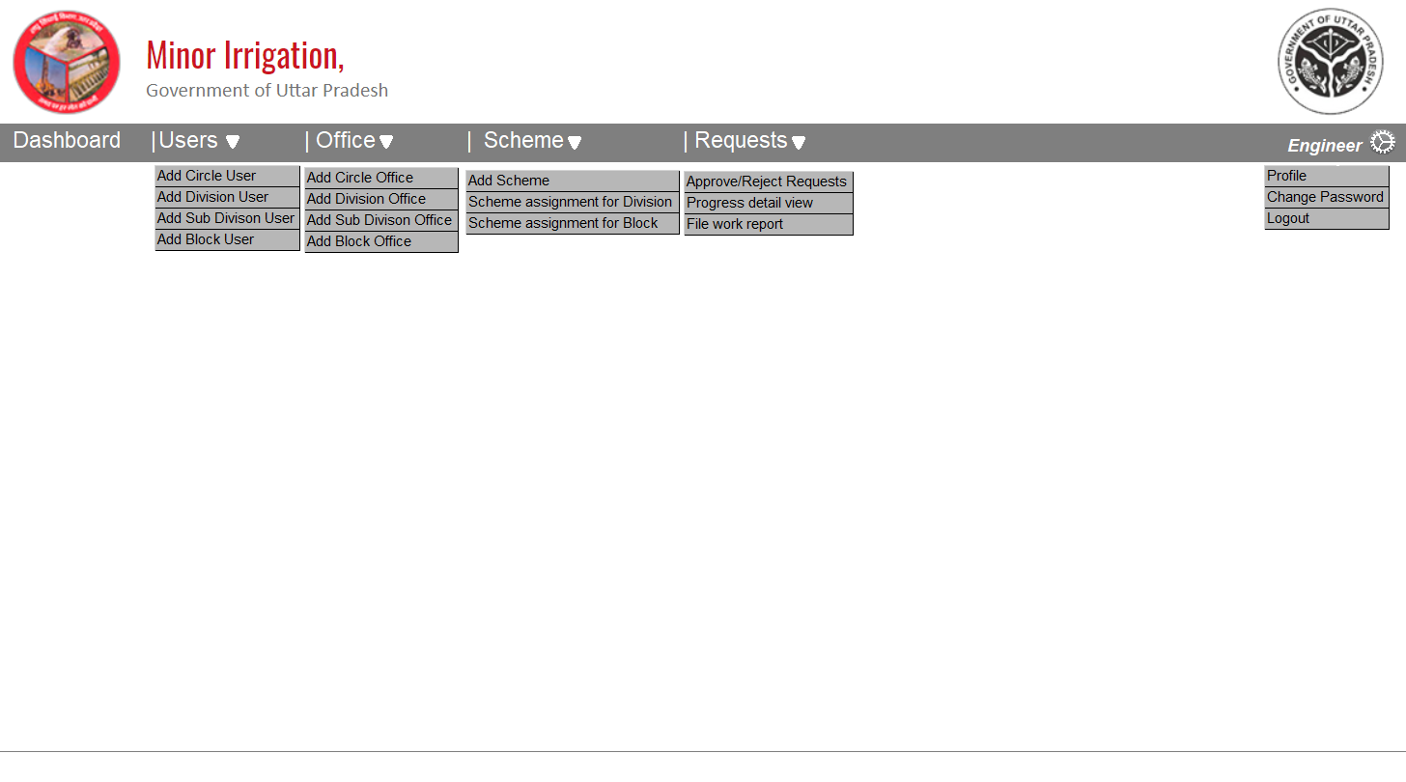

Slide 4
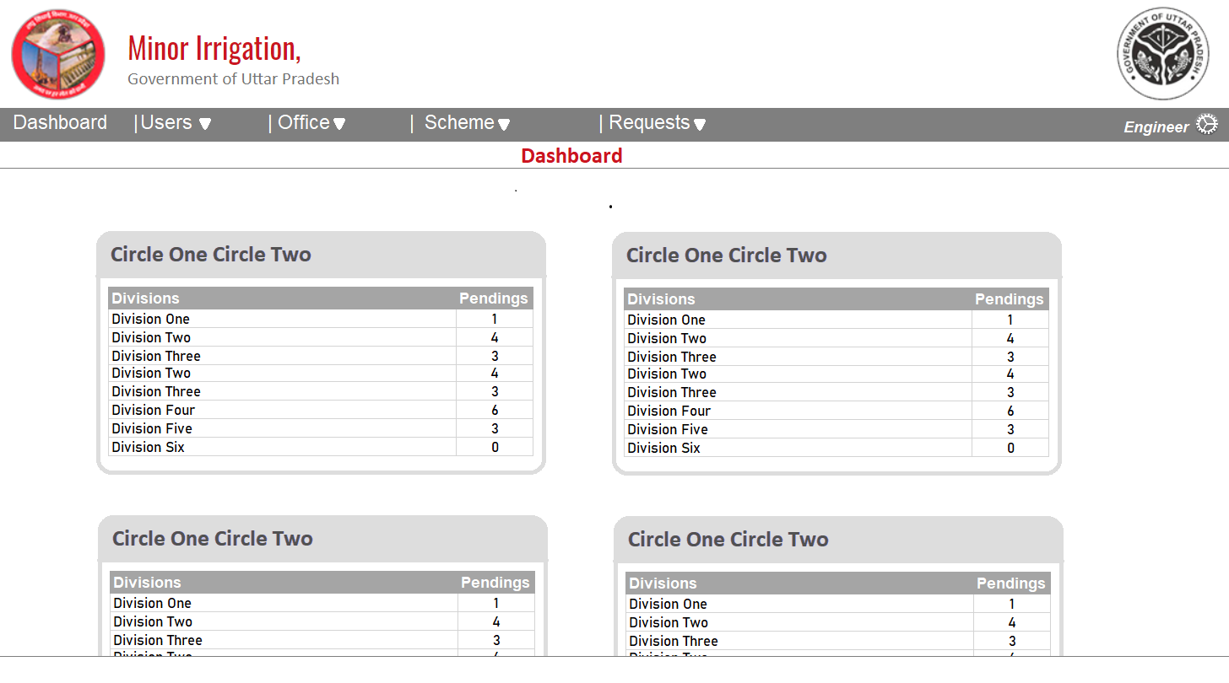

Slide 5
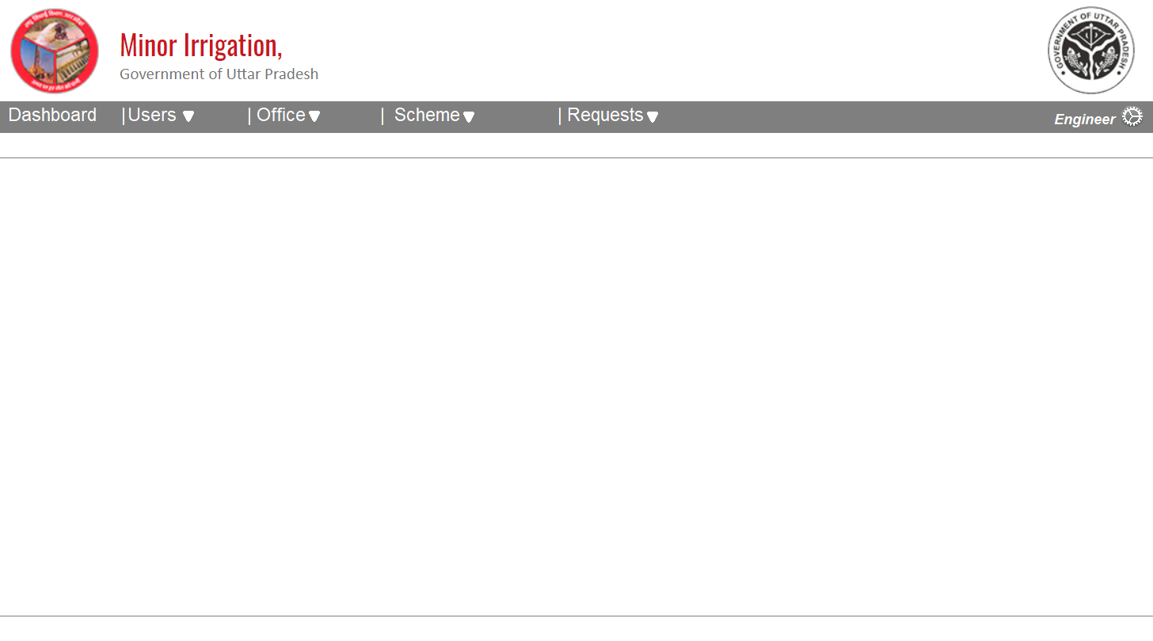
Add circle user

Slide 6
Add division user

Slide 7
Add sub-division user

Slide 8
Add block user

Slide 9
Manage users
Office Details | EmailId | Mobile No | Full Name | Designation | Emp. Code/Id
Circle/division/sub-division | abc@xyz.com | 999999999 | First Middle Last | CE | If available
Circle/division | abc@xyz.com | 999999999 | First Middle Last | CE | If available
Circle | abc@xyz.com | 999999999 | First Middle Last | CE | If available
Circle/division/sub-division | abc@xyz.com | 999999999 | First Middle Last | CE | If available
Circle/division | abc@xyz.com | 999999999 | First Middle Last | CE | If available

Slide 10
Add circle office

Slide 11
Add division office

Slide 12
Add sub-division office

Slide 13
Add block office

Slide 14
Manage offices
Office Details | Name | Telephone No | Office. Code/Id | Address
Circle/division/sub-division | Office name | 011-0000000 | First Middle Last | Address
Circle/division | Office name | 011-0000000 | First Middle Last | Address
Circle | Office name | 011-0000000 | First Middle Last | Address
Circle/division/sub-division | Office name | 011-0000000 | First Middle Last | Address
Circle/division | Office name | 011-0000000 | First Middle Last | Address

