Slide 1

CUSTOMER SHOPPING BEHAVIOR ANALYSIS
Uncovering insights from transactional data to guide strategic decisions.

Slide 2
PROJECT OVERVIEW
1
2
3
ANALYZE 3,900 PURCHASES
UNCOVER INSIGHTS
GUIDE DECISIONS
Spending patterns, segments, preferences, subscriptions.
Inform business strategy with data-driven findings.
Transactional data across product categories.

Slide 3
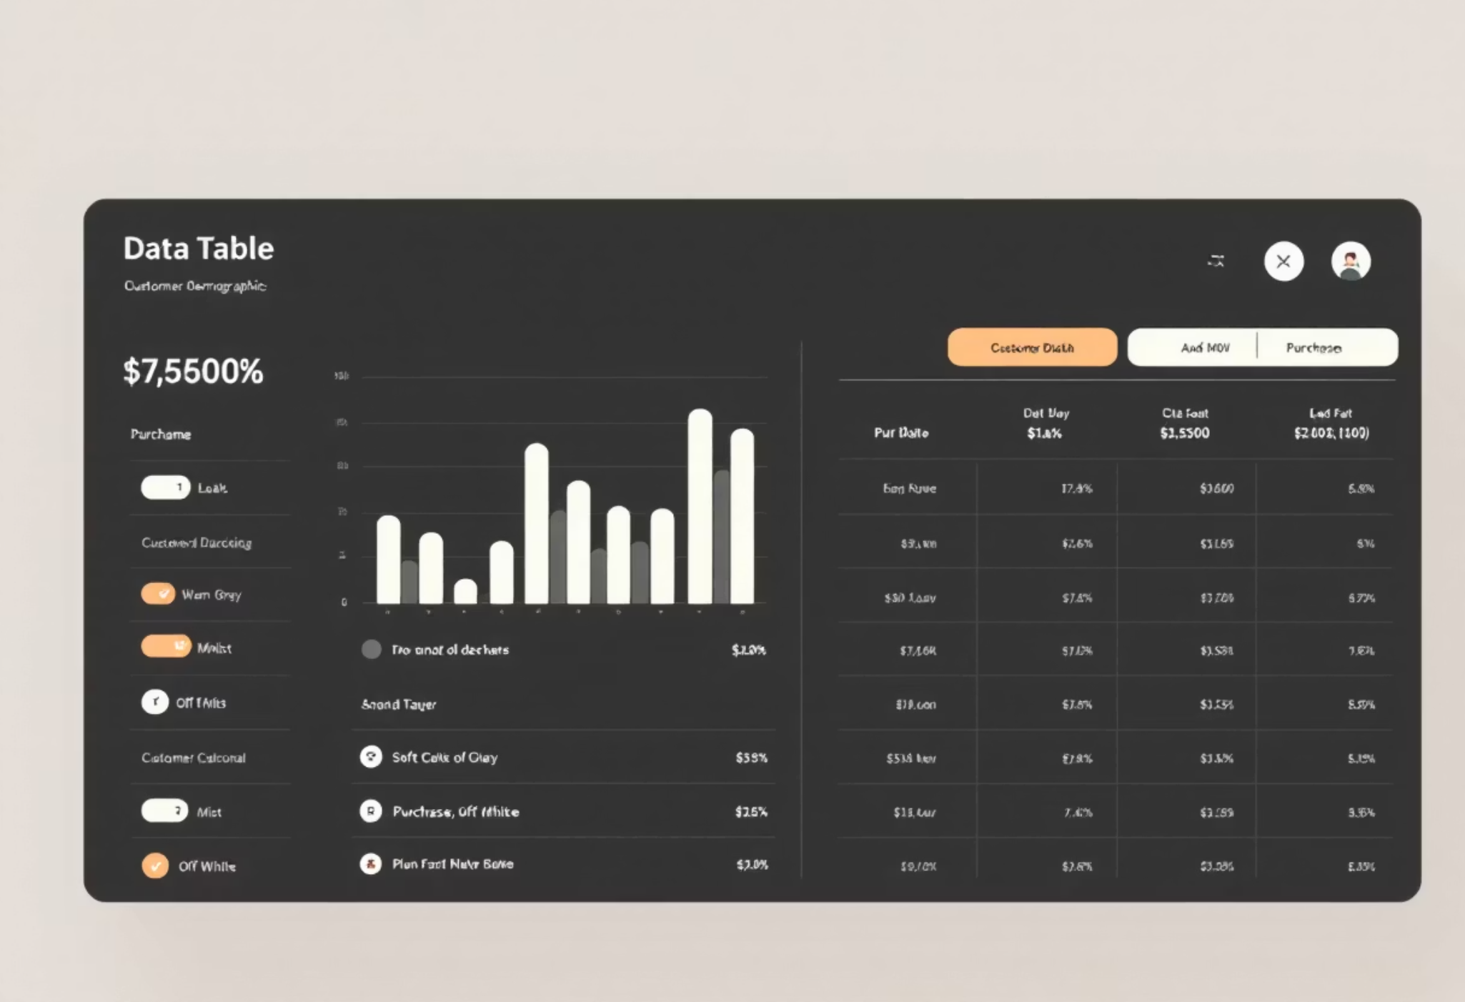
DATASET SUMMARY
DATA POINTS
3,900 Rows
18 Columns
KEY FEATURES
Customer Demographics
Purchase Details
Shopping Behavior
MISSING DATA
37 values in Review Rating column.

Slide 4
EXPLORATORY DATA ANALYSIS (PYTHON)
01
02
03
DATA PREPARATION
COLUMN STANDARDIZATION
FEATURE ENGINEERING
Loading, initial exploration, missing data handling.
Created age_group, purchase_frequency_days.
Renamed to snake_case for readability.
04
05
DATA CONSISTENCY
DATABASE INTEGRATION
Dropped redundant promo_code_used.
Loaded cleaned data into PostgreSQL.

Slide 5
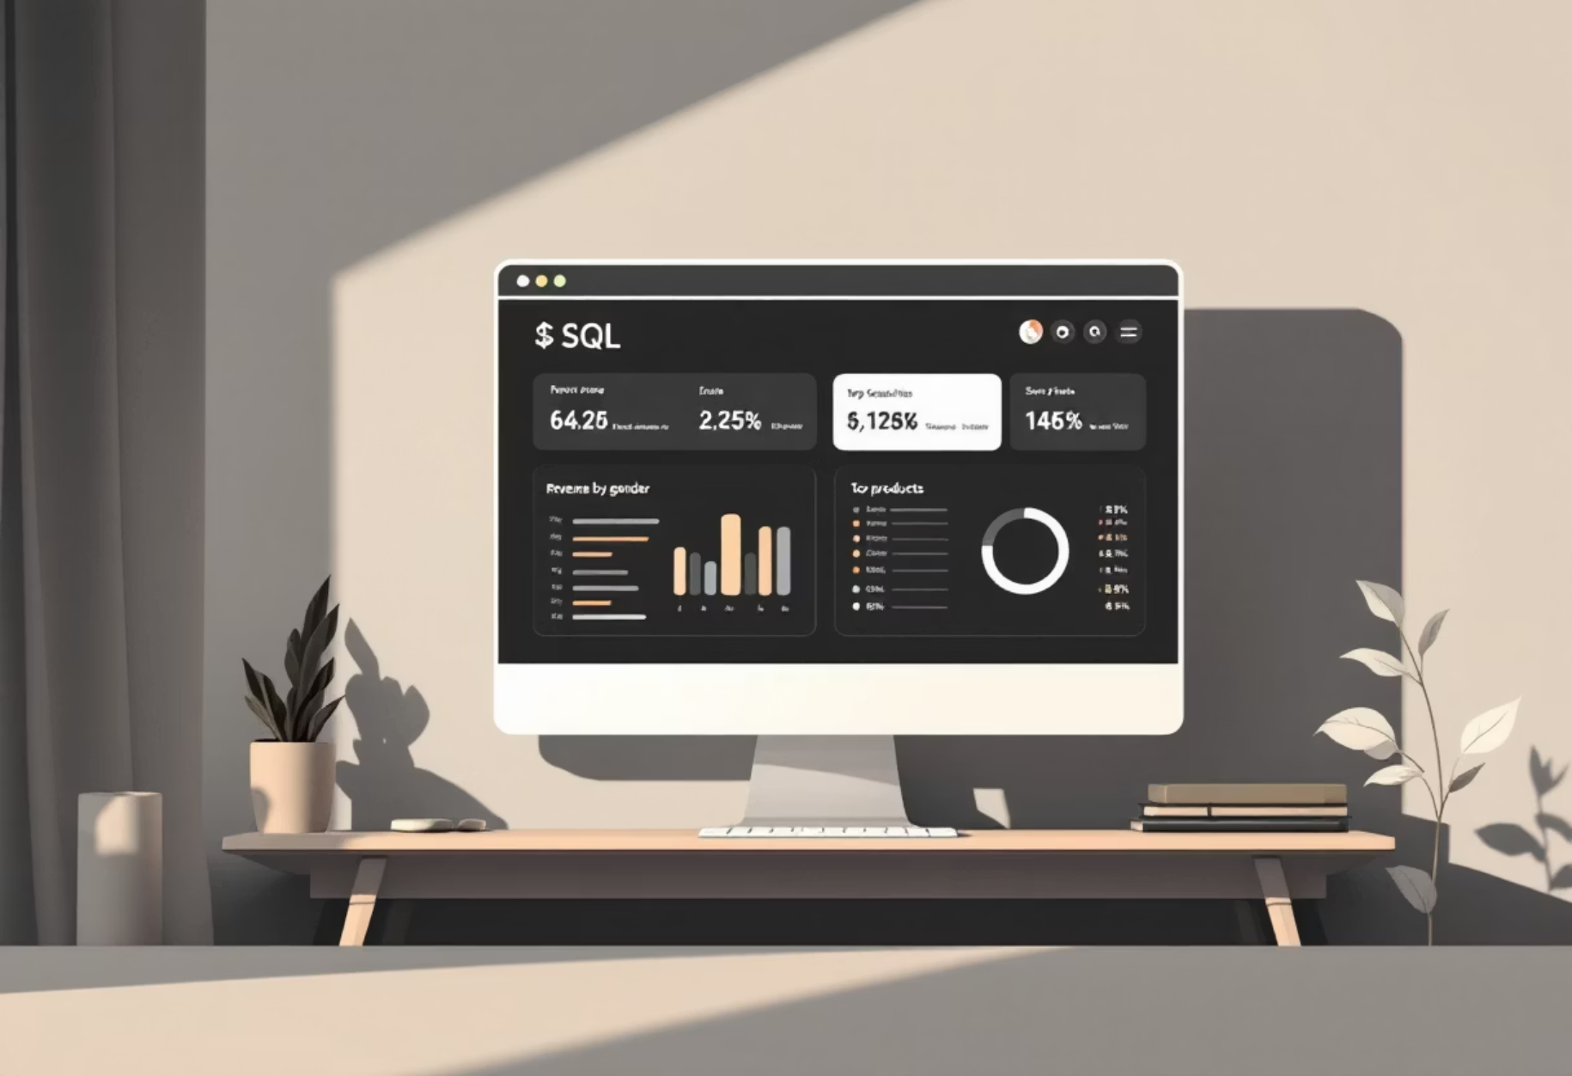
DATA ANALYSIS (SQL)
KEY BUSINESS QUESTIONS
Revenue by Gender
High-Spending Discount Users
Top 5 Products by Rating
Shipping Type Comparison
Subscribers vs. Non-Subscribers
ADDITIONAL INSIGHTS
Discount-Dependent Products
Customer Segmentation
Top 3 Products per Category
Repeat Buyers & Subscriptions
Revenue by Age Group

Slide 6
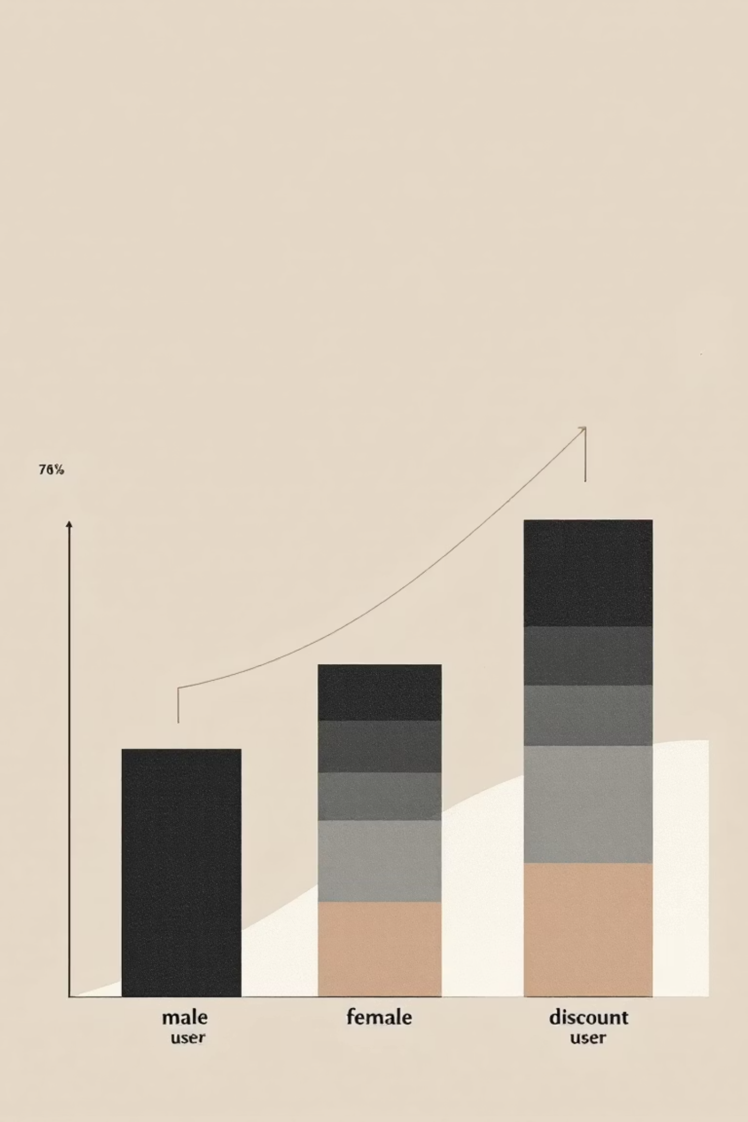
REVENUE & SPENDING INSIGHTS
$157,890
$75,191
839
MALE REVENUE
FEMALE REVENUE
HIGH-SPENDING DISCOUNT USERS
Significantly higher than female revenue.
Identified for targeted strategies.
Customers using discounts, spending above average.

Slide 7

PRODUCT & SHIPPING PERFORMANCE
TOP 5 PRODUCTS BY RATING
SHIPPING TYPE COMPARISON
Gloves (3.86)
Sandals (3.84)
Boots (3.82)
Hat (3.80)
Skirt (3.78)
Standard: $58.46 Avg. Purchase
Express: $60.48 Avg. Purchase
DISCOUNT-DEPENDENT PRODUCTS
Hat (50%)
Sneakers (49.66%)

Slide 8




CUSTOMER SEGMENTATION & SUBSCRIPTIONS
RETURNING CUSTOMERS
701 customers.
NEW CUSTOMERS
83 customers identified.
LOYAL CUSTOMERS
3,116 customers.
Repeat buyers with >5 purchases: 958 subscribers vs. 2518 non-subscribers.

Slide 9
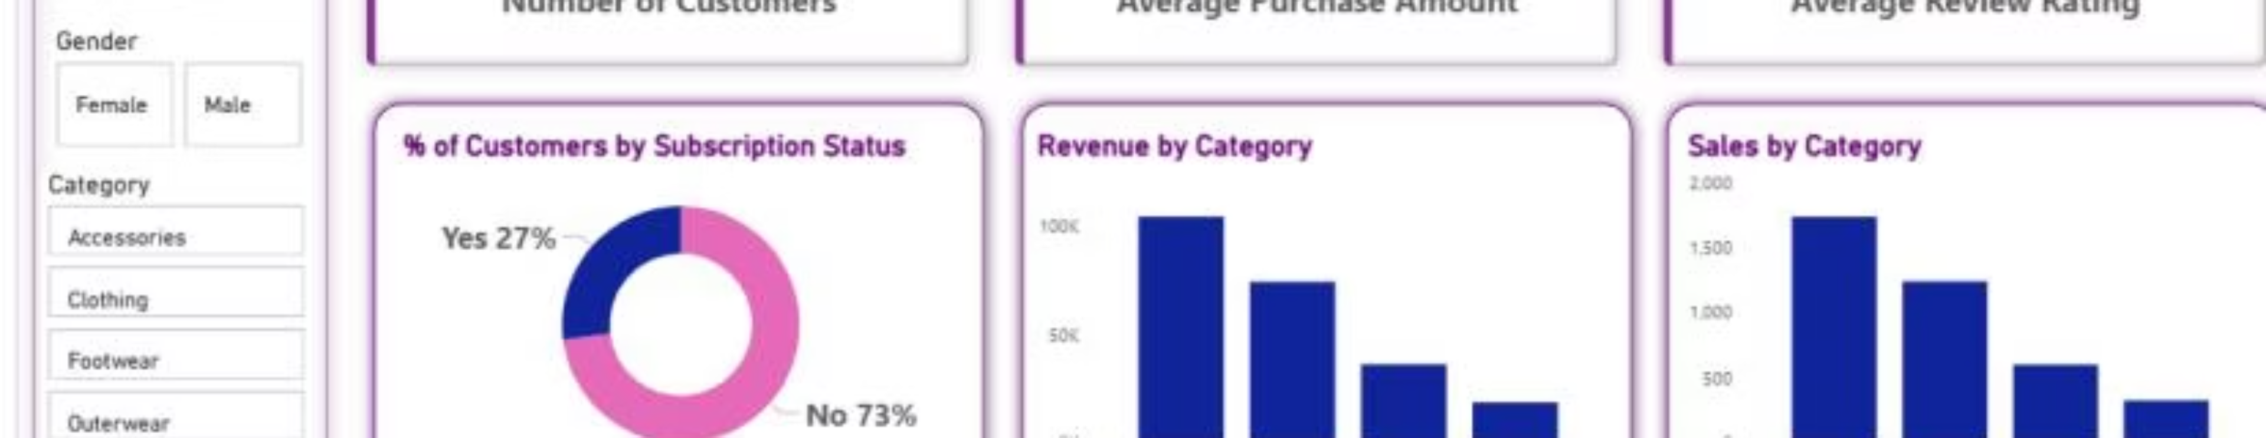
POWER BI DASHBOARD
3.9K CUSTOMERS
$59.76 AVG. PURCHASE
3.75 AVG. REVIEW RATING

Slide 10
BUSINESS RECOMMENDATIONS
BOOST SUBSCRIPTIONS
Promote exclusive benefits.
CUSTOMER LOYALTY PROGRAMS
Reward repeat buyers.
REVIEW DISCOUNT POLICY
Balance sales with margins.
PRODUCT POSITIONING
Highlight top-rated items.
TARGETED MARKETING
Focus on high-revenue age groups.

