Slide 1
AtliQ Business-360-insights
OVERVIEW OF ATLIQ
Atliq manufactures computer hardware and components they established themselves in the market and substantially grew in the last few years, they tried to develop their own store in Latin America but faced a huge loss and realized the reason was a decision made on some survey conducted. In the annual strategic meeting, atliq decided to hire a data analytical team to make data-driven decisions and bring transparency into data.

Slide 2
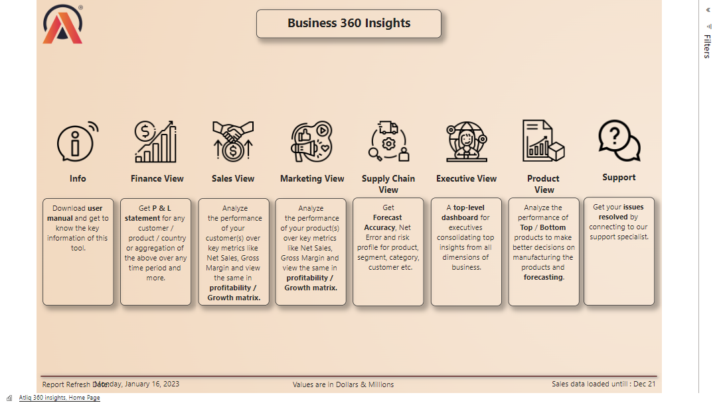

Slide 3
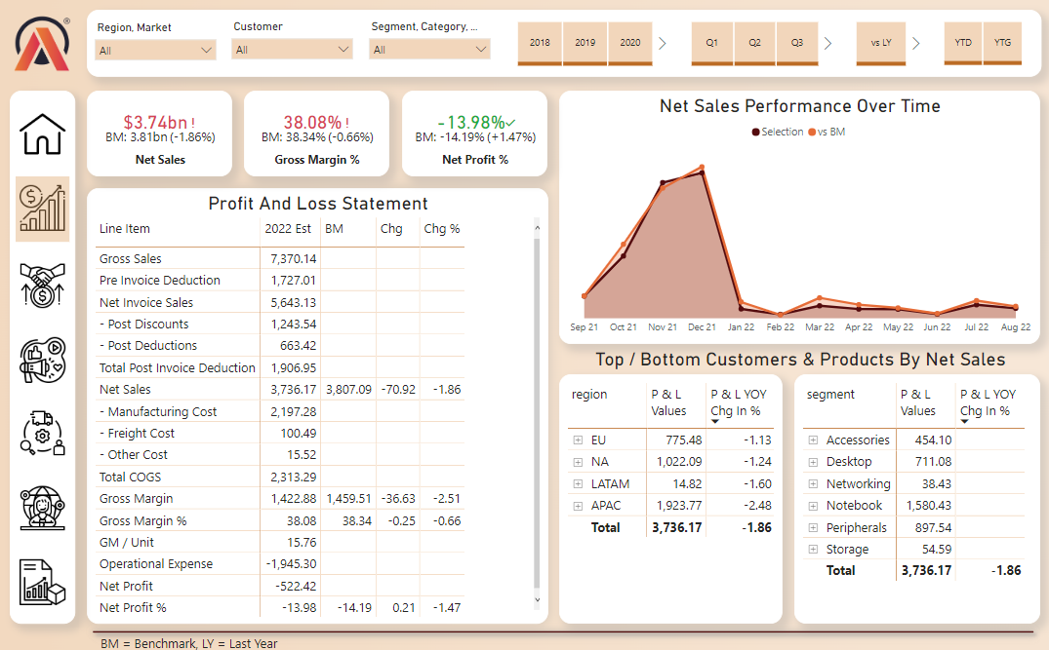
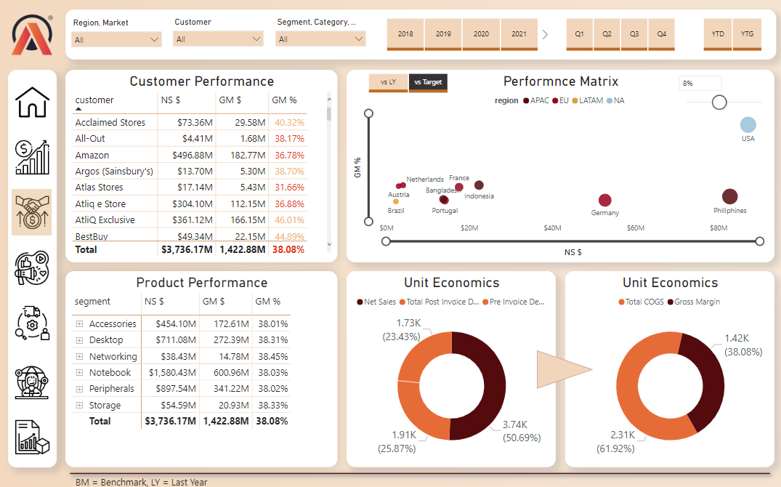
Financial view
The financial dashboard helps the organization analyze and explain its financial performance and also performs comparisons with historical data. It helps to understand the reasons for generating a lower or higher profit margin, which brings transparency to the stakeholders or top-level management to make the profit and loss statement informed so that better decisions can be made about future investment. The financial dashboard helps the organization analyze and explain its financial performance and also performs comparisons with historical data. It helps to understand the reasons for generating a lower or higher profit margin, which brings transparency to the stakeholders or top-level management to make the profit and loss statement informed so that better decisions can be made about future investment.
Sales view
The sales dashboard focuses primarily on customers based on net sales and gross margin, which analyze the relationship between these two metrics. This metric comparison is dependent on whether the company is a startup or a market leader. In this case, the sales team's important role is to analyze the customer and try to improve net sales and gross margin in the top quadrant of the graph to increase sales. This improvement can be done by giving discounts to customers and establishing good relationships With the customers.

Slide 4
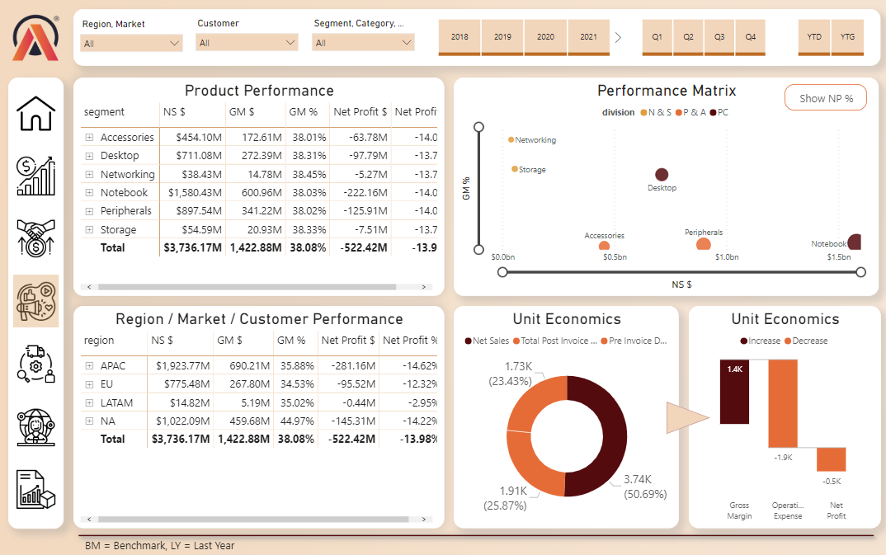
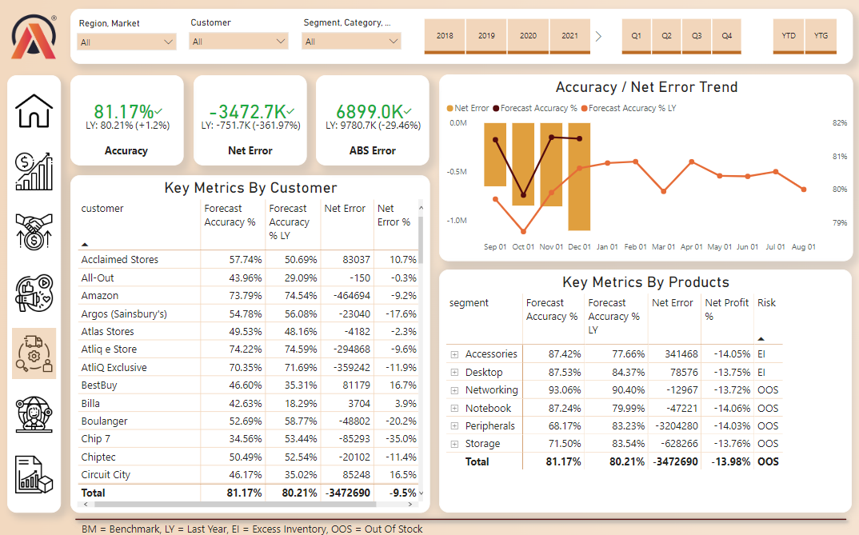
Marketing view
The marketing dashboard focuses on product-level analyses by customer and region to demonstrate how much money the team has spent on marketing and advertising. So, the team should be aware of net profit to maintain good consistency, which should not be impacted by advertisement costs. Here, along with the gross margin, the net profit is considered for comparison.
Supply Chain view
Supply chain dashboards provide a clear picture of the difference between actual sales and forecast sales. The metrics are compared by all customers, products, and regions to get an idea of the excess inventory and out-of-stock items, which helps analyze and organize the warehouse storage expenses for the products.

Slide 5
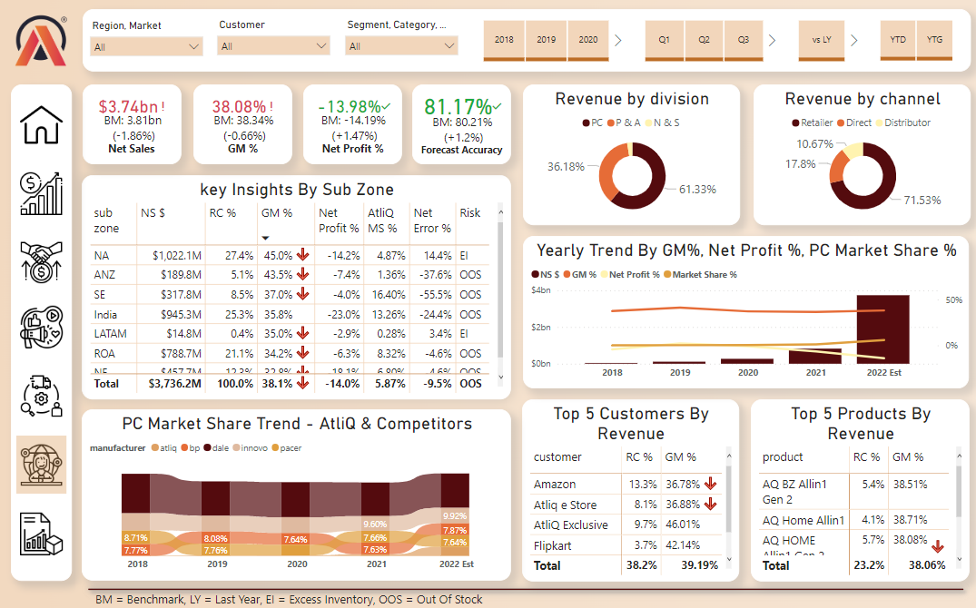
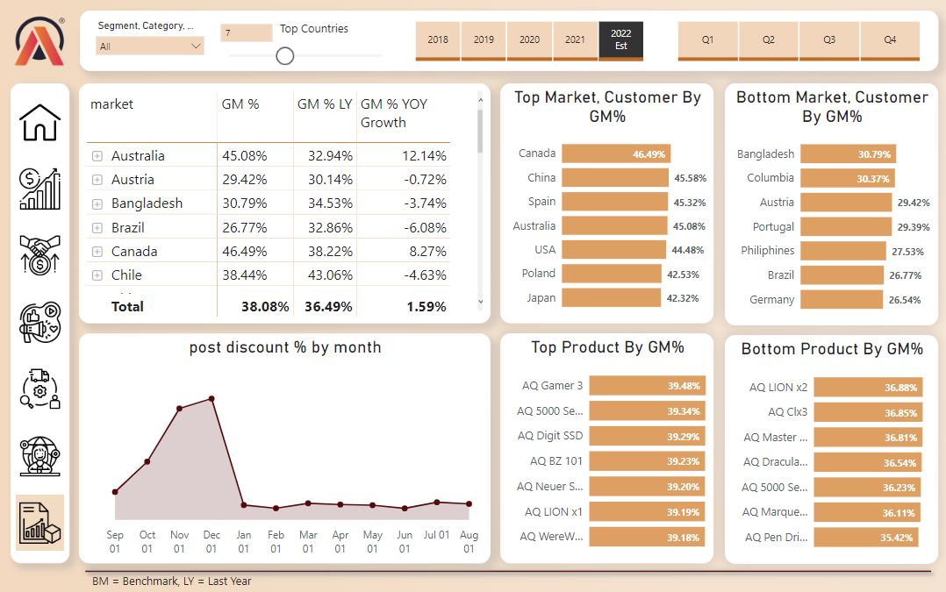
Executive view
The executive dashboard is used by c-level management to track critical KPIs to efficiently manage business operations. Executives can analyze the data and make strategic decisions to reduce risks and ensure growth.
Product view
The product performance dashboard helps to get a clear view of top / bottom level products by regions, customers, products, gross margin, and gross margin growth. The discount over time can help to understand the comparison by-products.

Slide 6
Power BI: AtliQ Business-360-insights
Learned how data transparency is brought to big organizations enabling users to make data-informed decisions.
Connected Power BI with MySQL and Excel to import ~4 million records. Performed data transformation in Power Query and data modeling by Star schema and Snowflake schema.
Built a dashboard in Power BI from scratch for finance, sales, marketing, supply chain and executives which will support the organization in gross margin improvement.
Created workspace in power service and published the report to the service.
Installed a gateway to access the MySQL database from a local computer to implement automatic data refresh.

