Slide 1
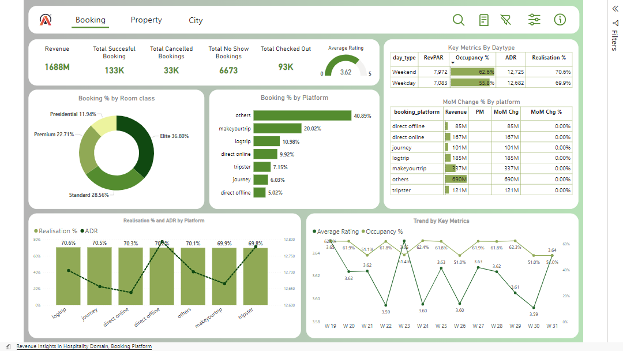

Slide 2
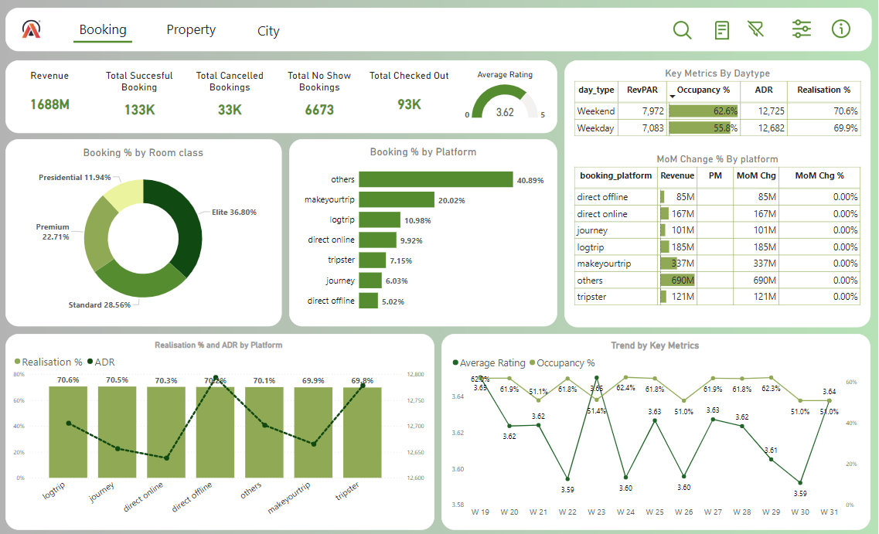
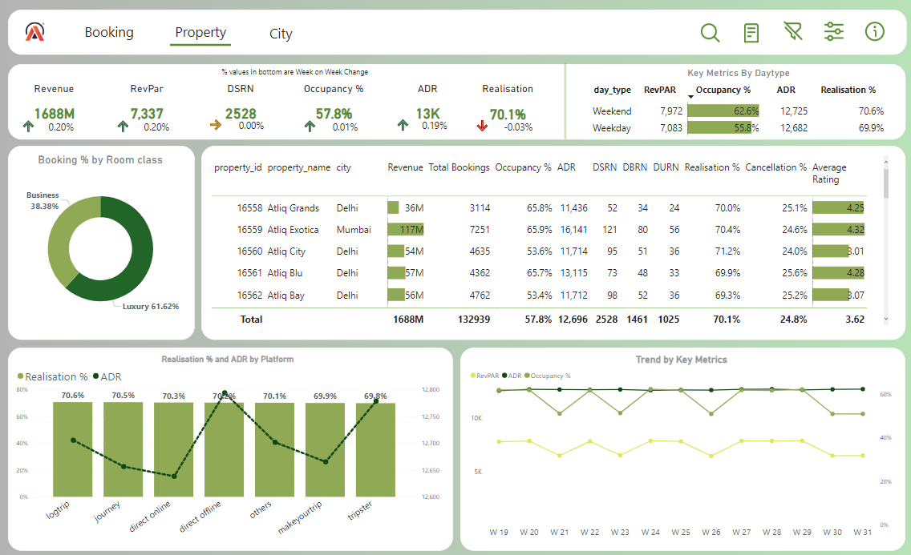
Power BI: Revenue Insights for AtliQ Grands(Hospitality domain)
To increase the Market share and revenue of Atliq grands incorporate business and data intelligence to make decisions.
Connected Power BI with Excel to import ~ 1.4 million records. Built data modelling to create calculated columns and dax measures.
Implemented necessary kpi’s and charts to track wow % change , mom % change, revenue, revpar, adr, occupancy %, realization %, rating.
Designed a dashboard to revenue team consist of booking, property, city view which will helps them to improve revenue, occupancy% and rating

