Slide 1

SRAAP University Attendance Portal
Welcome to the final prototype presentation for the SRAAP University Attendance Portal. This system streamlines attendance tracking for students, faculty, and administration.
TEAM MEMBERS :
P.SRINATH (2403A51015)
B.RAKESH (2403A51021)
B.SHIVA TEJA (2403A51025)

Slide 2
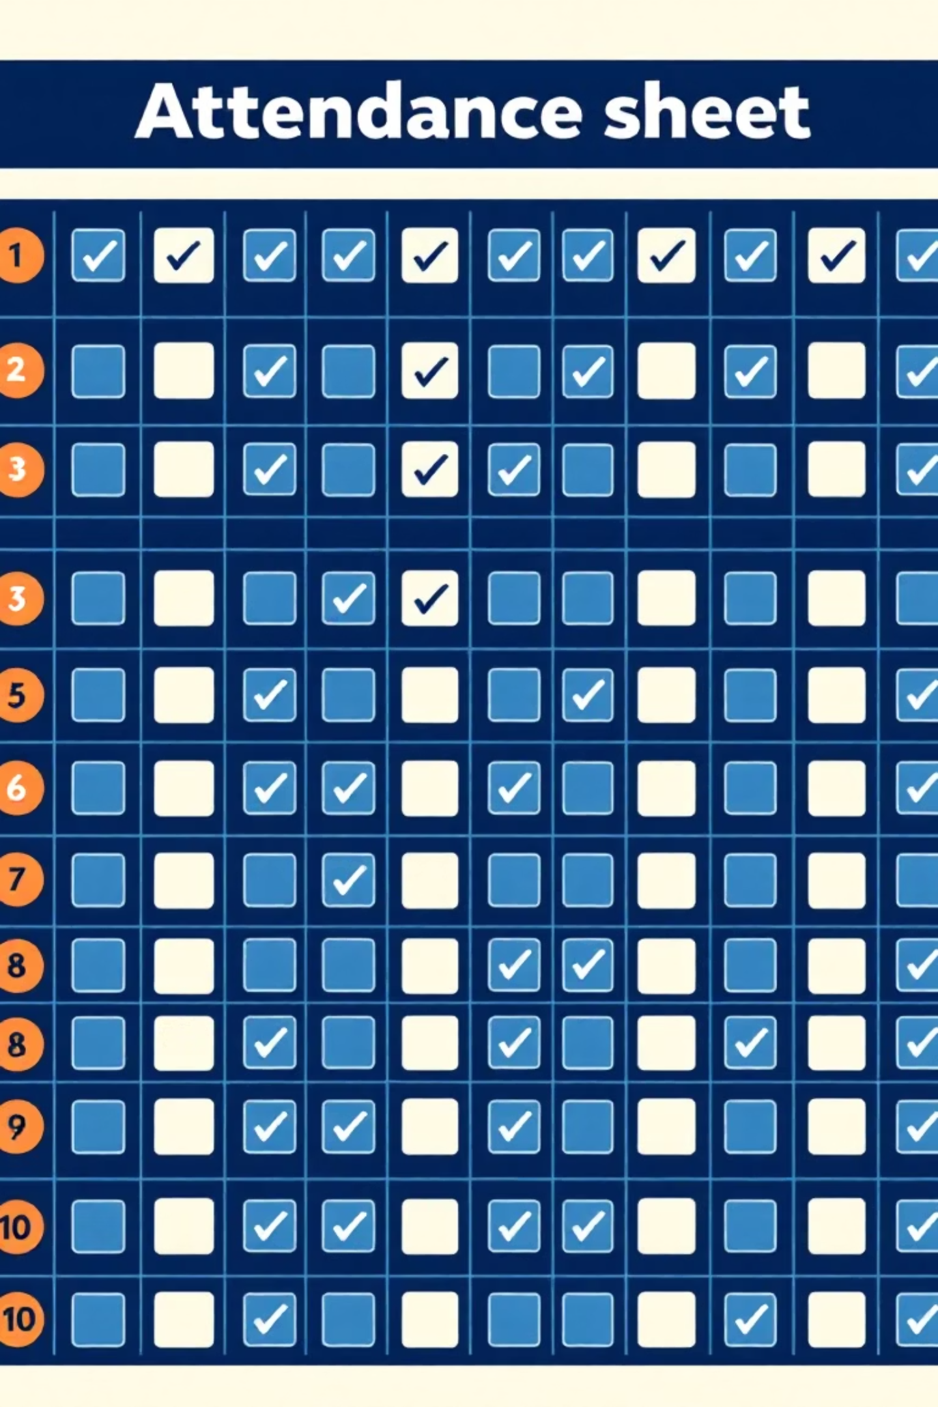
Project Objectives & Key Features
Simplified Login
Secure role-based access for students, faculty, and administrators.
Efficient Data Management
Centralised storage and export functions for attendance records.
Faculty Tools
Intuitive interface for marking attendance and managing correction requests.
Student Visibility
Clear overview of attendance percentages and detailed records with actionable requests.

Slide 3



Key Stakeholders
The SRAAP University Attendance Portal is designed to benefit various groups within the university ecosystem.
University Faculty
Students
Administrators
Simplifies the process of recording and managing class attendance, reducing administrative burden.
Provides transparent access to their attendance records and enables submission of correction requests.
Offers robust data export and management tools for oversight and reporting.

Slide 4

Technologies Utilised
The SRAAP portal leverages standard web technologies to ensure accessibility and maintainability.
Programming Languages:
HTML for structure
CSS for styling
JavaScript for interactivity
Tools & Software:
Web Browser (e.g., Chrome, Firefox)
Code Editor (e.g., VS Code)
Version Control (e.g., Git)

Slide 5
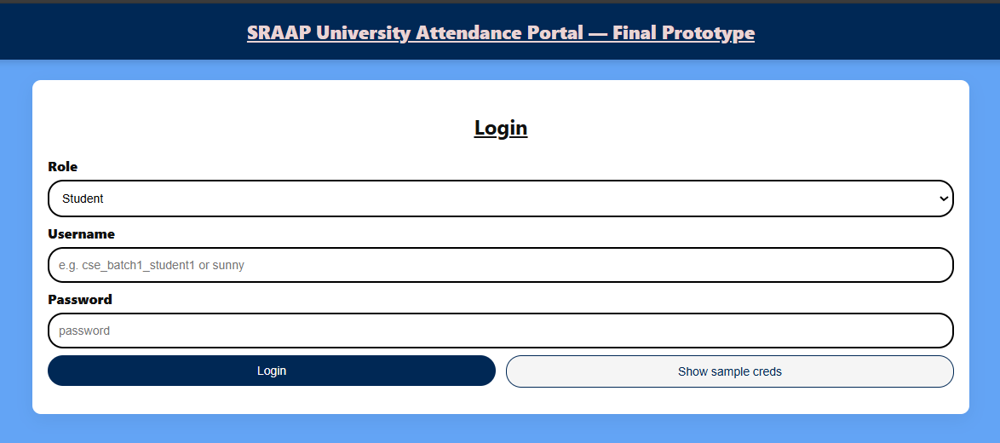
User Authentication: Login Portal
The login interface is designed for simplicity and security, allowing users to access the portal based on their assigned roles.
Role-Based Access: Users log in as a Student, Faculty member, or Administrator. This ensures that each user only sees and interacts with relevant features.
Sample Credentials: A convenient option to display sample login details for testing purposes, facilitating quick demonstration and onboarding.

Slide 6
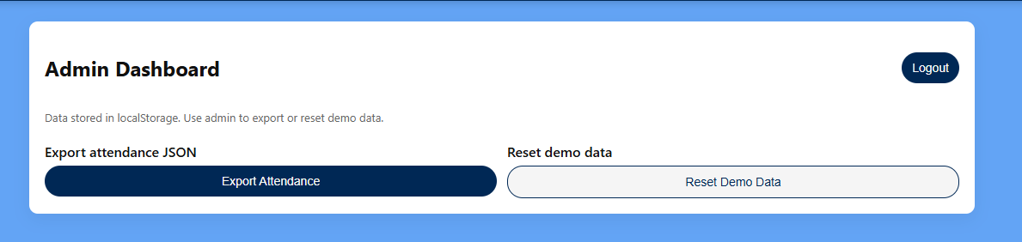
Administrator Dashboard: Data Management
The administrator dashboard provides essential functions for overseeing the attendance data.
Export Attendance Data: Allows administrators to export all attendance records in JSON format for external analysis or archiving.
Reset Demo Data: A crucial feature for testing and demonstrations, enabling a clean slate for new trials.
Local Storage: Data is stored locally in localStorage, making it efficient for prototype testing and development.

Slide 7

Faculty Dashboard: Marking Attendance
Faculty members have a comprehensive interface to accurately record class attendance.
Detailed Class Input: Faculty can specify department, batch, subject, hour slots, and topic discussed for each session.
Flexible Selection: Multi-select options for hour slots (Ctrl/Shift click) enhance usability.
Effortless Marking: Buttons to "Mark All Present" or "Mark All Absent" speed up the process, with individual student toggles for exceptions.

Slide 8
Faculty Dashboard: Managing Requests
Beyond marking attendance, faculty can efficiently handle student-submitted correction requests.
Load Saved / Modify: Option to retrieve and amend previously submitted attendance records.
Pending Correction Requests: A dedicated section to view and address requests from students regarding their attendance status.
This ensures transparency and fairness in attendance management.

Slide 9
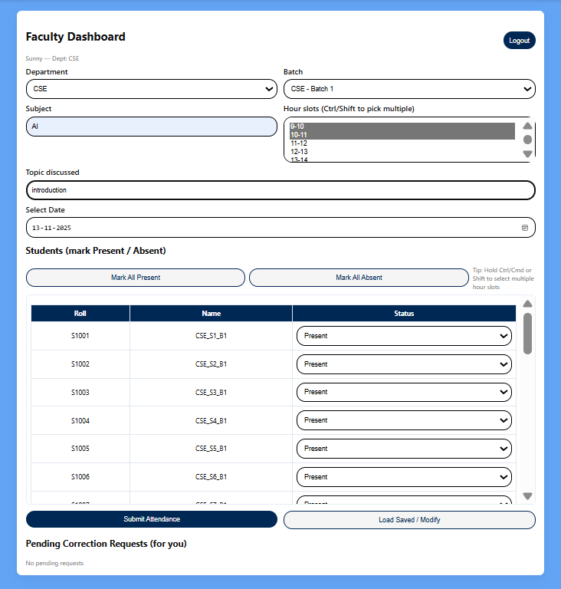

Slide 10
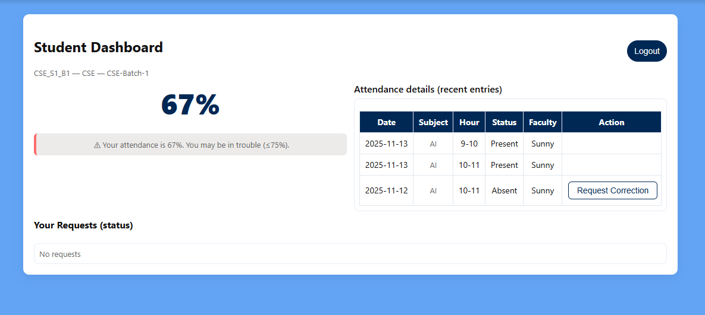
Student Dashboard: Attendance Overview
Overall Percentage: A prominent display of the student's attendance percentage, accompanied by a descriptive message.
Students can monitor their attendance records and overall percentage at a glance.
Recent Entries: A scrollable table showing detailed attendance records, including date, subject, hour, status, and faculty name.
Actionable Records: Students can initiate correction requests directly from their attendance history.

Slide 11
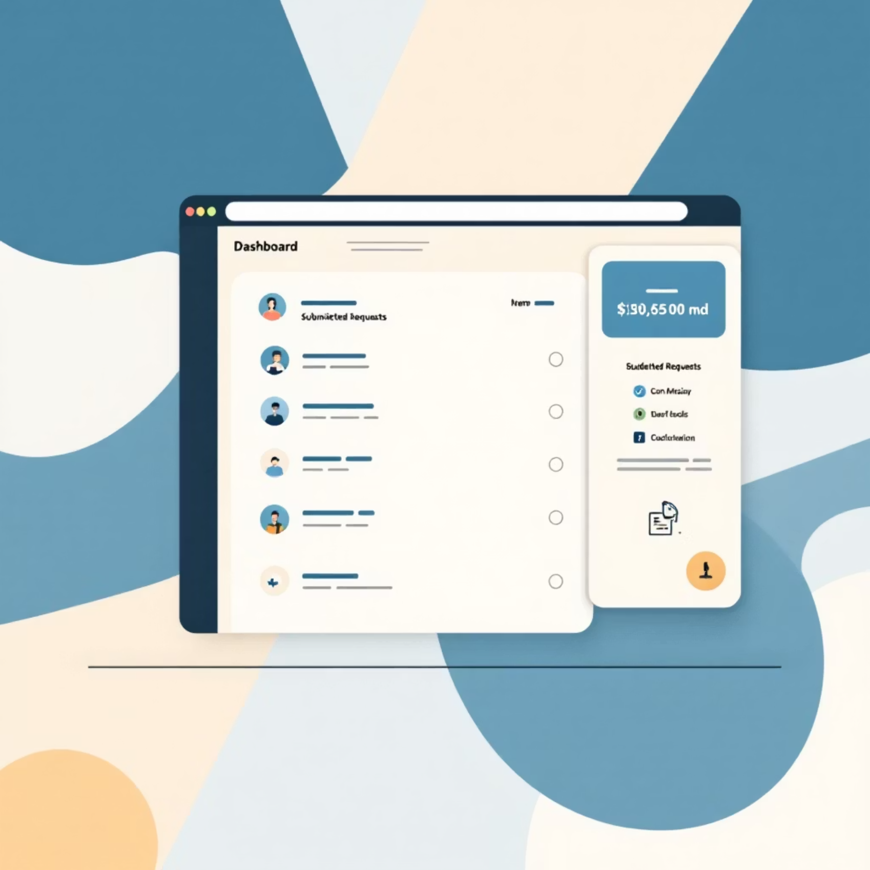
Student Dashboard: Request Management
Students can track the status of their submitted attendance correction requests.
Your Requests (Status): A dedicated section listing all submitted correction requests, indicating their current status (e.g., pending, approved, rejected).
This feature promotes clear communication and resolution of attendance discrepancies.

Slide 12
THANK YOU.

