Slide 1
Comparison of 2D-3D point correspondences
Master’s Thesis – Srinath Hanumantha Rao (G1800866F)

Slide 2
Scope
The OpenCV(Image Processing) library provides us with three different methods while using the SolvePNP function for perspective-n-projections during pose estimation.
The objective of this thesis is to evaluate which method and feature provides the best accuracy after hand-eye calibration using the Universal Robot arm.
All conditions are controlled during experimentation except the goal pose.
The various methods used are : CV_ITERATIVE ( Levenberg – Marquardt), CV_P3P and CV_EPNP(Efficient Perspective-n-Point)
The various feature identifiers are: Checkerboard, Aruco, Ellipses

Slide 3
Methodology
Parameters extraction by 2D – Camera Calibration
Getting 3D points using feature identification and point clouds
Getting the transformation from camera to object (1)
Getting the transformation from base link to hand of robot (2)
Utilizing 1 and 2 to calibrate the system.
Experimenting on accuracy using various methods and feature descriptors
Adding noise along with the methods to test accuracy

Slide 4
Parameters extraction by 2D – Camera Calibration
To remove distortion as well as get the required parameters or intrinsic relations for usage in the perspective-n-projection formulae, calibration is required.
The camera calibration would provide us with the intrinsic matrix that defines the focal length and the center of the image along with the distortion coefficients.
These parameters are used in the solvepnp function in OpenCV to determine the rotation and translation vectors(Pose)

Slide 5
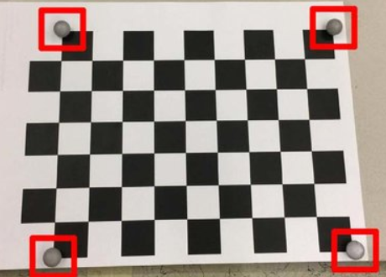
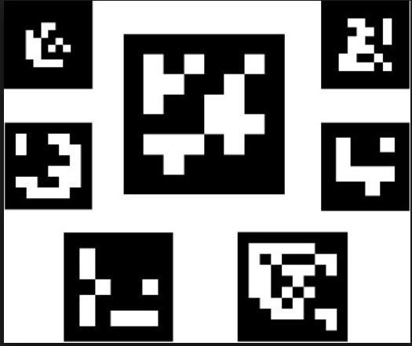
Getting 3D points using feature identification and point clouds
Along with the other parameters, we would also require 2d and 3d image points.
These are obtained using easily identifiable markers such as Checkerboards, Aruco and Ellipses.
The 2d image points are procured by identifying these markers.
The 3d image points are obtained from the pcl(point cloud)
The objectpoints are calculated taking the surface to have 0 height. Therefore z = 0

Slide 6
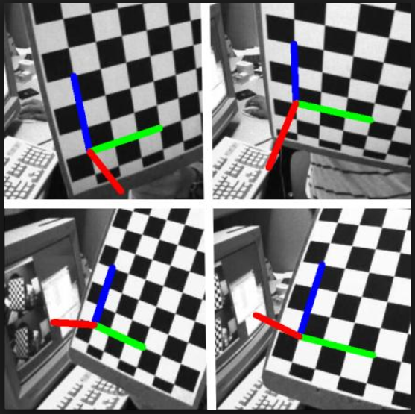
The SolvePNP function/ Getting the transformation from camera to object (1)
The function finds the object pose from 2d-3d correspondences.
Inputs:
Objectpoints- 3d world points of object corresponding to image points
Imagepoints – imagepoints extracted from features
Intrinsic matrix of camera
Distortion coefficients of camera
Flags(Methods)
Outputs:
Rotation vector
Translation vector
Using the rotation and translation vectors we can identify the pose of the object

Slide 7
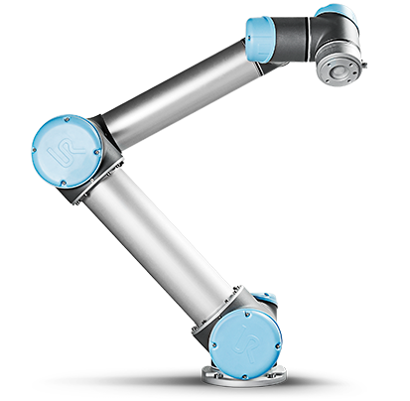
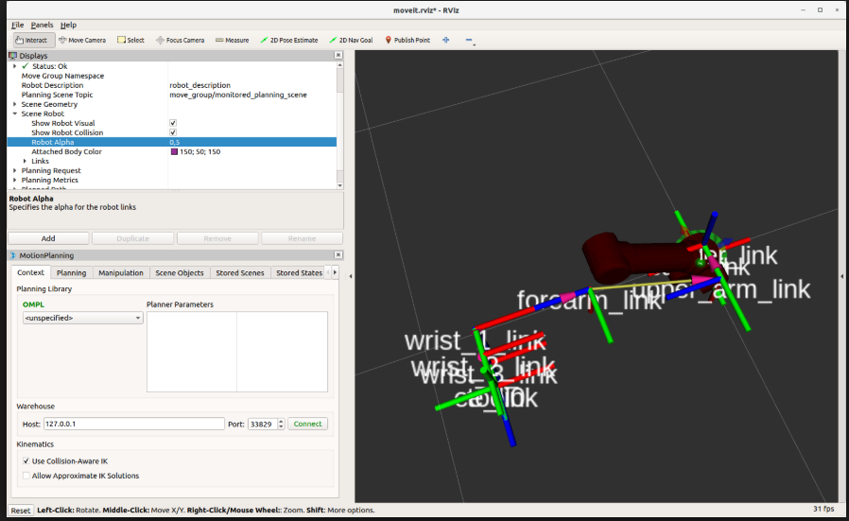
Getting the transformation from base link to hand of robot (2)
We will be utilizing a UR5/UR10 robot.
Each link of the robot has a TF(coordinate frame)
After attaching the marker on the hand of the robot, the transformation from the base link to the point on the marker is calculated.
This transformation serves as the second input to the calibrator

Slide 8
Calibration using VISP library
Once we receive both the transformations, we run the VISP library to calibrate the robot base link to the camera.
This provides us with the transformation between the base link of the robot and the center of the camera lens.
We can multiply this with the 3d image points received to get the location and pose of any object.

Slide 9
Experimentation using various methods
After calibration, easily objects will be placed under the same lighting, position and orientation to test the accuracy of the calibration under the specific conditions
The following table describes the various conditions under which the experimentation will take place for evaluation.
Without Noise |  |  |  | With Noise
Methods/Markers | Ellipse | Checkerboard | Aruco | Ellipse | Checkerboard | Aruco
CV_ITERATIVE
CV_EPNP
CV_P3P

