Slide 1

NEW YORK AIRBNB HOUSE PRICE PREDICTION
IBM CAPSTONE PROJECT
-Srinath Ramachandran

Slide 2
INTRODUCTION
Since 2008, guests and hosts have used Airbnb to expand on traveling possibilities and present more unique, personalized way of experiencing the world.
It therefore, becomes very important to serve the customers with the best possible pricing based on the area of the house.
BUSINESS QUESTIONS THAT CAN BE ANSWERED:
What can we learn about different hosts and areas?
What can we learn from predictions? (Example price)
What can we learn about the impact of nearby venues to the house location, do they impact pricing?

Slide 3

DATA DESCRIPTION
The data was obtained from Kaggle https://www.kaggle.com/dgomonov/new-york-city-airbnb-open-data.
This dataset describes the house listing activity and metrics in NYC, NY for 2019
Also, it includes all needed information to find out more about hosts, geographical availability, necessary metrics to make predictions and draw conclusions.
Number of Columns: 16 Number of Rows: 48,895

Slide 4
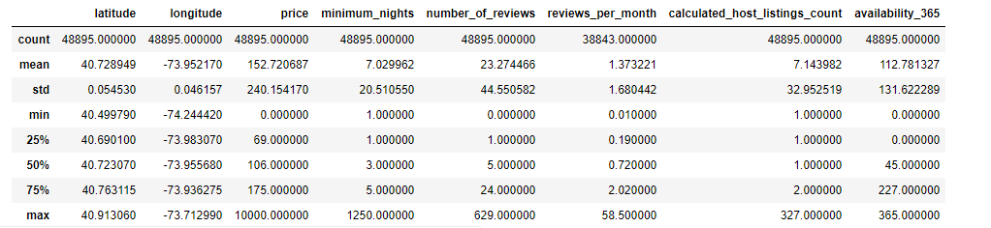
EXPLORATORY DATA ANALYSIS
Statistical Data Description:

Slide 5
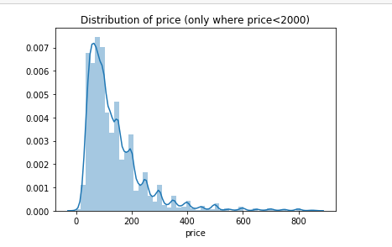
EXPLORATORY DATA ANALYSIS
Histogram showing Price Distribution:
Price of most listings is between $10 -$200

Slide 6
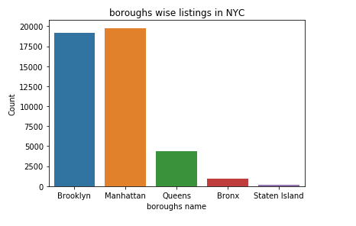
EXPLORATORY DATA ANALYSIS
Borough-wise listings in NYC:
Brooklyn and Manhattan dominate the borough-wise listings in NYC.

Slide 7
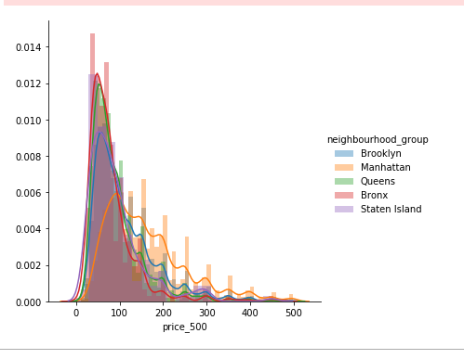
EXPLORATORY DATA ANALYSIS
The price of rooms in Manhattan and Brooklyn is more than the price of rooms in other boroughs.
Comparison of Prices(<500$) in different boroughs.

Slide 8
LINEAR REGRESSION (Before outlier removal and significant factor identification)
This was the initial model which was built. The model is pretty basic with the only use of standardization of independent variables.
The RMSE score of this model was $82.60.

Slide 9
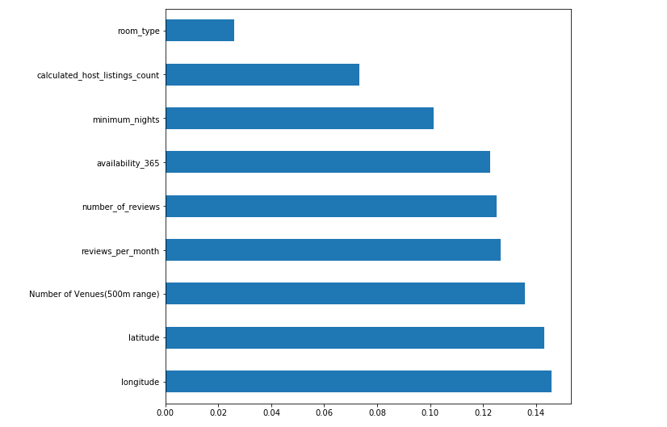
LINEAR REGRESSION SIGNIFICANT FACTOR CHART.
From this graph, it is pretty evident that Number of venues is indeed important in predicting the price of houses in a given locality.

Slide 10
LINEAR REGRESSION (After outlier removal and significant factor identification)
This was the final model due to which there was a drastic reduction in the RMSE value.
The final RMSE value was $41.75.

Slide 11

Conclusion:
The final error score was $41.75 and this error was just using the data of Bronx borough. This error is remarkable given the small amount of training data that was used.
Also, the idea of incorporating Neighbourhood data using Foursquare API was mindboggling. I could see the impact of neighborhoods on the price prediction of Airbnb listings.

