Slide 1

MULTI-SPORT DATABASE SYSTEM.
IST659 PROJECT BY
-SRINATH RAMACHANDRAN

Slide 2
PROJECT GOALS
The project is about designing a multi-sport database system that intends to integrate information of multiple sports so that the sport lovers can access the data in a single platform.
The database basically includes information of team sports like Baseball, Basketball, Kabaddi, Soccer, Cricket etc.
The users would be able to obtain statistics of players, teams, leagues and sports.
The users would come to know the popularity of a particular sport by seeing the ratings.
The ratings would be on year-to-year basis meaning the users would come to know which sport has dominated in terms of viewership ratings for that particular year.

Slide 3
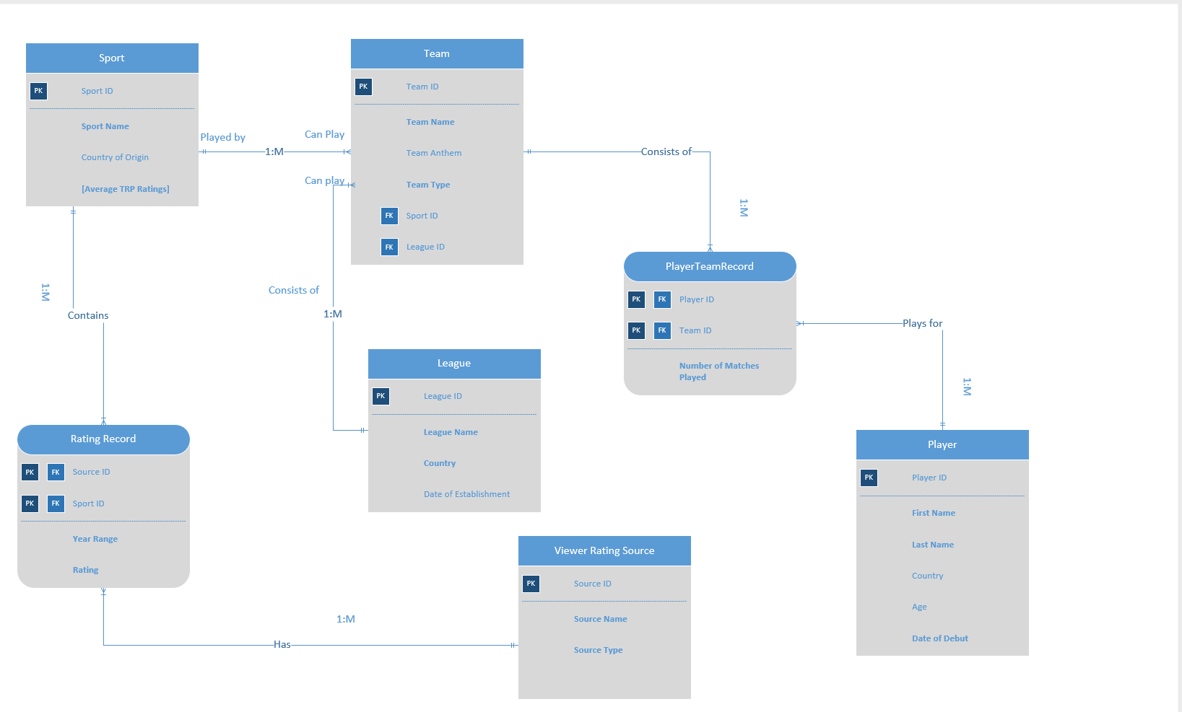
ER DIAGRAM-VISIO

Slide 4
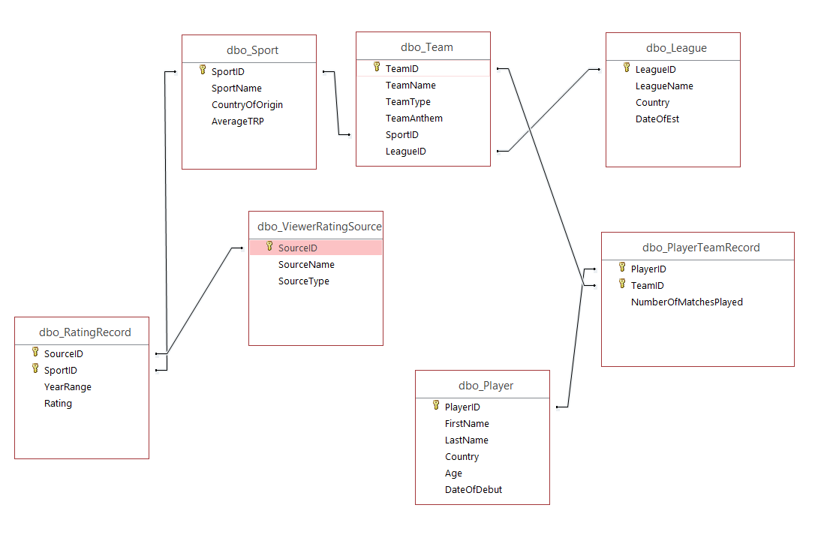
RELATIONSHIP DIAGRAM-ACCESS

Slide 5
FORMS
Total Number of Tables: 7
Total Number of Forms: 2
Player Information: Allows you to add & view information of a player in the Player Table.
Team Information: Allows you to add & view information of a team in the Team Table.

Slide 6
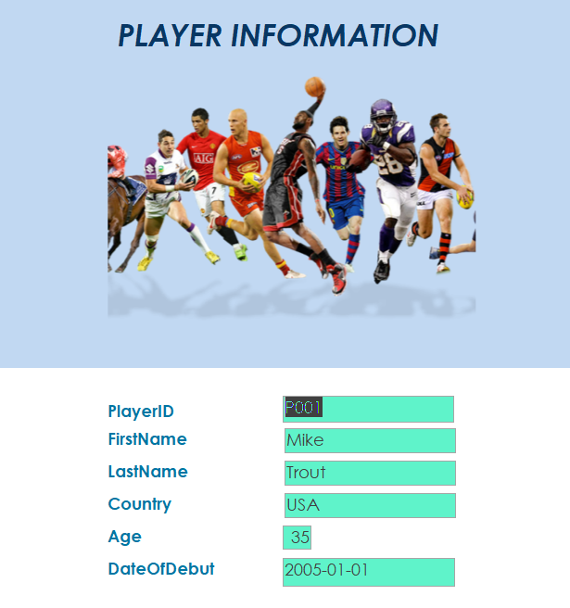
PLAYER INFORMATION FORM

Slide 7
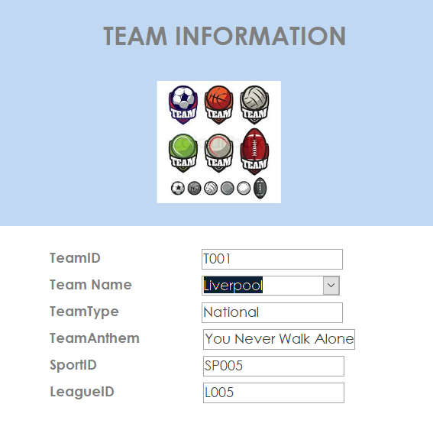
TEAM INFORMATION FORM

Slide 8
MAJOR DATA QUESTIONS-REPORTS
What is the Average TRP of a sport for a given year?
For how many teams has a player played for?
How many matches a player has played for a particular team?

Slide 9
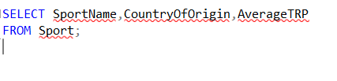
What is the Average TRP of a sport for a given year?
1. SQL QUERY:

Slide 10
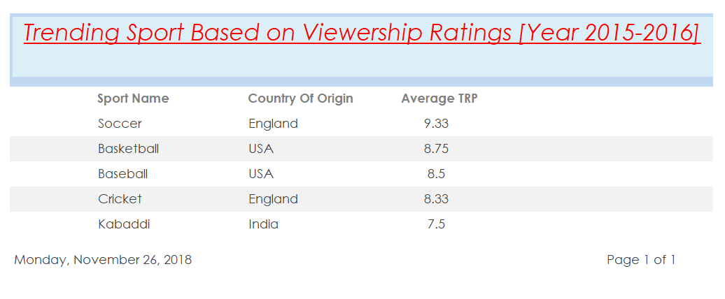
What is the Average TRP of a sport for a given year?
2. REPORT:

Slide 11
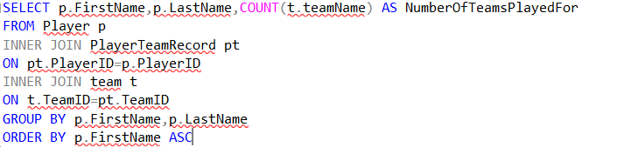
For how many teams has a player played for?
1. SQL QUERY:

Slide 12
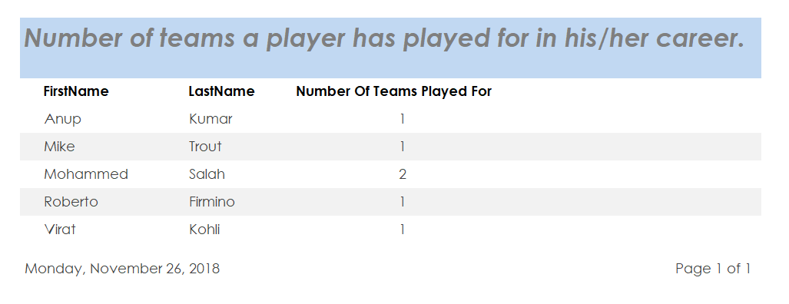
For how many teams has a player played for?
2. REPORT:

Slide 13
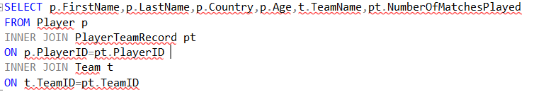
How many matches a player has played for a particular team?
1. SQL QUERY:

Slide 14
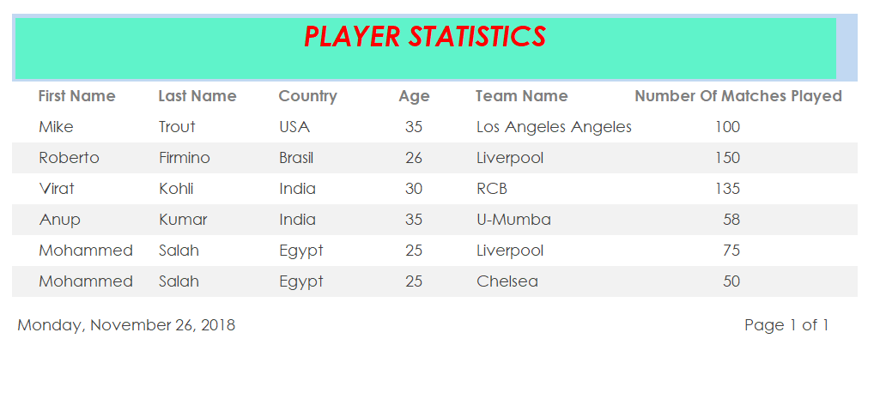
How many matches a player has played for a particular team?
2. REPORT:

Slide 15
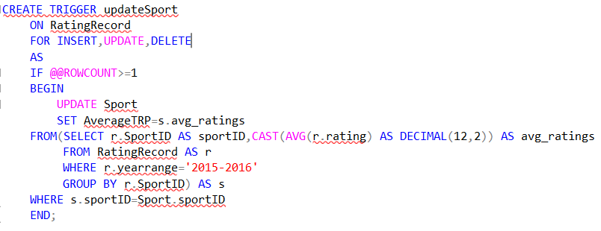
TRIGGER
The Trigger updates the average TRP once a rating is inserted,updated or deleted.

Slide 16
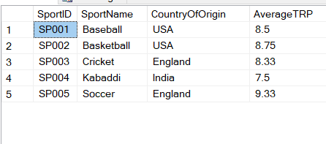
Sport Table before Trigger execution:
SELECT * FROM Sport;

Slide 17
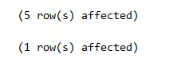
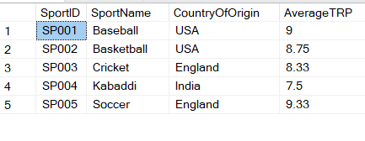
Sport Table after Trigger execution:
INSERT INTO RatingRecord VALUES('S003', 'SP001','2015-2016', 10);
SELECT * FROM Sport;

