Slide 1
Data Riders: EDA Mini-Project
Santhosh Kumar
Yuvaraj Nachimuthu
Ekta Chaurasia
Avishek Deb
Srinath Ganesh
Naren

Slide 2
Identify Gaps (in data)
What variables are missing
Selling Price and/or Product Revenue
Unit Sales
Geography of Sales
Outcome:
Explained the client the importance of these variables.
Explained the possible use-cases for gaining insights to the data.
Client got back and said this is what you got!
Data Pre Processing:
Handle Missing Values with KNN Imputation. (package info: VIM:kNN)
Categorise Products by Calories (High, Medium, Low).
Substitube Manufacture Symbol with Manufacturer Name.

Slide 3
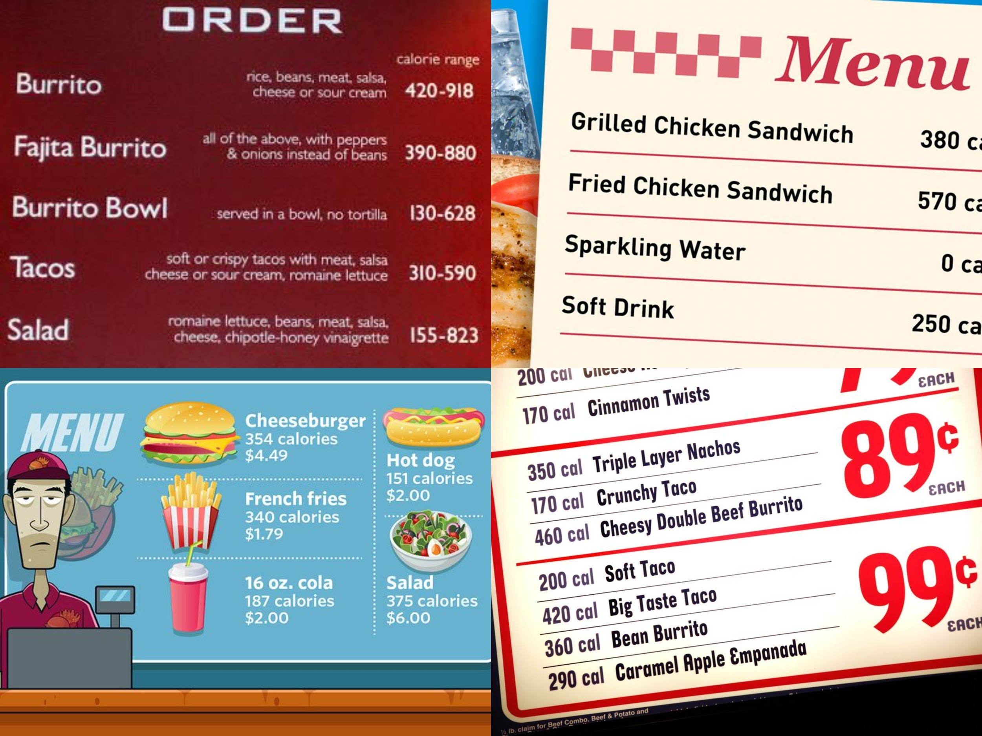
What worries people the most?

Slide 4
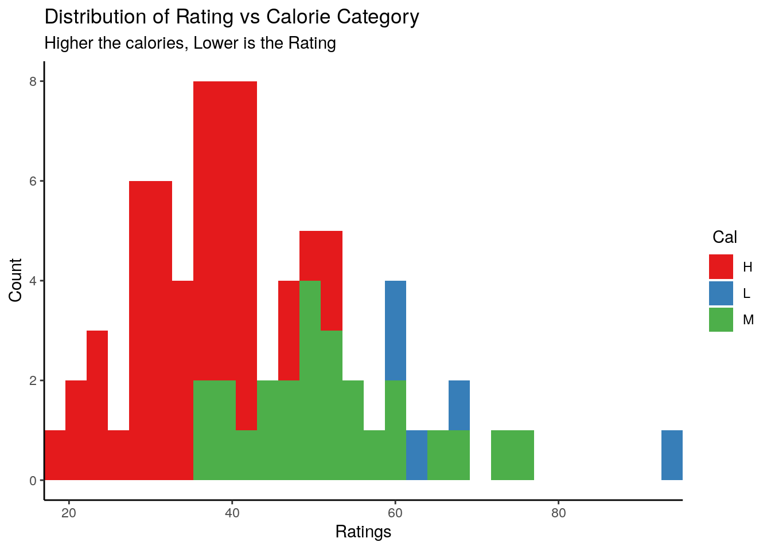

Slide 5
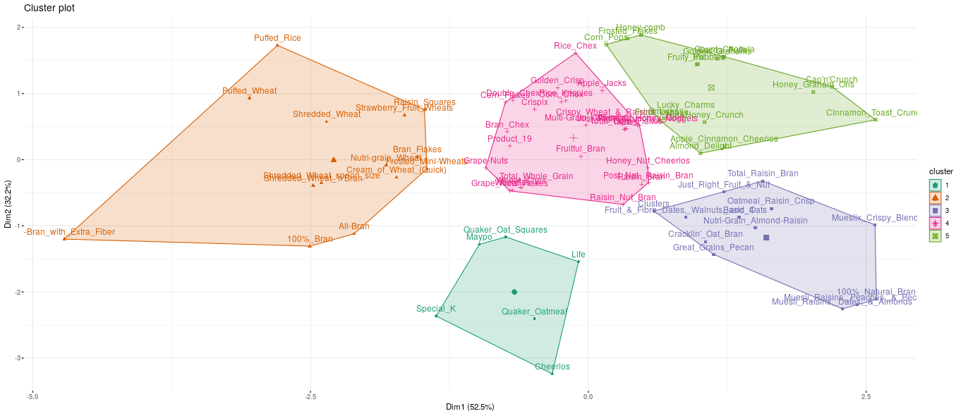
Identifying Patterns (with Clusters)
Observations:
Cluster 5 and 1 have Cereals that are good for health
Cluster 2, 3, 4 are not as good

Slide 6
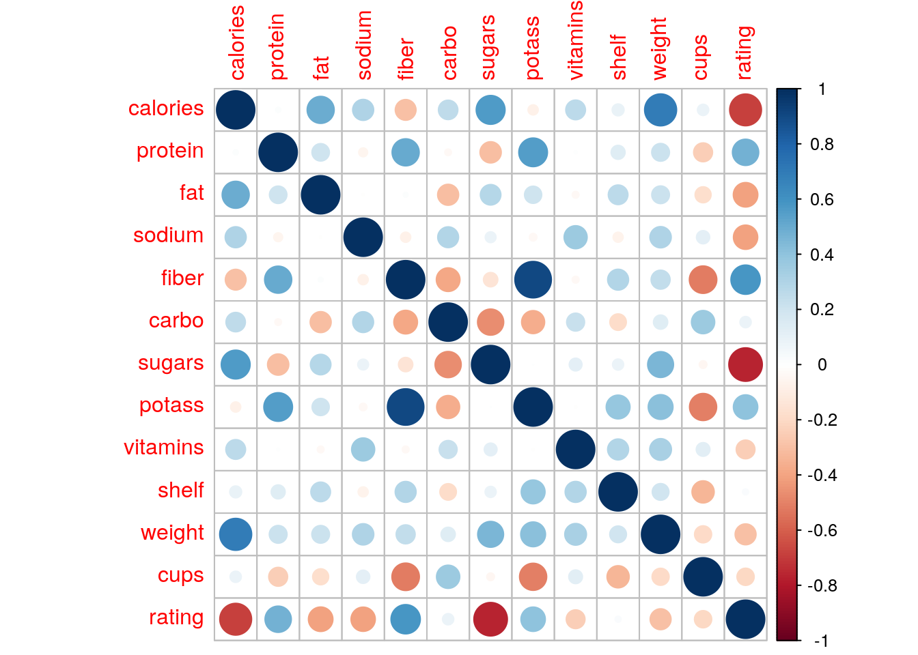
Good v/s Bad
Improves Rating:
Protein
Fiber
Potassium
Decreases Rating:
Calorie
Sugar
Fat
Sodium

Slide 7
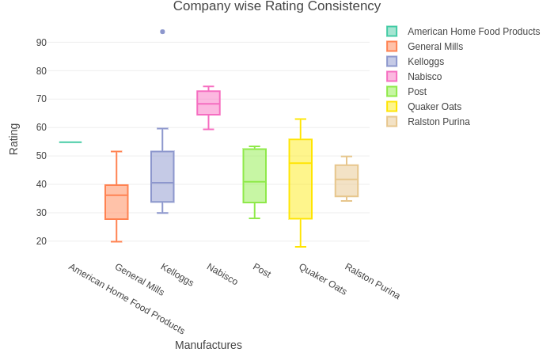
Company wise Product Consistency

Slide 8
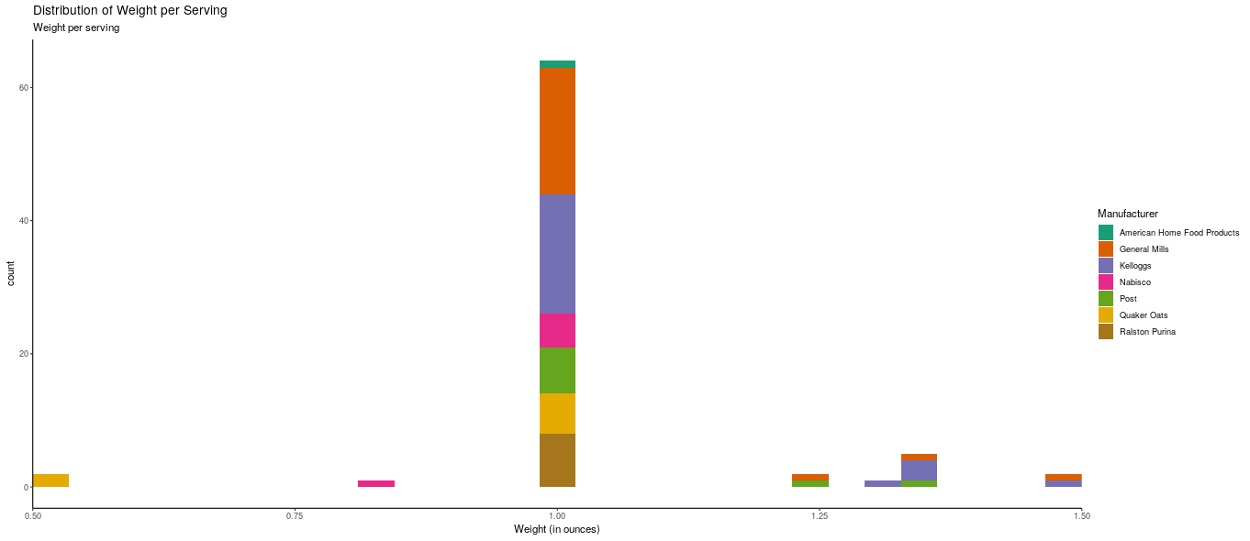
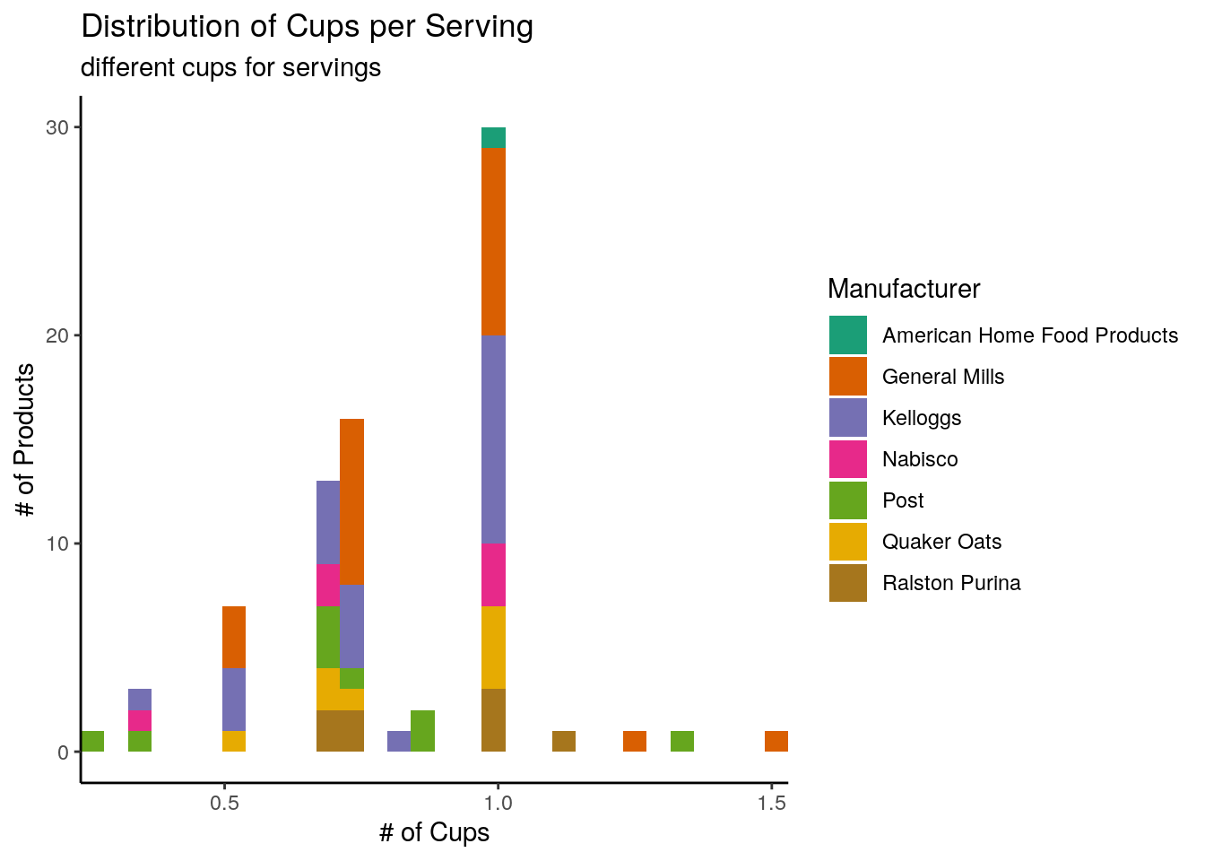
What you get in one Serving
General Trend:
One Cup in a serving
Serving weight of 1 Ounce

Slide 9


Slide 10
Thank you
Website: https://yuvarajnachimuthu.wixsite.com/datarider
Github: https://github.com/srinathganesh1/Data-Riders Citation for Copied Image resources:
en.wikipedia.org
mediapost.com
grubstreet.com
marketwatch.com
eater.com

