Slide 1
FNZ SharePoint Requirement and Design

Slide 2
About FNZ and Cognizant journey with them
UK Insurance and Wealth Management
FNZ Overview
UK Insurance Overview
FNZ – Cognizant engagement
Wealth Management Overview
FNZ – Cognizant Journey
FNZ Products
Team View
Functional scope with Cognizant
Governance and Commercials
Onboarding
Governance Model
Workforce Joining Formality
FNZ Connects
Machine Setup (Dev and Testing)
Jun’16 to Dec’19 Revenue
Training plan
Client Visits
Learning Materials

Slide 3
Development -Cognizant Scope and Delivery
Testing -
Cognizant Scope and Delivery
Delivery Model, Tech Stack
Delivery Model, Tech Stack
Metrics
Metrics
Process flow
Automation framework
Projects/Logo supported
Projects/Logo supported
Tech info
Value Adds
FAQ
Automation Tools
Technical Architecture
Investments Projects
TDD process
Automation Trainings
Proactive Proposals
Check list and other doc (eg: JIRA)

Slide 4
Operations
Miscellaneous
Offshore Locations and ODC
Daily, Weekly and Monthly Activity
BCP
Due Diligence (every 18 months)
Delivery Excellence Activity
Tracker – FSE, VM, Timesheet
MSA and SoW
PPT Repository (reference)
4

Slide 5
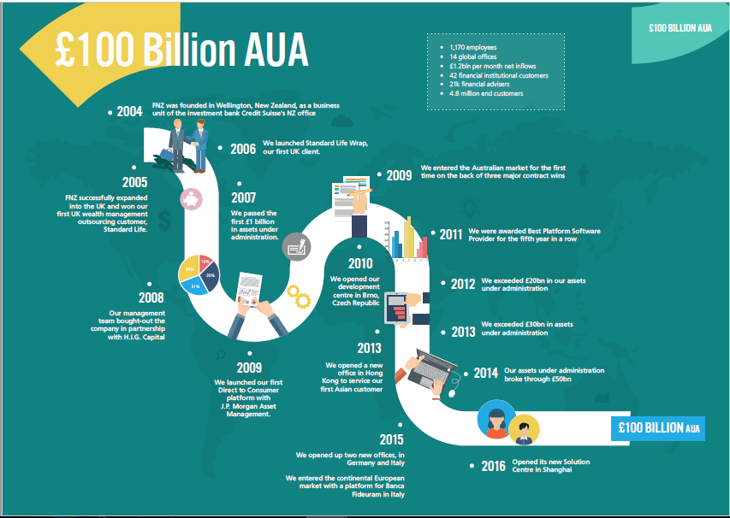
FNZ Overview
FNZ was founded as a start-up business in 2002 in New Zealand. Originally created as a business unit within the New Zealand branch of investment bank Credit Suisse, FNZ secured the majority of large institutional providers of investment platforms in NZ. This was followed by the expansion of operations to the UK in 2005
FNZ is a FinTech company specializing in providing investment platforms to major financial institutions in the financial services and wealth management sectors, They provide technology to banks, asset managers and discretionary wealth managers to deliver wealth management services, End customer and Group/corporate
They have delivered investment platform solutions to financial companies in the NZ, China, Australia, UK, CE, Hong Kong, Singapore

Slide 6

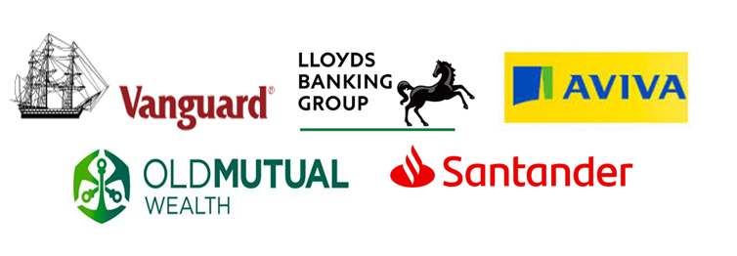


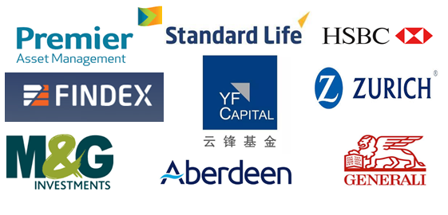

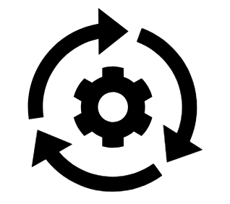








FNZ – Cognizant Engagement
Extended IT arm for FNZ’s System of Engagement Implementations
FNZ partners with major financial institutions, providing them with investment platforms to enable them to provide multi-channel wealth management services to their clients across direct, intermediated and workplace channels.
What We Do
End Clients
Success Factors
2
Channels - Direct to Customer portal and Advisor Portal
12+
months
6+
Rapid skilling – Training
Team composition – 2/3rds PA/PAT’s
95%
Offshore Delivery From Chennai and Kochi
How we work – Agile, primarily offshore
2
Agile Delivery – Sprints during build and Kanban during defect support
6+
months
6+
Test automation – 100% coverage for regression pack
25+
Full Stack Engineers
Factory model – Enabled everyone to do everything
Technologies - .Net, MVC, C#, Java script, React JS, Redux, Team city, Specflow, Nunit3, Selenium, GitHUB
10+
Dev + Testing – Software Development Engineer in Test
3+
months
6+
3+
Years of Partnering
Culture -Passion to deliver, flexibility to learn and cross skill
Notes:
FNZ is a FinTech company specializing in providing investment platforms to major financial institutions in the financial services and wealth management sectors, They provide technology to life insurance companies, banks, asset managers and discretionary wealth managers to deliver wealth management services via IFA's, End customer and Group/corporate
FNZ provides end-to-end technology, including investment front office, tax wrappers and investment back office under a software as a service delivery model. This technology is combined with back office dealing, settlement and administration services as either sub-custodian or third party administrator
FNZ was founded as a start-up business in 2002 in New Zealand. Originally created as a business unit within the New Zealand branch of investment bank Credit Suisse, FNZ secured the majority of large institutional providers of investment platforms in NZ. This was followed by the expansion of operations to the UK in 2005
They have delivered investment platform solutions to financial companies in the NZ, Australia, UK, Hong Kong
They take responsibility for the client lifecycle including on-boarding, payments, trade execution (as arranger), trade settlement and asset servicing activities as either sub-custodian or delegated third party administrator (TPA).

