Slide 1
Next-gen Government
Government in the age of Social Media
Conceived by Suvajit Sengupta
suvajit.sengupta@gmail.com
July 2013

Slide 2
Government – The Enabler
between
Individual Citizens
Citizens & Service Providers
Citizen & Public servants
Citizen & Information
Citizen & the Experience with the Government

Slide 3
What is Social Media ?
Direct communication channel
Easy collaboration tool
Interactive

Slide 4
Can new GOVERNMENT be
a better ENABLER leveraging
Social Media ?

Slide 5
Citizen
Interest Groups/NGO
Elected Candidates
21st century
CIVIC LIFE
Web as Civic Platform | Social Governance | Participatory Citizenship |Electoral Intelligence
Connect
Share
Represent
Research
Private Sector
Public Sector
Intermediary Agencies
Local Government
OpenData
Public Servants
Data, Information & Content
E-Office
Web Platform
Social Media + Community
State Government
Executive
Legislative
Judicial
Social Networks
Central Government
SaaS
Executive
Legislative
Judicial
Web Services

Slide 6
Government Connect
Better internal collaboration tools
Streamlined processes across Departments
Centralized Date, Information & content
Implementation of e-Office framework as proposed by DARPG

Slide 7
Citizen Connect
Social Media interface
Mobile Apps
Open Data

Slide 8
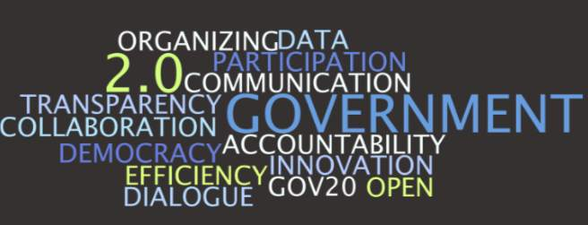
Thank You
Adapted from
http://www.zdnet.com/blog/hinchcliffe/building-a-vision-for-government-2-0/467

